Slide 1
Neutrinos from stored muon beams:
… an incremental approach to the
Neutrino Factory

Slide 2
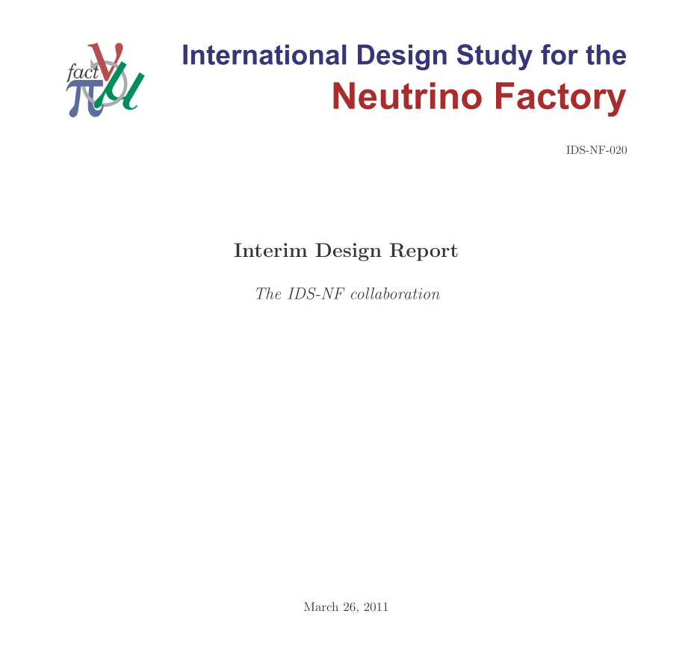
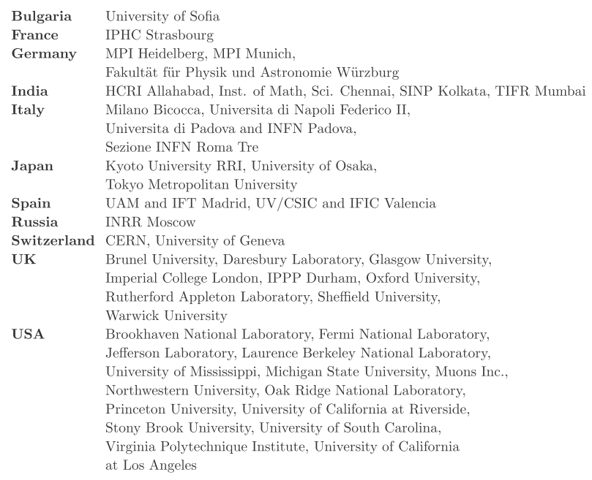
Acknowledgements:
Many thanks to those who provided information or material:
  And in particular the International Design Study for the Neutrino Factory (the IDS-NF), EUROnu and nuSTORM collaborations
136 authors, 48 Institutes:
See also:
https://www.ids
ICFA Beam
Dynamics
-
nf.org/wiki/FrontPage/Documentation/IDR
Newsletter
55
:
72
-
78
,
2011

Slide 3
Contents:
Neutrinos; beyond the Standard Model
Mass scale, Dirac or Majorana
The Standard Neutrino Model
Sterile neutrinos
Elements of the future programme
nuSTORM Expression of Interest
Conclusions

Slide 4
Neutrinos; physics beyond the Standard Model
Neutrinos from stored muon beams:

Slide 5
Standard Model:
The Standard Model neutrino was:
Massless
Chargeless
Helicity eigenstate

Slide 6
Extend SM to include neutrino mass:
Massive neutrino NOT helicity eigenstate, and …
  since neutrino has no conserved quantum numbers
    (except, perhaps, a global lepton number)
quantum mechanics implies neutrinos will mix

Slide 7
Schrödinger’s neutrino:

Slide 8
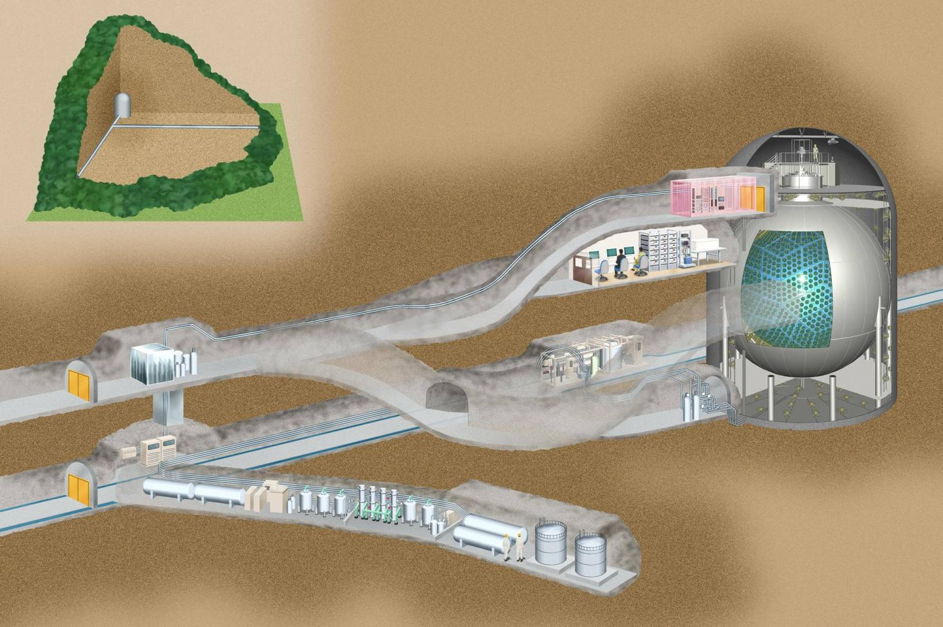
Reactor neutrinos: Kamland:

Slide 9
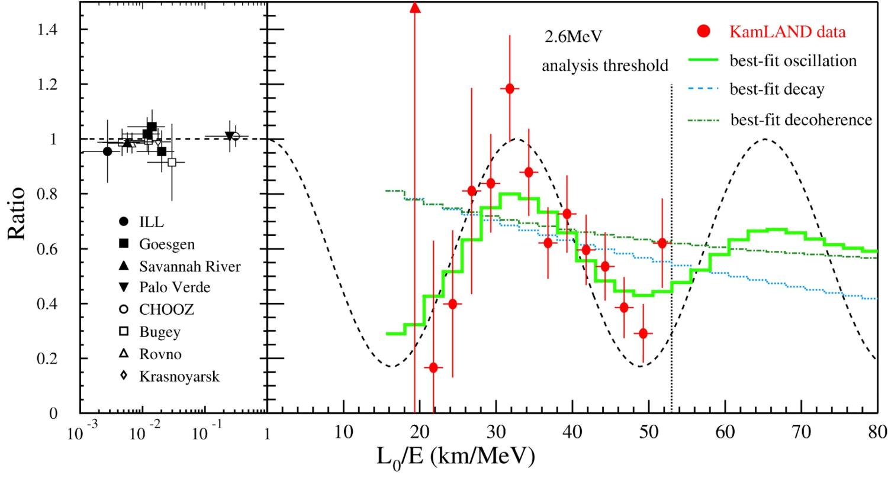
Oscillating electron (anti-)neutrinos

Slide 10
Physics beyond the Standard Model:
Massive neutrino NOT helicity eigenstate, and …
  since neutrino has no conserved quantum numbers
    (except, perhaps, a global lepton number)
quantum mechanics implies neutrinos will mix
Neutrino oscillations imply BSM physics:
  Either:
    Conserved lepton number distinguishes neutrino from antineutrino; or
    Neutrino is its own antiparticle; a new state of matter, a Majorana fermion
Mixing among three neutrino flavours admits possibility of CP-invariance violation

Slide 11
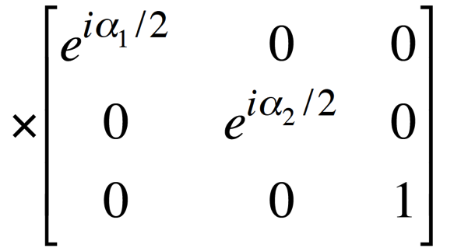
Standard Neutrino Model:
Three mass states
linked to three
flavour states via
unitary mixing
matrix;
Additional, sterile, states conceivable:
  Would imply:
    3-neutrino mixing matrix not unitary
Notes:
The Double Chooz collaboration, by measuring the "disappearance" of electron antineutrinos, presents hints for oscillation also involving the third angle with the following value: sin^2(2theta_13) = 0.085 +/- 0.051. The probability given by preliminary results that there is no oscillation is only 7.9%.

Slide 12
A window on the unknown:
Neutrino masses are tiny compared to those of the other fermions:
  Hint that neutrino masses do not arise from the same mechanism?
  Related to physics at very high mass scales as in “see-saw models”?
If Standard Model Lagrangian is treated as an effective theory:
  Dimensional analysis [Weinberg] indicates that:
    Majorana mass term for neutrinos is first term beyond the Standard Model Lagrangian
Fundamental questions:
  What is the nature of the neutrino, Majorana or Dirac?
  What is the absolute neutrino-mass scale?
  Is CP-invariance violated in neutrino oscillations?
  Is the neutrino-mass spectrum normal or inverted?
  Is the neutrino-mixing matrix unitary?
  Are there sterile neutrinos?
  Is there a connection between quark and lepton flavour?

Slide 13
Mass scale, Dirac or Majorana
Neutrinos from stored muon beams:

Slide 14
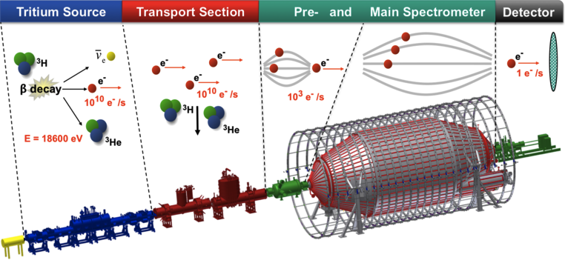
Neutrino mass-scale:
Determination of neutrino mass:
  Electron spectrum in
  nuclear beta decay
  If observed, through
  neutrino-less double
  beta decay (0νββ)
  Cosmological observables, e.g.:
    Large-scale structure;
    Cosmic microwave background temperature fluctuations
Important measurements!
  Clear programme with experiments of a scale that can be taken forward by appropriate laboratories

Slide 15
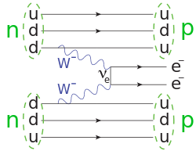
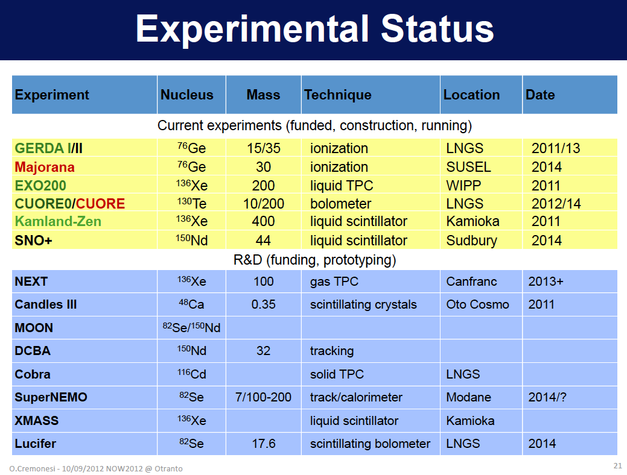
Dirac or Majorana:
Discovery of
0νββ would be
revolutionary:
  New state of
  matter
Importance justifies the variety of approaches:
  Clear programme developed in collaboration with deep underground laboratories

Slide 16
Standard Neutrino Model
Neutrinos from stored muon beams:

Slide 17
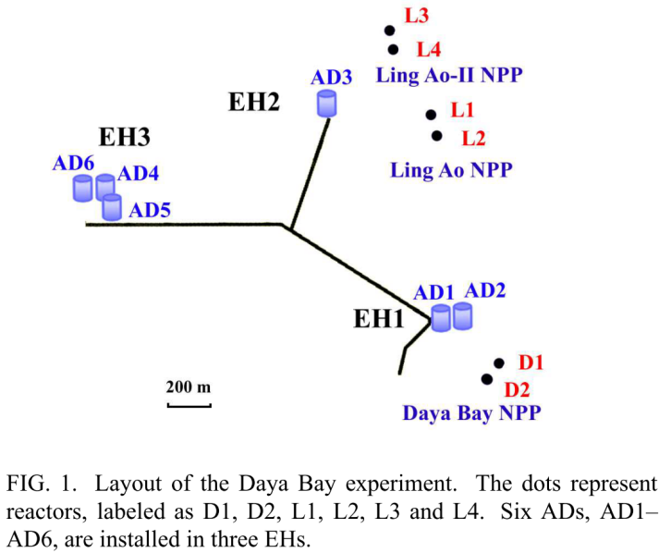
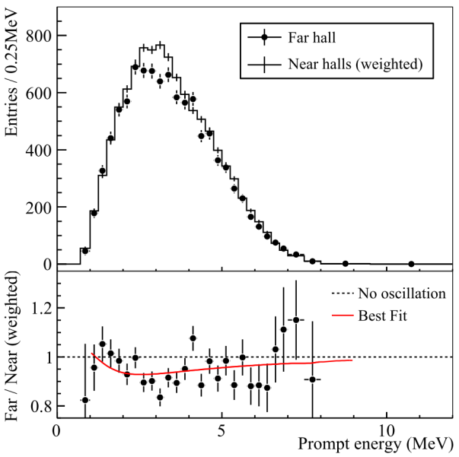
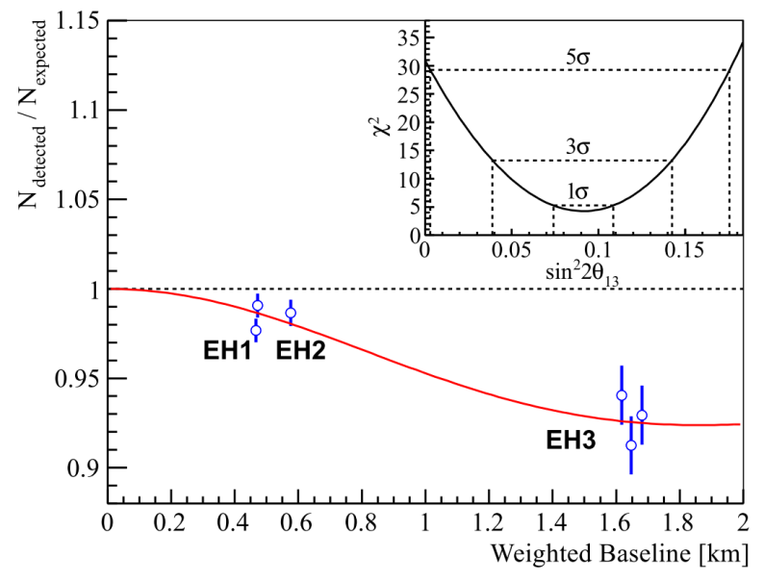
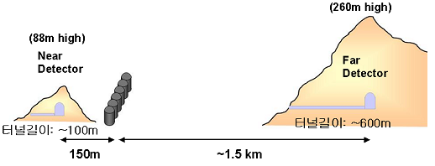
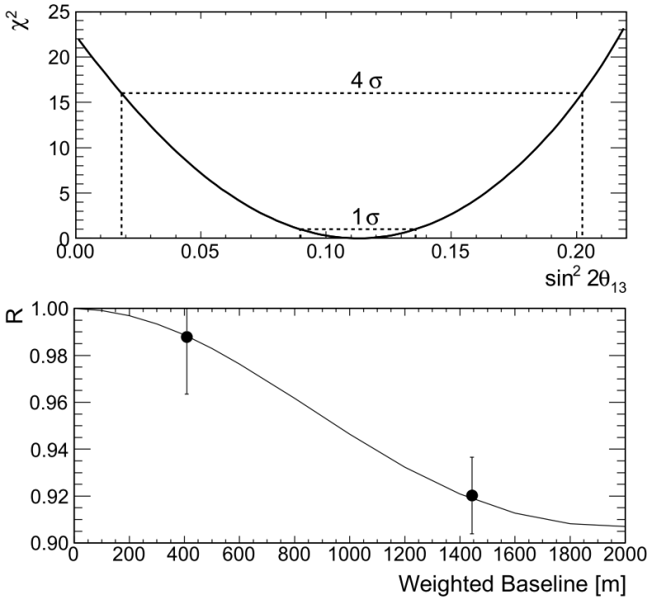
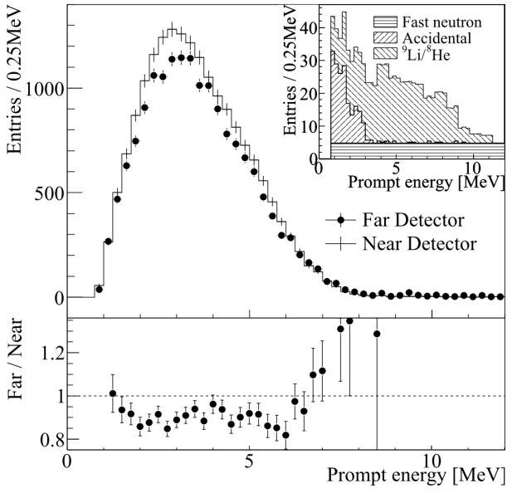
Daya Bay and RENO:

Slide 18
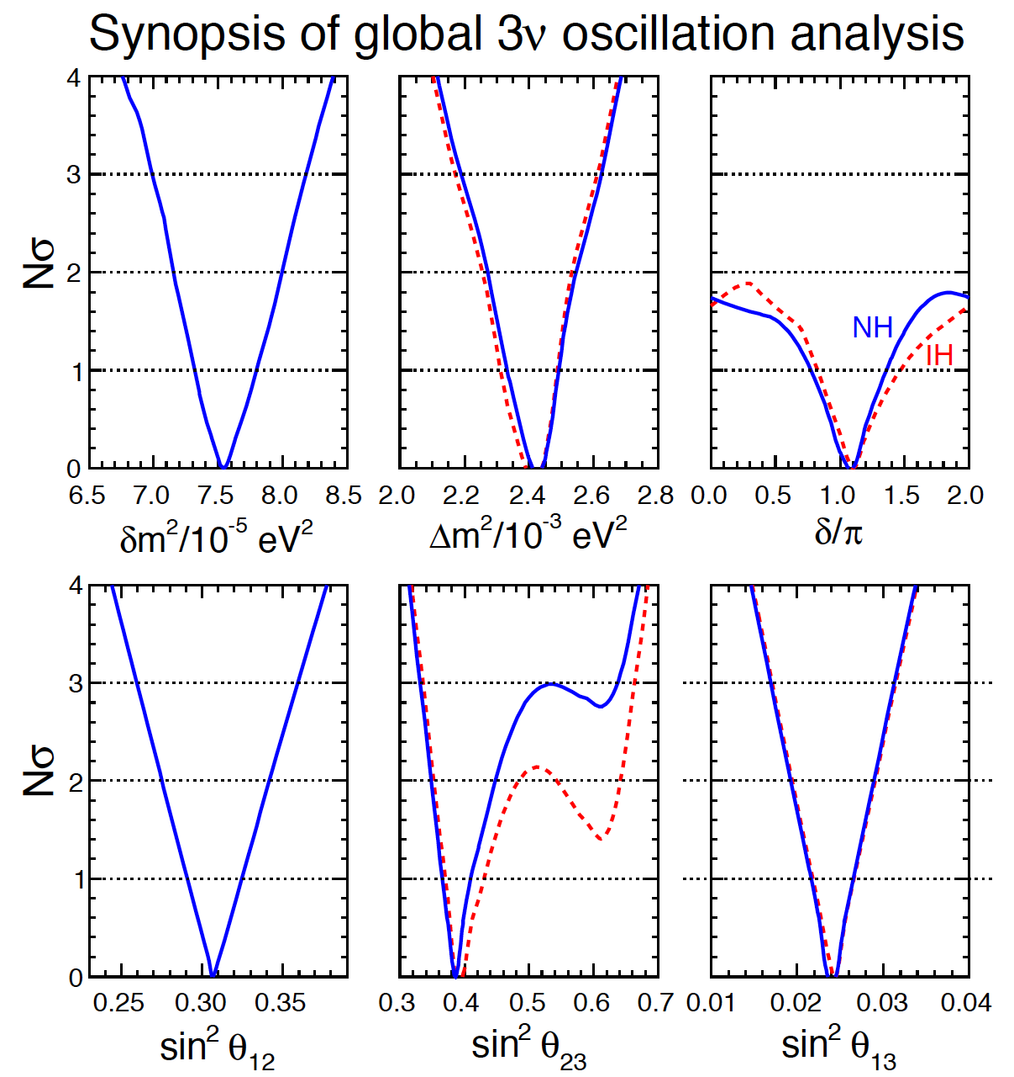
Standard Neutrino Model:
Exciting new data!
Discovery of leptonic
CP-violation is possible
Increases motivation for precision determination of the parameters and search for “non-standard effects”
Fogli, Lisi, Marrone,
Montanino, Palazzo,
Rotunno
arXiv:1205.5254v3
Notes:
The Double Chooz collaboration, by measuring the "disappearance" of electron antineutrinos, presents hints for oscillation also involving the third angle with the following value: sin^2(2theta_13) = 0.085 +/- 0.051. The probability given by preliminary results that there is no oscillation is only 7.9%.

Slide 19
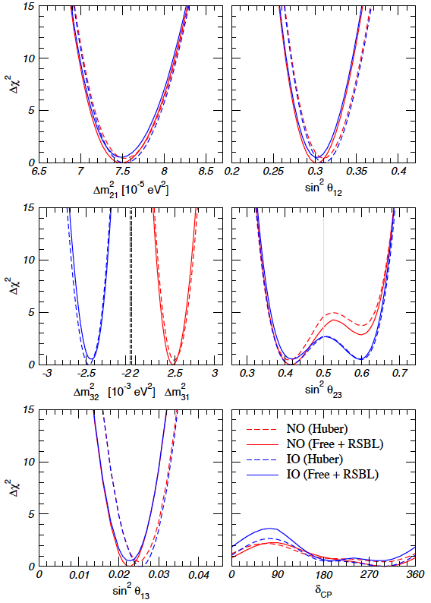

Standard Neutrino Model:
Exciting new data!
Discovery of leptonic
CP-violation is possible
Increases motivation for precision determination of the parameters and search for “non-standard effects”
Goncalez-Garcia,
Maltoni, Salvado,
Schwetz
arXiv:1209.3023v2
Notes:
The Double Chooz collaboration, by measuring the "disappearance" of electron antineutrinos, presents hints for oscillation also involving the third angle with the following value: sin^2(2theta_13) = 0.085 +/- 0.051. The probability given by preliminary results that there is no oscillation is only 7.9%.

Slide 20
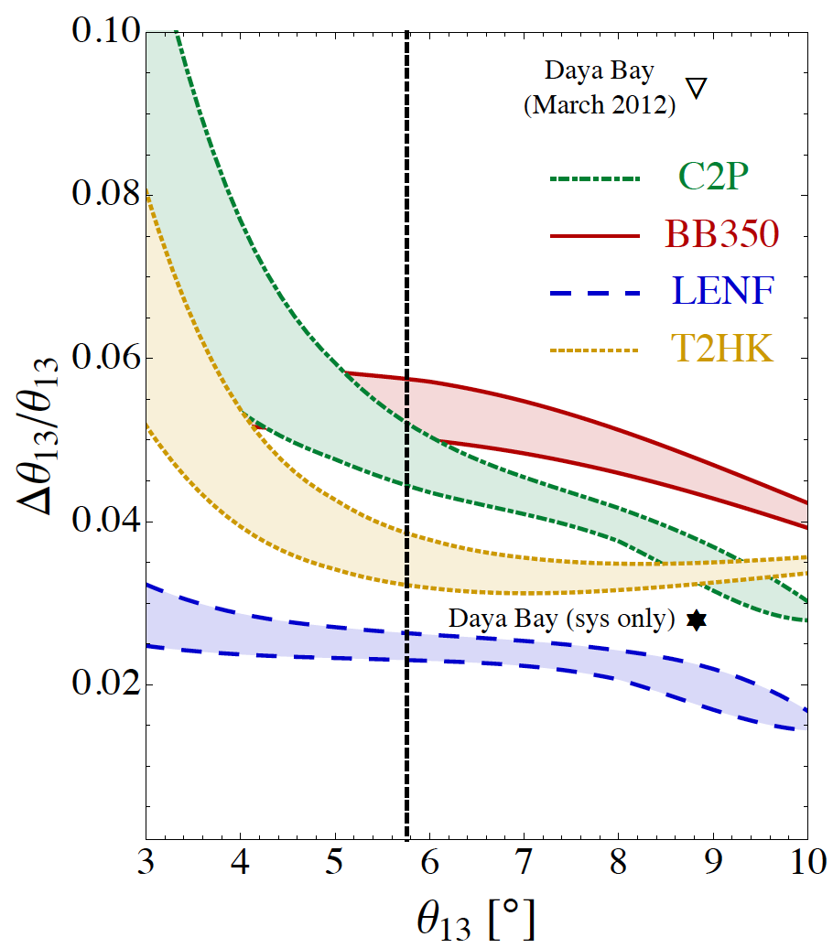
The SνM measurement programme:
Looking beyond MINOS, T2K,
NOνA, DChooz, Daya Bay, Reno, …
  θ₁₃ will be very well known
Therefore future programme
must:
  Complete the “Standard
  Neutrino Model” (SνM):
    Determine the mass hierarchy
    Search for (and discover?) leptonic
    CP-invariance violation
  Establish the SνM as the correct
  description of nature:
    Determine precisely the degree to which θ₂₃ differs from π/4
    Determine θ₁₃ precisely
    Determine θ₁₂ precisely
  Search for deviations from the SνM:
    Test the unitarity of the neutrino mixing matrix
    Search for sterile neutrinos, non-standard interactions, …
arXiv:1203.5651
Notes:
Peroration:
Goals of the presentation:
Show sensitivity and precision of the beta beam and neutrino factoru
Show maturity of R&D
Demonstrate that there are short-term contributions, especially nuSTORM

Slide 21
Option thumbnails:
Conventional super-beams:
  Wide-band, long baseline: e.g. LBNE, LBNO
    <E_{μ}> ~ 2—3 GeV; matched to LAr or Fe calorimeter;
    Long-baseline allows observation of first and second maximum
    Near detector exploited to reduce systematic errors
  Narrow-band, short baseline: e.g. T2HK, SPL
    <E_{μ}> ~ 0.5 GeV; matched to H₂0 Cherenkov;
    Short-baseline allows observation of first maximum
    Near detector exploited to reduce systematic errors
Beta-beam, short baseline: e.g. CERN γ=100;
  <E_{μ}> ~ 0.5 GeV; matched to H₂0 Cherenkov;
  Short-baseline allows observation of first maximum
  Requires short-baseline super-beam to deliver competitive performance
Neutrino Factory: IDS-NF baseline E_{μ}=10 GeV;
  Uniquely well known flux (flavour content and energy spectrum);
  Baseline 1500—2500 km
  Requires a magnetised detector
  Identified by EUROnu as the facility for the high-precision programme

Slide 22
Neutrino Factory:
Optimise discovery potential for CP and MH:
  Requirements:
    Large ν_{e} (ν_{e}) flux
      Detailed study of
      sub-leading effects
Unique:
    (Large) high-energy
    ν_{e} (ν_{e}) flux
      Optimise event rate at
      fixed L/E
      Optimise MH sensitivity
      Optimise CP sensitivity

Slide 23
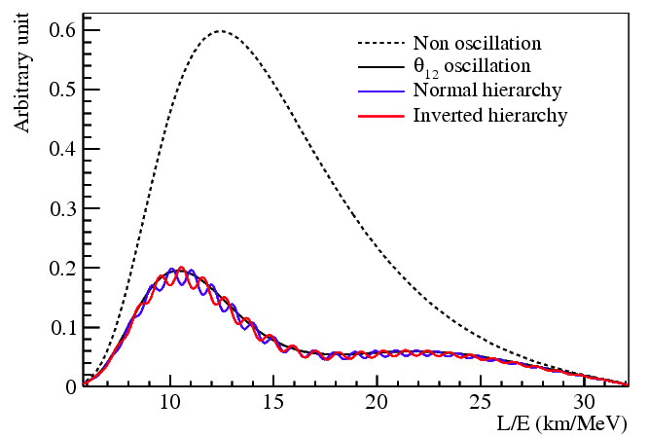
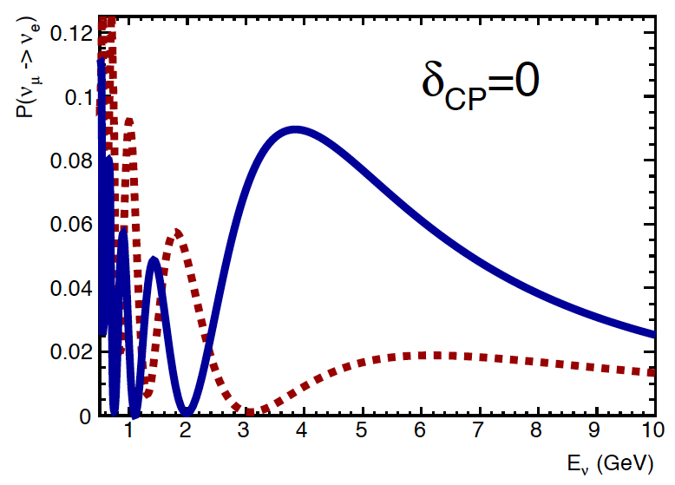
Mass hierarchy:
Two options:
  Exploit L/E spectrum:
    E.g. Daya Bay II:
      Liquid scintillator detector
      at 60 km
      Requires exquisite energy resolution
  Exploit matter effect:
    Electron-neutrino charged current interactions in the earth receive additional “charge-exchange” contribution
    Leads to a modification of the oscillation probability for long (~1000 km) baselines
Phys.Rev.D78:111103,2008
CERN-SPSC-2012-021;
SPSC-EOI-007

Slide 24
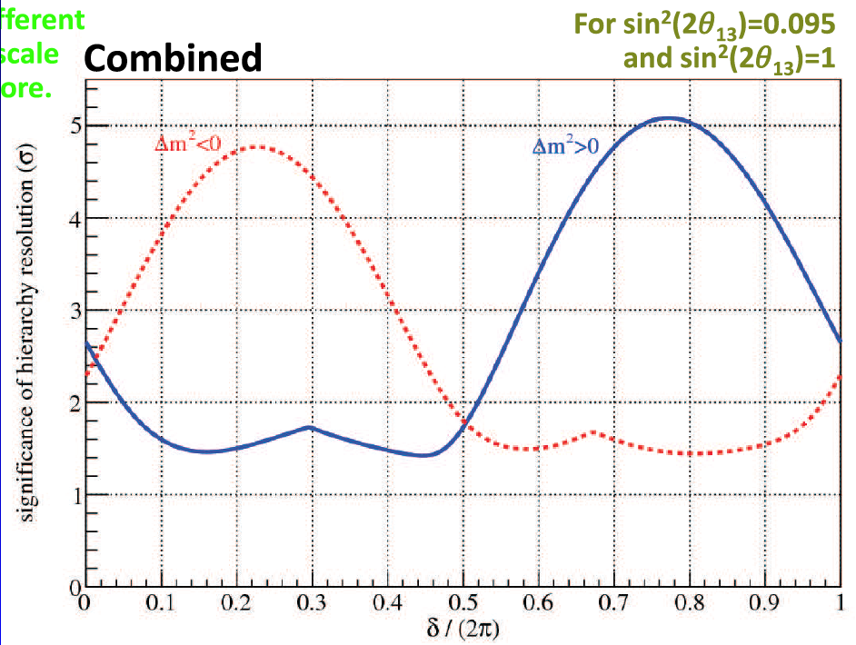
Mass hierarchy:
Charged current ν_{e}e interactions in earth yields:
  P(ν_{α} ➔ ν_{β}) ≠ P(ν_{α} ➔ ν_{β})
Potential of present/planned experiments
Projection with
T2K, NOvA and
final Daya Bay
R. Patterson
NuFact12

Slide 25
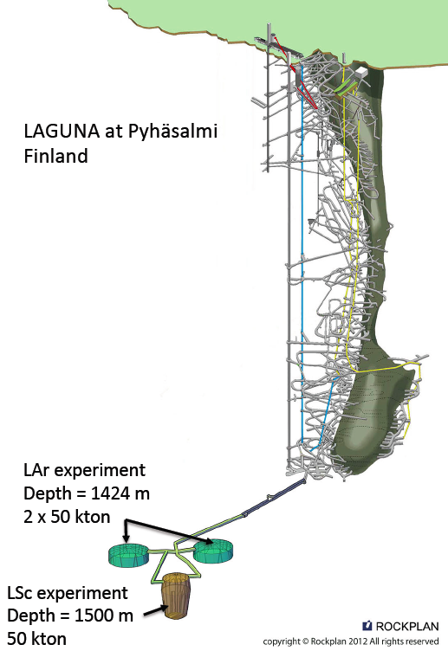
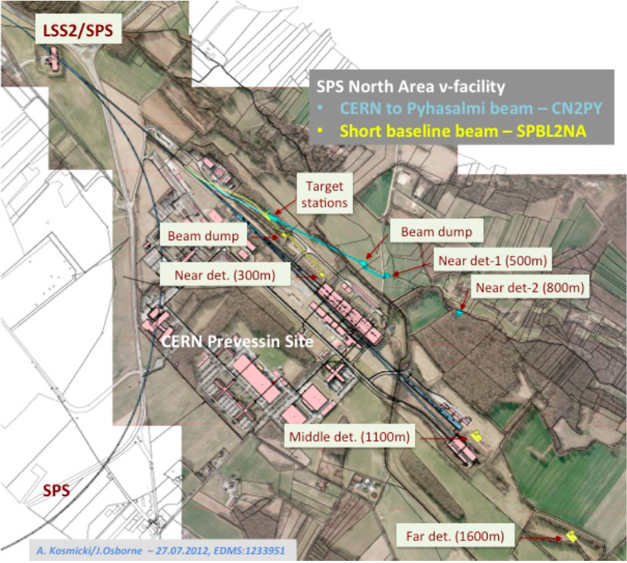
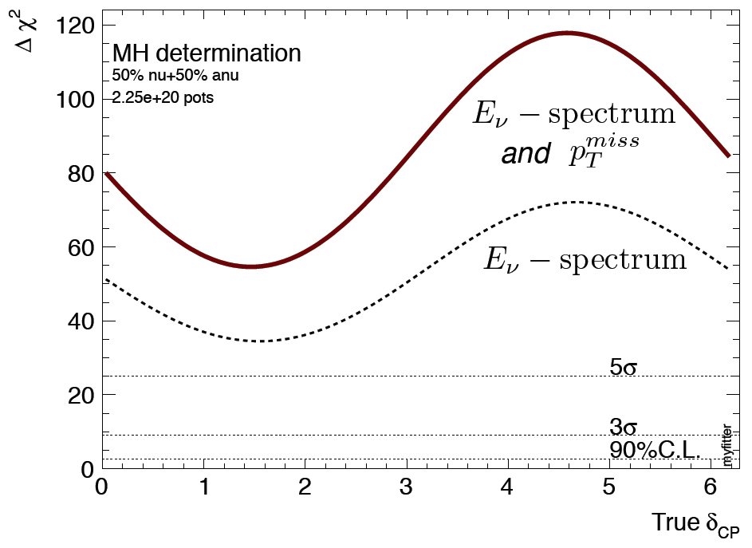
Exploiting the matter effect:
The matter effect may be exploited to determine the mass hierarchy:
  LBNO: > 5σ sensitivity for all δ
    Source: North Area at CERN;
    Detector at Phyasalmi, Finland
      Suite of detectors:
        LAr + MIND
        L-scintillator
      Strong astro-particle and nucleon-decay case too
CERN-SPSC-2012-021;
SPSC-EOI-007

Slide 26
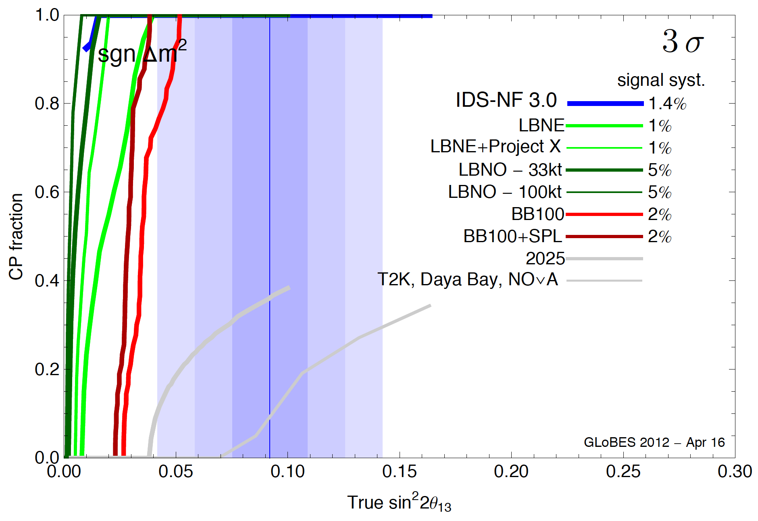
Mass hierarchy potential:
Huber et al
All options proposed for next-generation long-baseline experiment can determine the hierarchy
  Mass hierarchy determination may come with a hint of CP-invariance violation

Slide 27
Mass hierarchy summary:
In addition to reactor and LBL experiments:
  Atmospheric neutrinos:
    ORCA:
      Augment KM3Net with closely packed strings:
    PINGU:
      Augment Ice Cube with closely packed strings:
    Issues:
      Requires extremely large data set;
      Sufficient rejection of downward going muons; and
      Sufficient energy resolution (3 GeV)
    Iron calorimeter (ICAL) at the Indian Neutrino Observatory (INO):
      Opportunity:
        Detector is magnetised, can distinguish muon-neutrino- from anti-muon-neutrino-induced interactions;
      Issue:
        Detector resolution limits sensitivity to ~3σ
It is possible that a global fit to the results present and near future experiments will allow mass hierarchy to be determined;
  Assumes validity of the Standard (three) Neutrino Model

Slide 28
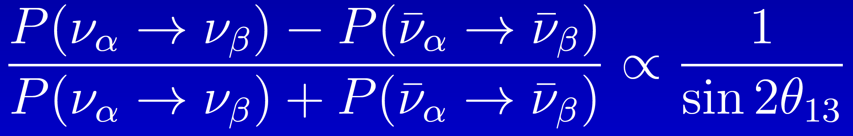
CP-invariance violation:
Seek to establish:
  P(ν_{α} ➔ ν_{β}) ≠ P(ν_{α} ➔ ν_{β})
by measuring the asymmetry:
Large θ₁₃ makes discovery conceivable, but:
  Places premium on the control of systematic uncertainties

Slide 29
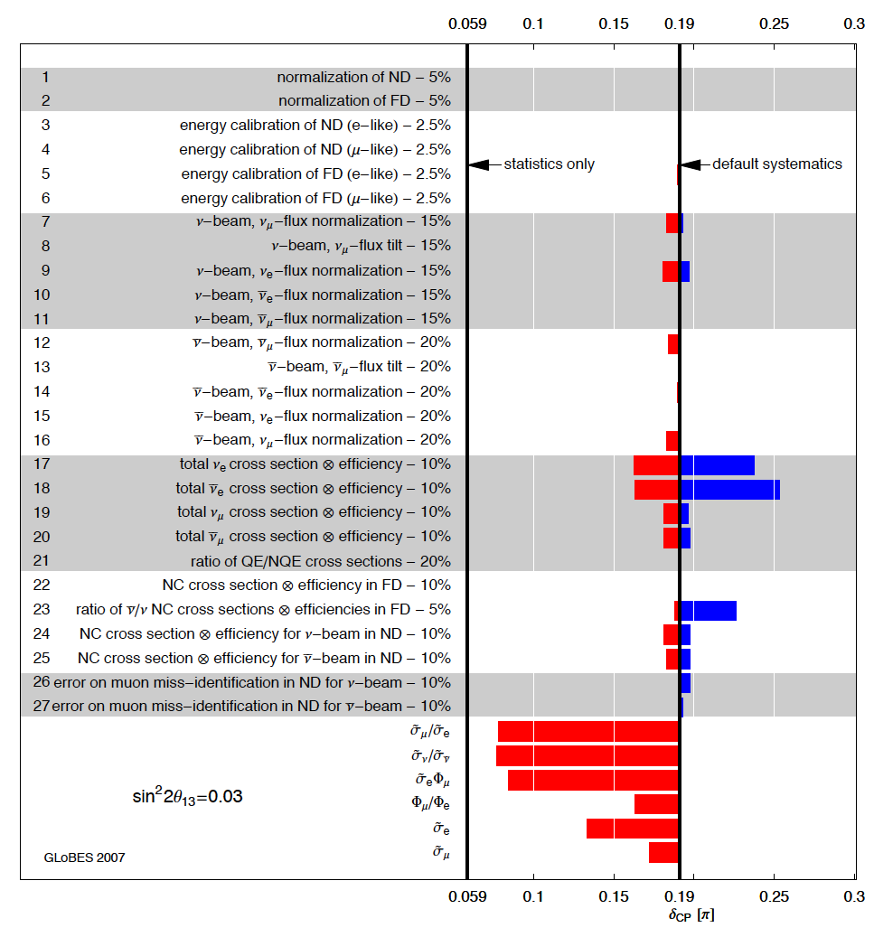
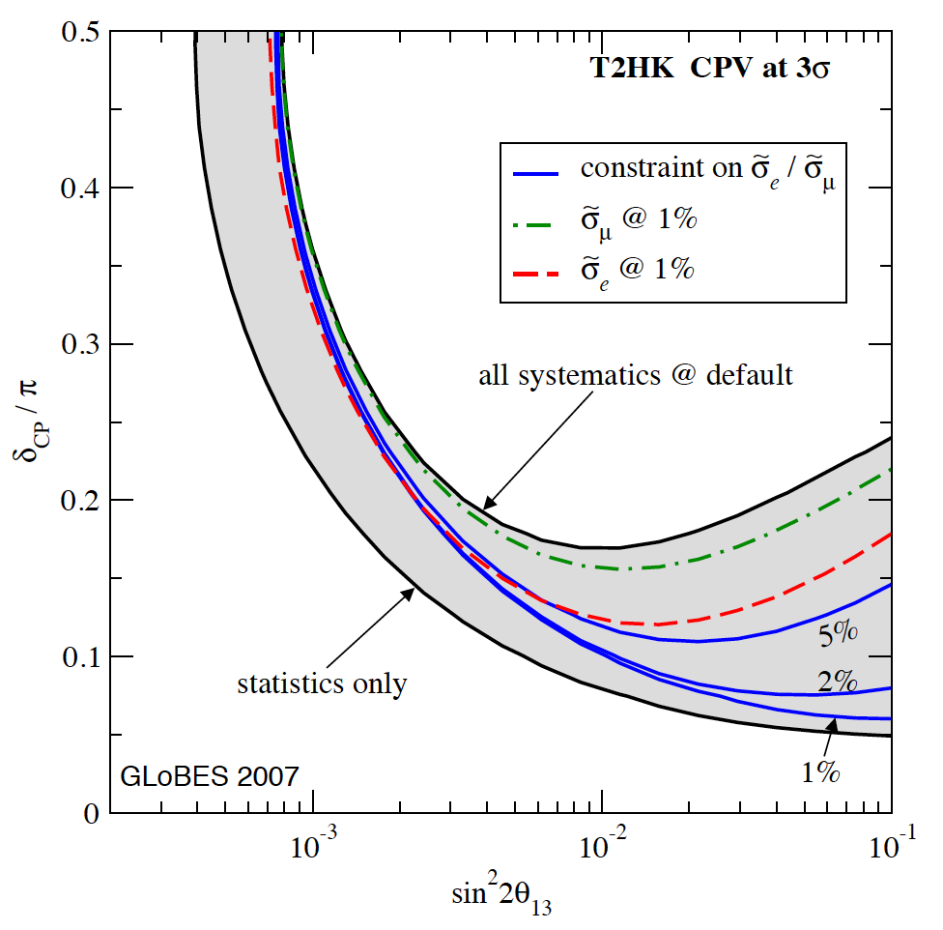
Systematic uncertainties:
T2HK, a case study:
[applicable to, e.g. C2CF, …]
  Narrow-band beam
  Near and far detector
— critical at large θ₁₃
Huber, Mezzetto, Schwetz,
arXiv:0711.2950v2

Slide 30
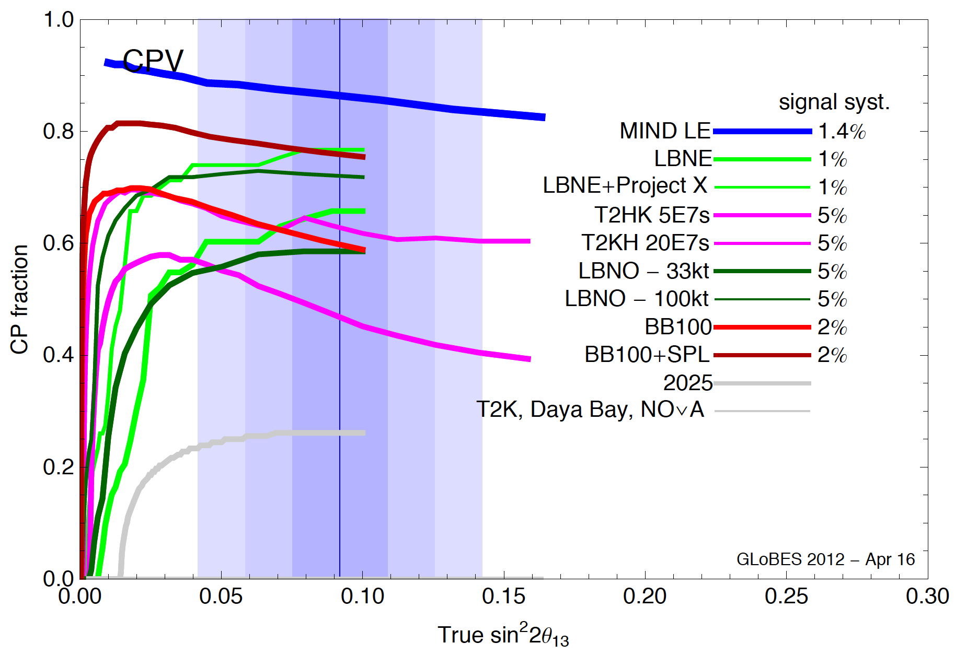
Discovery reach:
P. Coloma, P. Huber et al, IDS-NF#8:
https://www.ids-nf.org/wiki/GLA-2012-04-18/Agenda
Discovery reach at 3σ:
  Neutrino Factory: 85—90%
  Beta beam and SPL: 70—80%
  Super beam: 60—75%
Huber et al

Slide 31
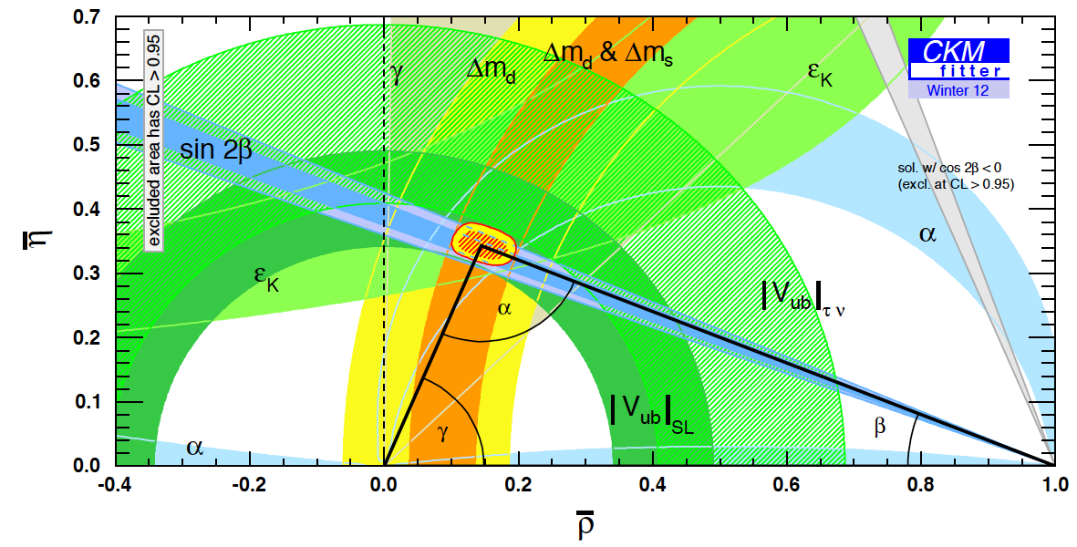
The case for precision:
What determines the goal for sensitivity and precision?
  Sensitivity:
    Definitive discovery!
      Must have sensitivity of “~5σ”
      To resolve the LSND/miniBooNE “suite of anomalies” may set the bar higher!
  Precision:
    Field presently led by experiment;
      Too many, or too few, theories;
    Goal to determine parameters with a precision comparable to that with which the quark-mixing parameters are known
PDG
Notes:
Peroration:
Goals of the presentation:
Show sensitivity and precision of the beta beam and neutrino factory
Show maturity of R&D
Demonstrate that there are short-term contributions, especially nSTORM

Slide 32
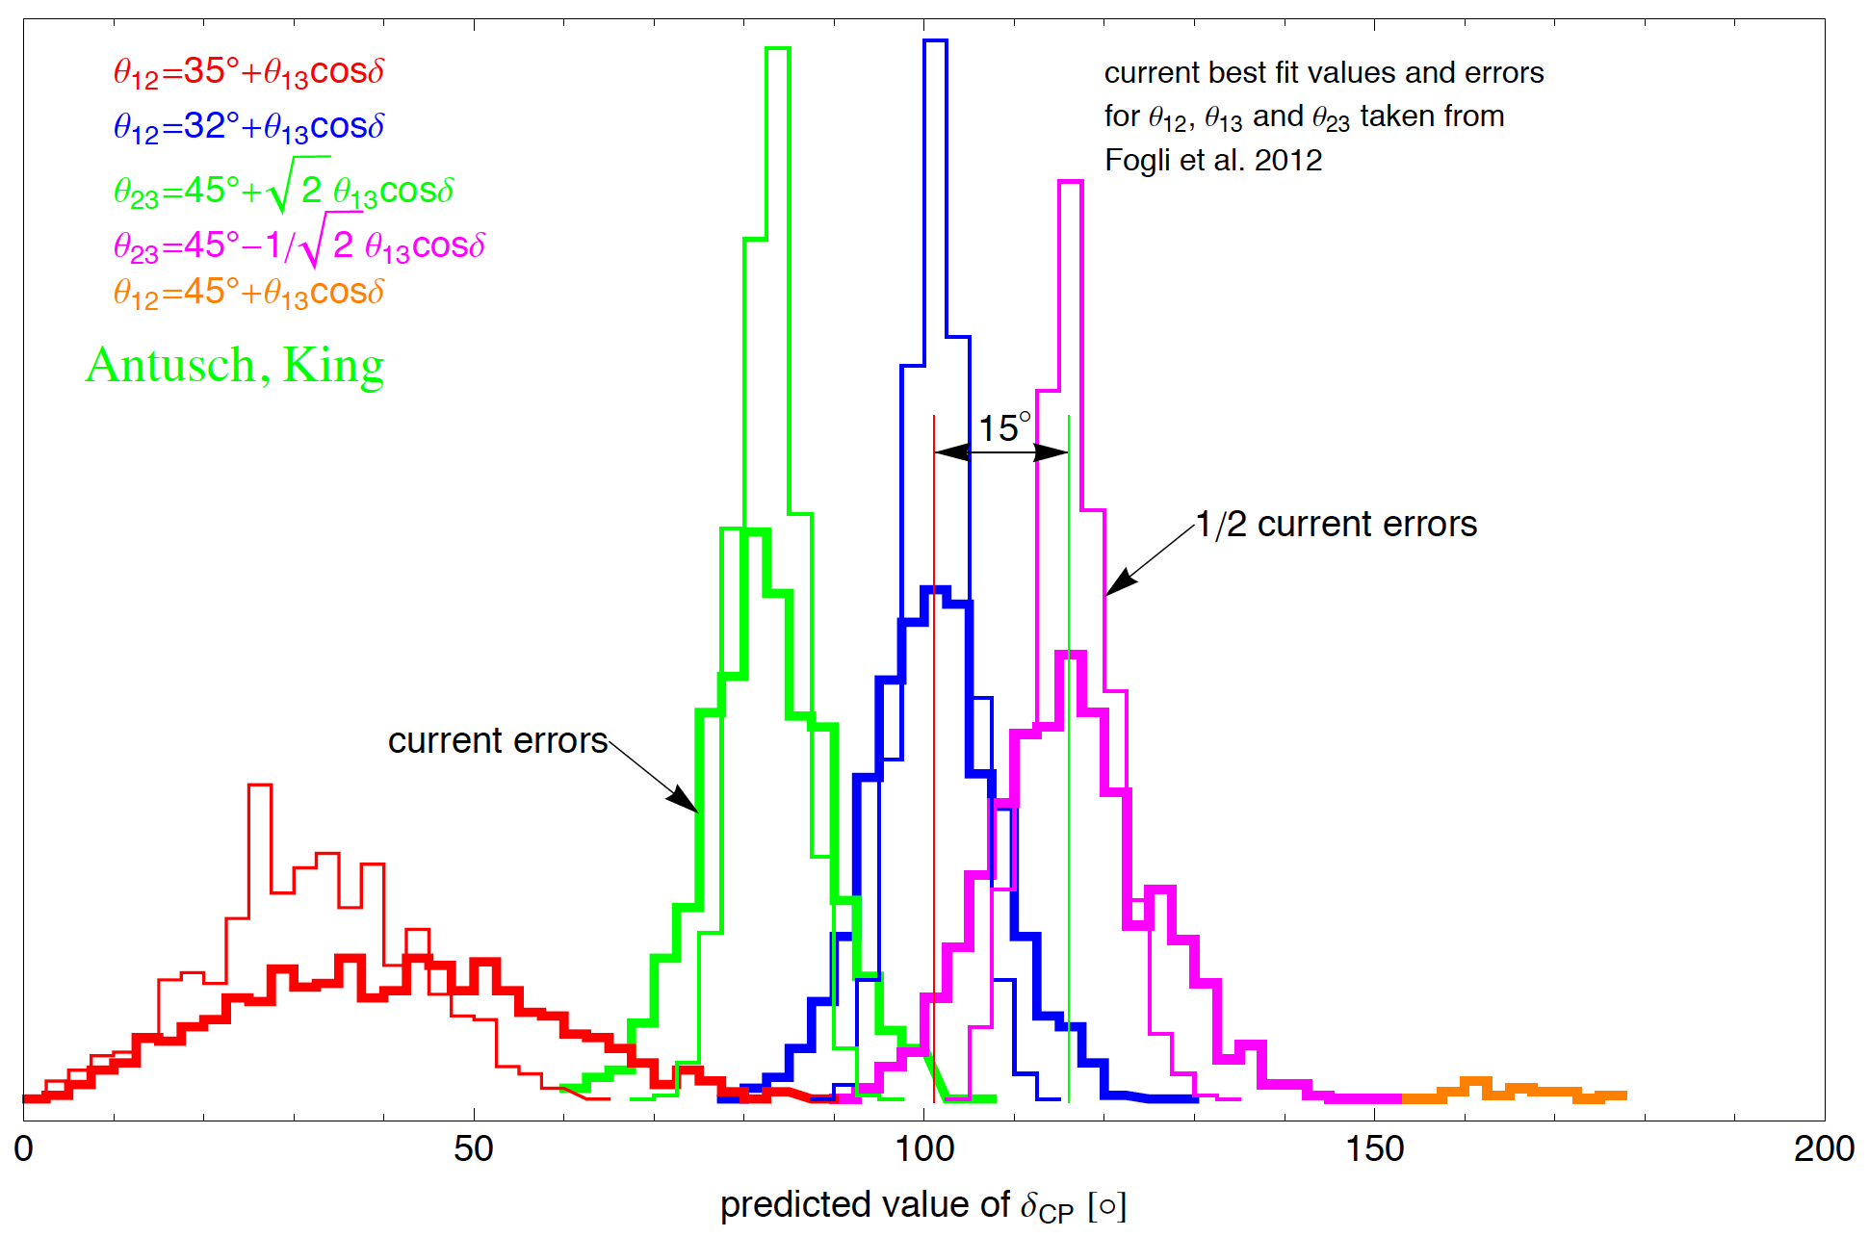
The case for precision:
Some guidance from theory:
  Models that relate quarks and leptons lead to sum rules
Antusch, King

Slide 33
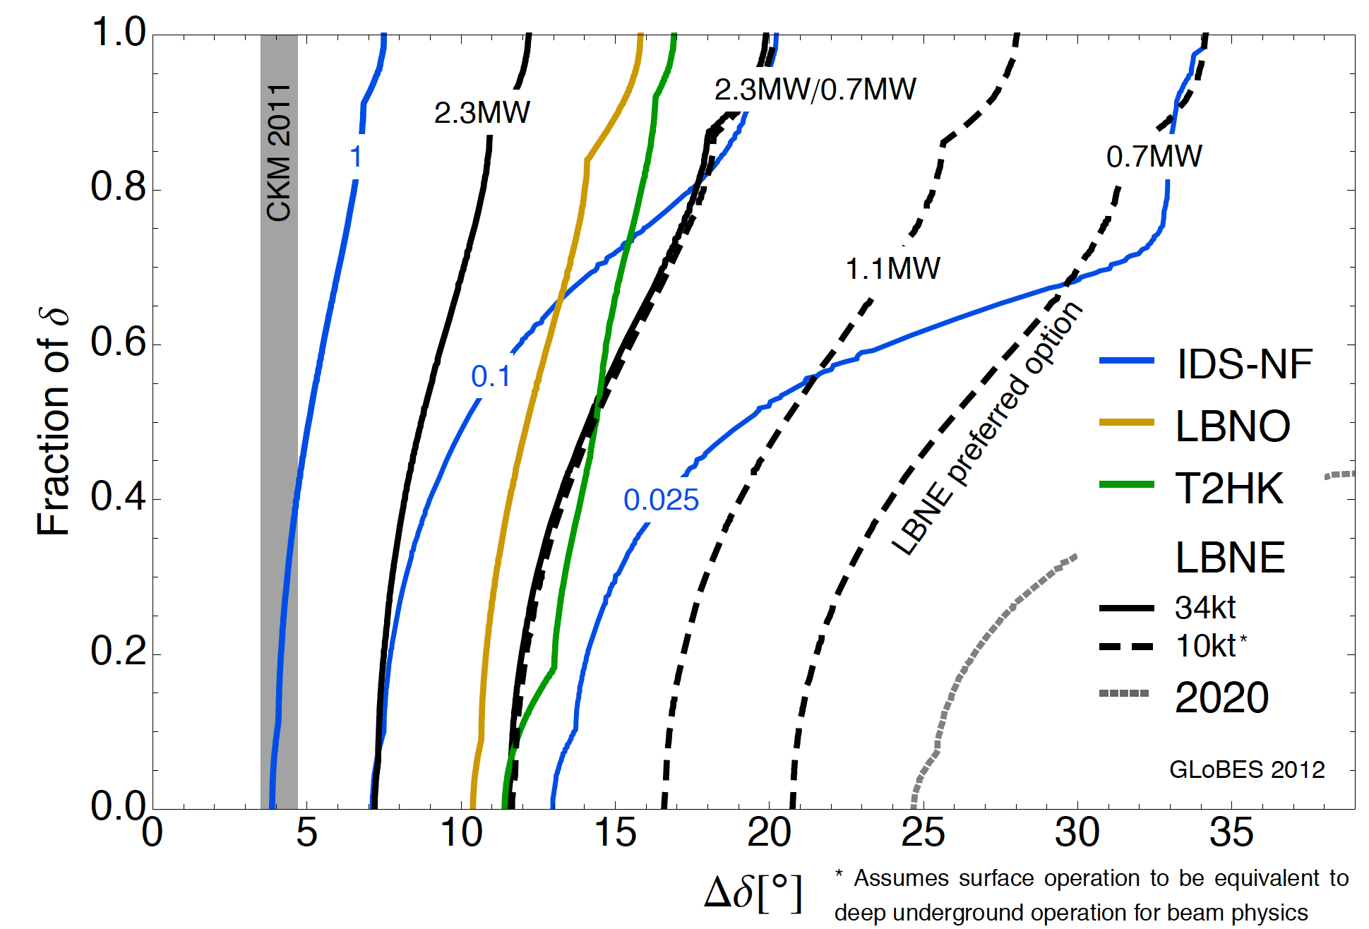
Comparison:
Coloma, Huber, Kopp, Winter
arXiv:1209.5973
Benefit of luminosity:
  Solid blue lines show effect on precision of scaling luminosity from baseline 10²¹ decays per year
  Potential for definition of staged upgrade programme

Slide 34
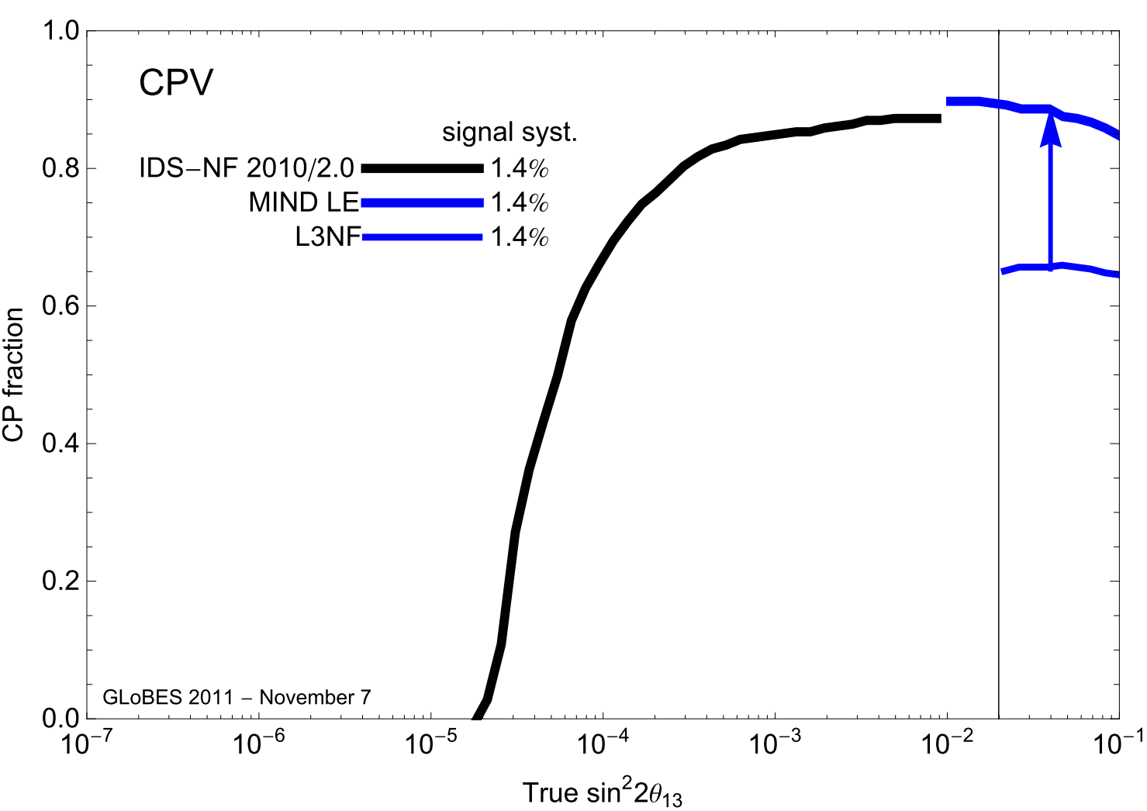
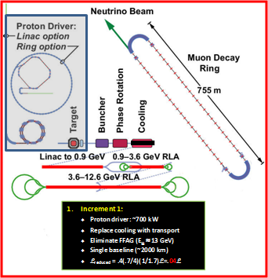

Slide 35
Sterile neutrinos
Neutrinos from stored muon beams:

Slide 36
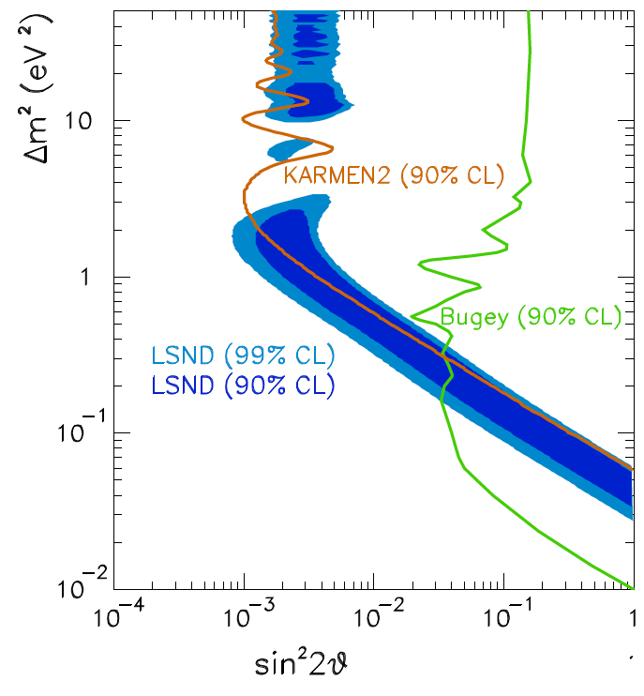
LSND:
LSND reported evidence for an oscillation with Δm² ~ 1 eV²:
  If confirmed, implies at least one neutrino state that does not couple to Standard Model W or Z
    I.e. one or more “sterile” neutrinos
1204.5379v1

Slide 37
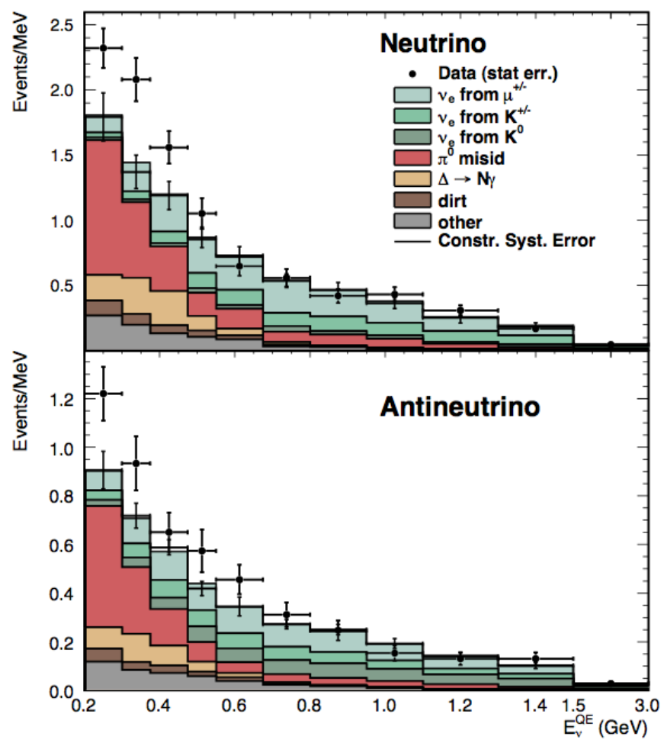
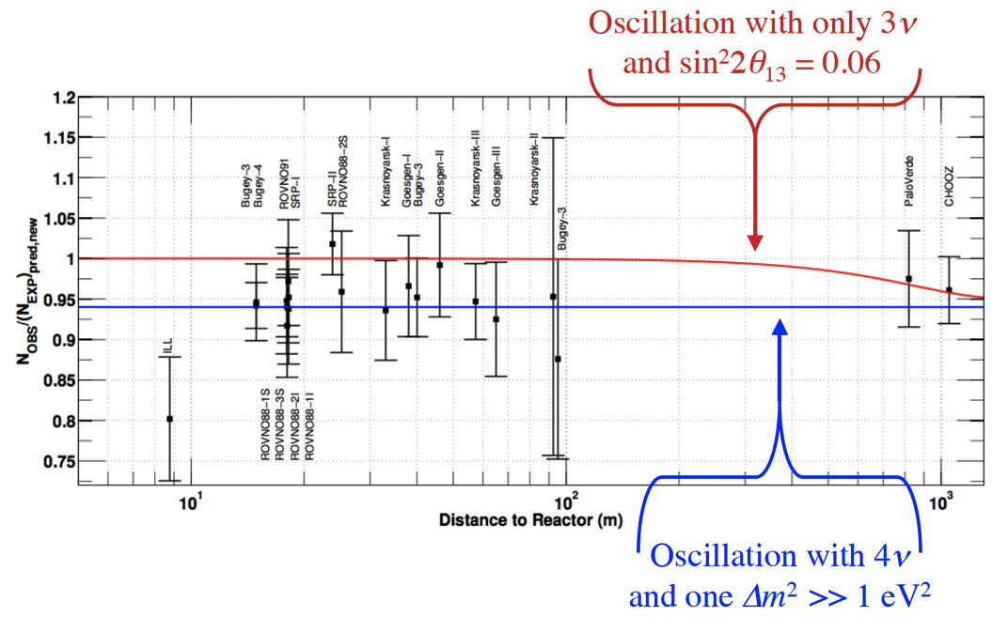
Further information on sterile neutrinos:
Additional information:
  MiniBooNE low E_{ν} excess
  Reactor neutrino flux
  ⁵¹Cr and ³⁷Ar ν_{e} rates
  Cosmic microwave background
Individually, or taken together, the “hints” are not convincing
Phys.Rev.Lett. 102, 101802 (2009),
Phys.Rev.Lett. 102, 101802 (2009)
MiniBOONE
However:
  Revolutionary if any one of the “hints” would be confirmed
  Clear need to resolve the issue
B. Kayser

Slide 38
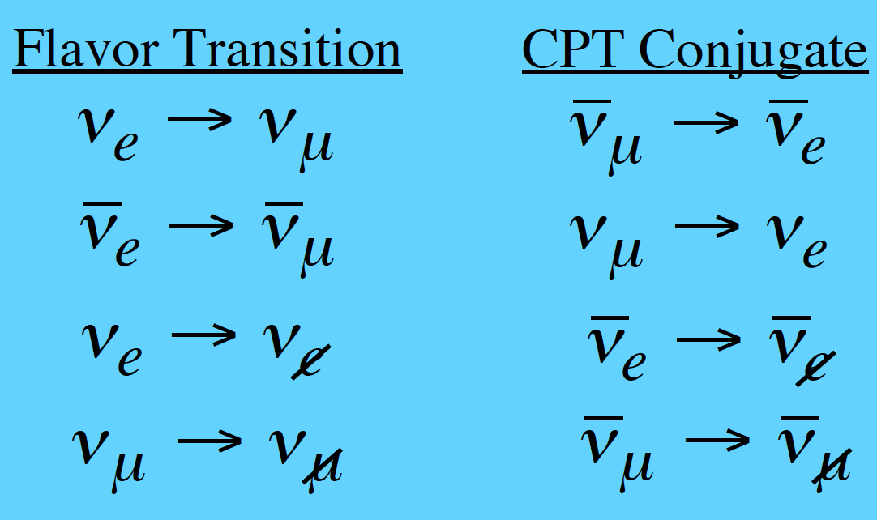
What we need to measure:
Present, inconclusive, information from ν_{e}➔ν_{X} and ν_{μ}➔ν_{X} transitions
Ideally, study:
and
  Determine neutral current rate
    oscillation to steriles will change neutral current rate
  Study ν_{e}N and ν_{μ}N scattering
    including hadronic final states to eliminate background uncertainties

Slide 39
Present programme and future options:
Present programme:
  Super-Kamiokande, MiniBooNE, SciBooNE, …
Electron-(anti)neutrino sources:
  Mono-energetic neutrinos from electron capture
  IsoDAR: ⁸Li produced in a cyclotron; observe ν_{e}
Muon-(anti)neutrino sources:
  LArl/NESSIE: near/far LAr detector combination at FNAL/CERN
Muon- and electron-(anti-)neutrino sources:
  LENA + cyclotron to produce muons
    Rate vs distance measurement from neutrinos produced in muon decay at rest
  nuSTORM
    Neutrinos from stored muon beams illuminating near/far detector combination

Slide 40

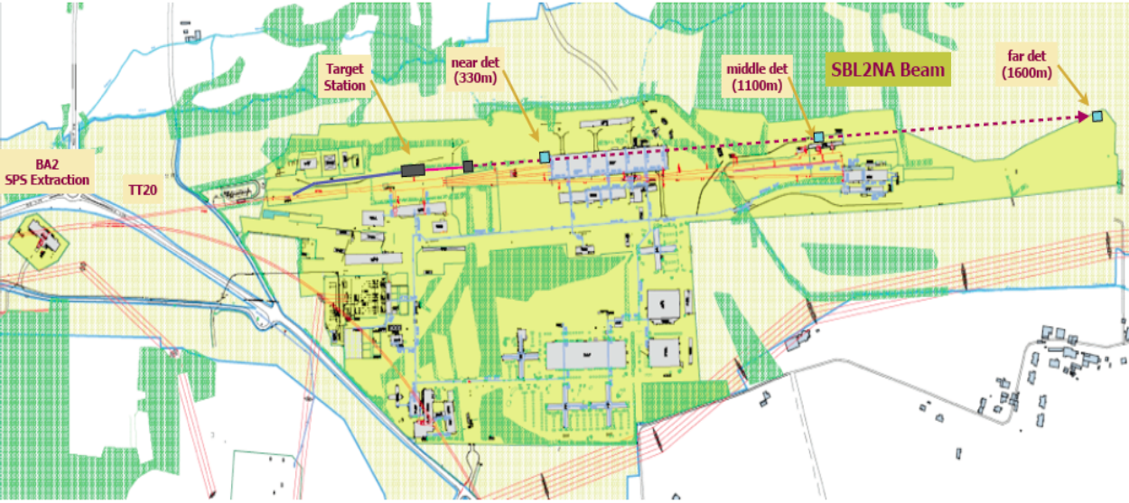
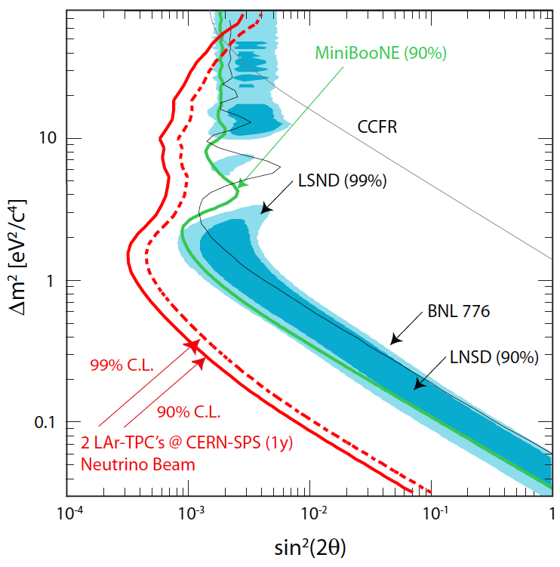
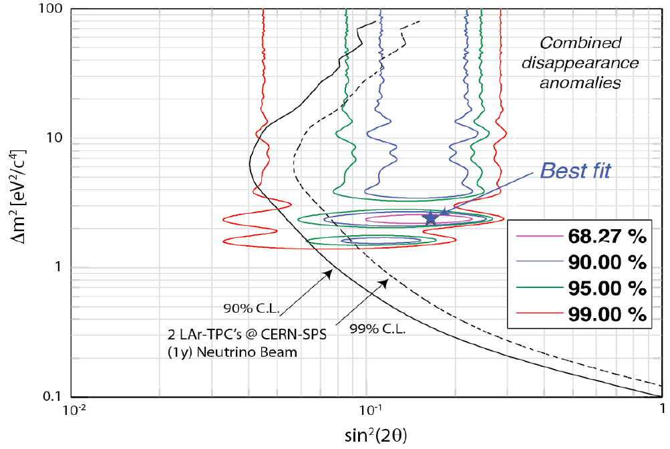
Two-baseline approach:
  Two LAr TPCs with MIND
Requires fast extraction at ~40 GeV from SPS to NA
Ambition:
  Implement for data taking start in 2016

Slide 41
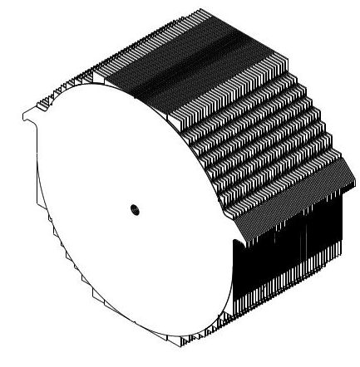
nuSTORM: conceptual design:
LOI [Bross et al];
Fermilab proposal P-1080 &
arXiv:1206.0294

Slide 42
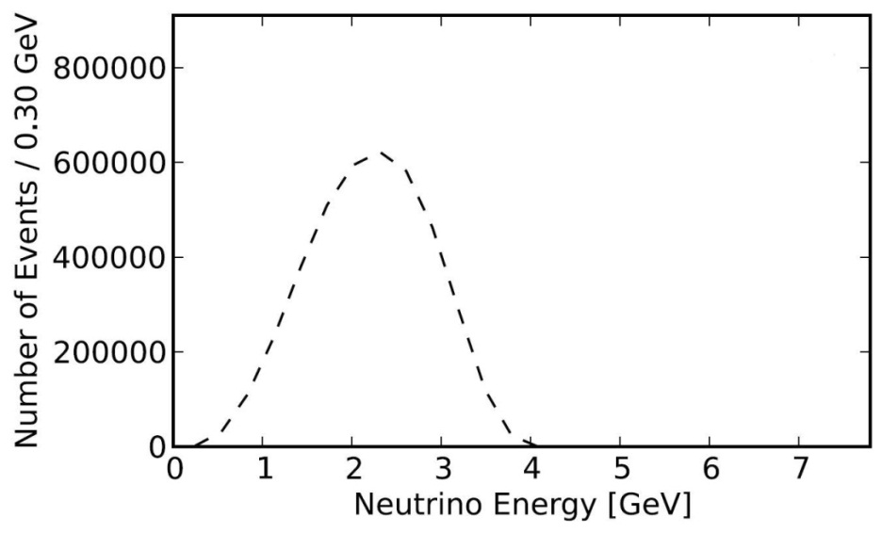
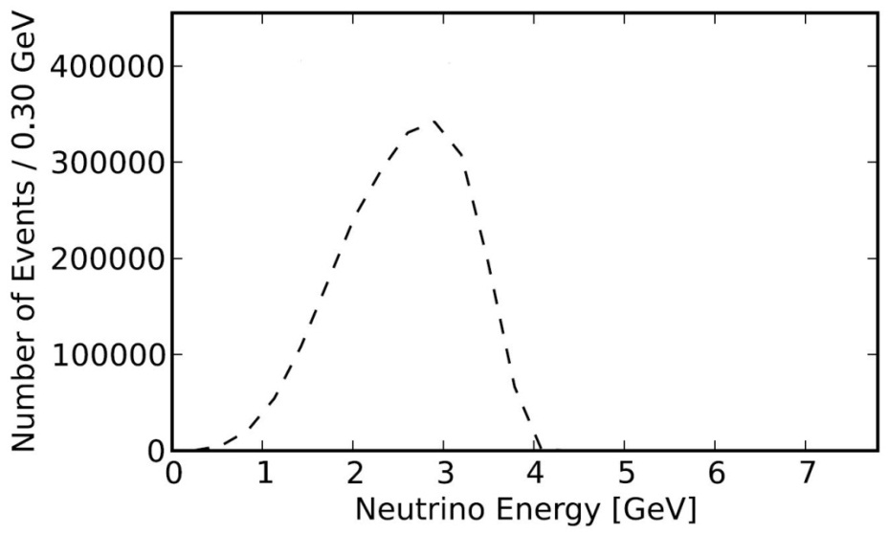
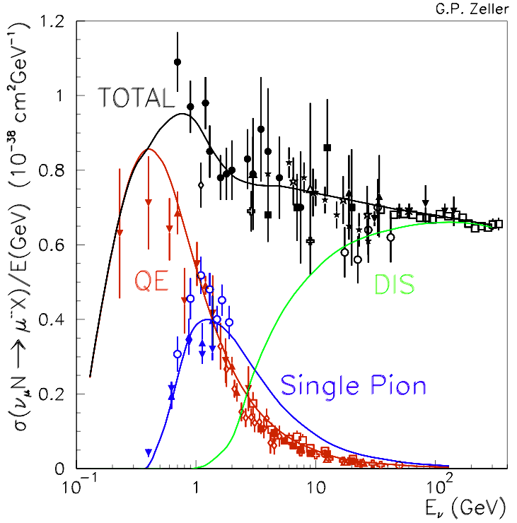
nuSTORM x-section measurement potential:
Above:
  nuSTORM event rates/100T at near detector 50 m from straight with μ⁺ stored
Right:
  State of the art:
    Almost no ν_{e} measurements

Slide 43
R&D and control of systematics
Neutrinos from stored muon beams:

Slide 44
Accelerator challenges:
Proton driver:
  4 MW; 5 < Ep < 15 GeV; bunch length 1—3 ns
  Linac (CERN, FNAL) and ring (RAL, JPARC) options: Progress: costing based on SPL
Pion-production target:
  Baseline: liquid mercury jet
  Options: powder jet or solid
  Progress: particle shielding, magnetic lattice
Muon front end:
  Chicane (new) to remove secondary hadrons:
    Bent solenoid transport & beryllium absorber
  Buncher & rotator:
    Progress: lattice revision in response to engineering study
  Cooling:
    Baseline: solenoid transport, LiH absorber
    Options: bucked coils or high-pressure H2
    Progress: lattice revision in response to engineering study
Rapid acceleration:
  Two options considered for acceleration to 10 GeV:
    Linac, RLA I and RLA II;
    Linac, RLA I and FFAG
  Choice based on cost and performance estimates
Proton driver:
  Development of high-power, pulsed proton source underway at proton labs
Pion-production target:
  MERIT experiment at CERN proved principle of mercury jet target
  Progress: particle shielding, magnetic lattice
Muon front end:
  Chicane (new) to remove secondary hadrons:
    Bent solenoid transport & beryllium absorber
  MuCool programme at FNAL:
    Study of effect of magnetic field on high-gradient, warm, copper cavities;
  MICE experiment at RAL:
    Proof of principle of ionization-cooling technique
    Progress: lattice revision in response to engineering stud
Rapid acceleration:
  EMMA experiment at DL:
    Proof of principal of non-scaling FFAG technique;
      Novel technology allows circular acceleration without magnet ramp

Slide 46
Detector challenges:
Measurement of oscillations:
  Requirements:
    Large mass;
    High granularity/resolution;
    Magnetisation;
  Options:
    LAr:
      Scaling to large mass needs to be demonstrated;
    Totally active scintillator:
      “Cost per channel” needs to be reduced;
    Magnetisation:
      Need to develop (or prove) a technique by which a large volume empty of ferrous material can be magnetised
Control of systematics:
  Require to develop a high-resolution detector or detectors capable of determining the νN cross sections and studying the hadronic final states with appropriate precision;
  Require to continue the programme of hadroproduction measurements required to improve the conventional flux models and simulation codes

Slide 47
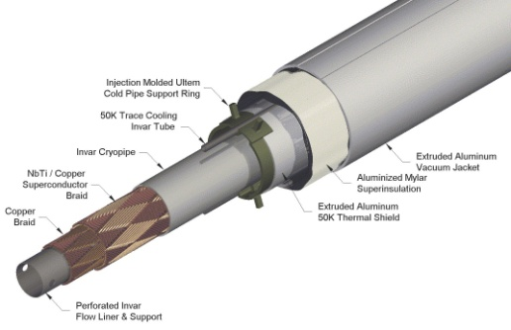
Magnetized Iron Neutrino Detector (MIND):
IDS-NF baseline:
  Intermediate baseline detector:
    100 kton at 1500—2500 km
  Appearance of “wrong-sign” muons
  Toroidal magnetic field > 1 T
    Excited with “superconducting transmission line”
  Segmentation: 3 cm Fe + 2 cm scintillator
  50-100 m long
  Octagonal shape
  Welded double-sheet
    Width 2m; 3mm slots between plates
Bross, Soler, Bayes, Cervera

Slide 49
Elements of a programme

Slide 50
Elements of a staged programme: [1]
Large value of θ₁₃, makes it likely that the next generation long-baseline experiments will determine the neutrino mass hierarchy;
  However, sensitivity to CP violation will be limited;
In the first instance, a combination of long-baseline (wide-band beam) experiments (e.g. LBNE/LBNO) and short baseline experiments (e.g. T2HK) may offer an attractive way forward:
  In such an approach:
    CP reach is limited by systematic effects;
    Hints of CP violation would require follow up by the Neutrino Factory.
Search for sterile neutrinos has the potential to revolutionize the field

Slide 51
Elements of a staged programme: [2]
The Neutrino Factory is the facility of choice for detailed studies of neutrino oscillations;
  Consensus:
    Will be required to:,
      Complete the Standard Neutrino Model and to test whether it is a good description of nature
But, stored muon beams have not yet been shown to be capable of serving a world-class neutrino programme:
  Require to push through R&D and complete IDS-NF, considering an incremental implementation in parallel; and
  Establish a first, realistic, scientifically first-rate neutrino experiment based on a stored muon beam
    nuSTORM has the potential to:
      Serve the neutrino programme by making unique ν_{e}N and ν_{μ}N cross section measurments; and
      Provide potentially decisive information on the existence of sterile neutrinos

Slide 52
nuSTORM expression of Interest
Neutrinos from stored muon beams:

Slide 53
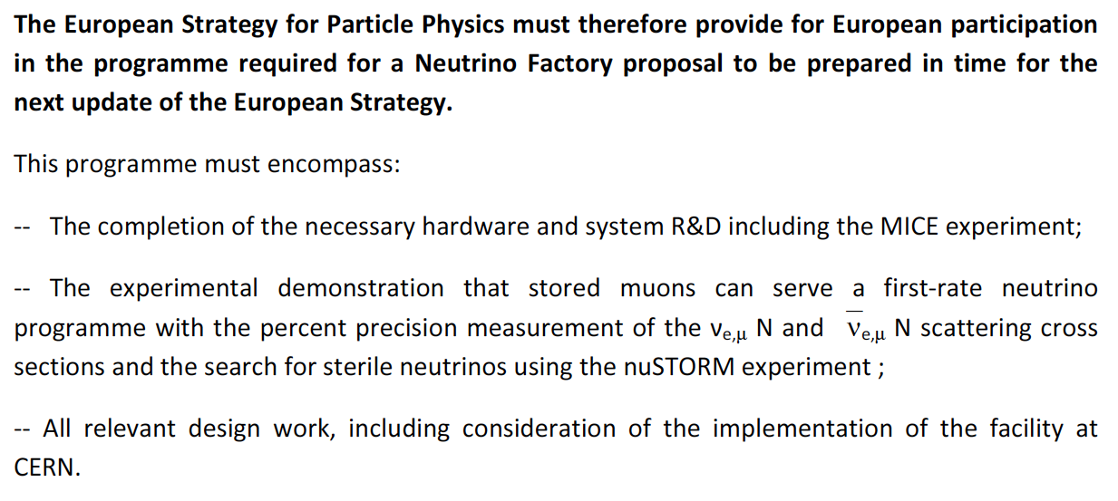
Community i/p to European Strategy update:
EUROnu conclusion emphasizes the Neutrino Factory:
    Beta-beam does not offer sufficient cost advantage
    Implementation would significantly interfere with LHC operation
Excerpt from European neutrino community input to the European Strategy Update:

Slide 54
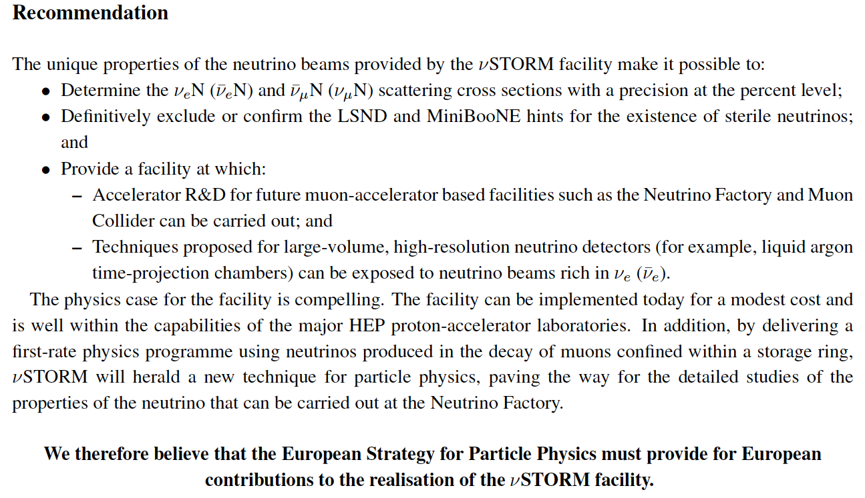
nuSTORM i/p to European Strategy update:

Slide 55
nuSTORM EoI to CERN
CERN would welcome the submission of an EoI;
EoI should contain:
  Physics case
  Outline of how nuSTORM could be mounted if carried out at CERN
    Have engaged with Elena Wildner and Simone Gilardone;
    Moves started to gain permission for some staff time
    Will follow up this week
  Outline of how a European collaboration, with CERN at its heart, could make a contribution to nuSTORM hosted at FNAL
  Request for CERN support in developing the concept
Timeline:
  Desirable to have EoI “handed in” in Jan13:
    Not a technical issue;
    Issue is with the “length of the non-UK European author list”:
      Some steps already taken to strengthen this
Scale of document:
  Still researching this, but, looks like we need:
    10—15 page document;
    Indication of effort request from CERN and indication of the desired timeline

Slide 56
nuSTORM EoI: proposed timeline
Goal:
  LoI available before Erice “European Strategy writing work shop”;
Skeleton for nuSTORM EoI: 09Nov12
  Done;
  Sections and lead authors defined
Text deadline for lead authors: 09Dec12
  Consolidate first complete draft …
Circulate for comment: 16Dec12
  Comments open until the end of nuSTORM #2
nuSTORM w/s #2 at CERN: Jan13:
  Review status of nuSTORM
  Review status of EoI
  Gather additional European authors
Submit to SPSC (CC to relevant Strategy Group members): 16Jan13

Slide 57
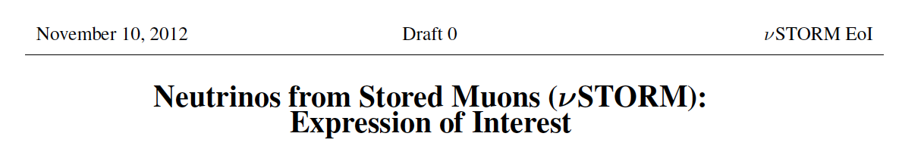
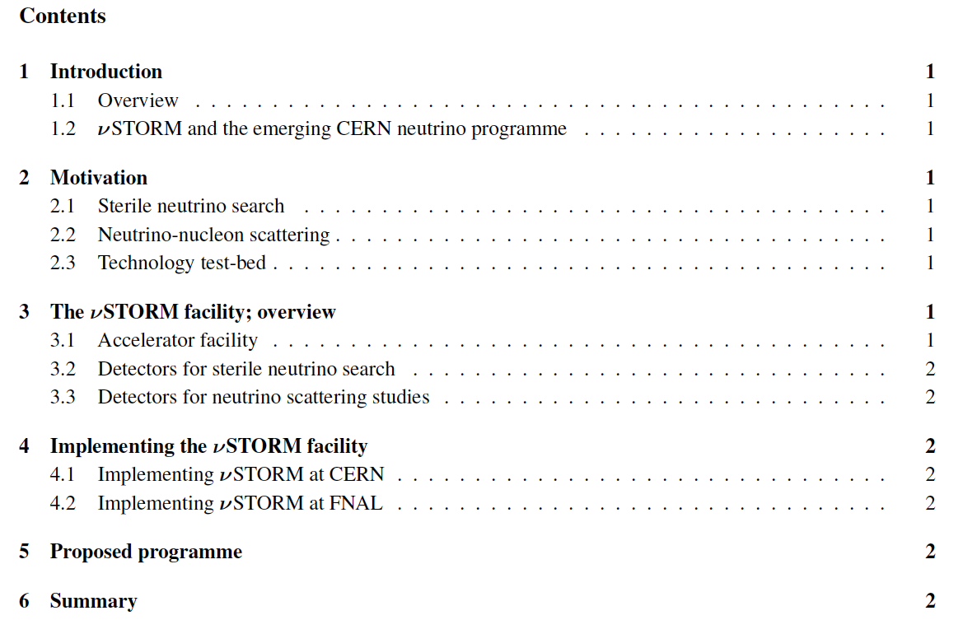

Slide 58
nuSTORM EoI: proposed timeline
Goal:
  LoI available before Erice “European Strategy writing work shop”;
Skeleton for nuSTORM EoI: 09Nov12
  Done;
  Sections and lead authors defined
Text deadline for lead authors: 09Dec12
  Consolidate first complete draft …
Circulate for comment: 16Dec12
  Comments open until the end of nuSTORM #2
nuSTORM w/s #2 at CERN: Jan13:
  Review status of nuSTORM
  Review status of EoI
  Gather additional European authors
Submit to SPSC (CC to relevant Strategy Group members): 16Jan13

Slide 59
Conclusions
Neutrinos from stored muon beams:

Slide 60
Conclusions [1]:
The study of the neutrino is the study of physics beyond the Standard Model:
  Possibly a window on extremely large mass scale
Exciting new data; exciting opportunities:
  Measurement of θ₁₃ emphasises:
    Discovery sensitivity for:
      CP-invariance violation;
      Mass hierarchy;
    Precision measurement of neutrino oscillations
  Sterile neutrinos situation unclear:
    Confirmation, or discovery of sterile state, would revolutionize our field

Slide 61
Conclusions [2]:
New data, new Design Studies, new accelerator R&D allow definition of powerful incremental programme encompassing:
  Conventional super-beam experiment(s):
    Determination of mass hierarchy;
    Initial scan of δ_{CP} space;
      Critical contribution: νe cross section measurements from nuSTORM
  Development of the Neutrino Factory:
    Unique; meeting the sensitivity and precision goals;
    Mature; key issues addressed, or being addressed;
    Incremental approach to full Neutrino Factory conceivable.
  Programme of sterile neutrino searches:
    Development of existing sterile-neutrino search programme;
    Down-selection of novel techniques:
      nuSTORM offers a qualitatively new technique that can address each of the channels of interest

Slide 62
All together a wonderful programme!
Thank you

