Slide 1

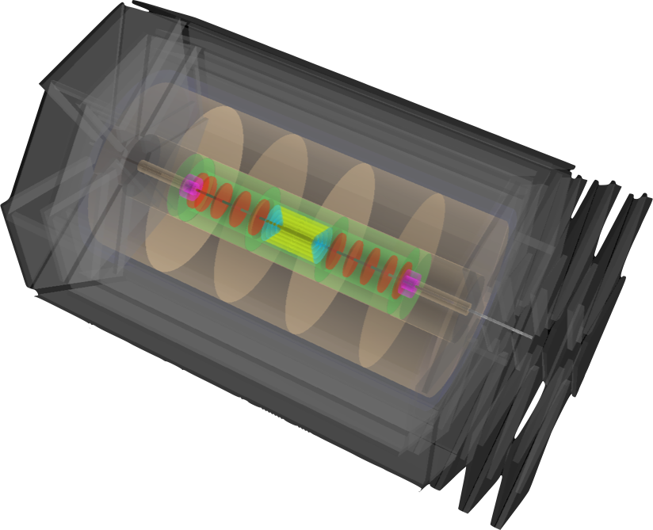
Electron-Ion Collider Collaboration Meeting
Machine and Detector Design at the LHeC
Polini
for the LHeC WGs
Outline
Basic Project Considerations and Physics Motivation
Options and Challenges
    Accelerator Design
    Interaction Region
    Detector Design
Status and Roadmap

Slide 2
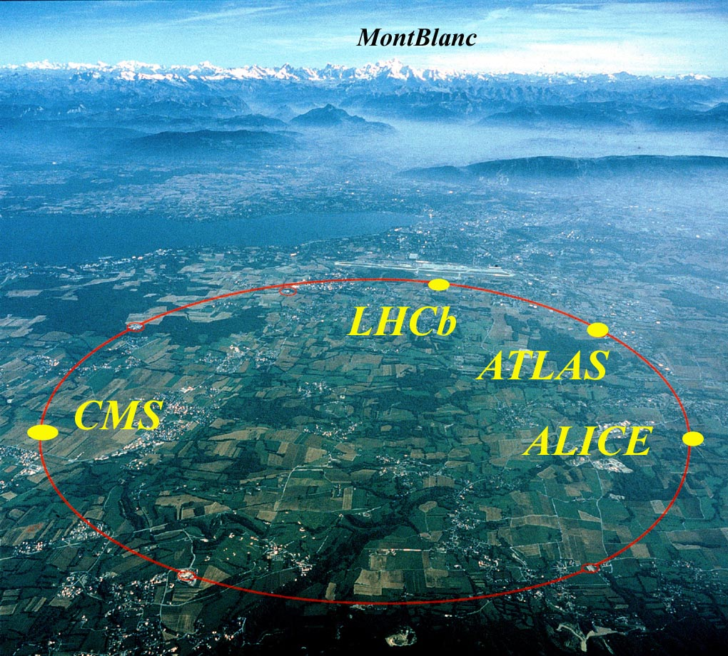
LHeC Challenge
Add an electron beam to the LHC
Next generation e±p collider
e± polarized beam
eA collider
Rich physics program: eq physics at TeV energies
precision QCD & electroweak physics
boosting precision and range of LHC physics results
beyond the Standard Model
high density matter: low x and eA
Tevatron/LEP/HERA (Fermiscale) → LHC/LC/LHeC (Terascale)
100 fold increase in luminosity, in Q² and 1/x w.r.t. HERA
LHC

Slide 3
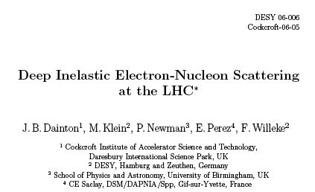
LHeC Context
The LHeC is not the first proposal for higher energy DIS, but it is the first with the potential for significantly higher luminosity than HERA …
Lepton Proton Scatering Facilities
Done
Planned
[JINST 1 (2006) P10001]

Slide 4
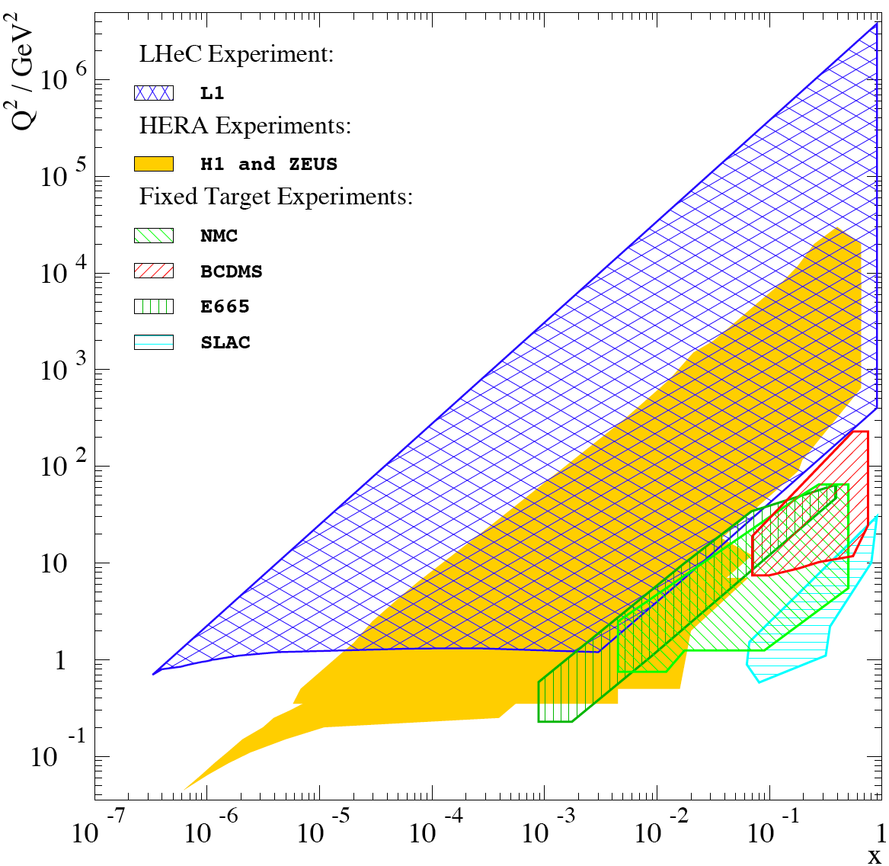
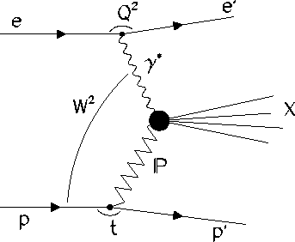
Kinematics & Motivation (60 GeV x 7 TeV ep)
√s>> 1 TeV
New physics, distance
scales few . 10⁻²⁰ m
Large x
partons
High precision
partons in LHC
plateau
High mass (M_{eq}, Q²) frontier
EW & Higgs
Q² lever-arm at smallest up to x near to 1 → PDFs
Low x frontier [ x below 10⁻⁶ at Q² ~ 1 GeV² ]
→ novel QCD …
Nuclear
Structure
& Low x
Parton
Dynamics
High Density
Matter

Slide 5
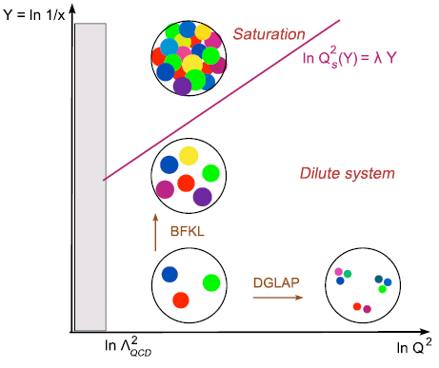
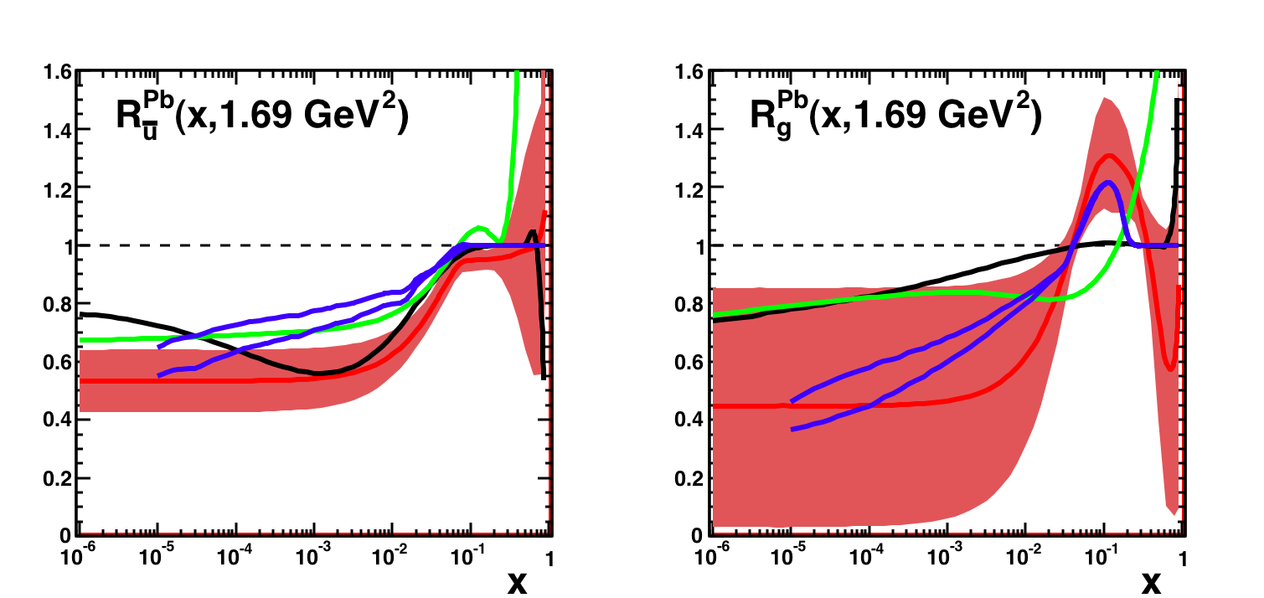
eA with the LHeC
Saturation (low x, nonlinear QCD)
Nuclear Parton Densities
eA: new realm: Extension of kinematic range by 3~4 orders of magnitude into saturation region
A: density ~A^{1/3} ~ 6 for Pb … worth 2 orders of magnitude in x
5

Slide 6

LHeC Status
CERN: European Organization for Nuclear Research
ECFA: European Committee for Future Accelerators
NuPECC: Nuclear Physics European Collaboration Committee
➔ Divonne III November 2010: CDR draft
http://cern.ch/LHeC

Slide 7
Organisation for the CDR
Scientific Advisory Committee
Working Group Convenors
Guido Altarelli (Rome)
Sergio Bertolucci (CERN)
Stan Brodsky (SLAC)
Allen Caldwell -chair (MPI Munich)
Swapan Chattopadhyay (Cockcroft)
John Dainton (Liverpool)
John Ellis (CERN)
Jos Engelen (CERN)
Joel Feltesse (Saclay)
Lev Lipatov (St.Petersburg)
Roland Garoby (CERN)
Roland Horisberger (PSI)
Young-Kee Kim (Fermilab)
Aharon Levy (Tel Aviv)
Karlheinz Meier (Heidelberg)
Richard Milner (Bates)
Joachim Mnich (DESY)
Steven Myers, (CERN)
Tatsuya Nakada (Lausanne, ECFA)
Guenther Rosner (Glasgow, NuPECC)
Alexander Skrinsky (Novosibirsk)
Anthony Thomas (Jlab)
Steven Vigdor (BNL)
Frank Wilczek (MIT)
Ferdinand Willeke (BNL)
Accelerator Design [RR and LR]
Oliver Bruening (CERN),
John Dainton (CI/Liverpool)
Interaction Region and Fwd/Bwd
Bernhard Holzer (CERN),
Uwe Schneeekloth (DESY),
Pierre van Mechelen (Antwerpen)
Detector Design
Peter Kostka (DESY),
Alessandro Polini (Bologna)
Rainer Wallny (UCLA),
New Physics at Large Scales
George Azuelos (Montreal)
Emmanuelle Perez (CERN),
Georg Weiglein (Durham)
Precision QCD and Electroweak
Olaf Behnke (DESY),
Paolo Gambino (Torino),
Thomas Gehrmann (Zuerich)
Claire Gwenlan (Oxford)
Physics at High Parton Densities
Nestor Armesto (Santiago),
Brian Cole (Columbia),
Paul Newman (Birmingham),
Anna Stasto (MSU)
Steering Committee
Oliver Bruening (CERN)
John Dainton (Cockcroft)
Albert DeRoeck (CERN)
Stefano Forte (Milano)
Max Klein - chair (Liverpool)
Paul Laycock (secretary) (Liverpool)
Paul Newman (Birmingham)
Emmanuelle Perez (CERN)
Wesley Smith (Wisconsin)
Bernd Surrow (MIT)
Katsuo Tokushuku (KEK)
Urs Wiedemann (CERN)
Frank Zimmermann (CERN)
7

Slide 8
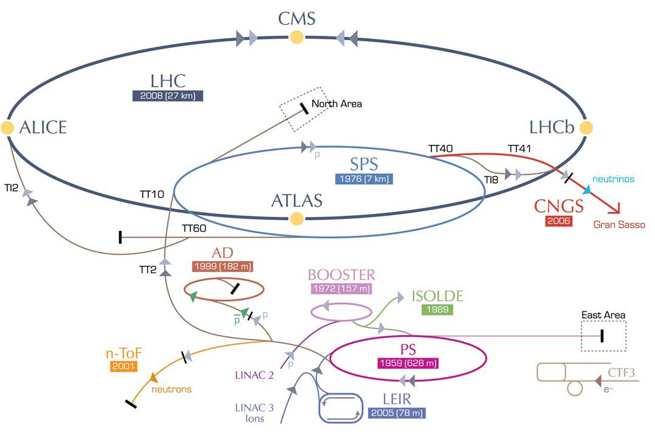
Accelerator: Two Alternative Designs
RR LHeC:
new ring
in LHC tunnel,
with bypasses
around
experiments
LR LHeC:
recirculating
linac with
energy
recovery
RR LHeC
e± injector
10 GeV,
10 min. filling time
8

Slide 9
Two Alternative Designs
Ring-ring
  e-p and e-A (A=Pb, Au, …) collisions,
  More “conventional” solution, like HERA, no difficulties of principle - at first sight - but constrained by existing LHC in tunnel
  polarization 40% with realistic misalignment assumptions
  Steady progress with detailed design
Linac-ring
  e-p and e-A (A=Pb, Au, …) collisions, polarized e from source, poorer Luminosity/Power
  No previous collider like this
  Comparisons of layouts

Slide 10
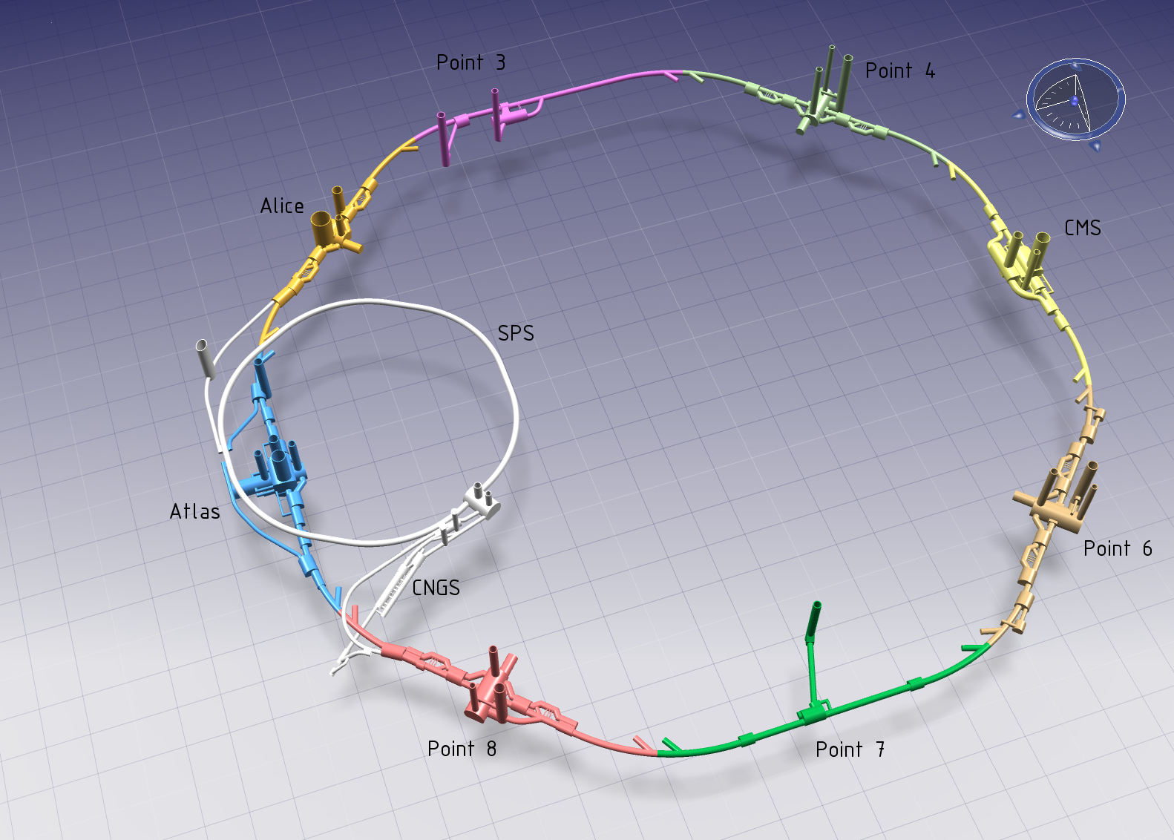
LHeC – Ring-Ring Configuration
Newly built magnets
installed on top of
the LHC bypassing
LHC experiments
in the twenties.
10 GeV injector into bypass of P1 2 x 10¹⁰e (LEP: 4 x10¹¹)
~10 min filling time synchronous ep + pp

Slide 11
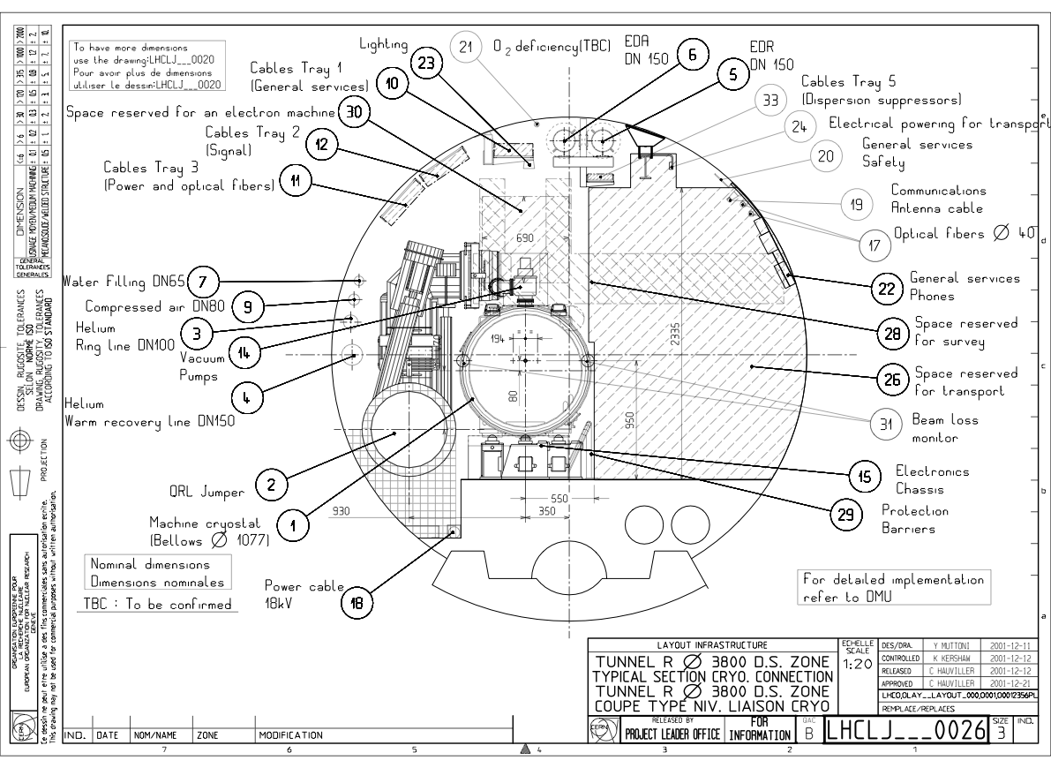
Ring-Ring Design Criteria
Compatibility with installed LHC and its tunnel infrastructure
Many details to study and take care of
LHC would be running in p-p in parallel
Minimise length of installation shutdown
LHC p-p would be running for high integrated luminosity
Bounds on power consumption (100 MW)
Transport zone must be kept free
LHeC
11

Slide 12
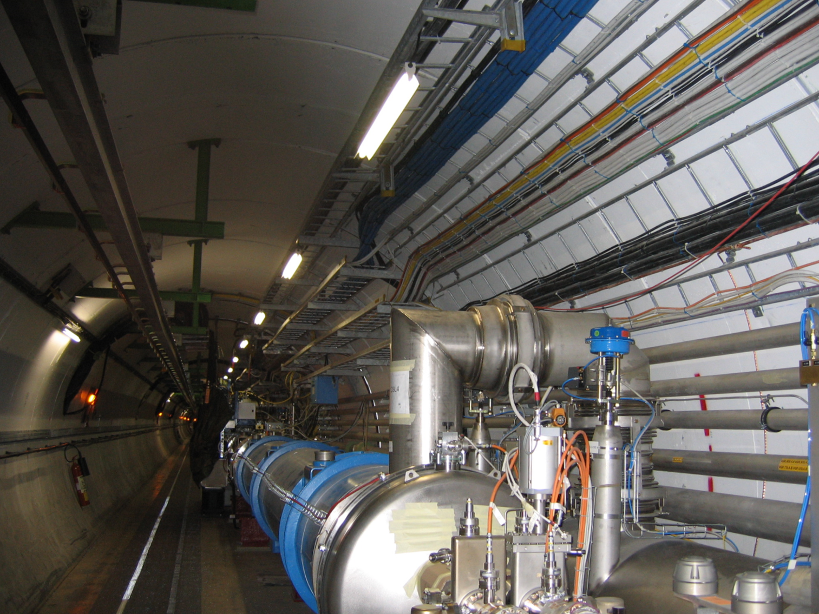
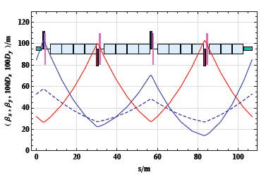
LHeC – e Ring Design
ARC cell design: L_{FODO}(e)=L_{FODO}(p)/2
Meet spatial LHC constraints
Synchrotron radiation < 50MW
Two types of quadrupoles
Reasonable sextupole parameters
Dipoles: 4 times lighter than LEP
Prototypes: Novosibirsk and CERN
LHC Cryo jumpers accounted for in asymmetric Focusing-Defocusing
Further interferences mapped and being studied
Experiments bypassed in new tunnels which house RF cavities
Notes:
12

Slide 13
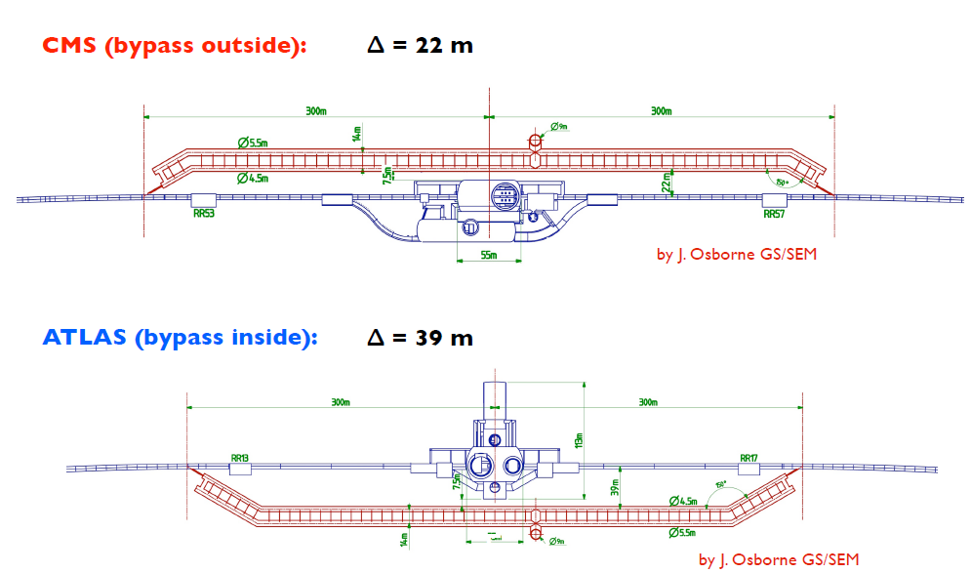
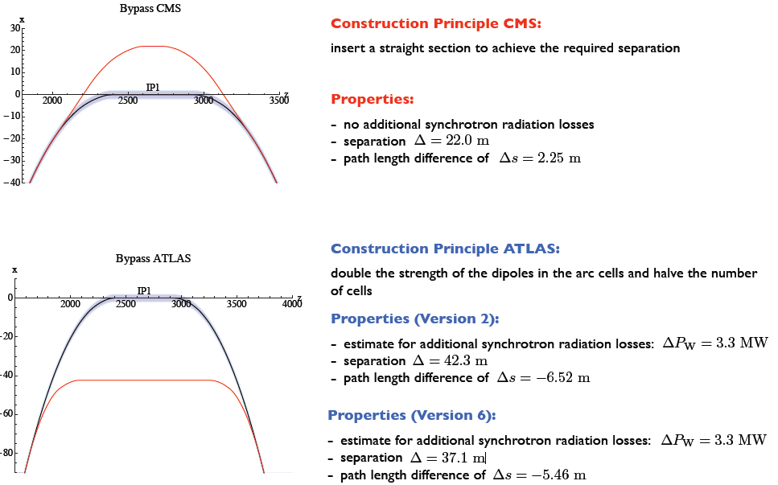
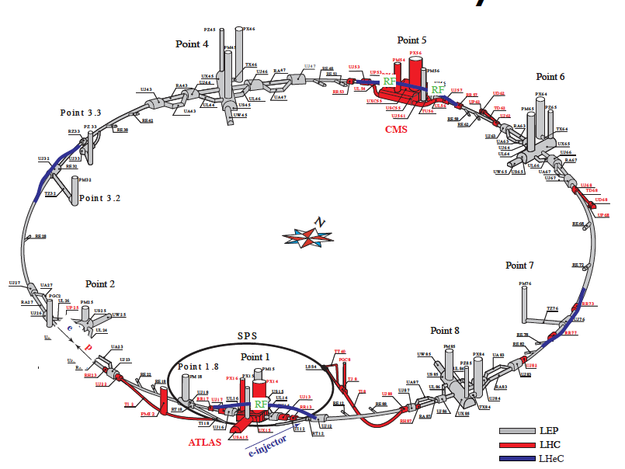
Overall Layout and Bypasses
M. Fitterer
e-p/A experiment could be at IP2 (shown), IP8 or …
Bypass design:
shutdown time
cost for tunnel
match LHC and eRing circumference
extra shafts being discussed

Slide 14
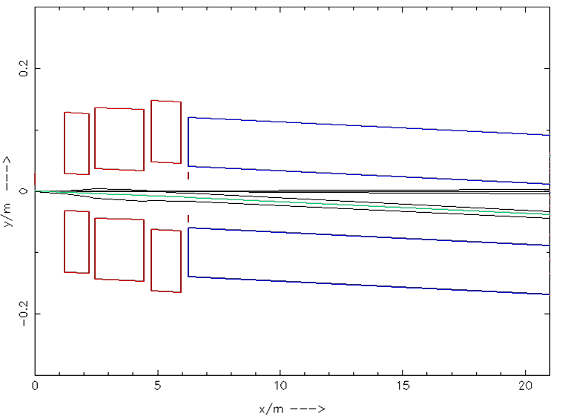
Beam Optics and Detector Acceptance
10⁰
1⁰
IP
Luminosity: 10°: ~1.7x10³³ cm s⁻² ; 1°: ~ 6 x10³² cm s⁻²
Design suggests two detector configurations:
Low Lumi, Low Q² → High acceptance detector 1°
High Lumi,High Q² → Main detector 10° aperture
14

Slide 15
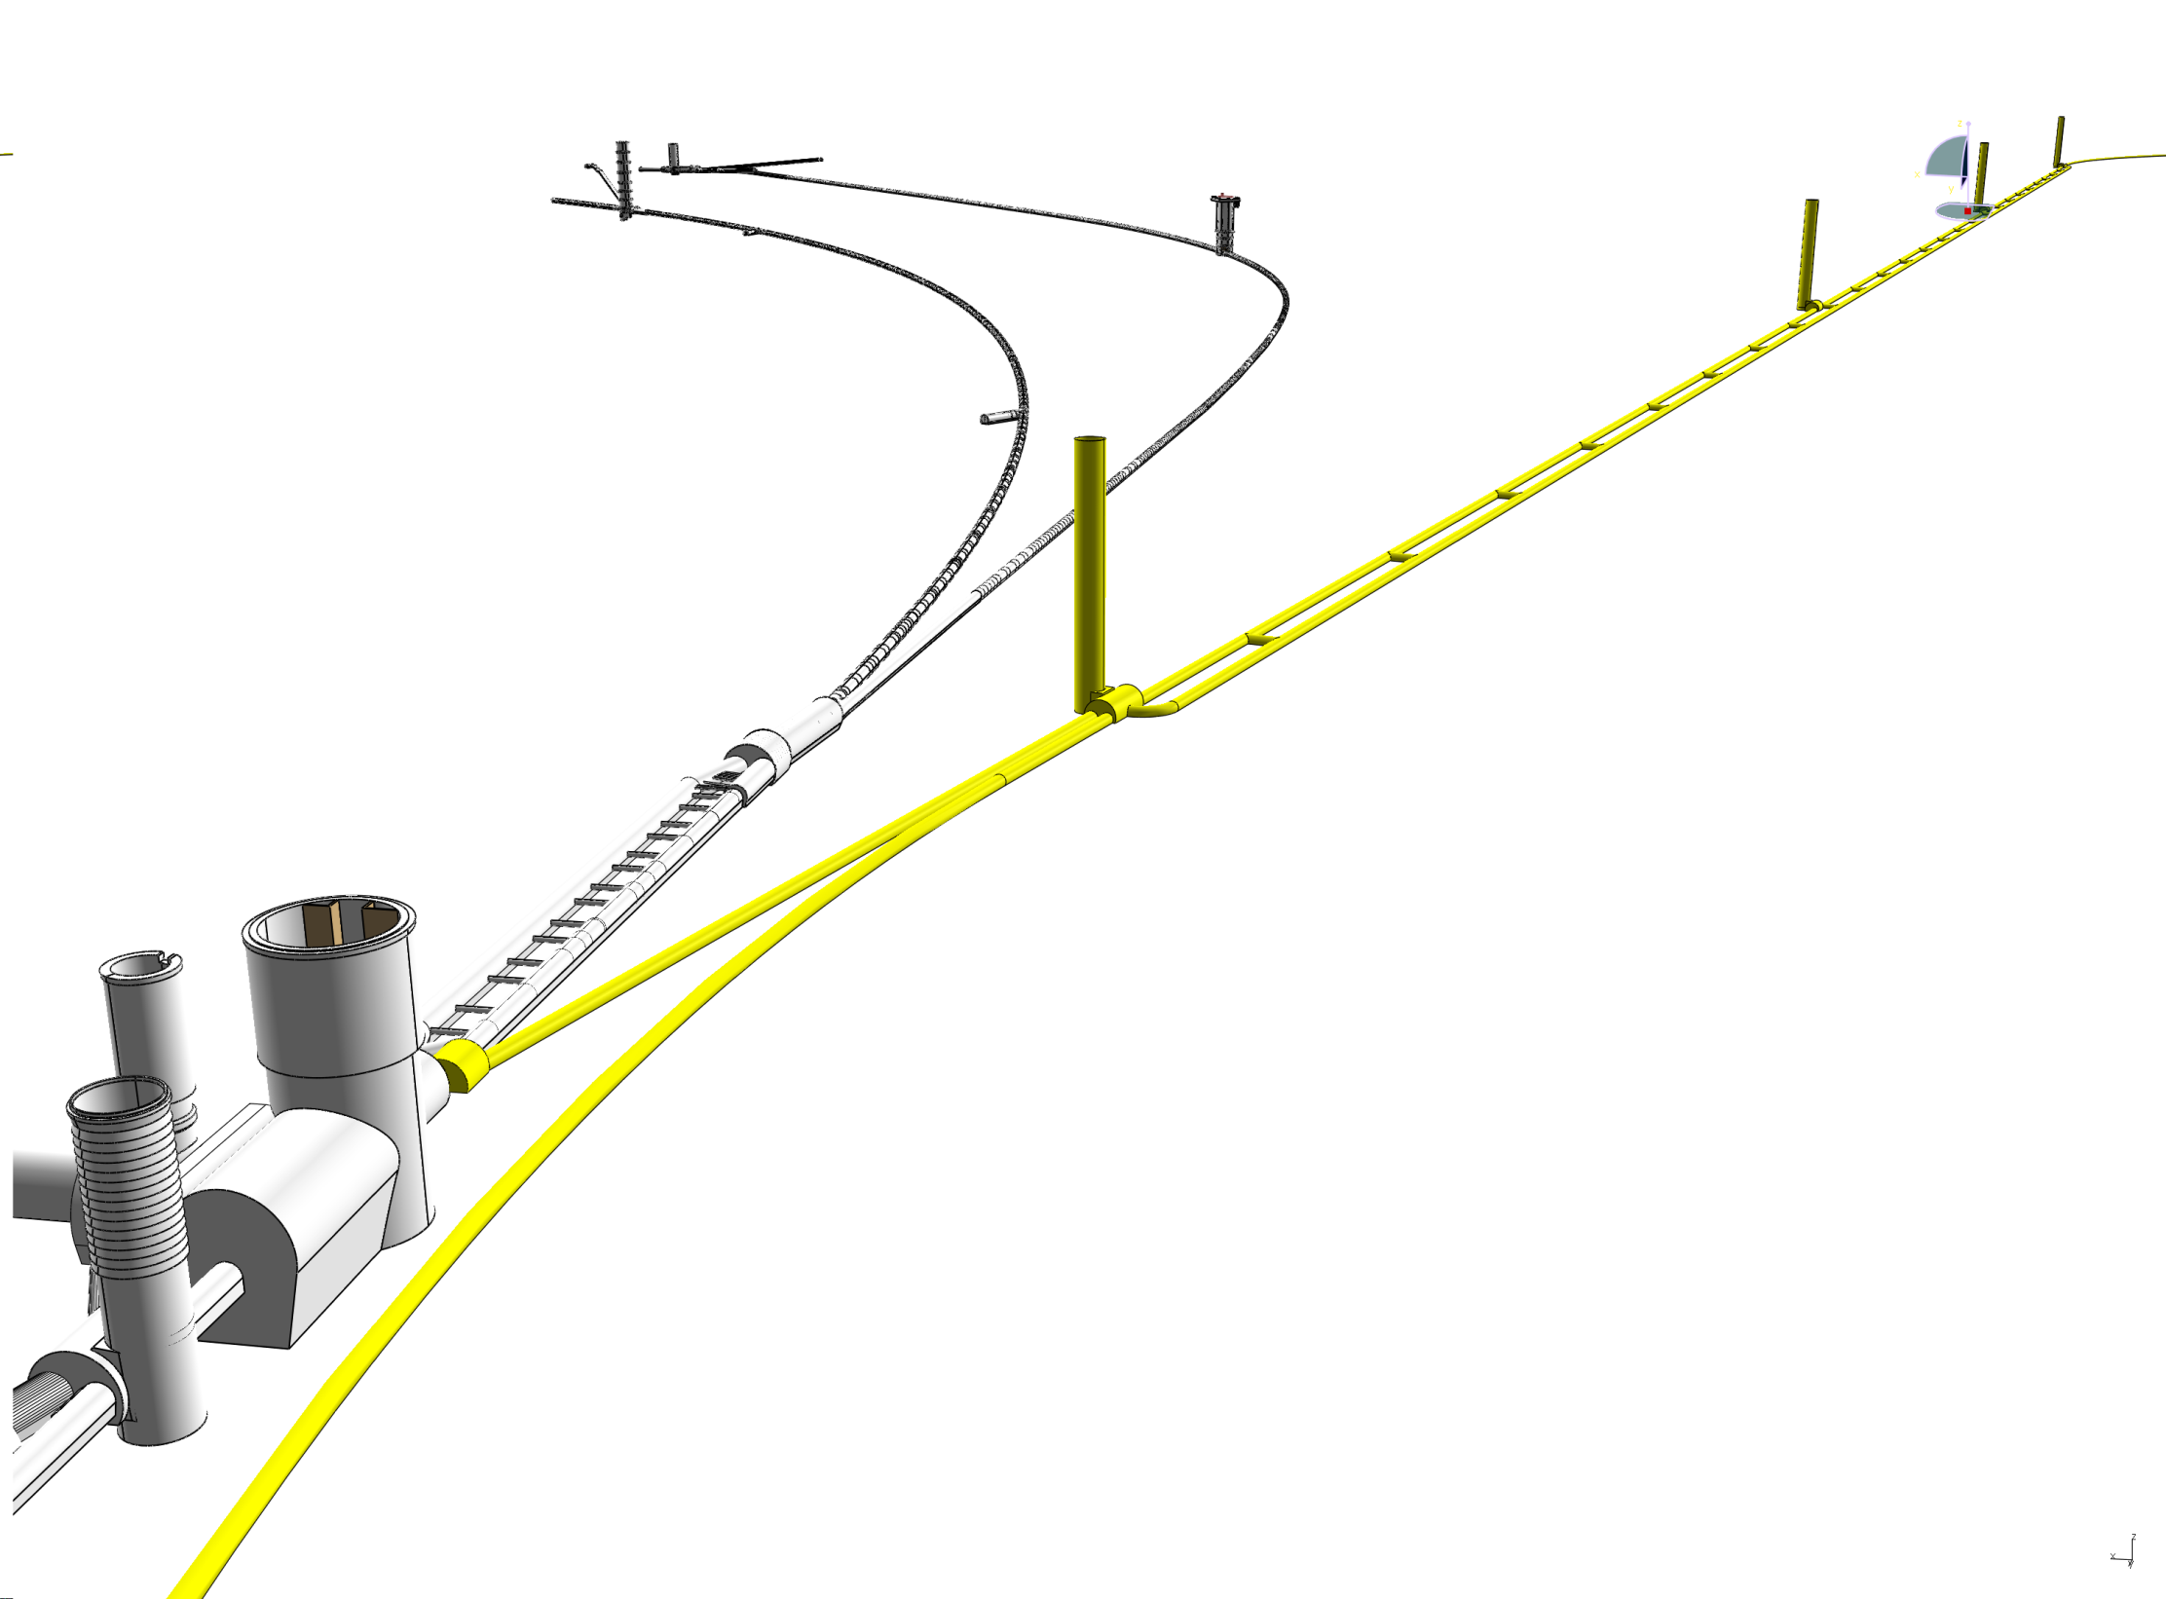
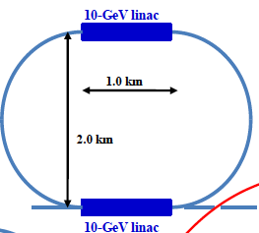
Linac-Ring Configuration
Baseline:
Energy Recovery Linac
60 GeV, Power 100MW
Also presented in CDR:
60 GeV pulsed 10³²cm⁻²s⁻¹
140 GeV pulsed 5 10³¹
Note: CLIC x LHC ~10³⁰
due to different time
structure (0.5 vs 50ns)

Slide 16
Linac-Ring Configurations
Pulsed-60
ERL
LHC p
10-GeV linac
1.67 km
injector
0.34 km
dump
1.0 km
injector
30-GeV linac
IP
dump
Least effort: ~ 10³²
2.0 km
LHC p
Pulsed-140
10-GeV linac
IP
Luminosity ~10³³
High Energy, 0.5 10³²
2.0 km
LHC p
3.9 km
injector
70-GeV linac
IP
dump
or linear
7.8 km
IP
injector
140-GeV linac
dump

Slide 17
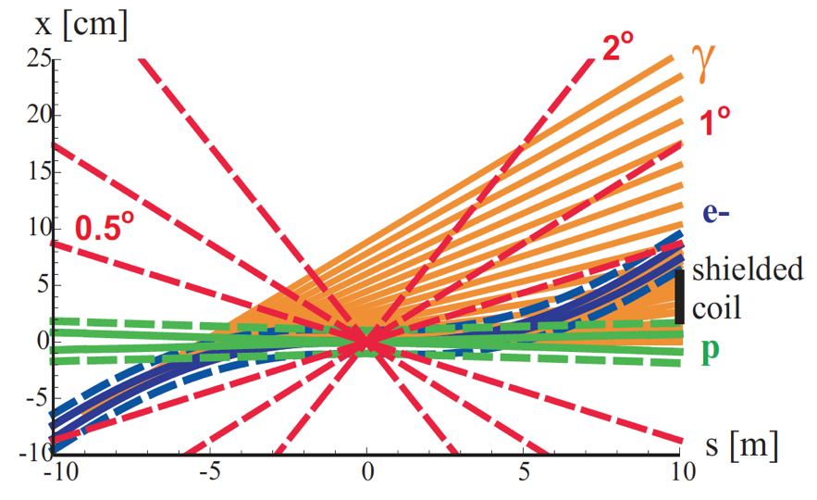
LR Option -Dipole-Separation - SR Fan
M. Sullivan
e p
Elliptical Beam Pipe:
(very preliminary)
inner-∅x = 12cm
inner-∅y = 5cm
outer-∅x = 12.8cm
outer-∅y = 5.8cm
thickness: 0.4cm
Beam envelopes of 10σ (electrons) [solid blue] or 11σ (protons) [solid green],
the same envelopes with an additional constant margin of 10 mm [dashed],
the synchrotron radiation fan [orange], and the approximate location of
the magnet coil between incoming protons and outgoing electron beam [black].

Slide 18
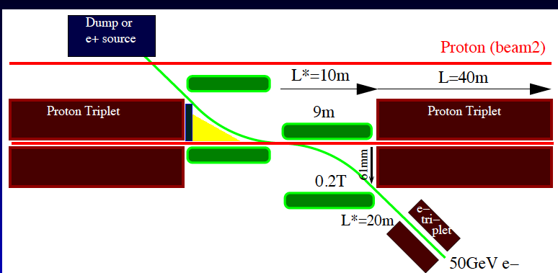
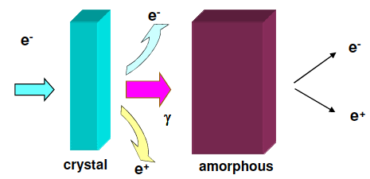
LR – Interaction Region
p e
IR Options:
Head on → dipoles
Crossing → like RR IR
β_{p}=10 cm
l*= 10 m
Positron source
Difficult to reach high intensity. Perhaps best suited: hybrid target
production of unpolarised
positrons. Several stations?
cf Divonne 2009

Slide 19
Design Parameters
electron beam | RR | LR ERL | LR
e- energy at IP[GeV] | 60 | 60 | 140
luminosity [10³² cm⁻²s⁻¹] | 17 | 10 | 0.44
polarization [%] | 5 - 40 | 90 | 90
bunch population [10⁹] | 26 | 2.0 | 1.6
e- bunch length [mm] | 10 | 0.3 | 0.3
bunch interval [ns] | 25 | 50 | 50
transv. emit. γε_{x,y} [mm] | 0.58, 0.29 | 0.05 | 0.1
rms IP beam size σ_{x,y} [μm] | 30, 16 | 7 | 7
e- IP beta funct. β*_{x,y} [m] | 0.18, 0.10 | 0.12 | 0.14
full crossing angle [mrad] | 0.93 | 0 | 0
geometric reduction H_{hg} | 0.77 | 0.91 | 0.94
repetition rate [Hz] | N/A | N/A | 10
beam pulse length [ms] | N/A | N/A | 5
ER efficiency | N/A | 94% | N/A
average current [mA] | 131 | 6.6 | 5.4
tot. wall plug power[MW] | 100 | 100 | 100
proton beam | RR | LR
bunch pop. [10¹¹] | 1.7 | 1.7
tr.emit.γε_{x,y} [μm] | 3.75 | 3.75
spot size σ_{x,y} [μm] | 30, 16 | 7
β*_{x,y} [m] | 1.8,0.5 | 0.1$
bunch spacing [ns] | 25 | 25
$ smaller LR p-β* value than for
nominal LHC (0.55 m):
  reduced l* (23 → 10 m)
  only one p beam squeezed
  IR quads as for HL-LHC
In progress last update 8.7.2010
RR = Ring – Ring
LR = Linac –Ring
ERL= Energy Recovery Linac

Slide 20
Interaction Region: Crossing Angle
p
HERA
96 ns bunch spacing
LHeC
25 ns bunch spacing
1st parasitic interaction
3.7 m from IP
e
p
e
At LHC 1st parasitic interaction at 3.7 m from IP
RR: Presently non zero crossing angle (0.93 mrad)
RR: Focusing Quadrupoles close to IR to achieve high Lumi (1.2m)
LR: Need dipole(s) close to interaction region
(B 0.2 ~ 0.4 T at 0 ~1.5 m-9m from IP)
RR could profit of bending dipole(s) to further reduce the crossing angle
20

Slide 21
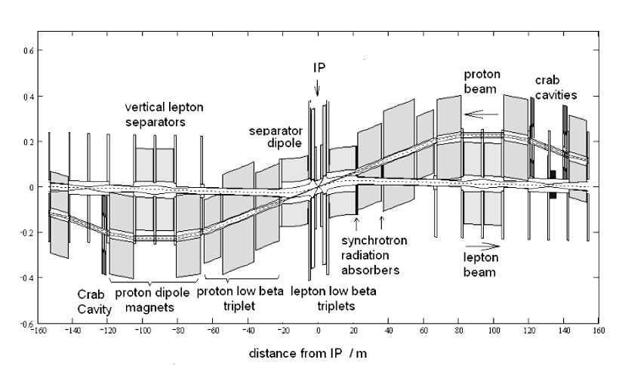
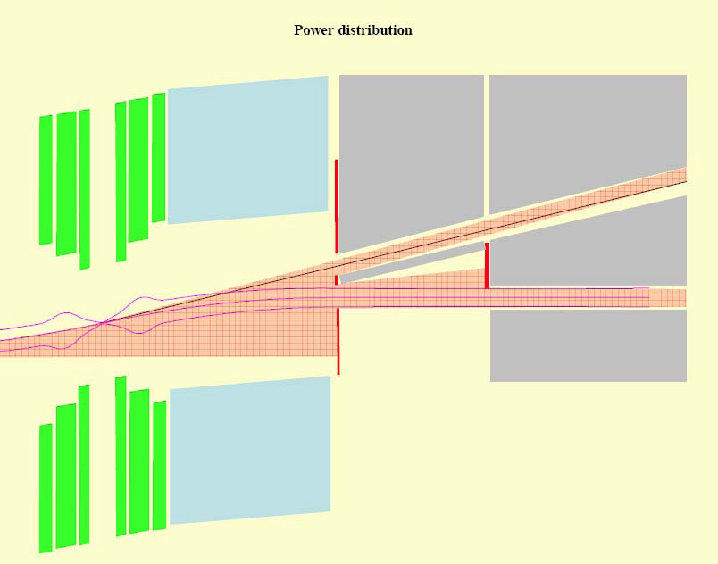
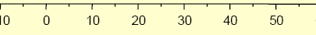
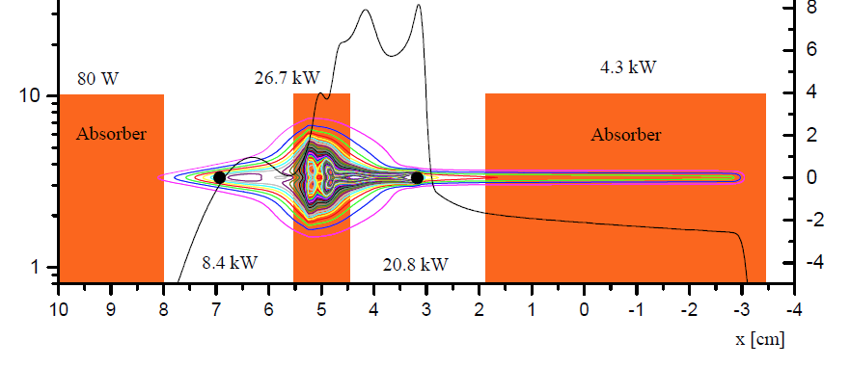
Synchrotron Radiation - RR
(very preliminary)
Top View of IR
B. Nagorny, W. Schneekloth
26.7 kW
16.4 kW
4.4 kW
Absorbers
m
21

Slide 22
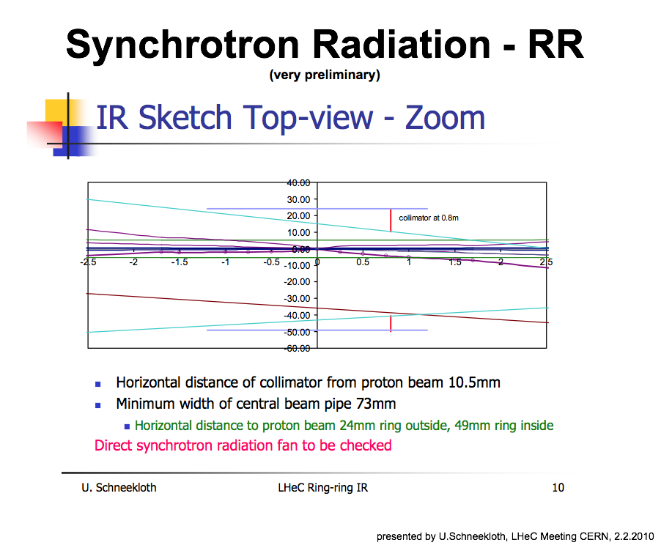
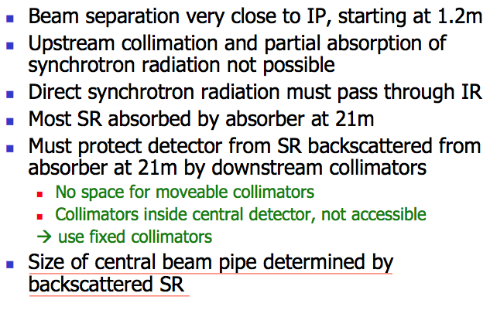
Backscattering of Sync Rad
(very preliminary)
U.Schneekloth
Synchrotron Radiation simulation and collimator
design with up to date optics is ongoing

Slide 23
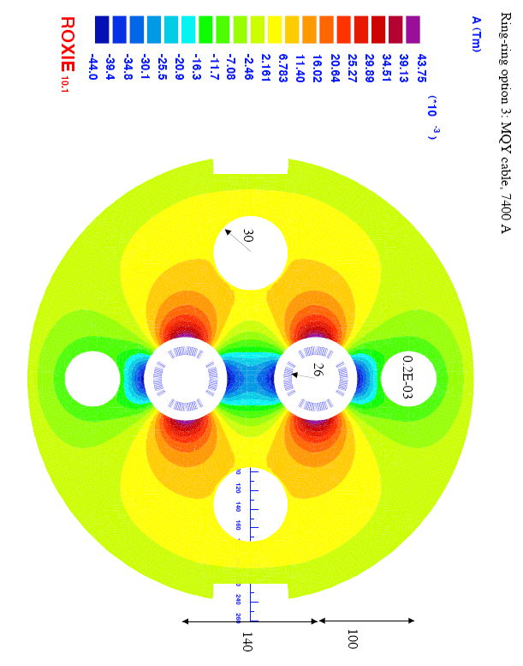
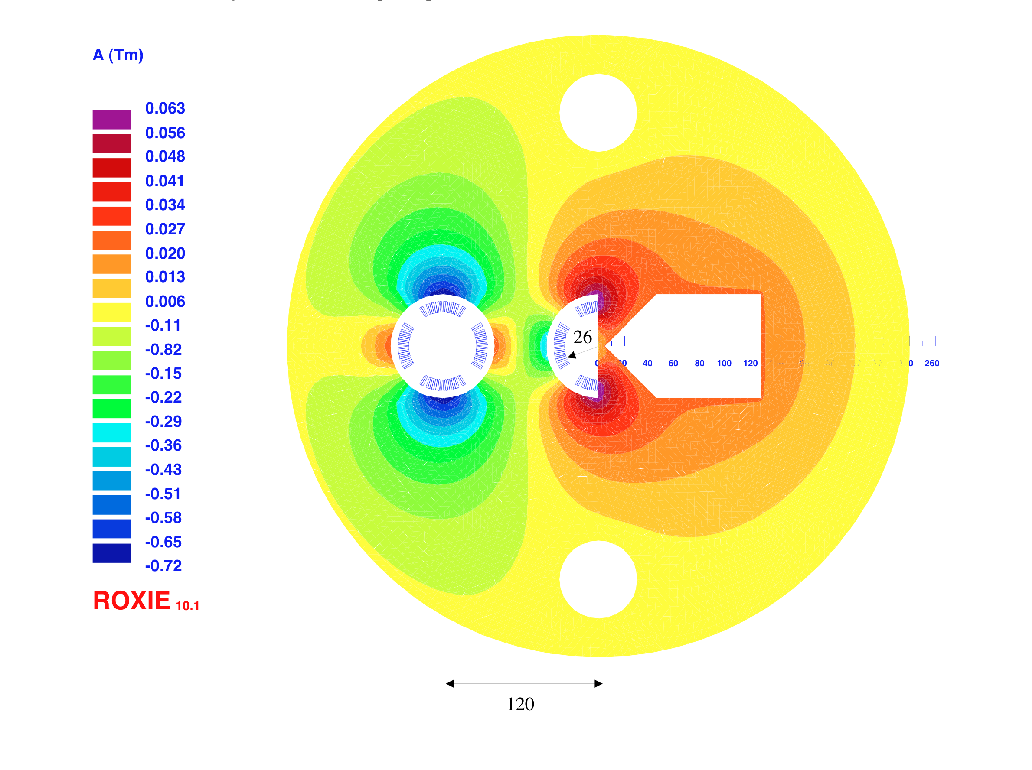
IR - Beam Separation
Crossing angle (0.93 mrad) to avoid first parasitic crossing (L x 0.77)
1st and 2nd bending quadrupoles
(Dipole in detector? Crab cavities? Design for 25ns bunch crossing [50ns?]
Synchrotron radiation –direct and back, absorption … recall HERA upgrade…)
2nd quad: 3 beams in horizontal plane
Separation 85 mm, MQY cables, 7400 A
Ring-Ring
1st SC half quad (focus and deflect)
separation 50mm, g=127T/m,
MQY cables, 4600A

Slide 24

Detector Design
Detector Outline
Physics Requirements
  Acceptance
  Track and energy resolution
  Benchmark processes
Interaction Region Boundaries
  Optics, synchrotron fans
  Beam pipe
Disclaimer:
  As many of the boundary conditions (Optics, BP, IR) are still open, mostly qualitative design is currently possible.
  Much of the design work and interfacing with physics requirements still to be done.
Goal:
  Aim for a design concept for the CDR, not the proposal or technical design report yet
  A baseline detector solution and RD options
24

Slide 25
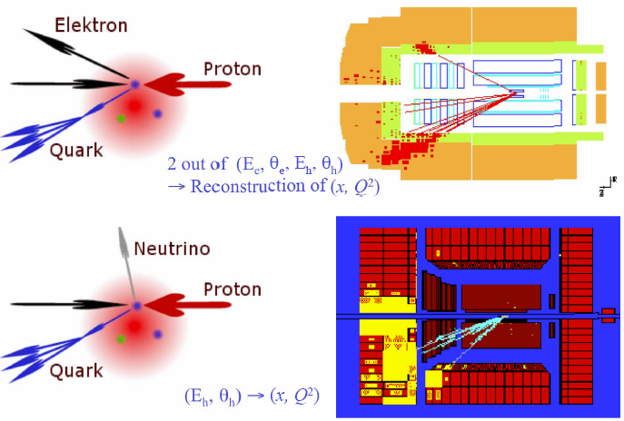
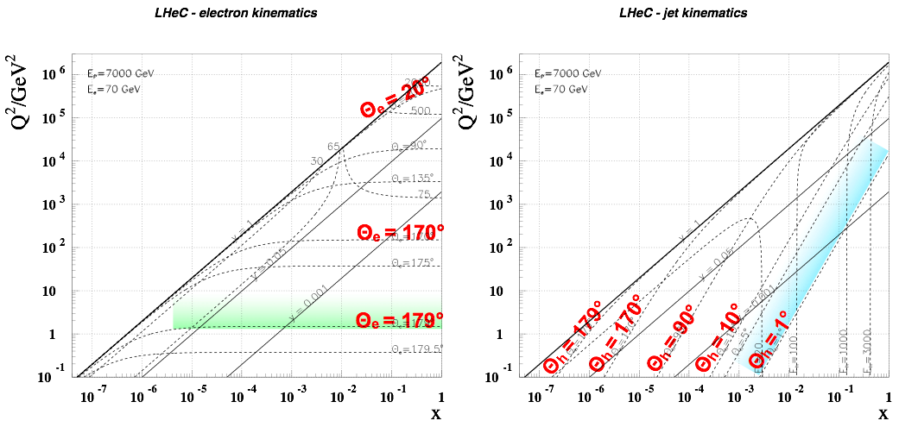
LHeC Kinematics
High x and high Q²: few TeV HFS scattered forward:
➔ Need forward calorimeter of few TeV energy range down to 10º and below █. Mandatory for charged currents where the outgoing electron is missing. Strong variations of cross section at high x demand hadronic energy calibration as good as 1%
Scattered electron: ➔ Need very bwd angle acceptance for accessing the low Q² and high y region █.
25

Slide 26
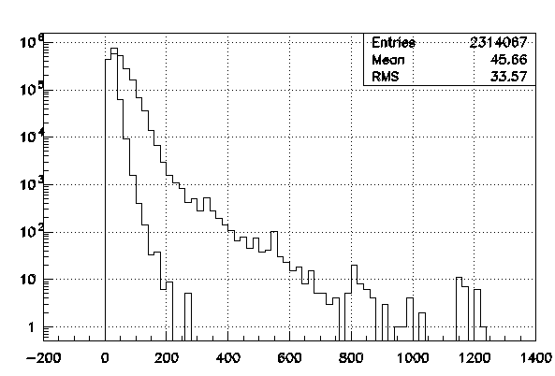
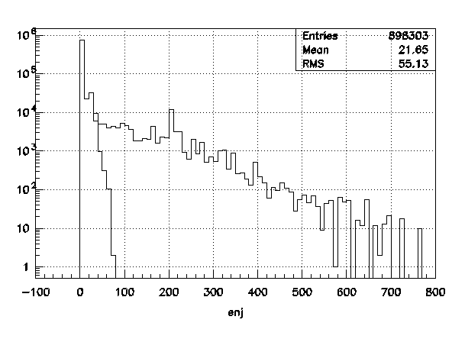
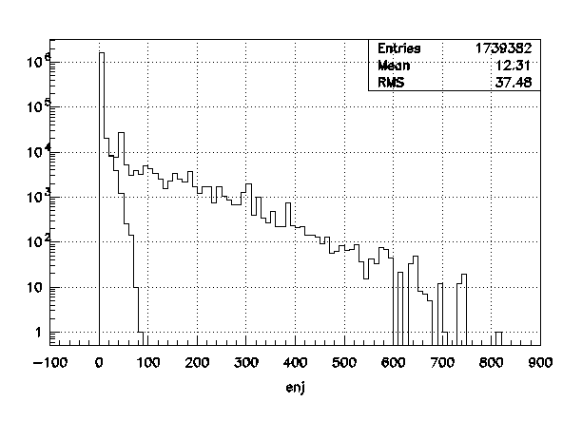
Detector Acceptance
CHARM 70GeV electron x 7 TeV proton
DIFF 70GeV electron x 7TeV proton
  RAPGAP-3.2 (H.Jung et.al.- http://www.desy.de/~jung/rapgap.html)
  HzTooL-4.2 (H.Jung et.al. - http://projects.hepforge.org/hztool/)
  selection: q².gt.5.
1°
DIFF 70GeV electron x 7 TeV proton
10°
1°
NRAD 70GeV electron x 7 TeV proton
10°
Jet Energy [GeV]
1°
10°
→ Highest acceptance - if possible
Jet Energy [GeV]
26

Slide 27
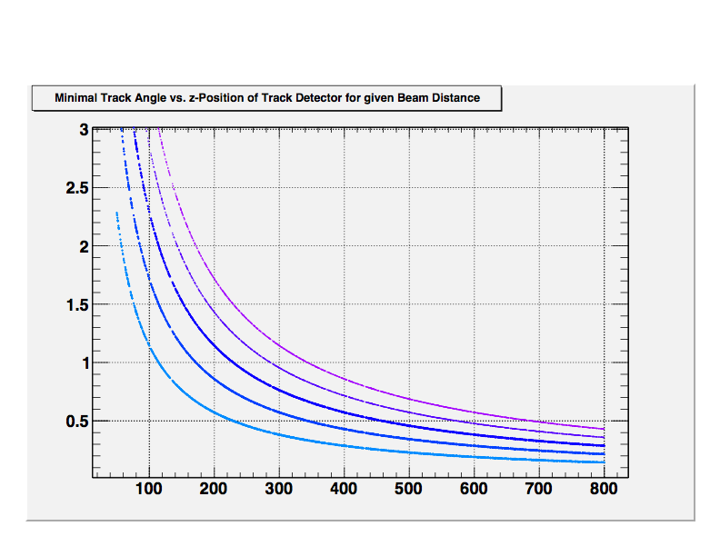
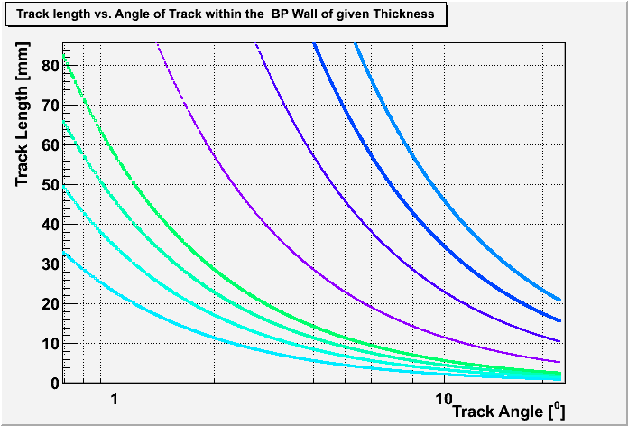
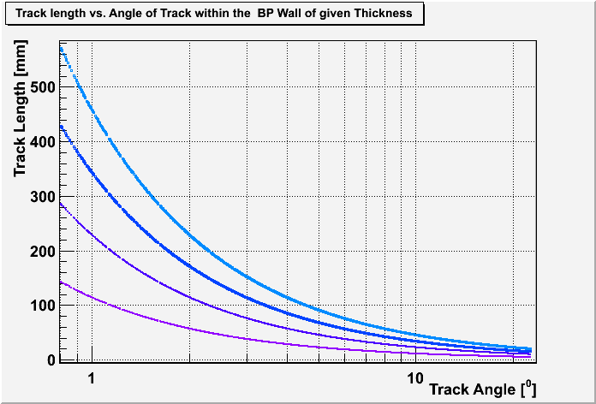
Beam Pipe
  The beam pipe drives the design:
    Elliptical: synchrotron radiation has to pass
    leaving the detector untouched (direct and
    backscattered SR); No φ symmetry.
    Length of detector - related at fixed angular
    acceptance to beam pipe radii The dimensions of the BP defines the
    z-extension of the detector.
    Multiple Scattering: BP as thin as possible
    SR collimators/absorbers incorporated
    1° polar angle traversing tracks - radiation length optimisation
Distance Detector-Beam-Line d [cm]
Track Angle [°]
d = 6.0
d = 5.0
d = 4.0
d = 3.0
d = 2.0
z-Distance to Vertex [cm]
Be [X0=347mm]
Be [X0=347mm]
Beam Pipe Thickness
Beam Pipe Thickness
8 mm
1 mm
8 mm
132
16
6 mm
0.8 mm
6 mm
99
13
Radiation Length X0 for Θ=1⁰ Tracks -Beryllium [%]
0.6 mm
Radiation Length X0 for Θ=1⁰ Tracks -Beryllium [%]
4 mm
4 mm
10
66
0.4 mm
2 mm
2 mm
7
33
27

Slide 28
Beam Pipe - continued
  Challenge: is it possible to build a long beam pipe as thin as necessary?
  BP sandwich structure:
  Metal - Carrier - Metal
  minimal thickness and excellent radiation length
  e.g. Be/Al - Nomex/Carbon foam - Be/Al *
  *NIM 228 (1984) 207-209, A SANDWICH STRUCTURE BEAM PIPE FOR STORAGE RINGS, G.B. BOWDEN,
  H.DESTAEBLER, Ch. T. HOARD and A. E. JOHNSTON, SLAC (… The pipe has a radiation thickness of
  5.8x10-3Xo, a failure pressure of 3.5 atm and was baked for high vacuum service; Al-NomexAl, length 560mm! )
  arXiv:nucl-ex/0205008v1 (2002), Integration and Conventional Systems at STAR, H.S. Matis et.al.
  R&D required:
  vacuum tight, mechanical-, electrical-, thermal stability
  The detector dimensions depend heavily on the beam pipe size
  Reminder: LHeC has 3 beams:
      Interacting electron beam (synchrotron radiation)
      Interacting proton beam
      Spectator proton beam
28

Slide 29
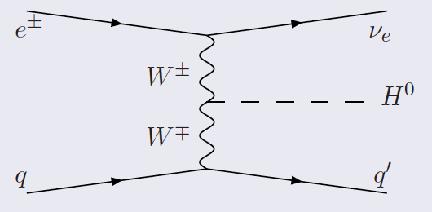
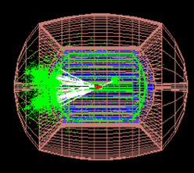
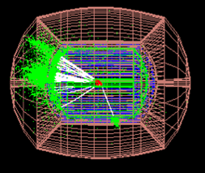
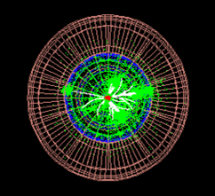
Benchmark Processes
One of the benchmark processes*:
Vector Boson Fusion @ LHC CC
where (one possible) background
process CC is
will challenge the detector design - requiring:
  large forward acceptance
  best resolution for hadrons produced
  good ET recognition and b tagging with maximal acceptance
* U. Klein
Higgs Production
in ep event*
Ilcroot package:
V. di Benedetto,
C. Gatto
29

Slide 30
Detector Requirements
High resolution tracking system
  excellent primary vertex resolution (rad hard, low budget material)
  resolution of secondary vertices down to small angles in forward direction for high x heavy flavor physics and searches
  precise pt measurement matching to calorimeter signals, calibrated and aligned to 1 mrad accuracy
  Acceptance in particular at small forward and backward angles (1°, 10°)
The calorimeters - Energy flow
  Full containment, granularity, forward acceptance
  electron energy to about 10%/ √ E calibrated using the kinematic peak and double angle method, to permille level
    Tagging of γ's and backward scattered electrons -
    precise measurement of luminosity and photo-production physics
  hadronic part 30%/√ E calibrated with pT_{e} /pT_{h} to 1% accuracy
Muon detector/spectrometer, very forward detectors, luminosity measurement
30

Slide 31

… the detector
… a draft
31

Slide 32

Inner Tracking
Radius [cm]
Elliptical pixel detector: 2.9–4.6/3.47-6.05
32

Slide 33
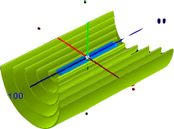
Inner Tracking
Radius [cm]
Elliptical pixel detector: 2.9–4.6/3.47-6.05
Barrel layer 1-5: 7.5–61
33

Slide 34
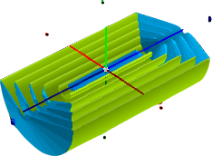
Inner Tracking
Radius [cm]
Elliptical pixel detector: 2.9–4.6/3.47-6.05
Barrel layer 1-5: 7.5–61
Barrel cone 1-4: 5–61
34

Slide 35
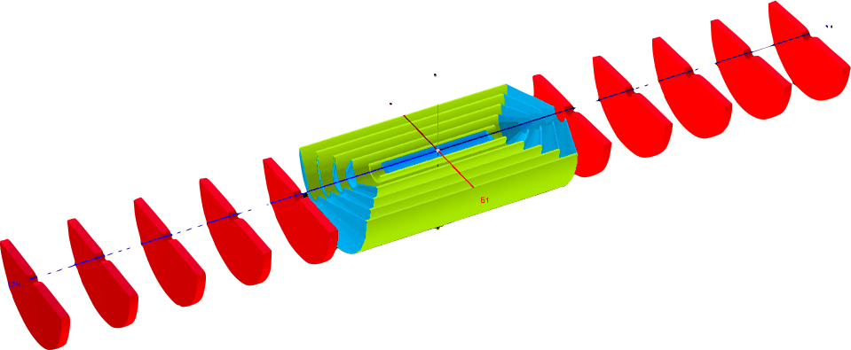
Full Tracking (down to 1 degree)
(to be optimised)
One option: GAS-Si Tracker - GOSSIP Type ^{NIKHEF}
Container Model
Gas On Slimmed Silicon Pixels (or Strixels/Pads)
9.2˚
Angles for inner cone radius 8.5cm (6cm)
13.5˚
11.0˚
4.1 (2.9)˚
17.5˚
50.2˚
layer 5
4.6 (3.2)˚
24.8˚
46.2˚
layer 4
5.2 (3.6)˚
41.2˚
layer 3
5.9 (4.2)˚
Track Angles
32.2˚
16.7˚
layer 2
layer 1
9.1˚
Layer 0
2.9˚
1.9˚
1.4˚
1.2˚
0.9˚
Forward and backward (red) disks to be removed
For the High Lumi-High Q² running.
Alternative technologies: Pixels, MAPS, DEPFET etc.
35

Slide 36
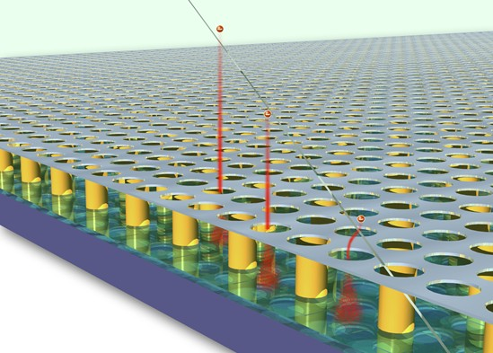
Precision Tracking: Si-Gas Tracker – GOSSIP Gas on Slimmed Silicon Pixels
Gas for charge creation, Si-pixel/strips/pads for signal collection
Lightweight detector (including mechanics, cooling infrastructure…)
More than one hit per track - defines track segments
Si radiation hard - standard CMOS ( 90 nm process )
Trigger capable: 25ns, Gossipo 3|4 readout chip ~O(1) ns time resolution.
Large volume detector
affordable, industrial production
Time measurement – 3D tracking
Gas choice: radiator :
Transition Radiation Tracker
- e/π identification
Diffusion and drift velocity
limits position measurement
currently to ~<<20μm
Gossip Presentations:
E. Koffeman (Divonne 2008)
H. VanDerGraaf (Divonne 2009)
Interesting option for LHeC
36

Slide 37
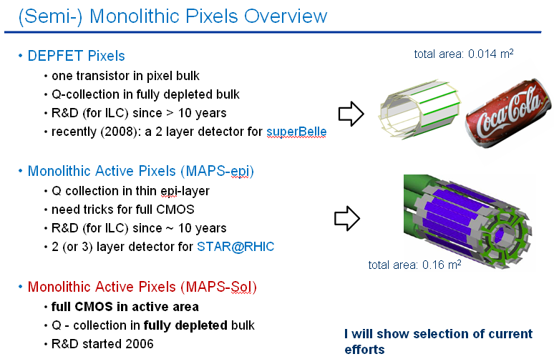
Silicon Pixel Detector
N. Wermes
37

Slide 38
The Calorimeter
A step back …

Slide 39
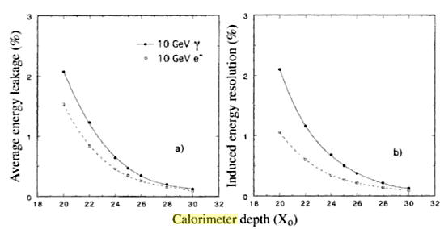
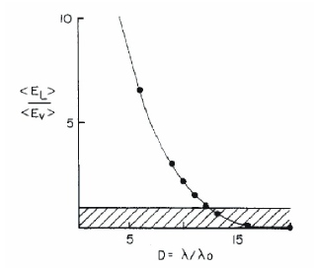
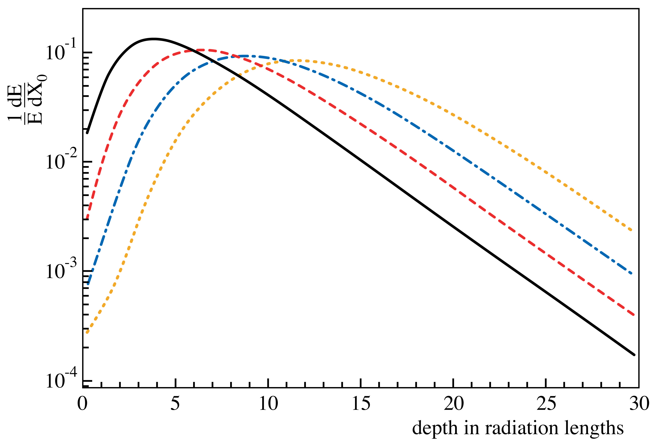
The Calorimeter
A step back … … some distributions
Courtesy R. Wigmans et al.
Calorimeter depth (X₀)
Ratio of energy loss due to longitudinal leakage divided
by loss due to neutrinos vs thickness in interaction lengths
1,10,100,1000 GeV
Longitudinal profile
39

Slide 40

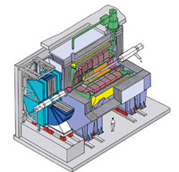




HERA Calorimeters
SC Solenoid
outside CAL
SC Solenoids
inside CAL
H1
  Liquid Argon (cf. ATLAS)
  High granularity, compensation achieved via software
  Solenoid outside of the LAr CAL
ZEUS
  Compensating Calorimeter (Uranium Scintillator)
  EMC 15%/√E; HAC 35%/√E, up to 7 λ_{I}
  Lower granularity
  Solenoid between central tracking and main CAL
HERA
920 GeV p 27 GeV e±
c.m.s. energy
√s ~ 300 GeV
40

Slide 41

LHeC Calorimetry
LHeC:
precision physics
Similar energies and resolution required for ILC
High energy resolution
Jet Energies ~ O(1 TeV)
Higher granularity
Possibly compact design (detector size)
Choices:
PFA (particle Flow Algorithm)
  CALICE High granularity calorimeters. Software compensation & PID combining with information coming from the tracking system
New Concepts
  New Materials, Silicon, RPC, etc.
  Dual Readout Calorimeters:
  Combine energy and Cherenkov measurements
Liquid Argon concept still applicable as baseline solution
Calice: W-Si prototype
W plates: 10 x 1.4mm(0.4X0)
10 x 2.8
10 x 4.2mm
Si pads: 1cm x 1cm
41

Slide 42


LHeC Calorimeter
Present choice: Energy Flow Calorimetry:
For the geometry given:
Electromagnetic Calorimeter:
~30 x X₀ Pb/W & different det./R/O
Hadronic Calorimeter:
6 – 10+ x λ_{I} Fe/Cu & different det./R/O
Presently the fwd/bwd calorimeter asymmetry more in functionality/detector response rather then in geometry
A dense EmCAL with high granularity (small transverse size cells),
high segmentation (many thin absorber layers), and with ratio λ_{I}/X0 large,
is optimal for E-Flow measurement → 3-D shower reconstruction
Example Fe, W
brass (Cu) an option also ( CMS ), λ_{I} =15.1cm - denser than Fe (adding λ_{I})
42

Slide 43

The Detector - Low Q² Setup
- High Acceptance
217
250
250
250
217
[cm]
HaC-Barrel-fwd
HaC-Barrel-bwd
40
EmC-Endcap-bwd
Fwd Tracking
Bwd Tracking
EmC-insert-½-bwd
177
EmC-fwd
EmC-Barrel
EmC-bwd
10⁰ and 170⁰
177
5⁰ and 175⁰
4⁰ and 176⁰
3⁰ and 177⁰
2⁰ and 178⁰
1⁰ and 179⁰
20
20
40
Central Tracking
40
HaC-insert-½-fwd
HaC-insert-½-bwd
60
60
112
112
EmC-insert-½-fwd
40
EmC-Endcap-fwd
289
289
Solenoid
Fwd/Bwd asymmetry in energy deposited and thus in technology [W/Si vs Pb/Sc..]
Present dimensions: LxD =17x10m² [CMS 21 x 15m² , ATLAS 45 x 25 m²]

Slide 44

The Detector - High Q² Setup
- High Luminosity
217
250
250
250
217
[cm]
HaC-Barrel-fwd
HaC-Barrel-bwd
40
EmC-Endcap-bwd
EmC-insert-½-bwd
177
EmC-Barrel
177
10⁰ and 170⁰
5⁰ and 175⁰
4⁰ and 176⁰
3⁰ and 177⁰
2⁰ and 178⁰
1⁰ and 179⁰
20
20
40
Central Tracking
40
HaC-insert-½-fwd
HaC-insert-½-bwd
60
60
112
112
EmC-insert-½-fwd
40
EmC-Endcap-fwd
Low Beta Magnet
Low Beta Magnet
+ MagCal
+ MagCal
289
289
Solenoid
➔Aim of current evaluations:
avoid detector split in two phases: time and effort

Slide 45

Solenoid
Modular structure:
assembly CMS like on surface level or in the experimental area depending on time constraints and access shaft opening
Solenoid dimensions:
6m half length
300 cm inner radius
B field = 3.5 T
Geometry constraints:
Current beam pipe dimensions
Requirement of 10° tracking coverage
Homogeneous B field in the tracking area
Detector Track Resolution:
i.e. assuming / using (Glückstern relation): with
N track points on L; length of track perpendicular to field B, accuracy σ(x)
B = 3.5 T, N_{min}= 56 track points (2 x 5 (min. hits per layer) x 5 + 2 x 3 B-layer hits )
s-gas module ~10° inclined more track points for inclined tracks - extended track segments
➔ Δp_{T}/p_{T} = 0.03% p_{T}
45

Slide 46

Fwd Tracker - active Thickness 8. cm each
Si-Pix/Si-Strip/SiGas Tracker:
inner R = 4.86 cm; outer R = 61.3 cm
Planes 1 - 5:
z1-5 = 140. / 200. / 260. / 320. / 370. cm
Barrel Tracker - active Radius 2.5cm each
Si-Pix/Si-Strip/SiGas Tracker:
1. layer: inner R = 8.8 cm; outer R = 11.3 cm2. layer: = 21.3 cm; = 23.8 cm3. layer: = 33.8 cm; = 36.3 cm4. layer: = 46.3 cm; = 48.8 cm5. layer: = 58.8 cm; = 61.3 cm
Low Q² Detector
4 Cone structured fwd/bwd Si-pix/Si-strip/Si-gas Tracker
R min = 4.86 cm
2.5cm active thickness
Elliptical Pixel Tracker:
inner-∅x = 9.32cm
inner-∅y = 7.82cm
2.4cm active radius
10° and 170°
5° and 175°
Hadron Calorimeter - 5 Modules (beige)
inner R = 112. cm; outer R = 289. cm
Modules 1 - 5:
ΔZ1-5 = 217. / 250. / 250. / 250. / 217. cm
4° and 176°
3° and 177°
2° and 178°
1° and 179°
Bwd Tracker - active Thickness 8. cm each
Si-Pix/Si-Strip/SiGas Tracker:
inner R = 4.86 cm; outer R = 61.3 cm
Planes 1 - 5:
z1-5 = -140. /-210. /-280. /-340. /-370. cm
Solenoid - 3.5T
inner-R = 300.0cm
inner-R = 330.0cm
half length = 600. cm
Fwd/Bwd Electromagn. Calo 2 - (green)
inner R = 21. cm; outer R = 110. cm
ΔZ = 40. cm
Elliptical Beam Pipe:
inner-∅x = 7.3cm
inner-∅y = 5.8cm
outer-∅x = 8.1cm
outer-∅y = 6.6cm
thickness: 0.8cm
Fwd/Bwd Electromagn. Calo 1 - (green)
inner R = 70. cm; outer R = 110. cm
ΔZ = 250. cm
Barrel Electromagn. Calo - (green)
inner R = 70. cm; outer R = 110. cm
ΔZ = 250. cm
Fwd/Bwd Hadron Calo - (grey)
inner R = 21.0 cm; outer R = 110. cm
ΔZ = 177. cm
Fwd/Bwd Elecromagn Calo Insert 1&2 - (pink)
inner R1= 6.5 cm; outer R = 20. cm
inner R2= 21. cm; outer R = 40. cm
ΔZ = 40. cm
Fwd/Bwd Hadron Calo Insert - (beige)
inner R = 6.5 cm; outer R = 20. cm
ΔZ = 177. cm
46

Slide 47



Instrumented Magnets (a study)
Tim Greenshaw
MAGCAL Design
Geant 4 studies (Birmingham)
→ Divonne 2009 workshop
MAGCAL
47

Slide 48


Luminosity Measurement
Sergey Levonian
Linac-Ring:
Head on collisions
Similar to HERA, γ’s travel along the p-beam
Luminosity monitor located at z=100m
Challenge: large aperture required for p at 60-80m
Ring-Ring:
Non zero crossing angle at IP
Large synchrotron radiation flux
Challenge: difficult to catch zero-angle γ’s
RR scheme
48

Slide 49




Luminosity Measurement
Sergey Levonian
γ-tagger
e-tagger
49

Slide 50
Further Considerations
About external detectors:
Return Yoke + Backing Calorimeter (or alternative solutions)
Muon Detectors/Spectrometers
Very Forward Detectors
not detailed here, are being studied and will be included in the CDR
Considerations:
It is clear that the definition of the beampipe, the boundaries of the optics and interaction region will push forward the detector design and will allow soon a more precise design
The presence of additional dipole(s), required in the linac-ring design and useful in ring-ring option, is being presently worked out
New concepts and baseline solutions with the aim to demonstrate the feasibility of the project. But still lots of work ahead.
50

Slide 51
Summary - Outlook
The physics arguments for an LHeC experiment at CERN is getting more pronounced
Two independent machine options (Ring-Ring and Linac-Ring) are being investigated and are well advanced in the their concepts
The beam pipe and the interaction region design play a key role defining the detector and currently in focus
A base of a LHeC detector design has been presented and some boundary conditions for set up and performance discussed
The LHeC detector is in some respects as complex and sizable as an LHC detector and aims for accuracy as an ILC detector. It will be a fantastic challenge to it build
It would be a waste not to exploit the 7 TeV beams for ep and eA physics at some stage during the LHC time (G. Altarelli)
51

Slide 52
Towards a Tentative Schedule
CDR printed in spring 2011 Study of installation and interference issues still to be done
Installation of (ring or linac) LHeC towards 2021 Make maximum use of LHC shutdowns (~50 months).
2021-30: ~10 years of operation with LHC [p/A] colliding with E_{e} ≈ 60 GeV [e⁻/e⁺ ]: ~100 fb⁻¹ in ep
later: possible extension to high E_{e} LHeC During HE-LHC upgrade shutdown and long term operation with 16 TeV p colliding with e.g. E_{e}=140 GeV [e⁻/e⁺] Q²_{max}=9TeV² x_{min}=10⁻⁷ in DIS region
The time schedule of the LHeC is linked to the LHC, ep has to be doable as an upgrade or a 5th experiment to the LHC; so far that looks feasible
52

Slide 53
Acknowledgements
Many thanks to:
R. Appleby, H. Burkhardt, M. Fitterer, B. Holzer, J. Jowett, M. Klein,
U. Klein, P. Kostka, B. Nagorny, P. Newman, U. Schneekloth, M. Sullivan,
R. Thomas, U. Wienands, F. Zimmermann
… many others for the material and the discussions
Many thanks also to the organizers:
Elke Aschenauer, Abhay Deshpande, Tanja Horn
for the opportunity of participating to this very cool workshop :-)
More info and references:
http://lhec.cern.ch/
53

Slide 54
backup

Slide 55

NuPECC – Roadmap 5/2010: New Large-Scale Facilities
G. Rosner, NuPECC Chair, Madrid 5/10 - DRAFT
55
Notes:
55

Slide 56

Prospects for polarized electron beam
preliminary
Depolarizing effects of energy spread: polarization drop fast above ~ 60 GeV
But reasonable levels attainable with best design and techniques below this energy.
More exotic possibilities, e.g., snakes and asymmetric bends.
Linac Ring: 90% e- polarization
Recent simulations, models,
D.P. Barber, U. Wienands
56
Rely on self-polarization of e beam by Sokolov-Ternov mechanism
Theoretical understanding of 1980s confirmed by empirical experience of LEP:

Slide 57



Crossing angle: Luminosity Loss Factor
Other possibility: use of Crab Cavities:
with 7 TeV protons ➔ additional issues
Notes:
57

Slide 58

R-R: Injector options with recirculation
Consider 10 GeV electron injector
Not a major problem in comparison with rest of project but must be designed
Natural to use same SC cavities as LeR
Linac ~ 500 m,
Possibly with recirculation, like scaled-down former ELFE project
H. Burkhardt

Slide 59
e-Pb collisions in Ring-Ring
J.M. Jowett
59
Assume present nominal Pb beam in LHC
  Same beam size as protons, fewer bunches
Assume lepton injectors can create matching train of e⁻
Lepton-nucleus or lepton-nucleon luminosity in ring-ring option at 70 GeV
  May be possible to exploit additional power by increasing electron single-bunch intensity by factor 592/2808=4.7

