Slide 1
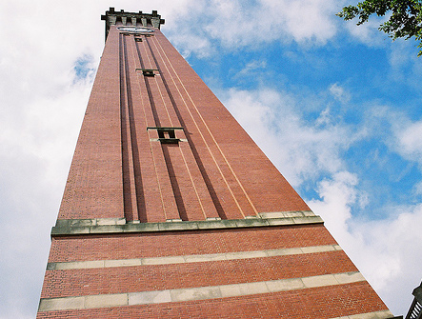


Heavy Ion Physics and the Large Hadron electron Collider
Paul Newman
Birmingham University
… for the LHeC
Study Group
Strangeness in Quark Matter
Birmingham, Tues 23 July 2013
Can we add ep and eA
collisions to the existing LHC
pp, AA and pA programme?
… towards a full understanding
of QCD at high temperatures,
baryon and parton densities …
http://cern.ch/lhec

Slide 2
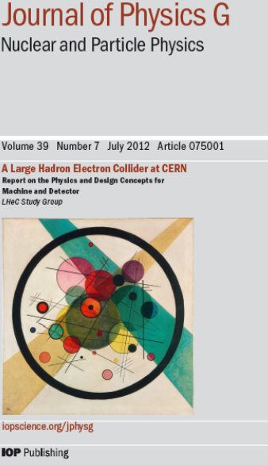
Conceptual Design Report (July 2012)
[arXiv:1206.2913]
630 pages, summarising 5 year workshop commissioned by CERN,
ECFA and NuPECC
~200 participants, 69 institutes
Additional material in subsequent
updates:
“A Large Hadron Electron Collider at CERN” [arXiv:1211.4831]
“On the Relation of the LHeC and the LHC” [arXiv:1211.5102]

Slide 3
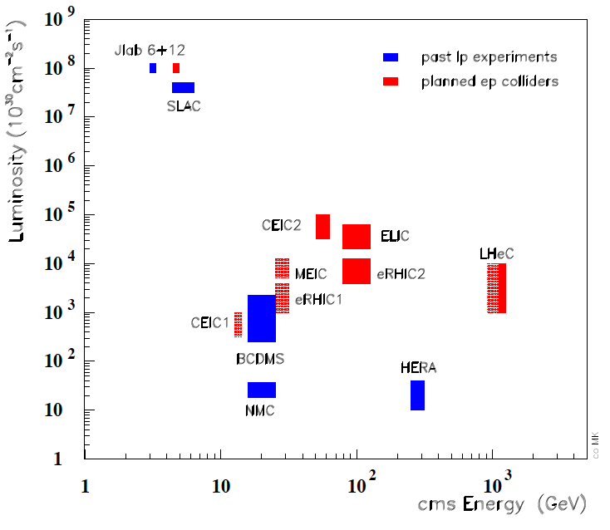
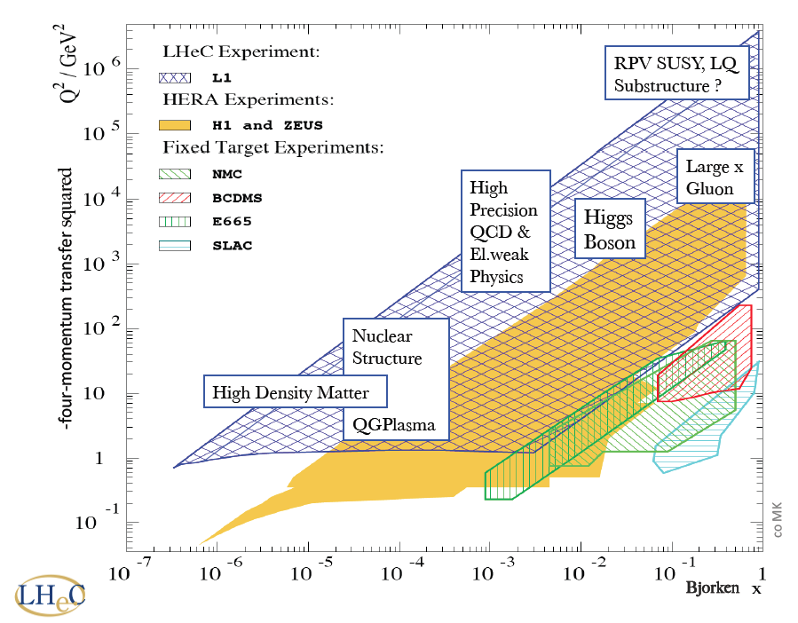
LHeC Context
Latest & most promising idea
to take lepton-hadron physics
to the TeV centre-of-mass scale
… at high luminosity
Designed to exploit
intense hadron beams
in high luminosity
phase of LHC running
from mid 2020s

Slide 4
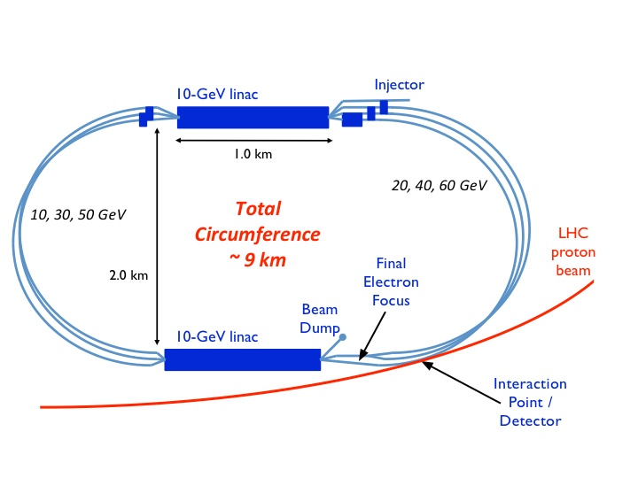
Baseline♯ Design (Electron “Linac”)
Design constraint: power consumption < 100 MW → E_{e} = 60 GeV
Two 10 GeV linacs,
3 returns, 20 MV/m
Energy recovery in
same structures
[CERN plans energy
recovery prototype]
ep Lumi 10³³ – 10³⁴ cm⁻² s⁻¹
10 - 100 fb⁻¹ per year
100 fb⁻¹ – 1 ab⁻¹ total
eD and eA collisions have always been integral to programme
e-nucleon Lumi estimates ~ 10³¹ (10³²) cm⁻² s⁻¹ for eD (ePb)
♯ Alternative designs based on electron ring and on higher energy, lower
luminosity, linac also exist

Slide 5
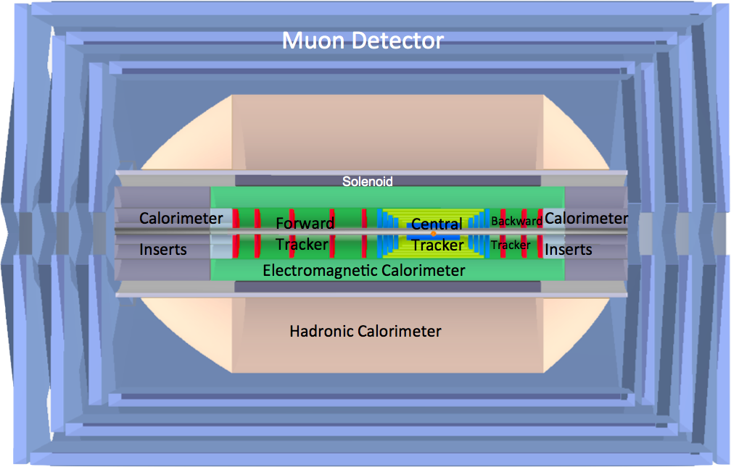
Detector Overview
e
p
Forward / backward asymmetry reflecting beam energies
Present size 14m x 9m (c.f. CMS 21m x 15m, ATLAS 45m x 25m)
ZDC, proton spectrometer integral to design from outset

Slide 6
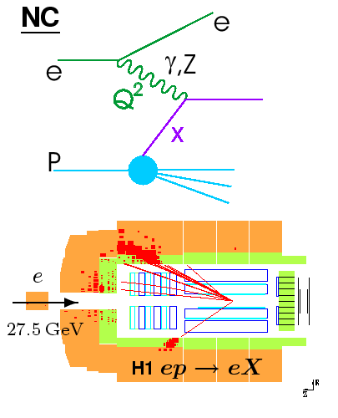
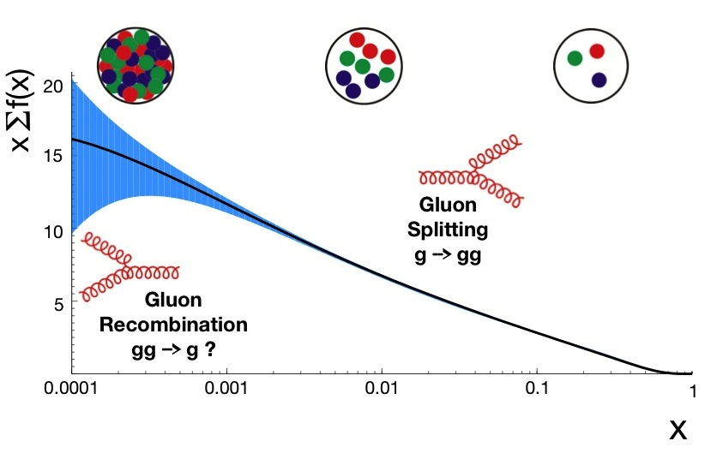
DIS: Parton Microscopy
Q²: exchanged boson resolving power
x: fractional momentum of struck quark
Only previously studied in collider
mode and in ep at HERA (1992-2007)
Proton parton density
at Q² = 10 GeV² from
HERA data alone
[HERAPDF1.5 NNLO]
… Low x saturation?

Slide 7
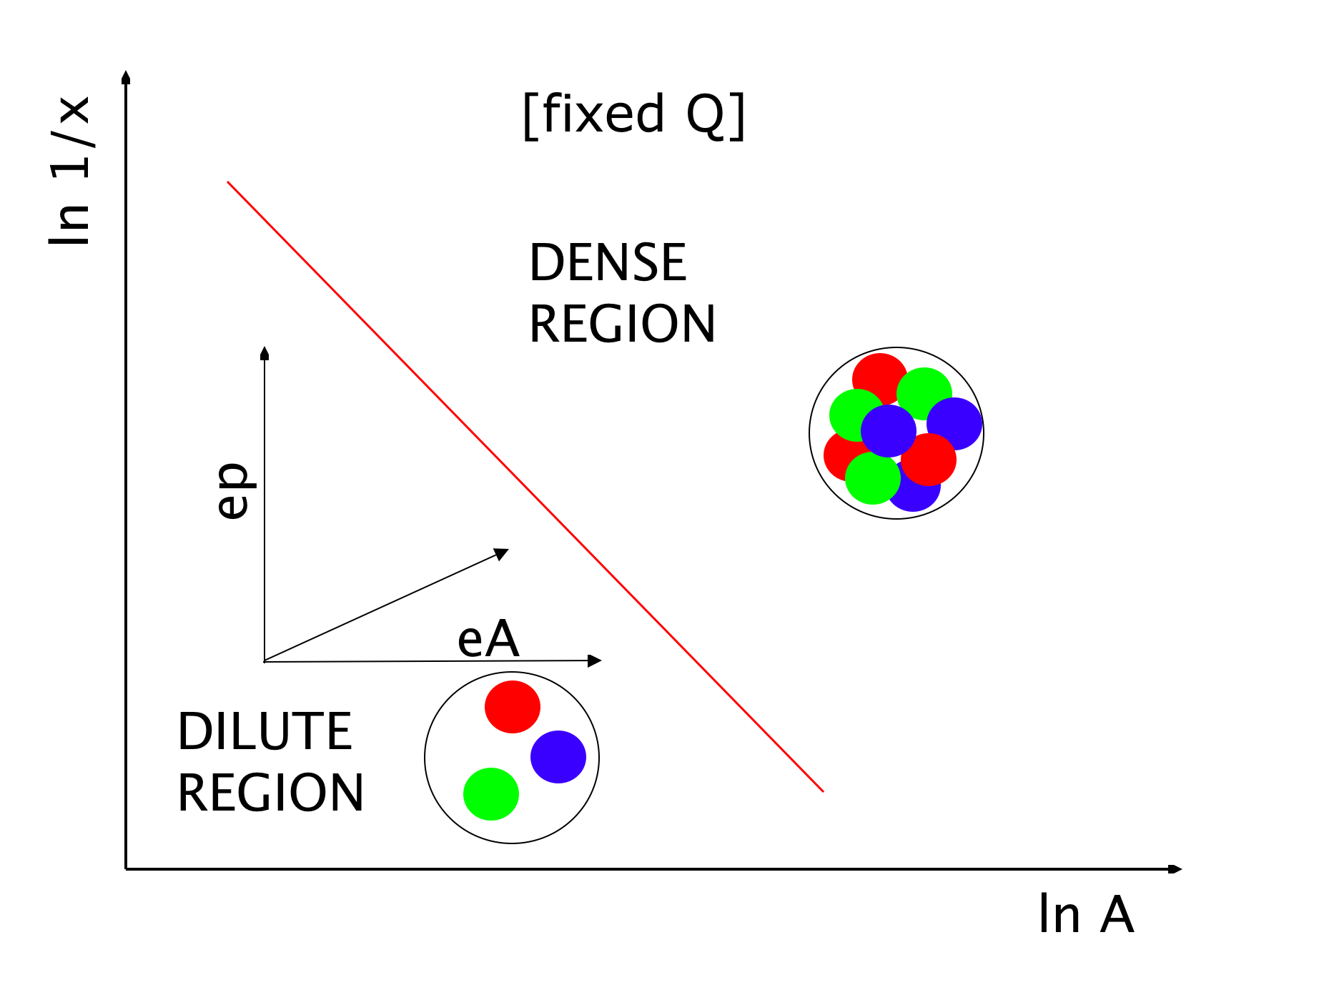
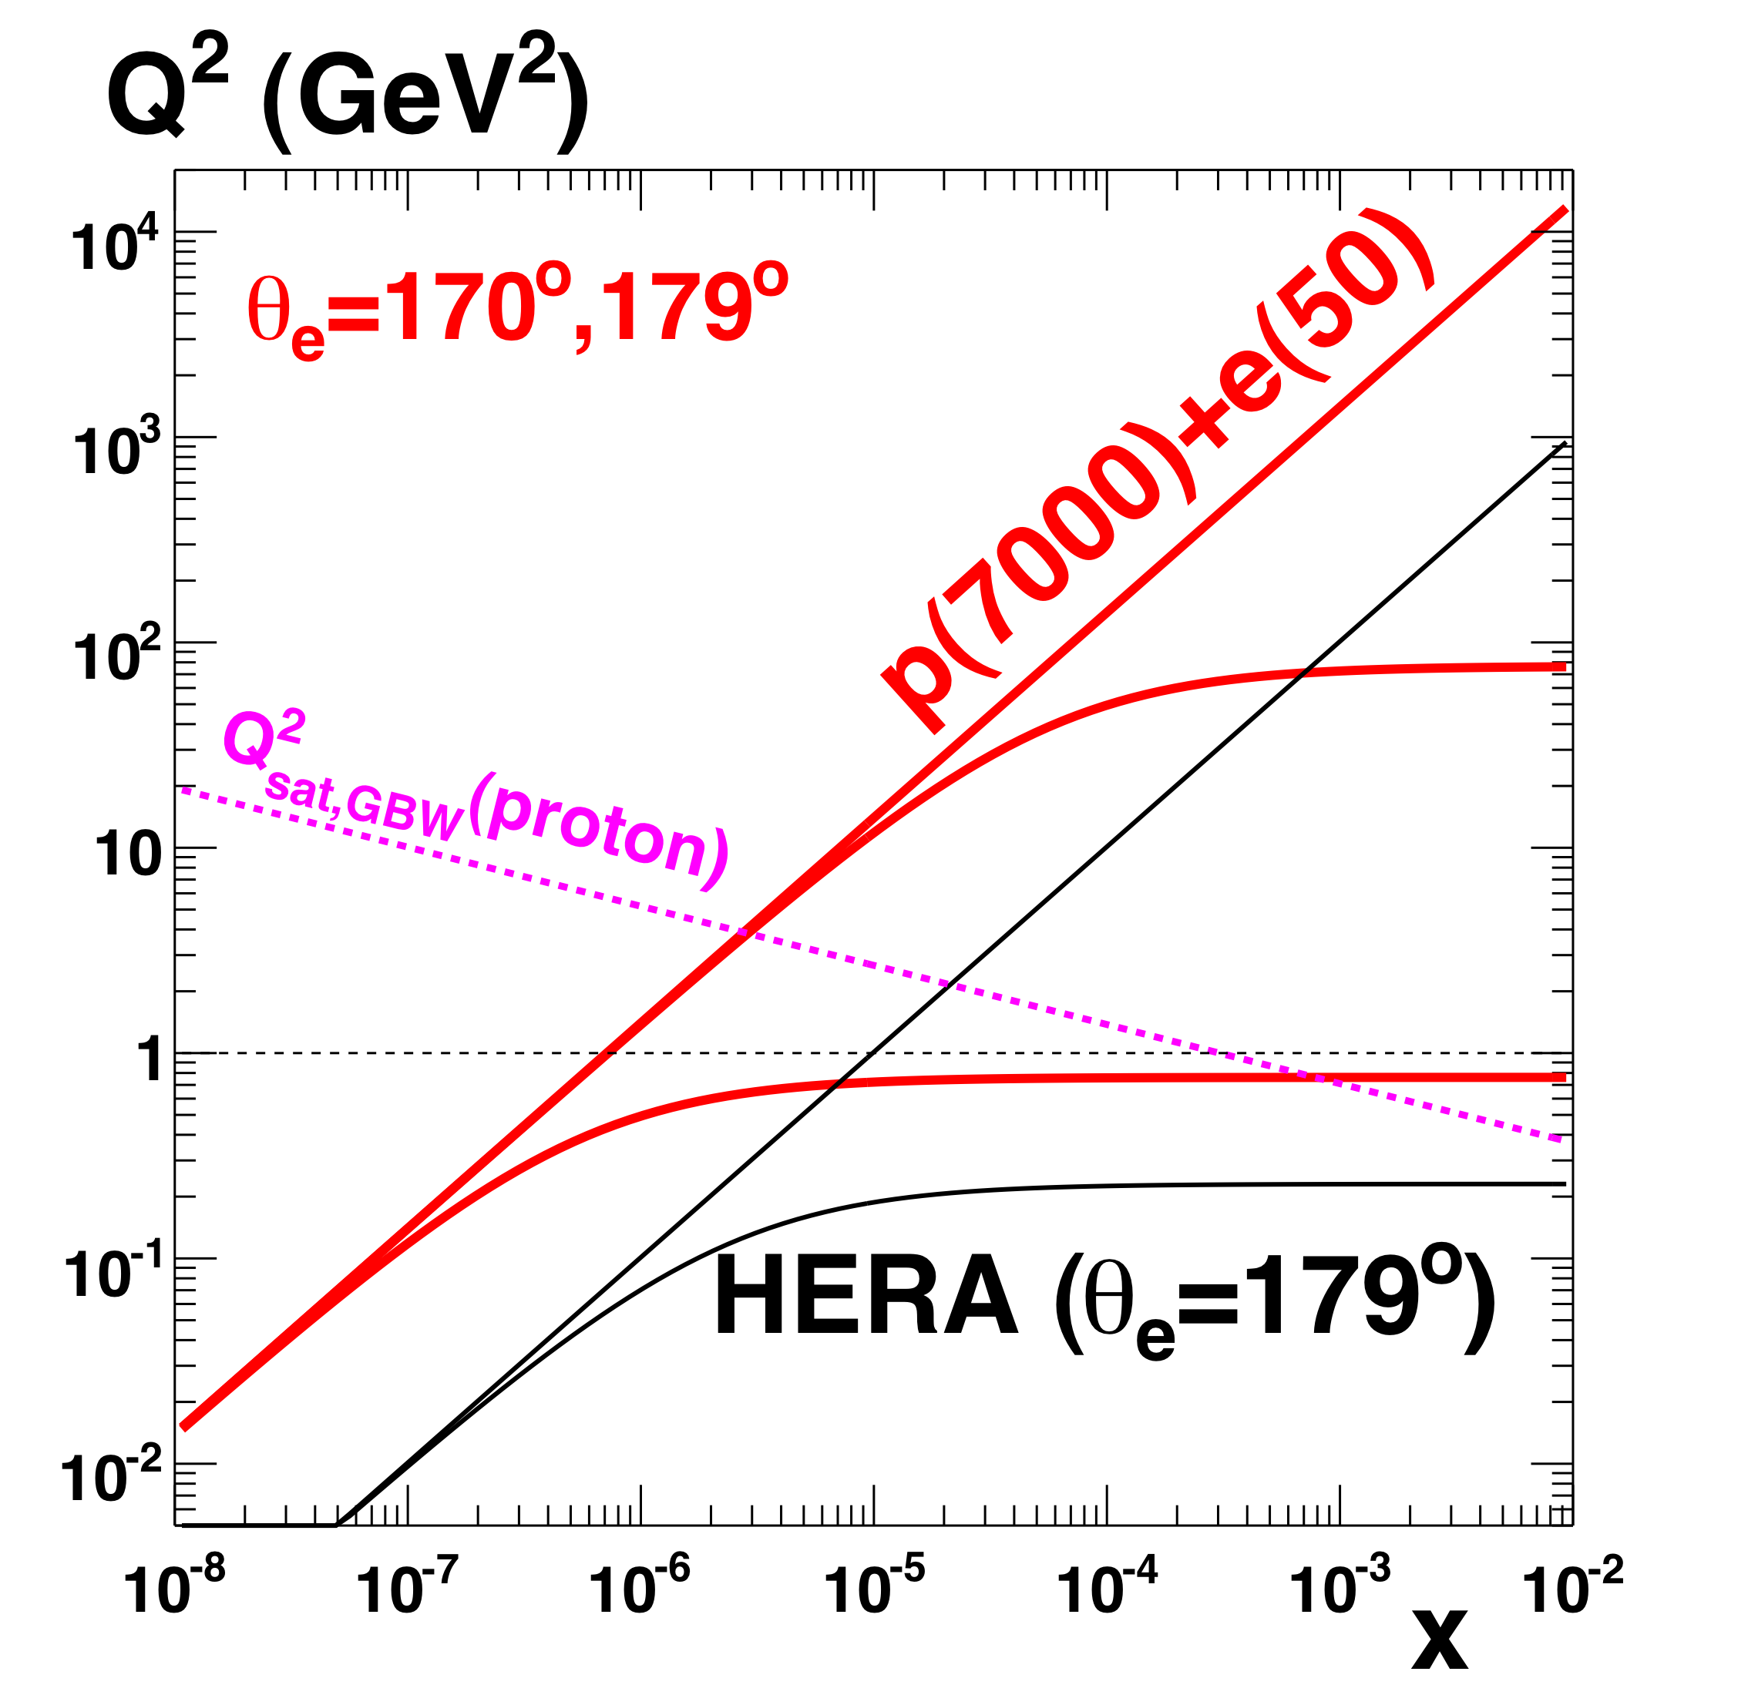
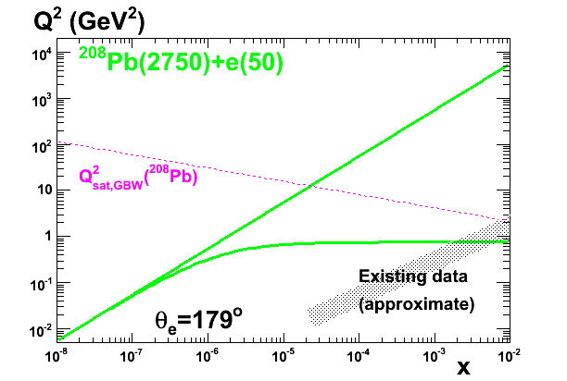
LHeC Strategy for making the target blacker
LHeC delivers a 2-pronged approach:
Enhance target `blackness’ by:
1) Probing lower x at fixed Q² in ep
[evolution of a single source]
2) Increasing target matter in eA
[overlapping many sources at fixed kinematics … density ~
A^{1/3} ~ 6 for Pb … worth 2 orders of magnitude in x]
… Reaching
saturated
region in
both ep & eA
according to
current models

Slide 8
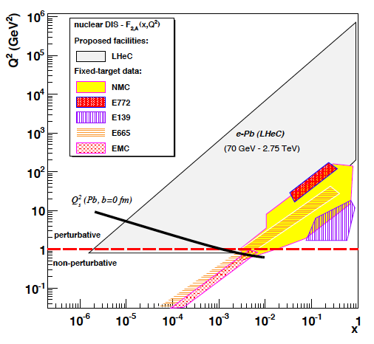
LHeC as an Electron-ion Collider
Four orders of magnitude increase
in kinematic range over previous
DIS experiments.
Revolutionise our
view of the partonic structure of
nuclear matter.
Study interactions of densely packed, but weakly coupled, partons
Ultra-clean probe of
passage of `struck’
partons through cold nuclear matter
eA

Slide 9
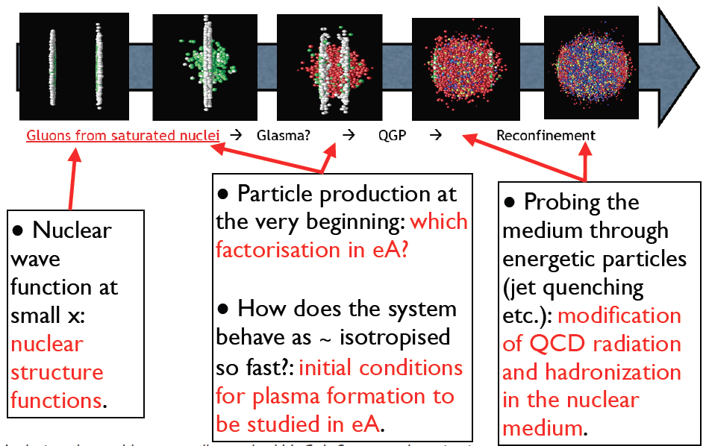
Relation to the Heavy Ion Programme

Slide 10
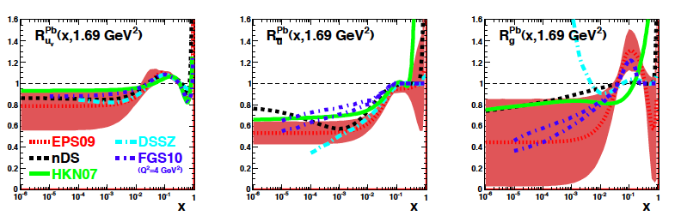
Current Status of Nuclear Parton Densities
Complex nuclear effects,
not yet fully understood
Quarks from DIS & DY
Gluon mainly from dAu
single π⁰ rates
All partons poorly
constrained for x < 10⁻²
[Existing
DIS data]
R_{i} = Nuclear PDF i / (A * proton PDF i)
Valence
Sea
Gluon

Slide 11
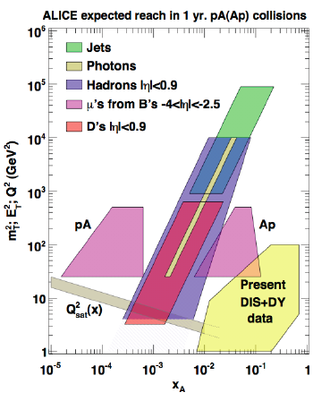
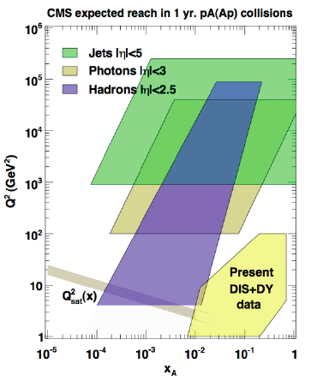
Complementarity of pA and eA
eA
New effects likely to be revealed in tensions between eA and pA, AA, ep (breakdown of factorisation)
Detailed precision understanding likely to come from eA
- LHeC offers access to lower x than is realistically achievable in pA at the LHC
- Clean final states / theoretical control to (N)NLO in QCD

Slide 12
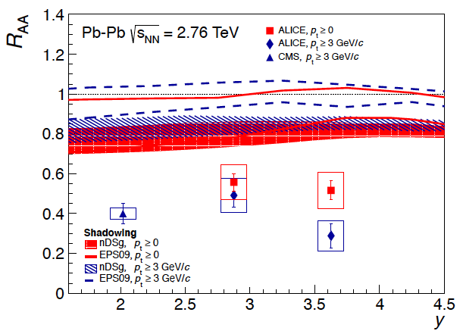
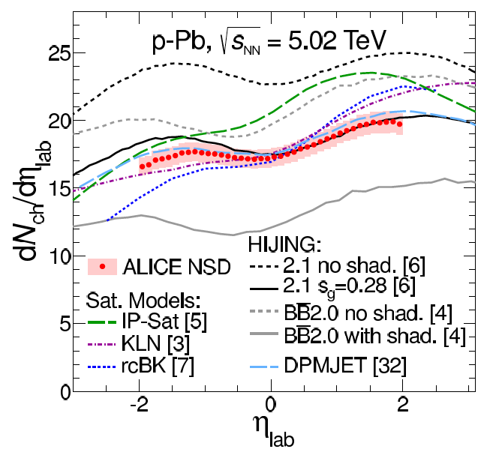
Current Low x Understanding in LHC Ion Data
Inclusive J/Ψ AA data
Uncertainties in low-x nuclear
PDFs preclude precision
statements on medium produced
in AA (e.g. extent of screening
of c-cbar potential)
Minimum Bias pA data
η dependence of pPb charged
particle spectra best described
by shadowing-only models
(saturation models too steep?)
… progress with pPb, but
uncertainties still large, detailed
situation far from clear
Pb
p

Slide 13
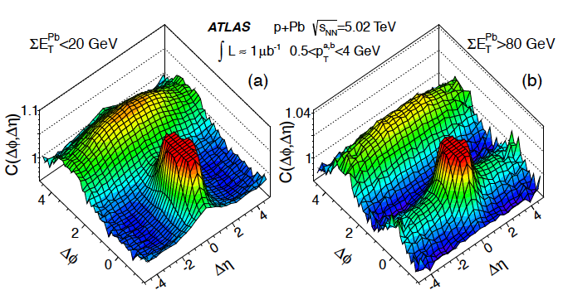
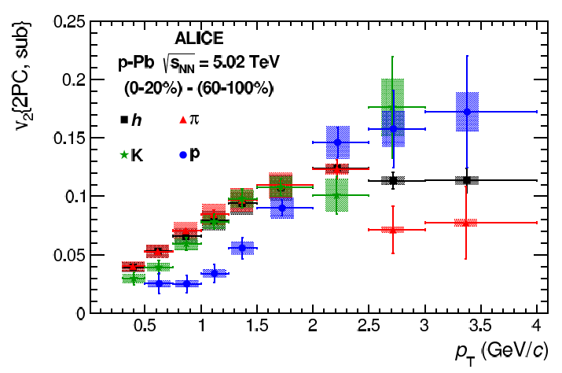
Further Puzzles from pA Data
Surprising ridge
structures observed in high multiplicity pPb events have been
attributed to saturation
effects (CGC …)
Flow characteristics in pPb (mass ordering at low p_{T}) resembles that in PbPb … ascribed to hydrodynamics.
“A lot more needs to be understood about our pA baseline”

Slide 14
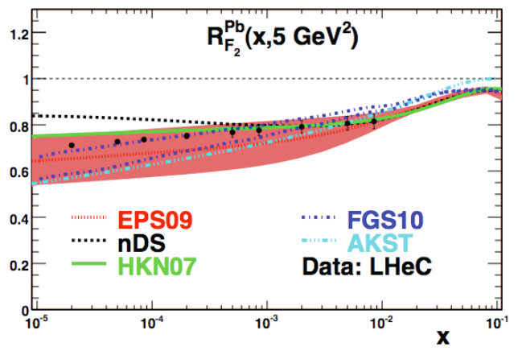
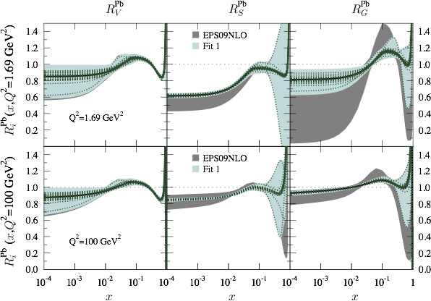
Impact of eA F₂ LHeC data
Simulated LHeC ePb F₂ measurement
has huge impact on uncertainties
Most striking effect for sea & gluons
High x gluon uncertainty still large
Valence
Glue
[Example
pseudo-data
from single
Q² Value]
Sea
[Effects
on EPS09
nPDF fit]

Slide 15
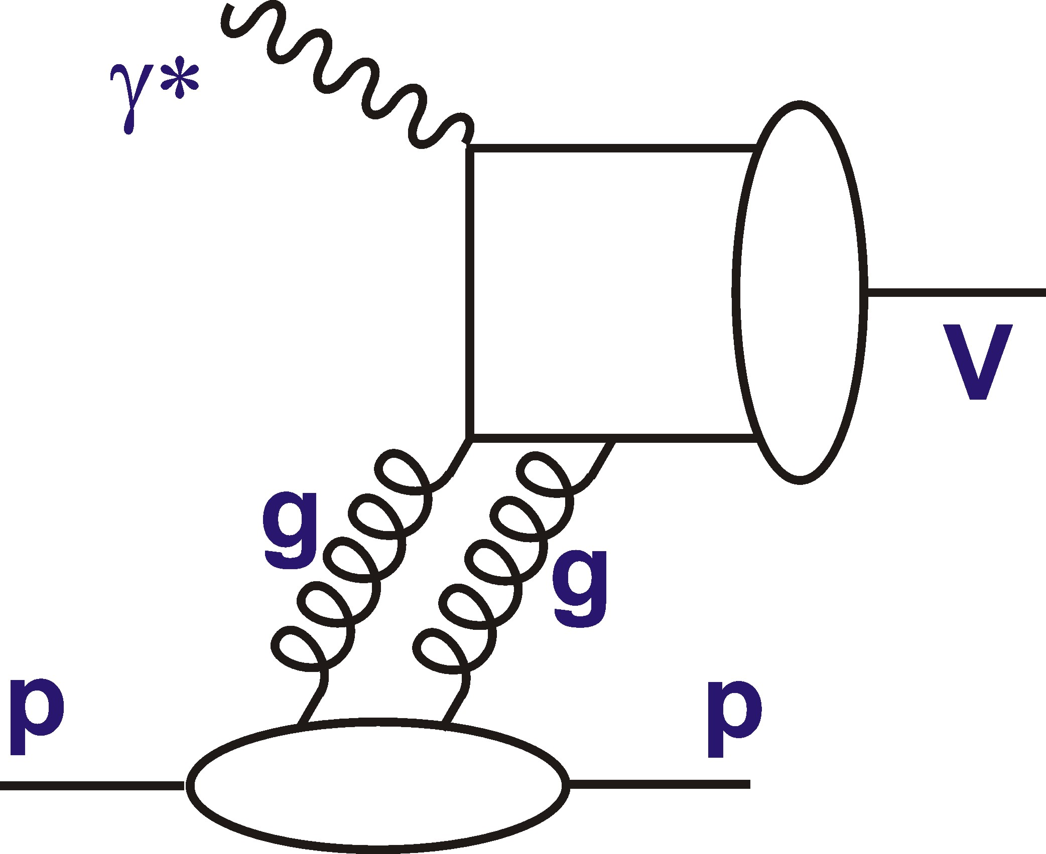
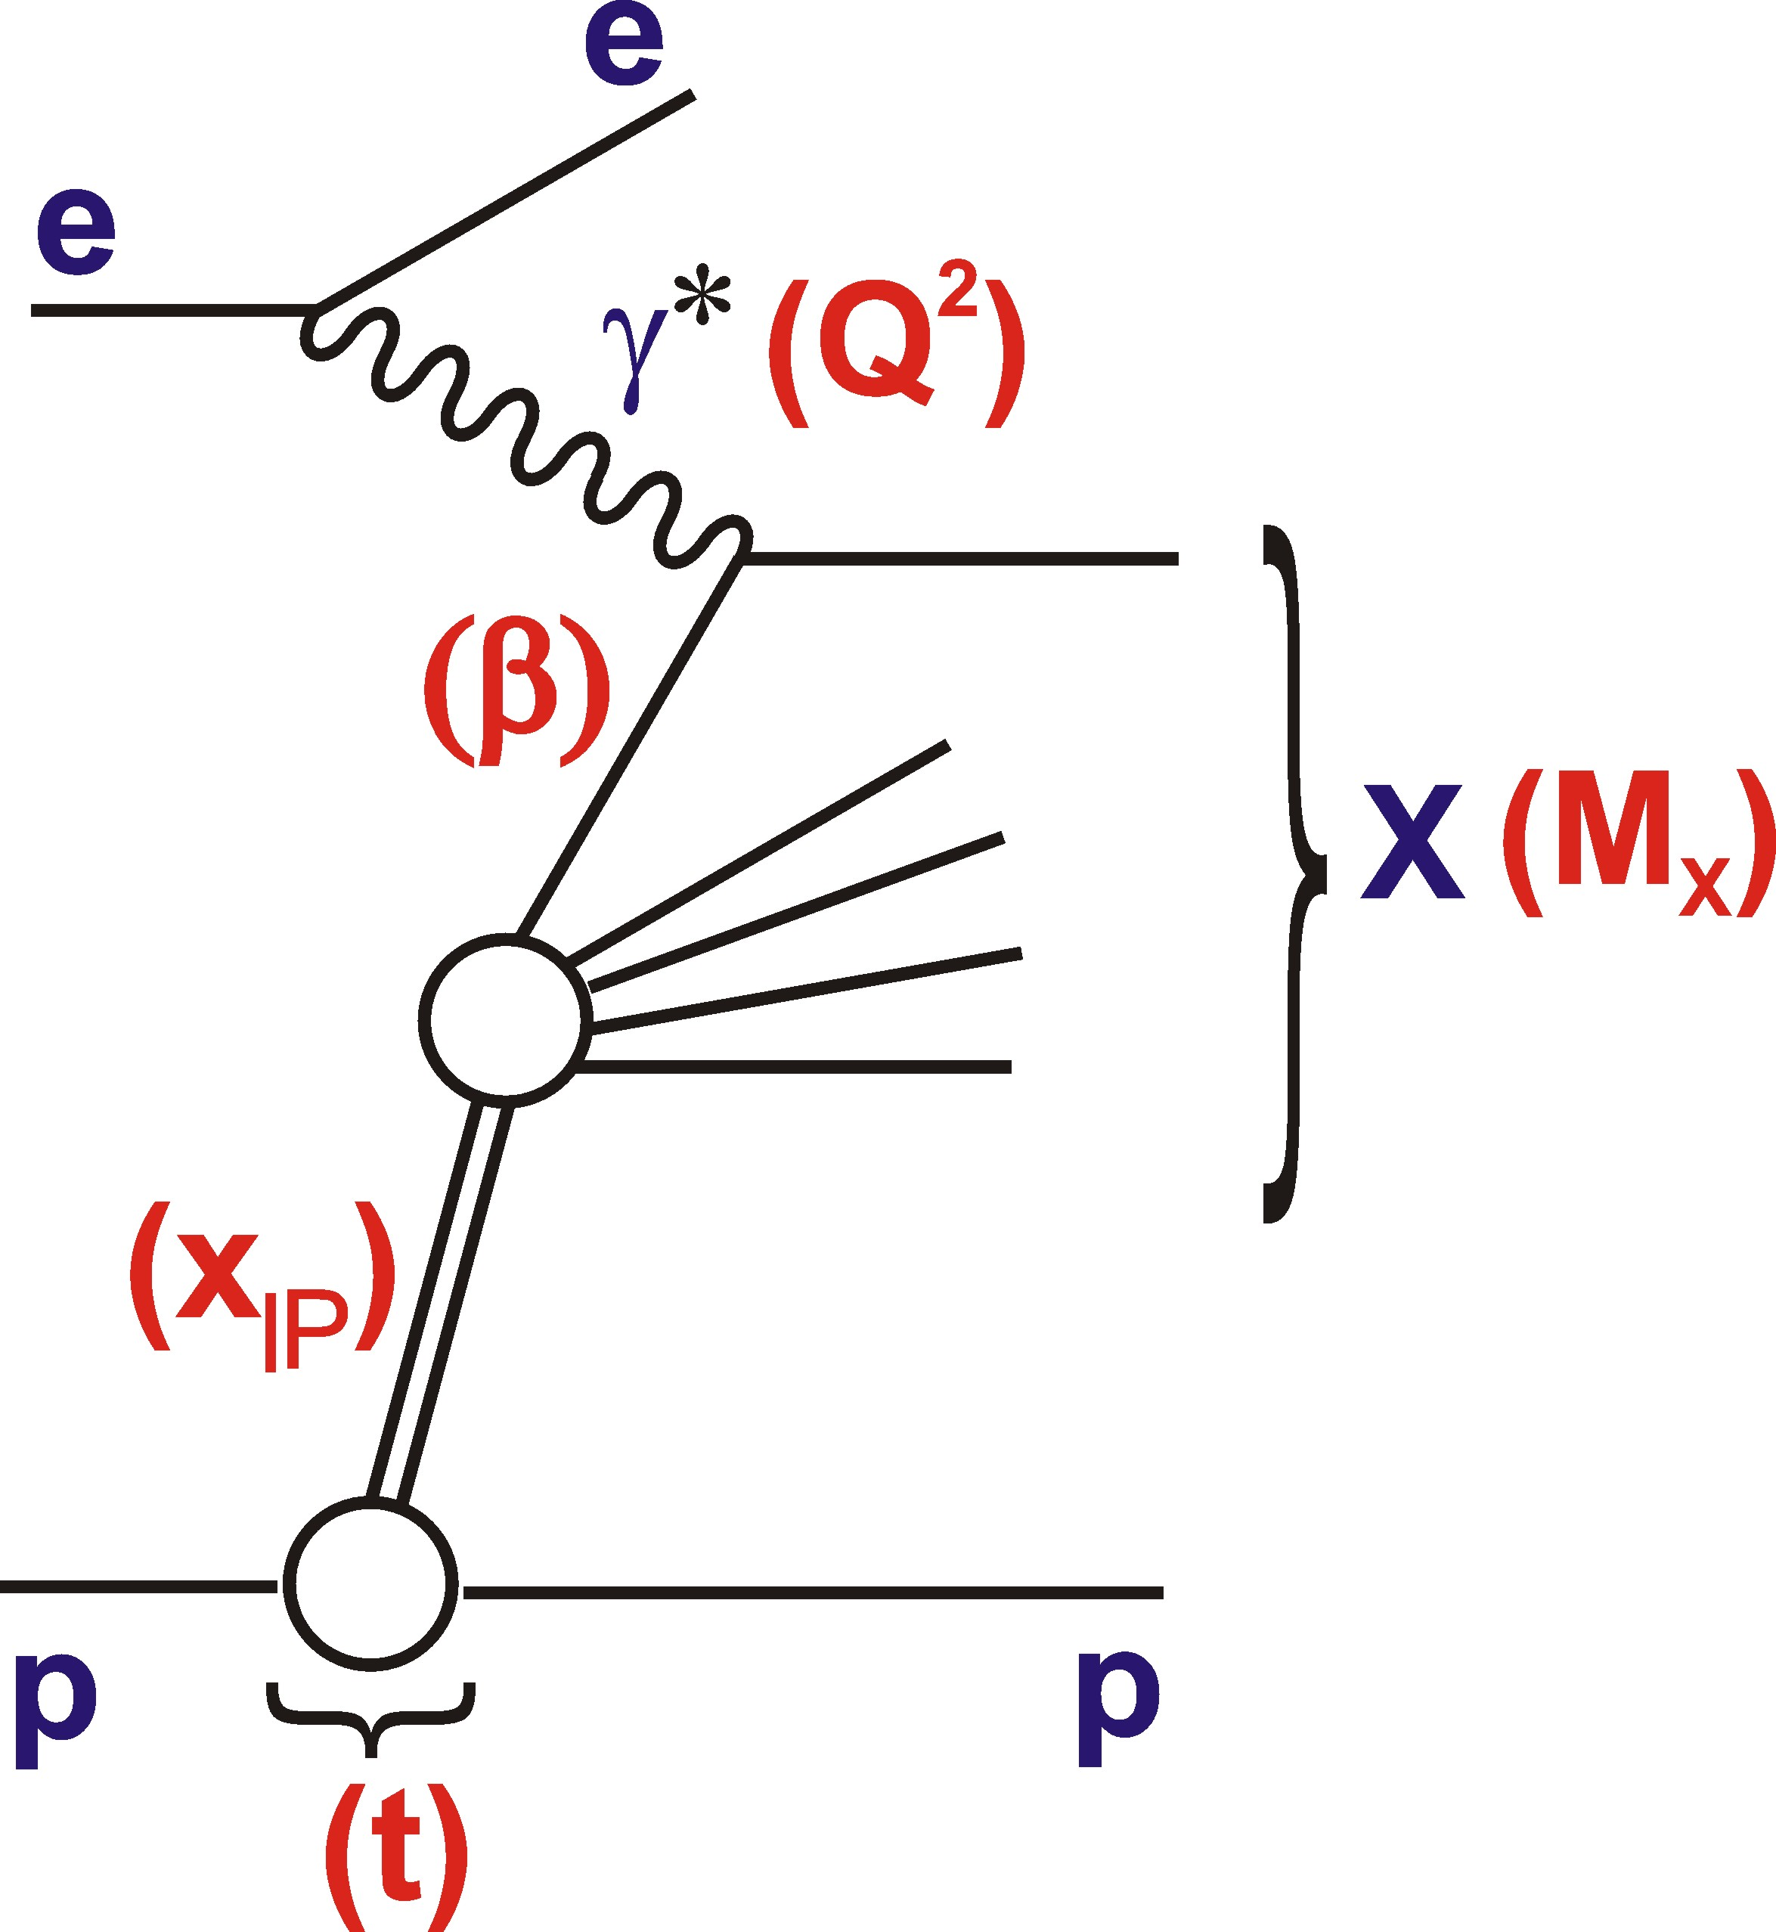
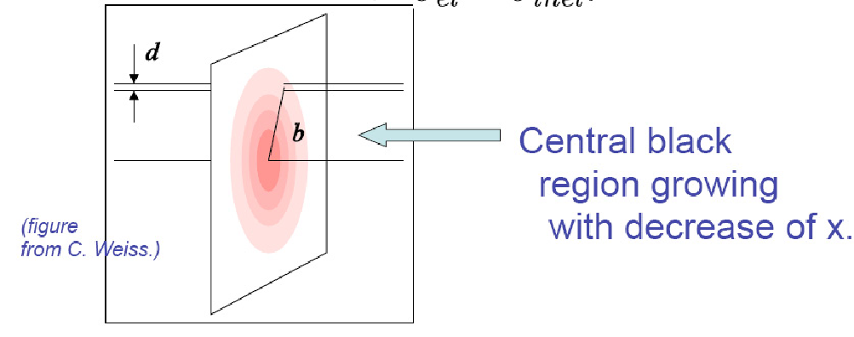
Exclusive / Diffractive Channels and Saturation
[Low-Nussinov] interpretation as 2 gluon exchange enhances sensitivity to low x gluon
Additional variable t gives access to impact parameter (b) dependent amplitudes
→ Large t (small b) probes densest
packed part of proton?

Slide 16
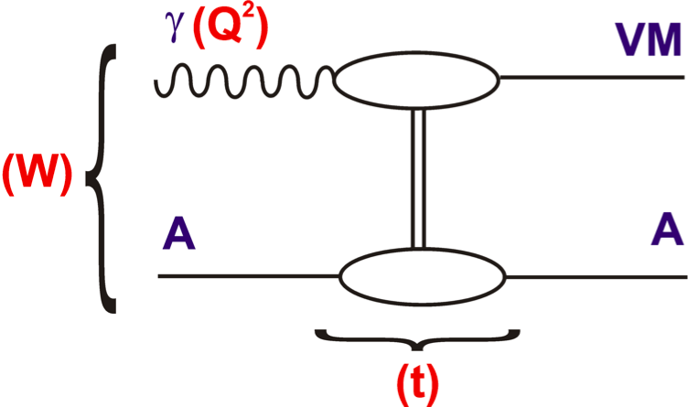
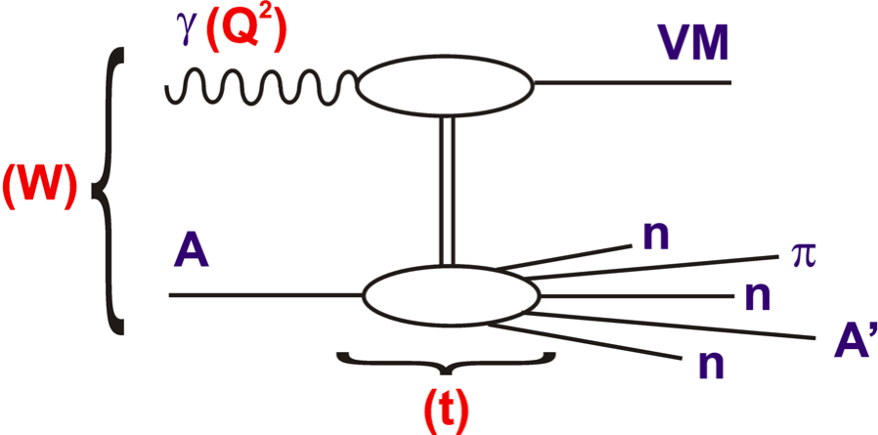
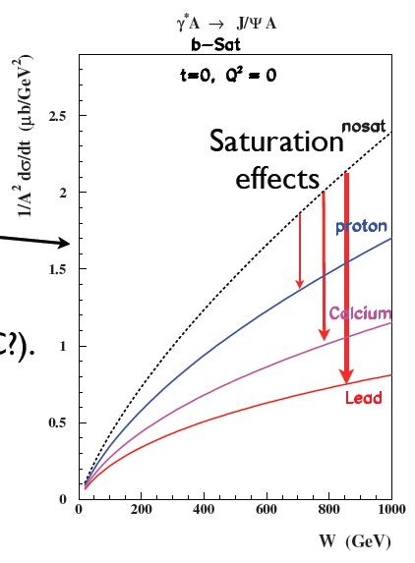
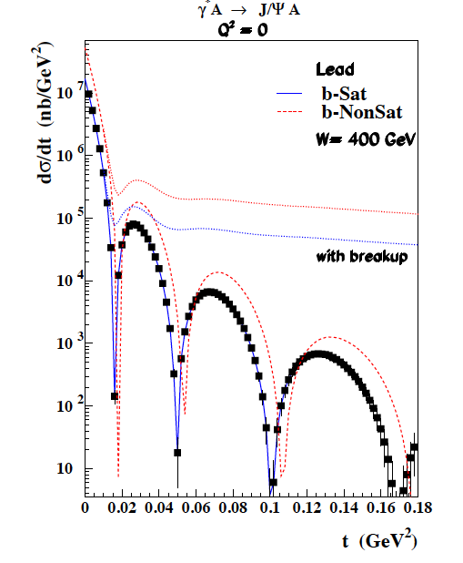
Exclusive Diffraction in eA
Experimentally clear signatures and
theoretically cleanly calculable
saturation effects in coherent
diffraction case (eA → eVA)
Experimental
separation of
incoherent
diffraction
based mainly
on ZDC
… potential
saturation
smoking gun?

Slide 17
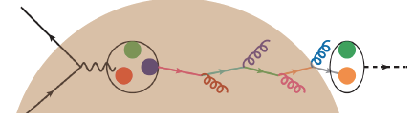
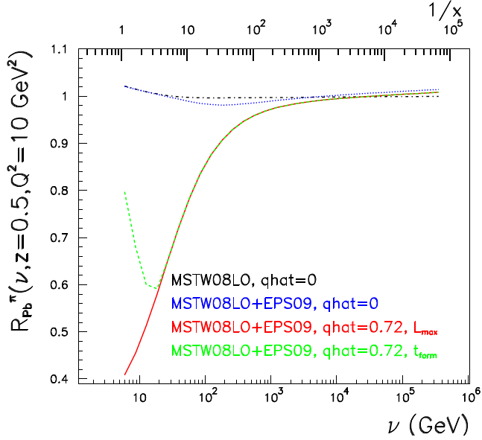
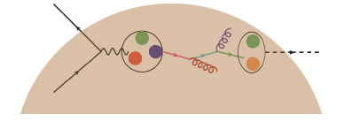
In-medium radiation and hadronisation effects
How do virtual parton probes lose
Virtuality and colour to hadronise?
Ratio of π⁰ frag^{n} functions
Pb / p (Armesto et al.)
Large ν: Hadronisation beyond medium. Partonic energy loss
= struck parton
energy in target
rest frame
Small ν: Hadron formation
may be inside. Hadronic energy loss
LHeC most sensitive to partonic loss. → Baseline `cold matter’ input to use energy loss mechanisms to characterise QGP

Slide 18
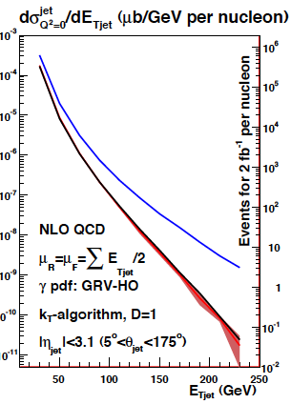
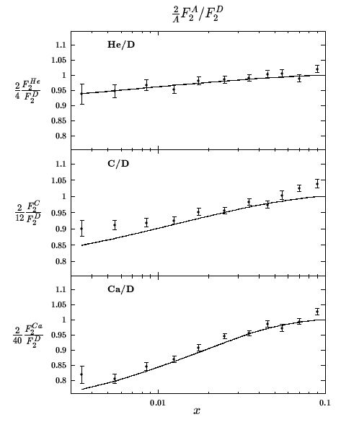
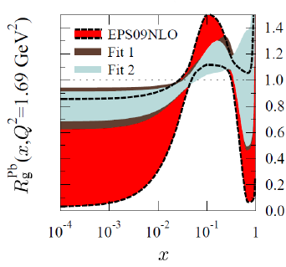
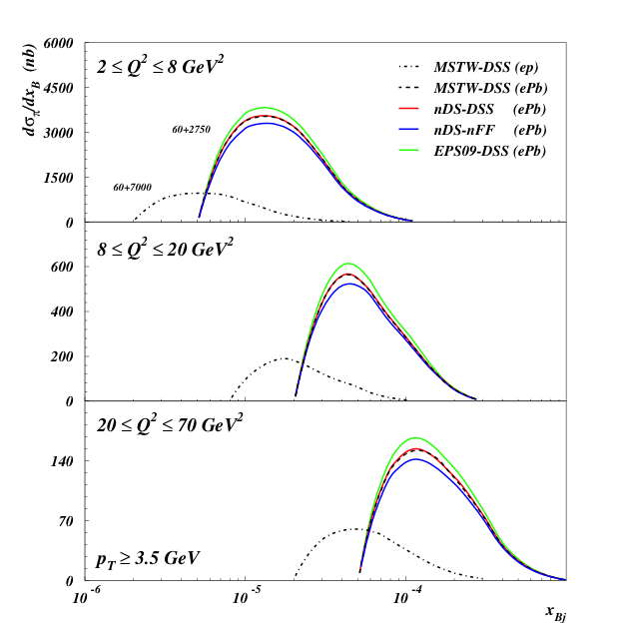
Some other LHeC eA Studies …
Jet
photoproduction
Inclusive ep
diffraction
v nuclear
shadowing
Forward π⁰
production &
fragmentation
Impact of
eA charm &
beauty data
Many more processes and
observables still to be
investigated

Slide 19
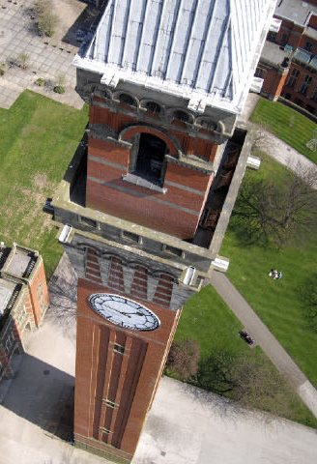
Summary / Outlook
[More at http://cern.ch/lhec]
LHC is a new world for heavy ions even more than for protons
LHeC adds ep and eA to existing pp, pA and AA programme
  3-4 orders of magnitude in nPDF kinematic range
- New non-linear QCD dynamics of
low x parton saturation?
- Baseline for establishing QGP effects
Conceptual Design Report available.
Ongoing work …
- Further physics motivation
- Detector / simulation,
- Superconducting RF, ERL, machine
Timeline?... Optimal impact by running in High Lumi LHC Phase

Slide 20
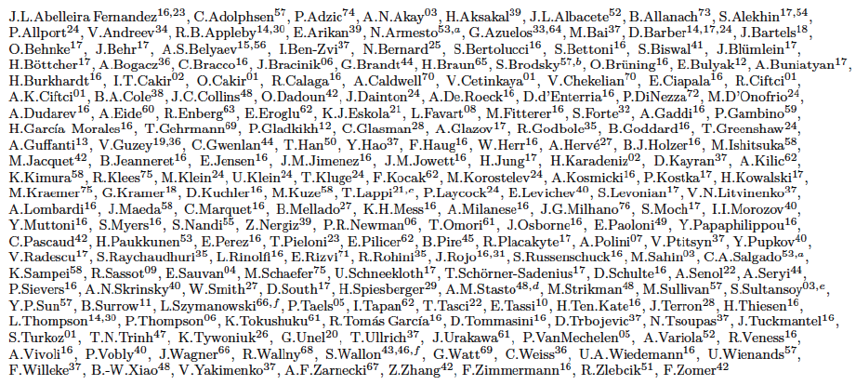
… with thanks to Nestor Armesto, Max Klein,
Anna Stasto and many experimentalist, theorist
& accelerator scientist colleagues …
LHeC study group …

