Slide 1
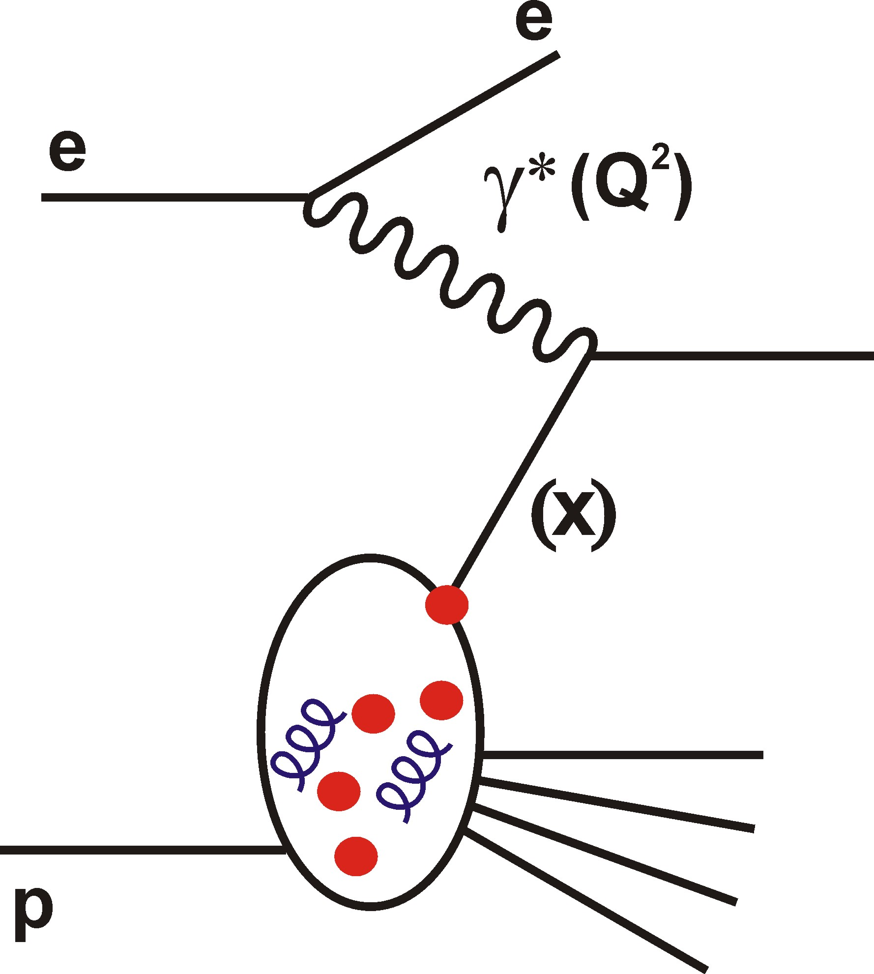



Future High Energy
Electron – Hadron Scattering:
The LHeC Project
Lepton-hadron
collider for the
2020s, based on
the high lumi LHC
Can we add ep and eA
collisions to the existing LHC
pp, AA and pA programme?
Paul Newman
Birmingham University
Jammu, 8 September 2013
http://cern.ch/lhec

Slide 2

Conceptual Design Report (July 2012)
[arXiv:1206.2913]
630 pages, summarising 5 year workshop commissioned by CERN,
ECFA and NuPECC
~200 participants, 69 institutes
Additional material in subsequent
updates:
“A Large Hadron Electron Collider at CERN” [arXiv:1211.4831]
“On the Relation of the LHeC and the LHC” [arXiv:1211.5102]

Slide 3
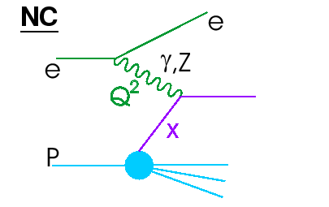
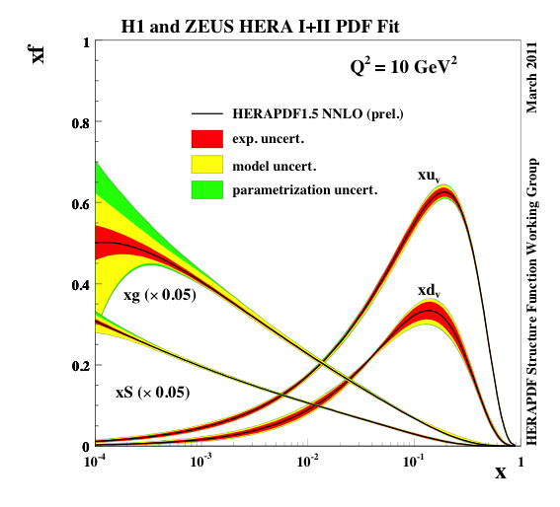
DIS and HERA
Q²: exchanged boson resolving power
x: fractional momentum
of struck quark
HERA Proton parton densities in x range well matched to LHC rapidity plateau … BUT…
- Insufficient lumi for high x
Lack of Q² lever-arm
for low x gluon
Assumptions on quark
flavour decomposition
No deuterons or heavy ions

Slide 4
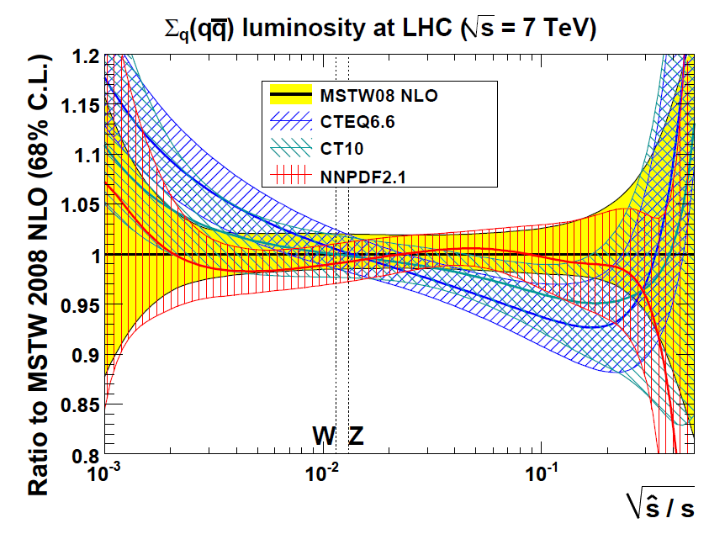
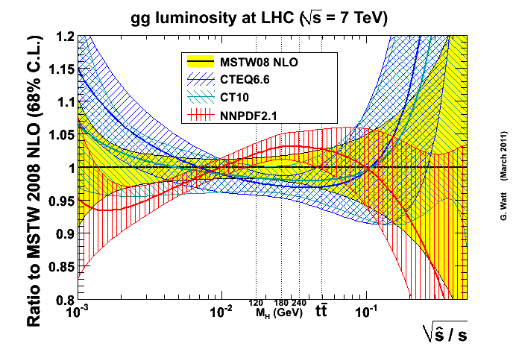
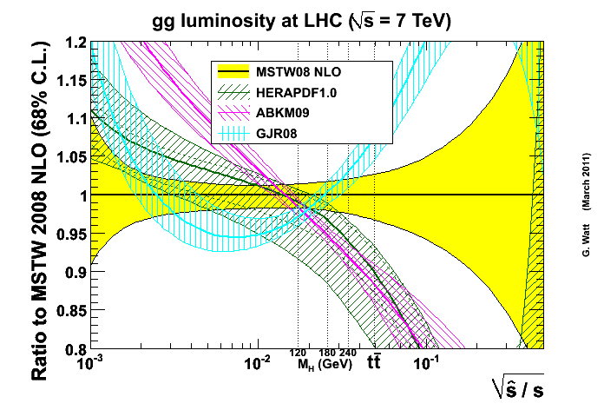
Current PDFs & LHC
Current uncertainties due to
PDFs for particles on LHC
rapidity plateau (NLO):
- Most precise for quark initiated processes around EW scale
- Gluon initiated processes less
well known
All uncertainties explode for largest masses

Slide 5
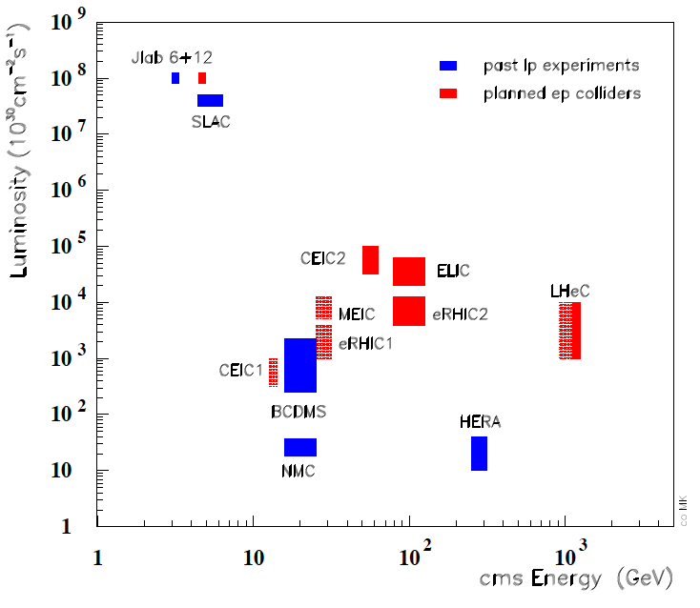
Beyond HERA: LHeC Context
- LHeC is latest & most promising idea to take lepton-hadron physics to the TeV centre of mass scale
- High luminosity:
10³³ - 10³⁴ cm⁻² s⁻¹
Runs simultaneous
with ATLAS / CMS
in post-LS3 HL-LHC period

Slide 6
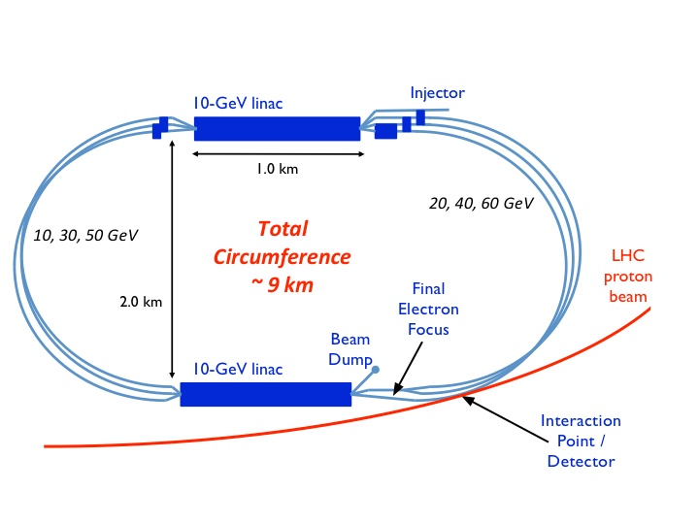
Baseline♯ Design (Electron “Linac”)
Design constraint: power consumption < 100 MW → E_{e} = 60 GeV
Two 10 GeV linacs,
3 returns, 20 MV/m
Energy recovery in
same structures
[CERN plans energy
recovery prototype]
ep Lumi 10³³ – 10³⁴ cm⁻² s⁻¹
10 - 100 fb⁻¹ per year
100 fb⁻¹ – 1 ab⁻¹ total
eD and eA collisions have always been integral to programme
e-nucleon Lumi estimates ~ 10³¹ (10³²) cm⁻² s⁻¹ for eD (ePb)
♯ Alternative designs based on electron ring and on higher energy, lower
luminosity, linac also exist

Slide 7
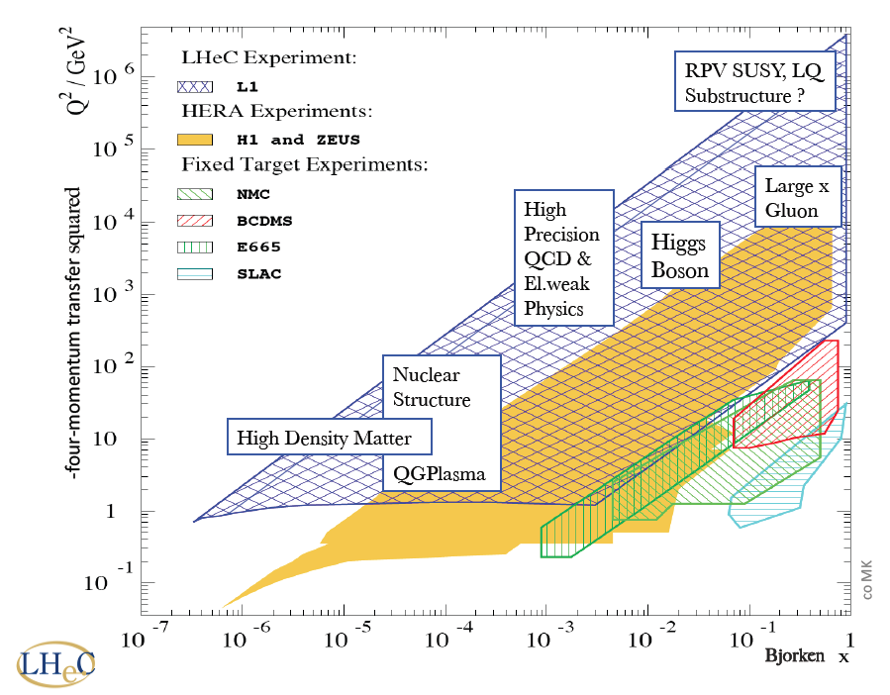
Physics Overview

Slide 8
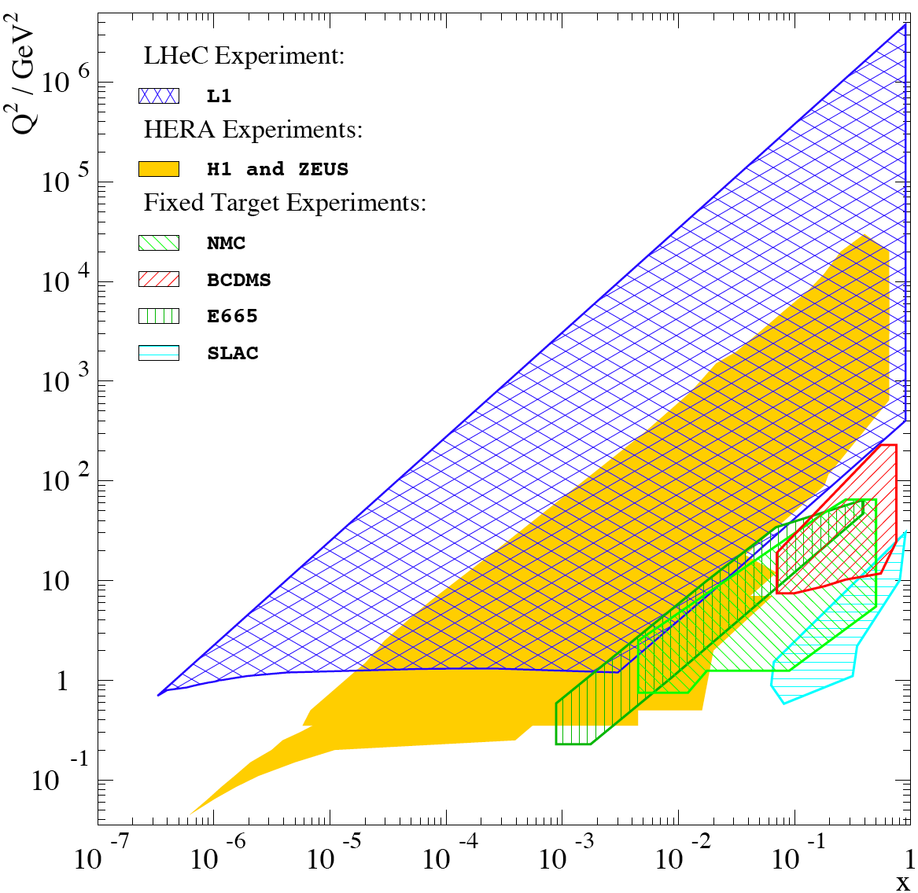
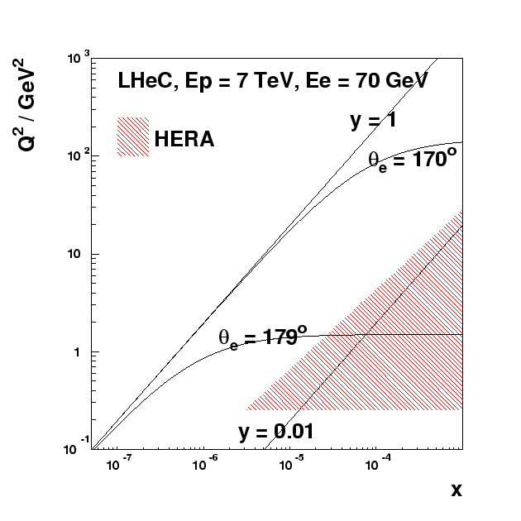
LHeC Detector Acceptance Requirements
Access to Q²=1 GeV² in ep mode for all x > 5 x 10⁻⁷ requires scattered
electron acceptance to 179º
Similarly, need 1º acceptance
in outgoing proton direction
to contain hadrons at high x
(essential for good kinematic
reconstruction)

Slide 9
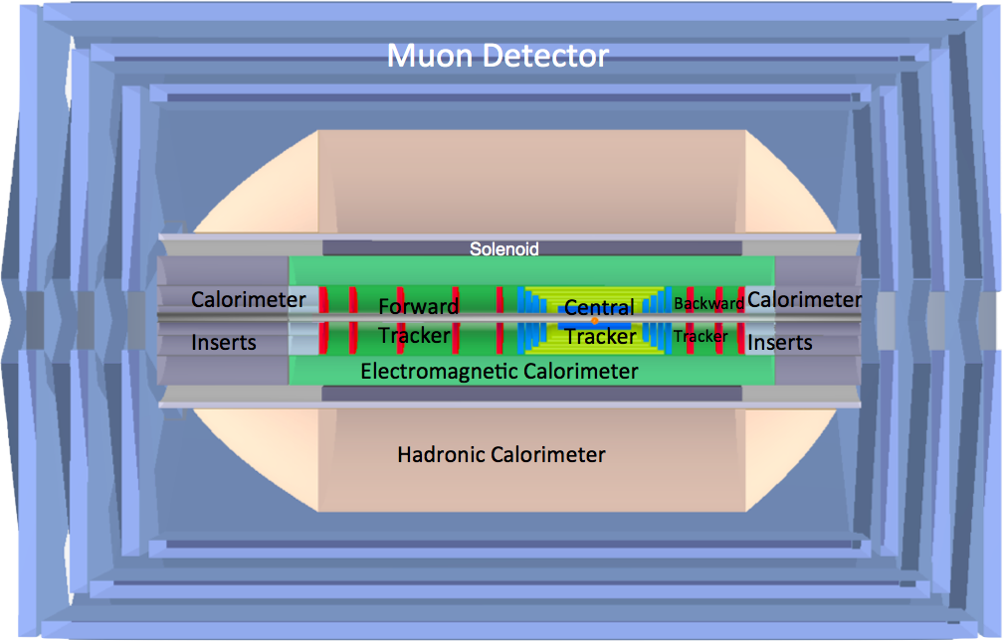
Detector Overview
e
p
Forward / backward asymmetry reflecting beam energies
Present size 14m x 9m (c.f. CMS 21m x 15m, ATLAS 45m x 25m)
ZDC, proton spectrometer integral to design from outset

Slide 10
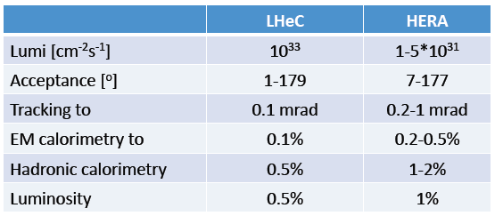
Assumed Systematic Precision
In the absence of a detailed simulation set-up, simulated `pseudo-data’ produced with reasonable assumptions on systematics (typically 2x better than H1 and ZEUS at HERA).

Slide 11
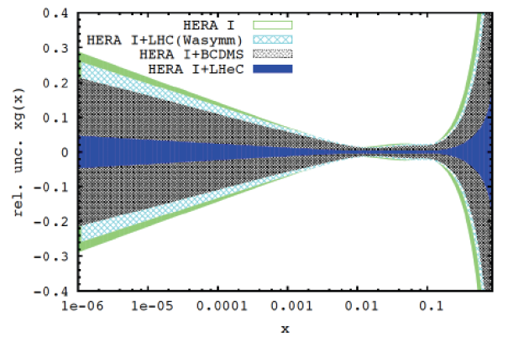
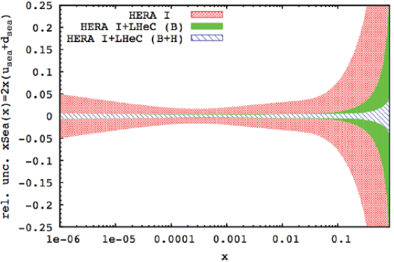
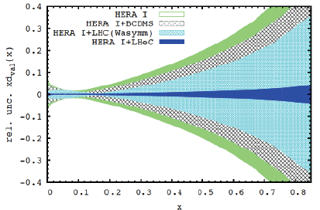
PDF Constraints at LHeC
Full simulation of inclusive NC and CC DIS data, including
systematics → NLO DGLAP fit using HERA technology…
Gluon
Sea
… impact at low x (kinematic range) and high x (luminosity)
… precise light quark vector, axial couplings, weak mixing angle
… full flavour decomposition
d valence

Slide 12
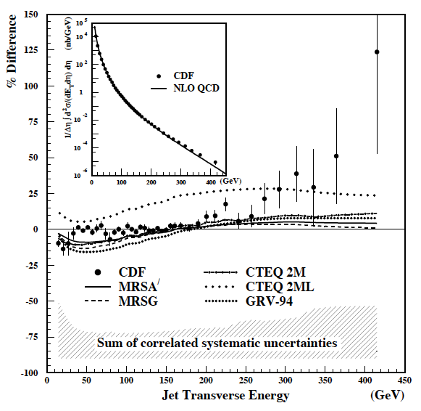
Do we need to Care about High x?
PRL 77 (1996) 438
Ancient history (HERA, Tevatron)
- Apparent excess in large E_{T} jets at Tevatron turned out to be explained by too low high x gluon density in PDF sets
- Confirmation of (non-resonant) new physics near LHC kinematic limit relies on breakdown of factorisation between ep and pp
Searches near LHC kinematic boundary may ultimately be
limited by knowledge of PDFs (especially gluon as x → 1)

Slide 13
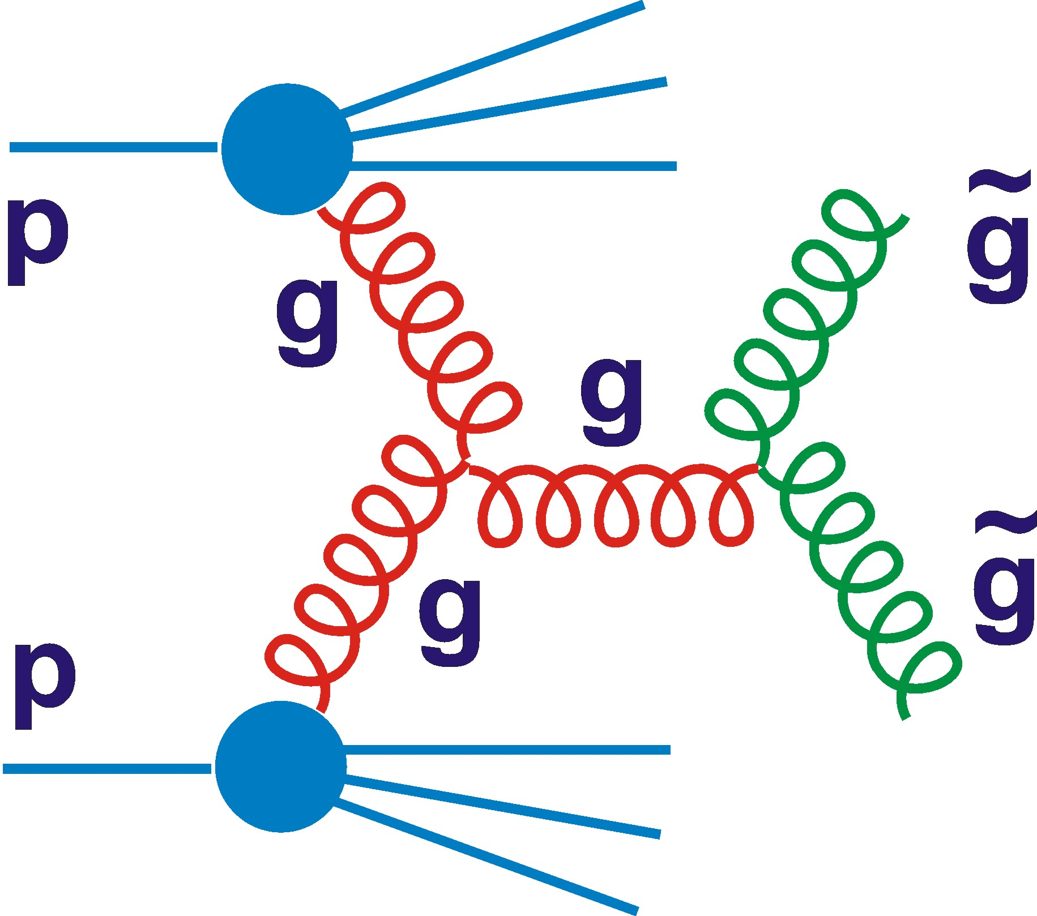
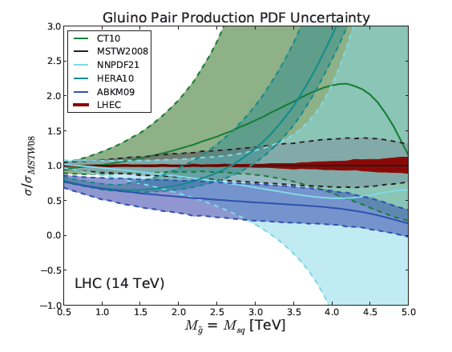
e.g. High Mass 2 Gluino Production
- Signature is excess @ large invariant mass
Expected SM background (e.g. gg → gg)
poorly known for s-hat > 1 TeV.
Both signal & background
uncertainties driven by
error on gluon density …
Essentially unknown for
masses much beyond 2 TeV
Similar conclusions for
other non-resonant LHC
signals involving high x
partons (e.g. contact
interactions signal in
Drell-Yan)

Slide 14
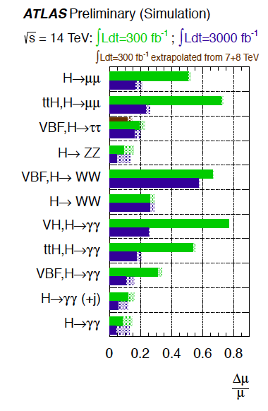
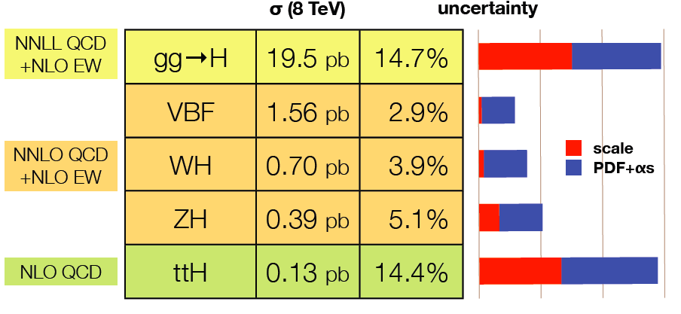
PDF Uncertainties for Higgs Physics
Theory Cross Section
Uncertainties
(125 GeV Higgs
J Campbell, ICHEP’12)
Projected Experimental
Uncertainties
Similarly fermionic modes (bbbar, ccbar)
… tests of Standard Model in Higgs sector may become limited by knowledge of PDFs in HL-LHC era
[Dashed regions
= scale & PDF
contributions

Slide 15
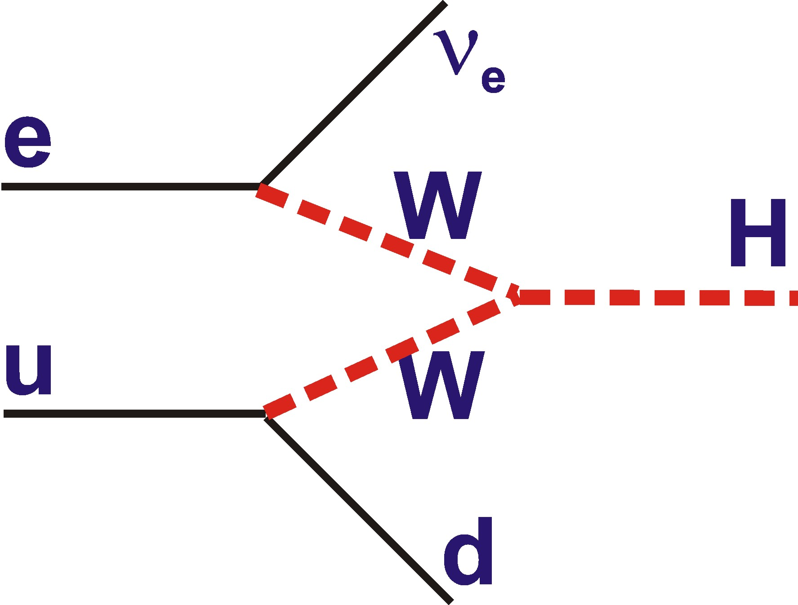
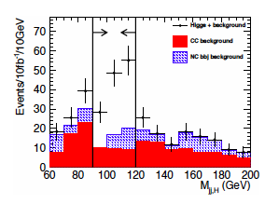
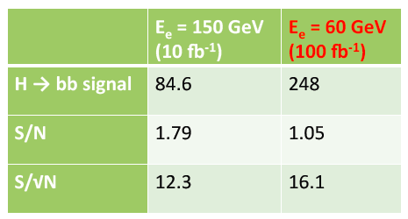
A Direct Higgs Study
Dominant charged current process has similar
cross section to linear e+e- collider
Study of H → bbbar in generic
simulated LHC detector
m_{H} = 120 GeV,
LHeC with 10fb⁻¹
… + 90% lepton polarisation enhances signal by factor 1.9
… + With 10³⁴ luminosity, x10 more data
→ ~5000 events @ Ee = 60 GeV … H→bbbar coupling to ~ 1%.

Slide 16
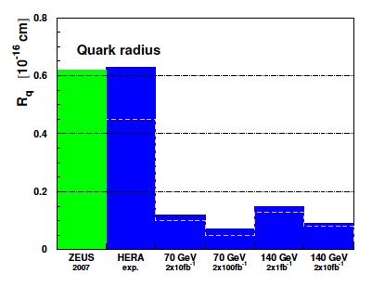
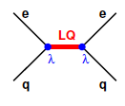
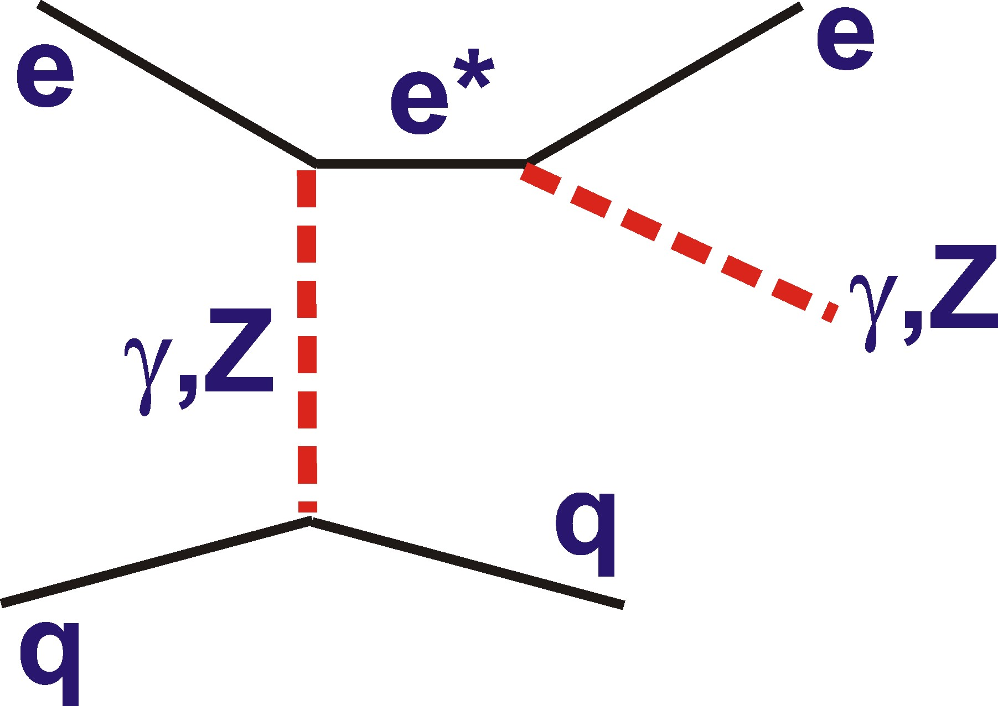
Direct Sensitivity to New Physics
The (pp) LHC has much better discovery potential than LHeC (unless E_{e} increases to >~500 GeV and 10³⁴ lumi achieved)
e.g. Expected quark
compositeness limits
below 10⁻¹⁹ m at LHeC
… big improvement on
HERA, but already beaten
by LHC
LHeC is competitive with LHC in cases where initial
state lepton is an advantage and offers cleaner final states
~
e
e
χ⁰
~
q
q

Slide 17
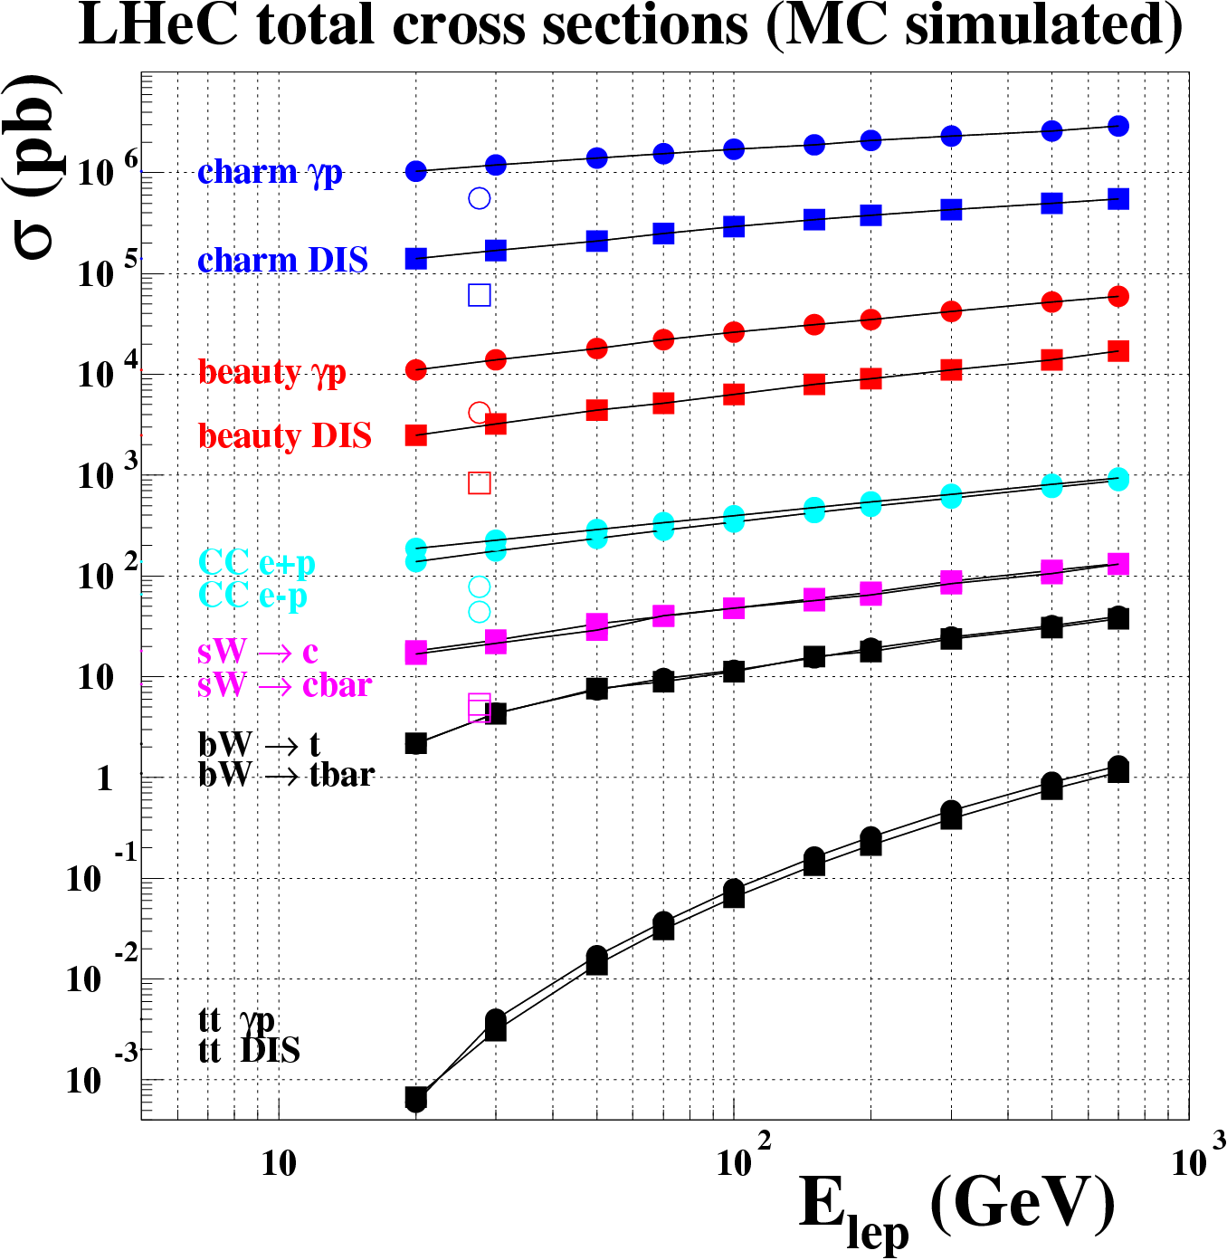
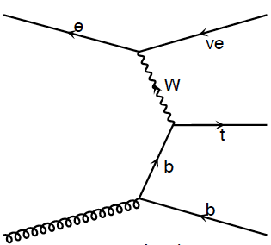
Cross Sections and Rates for Heavy Flavours
HERA 27.5 x 920
Charm
Beauty
cc
sW → c
bW → t
ttbar
[10¹⁰ / 10 fb⁻¹]
[10⁸ / 10 fb⁻¹]
[4.10⁵ / 10 fb⁻¹]
[10⁵ / 10 fb⁻¹]
[10³ / 10 fb⁻¹]
c.f. luminosity of ~10 fb⁻¹ per year …

Slide 18
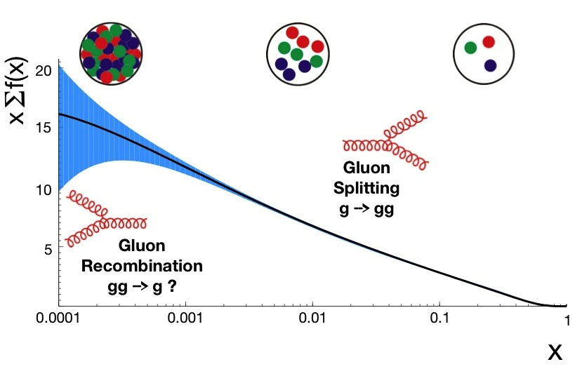
Low-x Physics and Parton Saturation
[HERAPDF
1.6 NNLO]
Somewhere & somehow, the low x growth of cross sections
must be tamed to satisfy unitarity … non-linear effects
… new high density, small coupling parton regime of non-linear parton evolution dynamics (e.g. Colour Glass Condensate)? …
… gluon dynamics → confinement and hadronic mass generation

Slide 19
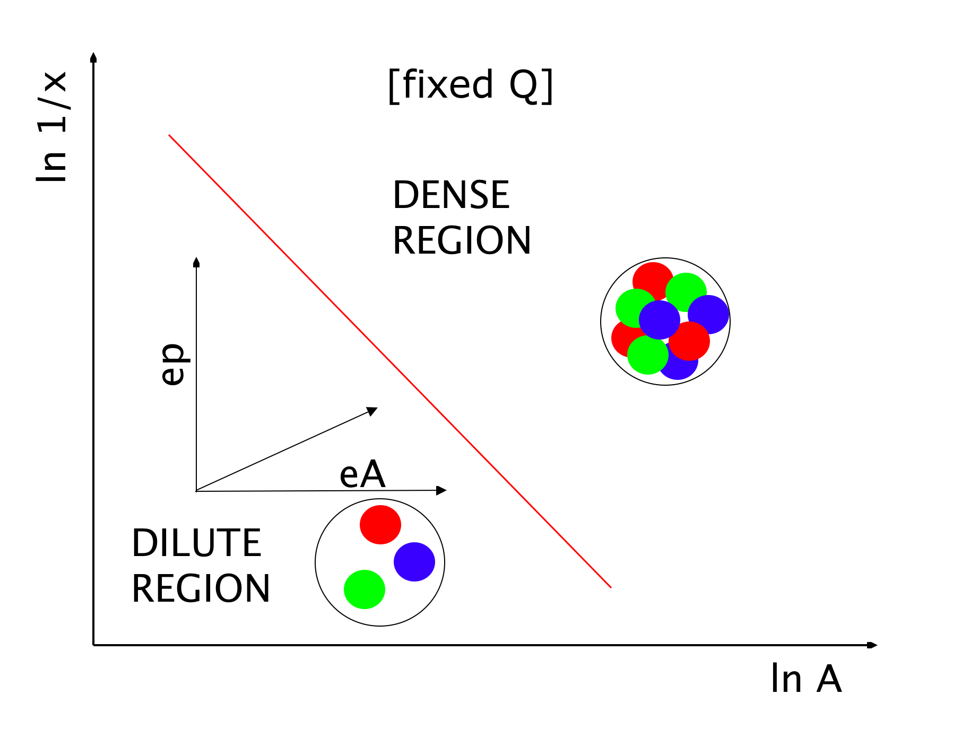
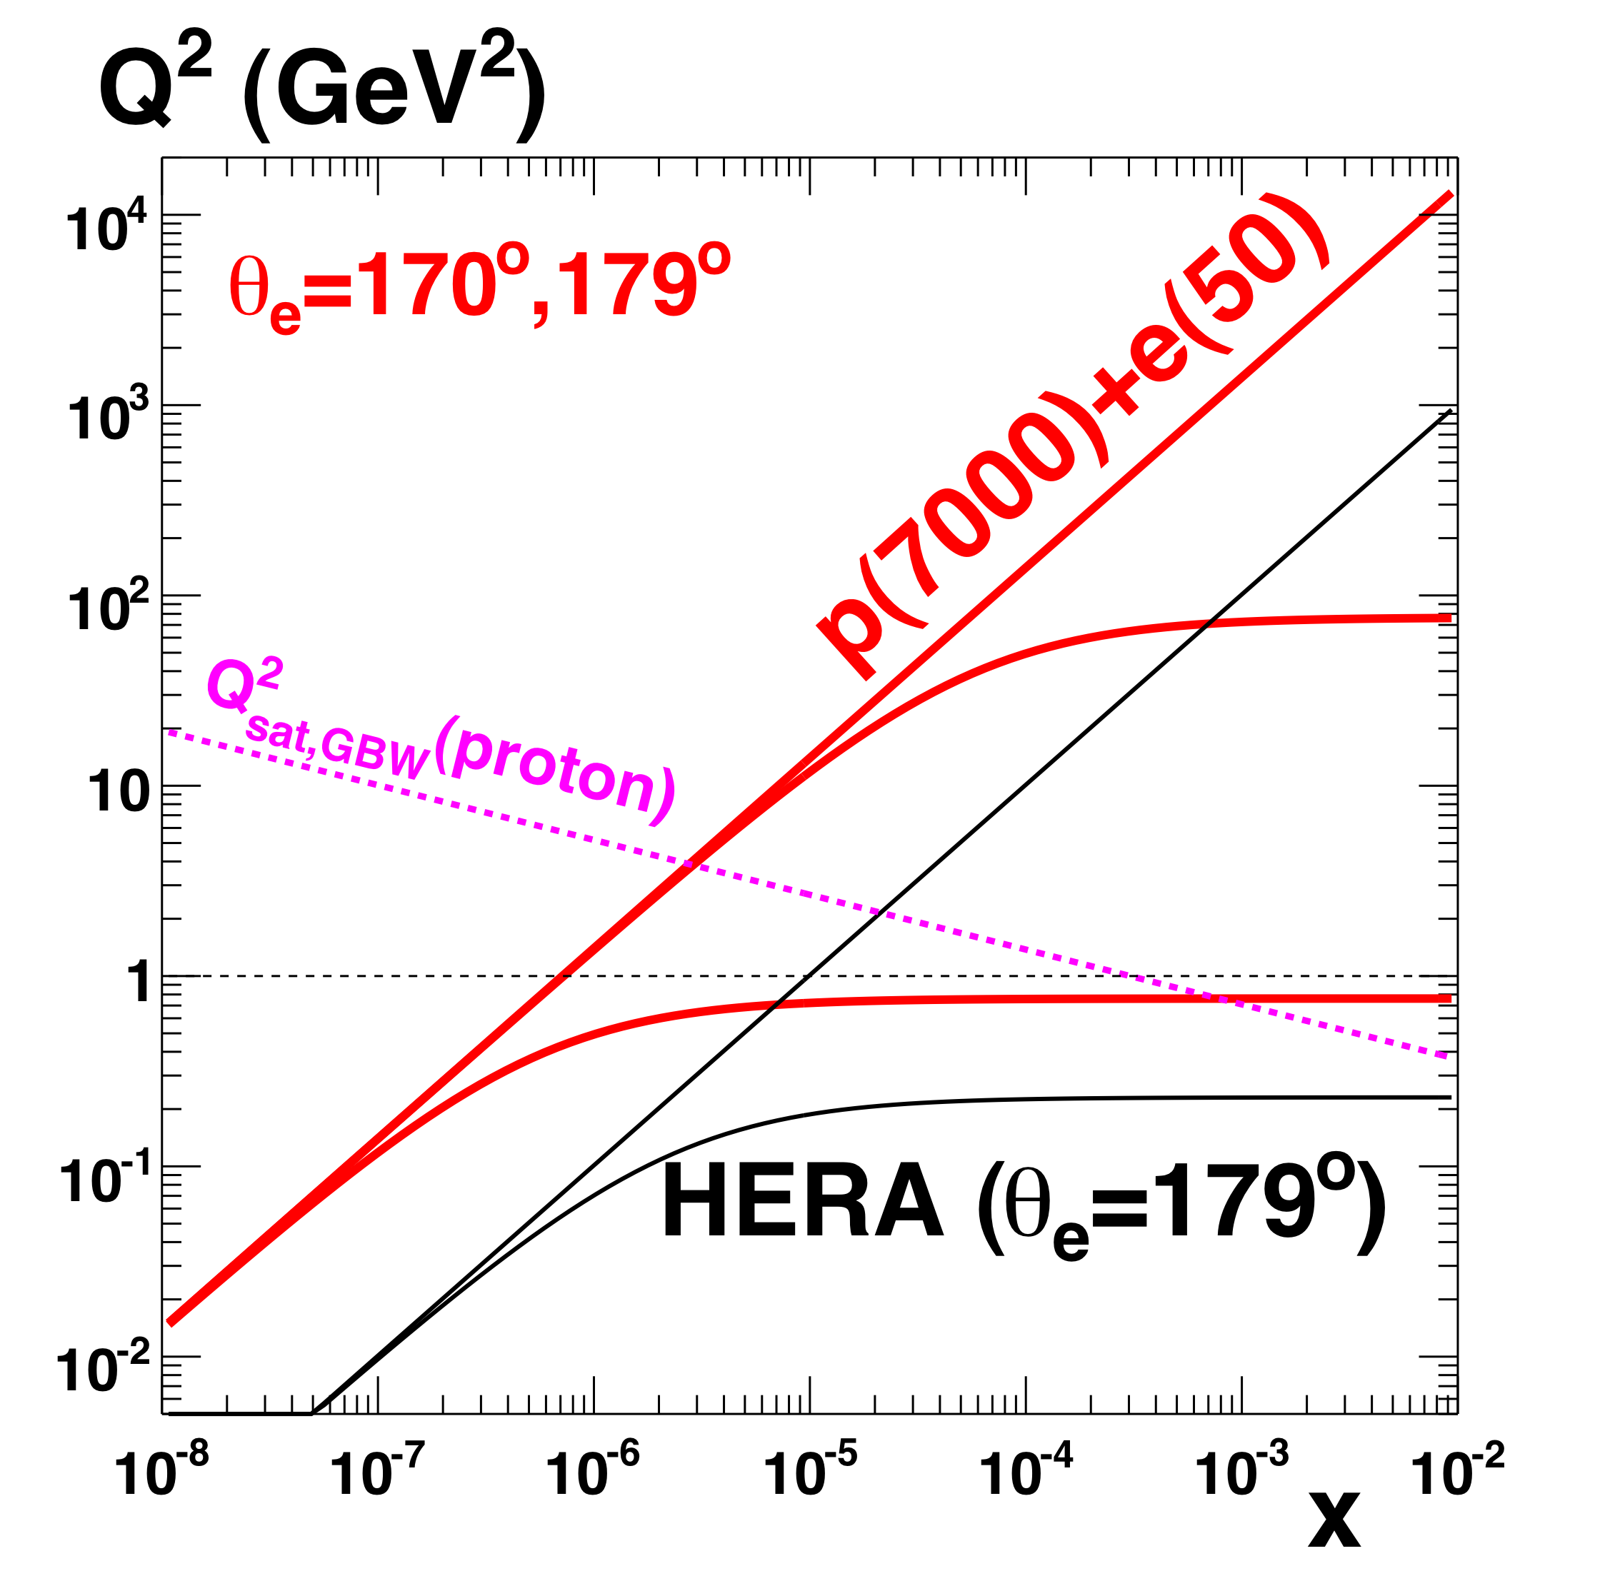
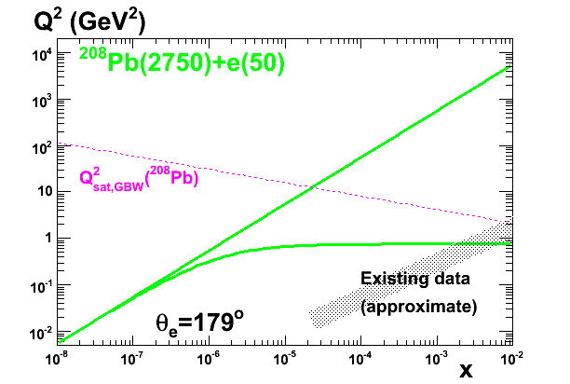
LHeC Strategy for making the target blacker
LHeC delivers a 2-pronged approach:
Enhance target `blackness’ by:
1) Probing lower x at fixed Q² in ep
[evolution of a single source]
2) Increasing target matter in eA
[overlapping many sources at fixed kinematics … density ~
A^{1/3} ~ 6 for Pb … worth 2 orders of magnitude in x]
… Reaching
saturated
region in
both ep & eA
according to
current models

Slide 20
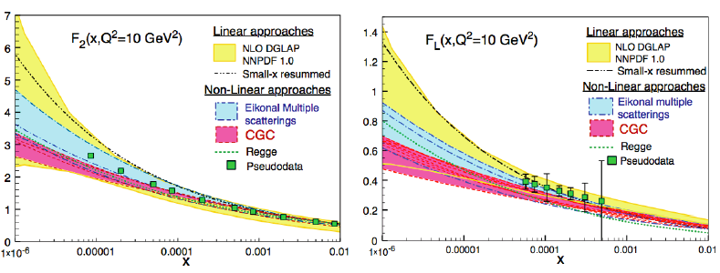
Establishing and Characterising Saturation
With 1 fb⁻¹ (1 month at 10³³ cm⁻² s⁻¹), F₂ stat. < 0.1%, syst, 1-3%
F_{L} measurement to 8% with 1 year of varying E_{e} or E_{p}
LHeC can distinguish between different QCD-based models for the onset of non-linear dynamics
Unambiguous observation of saturation will be based on tension
between different observables e.g. F₂ v F_{L} in ep or F₂ in ep v eA

Slide 21
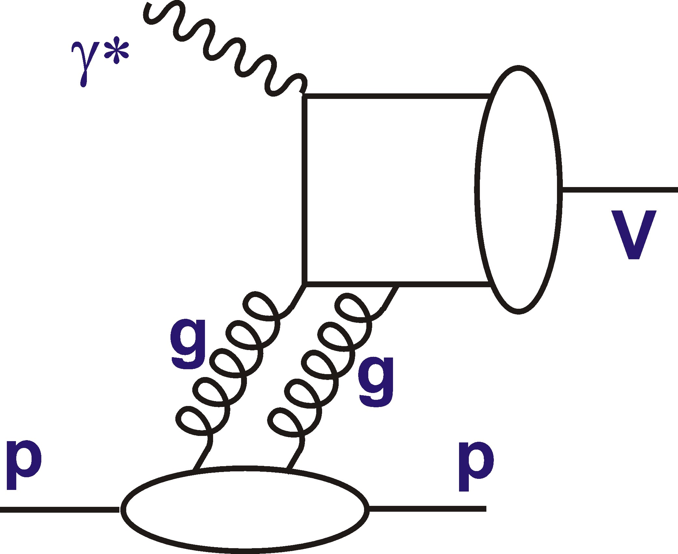
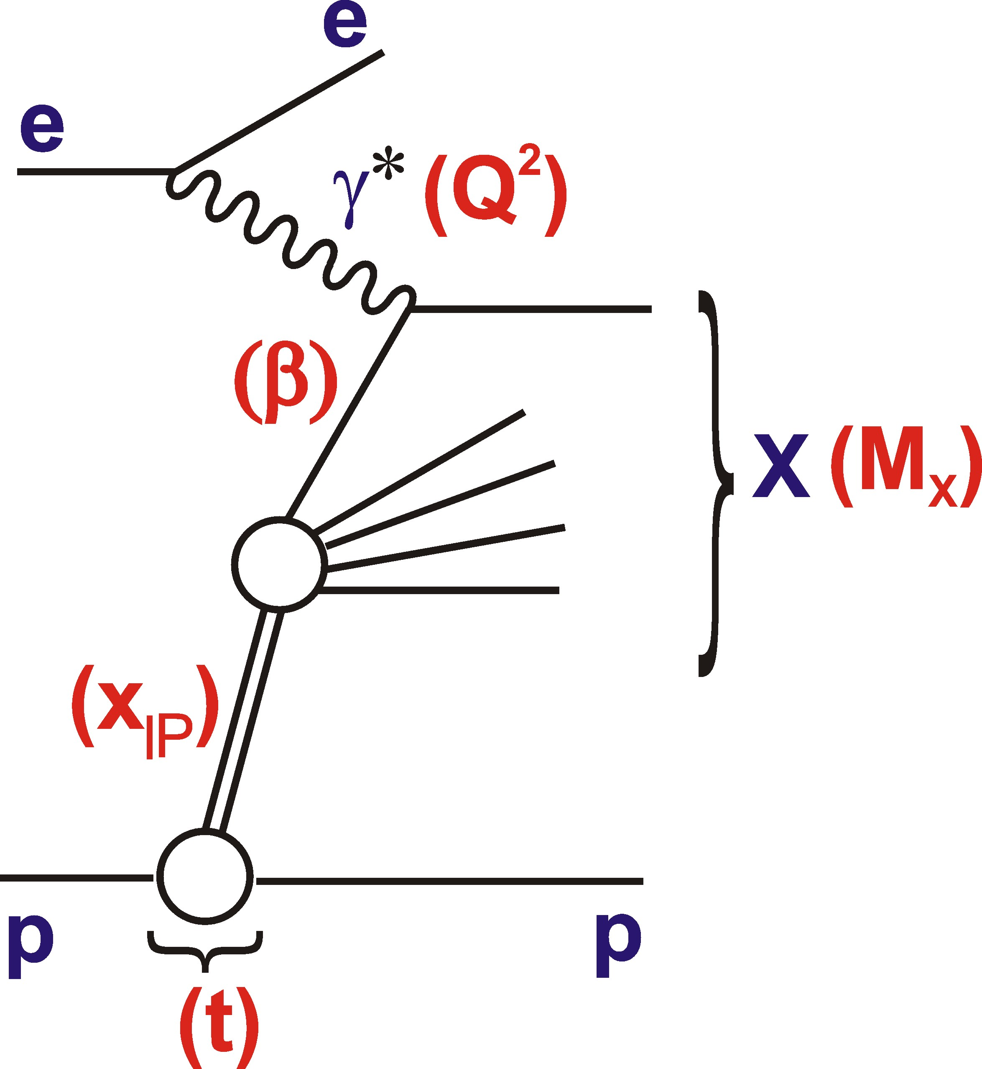
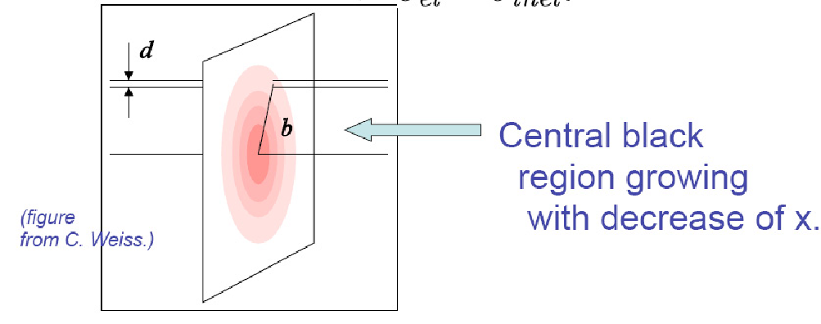
Exclusive / Diffractive Channels and Saturation
[Low-Nussinov] interpretation as 2 gluon exchange enhances sensitivity to low x gluon
Additional variable t gives access to impact parameter (b) dependent amplitudes
→ Large t (small b) probes densest
packed part of proton?

Slide 22
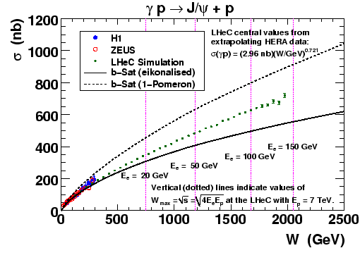
e.g. J/ψ Photoproduction
e.g. “b-Sat” Dipole model
- “eikonalised”: with impact-parameter
dependent saturation
- “1 Pomeron”: non-saturating
Significant non-linear
effects expected in LHeC
kinematic range.
Data shown are
extrapolations of
HERA power law fit
for E_{e} = 150 GeV…
→ Sat^{n} smoking gun?
[2 fb⁻¹]

Slide 23
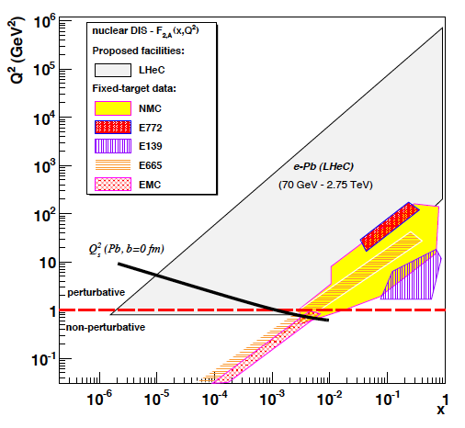
LHeC as an Electron-ion Collider
Four orders of magnitude increase
in kinematic range over previous
DIS experiments.
Revolutionise our
view of the partonic structure of
nuclear matter.
Study interactions of densely packed, but weakly coupled, partons
Ultra-clean probe of
passage of `struck’
partons through cold nuclear matter
eA

Slide 24
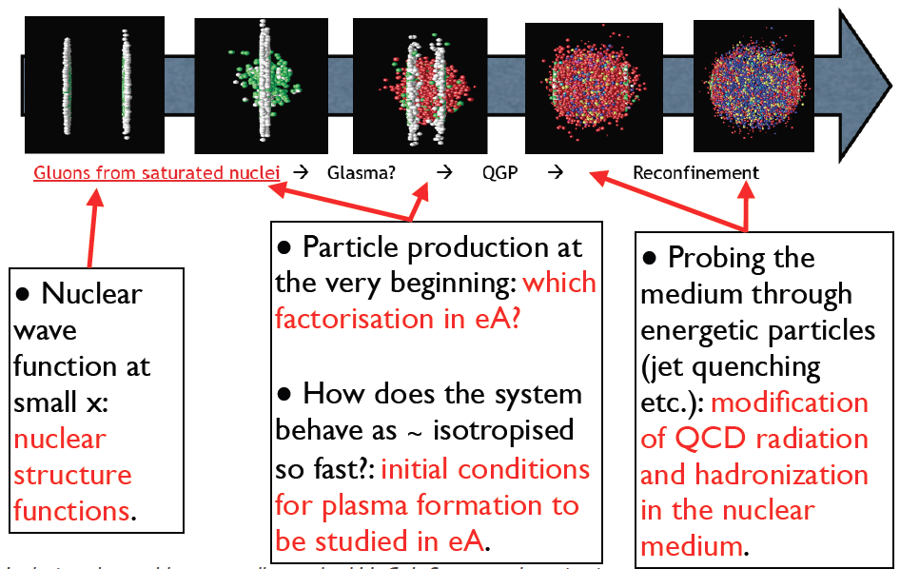
Relevance to the Heavy Ion Programme

Slide 25
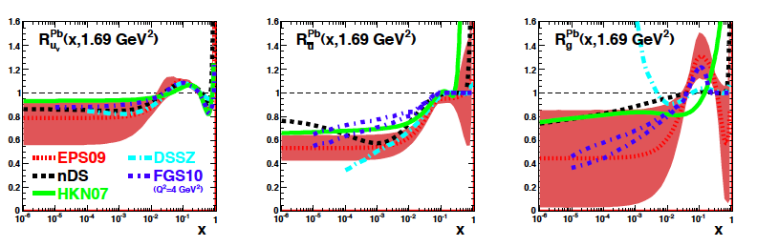
Current Status of Nuclear Parton Densities
Complex nuclear effects,
not yet fully understood
Quarks from DIS & DY
Gluon mainly from dAu
single π⁰ rates
All partons poorly
constrained for x < 10⁻²
[Existing
DIS data]
R_{i} = Nuclear PDF i / (A * proton PDF i)
Valence
Sea
Gluon

Slide 26
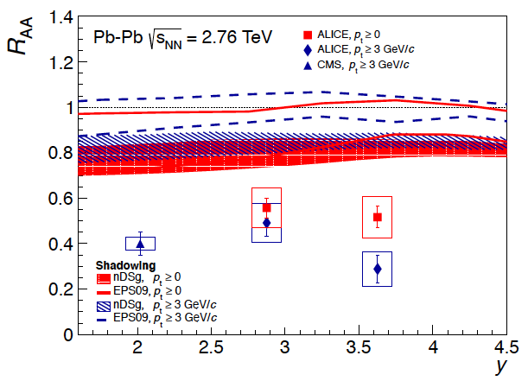
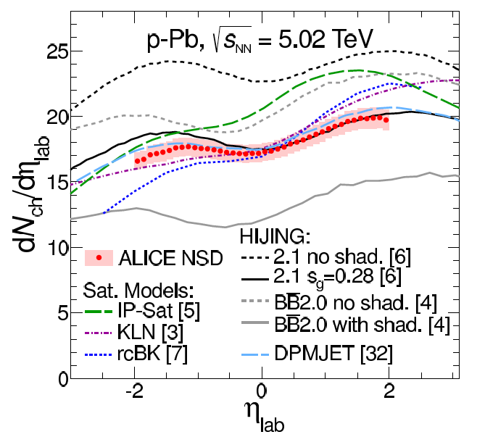
Current Low x Understanding in LHC Ion Data
Inclusive J/Ψ AA data
Uncertainties in low-x nuclear
PDFs preclude precision
statements on medium produced
in AA (e.g. extent of screening
of c-cbar potential)
Minimum Bias pA data
η dependence of pPb charged
particle spectra best described
by shadowing-only models
(saturation models too steep?)
… progress with pPb, but
uncertainties still large, detailed
situation far from clear
Pb
p

Slide 27
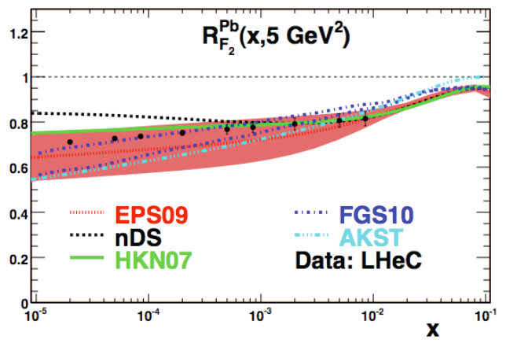
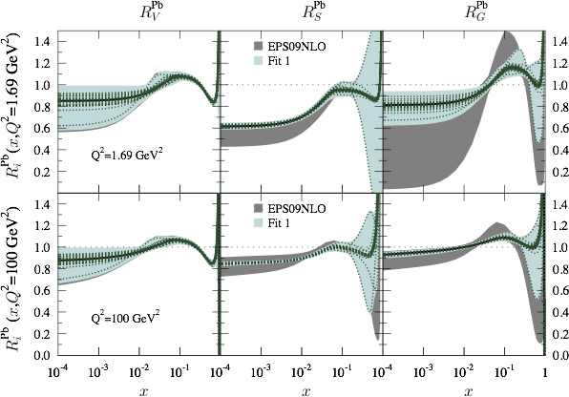
Impact of eA F₂ LHeC data
Simulated LHeC ePb F₂ measurement
has huge impact on uncertainties
Most striking effect for sea & gluons
High x gluon uncertainty still large
Valence
Glue
[Example
pseudo-data
from single
Q² Value]
Sea
[Effects
on EPS09
nPDF fit]

Slide 28
Summary and Outlook
LHC is new world for p-p physics
(even more for heavy ion) physics
Conceptual Design Report available.
Timeline?... Optimal
impact by running in
High Lumi LHC Phase
Ongoing work …
- Physics motivation
- Detector / simulation
- Superconducting RF,
ERL, machine …
More at:
- http://cern.ch/lhec
- CDR [arXiv:1206.2913]
- `Dig Deeper’,
Newman & Stasto,
Nature Physics 9 (2013) 448

Slide 29
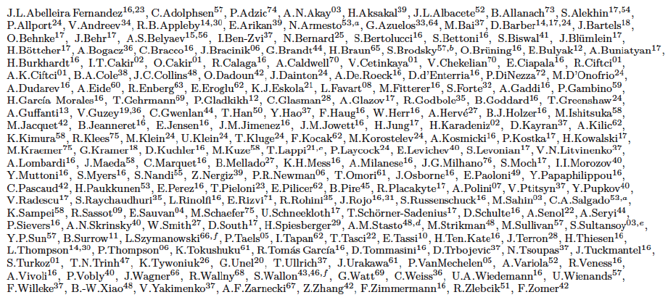
… with thanks to Nestor Armesto, Max Klein,
Anna Stasto and many experimentalist, theorist
& accelerator scientist colleagues …
LHeC study group …

