Slide 1
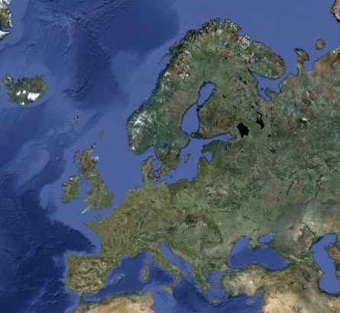
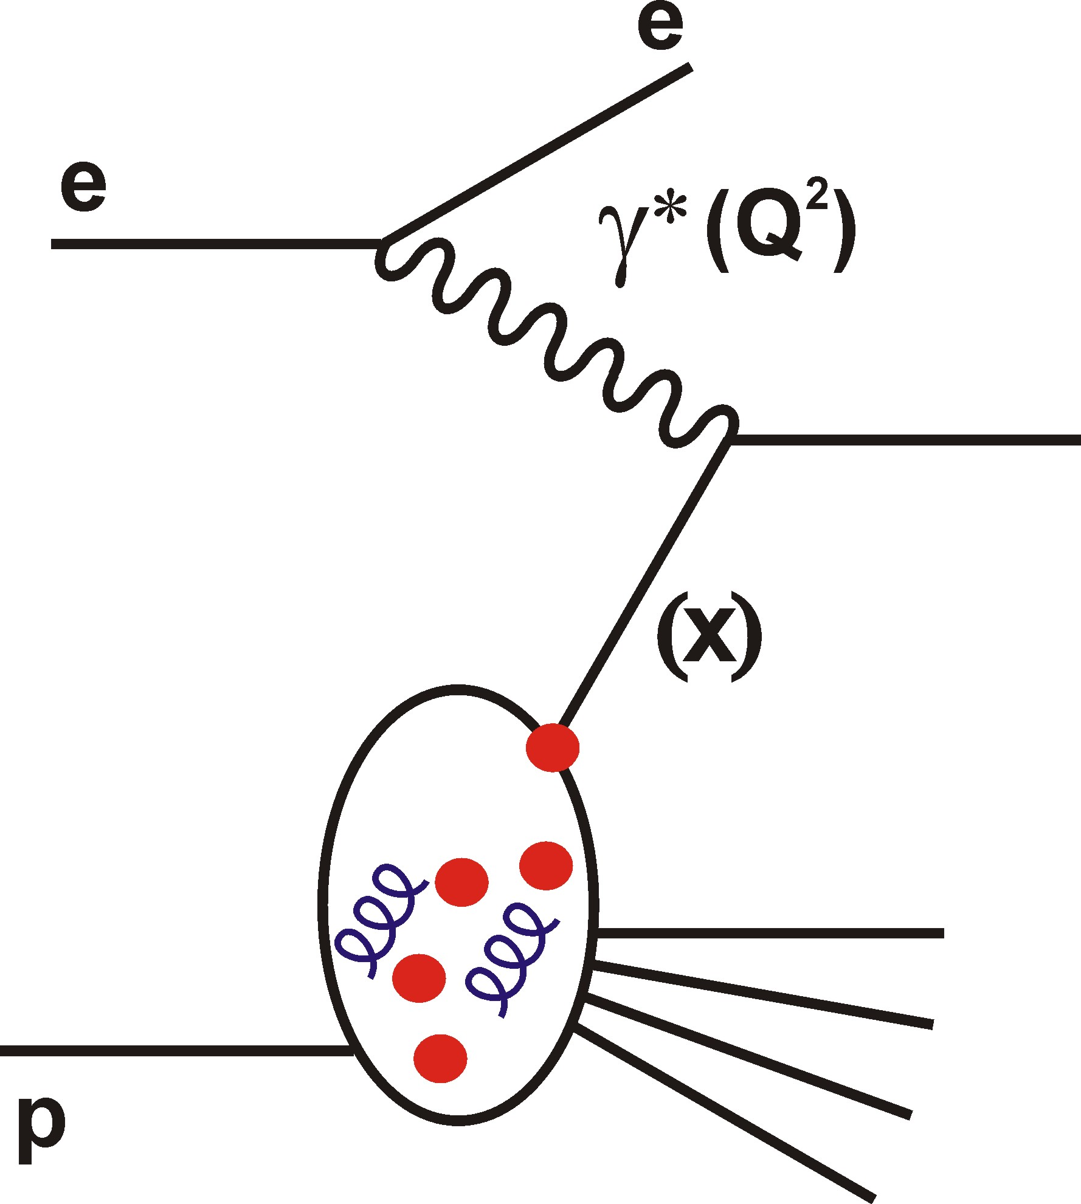

Future of DIS
Part II: “Europe”
Paul Newman
Birmingham University
Summary Talk from
DIS 2012 (Bonn)
Fri 30 March 2012

Slide 2
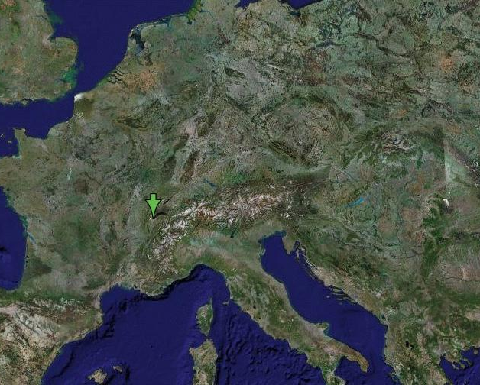
… or to be more precise …

Slide 3

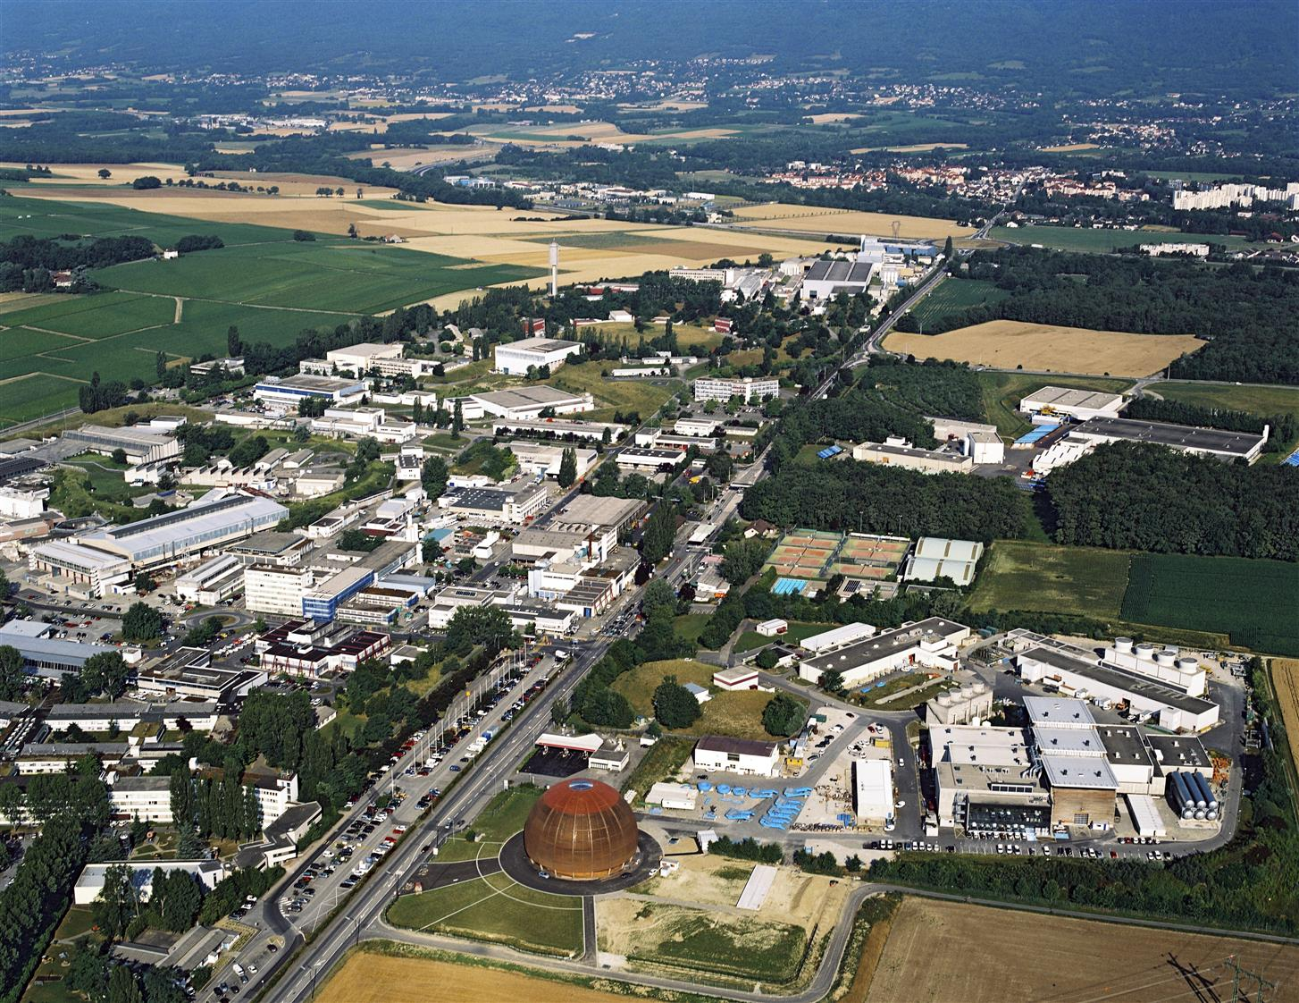

Slide 4
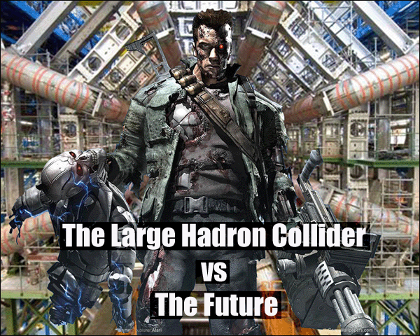

Slide 5

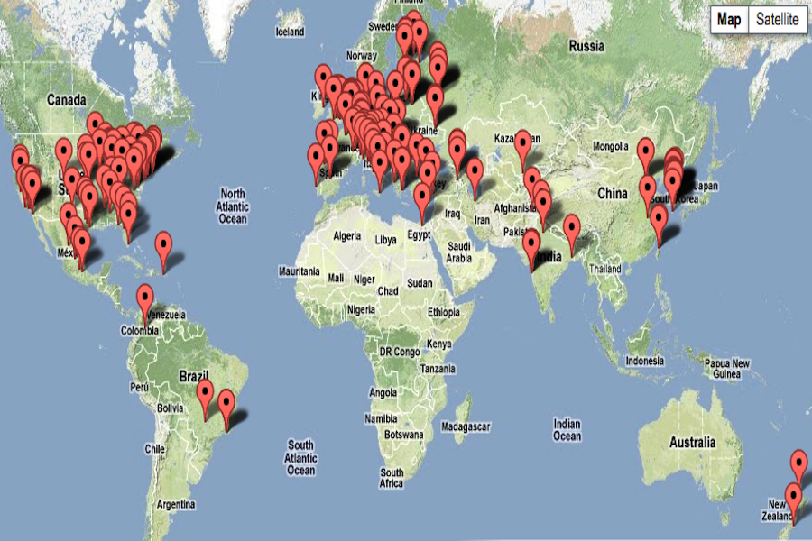
… not that being located in Europe
means anything about participation …
5
Notes:
5

Slide 6
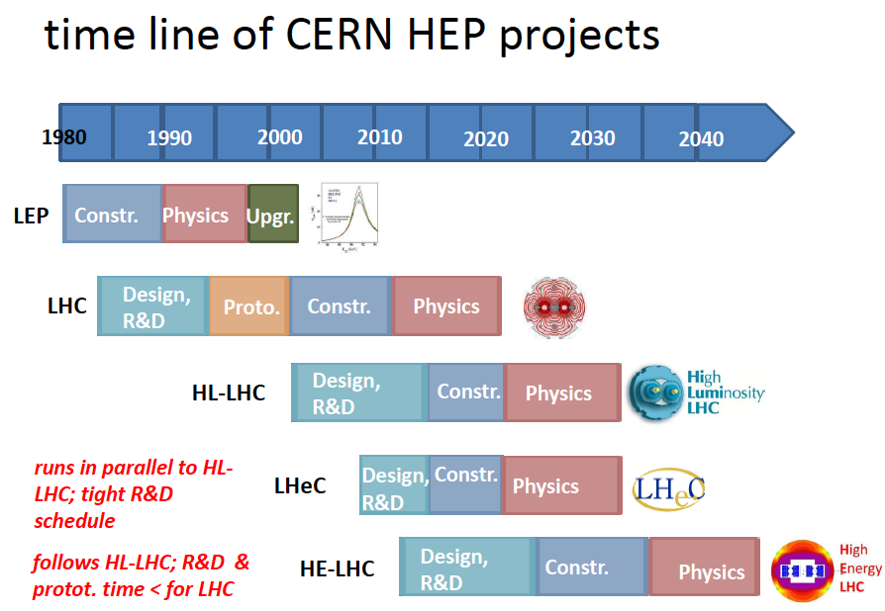
Part 1
LHC upgrades
2012 Chamonix LHC Performance workshop summary (Rossi)

Slide 7
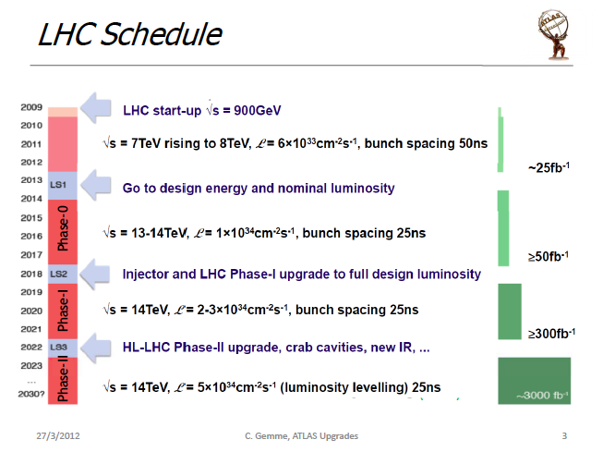

Slide 8
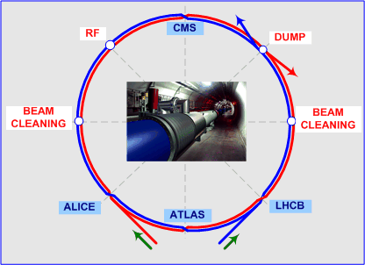
Claudia
Gemme
Thomas
Peitzmann
Renaud
le Gac
- Mainly consolidation at phase 0
- Staged modifications to cope with high lumi at phases 1 and 2
ATLAS/CMS: coping with immense event rates / pile-ups
ALICE: enhance rate capabilities to 50 kHz (PbPb)
LHCb: Increase peak lumi to 2x10³³ cm⁻²s⁻¹ → increase
integrated lumi from 5 fb⁻¹ pre-2017 to 50 fb⁻¹

Slide 9
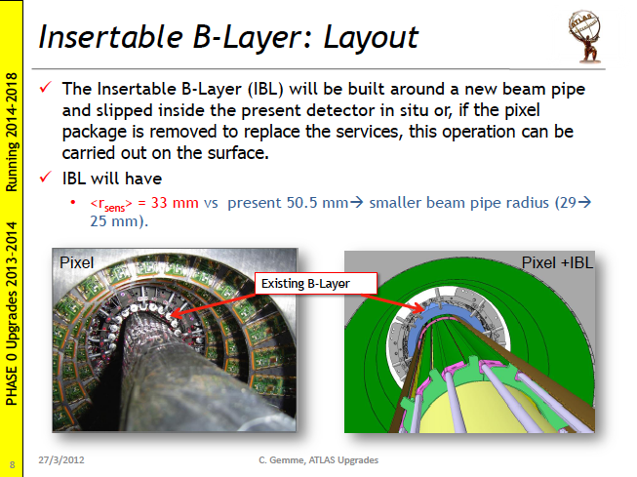
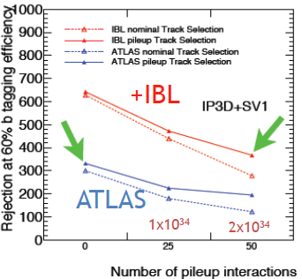

Slide 10
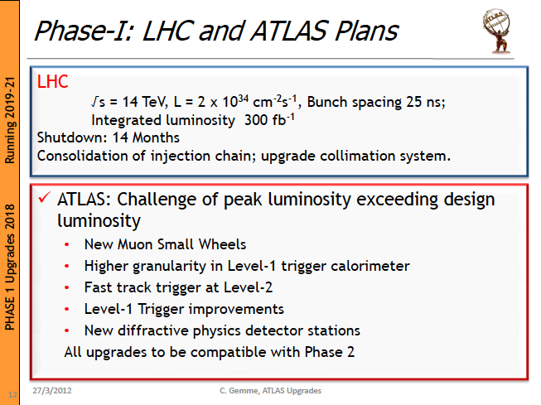

Slide 11
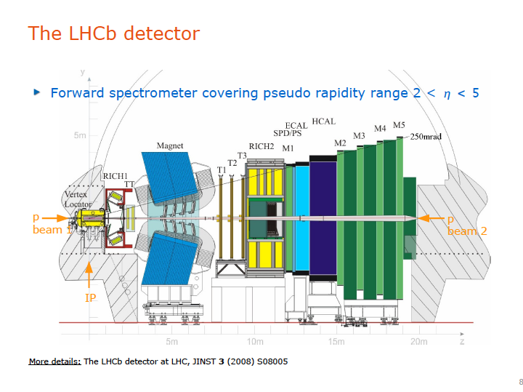

Slide 12
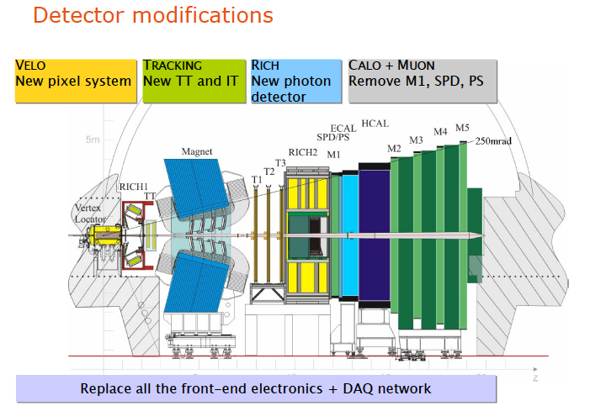
[All for phase 1 upgrade]

Slide 13
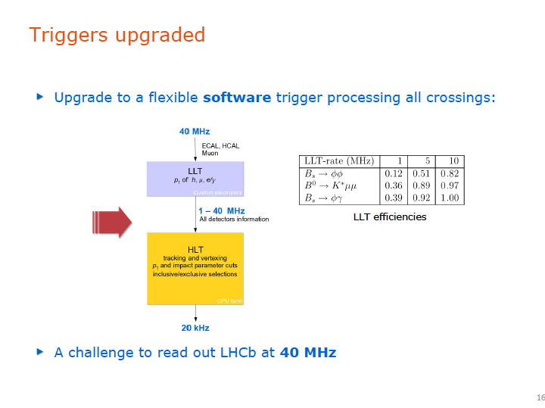
[1MHz now]
[2kHz now]

Slide 14
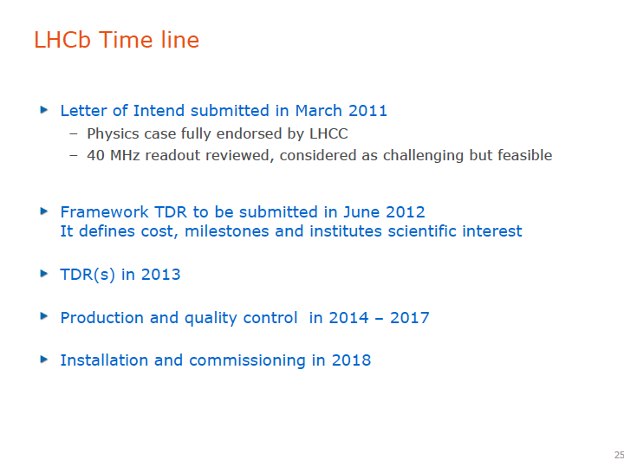

Slide 15
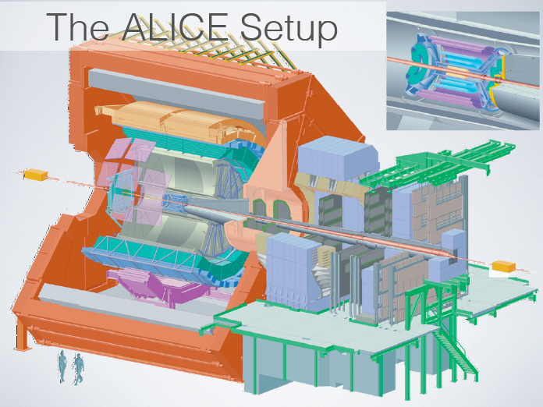

Slide 16
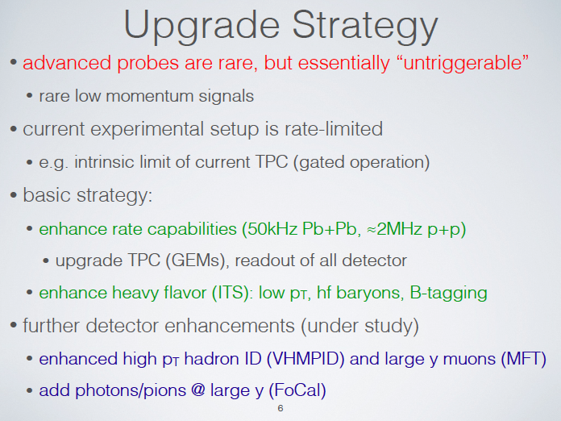

Slide 17
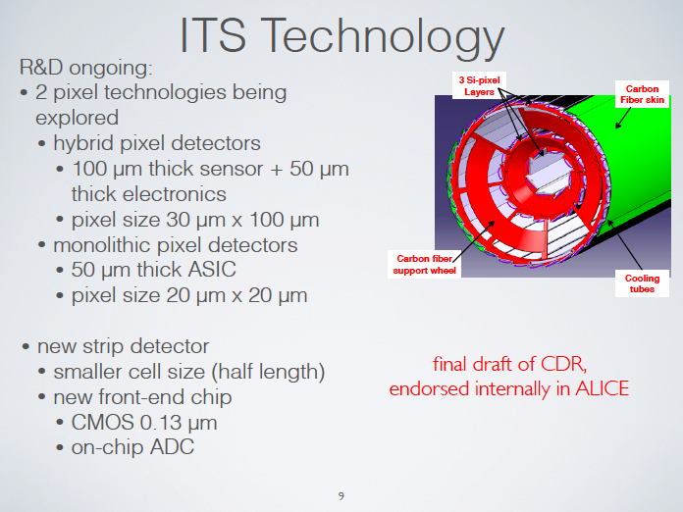
7 new layers, nearest at
2.2 cm from beam

Slide 18
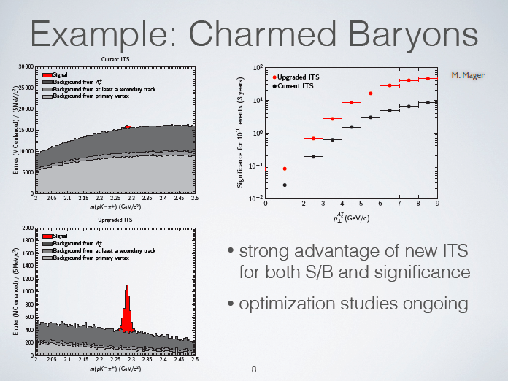

Slide 19
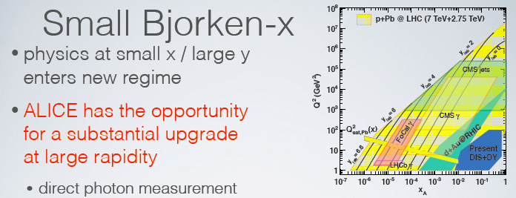
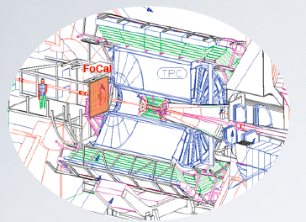
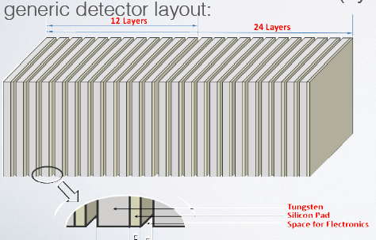
2.5 < η < 4.5
Various ideas under study
e.g. Silicon Tungstate

Slide 20
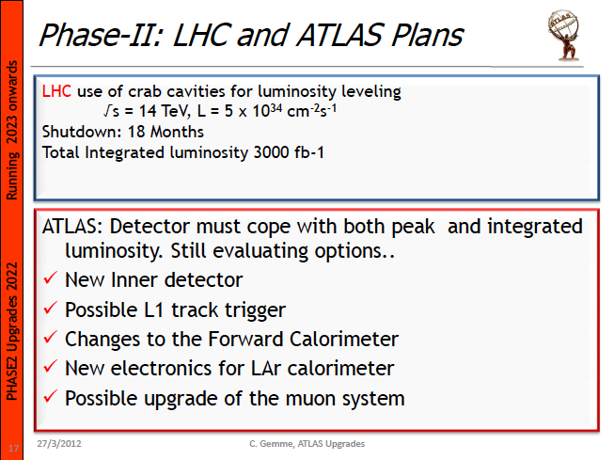

Slide 21
Part 2
LHeC
2012 Chamonix LHC Performance workshop summary (Rossi)

Slide 22
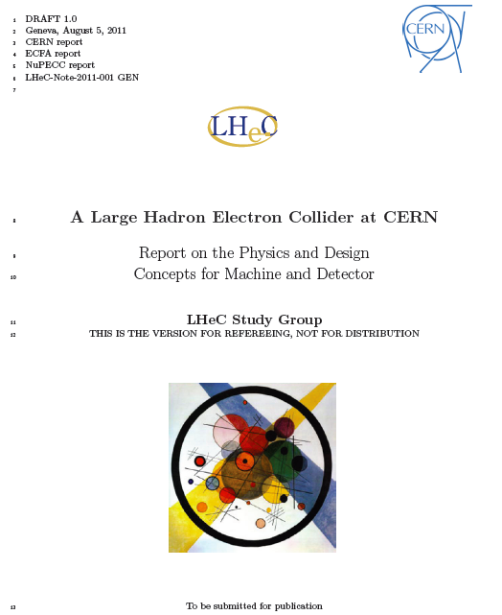
Material Taken from Draft
Conceptual Design Report
525 pages, summarising
work of ~150 participants
over 5 years
Currently under review
by CERN-appointed
referees → final version
expected April / May 2012

Slide 23
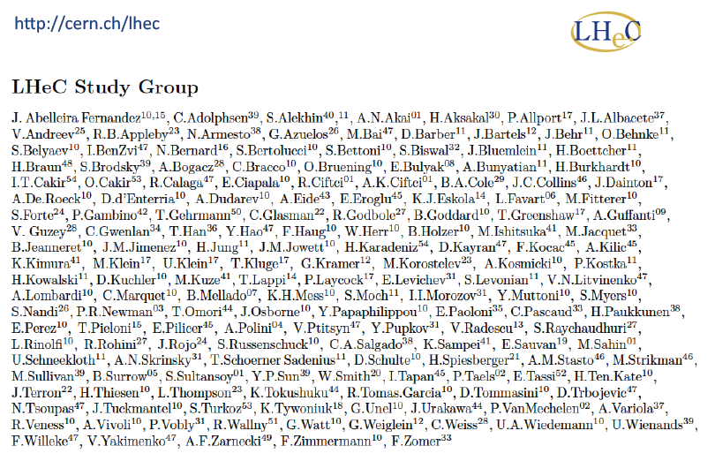
… with thanks to many colleagues working on LHeC …

Slide 24
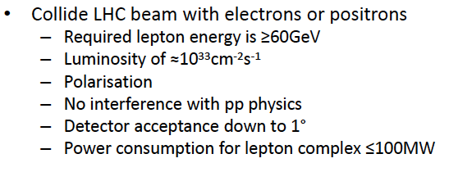
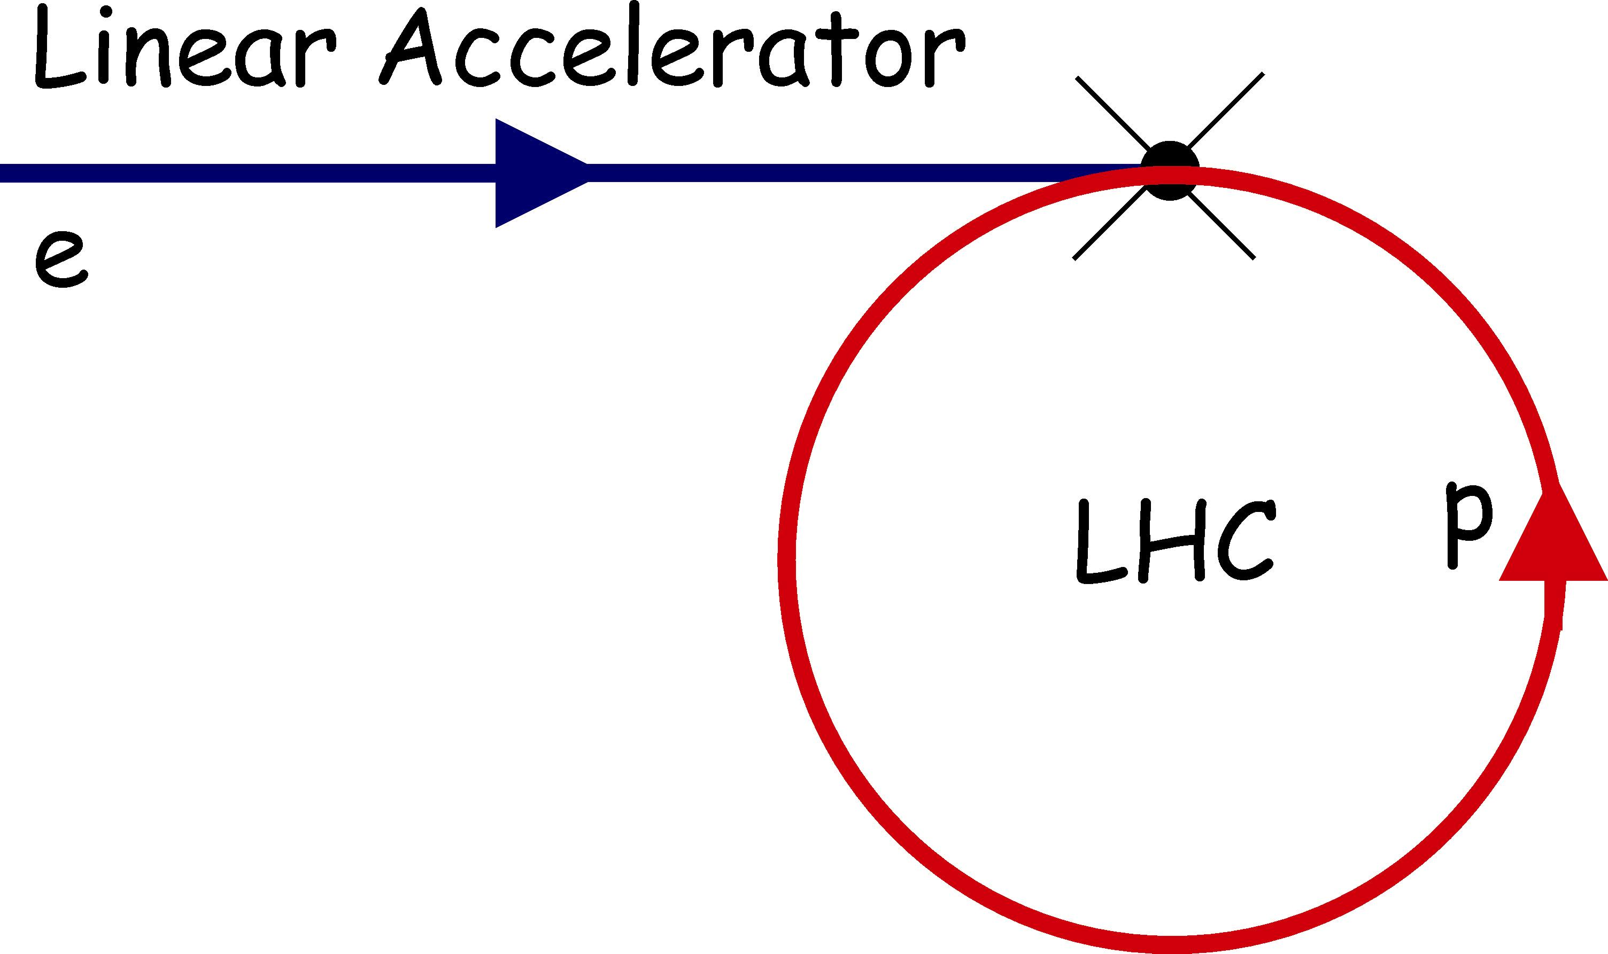
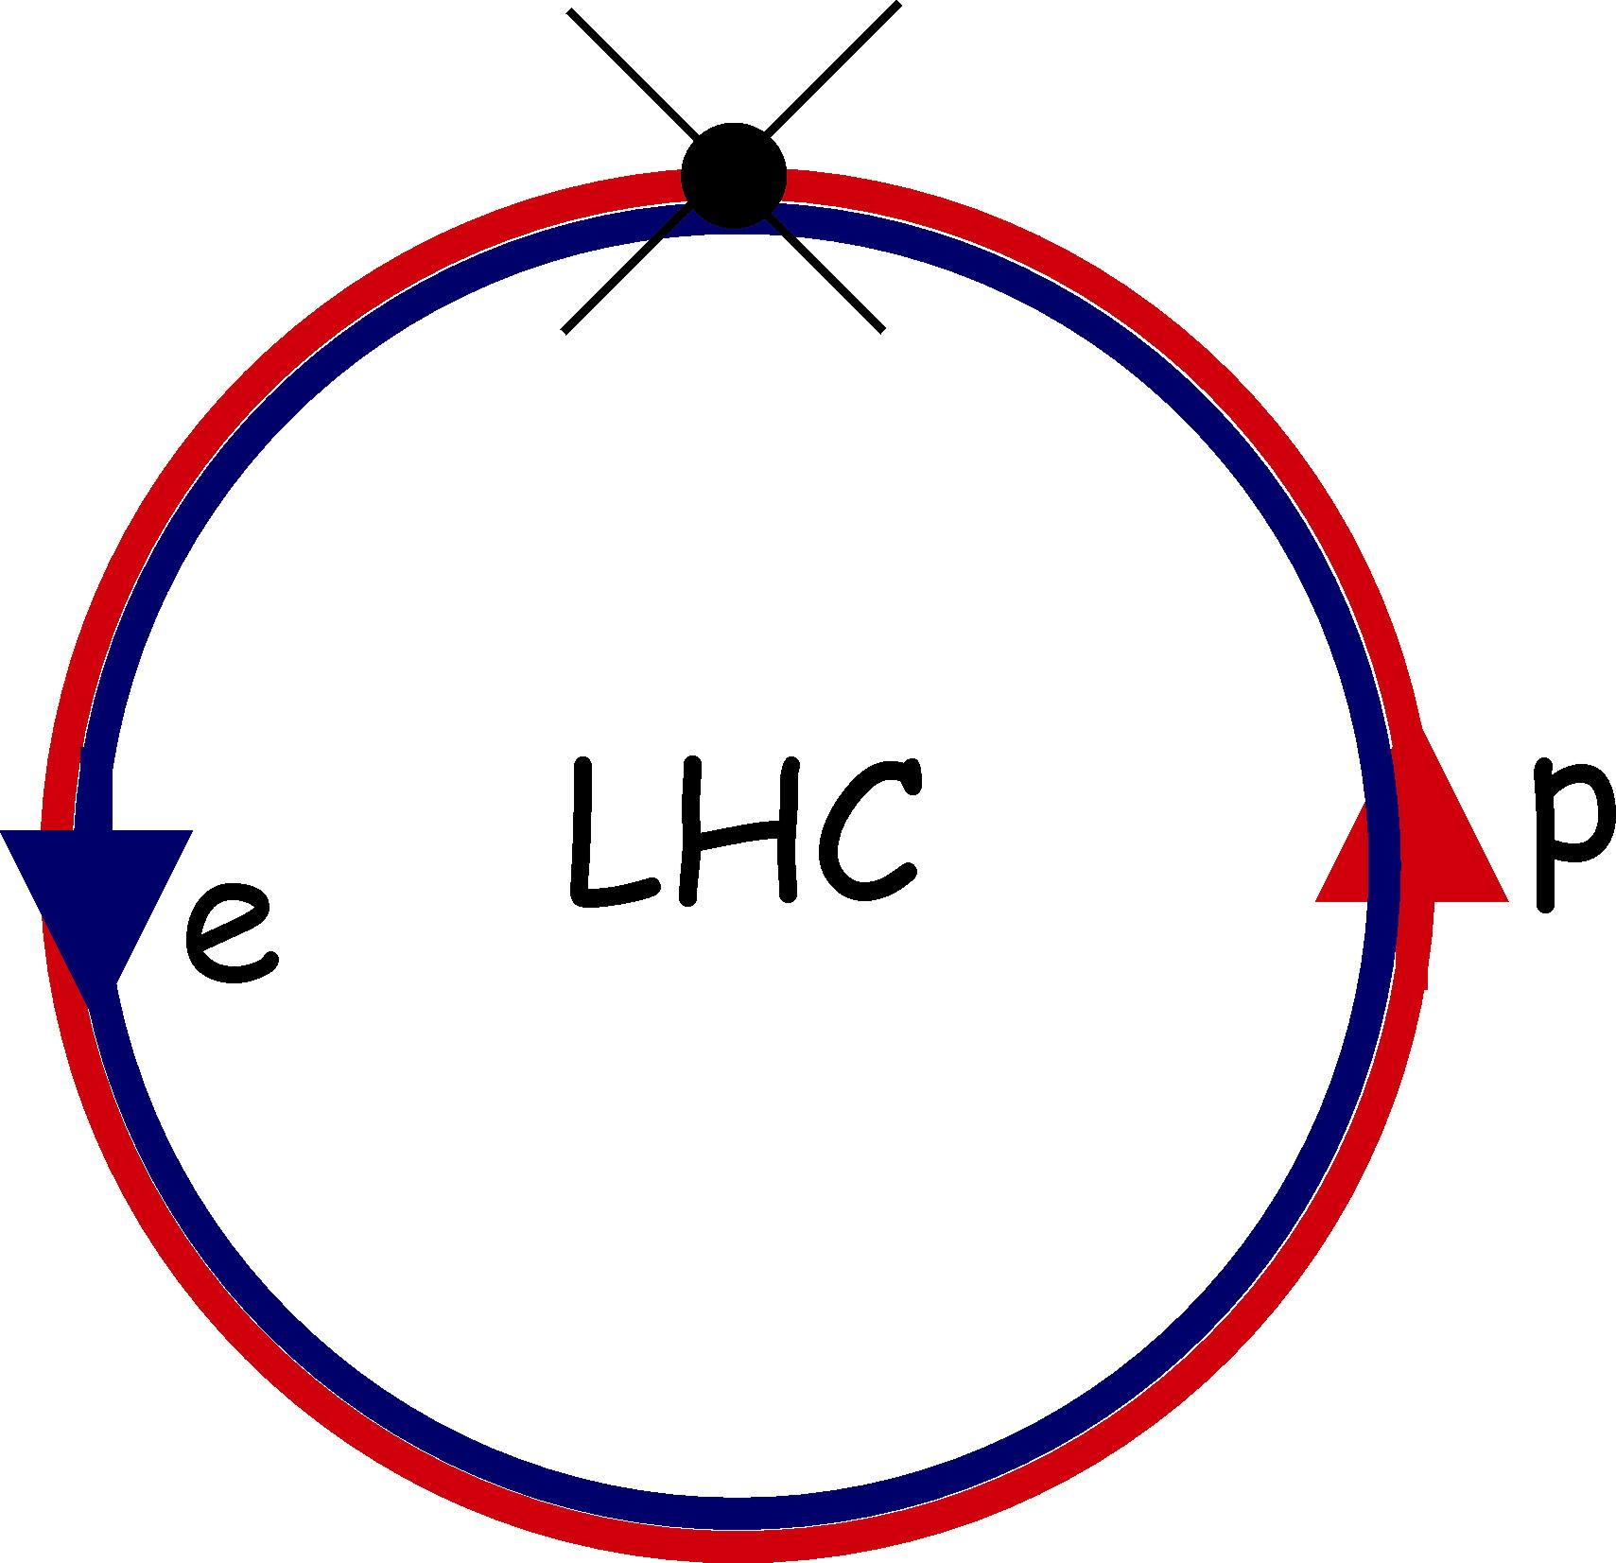
LHeC Accelerator Design (Daniel Schulte)
RING-RING
LINAC-RING
Baseline solutions exist in both versions

Slide 25
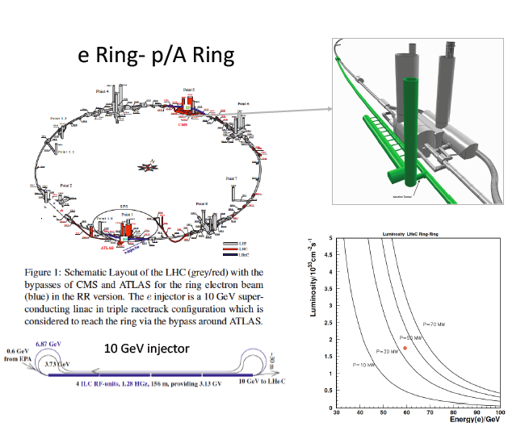
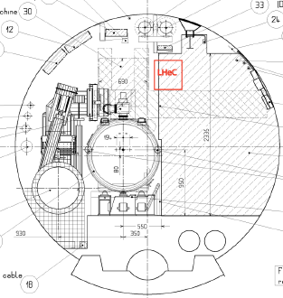

Slide 26
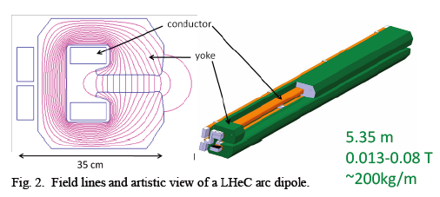
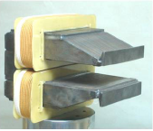
Magnets for Electron Ring
5m long x (35cm)² transverse, 0.013 – 0.08 T, ~ 200 kg / m
Prototypes
(Novisibirsk)
Electron ring solution maximises luminosity (~2x10⁻³³ cm⁻² s⁻¹)
(Serious?) disadvantage = interference with working LHC.
Long shutdown may be required
Linac solution avoids this (and offers valuable experience with
linacs / energy recovery …)

Slide 27
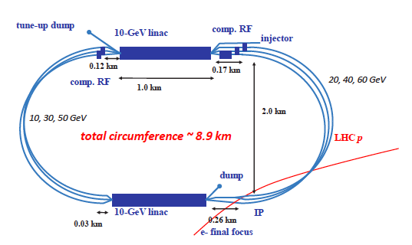
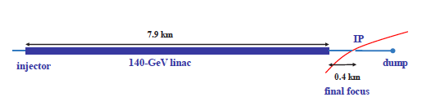
Accelerator Design in Linac-Ring Configuration
Baseline design:
500 MeV injection
Two 10 GeV linacs,
3 returns, 20 MV/m CW
Energy recovery in
same structures
More ambitious:
Pulsed single
140 GeV Linac
31.5 MV/m (ILC)

Slide 28
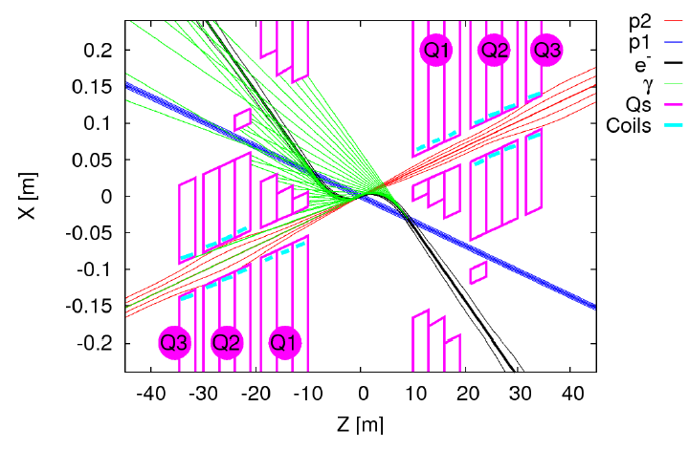
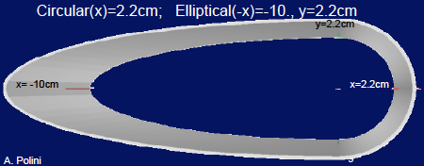
Interaction Region for LR (Rogelio Tomas)
[Spectator
Proton beam]
2 x 9m dipole magnets (0.3T)
through detector region bend
electrons into head-on collisions
Synchrotron fan can be absorbed, but
has implications for beampipe design

Slide 29
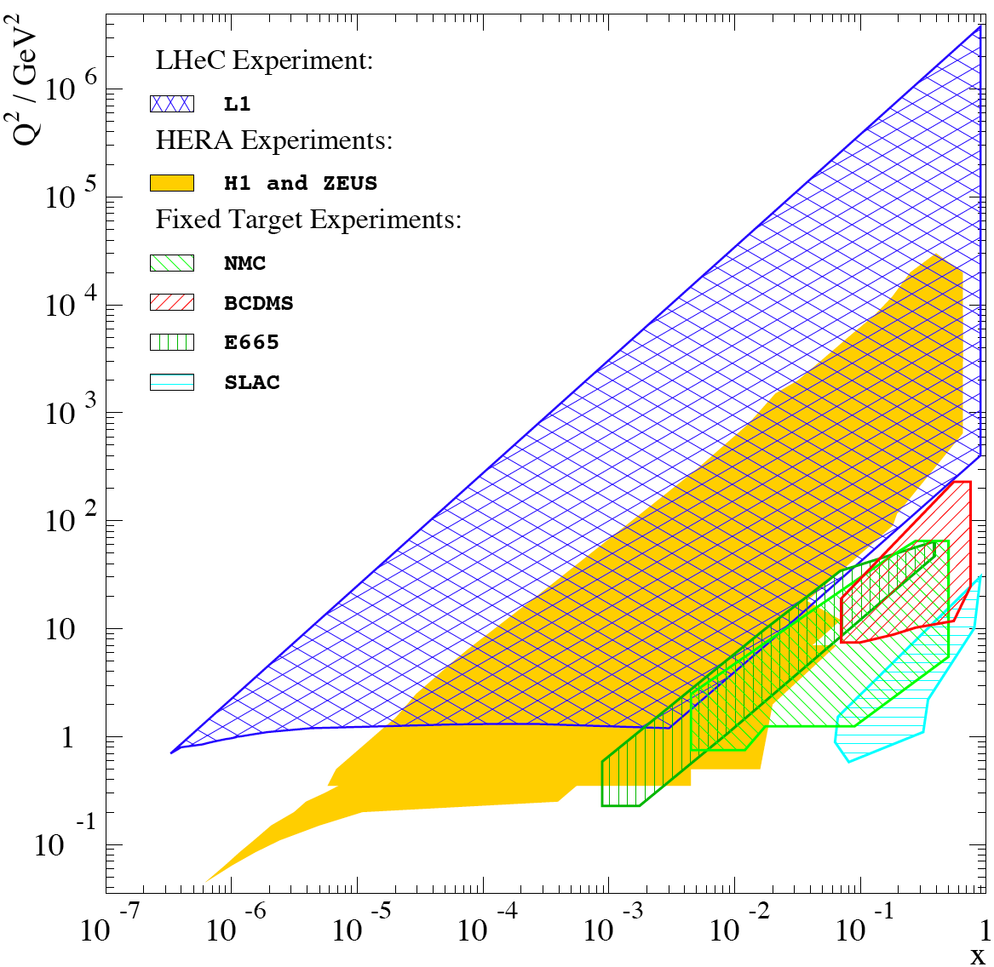
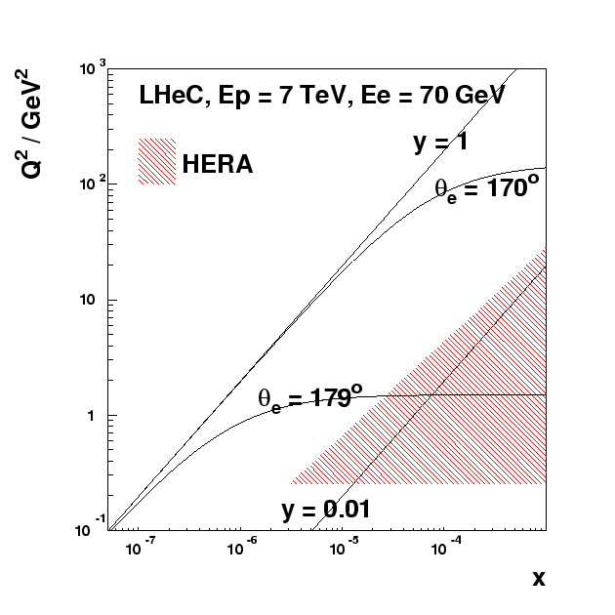
Detector Acceptance Requirements
Access to Q²=1 GeV² in ep mode for all x > 5 x 10⁻⁷ requires scattered
electron acceptance to 179º
Similarly, need 1º acceptance
in outgoing proton direction
to contain hadrons at high x
(essential for good kinematic
reconstruction)

Slide 30
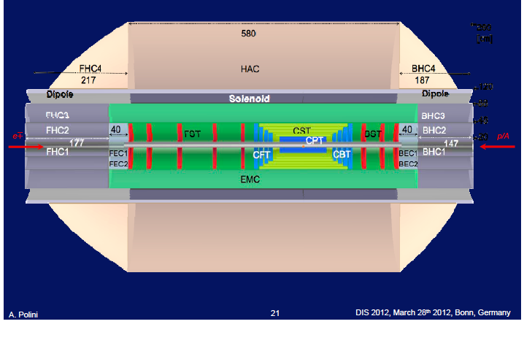
Central Detector (Alessandro Polini)
e
p
Forward/backward asymmetry in energy deposited and thus in geometry and technology
Present dimensions: LxD =14x9m² [CMS 21 x 15m² , ATLAS 45 x 25 m²]
Taggers at -62m (e),100m (γ,LR), -22.4m (γ,RR), +100m (n), +420m (p)

Slide 31
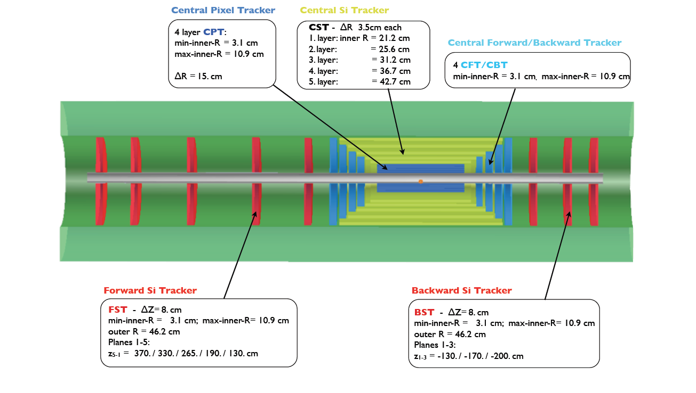
Tracking Region
Transverse momentum
Δp_{t}/p²_{t} → 6 10⁻⁴ GeV⁻¹
transverse
impact parameter
→ 10μm
[encased in
3.5T solenoid
field]
EM Calorimeter
Full angular coverage, long tracking region → 1º acceptance
Several technologies under discussion

Slide 32
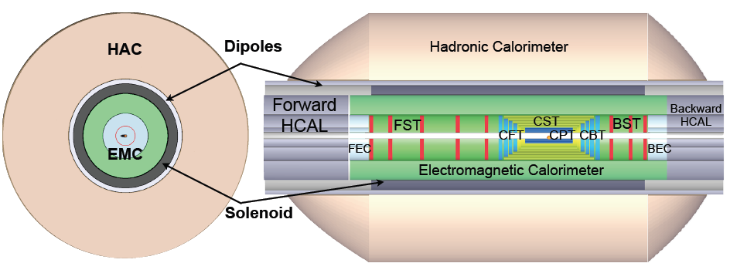
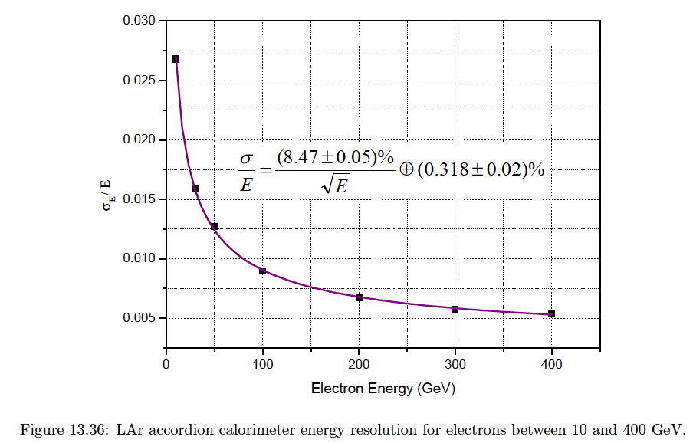
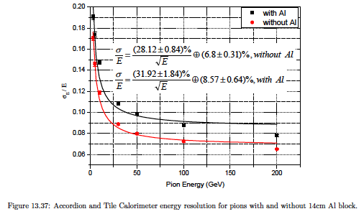
Calorimeters
Liquid Argon EM Calorimeter [accordion geometry, inside coil]
Barrel: Pb, 20 X₀ , 11m³ FEC: Si -W, 30 X₀ BEC: Si -Pb, 25 X
Hadronic Tile Calorimeter [modular, outside coil: flux return]

Slide 33
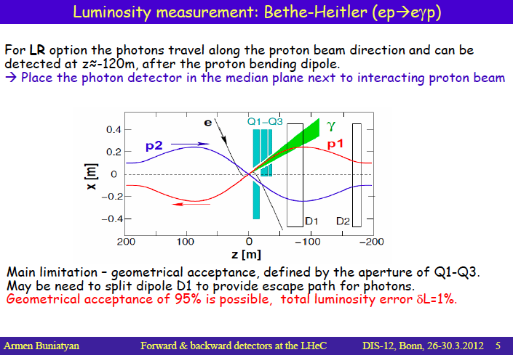
Fwd / Bwd Detectors (Armen Bunyatyan)
QED-Compton method and electron tagging also considered

Slide 34
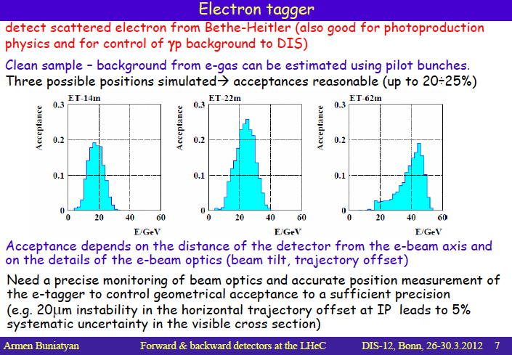

Slide 35
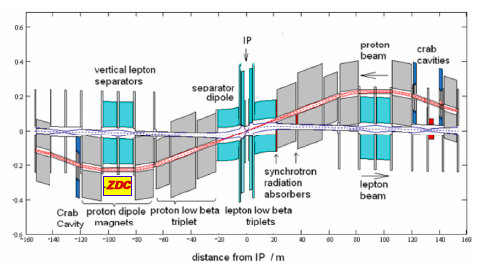
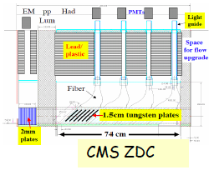
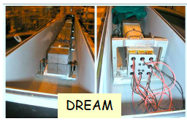
Forward Neutron Calorimeter
ZDC can be similar to LHC experiments
(or can steal the DREAM prototype)

Slide 36
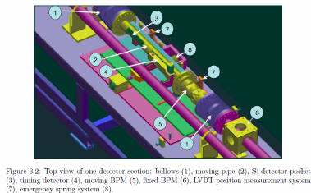

Forward Proton Detection
Can also rely on work for
existing LHC experiments
(FP420, ATLAS AFP)
ATLAS
AFP

Slide 37


Physics Programme
Breaking News: LHC is the discovery machine at the energy
frontier for the foreseeable future.
LHeC may compete with LHC in cases where initial state
lepton is an advantage and offers cleaner final states
~
e
e
χ⁰
~
q
q
LHeC enhances LHC discovery potential by clarifying signals
→ Quantum Number Determinations
→ Reducing uncertainties due to PDFs / QCD modelling
Unique sensitivity to novel low x effects, partonic structure of
hadrons: unprecedented breadth and precision in QCD studies

Slide 38



Anomalous Higgs Couplings (Rohini Godbole)
Clean signal to identify Higgs production via WW fusion (and decay to b-bbar) H + j + E_{t}^{miss}
~ 100 events / year after cuts (S/B = 1.8)
e.g. Search for
anomalous CP
structure of HWW
vertex using Δφ
between jet / Etmiss
(c.f. Zeppenfeld et al
for VBF Higgs at LHC)

Slide 39

QCD and Electroweak Physics (Olaf Behnke)

Slide 40



LHeC Impact on Parton Densities
Full simulation of inclusive NC
and CC DIS data, including
systematics → NLO DGLAP fit
using HERA technology…
… typically expect 100 times HERA
Event yields in DIS region, with
extended kinematic range
… big impact at low x (kinematic
range) and high x (luminosity)
… precise light quark vector,
axial couplings, weak mixing angle
… full flavour decomposition
Gluon
Sea
d valence

Slide 41


Slide 42


Cross Sections and Rates for Heavy Flavours
HERA 27.5 x 920
Charm
Beauty
cc
sW → c
bW → t
ttbar
[10¹⁰ / 10 fb⁻¹]
[10⁸ / 10 fb⁻¹]
[4.10⁵ / 10 fb⁻¹]
[10⁵ / 10 fb⁻¹]
[10³ / 10 fb⁻¹]
c.f. luminosity of ~10 fb⁻¹ per year …

Slide 43




Low-x Physics / Parton Saturation
(Nestor Armesto and Anna Stasto)
Most people agree that somewhere & somehow, the low x growth of parton
densities must be tamed by
non-linear effects (`Saturation’).
Can it be understood microscopically?
2 pronged approach at LHeC …

Slide 44
Can Parton Saturation be Established in ep @ LHeC?
Simulated LHeC data based on a dipole model containing low x saturation (FS04-sat)… Fit with standard (NNPDF) NLO DGLAP
… NNPDF (also HERA framework) DGLAP QCD fits cannot accommodate saturation effects if F₂ and F_{L} both fitted
Conclusion: clearly establishing non-linear effects needs a
minimum of 2 observables … (F₂^{c} may work in place of F_{L})…

Slide 45



Exclusive / Diffractive Channels and Saturation
[Low-Nussinov] interpretation as 2 gluon exchange enhances sensitivity to low x gluon
Additional variable t gives access to impact parameter (b) dependent amplitudes
→ Large t (small b) probes densest
packed part of proton?

Slide 46

Simulation of J/ψ Photoproduction

Slide 47







What is Initial State of LHC AA Collisions?
Gluons from saturated nuclei → Glasma? → QGP → Reconfinement
R_{i} = Nuclear PDF i / (A * proton PDF i)

Slide 48

Nuclear PDFs (Carlos Salgado)

Slide 49

Nuclear PDFs
Fixed target pA and RHIC dAu data already play a role in
nuclear PDF determinations.
pA at LHC will
give new
constraints
at low x
… implementation
of observables in
fitting code non-trivial and uncertainties often large
No substitute for low x DIS data

Slide 50


Study of Impact of e-Pb LHC data
LHeC ePb F₂ measurement
has huge impact relative to
current uncertainties
Striking effect on quark
sea and gluons in particular
High x gluon uncertainty
remains large

Slide 51
LHeC Physics Studies I didn’t cover
eD scattering
α_{s} determination and sin² θ_{W} determinations
Beauty and charm (high Q², low x, intrinsic …)
s-sbar from charm in charged current
Jet production in DIS (with E_{T} up to 500 GeV)
Jet photoproduction in ep and eA
Forward jets, azimuthal decorrelation between jets
F_{L} in eA
Inclusive diffraction in ep and eA
Diffractive jet production
DVCS
Vector mesons in eA
Odderon searches
Total photoproduction cross section
Connections to ultra-high energy neutrinos
Forward π⁰ production
Medium-induced soft gluon radiation

Slide 52

Schedule and Remarks
Aim to start operation by 2023 [high lumi phase of LHC]
The major accelerator and detector technologies exist
Cost is modest in major HEP project terms
Steps: Conceptual Design Report, 2012
Evaluation within CERN / European PP/NP strategy
Move towards a TDR 2013/14

Slide 53
Closing (Personal) Remarks
LHeC and EIC are not in competition (largely different
physics, funding streams, communities). Mutual learning curves.
2) Strong interactions, QCD, low x physics, proton and nuclear
structure and spin are fundamentally important topics, contain
much to be discovered and new projects should be worthy of
funding on breadth and precision alone
3) The LHC is a milestone in our field. It is entirely reasonable to
ask what else it can do beyond pp and AA
4) We have an opportunity in around 10 years … not very long! –
Serious detector R&D etc needs to start now!

Slide 54
Big Thanks to all speakers in our sessions…
Apologies if time (or incompetence) prevented us from
doing justice to your work in the summary
Claudia Gemme
Thomas Peltzmann
Renaud le Gac
Joel Mousseau
Jorge Morfin
Markus Diefenthaler
Gerhard Mallot
Feng Yuan
Tom Burton
Salvatore Fazio
Dieter Mueller
Marco Stratmann
Benedikt Zihlmann
Keith Griffioen
Kalyan Allada
Kieran Boyle
Ed Nissen
Vadim Ptitsyn
Cynthia Keppel
Matthew Lamont
Armen Bunyatyan
Alessandro Polini
Rogelio Tomas
Klaus Dehmelt
Alexander Bazilevsky
Rohini Godbole
Hubert Spiesberger
Hao Ma
Carlos Salgado
Nestor Armesto
JH Lee
Daniel Schulte
Olaf Behnke
Anna Stasto

