Slide 1
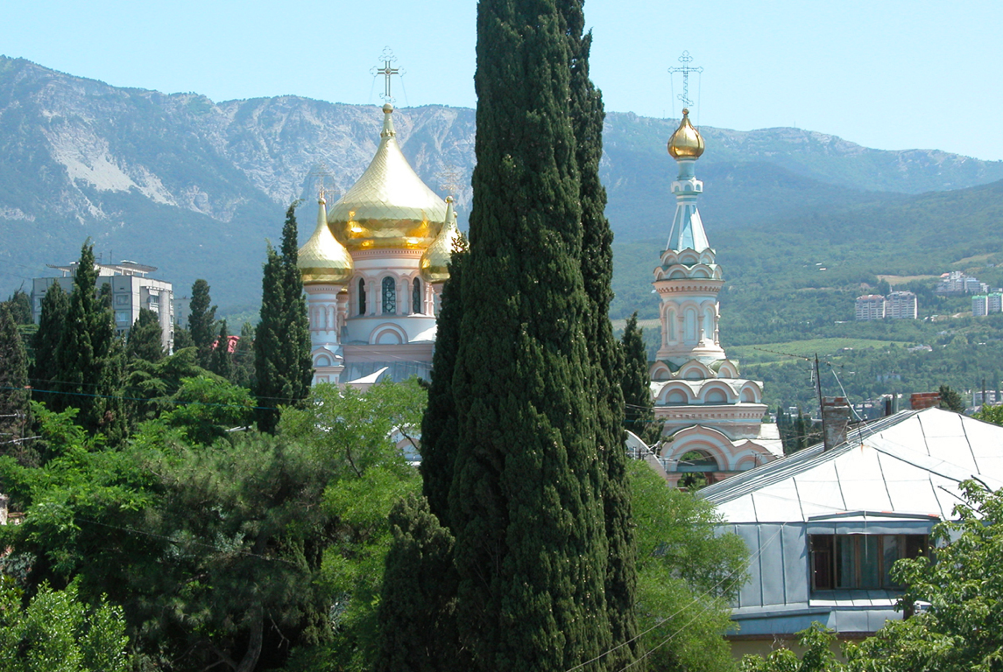
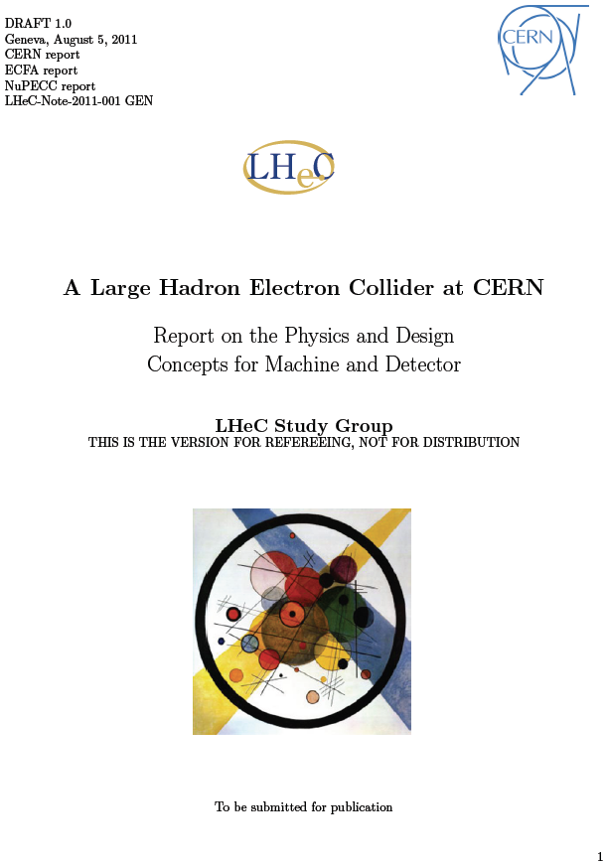


On the Project
http://cern.ch/lhec
P. Kostka - for the LHeC Study Group
NEW TRENDS IN HIGH-ENERGY PHYSICS
(experiment, phenomenology, theory)
Alushta, Crimea, Ukraine, September 3 - 10, 2011
The project is intended to becomes part of European
deliberation of future directions of particle physics.
It must be seen in the context of the LHC and the results there;
it will substantially enrich and extend its physics program
and further exploits the investment made in the LHC
1

Slide 2

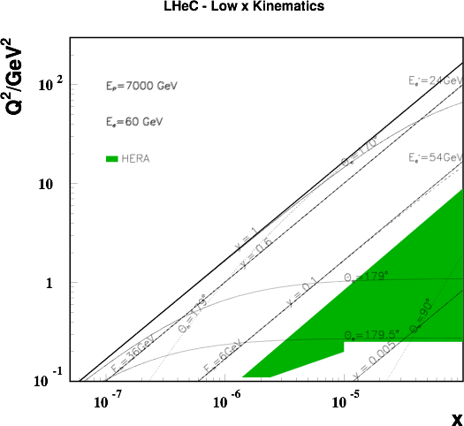
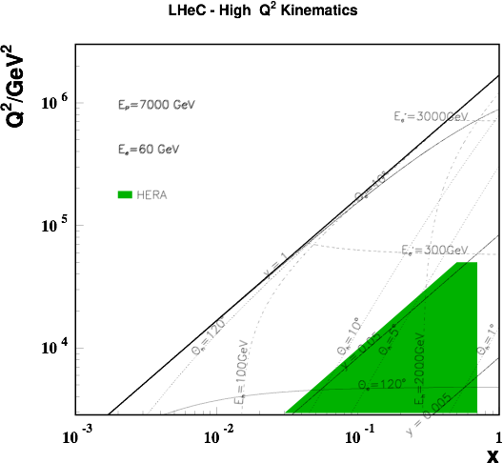
New Terascale Facility
Electrons of 60-140 GeV collide with LHC protons of 7000 GeV
ep design L≈10³³ cm⁻²s⁻¹ with Ecms in the range of 1-2 TeV
- exceeding the integrated luminosity at HERA by
2 orders of magnitude and the kinematic range by a factor of 20 in (Q²; x⁻¹)
Q² = 4momentum transfer² x = Bjorken x: fraction of p’s momentum

Slide 3
Exciting Physics Program
Electrons of 60-140 GeV collide with LHC protons of 7000 GeV
ep design L≈10³³ cm⁻²s⁻¹ with Ecms in the range of 1-2 TeV
- exceeding the integrated luminosity at HERA by
2 orders of magnitude and the kinematic range by a factor of 20 in (Q²; x⁻¹)
Selected Highlights
Physics complementing the LHC
High precision deep inelastic scattering (DIS)
Address important questions in strong and
electroweak interactions
Includes electron-ion (eA) scattering into a (Q²; x⁻¹)
4 orders of magnitude extended compared to
previous lepton-nucleus DIS experiments.
αs measured to per mille
→ Grand unification of the couplings
Complete unfolding of proton structure
→ Maximise the potential of LHC
Saturation at low x
→ Study in pQCD regime
eA - nuclear structure functions
→ Complementary to e.g. EIC
Heavy flavour factory, precision tests of the treatment of mass in pQCD
→ Understand the fits
Leptoquarks, excited electrons, Higgs
→ Complementary to LHC searches

Slide 4
Deep Inelastic e/μ p Scattering
Physics
eQ states
GUT (δα_{s}=0.1%)
Excited fermions
Hot/cold spots
Single top Higgs
PDFs
Multi-Jets
DVCS
Unintegrated partons
Saturation
Vector Mesons
IP - graviton
Odderons
NC couplings
sin²Θ
Beauty
Charm
Partons in nuclei
Shadowing
….
Q² = 4momentum transfer² x = Bjorken x: fraction of p’s momentum

Slide 5
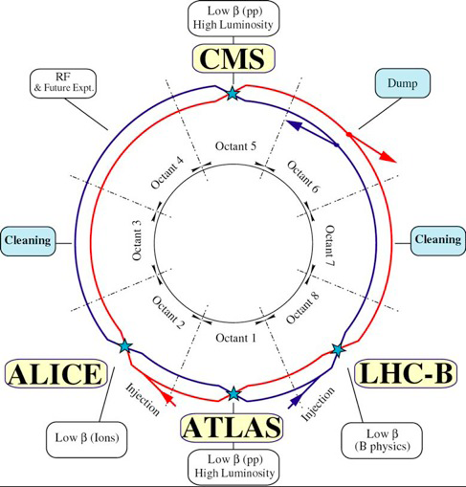
LH C
Accelerator Concept(s)
e
Assuming that ep collisions
take place at point IP2
which currently houses the
ALICE experiment
IP2
Add e∓ (polarised) on genuine p/A beams and running simultaneously with LHC program
Ring-Ring (RR)
First considered 1984: LEP x LHC
Difficulties:building e ring into LHC tunnel,synchrotron radiation andlimitations of energy
Linac-Ring (LR)
THera (DESY)
low interference with LHC,higher electron energy,
lower lumi at reasonable power
5

Slide 6
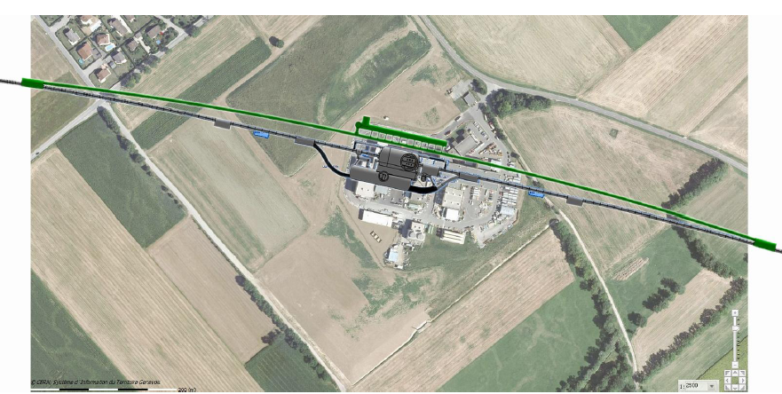
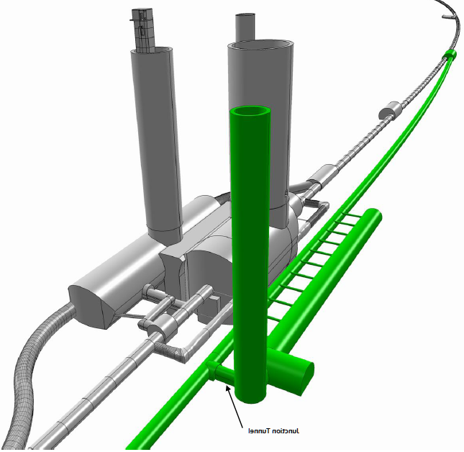
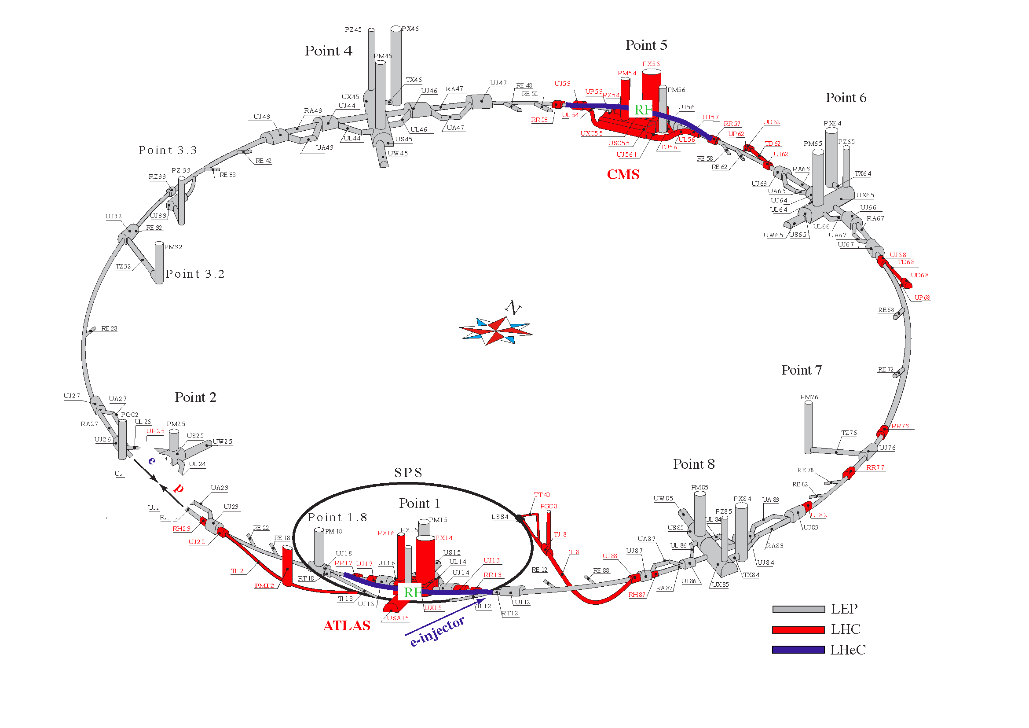
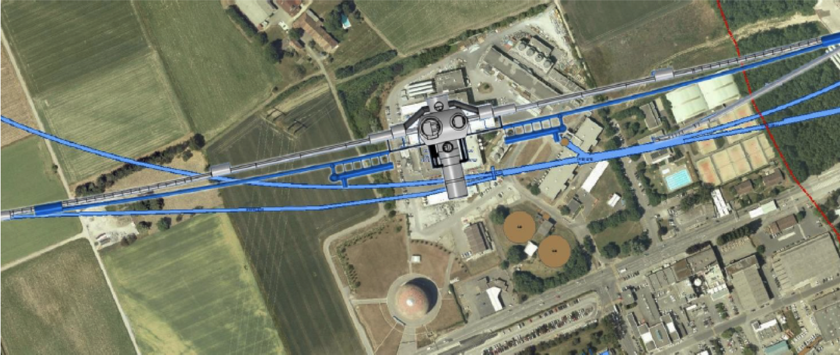
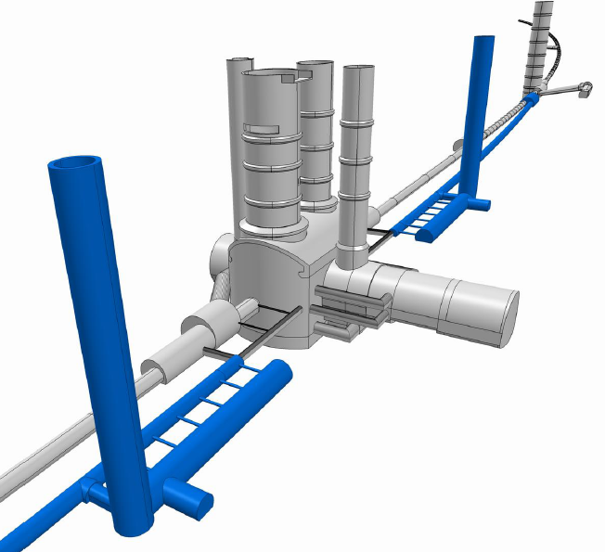
The LHeC Ring-Ring
Challenge: Bypassing the main LHC detectors
Bypassing CMS: 20m distance to Cavern
Challenging: bypassing the main LHC Detectors
For the CDR the bypass concepts were decided to be confined to ATLAS and CMS.
LHCb bypass may be similar
IP2
e-injector is a 10 GeV sc linac
in triple racetrack configuration
Bypassing ATLAS: 100m wo survey gallery
6

Slide 7
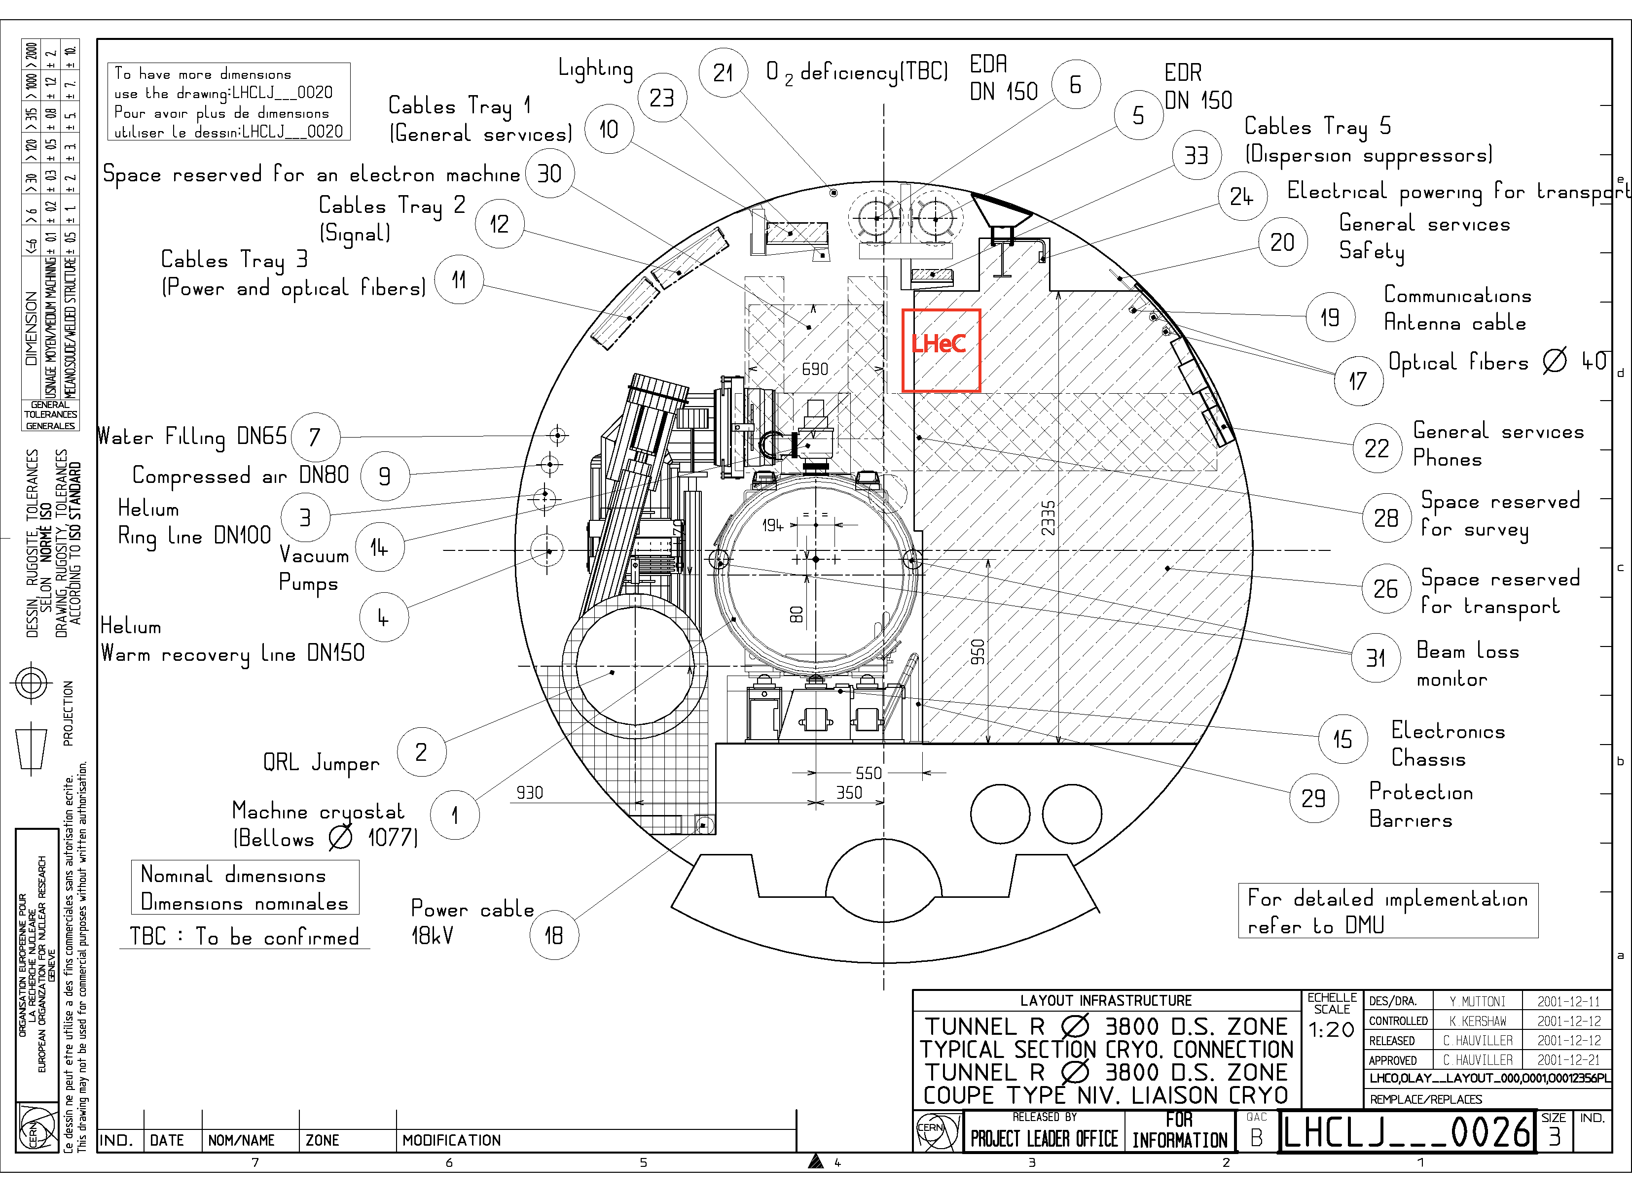
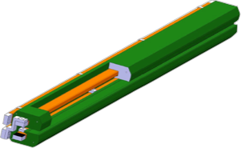
The LHeC Ring-Ring
Challenging: Installation with LHC circumference
requires:
support structure
with
efficient installation
and
compact magnets
(Novosibirsk,
CERN
dipole-prototypes)
LHeC Ring Dipole Magnet
.12-.8T
1.3kA
0.8MW
LHeC Ring Dipole Magnet
.12-.8T
1.3kA
0.8MW
5m long
(35cm)²
slim + light
for installation

Slide 8
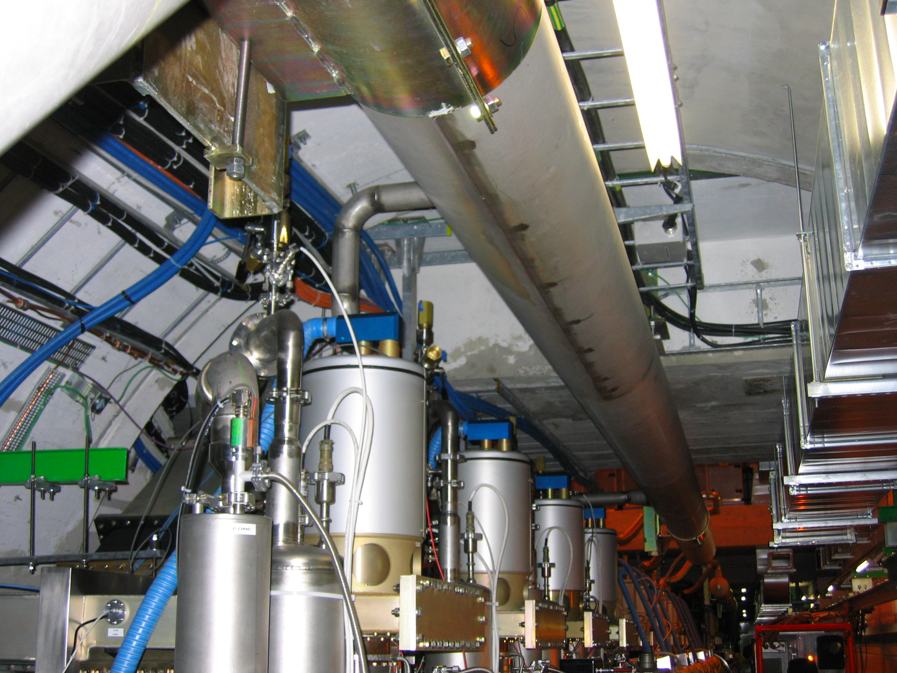
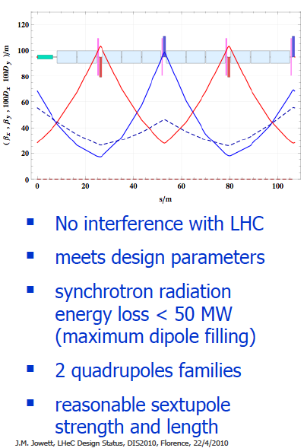
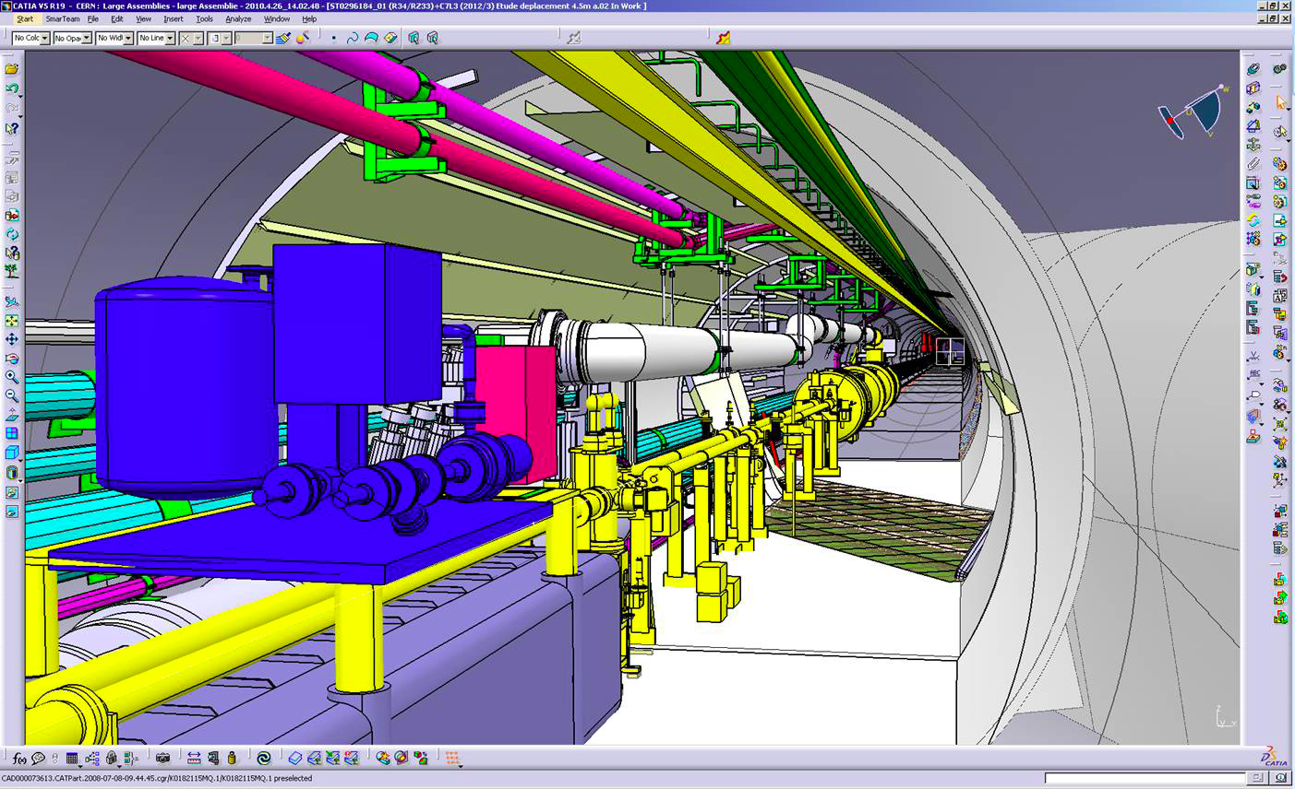
The LHeC Ring-Ring
RF Installation in IR4
Integration in the LHC tunnel
Arc Cell Design – Double FODO
Cryo link in IR3
IP2
Maximum energy with the Ring-Ring arrangement could reach about 120 GeV
however, many parameters to be extreme
rf power and synchrotron radiation effects increase

Slide 9
The LHeC Linac-Ring
LR LHeC:
recirculating*
linac with
e∓ energy
recovery,
or straight
linac
IP2
^{*)} bypassing own IP

Slide 10
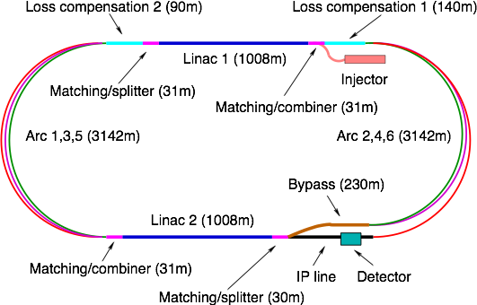

Baseline Linac-Ring Option
Super Conducting Linac with Energy Recovery & high current (> 6mA)
10 GeV
Two 1 km long sc Linacs (10GeV)
in cw operation (Q ≈ 1010)
10, 30, 50 GeV
10 GeV
Relatively large return arcs
ca. 9 km underground tunnel installation
total of 19 km bending arcs
same magnet design as for RR option: > 4500 magnets
EPS-HEP, 23 July 2011, Grenoble
Oliver Brüning CERN

Slide 11
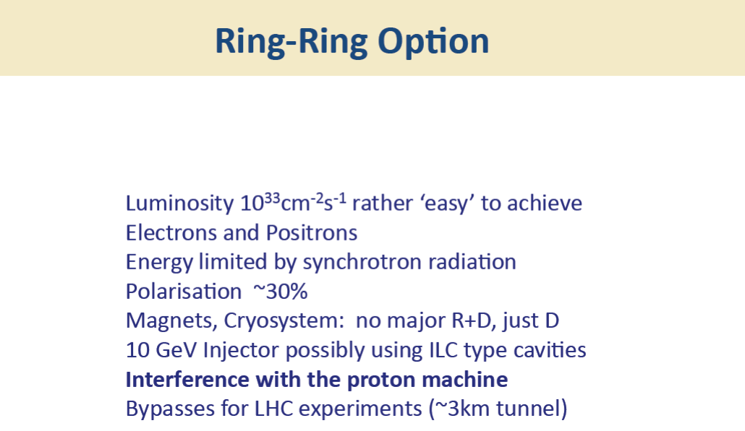
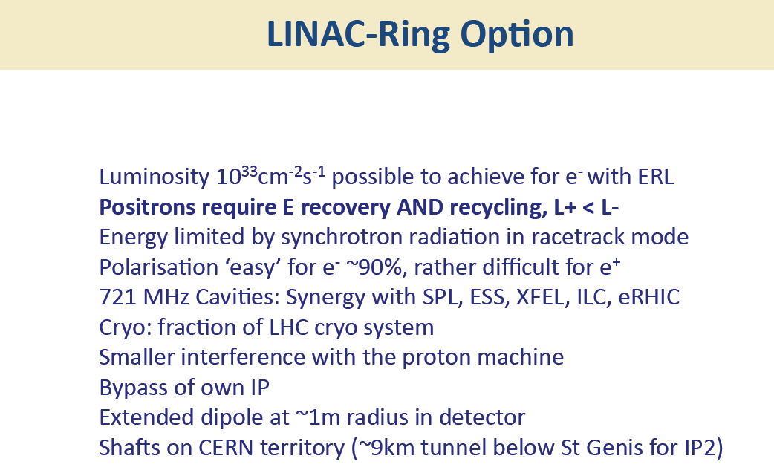
RR: electrons beam circulates
in the existing LHC tunnel
LR: less invasive with respect
to the existing LHC,
needs the construction of a
new linear accelerator complex
DIS 2011, Max Klein, Liverpool

Slide 12
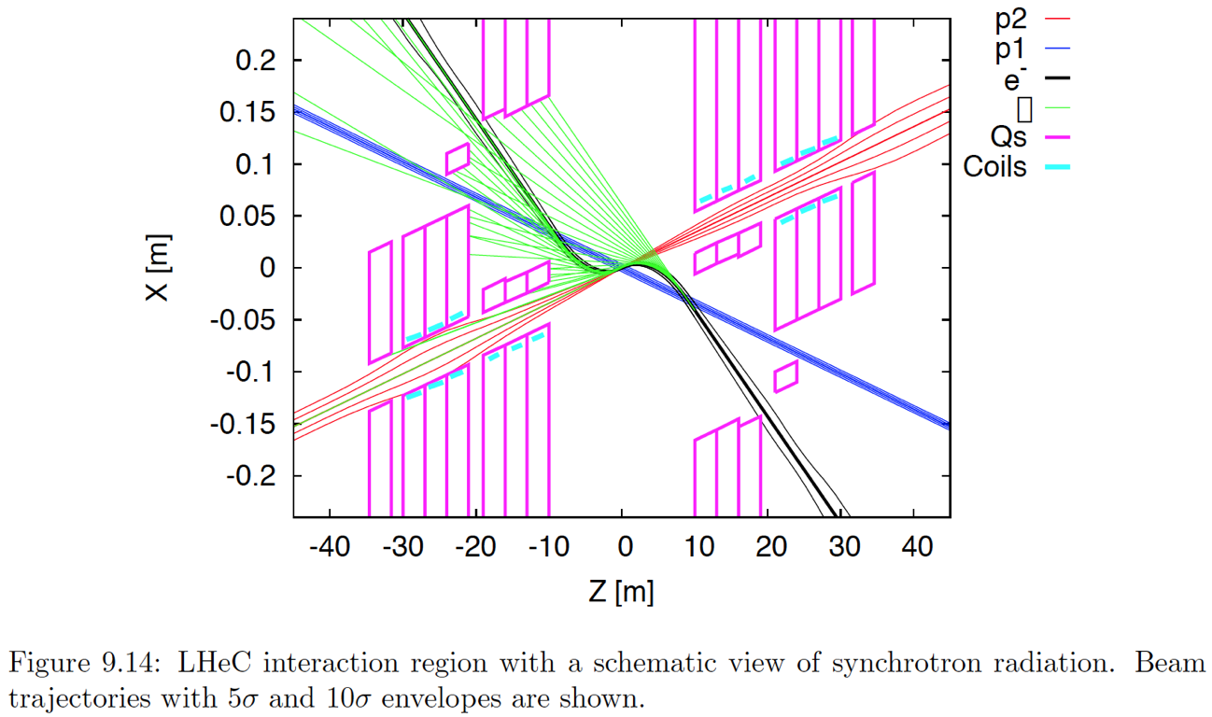
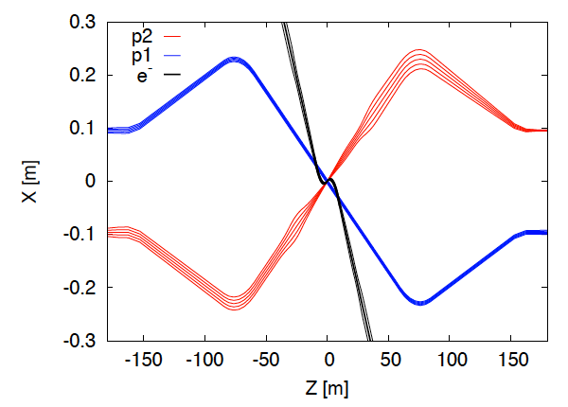
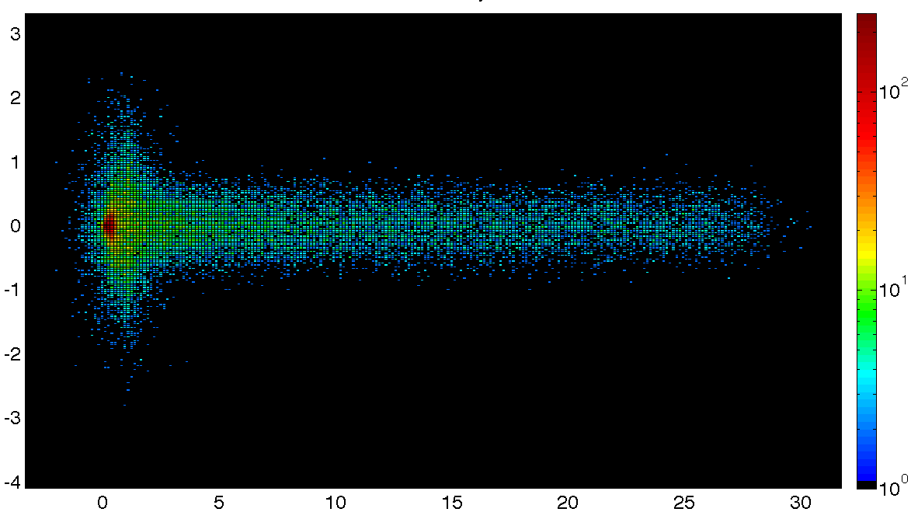
LR Interaction Region
Special attention is devoted to the interaction region design, which comprises beam bending,
direct and secondary synchrotron radiation, vacuum and beam pipe demands.
3 beams, head‐on collisions
SR
p-beam 2
p-beam 1
Photon Number Density at the IP
e-beam
y [mm]
x [mm]
Dipoles around the IP (2 x 9m, 0.3T)
make electrons collide head-on with p-beam 2 & safely extract the disrupted electron beam.
Simulation of SR load in the IR and design of absorbers / masks
shielding SR from backscattering into the detector & from propagating with e± beam.
Beam pipe design - space for SR fan - tracking/calorimetry close to the IP / beam line (goal: 1°-179°)

Slide 13
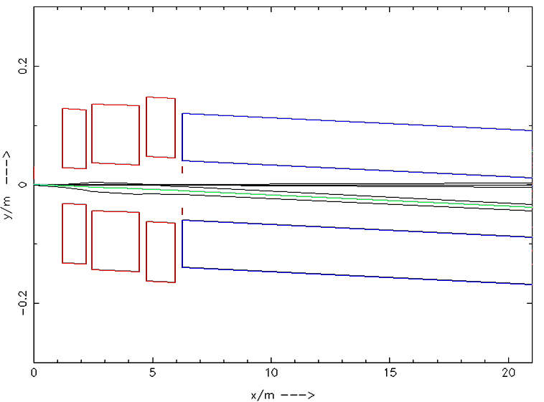
RR Beam Optics and Detector Acceptance
  High Acceptance
  first e beam magnet placed at z= ±6.2m
  L ~ 7.3 x 10³² cm⁻² s⁻¹ (1° < θ < 179°)
  L ~ 1.3 x 10³³ cm⁻² s⁻¹ (10° < θ < 170°)
  High Luminosity
  Low β* magnets near the IP (HERA2) (at z= ±1.2m)
  Detector flexible accommodating both HA / HL
  (forward / backward tracker & calorimeter end-caps)
  RR: 1mrad crossing angle (25ns bunch spacing; avoiding parasitic interactions);
  LR: head on (but dipoles for beam separation over full detector length + beyond)
  Consequences on detector design:
  RR Lower Lumi, Low Q² access → High Acceptance detector 1° - 179°
  RR Higher Lumi, High Q² access → High Luminosity detector 10° - 170° aperture
10⁰
1⁰
  ↕ factor ~ 2 only
IP

Slide 14
The LHeC Detector Concept(s)
  High Precision
  resolution, calibration, low noise at low y, tagging of b,c;
  based on the recent detector developments, using settled technology, avoiding R&D programs.
  Modular and flexible - accommodating the HA/HL physics programs (RR);
  High modularity - “fast” detector construction above ground; access.
  Small radius and thin beam pipe optimized in view of aperture
  (1-179º acceptance for low Q², high x access),
  synchrotron radiation and background production.
  Affordable - comparatively reasonable cost.

Slide 15
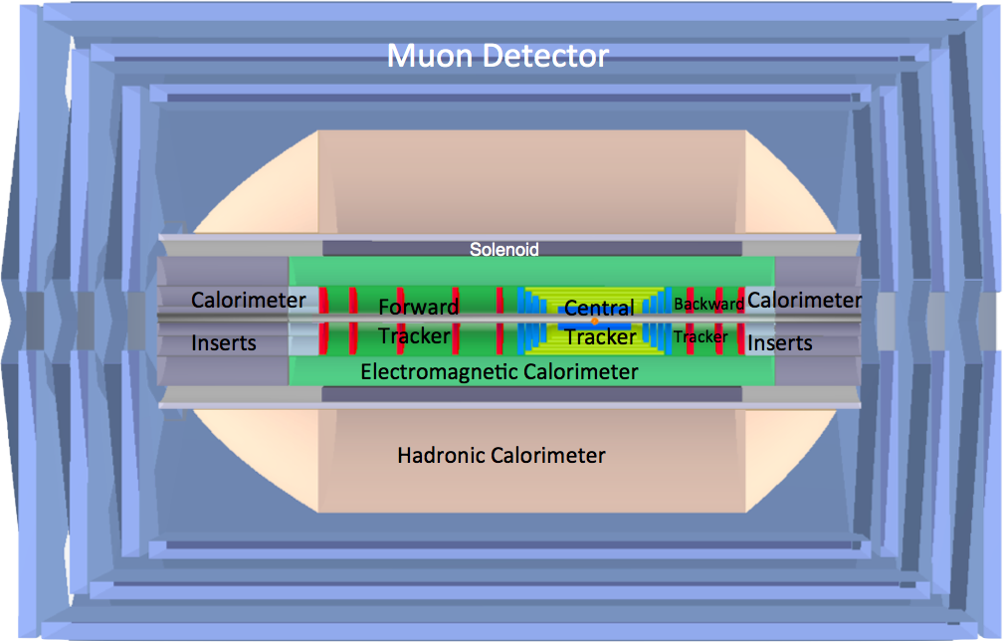
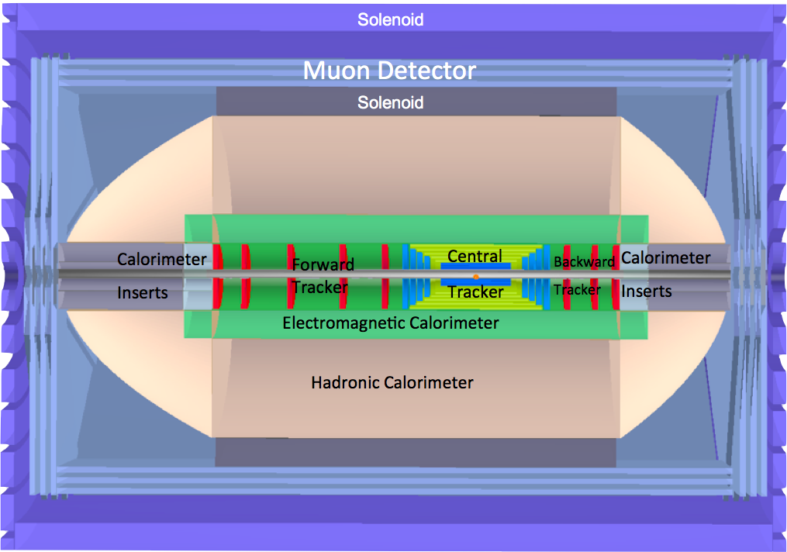
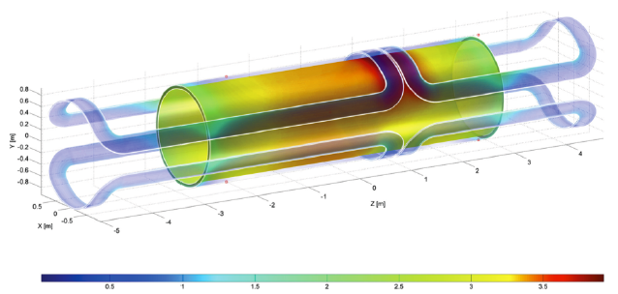
Detector Options - 1
dipole
dipole
e∓
p/A
p/A
LR detector in the r-z plane
dipole (radius ~0.6m, 0.3T) and solenoid (3.5T) placement
between the electromagnetic and the hadronic calorimeters.
The IP is surrounded by a central tracker system,
large forward and backward tracker telescopes
and sets of calorimeters.
Detector dimensions z≈14m, diameter ∅≈9m.
RR option only (no dipole) - High Acceptance
Option studied also where the larger solenoid surrounds the hadronic calorimetry.
Magnetic field outside the solenoid (3.5T) is ≈1.5T;
Volume instrumented with 3 multilayers of muon chambers.
The overall dimensions of this detector configuration are about 11m length and 8m diameter.
dipole layout

Slide 16
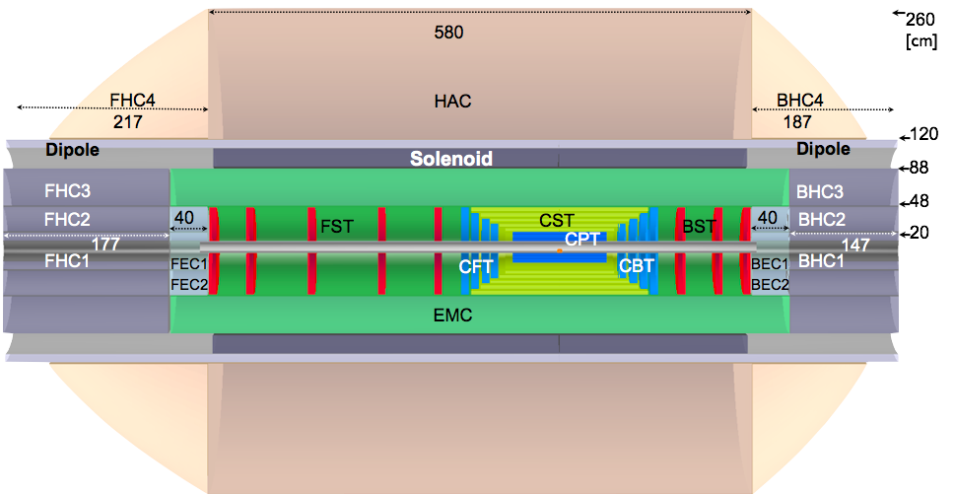
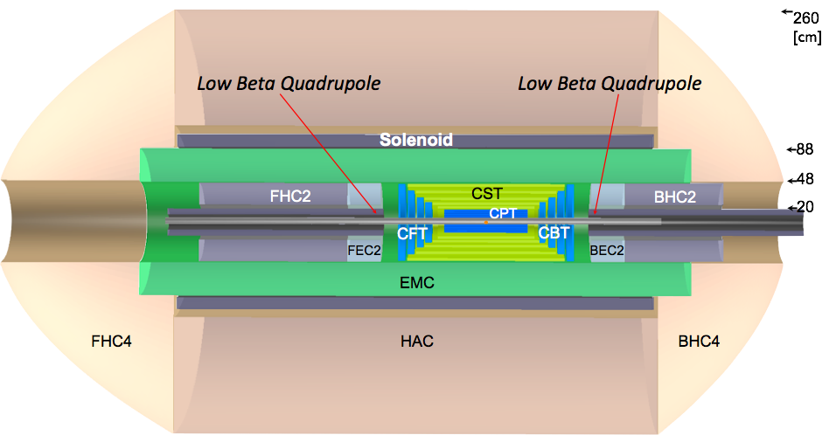

Detector Options - 2
e∓
p/A
p/A
The baseline configuration (LR case).
Central barrel:
silicon pixel detector (CPT)
silicon tracking detectors (CST,CFT/CBT)
electromagnetic calorimeter (EMC)
surrounded by the magnets (Solenoid, Dipoles)
hadronic calorimeter (HAC)
Backward silicon tracker (BST) energy measured in the BEC and BHC calorimeters
Forward silicon tracking (FST)
and calorimetry (FEC, FHC) measuring TeV energy final states
Main detector for the RR
- luminosity maximised by low β quadrupole magnets
The forward/backward tracking has been removed and the outer calorimeter inserts have been moved nearer to the interaction point.
Detector design
- follow BP shape (CPT/CST shown)
For numeric studies and plots see recent talks at DIS10, DIS11, ICHEP10,
EPS11, IPAC11, … EIC and LHeC Workshopsat http://cern.ch/lhec
of course: CDR to be published (more then 500 pages yet)
Linac-Ring - beam pipe
inner-Rcirc=2.2cm
inner-Relliptical=10.cm

Slide 17
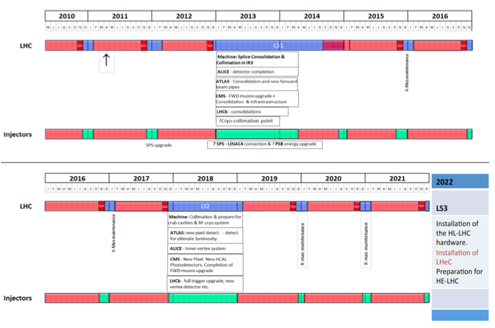
Not yet approved!

Slide 18
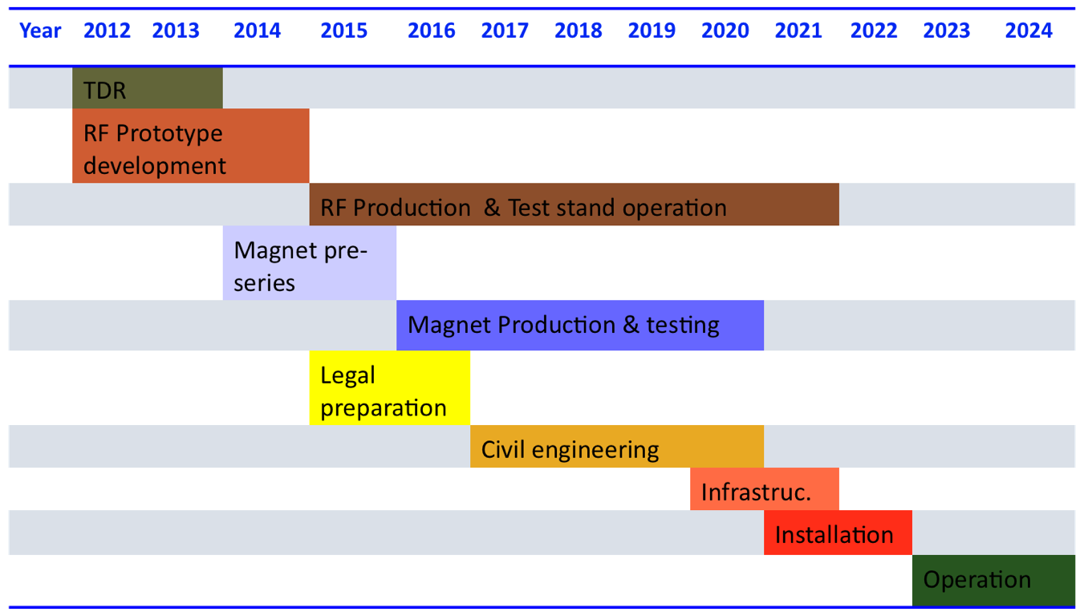
LHeC Tentative Time Schedule
Machine only
HL LHC

Slide 19
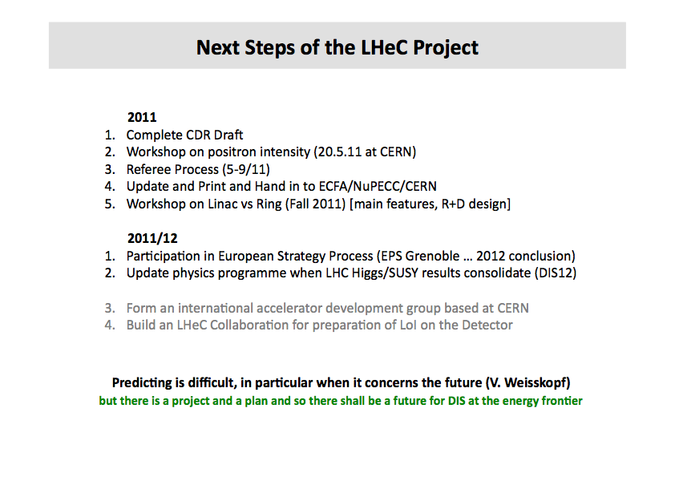
√
√
(8-11/11)
DIS 2011, Max Klein, Liverpool

Slide 20
Conclusions
  Both machine variants RR/LR could be realised in time for the
  HL LHC running (~2023)
  - some R&D / prototyping necessary (LR mostly);
  - synergies with other projects
  The detector ensuring the physics program
  - high precision; first simulations promising
  - flexible/modular
  - using available technology
  New and exciting physics of DIS in at CERN
  Thanks to my colleagues from whom I have taken slides/details
  and with whom I’m enjoying the LHeC adventure
  … the LHeC is already half built (J.Engelen)

Slide 21
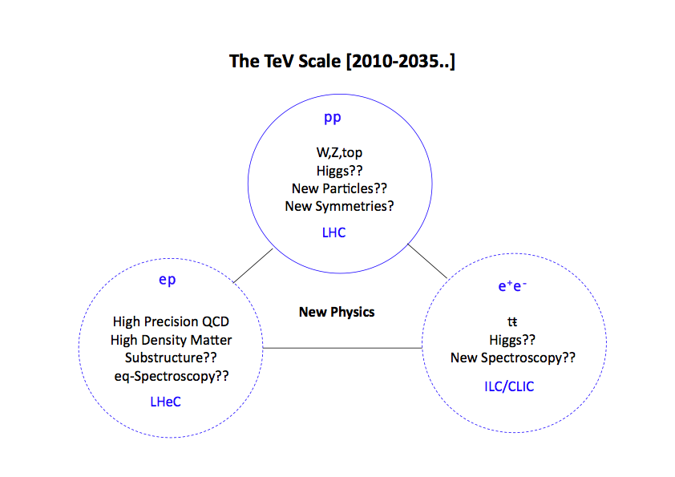
Fruitfully Collider Triumvirate at Terascale
Max Klein, Liverpool
It should be used

Slide 22
Backup Slides

Slide 23
CDR Authorlist 5th August 2011
C. Adolphsen (SLAC)
Alekhin (Serpukhov, DESY)
A.N.Akai (Ankara)
H. Aksakal (CERN)
P. Allport (Liverpool)
J.L. Albacete (IPhT Saclay)
V. Andreev (LPI Moscow)
R. Appleby (Cockcroft)
N. Armesto (St. de Compostela)
G. Azuelos (Montreal)
M. Bai (BNL)
D. Barber (DESY)
J. Bartels (Hamburg)
J. Behr (DESY)
O. Behnke (DESY)
S. Belyaev (CERN)
I. Ben Zvi (BNL)
N. Bernard (UCLA)
Bertolucci (CERN)
S. Biswal (Orissa)
S. Bettoni (CERN)
J. Bluemlein (DESY)
Boettcher (DESY)
H. Braun (PSI)
S. Brodsky (SLAC)
A. Bogacz (Jlab)
C. Bracco (CERN)
Bruening (CERN)
E. Bulyak (Charkov)
A. Bunyatian (DESY)
Burkhardt (CERN)
I.T. Cakir (Ankara)
O. Cakir (Ankara)
R. Calaga (BNL)
E. Ciapala (CERN)
R. Ciftci (Ankara)
A.K.Ciftci (Ankara)
B.A. Cole (Columbia)
J.C. Collins (Penn State)
J. Dainton (Liverpool)
A. De Roeck (CERN)
D. d'Enterria (CERN)
A. Dudarev (CERN)
A. Eide (NTNU)
E. Eroglu (Uludag)
K.J. Eskola (Jyvaskyla)
L. Favart (IIHE Brussels)
M. Fitterer (CERN)
S. Forte (Milano)
P. Gambino (Torino)
T. Gehrmann (Zurich)
C. Glasman (Madrid)
R. Godbole (Tata)
B. Goddard (CERN)
T. Greenshaw (Liverpool)
Guffanti (Freiburg)
V. Guzey (Jefferson)
C. Gwenlan (Oxford)
T. Han (Harvard)
Y. Hao (BNL)
F. Haug (CERN)
W. Herr (CERN)
B. Holzer (CERN)
M. Ishitsuka (Tokyo I.Tech.)
M. Jacquet (Orsay, LAL)
B. Jeanneret (CERN)
J.M. Jimenez (CERN)
H. Jung (DESY)
Jowett (CERN)
H. Karadeniz (Ankara)
D. Kayran (BNL)
F. Kosac (Uludag)
A. Kilic (Uludag}
K. Kimura (Tokyo I.Tech.)
M. Klein (Liverpool)
U. Klein (Liverpool)
T. Kluge (Hamburg)
G. Kramer (Hamburg)
M. Korostelev (Cockcroft)
A. Kosmicki (CERN)
P. Kostka (DESY)
Kowalski (DESY)
D. Kuchler (CERN)
M. Kuze (Tokyo I.Tech.)
T. Lappi (Jyvaskyla)
P. Laycock (Liverpool)
E. Levichev (BINP)
S. Levonian (DESY)
V.N. Litvinenko (BNL)
A.Lombardi (CERN)
C. Marquet (CERN)
B. Mellado (Harvard)
K-H. Mess (CERN)
S. Moch (DESY)
I.I. Morozov (BINP)
Y. Muttoni (CERN)
Myers (CERN)
S. Nandi (Montreal)
P.R. Newman (Birmingham)
T. Omori (KEK)
Osborne (CERN)
Y. Papaphilippou (CERN)
E. Paoloni (Pisa)
C. Pascaud (LAL Orsay)
H. Paukkunen (St. de Compostela)
E. Perez (CERN)
T. Pieloni (CERN)
E. Pilicer (Uludag)
A. Polini (Bologna)
V. Ptitsyn (BNL)
Y. Pupkov (BINP)
V. Radescu (Heidelberg U)
S. Raychaudhuri (Tata)
L. Rinolfi (CERN)
R. Rohini (Tata India)
J. Rojo (Milano)
S. Russenschuck (CERN)
C. A. Salgado (St. de Compostela)
K. Sampai (Tokyo I. Tech)
Sauvan (Lyon)
M. Sahin (Ankara)
Schneekloth (DESY)
A.N. Skrinsky (Novosibirsk)
T. Schoerner Sadenius (DESY)
D. Schulte (CERN)
N. Soumitra (Torino)
H. Spiesberger (Mainz)
A.M. Stasto (Penn State)
M. Strikman (Penn State)
M. Sullivan (SLAC)
B. Surrow (MIT)
S. Sultansoy (Ankara)
Y.P. Sun (SLAC)
W. Smith (Madison)
I. Tapan (Uludag)
Taels (Antwerpen)
E. Tassi (Calabria)
H. Ten Kate (CERN)
J. Terron (Madrid)
H. Thiesen (CERN)
L. Thompson (Cockcroft)
K. Tokushuku (KEK)
R. Tomas Garcia (CERN)
D. Tommasini (CERN)
D. Trbojevic (BNL)
N. Tsoupas (BNL)
Tuckmantel (CERN)
S. Turkoz (Ankara)
K. Tywoniuk (Lund)
G. Unel (CERN)
J. Urakawa (KEK)
Van Mechelen (Antwerpen)
A. Variola (SACLAY)
R. Veness (CERN)
A. Vivoli (CERN)
P. Vobly (BINP)
R. Wallny (ETHZ)
G. Watt (CERN)
G. Weiglein (Hamburg)
C. Weiss (JLab)
U.A. Wiedemann (CERN)
U. Wienands (SLAC)
F. Willeke (BNL)
V. Yakimenko (BNL)
A.F. Zarnecki (Warsaw)
F. Zimmermann (CERN)
F. Zomer (Orsay LAL)
No one could work full time on LHeC

Slide 24
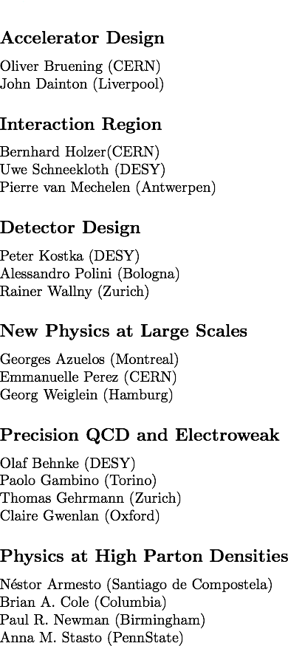
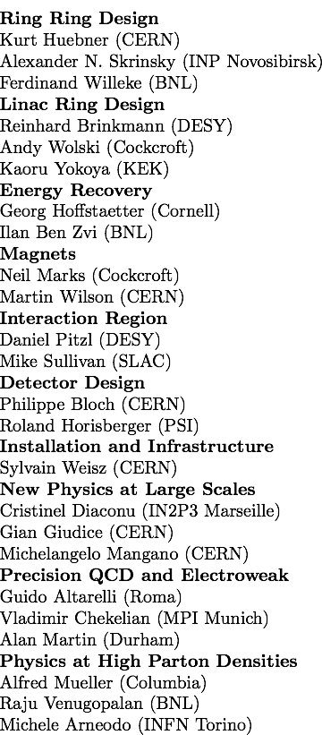
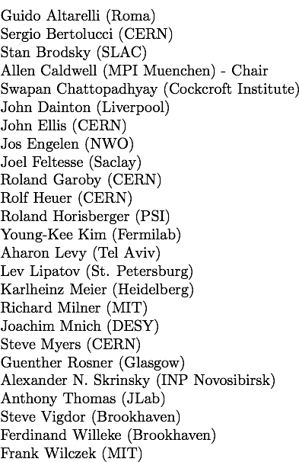
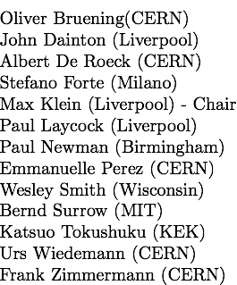
LHeC Organisation
Scientific Advisory Committee
Working Group Convenors
CERN Referees
Steering Committee

Slide 25

Accelerator: Participating Institutes

Slide 26
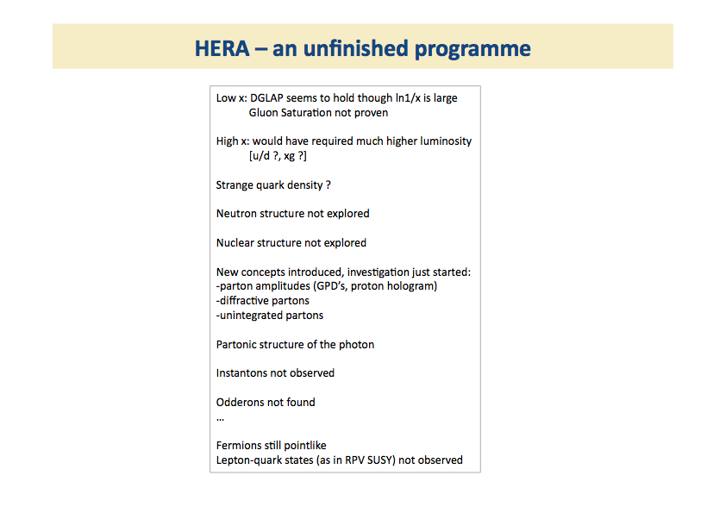
DIS 2011, Max Klein, Liverpool

Slide 27
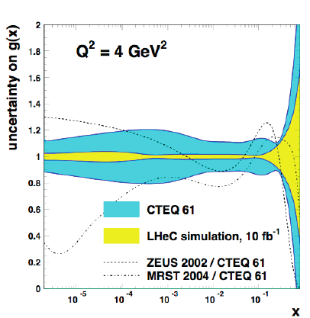
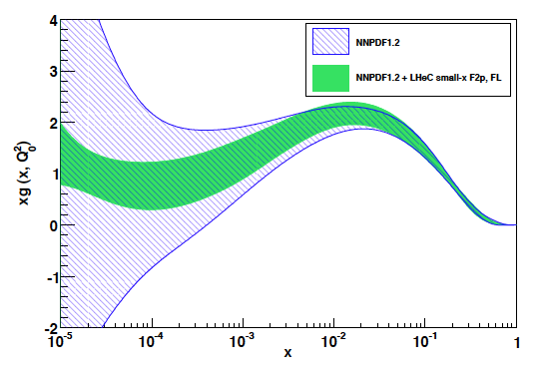
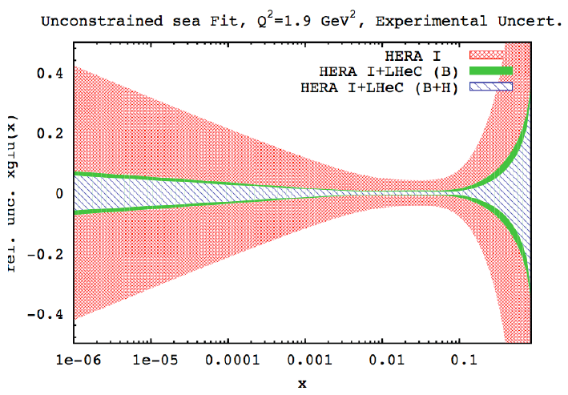
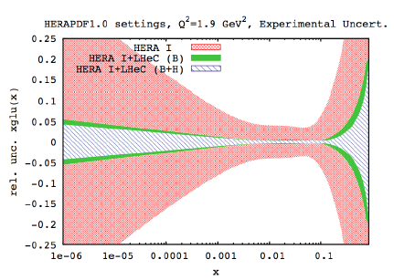
High Precision Gluon Measurements
HERA + LHeC
F2 + FL
Q² = 2 GeV²
NLO QCD “Fits” of LHeC simulated data

Slide 28
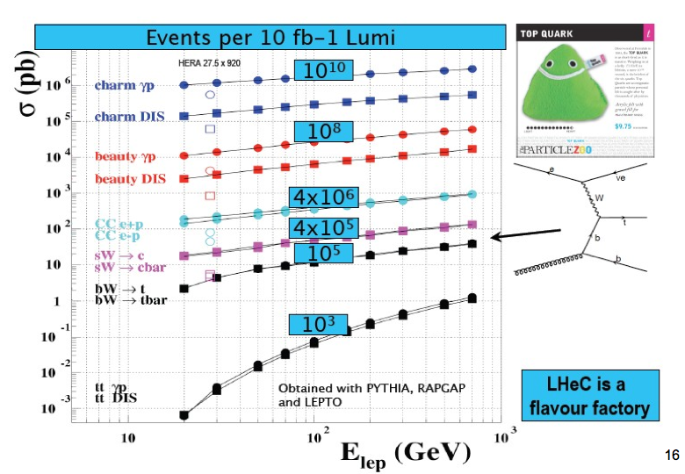
Heavy Flavour @ LHeC
DIS 2011, Olaf Behnke, DESY

Slide 29
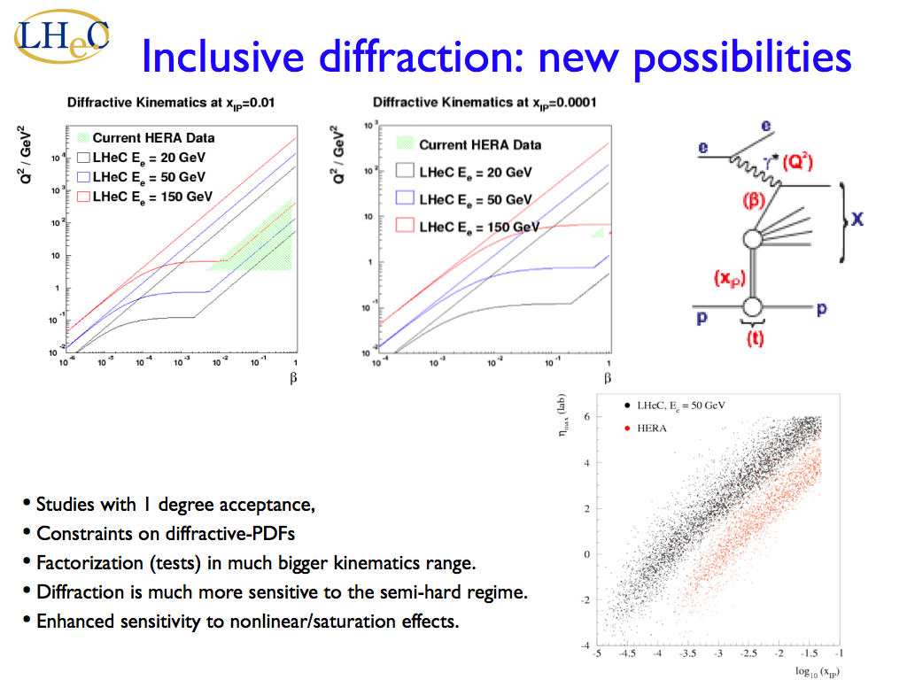

DIS 2011, Anna Stasto, Penn State & RIKEN BNL & Cracow INP

Slide 30
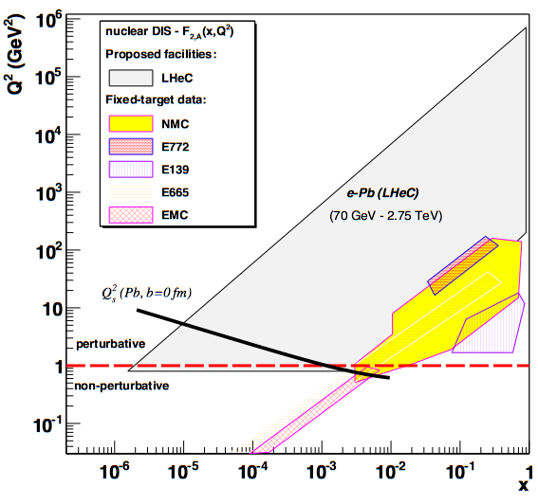
LHeC e+A Kinematic Coverage
The LHeC will
dramatically
expand
coverage of
nuclear DIS
measurements.
- Nuclear PDF’s
Access to
saturation
scales
– at b = 0.
DIS 2011, Brian A. Cole, Columbia Univ.

Slide 31
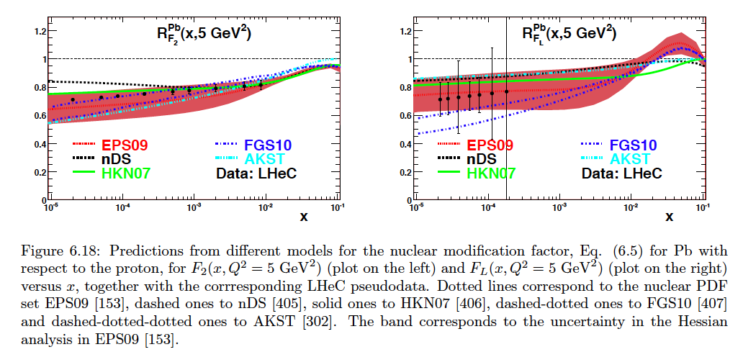
Improvements in Nuclear PDFs

Slide 32
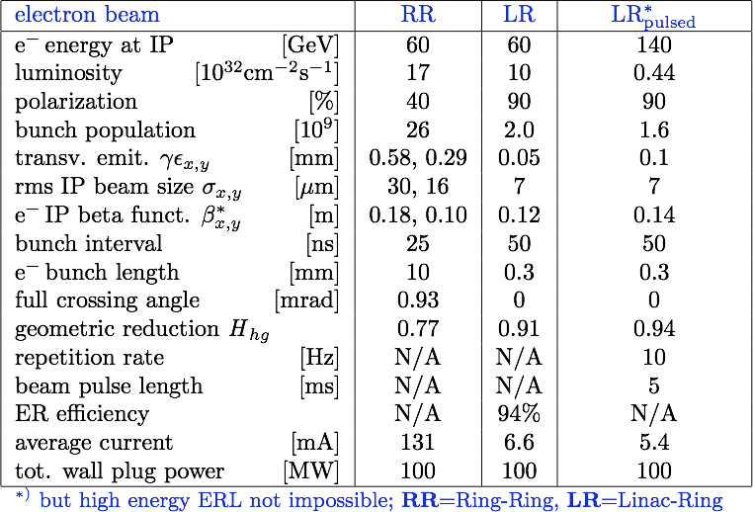
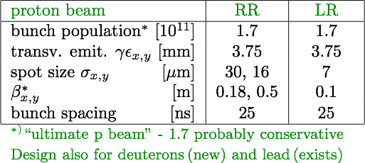
Design Parameters
Draft CDR - 5th August 2011

Slide 33
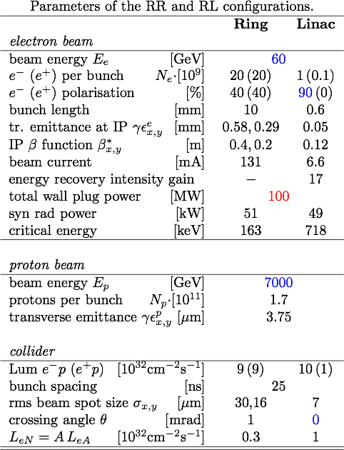
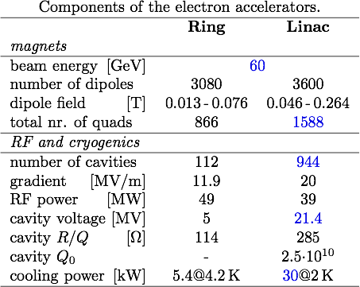
Summary of Machine Parameters

Slide 34

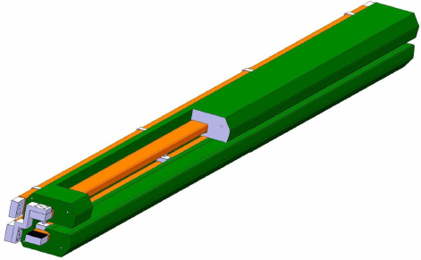
Accelerator: Ring - Ring
Workpackages as formulated in 2008, now in the draft CDR
Baseline Parameters and Installation Scenarios
Lattice Design [Optics, Magnets, Bypasses]
IR for high Luminosity and large Acceptance
rf Design [Installation in bypasses, Crabs?]
Injector Complex [Sources, Injector]
Injection and Dump
Cryogenics – work in progress
Beam-beam effects
Impedance and Collective Effects
Vacuum and Beam Pipe
Integration into LHC
e Beam Polarization
Deuteron and Ion Beams
LHeC Ring Dipole Magnet
.12-.8T
1.3kA
0.8MW
5.3m long
(35 cm)²
slim + light(er)
3080 magnets
Prototypes:
BINP-CERN
DIS, 2011
M.Klein

Slide 35
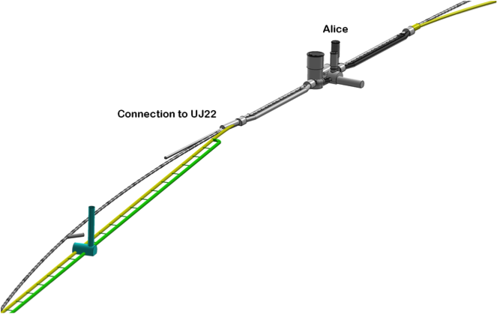
LINAC - Ring
Workpackages as formulated in 2008, now in the draft CDR
Baseline Parameters [Designs, Real photon option, ERL]
Sources [Positrons, Polarisation]
Rf Design
Injection and Dump
Beam-beam effects
Lattice/Optics and Impedance
Vacuum, Beam Pipe
Integration and Layout
Interaction Region
Magnets
Cryogenics
IP2
1056 cavities
66 cryo modules per linac
721 MHz, 19 MV/m CW
Similar to SPL, ESS, XFEL, ILC, eRHIC, Jlab
21 MW RF power
Cryo 29 MW for 37W/m heat load
Magnets in the 2 * 3 arcs:
600 - 4m long dipoles per arc
240 - 1.2m long quadrupoles per arc
Linac (racetrack)
inside the LHC for
access at CERN
Territory
U=U(LHC)/3=9km
DIS, 2011
M.Klein

Slide 36



Ring: Dipole + Quadrupole Magnets
BINP &
CERN
prototypes
5m long
(35 cm)²
slim + light
for installation
736 magnets
1.2 m long
DIS, 2011
M.Klein

Slide 37
High Energy Frontier (Colliders)
Recent Progress
    Tevatron
    RHIC
    LHC
Future Directions
    Future Ion Colliders
    HL-LHC
    ILC/CLIC
    electron-hadron colliders
    HE-LHC
    Neutrinos (Intensity Frontier)
    Muon collider
Operating
Approved, funded?
Not yet approved
July 23, 2011
S. Myers ECFA-EPS, Grenoble

Slide 38
Ad personam Issues (1)
The physics output from the LHC will be decisive
If 500GeV cm is sufficient:
  ILC500; almost ready to go with construction (>200MW of electrical power, capital cost)
  CLIC500; staged version, several years technical development needed (>200MW of electrical power, capital cost)
If 1000GeV is needed and sufficient
  ILC1000; at the upper energy limit of this technology (~400MW Electrical power, serious issue, capital cost, 50km)
  CLIC1000; staged version, several years technical development needed (~400MW Electrical power is a serious issue)
If 3000GeV is needed and sufficient
  CLIC3000; maximum energy imaginable, still some major feasibility issues (560MW of electrical power would make this highly undesirable for the ecologists + operational costs)
If even higher energies are needed
  HE-LHC; aggressive R&D for high field sc magnets needed, SPS upgrade, injection/extraction systems, synchrotron radiation…
  Muon collider; many as yet unsolved technical issues (list too long to record), but very interesting accelerator physics… very long term
Aggressive R&D needed to increase the efficiency wall-plug to beam
July 23, 2011
S. Myers ECFA-EPS, Grenoble

Slide 39
Summary (2)
If e-p is interesting as a complimentary project:
    LHeC (RR): certainly technically do-able. Integration presents major challenges, impact on the LHC operation is a major concern. By-passes are not trivial
    LHeC (LR): luminosity (10³³)may be difficult to achieve, ERL a major challenge but is very interesting due to synergy with many other projects.
All these projects need continuing accelerator R&D so that the right decision can be made when the time comes to identify the next energy frontier accelerator (collider). We need to keep our choices open.
July 23, 2011
S. Myers ECFA-EPS, Grenoble

Slide 40
NuPECC – Roadmap 5/2010: New Large-Scale Facilities
 |  |  | 2010 |  |  |  |  | 2015 |  |  |  |  | 2020 |  |  |  |  | 2025
FAIR | PANDA | R&D Construction Commissioning |  |  |  |  |  |  |  |  | Exploitation
 | CBM | R&D Construction Commissioning |  |  |  |  |  |  |  |  | Exploitation |  |  | SIS300
 | NuSTAR | R&D Construction Commissioning |  |  |  |  |  |  |  |  | Exploit. |  | NESR FLAIR
 | PAX/ENC | Design Study R&D Tests Construction/Commissioning |  |  |  |  |  |  |  |  |  |  |  |  |  | Collider
SPIRAL2 |  | R&D Constr./Commission. |  |  |  |  | Exploitation |  |  |  |  |  |  | 150 MeV/u Post-accelerator
HIE-ISOLDE |  |  | Constr./Commission. |  |  |  | Exploitation |  |  |  |  |  |  |  | Injector Upgrade
SPES |  |  |  | Constr./Commission. |  |  |  | Exploitation
EURISOL |  | Design Study R&D Preparatory Phase / Site Decision Engineering Study Construction
LHeC |  | Design Study R&D Engineering Study Construction/Commissioning
We are here: at the transition from
Design Study to R&D
G. Rosner, NuPECC Chair, Madrid 5/10 – published in December 2010

