Slide 1

The Large Hadron Electron Collider at CERN
An Introduction to the LHeC Project
Max Klein
University of Liverpool
Project
Deep Inelastic Scattering
Physics Programme
Two Accelerator Options
Detector Design
Outlook
http://cern.ch/lhec
Seminar at University of Prague, 12.01.2012

Slide 2
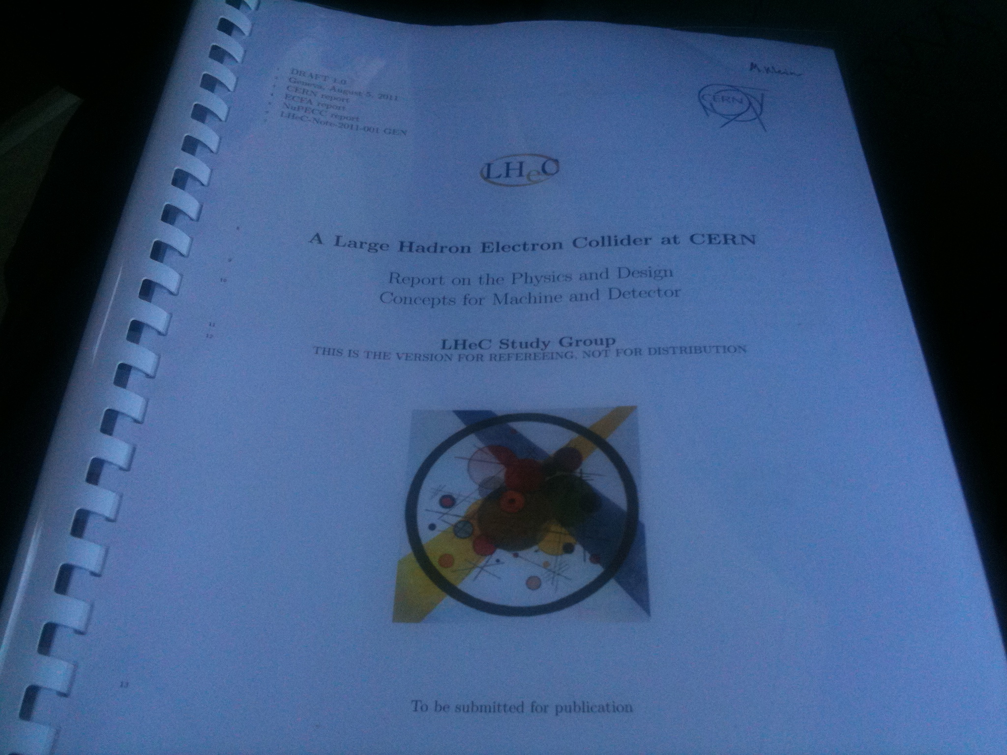
Draft LHeC Design Report
530 pages being refereed
Most of plots from CDR.
LHeC-Note-2011-003 GEN

Slide 3
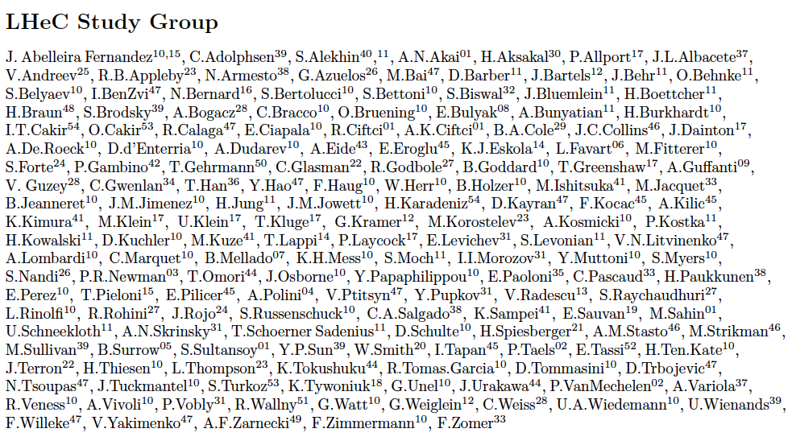
http://cern.ch/lhec
Supported by
CERN, ECFA, NuPECC
About 150 Experimentalists and Theorists from 50 Institutes
Tentative list of those who contributed to the CDR

Slide 4
Project Milestones
2007: Invitation by SPC to ECFA and by (r)ECFA to work out a design concept
2008: First CERN-ECFA Workshop in Divonne (1.-3.9.08)
2009: 2nd CERN-ECFA-NuPECC Workshop at Divonne (1.-3.9.09)
2010: Report to CERN SPC (June)
3rd CERN-ECFA-NuPECC Workshop at Chavannes-de-Bogis (12.-13.11.10)
NuPECC puts LHeC to its Longe Range Plan for Nuclear Physics (12/10)
2011: Draft CDR (530 pages on Physics, Detector and Accelerator) (5.8.11)
being refereed and updated
2012: Publication of CDR – European Strategy
New workshop (tentatively in May 10-11, 2012)
Goal: TDR by 2014
Perspective: Operation by 2023 (synchronous with pp)

Slide 5
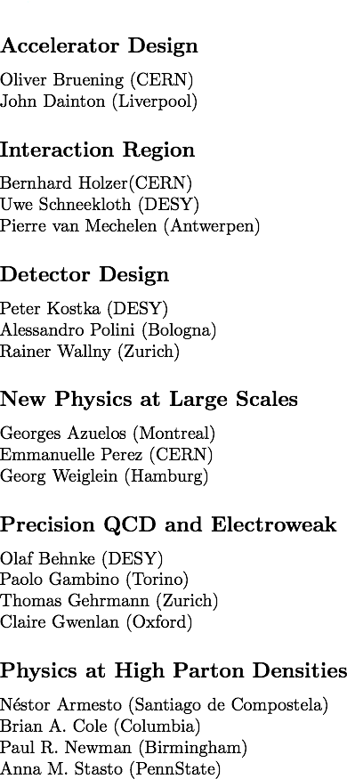
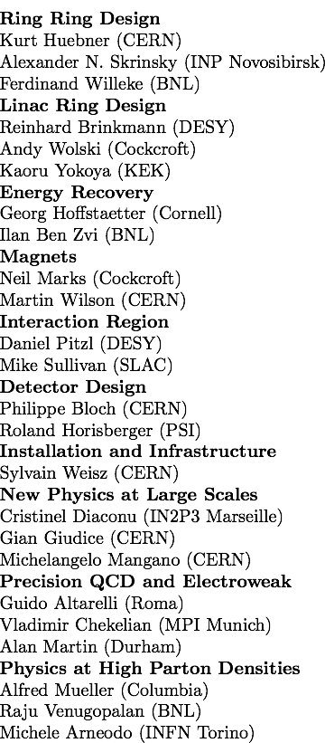
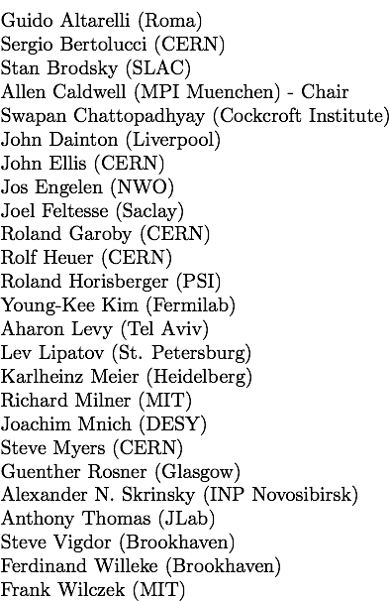

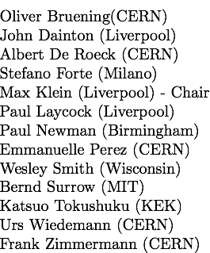
Organisation for CDR
Review ongoing:
Scientific Advisory Committee
Working Group Convenors
CERN Referees
Steering Committee

Slide 6
I. Deep Inelastic Scattering, HERA,LHC and Physics at the LHeC

Slide 7
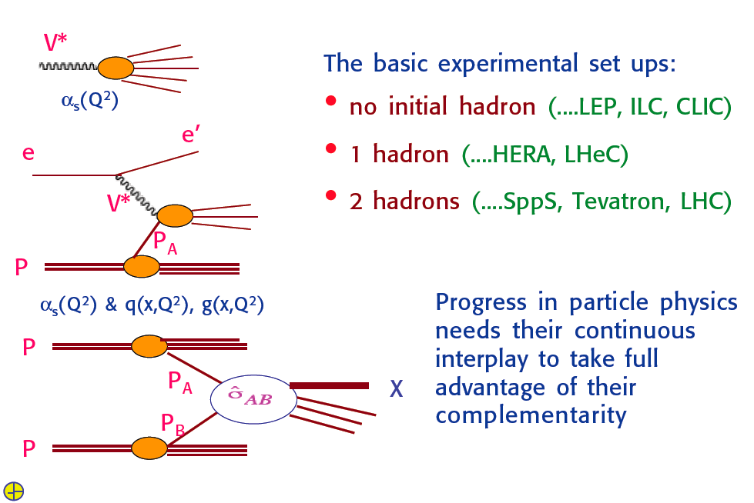
ee, ep, pp
G.Altarelli, LHeC Workshop Divonne 9/08

Slide 8
The Fermi Scale [1985-2010]
pp
b quark
top quark
M_{W}, H?
Tevatron
ep
e⁺e⁻
The Standard
Model Triumph
M_{Z} , sin² Θ
3 neutrinos
h.o. el.weak (t,H?)
gluon
h.o. strong
c,b distributions
high parton densities
LEP/SLC
HERA

Slide 9
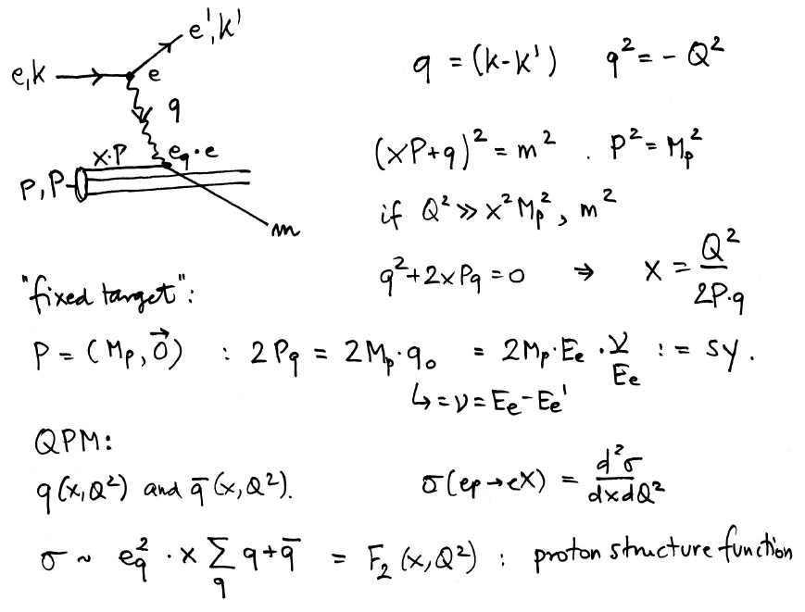
Deep Inelastic Scattering
In DIS the inclusive
cross section depends
on two variables, the
negative 4-momentum
transfer squared (Q² ),
which determines the
resolving power of the
exchanged particle in
terms of p substructure,
and the variable
Bjorken x, which Feynman
could relate to the fraction
of momentum of the proton
carried by a parton [in
what he called the
‘infinite momentum frame’
in which the transverse
momenta are neglected].
Feynman’s partons were
readily linked to Gell-Mann
and Zweig’s quarks.
This process has been for
20 years recently been
investigated at HERA.
- ep collider
Deep inelastic scattering resolves the nucleon structure. If s is high: produce new states
Kinematics is determined with scattered electron or with HFS → high precision due to redundancy

Slide 10
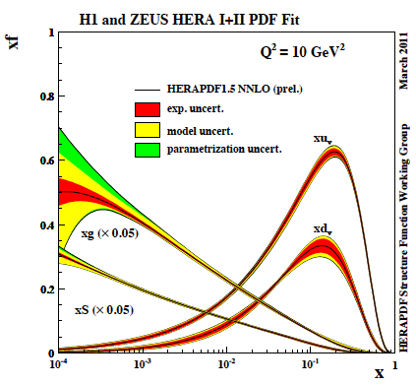
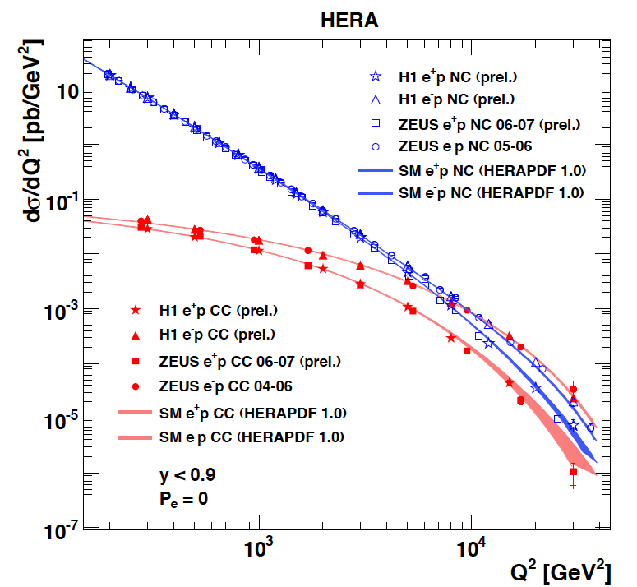
Results from HERA
F₂ rises towards low x, and xg too.
Parton evolution - QCD to NNLO
The weak and electromagnetic interactions reach similar strength when Q² ≥ M²_{W,Z}
Measurements on α_{s}, Basic tests of QCD: longitudinal structure function, jet production, γ structure
Some 10% of the cross section is diffractive (ep → eXp) : diffractive partons; c,b quark distributions
New concepts: unintegrated parton distributions (k_{T}) , generalised parton distributions (DVCS)
New limits for leptoquarks, excited electrons and neutrinos, quark substructure, RPV SUSY
Interpretation of the Tevatron measurements (high Et jet excess, M_{W}, searches..)
M.Klein, R.Yoshida: Collider Physics at HERA Prog.Part.Nucl.Phys. 61 (2008) 343-393 and recent H1,ZEUS results

Slide 11
What HERA could not do or has not done
Test of the isospin symmetry (u-d) with eD - no deuterons
Investigation of the q-g dynamics in nuclei - no time for eA
Verification of saturation prediction at low x – too low s
Measurement of the strange quark distribution – too low L
Discovery of Higgs in WW fusion in CC – too low cross section
Study of top quark distribution in the proton – too low s
Precise measurement of F_{L} – too short running time left
Resolving d/u question at large Bjorken x – too low L
Determination of gluon distribution at hi/lo x – too small range
High precision measurement of α_{s} – overall not precise enough
Discovering instantons, odderons – don’t know why not
Finding RPV SUSY and/or leptoquarks – may reside higher up
…
The H1 and ZEUS apparatus were basically well suited
The machine had too low luminosity and running time
HEP needs a TeV energy scale machine with 100 times
higher luminosity than HERA to develop DIS physics
further and to complement the physics at the LHC. The
Large Hadron Collider p and A beams offer a unique
opportunity to build a second ep and first eA collider
at the energy frontier.
LEP-LHC studies, J.Dainton et al. “DIS at the LHC”, JINST 1 (2006) P10001
HERA in one box
the first ep collider
E_{p}*E_{e}=
920*27.6GeV²
√s=2√E_{e}E_{p}=320 GeV
L=1..4 10³¹cm⁻²s⁻¹
→ ΣL=0.5fb⁻¹
1992-2000 & 2003-2007
Q²= [0.1 -- 3 * 10⁴ ] GeV²
-4-momentum transfer²
x=Q²/(sy) ≅10⁻⁴ .. 0.7
Bjorken x
y≅0.005 .. 0.9
inelasticity

Slide 12
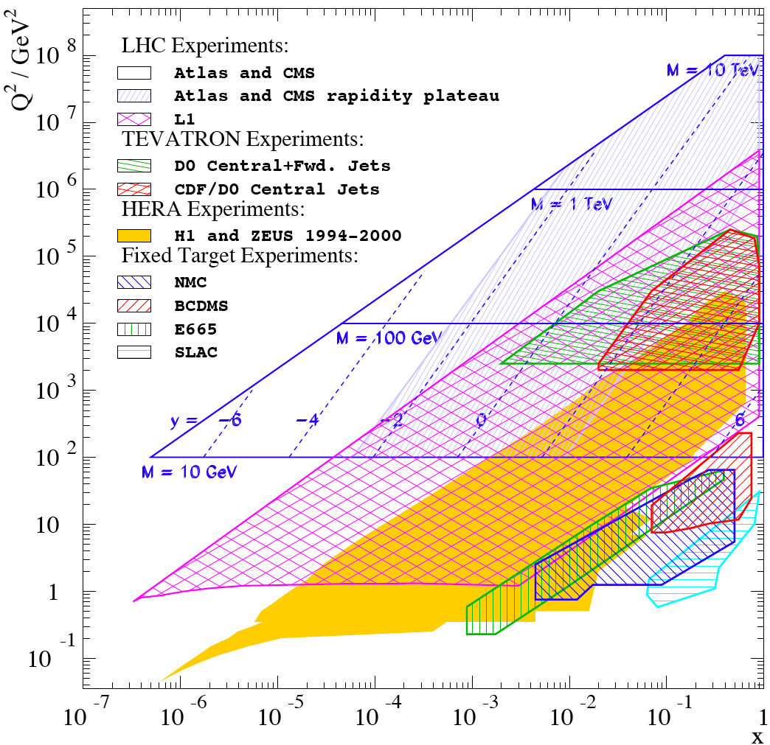
Complementing the LHC with ep/A
LHC partons: W,Z +c,b new constraints but severely limited in x,Q² range
Discoveries at the LHC will be at high
masses: large x and very high Q² which require high s, lumi of LHeC
for precision PDFs (u,d,xg mainly)
If the Higgs exists, its study will become a major field of research:
ep: WW→ H → bbar (CP odd/even?)
top distribution in the proton TDF
IF RP is violated and LQ or RPV SUSY
discovered: LHeC is uniquely suited
AA: QGP: study initial state in eA
Resolve parton distributions in nuclei
LHeC is unique in various areas, e.g.:
Low x and saturation physics
Strong coupling constant to 0.1% level
DIS →
In Drell-Yan kinematics: mass and rapidity relate to Q² and x

Slide 13
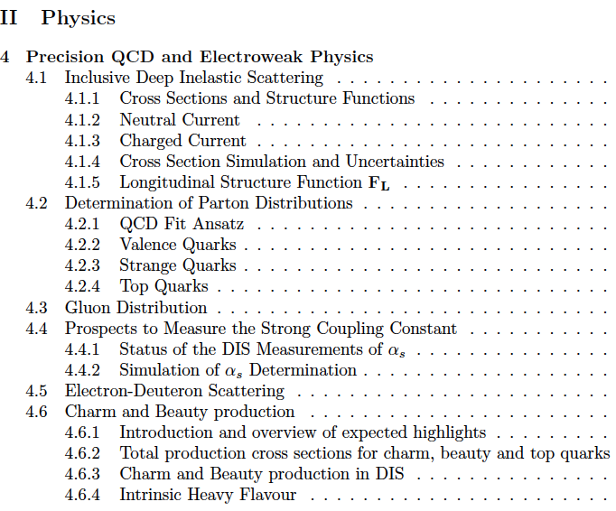
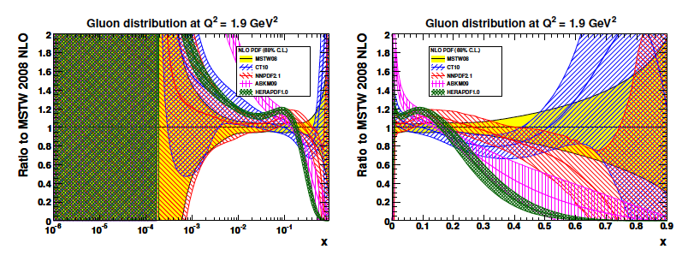
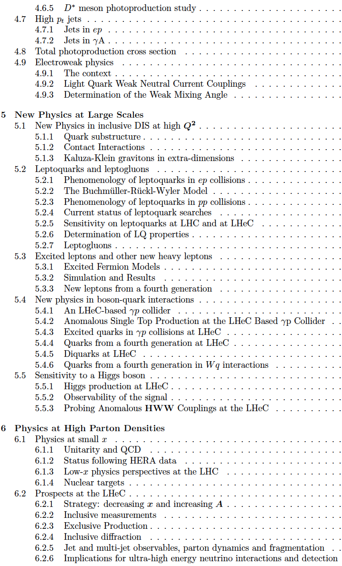
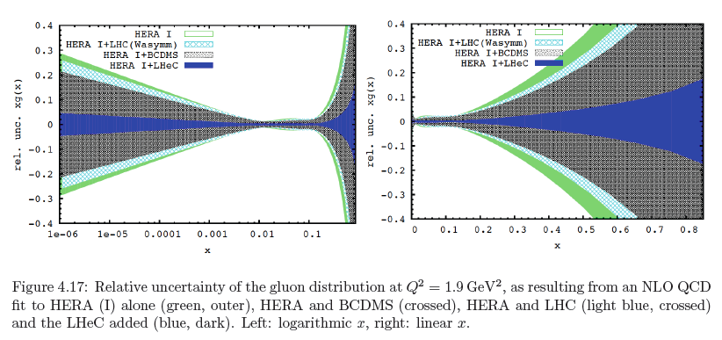
CDR
Gluon Distribution
153 pages
now
then
Precision measurement of gluon density to extreme x → α_{s}
Low x: saturation in ep? Crucial for QCD, LHC, UHE neutrinos!
High x: xg and valence quarks: resolving new high mass states!
Gluon in Pomeron, odderon, photon, nuclei.. Local spots in p?
Heavy quarks intrinsic or only gluonic?

Slide 14
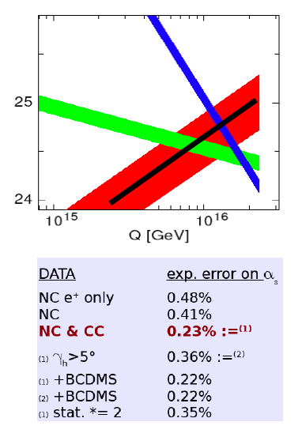
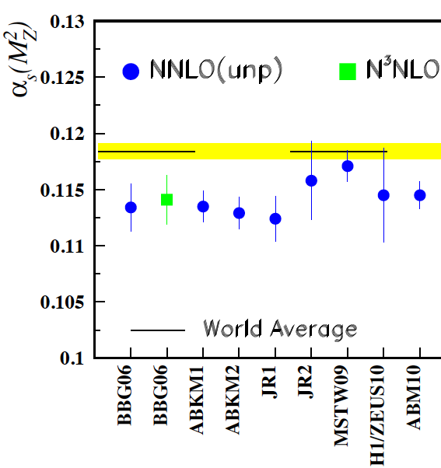
Strong Coupling Constant
α_{s} least known of coupling constants
Grand Unification predictions suffer from δα_{s}
DIS tends to be lower than world average
Recently challenged by MSTW and NNPDF – jets??
LHeC: per mille accuracy - independent of BCDMS.
Challenge to experiment and to h.o. QCD →
A genuine DIS research programme rather than
one outstanding measurement only.
Simulation of α_{s} measurement at LHeC
1/α
fine structure
weak
strong
MSSM - B.Allnach et al, hep-ex/0403133
?
+pol
Two independent analyses performed
J.Bluemlein and H. Boettcher, arXiv 1005.3013 (2010)

Slide 15
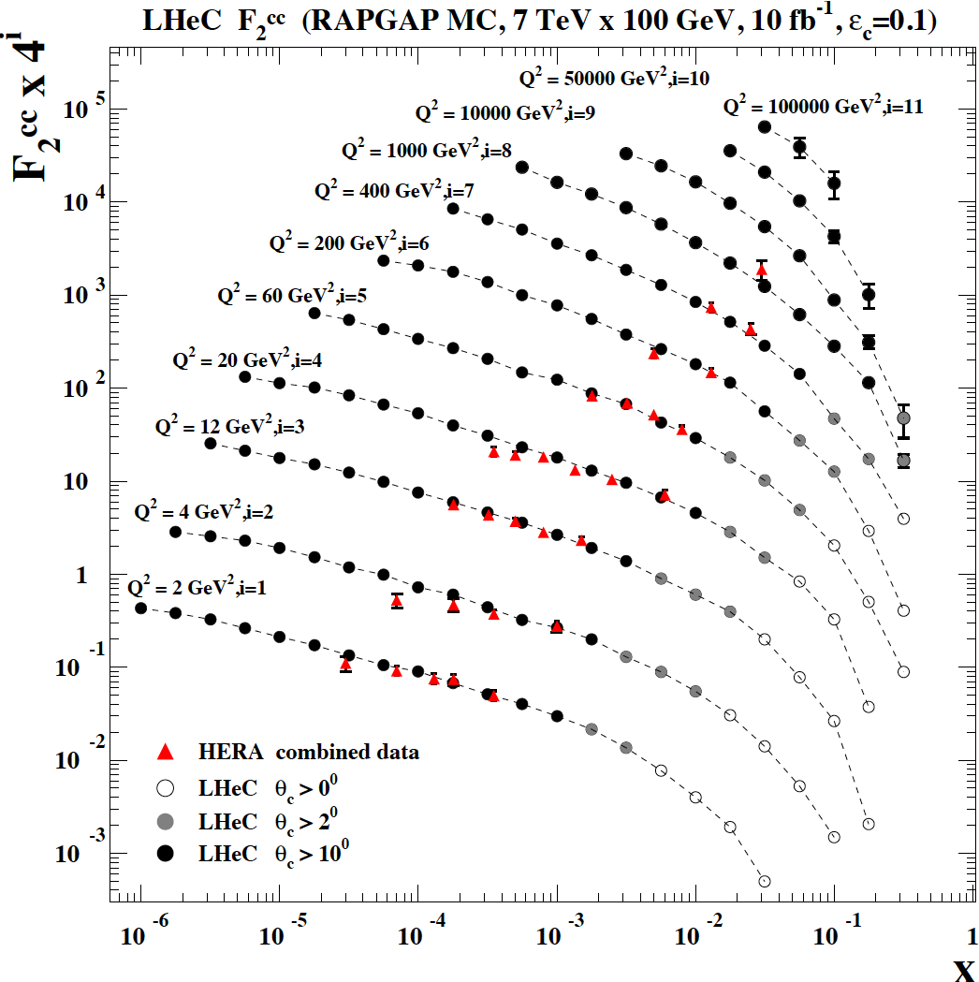
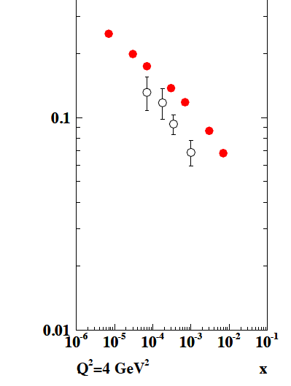
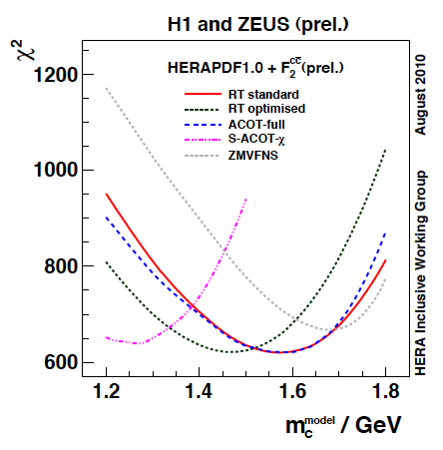
Treatment of charm influences α_{s}
F₂^{cc}
LHeC
HERA
LHeC vs HERA: higher fraction of c, larger range,
smaller beam spot, better Silicon detectors
note: 100 MeV of m_{c} is about 1% on α_{s}
CDR

Slide 16
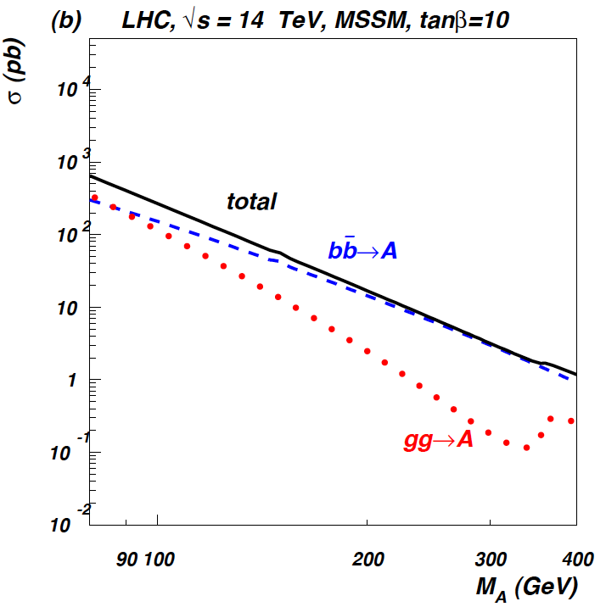
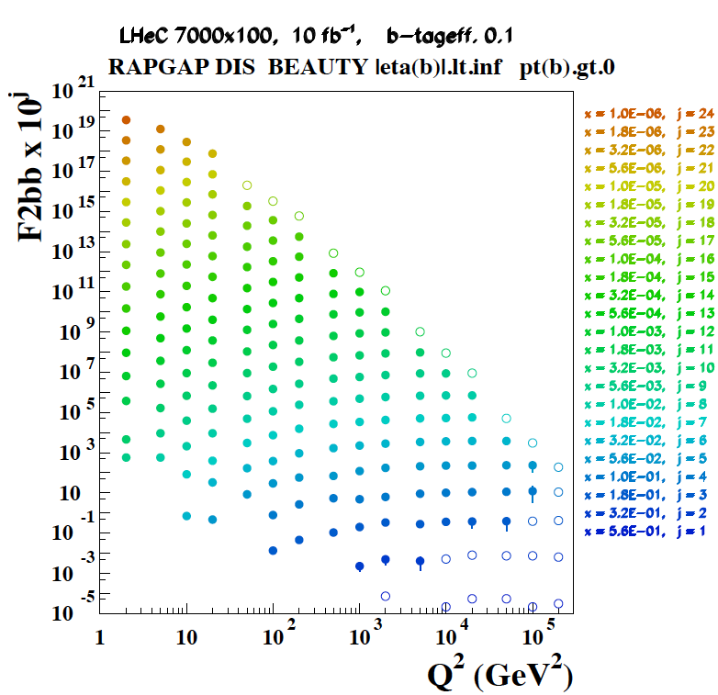
Beauty - MSSM Higgs
CTEQ Belyayev et al. JHEP 0601:069,2006
In MSSM Higgs production is b dominated
HERA: First measurements of b to ~20%
LHeC: precision measurement of b-df
LHeC: higher fraction of b, larger range,
smaller beam spot, better Si detectors

Slide 17
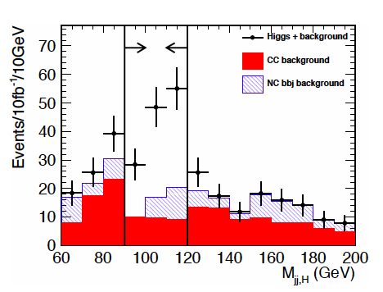
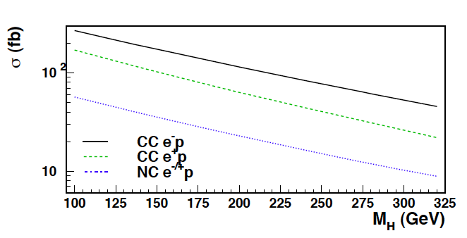
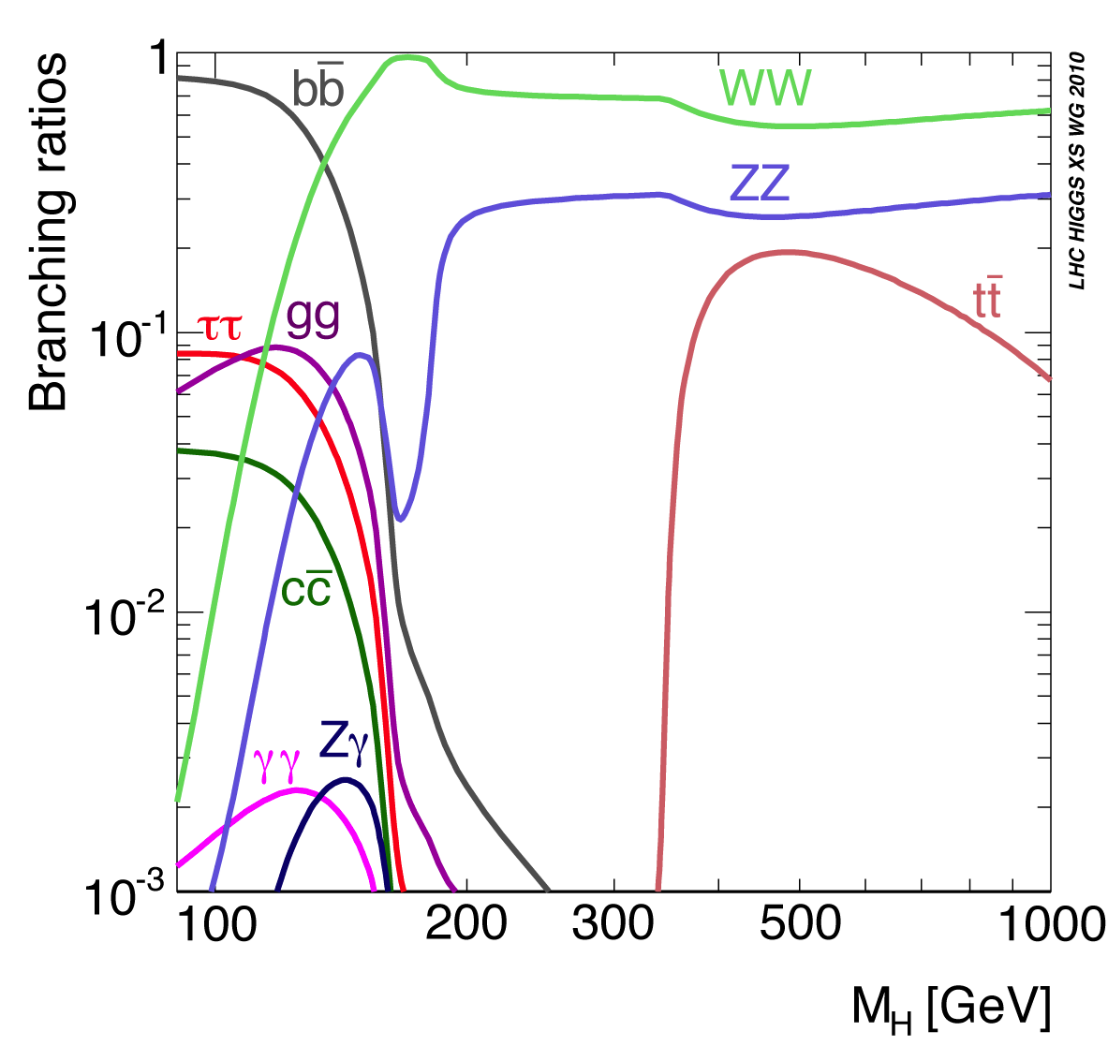
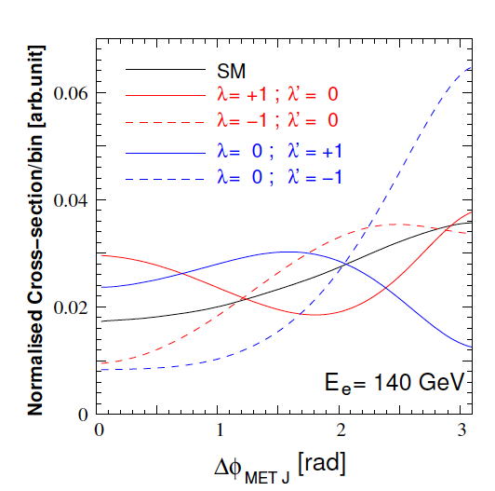
Higgs
Process determines
much of detector
acceptance and
calibration and b tag
(also single top)
and L/E_{e} requirement
Higgs is light (or absent), CC: WW→H→bb
CP even: SM, CP odd: nonSM, mixture?

Slide 18
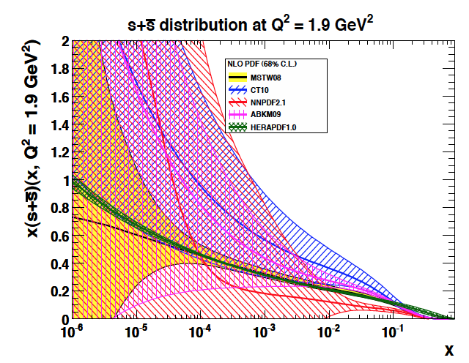
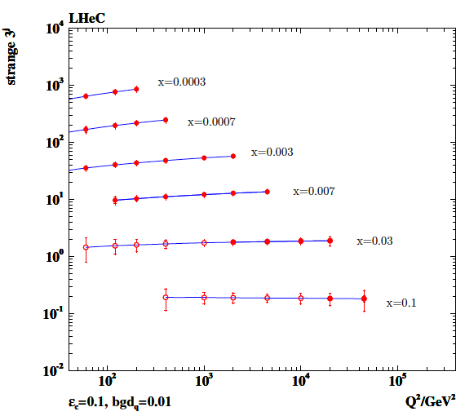
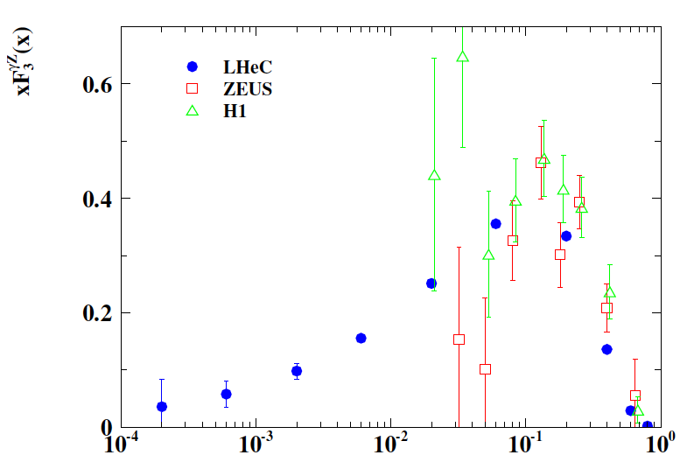

Strange and Valence Quarks
W,Z (LHC)
νN→c..
Strange quark density unknown
at low x and controversial at high x~0.1
Low x sea to be unfolded with LHeC
CC and ep and eD measurements
down to x=10^{-4..6}
Sea Quarks=Antiquarks? Need u_{v},d_{v}
LHeC: much extended range and 100 * L (HERA)

Slide 19
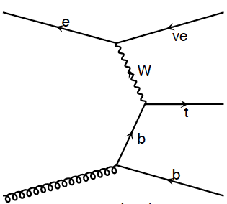
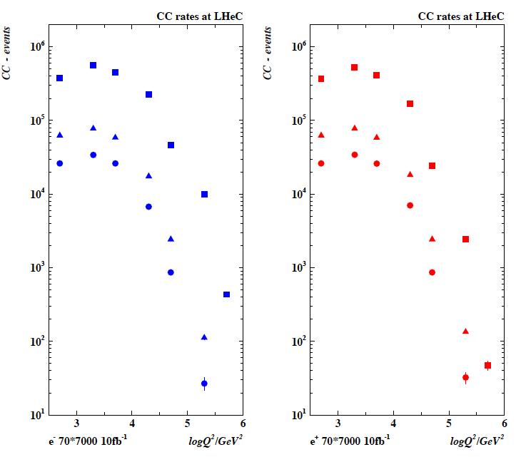
Top and Top Production in Charged Currents
LHeC copious
single top and anti-top
quark production
with a CC cross section
of O(10) pb
Study Q² evolution of
top quark onset –
6 quark CFNS
(Pascaud at DIS11)
m_{top}
Not yet simulated..

Slide 20
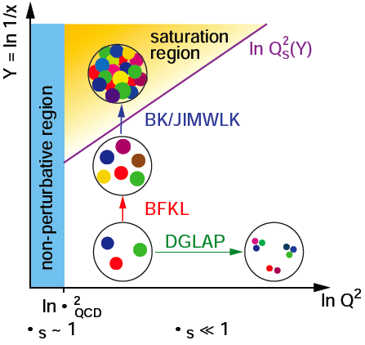
High Parton Densities
Should lead to
non-linear evolution
and eventually
saturation of
rise of cross section
(unitarity limit)
CDR L_{eN} ≅ 3 * 10³¹ cm⁻²s⁻¹ for D,A - not optimised

Slide 21
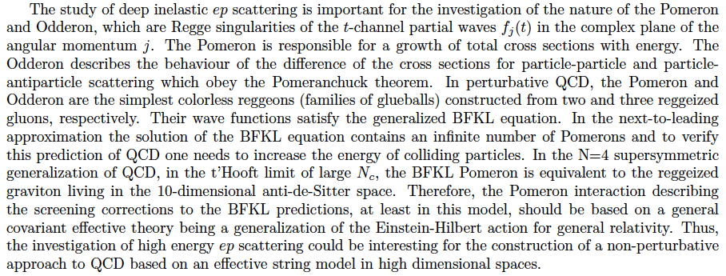
Lev Lipatov in the CDR…

Slide 22
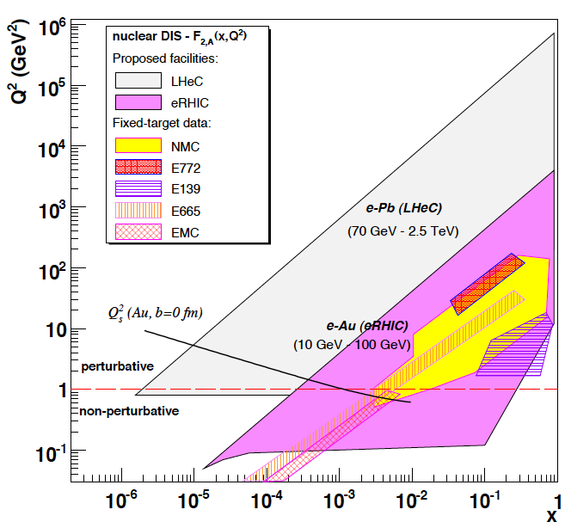
Electron-Ion Scattering
Dipole models predict saturation which
resummation in pQCD moves to lower x..
It requires highest energy, low x, Q²>M_{p}²
Saturation at the LHeC is predicted to be
observed both in ep AND in eA.
This combination is crucial to disentangle nuclear from unitarity effects.
Expect qualitative changes of behaviour
- Black body limit of F₂
Saturation amplified with A^{1/3}
Rise of diffraction to 50%? ….
Below x ~ 10⁻²: DIS data end. NO flavour
separation yet. However indications are
that e.g. shadowing is flavour dependent.
Deuterons: tag spectator,
relate shadowing-diffraction (Gribov)!
stabilise QCD evolution (singlet!)
Neutron (light sea, UHE neutrinos, QPM)
EIC programme:
see recent workshop arXiv:1108.1713 [nucl-th]

Slide 23
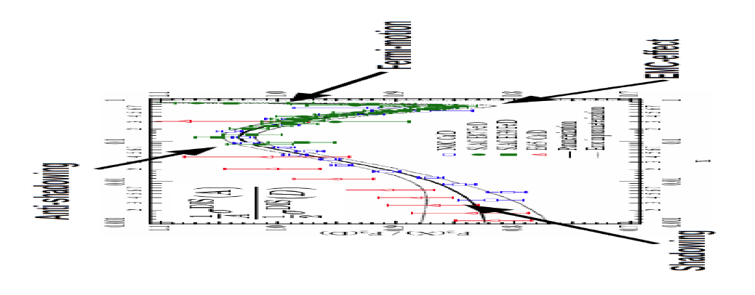
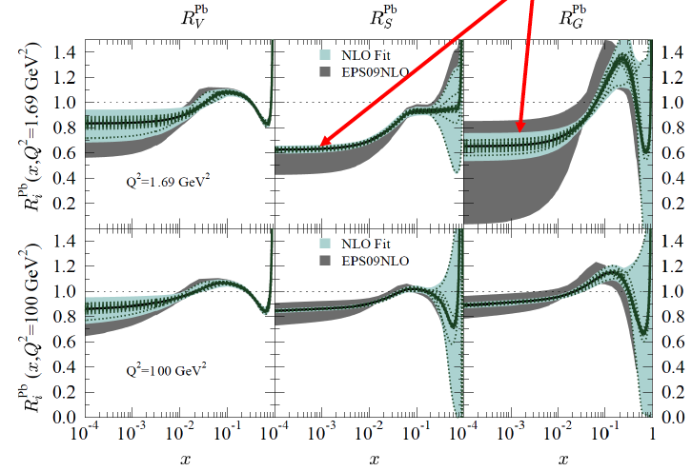
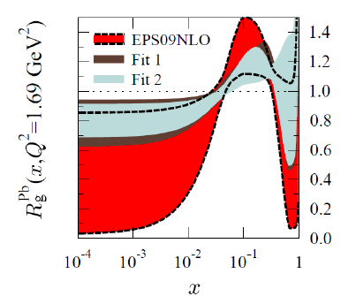
Nuclear Parton Distributions
Study using eA LHeC pseudodata
R=q^{Pb}/q^{p}
A complete determination of nPDFs in grossly extended range, into nonlinear regime
certainly more diverse than in V,S,G terms and cleaner than pA at the LHC
K.Eskola, H.Paukkunen, C.Salgado, Divonne09

Slide 24
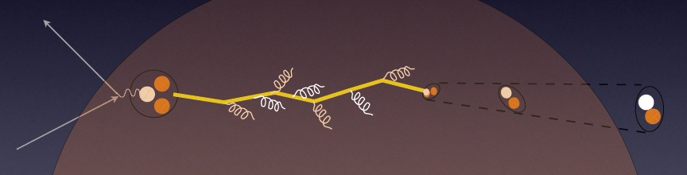
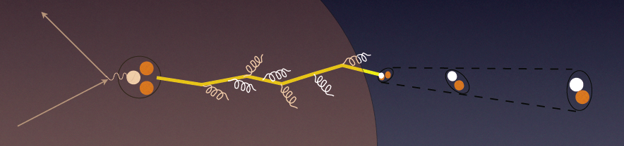
In-medium Hadronisation
The study of particle production in eA (fragmentation functions and hadrochemistry)
allows the study of the space-time picture of hadronisation (the final phase of QGP).
Low energy (ν): need of
hadronization inside.
Parton propagation: pt broadening
Hadron formation: attenuation
High energy (ν): partonic
evolution altered in the
nuclear medium.
W.Brooks, Divonne09
LHeC :
+ study the transition from small to high energies in much extended range wrt. fixed target data
+ testing the energy loss mechanism crucial for understanding of the medium produced in HIC
+ detailed study of heavy quark hadronisation …
Notes:
24

Slide 25
The TeV Scale [2010-2035..]
pp
W,Z,top
Higgs??
New Particles??
New Symmetries?
LHC
ep
e⁺e⁻
New Physics
ttbar
Higgs??
Spectroscopy??
High Precision QCD
High Density Matter
Substructure??
eq-Spectroscopy??
ILC/CLIC
LHeC

Slide 26
II. Accelerator and Detector

Slide 27



















LHeC Accelerator Design: Participating Institutes
TOBB ETU
KEK

Slide 28
Electron Beam -Two Options
Ring-Ring
Power Limit of 100 MW wall plug
“ultimate” LHC proton beam
60 GeV e± beam
L = 2 10³³ cm⁻²s⁻¹ → O(100) fb⁻¹
LINAC Ring
Pulsed, 60 GeV: ~10³²
High luminosity:
Energy recovery: P=P₀/(1-η)
β*=0.1m
[5 times smaller than LHC by
reduced l*, only one p squeezed
and IR quads as for HL-LHC]
L = 10³³ cm⁻²s⁻¹ → O(100) fb⁻¹
Synchronous ep and pp operation (small ep tuneshifts)
The LHC p beams provide 100 times HERA’s luminosity

Slide 29
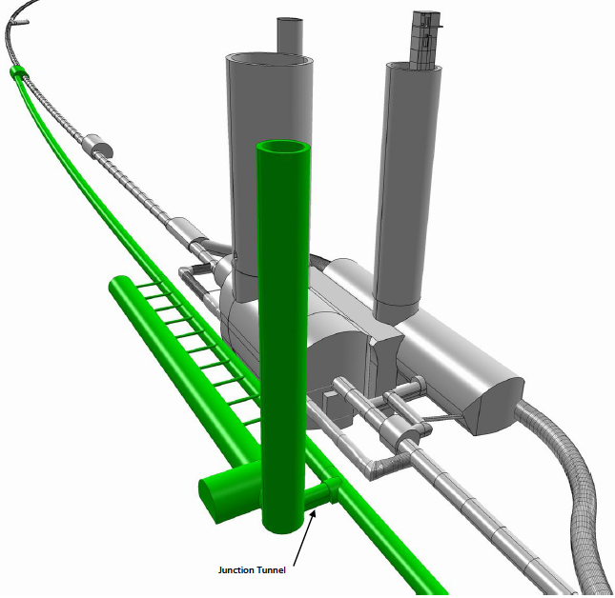
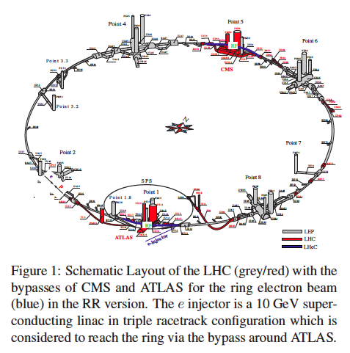
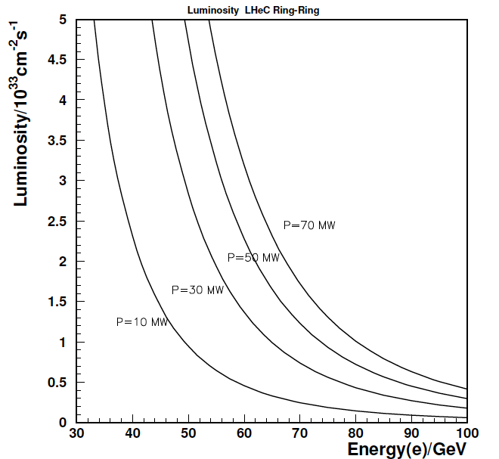
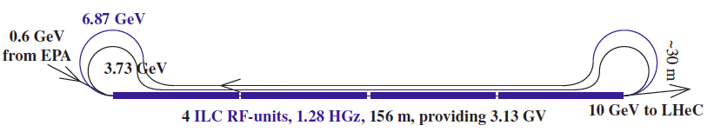
e Ring- p/A Ring
10 GeV injector

Slide 30
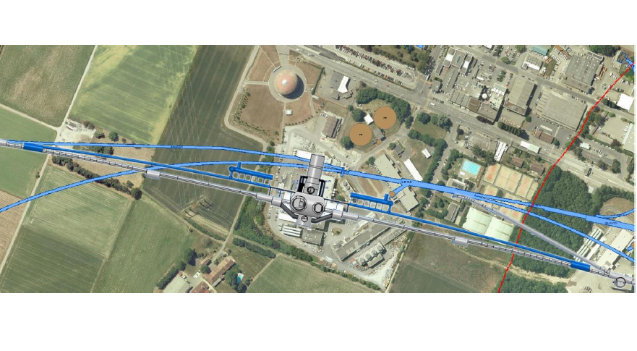
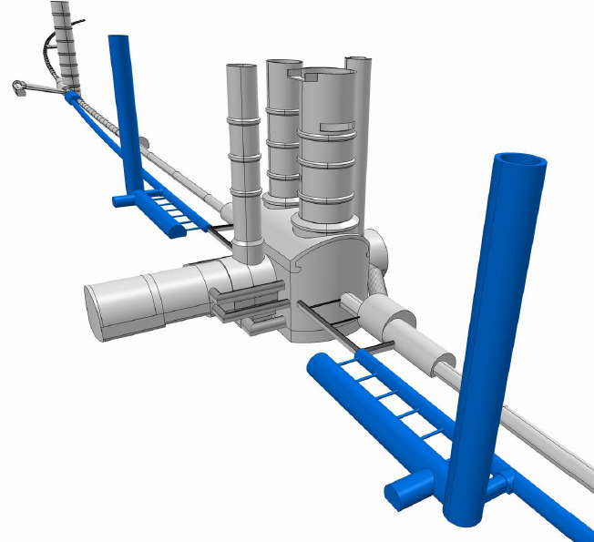
Bypassing ATLAS
For the CDR the bypass concepts
were decided to be confined to
ATLAS and CMS

Slide 31
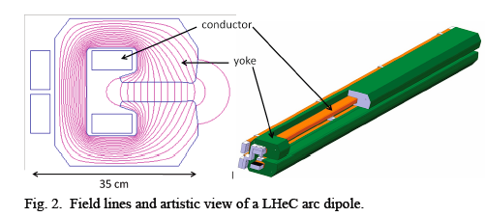
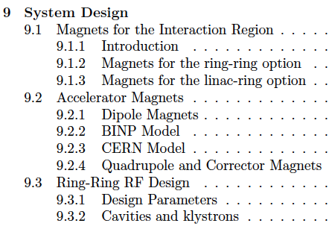
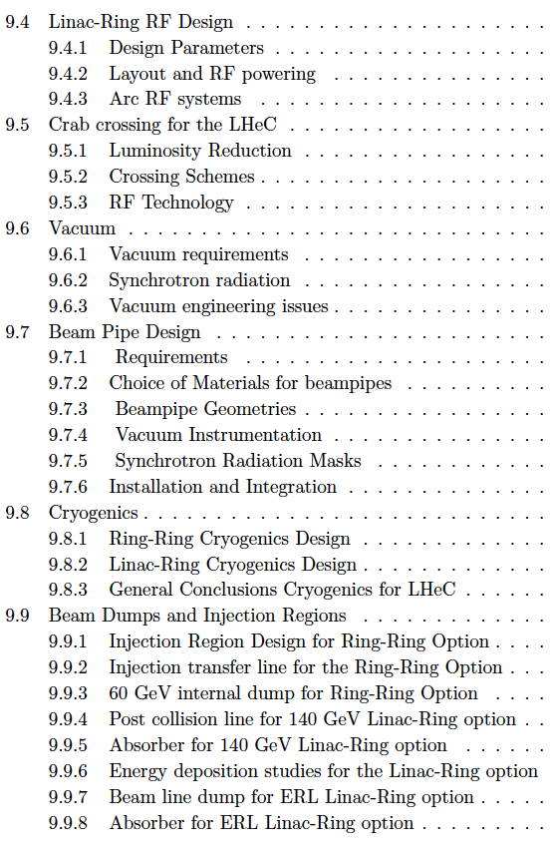
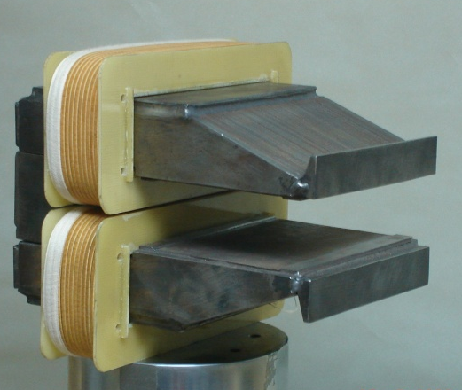
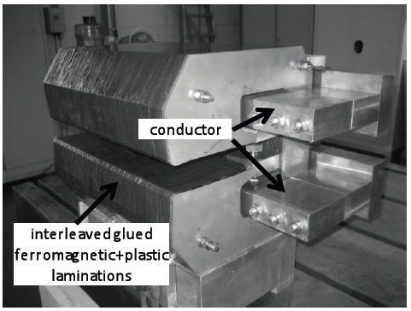

Magnets
5.35 m
0.013-0.08 T
~200kg/m
Prototypes from BINP and CERN: function to spec’s

Slide 32



60 GeV Energy Recovery Linac
CERN 1
CERN 2
Jlab
BNL
Two 10 GeV energy recovery Linacs, 3 returns, 720 MHz cavities

Slide 33


Linac Infrastructure
U_{LHeC}=U_{LHC}/3 : 1.5 x HERA
944 cavities
59 cryo modules per linac
721 MHz
20 MV/m CW
Multibunch wakefields - ok
Emittance growth - ok
[ILC 10nm, LHeC 10μm]
36σ separation at 3.5m - ok
Fast ion instability - probably ok
with clearing gap (1/3)

Slide 34



Cryogenics
from CDR LHeC

Slide 35



Detector Requirements
  High Precision
  resolution, calibration, low noise at low y, tagging of b,c;
  Based on the recent detector developments, “settled” technology,
  avoiding time consuming dedicated R&D programs.
  Modular for installation and flexible for access
  Detector construction above ground (LHC schedule!)
  Small radius and thickness of beam pipe optimized in view of
  1-179º acceptance [for low x,Q² (e) as for high x (final state),
  synchrotron radiation and background production.
  Affordable - comparatively reasonable cost.
  One IR, one detector (no push-pull, two teams/reconstructions..?)

Slide 36

LHeC Detector Overview
LAr electromagnetic calorimeter
Tile Calorimeter
Detector option 1 for LR and full acceptance coverage
Forward/backward asymmetry in energy deposited and thus in geometry and technology
Present dimensions: LxD =14x9m² [CMS 21 x 15m² , ATLAS 45 x 25 m²]
Taggers at -62m (e),100m (γ,LR), -22.4m (γ,RR), +100m (n), +420m (p)

Slide 37


Detector Magnets
Dipole (for head on LR) and
solenoid in common cryostat,
perhaps with electromagnetic LAr
3.5T field at ~1m radius to house
a Silicon tracker
Based on ATLAS+CMS experience

Slide 38


Silicon Tracker and EM Calorimeter
Transverse momentum
Δp_{t}/p²_{t} → 6 10⁻⁴ GeV⁻¹
transverse
impact parameter
→ 10μm

Slide 39



Liquid Argon Electromagnetic Calorimeter
Inside Coil
H1, ATLAS
experience.
Barrel: Pb, 20 X₀ , 11m³
fwd/bwd inserts:
FEC: Si -W, 30 X₀ ,0.3m³
BEC: Si -Pb, 25 X₀,0.3m³
GEANT4 Simulation

Slide 40




Hadronic Tile Calorimeter
Outside Coil: flux return
Modular. ATLAS experience.
R=2.6m
+5.9m
-3.6m
Combined GEANT4 Calorimeter Simulation

Slide 41
Outlook

Slide 42

Tentative Time Schedule
LS3 --- HL LHC
from draft CDR

Slide 43

Draft LHC Schedule for the coming decade
as shown by S. Myers at EPS 2011 Grenoble

Slide 44

Summary
CERN-ECFA-NuPECC:
CDR Draft (530pages) being refereed
Publish spring 2012
Steps towards TDR (tentative)
Prototype IR magnet (3 beams)
Prototype Dipole (1:1)
Develop Cavity/Cryomodule
Civil Engineering, …
Build international collaborations
for the accelerator and detector
development. Strong links to ongoing
accelerator and detector projects.
The LHC offers the unique perspective
for a further TeV scale collider. The
LINAC’s are of about 2mile length, yet
the Q² is 10⁵ times larger than was
achieved when SLAC discovered quarks.
Particle physics needs pp, ll and ep.
Here is a realistic prospect to progress
You are cordially invited to join
M.Klein at IPAC11
Both the ring and the linac are feasible and both
come very close to the desired performance.
The pleasant challenge is to soon decide for one.

Slide 45
backup

Slide 46


Deep Inelastic Scattering - History and Prospects
History of Deep Inelastic Scattering
Stanford
Stanford

Slide 47

Physics and Range
New Physics
Large x
High precision
partons in plateau
of the LHC
Nuclear
Structure
& dynamics
High Density Matter
Q² = 4momentum transfer² x = Bjorken x: fraction of p’s momentum

Slide 48
Why an ep/A Experiment at TeV Energies?
For resolving the quark structure of the nucleon with p, d and ion beams
For the development of perturbative QCD [37-28-15]
For mapping the gluon field
For searches and the understanding of new physics
For investigating the physics of parton saturation
QPM symmetries, quark distributions (complete set from data!), GPDs, nuclear PDFs ..
N^{k}LO (k≥2) and h.o. eweak, HQs, jets, resummation, factorisation, diffraction
Gluon for ~10⁻⁵ < x <1 , is unitarity violated? J/ψ, F₂^{c}, … unintegrated gluon
GUT (α_{s} to 0.1%), LQs RPV, Higgs (bb, HWW) … PDFs4LHC… instanton, odderon,..?
Non-pQCD (chiral symm breaking, confinement), black disc limit, saturation border..
..For providing data which could be of use for future experiments [Proposal for SLAC ep 1968]

Slide 49
Summary of Design Parameters
electron beam | RR | LR | LR
e- energy at IP[GeV] | 60 | 60 | 140
luminosity [10³² cm⁻²s⁻¹] | 17 | 10 | 0.44
polarization [%] | 40 | 90 | 90
bunch population [10⁹] | 26 | 2.0 | 1.6
e- bunch length [mm] | 10 | 0.3 | 0.3
bunch interval [ns] | 25 | 50 | 50
transv. emit. γε_{x,y} [mm] | 0.58, 0.29 | 0.05 | 0.1
rms IP beam size σ_{x,y} [μm] | 30, 16 | 7 | 7
e- IP beta funct. β*_{x,y} [m] | 0.18, 0.10 | 0.12 | 0.14
full crossing angle [mrad] | 0.93 | 0 | 0
geometric reduction H_{hg} | 0.77 | 0.91 | 0.94
repetition rate [Hz] | N/A | N/A | 10
beam pulse length [ms] | N/A | N/A | 5
ER efficiency | N/A | 94% | N/A
average current [mA] | 131 | 6.6 | 5.4
tot. wall plug power[MW] | 100 | 100 | 100
proton beam | RR | LR
bunch pop. [10¹¹] | 1.7 | 1.7
tr.emit.γε_{x,y} [μm] | 3.75 | 3.75
spot size σ_{x,y} [μm] | 30, 16 | 7
β*_{x,y} [m] | 1.8,0.5 | 0.1
bunch spacing [ns] | 25 | 25
“ultimate p beam”
1.7 probably conservative
and emittance too
CDR has design also for
D and A (L_{eN} ≅ 3 * 10³¹ cm⁻²s⁻¹)
RR= Ring – Ring
LR =Linac –Ring
Ring: use 1º as baseline : L/2
Linac: clearing gap: L*2/3
High E_{e} Linac option (ERL?) if physics demands HE-LHC?

Slide 50




J/ψ in γ*p/A
Test of saturation
E=J/ψ or γ (DVCS)
Optical theorem relates J/ψ to F_{T}=F₂-F_{L}
Coherent production in y*A
Probing of nuclear matter
CDR

Slide 51




Quark-Gluon Dynamics - Diffraction and HFS (fwd jets)
Factorisation broken
(LHC fwd – LHeC diff)
Understand multi-jet emission (unintegr. pdf’s), tune MC’s
Production of high mass 1⁻ states
CDR
At HERA resolved γ effects mimic non-kt ordered emission

