Slide 1


Report on the Design Concepts for the LHeC
Physics
Accelerator
Components
Detector
Conclusion
Max Klein
for the LHeC Study Group
ECFA, CERN, 26.11.10
http://cern.ch/lhec

Slide 2
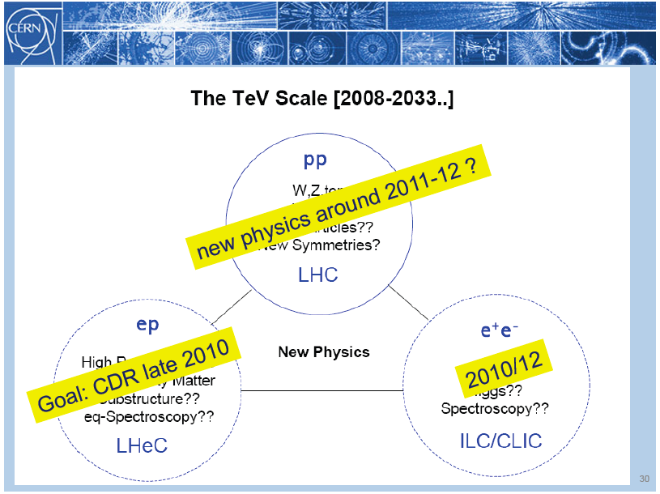
title
Rolf Heuer: 3/4. 12. 09 at CERN: From the Proton Synchroton to the Large Hadron Collider
50 Years of Nobel Memories in High-Energy Physics

Slide 3
LHeC Physics -1
Grand unification? α_{s} to per mille accuracy: jets vs inclusive
ultraprecision DIS programme: N^{k}LO, charm, beauty, ep/eD,..
A new phase of hadronic matter: high densities, small α_{s}
saturation of the gluon density? BFKL-Planck scale
superhigh-energy neutrino physics (p-N)
Partons in nuclei (4 orders of magnitude extension)
saturation in eA (A^{1/3}?), nuclear parton distributions
black body limit of F₂, colour transparency, …
Novel QCD phenomena
instantons, odderons, hidden colour, sea=antiquarks (strange)
Complementarity to new physics at the LHC
LQ spectroscopy, eeqq CI, Higgs, e*
Complete unfolding of partonic content of the proton,
direct and in QCD

Slide 4
LHeC Physics - 2
Neutron structure free of Fermi motion
Diffraction – Shadowing (Glauber). Antishadowing
Vector Mesons to probe strong interactions
Diffractive scattering “in extreme domains” (Brodsky)
Single top and anti-top ‘factory’ (CC)
Gluon density over 6 orders of magnitude in x
GPDs via DVCS
Unintegrated parton distributions
Partonic structure of the photon
Electroweak Couplings to per cent accuracy
….
For numeric studies and plots see recent talks at DIS10, ICHEP10, EIC and LHeC Workshops [ cern.ch/lhec]
Every major step in energy can lead to new unexpected results, ep: SLAC, HERA
Requires: High energy, e±, p, d, A, high luminosity, 4π acceptance, high precision (e/h)
TeV scale physics, electroweak, top, Higgs, low x unitarity

Slide 5
Two Options
Ring-Ring
Power Limit of 100 MW wall plug
“ultimate” LHC proton beam
60 GeV e± beam
L = 2 10³³ cm⁻²s⁻¹ → O(100) fb⁻¹
HERA 0.5fb⁻¹ with 100 times less L
LINAC Ring
Pulsed, 60 GeV: ~10³²
High luminosity:
Energy recovery: P=P₀/(1-η)
β*=0.1m
[5 times smaller than LHC by
reduced l*, only one p squeezed
and IR quads as for HL-LHC]
L = 10³³ cm⁻²s⁻¹ → O(100) fb⁻¹
Synchronous ep and pp operation (small ep tuneshifts)

Slide 6
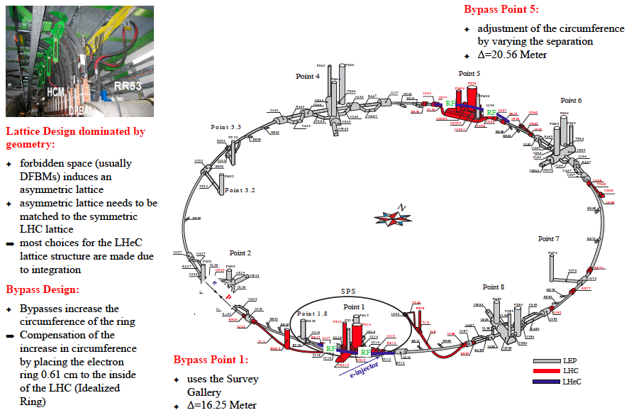
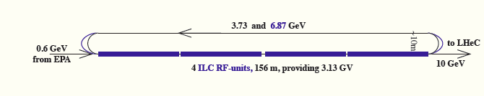
A 60 GeV Ring with 10 GeV LINAC Injector
5min filling time

Slide 7

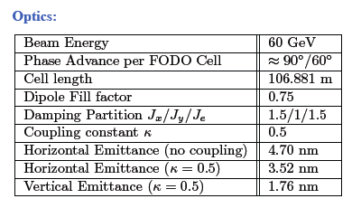
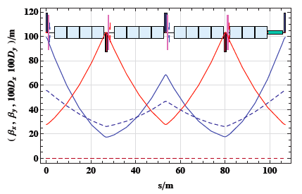
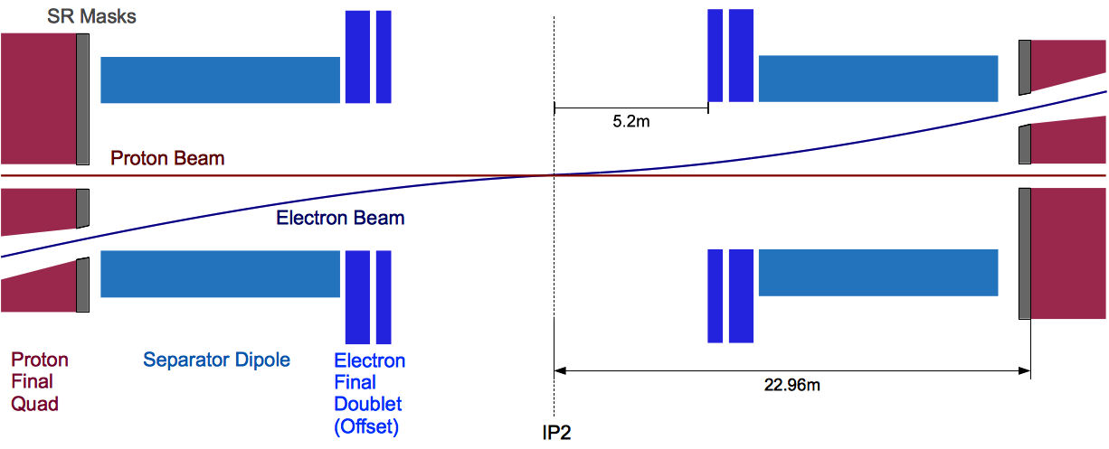
Ring - Arc Optics and matched IR

Slide 8
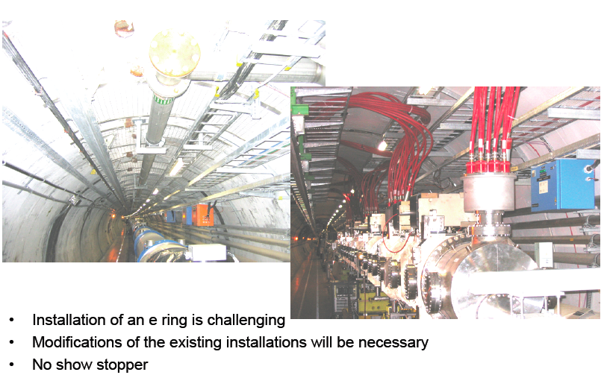
Ring Installation Study
This is the big question for the ring option (interference, activation,..)

Slide 9

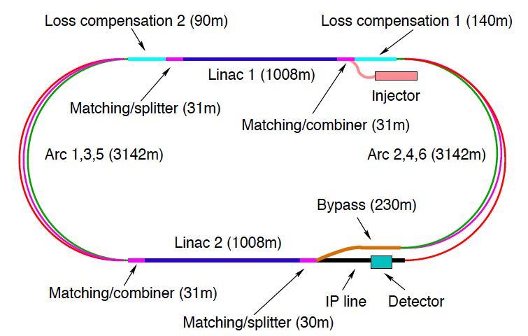
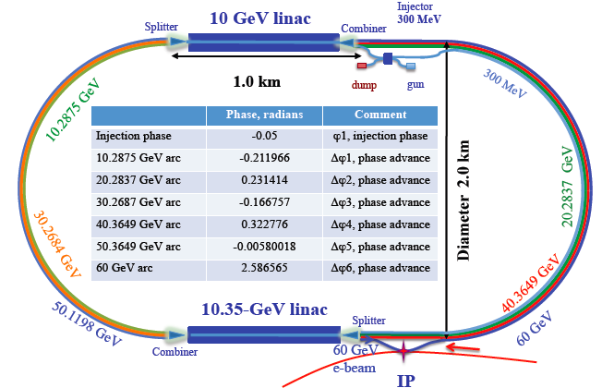
LINACs
CERN 1
CERN 2
Jlab
BNL
Two 10 GeV Linacs, 3 returns, compensation for synchrotron radiation losses, recovery of power

Slide 10
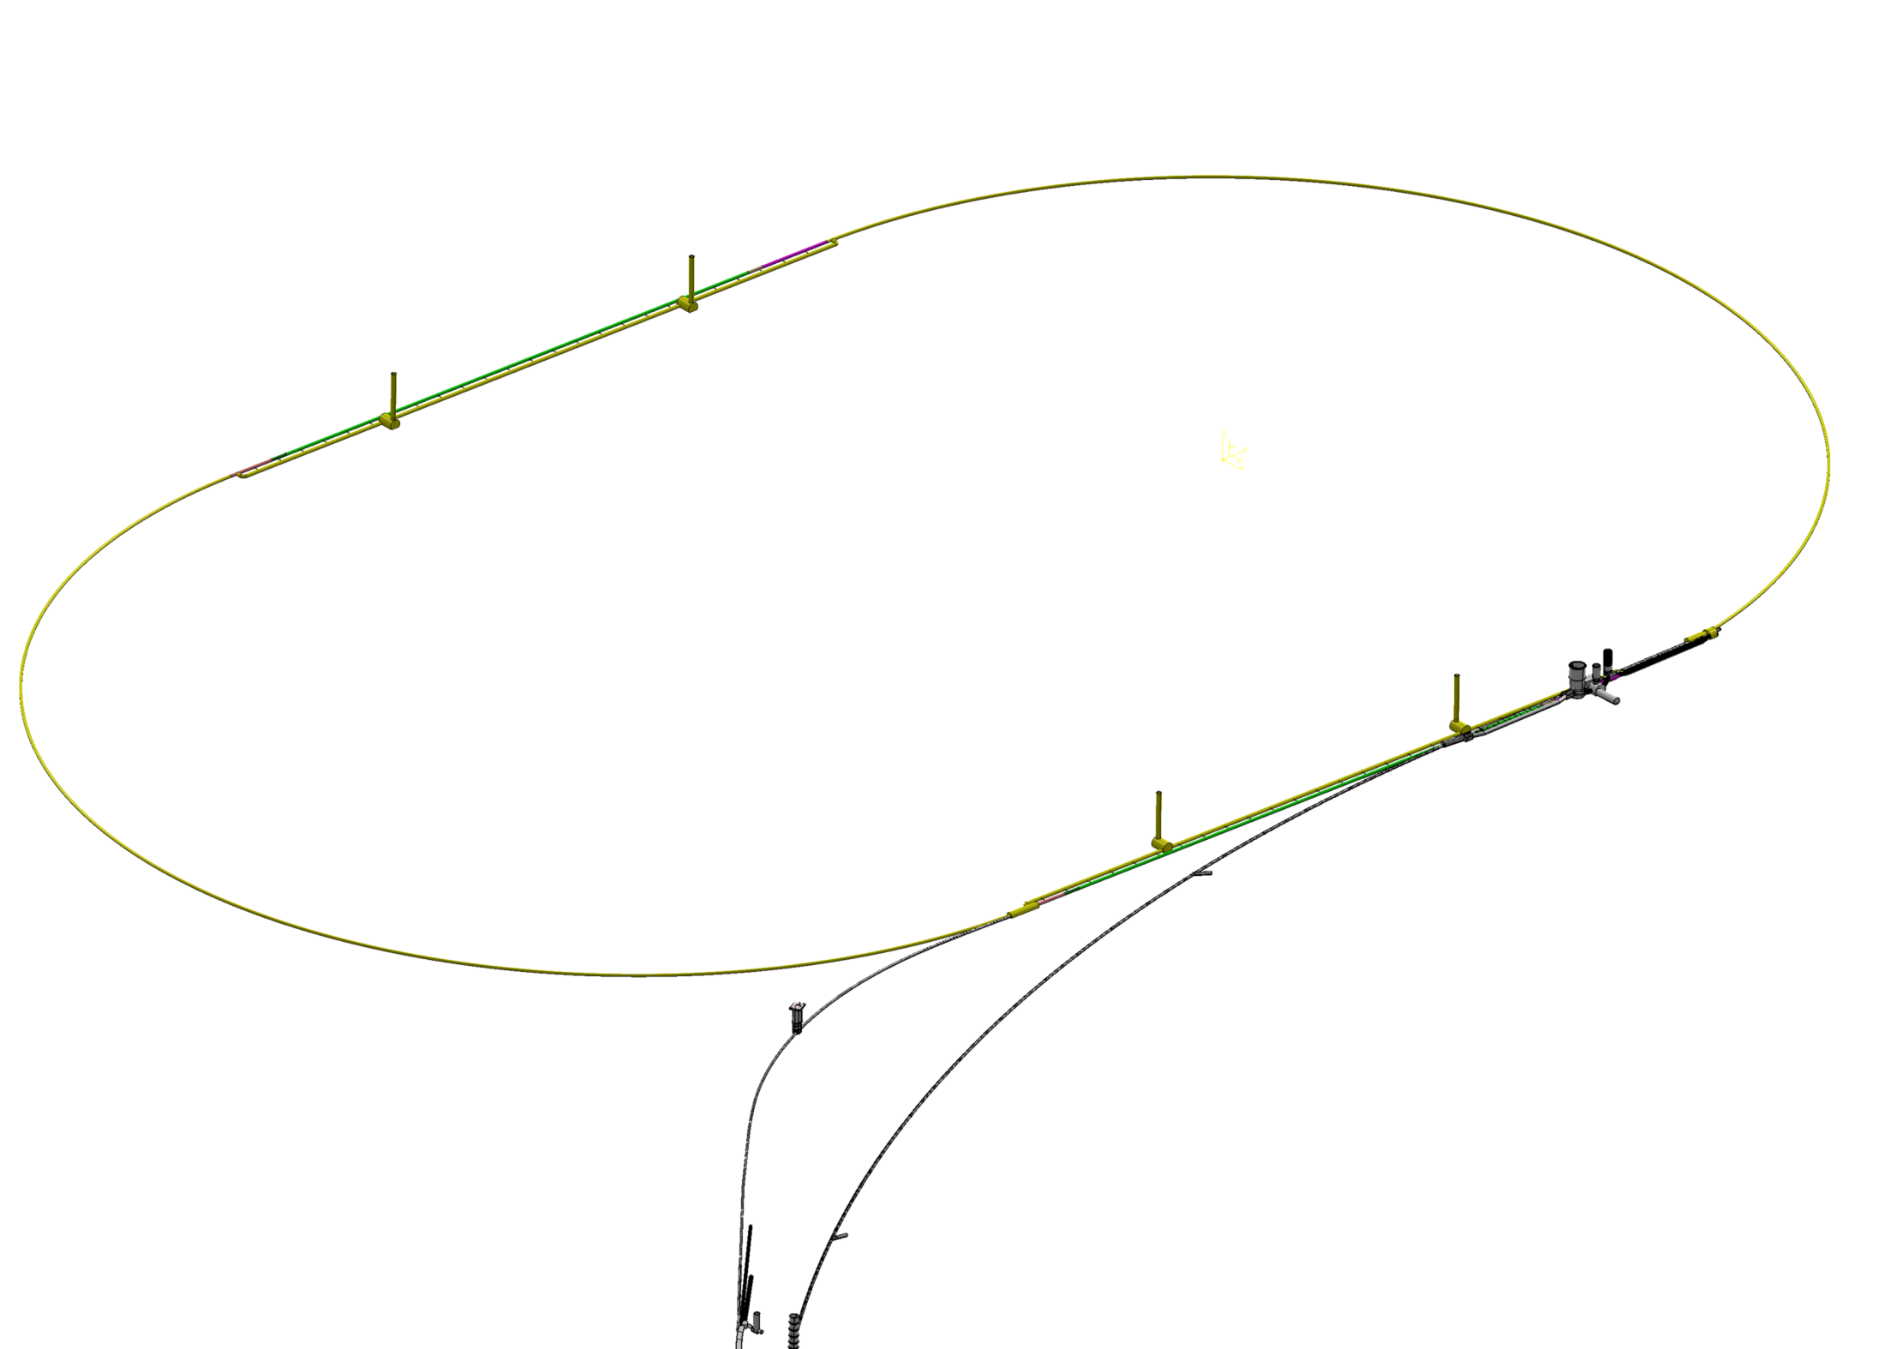
60 GeV Energy Recovery Linac
U=1/3 U(LHC)
Multibunch wakefields - ok
Emittance growth - ok
[ILC 10nm, LHeC 10μm]
36σ separation at 3.5m - ok
Fast ion instability - probably ok
with clearing gap (1/3)
Q – probably ok (between ILC/BNL)

Slide 11
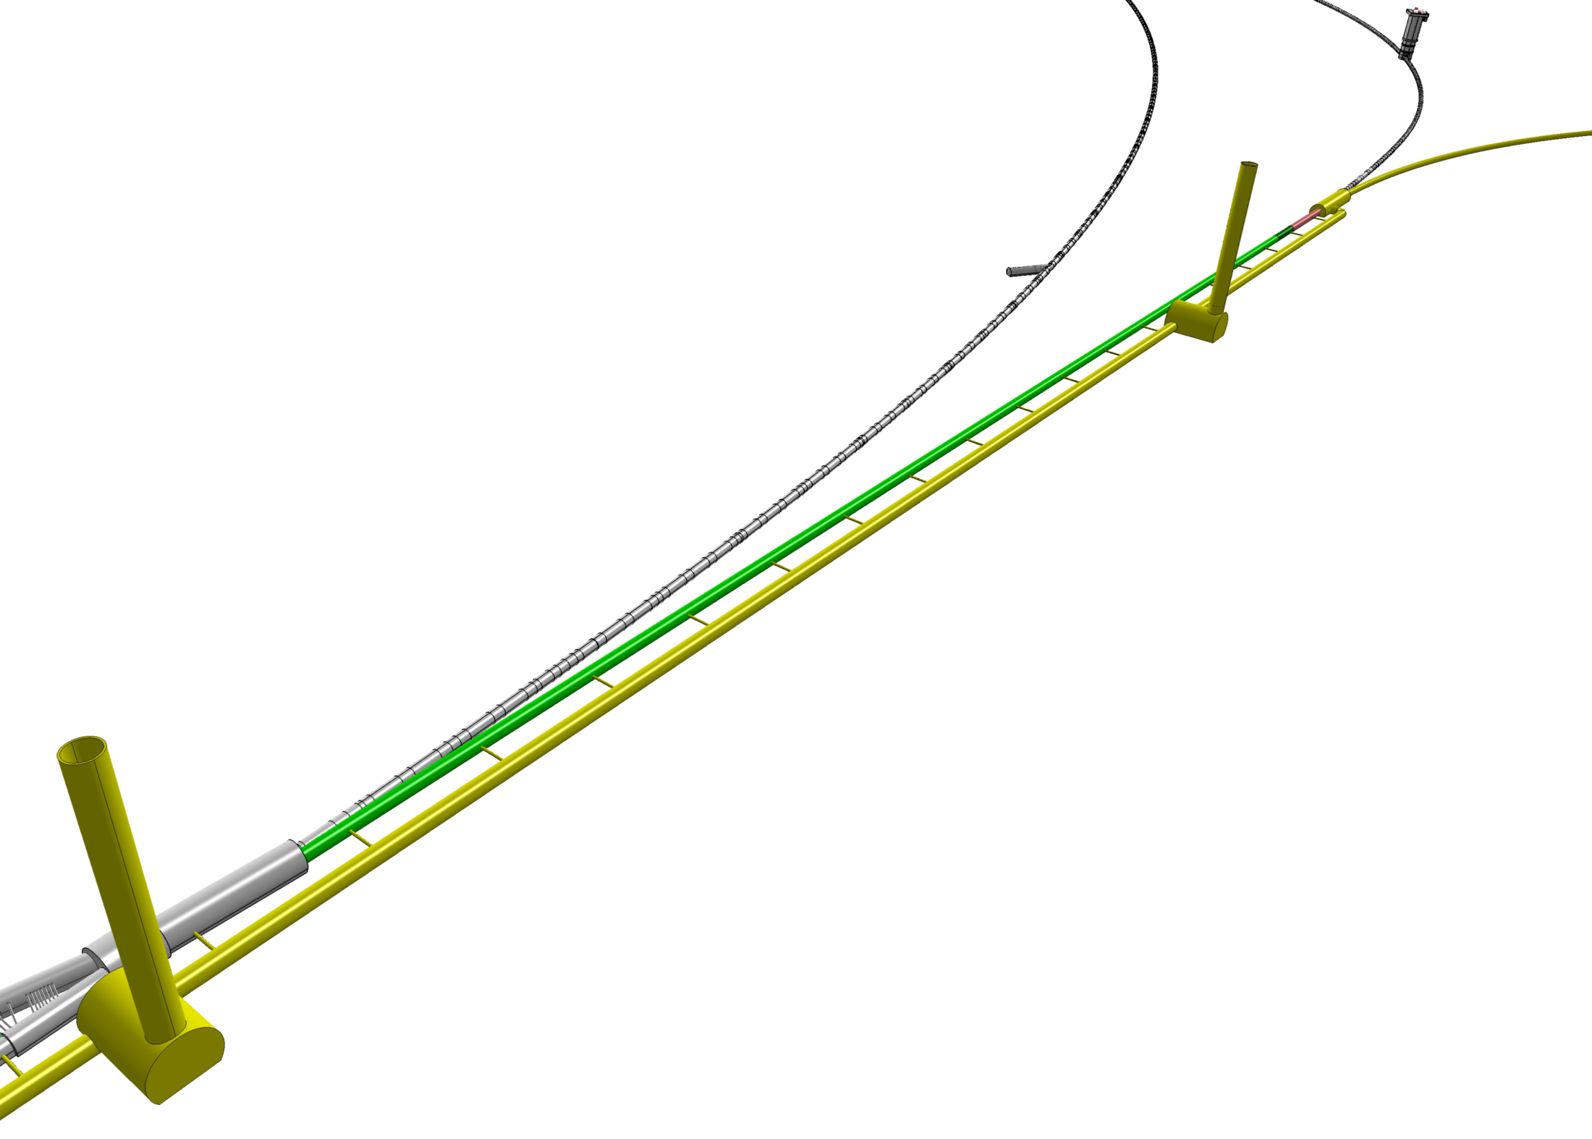
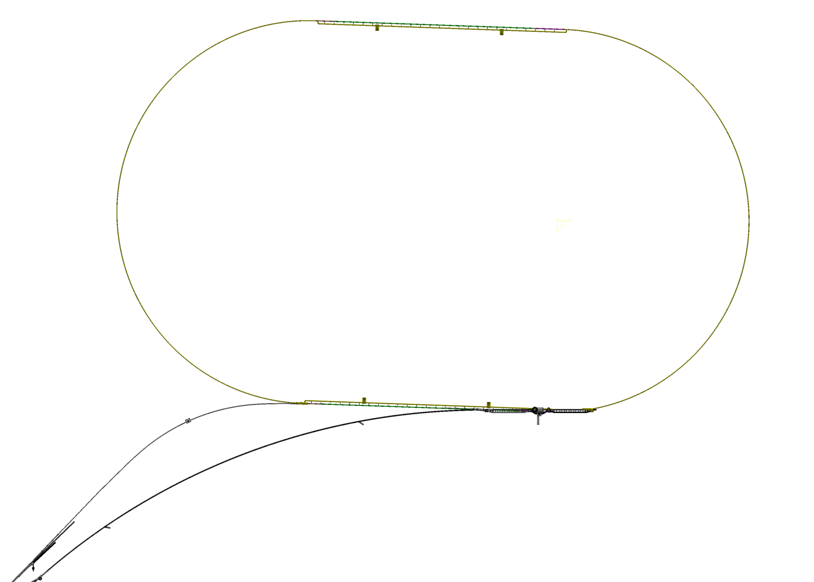
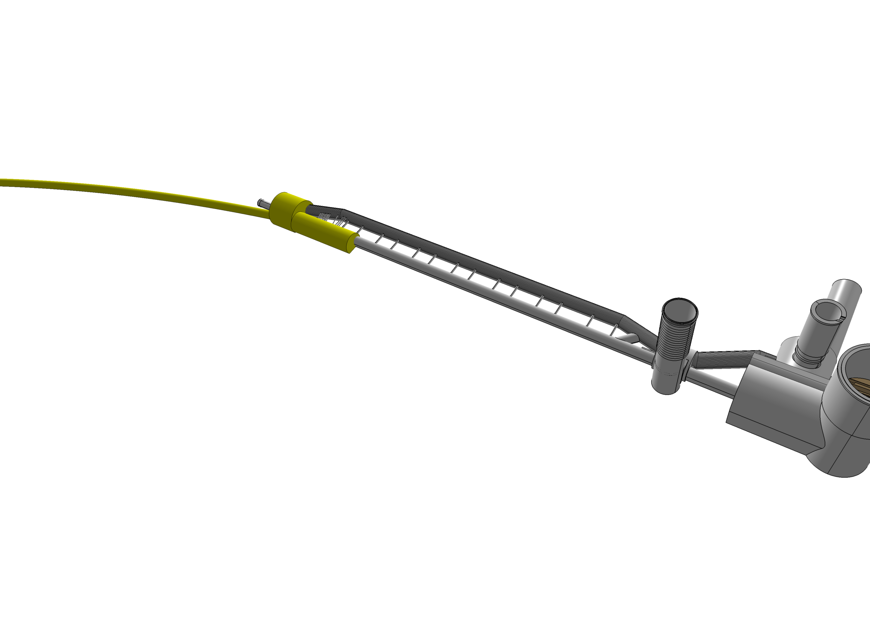
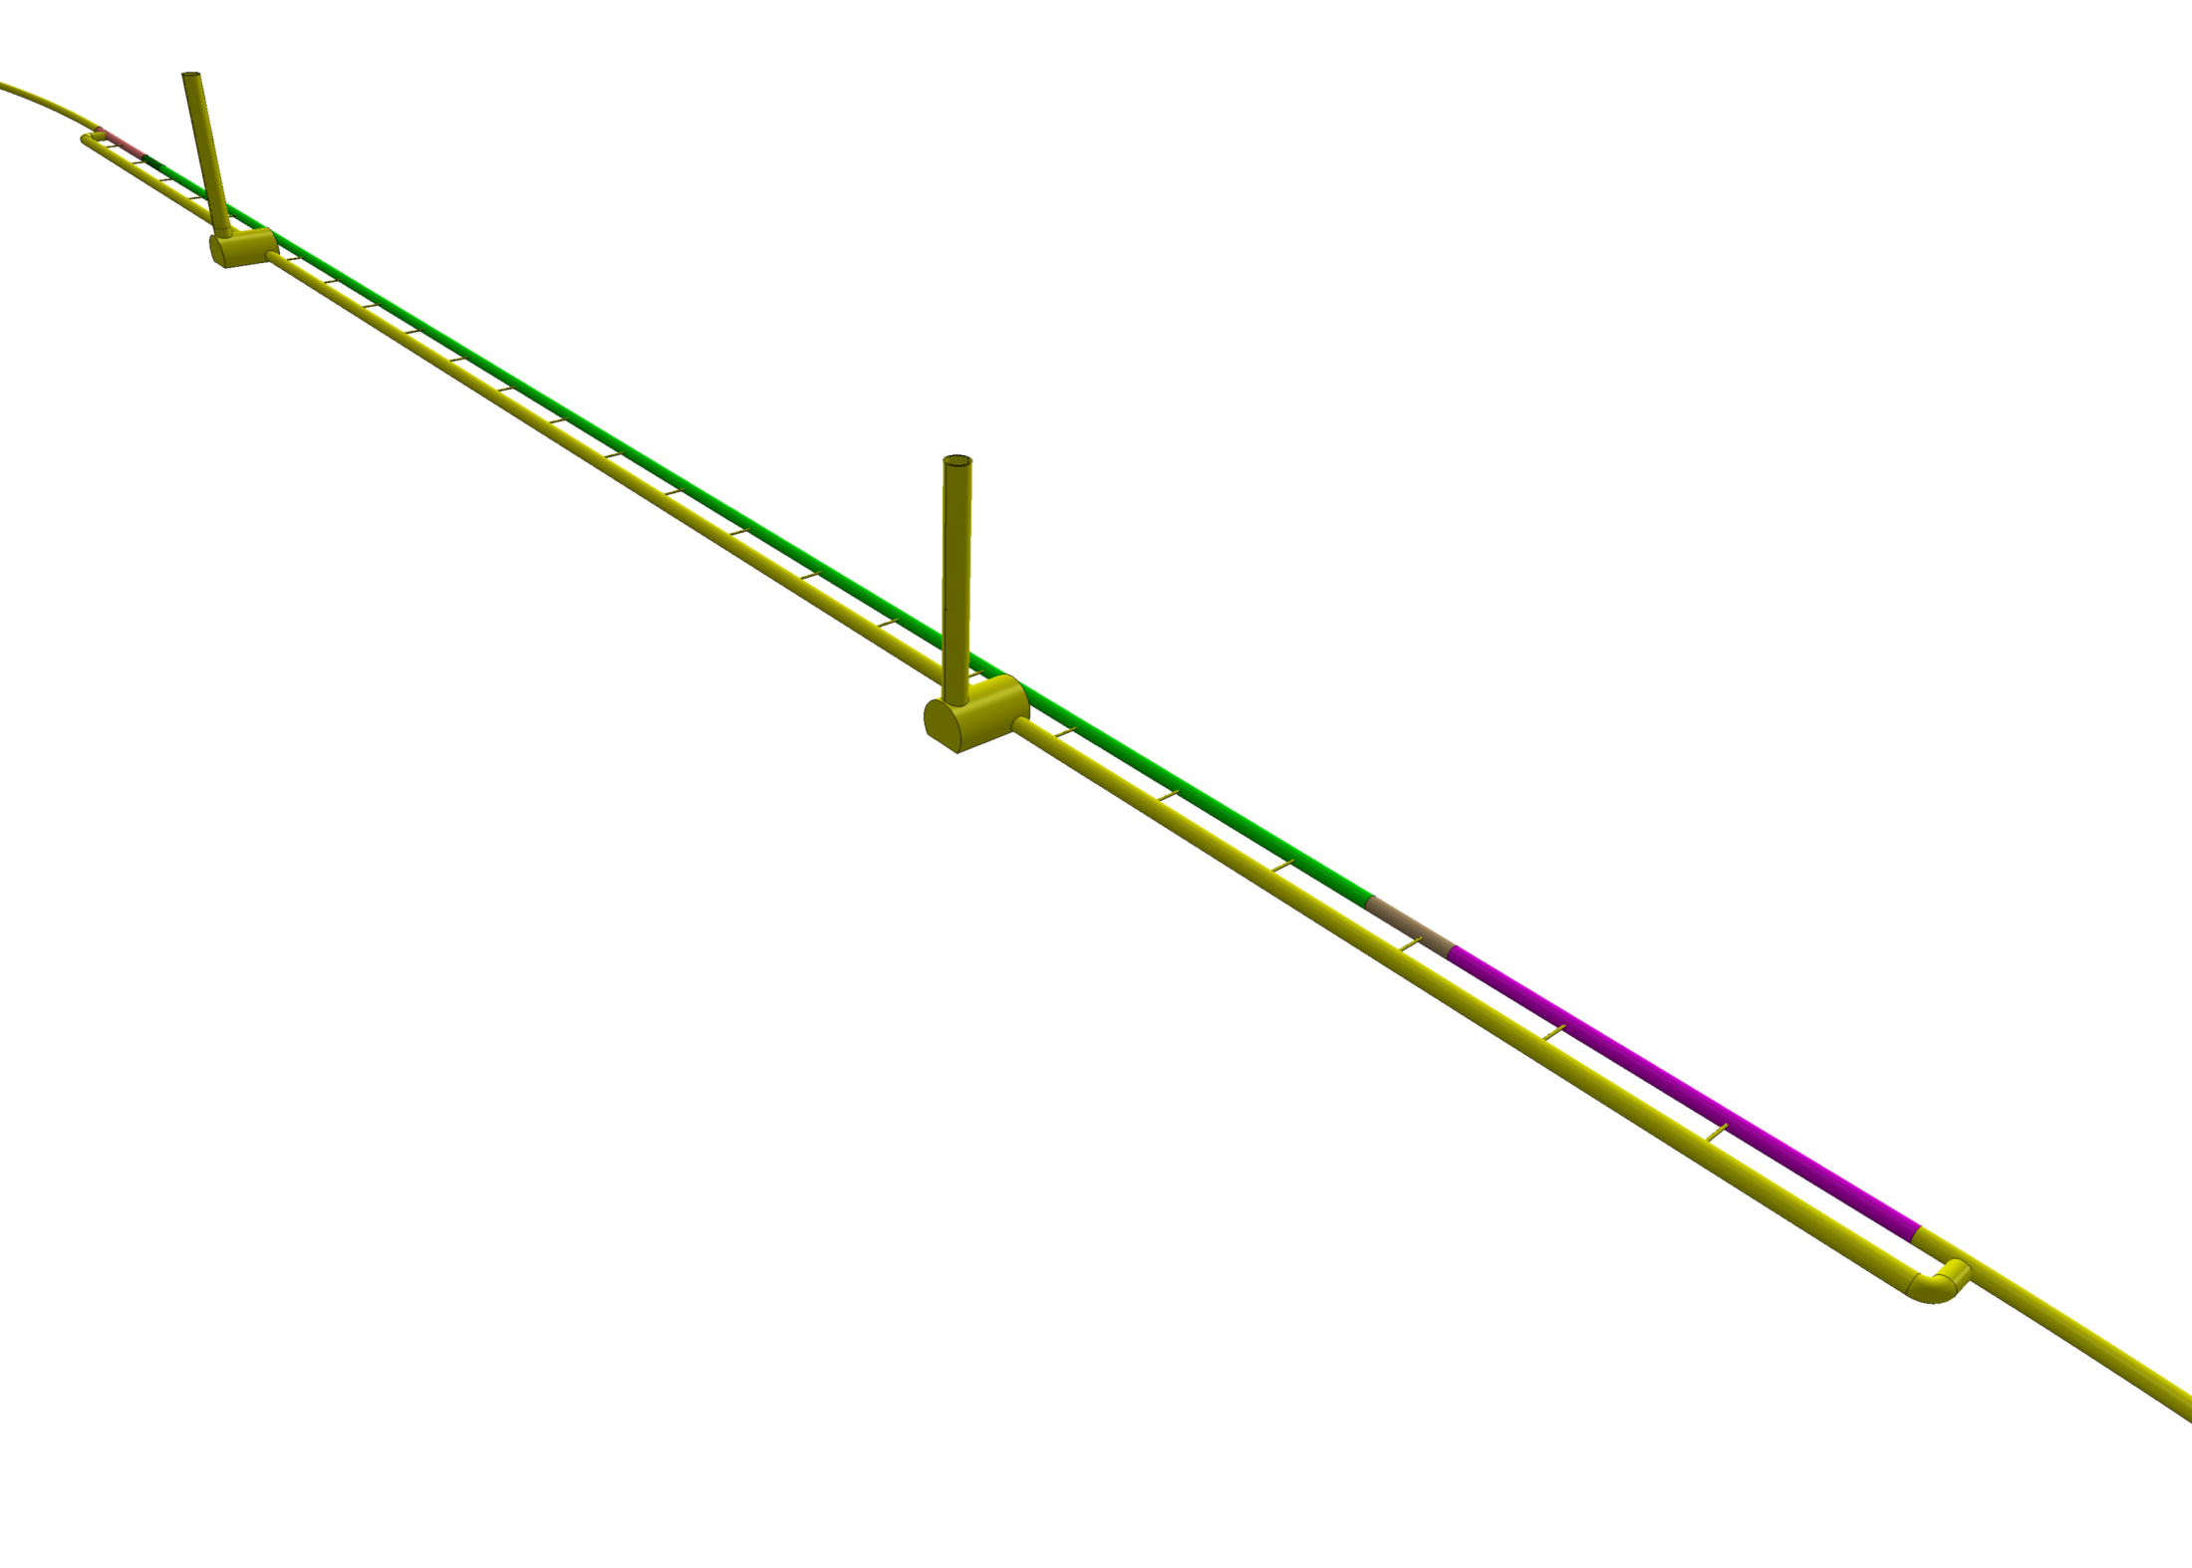
LINAC Views
LINAC into hall
TI2 use tentative
LINAC when assigned to ALICE hall
Injector, dumps to be drawn still
LINAC leaving hall
initial LINAC

Slide 12
Design Parameters
electron beam | RR | LR | LR
e- energy at IP[GeV] | 60 | 60 | 140
luminosity [10³² cm⁻²s⁻¹] | 17 | 10 | 0.44
polarization [%] | 40 | 90 | 90
bunch population [10⁹] | 26 | 2.0 | 1.6
e- bunch length [mm] | 10 | 0.3 | 0.3
bunch interval [ns] | 25 | 50 | 50
transv. emit. γε_{x,y} [mm] | 0.58, 0.29 | 0.05 | 0.1
rms IP beam size σ_{x,y} [μm] | 30, 16 | 7 | 7
e- IP beta funct. β*_{x,y} [m] | 0.18, 0.10 | 0.12 | 0.14
full crossing angle [mrad] | 0.93 | 0 | 0
geometric reduction H_{hg} | 0.77 | 0.91 | 0.94
repetition rate [Hz] | N/A | N/A | 10
beam pulse length [ms] | N/A | N/A | 5
ER efficiency | N/A | 94% | N/A
average current [mA] | 131 | 6.6 | 5.4
tot. wall plug power[MW] | 100 | 100 | 100
proton beam | RR | LR
bunch pop. [10¹¹] | 1.7 | 1.7
tr.emit.γε_{x,y} [μm] | 3.75 | 3.75
spot size σ_{x,y} [μm] | 30, 16 | 7
β*_{x,y} [m] | 1.8,0.5 | 0.1
bunch spacing [ns] | 25 | 25
“ultimate p beam”
1.7 probably conservative
Design also for deuterons
(new) and lead (exists)
RR= Ring – Ring
LR =Linac –Ring
Parameters from 8.7.2010
New: Ring: use 1º as baseline : L/2
Linac: clearing gap: L*2/3

Slide 13
Ring RF system at 721.4 MHz. 60 GeV 100 mA
Synchrotron losses ≈400 MeV: 500 MV => 43 MW rated RF system (RF Feedback margin)
Efficiency: take 40% => < 100 MW mains power.
SPL like 700 MHz cavity, but at harmonic that allows 25 ns bunch spacing (40.08 MHz multiple -> 721 MHz)
= > Synergy with ongoing SPL cavity prototyping work. Here limitation is not gradient but input power !
Assume 225 kW per coupler, 2 couplers per cavity, => 96 cavities (reasonable number)
5.2 MV/cavity only needed; SPL cavity is 25 MV/m in 5 cells length 1.06 m i.e. use 2 cell cavity.
=> 8 double cell cavities in 12 x 10 m cryomodules, Total Length 144 m, Incl. quads, vacuum, BI equipment.
Two cavities per one 1 MW Klystron - (Less space, “Only” 48 klystrons...)
Install all cavities in the IR bypass sections
208 m available (124 + 2 *42)
6 modules at CMS bypass = 72m
2 x 3 modules at ATLAS bypass = 2 * 36m
RF Power System underground
Need 100m² per 8 cavity module in adjacent RF gallery, i.e. 7-8 m wide over the module length
Surface: Need one HV Power Converter rated 6-8 MVA per 4 klystrons on surface.. (12)
Cryogenics: Split cold boxes: on surface and underground

Slide 14
3 – Pass ERL RF system at 721 MHz
Energy = 3 * 20 GeV, 2 x 10 GeV Linacs, 6.6 mA, Take 721 MHz, to allow 25 ns bunches
Take SPL type cavity @18 MV/m (Close to BNL design for eRHIC)
1.06 m/cavity => 19.1 MV/cav => 1056 cavities total (=132 x 8)
Take 8 cavities in a 14 m cryomodule (cf SPL) => 66 cryo modules/linac
Total length = 924 m/linac + margin ~10%
Power loss in arcs = 9.5 MW, 9 kW/cavity, Take P_{rf} = 20 kW/cavity with overhead for feedbacks, total installed RF 21 MW.
No challenge for power couplers, power sources – could be solid state
However, still need adjacent gallery to house RF equipment (high gradient = radiation !) 4-5 m diameter sufficient
Synchrotron radiation losses in arcs: need re-accelerating ‘mini’-linacs
Future: could hardware prototyping be initiated, on SC cavities, - good synergy with SPL Proton Driver study which is well underway. => Possibility of test of ERL concept at CERN ?

Slide 15
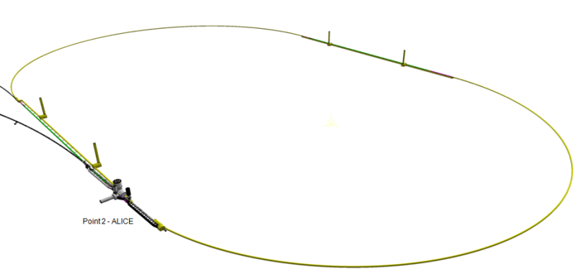
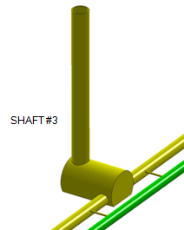
Linac-Ring Cryogenics
Cryo supply
ERL
Sector 250 m
Picture not to scale
1 km
string of cryomodules
CW operation, 18 MV/m
2 K thermal load: 37 W/m (for active length)
2 K total therma l load: 42 kW @ 2 K
Electric power: 30 MW
(with a COP of 700)
2 Cryoplant units
Compressor s
On surface
Cooling requirements dominated by dynamic losses at 2 K
(other loads neglected here for simplicity)
Split cold boxes (see LEP2, LHC)
Lay-out is based on LHC cryogenic principles with split cold boxes (surface cold box and underground cold box with cold compressors).
Refrigerator units of approx. 5 kW @ 2 K assumed. To be designed. Technology and experience: LHC, CEBAF (JLAB).
Underground cavern
Distribution
Cryo supply

Slide 16
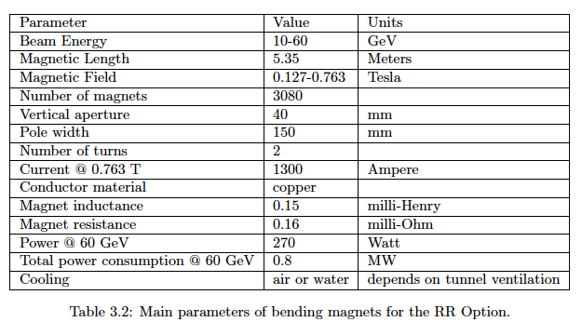
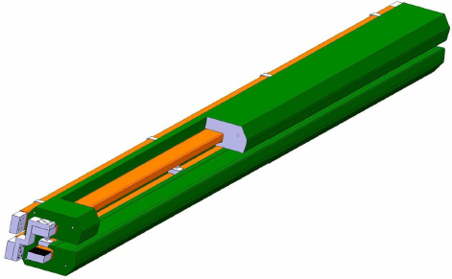
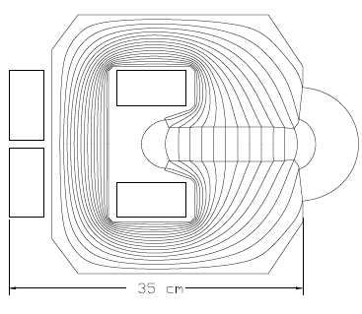
Ring Dipole Magnets
BINP &
CERN
prototypes
5m long
(35 cm)²
slim + light
for installation

Slide 17
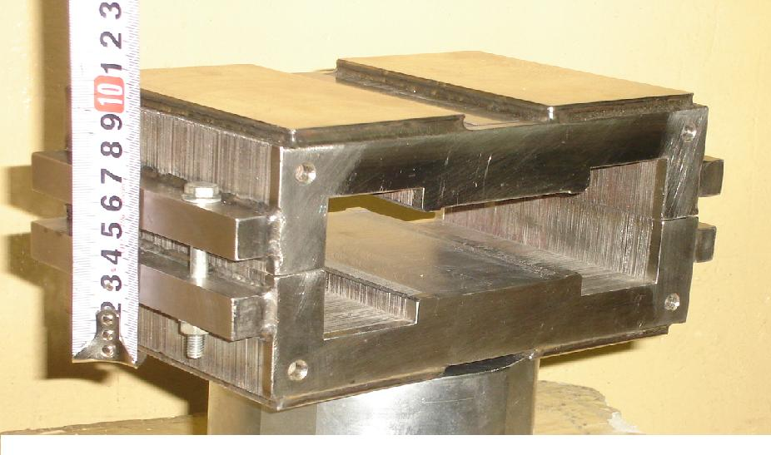
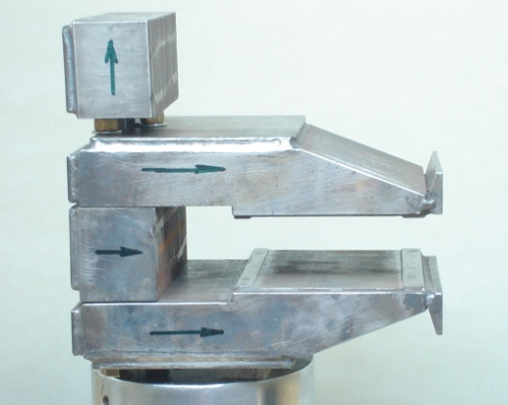
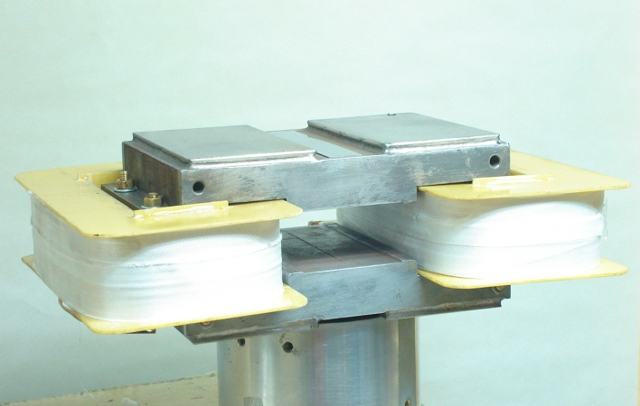
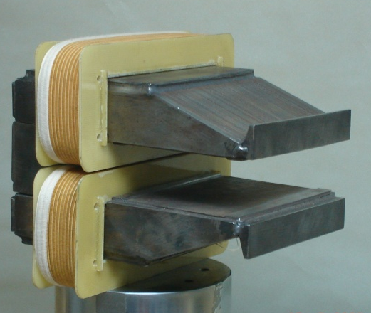
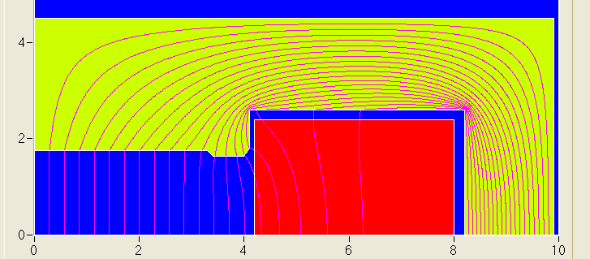
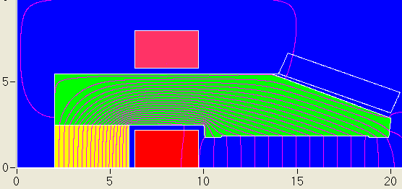
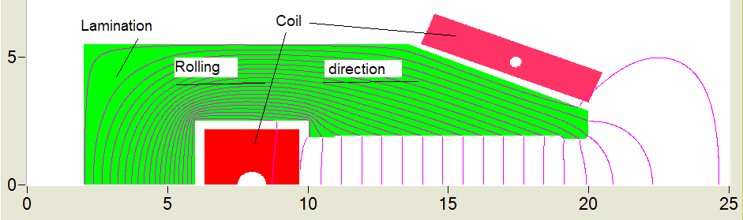
Dipole Prototype- BINP
22A/m
6A/m
3408 grain oriented steel
0.35 mm thick laminations
same results for the two alternatives
laminations of alternated rolling
Reproducibility of injection field is below 0.1 Gauss!

Slide 18
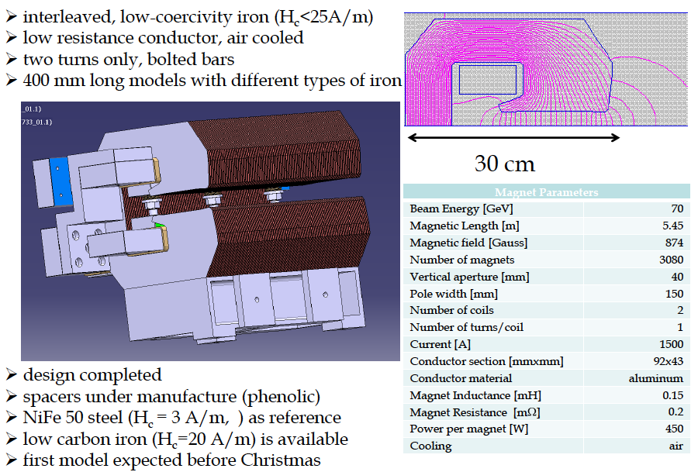
Status of CERN Dipole Prototype

Slide 19
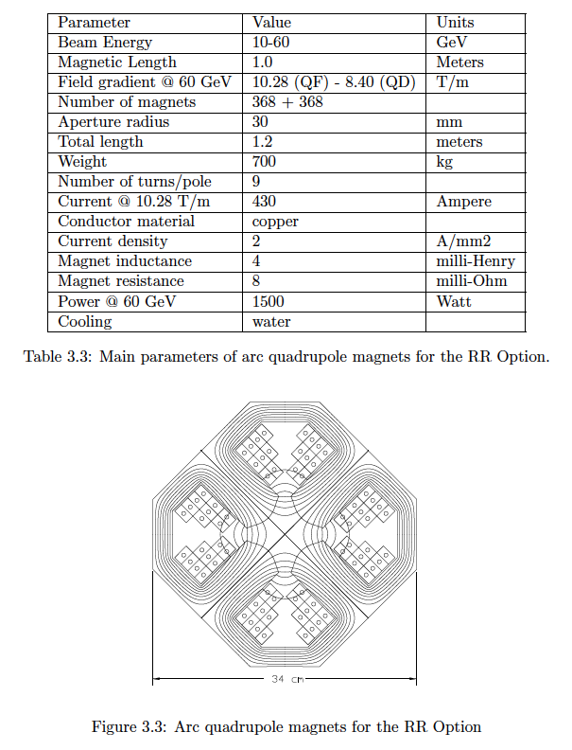
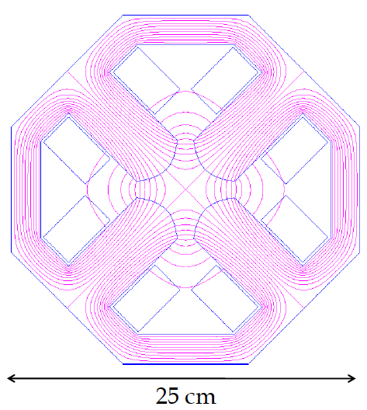
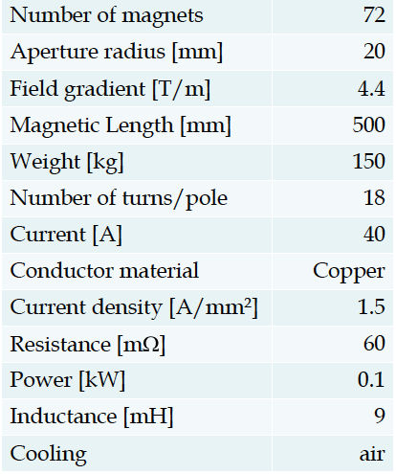
Ring-Arc Quadrupoles Linac
34 cm

Slide 20
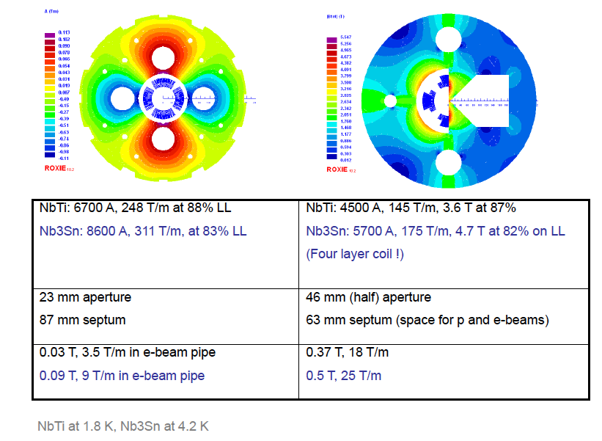
Final Proton Quadrupoles
Focus and deflect
3 beams in horizontal plane

Slide 21
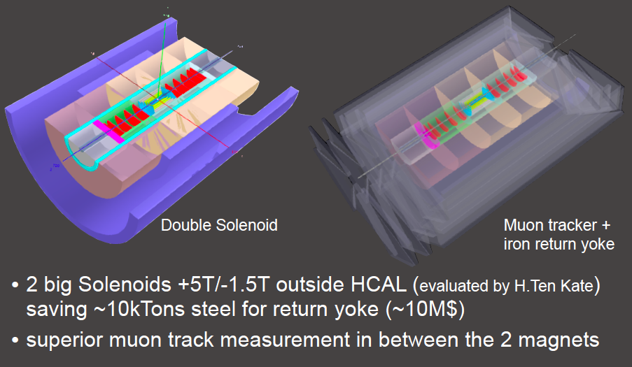
Double Solenoid Detector
Fwd/Bwd asymmetry in energy deposited and thus in technology [W/Si vs Pb/Sc..]
Present dimensions: LxD =17x10m² [CMS 21 x 15m² , ATLAS 45 x 25 m²]
Taggers at -62m (e),100m (γ,LR), -22.4m (γ,RR), +100m (n), +420m (p)

Slide 22
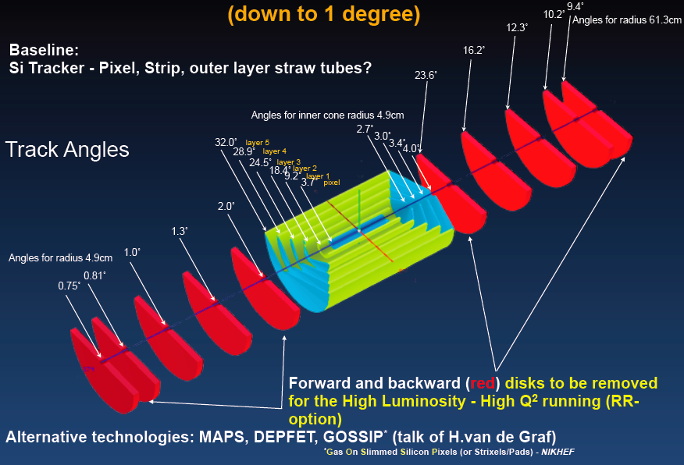
Track Detector Concept

Slide 23
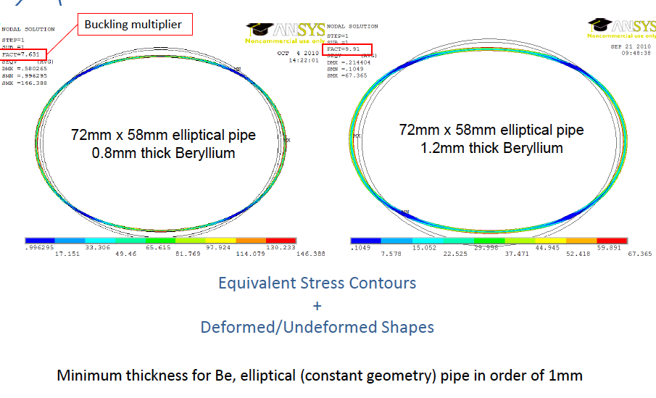
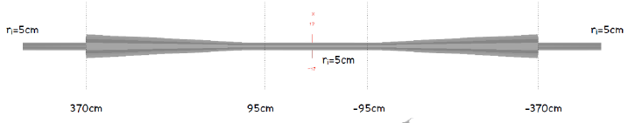
Beam Pipe Design
Also studied conical design (a la LHCb)

Slide 24
LHeC DRAFT Timeline
Based on LHC constraints, ep/A programme, series production, civil engineering etc
Year | 2012 | 2013 | 2014 | 2015 | 2016 | 2017 | 2018 | 2019 | 2020 | 2021 | 2022
 | Prototyping- testing
 |  |  |  | Production main components
 |  |  | Civil engineering
 |  |  |  |  |  |  |  | Installation
 |  |  |  |  |  |  |  |  |  | Operation
Variations on timeline:
production of main components can overlap with civil engineering
Installation can overlap with civil engineering
Additional constraints from LHC operation not considered here
in any variation, a start by 2020 requires launch of prototyping of
key components by 2012

Slide 25
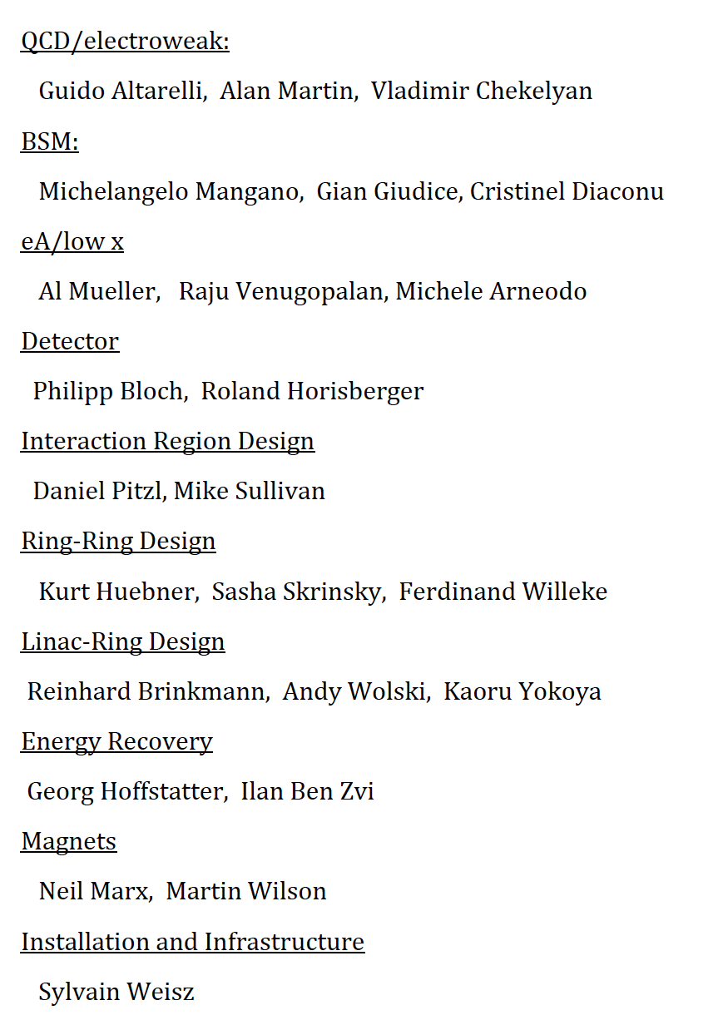
Organisation for the CDR
Accelerator Design [RR and LR]
Oliver Bruening (CERN),
John Dainton (CI/Liverpool)
Interaction Region and Fwd/Bwd
Bernhard Holzer (DESY),
Uwe Schneeekloth (DESY),
Pierre van Mechelen (Antwerpen)
Detector Design
Peter Kostka (DESY),
Rainer Wallny (U Zurich),
Alessandro Polini (Bologna)
New Physics at Large Scales
George Azuelos (Montreal)
Emmanuelle Perez (CERN),
Georg Weiglein (Durham)
Precision QCD and Electroweak
Olaf Behnke (DESY),
Paolo Gambino (Torino),
Thomas Gehrmann (Zuerich)
Claire Gwenlan (Oxford)
Physics at High Parton Densities
Nestor Armesto (Santiago),
Brian Cole (Columbia),
Paul Newman (Birmingham),
Anna Stasto (MSU)
Referees of CERN
Scientific Advisory Committee
Guido Altarelli (Rome)
Sergio Bertolucci (CERN)
Stan Brodsky (SLAC)
Allen Caldwell -chair (MPI Munich)
Swapan Chattopadhyay (Cockcroft)
John Dainton (Liverpool)
John Ellis (CERN)
Jos Engelen (CERN)
Joel Feltesse (Saclay)
Lev Lipatov (St.Petersburg)
Roland Garoby (CERN)
Roland Horisberger (PSI)
Young-Kee Kim (Fermilab)
Aharon Levy (Tel Aviv)
Karlheinz Meier (Heidelberg)
Richard Milner (Bates)
Joachim Mnich (DESY)
Steven Myers, (CERN)
Tatsuya Nakada (Lausanne, ECFA)
Guenther Rosner (Glasgow, NuPECC)
Alexander Skrinsky (Novosibirsk)
Anthony Thomas (Jlab)
Steven Vigdor (BNL)
Frank Wilczek (MIT)
Ferdinand Willeke (BNL)
Steering Committee
Oliver Bruening (CERN)
John Dainton (Cockcroft)
Albert DeRoeck (CERN)
Stefano Forte (Milano)
Max Klein - chair (Liverpool)
Paul Laycock (secretary) (L’pool)
Paul Newman (Birmingham)
Emmanuelle Perez (CERN)
Wesley Smith (Wisconsin)
Bernd Surrow (MIT)
Katsuo Tokushuku (KEK)
Urs Wiedemann (CERN))
Frank Zimmermann (CERN)
Working Group Convenors

Slide 26
Final Remarks
The CDR draft is currently being written (140 pages on svn) by perhaps 100 authors.
November 12/13: 3rd LHeC Workshop. December and January for completion and updates
February/March for referees to comment, followed by updating the CDR
Cost estimate organised by CERN Print in spring 2011
Issues of present concern and attention: Coherence, plots, text for all chapters.
Detailed IR layout with masks and absorbers – finalisation of detector concept
Understanding and write-up of necessary R+D steps
For the continuation of the project, a new mandate/expressions of interest by ECFA and NuPECC
are essential, which allow to adapt the organisation of the further work, together with CERN.
The Ring (which has Linac elements) has high lumi with both charges, reserve for high luminosity and estimated lepton polarisation between 25 and 40%. It looks easier to build but is hard to install.
The Linac (which has arcs..) with ER has high lumi for e⁻ and >80% polarisation, yet is much less luminous for e⁺. It is challenging to build but easier to install.
It has been decided early on to first conclude the design work and then choose L vs R. This is not
unrelated to the LHC. The CDR also has a section on a 140 GeV straight LINAC, which would need more than 100 MW to exceed 10³² luminosity (and thus extraordinary physics reasons to be built).
The detector will and can be based on ‘existing’ technology, but it needs 10 years too.
The LHeC is worth an intensified, broadened effort, but cannot ignore the pace of the LHC clock.

Slide 27

Thanks
BINP Novosibirsk
BNL
CERN
Cockcroft
Cornell
DESY
EPFL Lausanne
Jlab
KEK
Liverpool U
SLAC
TAC Turkey
To the many experts in engineering, accelerators, detectors, experimental
physics, software, theory and politics for their engagement in this project,
which was launched in 2007 by the SPC, CERN and ECFA and approaches
completion of its first phase in the attempt to reach the real world.
Particular thanks to the directors of CERN, to ECFA and NuPECC for their
attention and support.
Personal thanks to Patricia Mage, to my Liverpool colleagues for extending
their understanding of academic freedom to my ‘hobby’ and many old and
new friends.
Gell-Mann 1966

Slide 28
RF

Slide 29
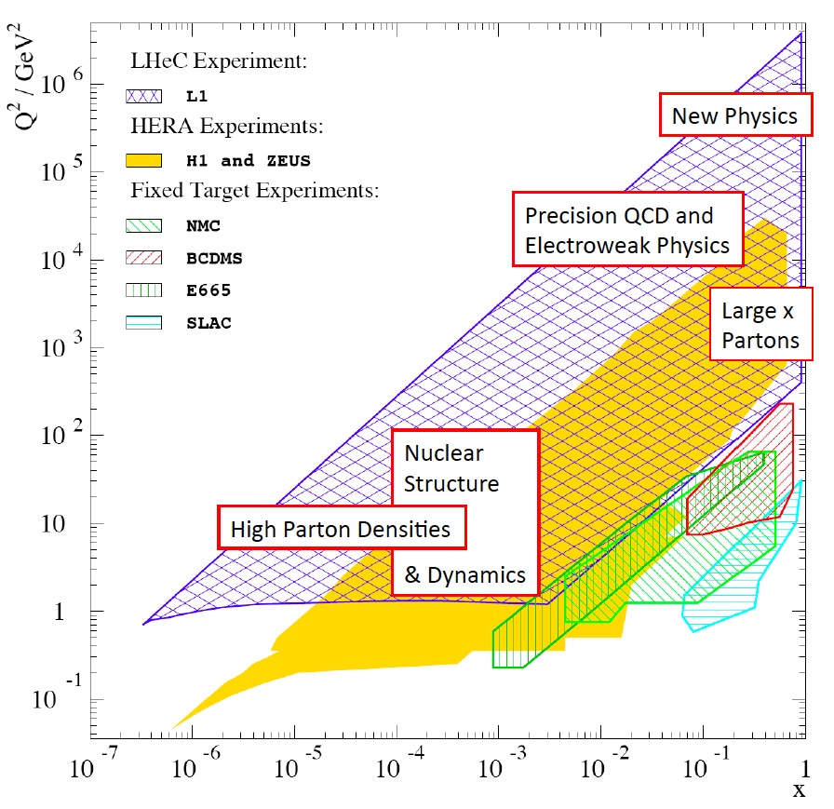

Slide 30
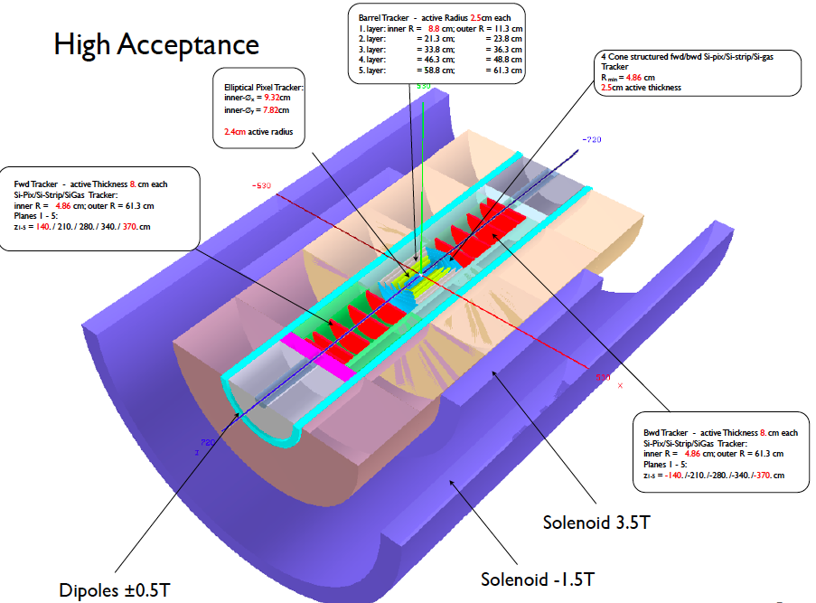
2 solenoid detector concept

Slide 31
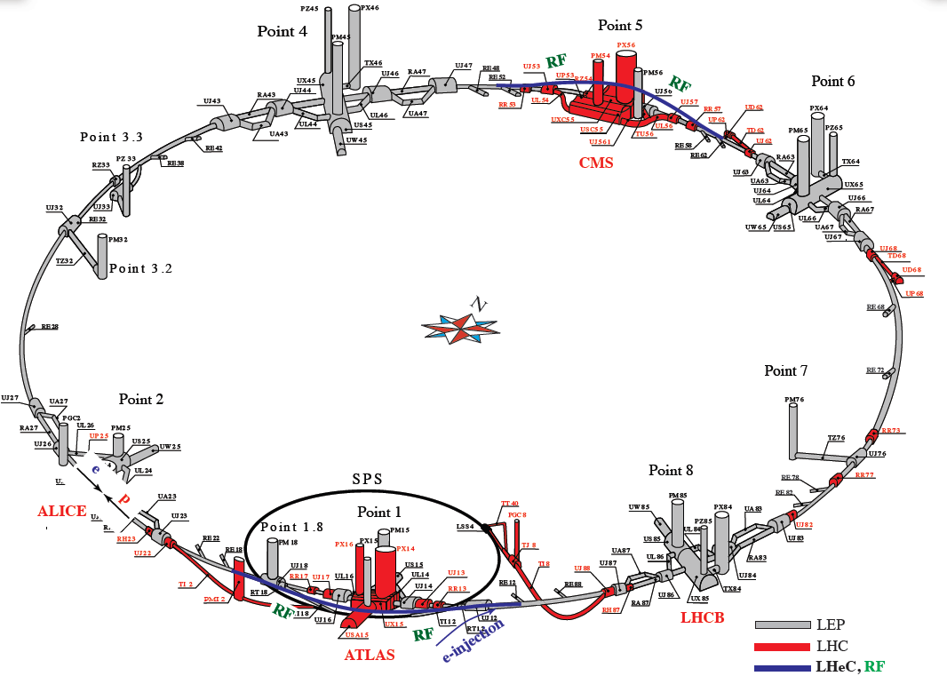
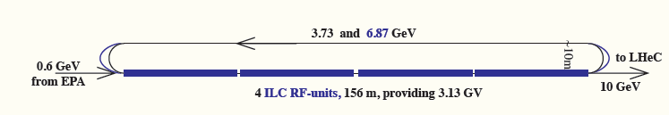
Ring-Ring Cryogenics (basics)
For the CMS and ATLAS bypasses are considered:
LHC type cryomodules (400 MHZ)
SPL type cryomodules (704 MHz)
Cryogenics requirements
4.5 K operation. Two cryoplants of approx. 10 kW @ 4.5 K each. El. power approx. 5 MW total.
2 K operation. The installed power of the cryoplants is a function of acc. field (to be determined). (El. power comparable to 1.)
CMS by-pass
cryoplant
String of cryomodules
cryoplant
ATLAS by-pass
String of cryomodules
Injector:
12 ILC (XFEL) cryomodules. Intermittend operation. Operation temp. 2K.
Cryoplant of modest size
(0.2 kW @ 2 K)
beam
Injector
ATLAS area

Slide 32
Time Considerations for an LHeC Installation:
LHC upgrade plans:
HiLumi upgrade planned for 2020 with goal of
  an average luminosity of 5 10³⁴ cm⁻² sec⁻¹
  an integrated luminosity of 250fb⁻¹ per year and
  a total of 3000 fb-1 over the lifetime of the LHC.
With the HiLumi parameters the LHC will reach the lifetime goal of
3000 fb⁻¹ by 2030 to 2035 depending on the efficiency of the HiLumi
commissioning performance ramp up.
Aiming for a minimum of 10 years of exploitation for the LHeC this
requires start of LHeC operation by about 2020
Based on the experience of other projects (e.g. LEP, XFEL and LHC),
a large facility like the LHeC will require 1-2 years of installation;
ca. 3 years of production including pre-series production; plus ca
1-2 years of test bench operation of the key components
Total installation time of 5 to 7 years.

Slide 33
Civil Engineering Requirements
Energy recovery linac option for linac-ring design:
total tunnel length of ca. 10km (similar to 500 GeV CLIC option):
4 years for civil engineering
2 years of service installation (piping, cabling, EL general services)
2 years of actual machine installation
Total of 6 years with partial overlap of some of these activities
(Not counting any time for legal preparations for construction on communal property!)
Bypass for ring-ring option:
Total tunnel length of ca. 2km (ca. 500 on either side of experiment)
But also requires two access shafts (safety)
Requires dedicated alcoves for Klystrons and RF system
perhaps slightly shorter intervention time as for Linac-Ring options
Total of 5 years with partial overall of some of these activities
(Civil engineering for injector complex not considered here)

Slide 34
CDR in 2010/2011
April - DIS and QCD Workshop at Florence (DIS10)
May - KEK IPAC
NuPECC at Madrid → LHeC on Long Range Plan (Roadmap)
June - CERN SPC → Reported to Council
July - ICHEP at Paris
October – Dipole Prototype (Novosibirsk) successfully tested
November – 3rd CERN-ECFA-NuPECC Workshop (12/13.11.) http://cern.ch/lhec
December/January – Completion/editing of CDR
February/March – Refereeing
April/May – Update and Print

Slide 35
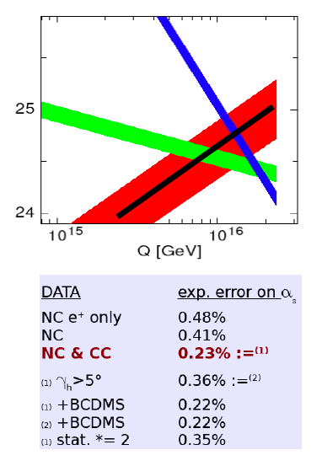
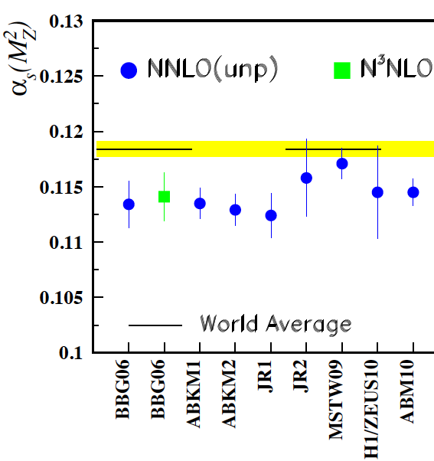
Strong Coupling Constant
Simulation of α_{s} measurement at LHeC
α_{s} least known of coupling constants
Grand Unification predictions suffer from δα_{s}
DIS tends to be lower than world average
LHeC: per mille accuracy indep. of BCDMS.
Challenge to experiment and to h.o. QCD
1/α
fine structure
weak
strong
MSSM - B.Allnach et al, hep-ex/0403133
?
+pol
J.Bluemlein and H. Boettcher, arXiv 1005.3013 (2010)

Slide 36
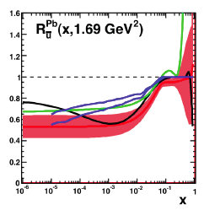
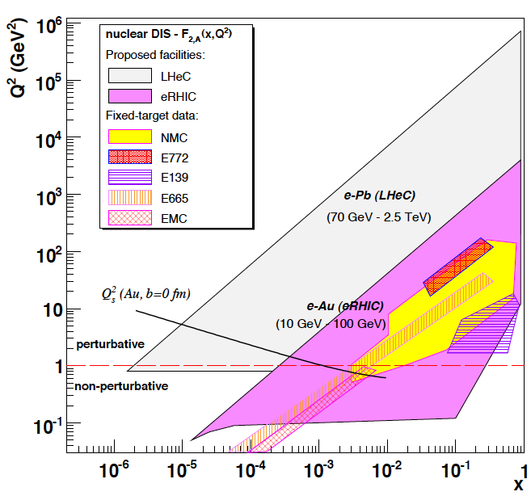
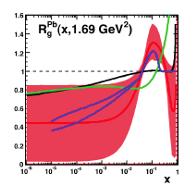
eA → eX
Extension of kinematic range by 3-4 orders of
magnitude into saturation region (with p and A)
Like LHeC ep without HERA.. (e.g. heavy quarks in A)

Slide 37
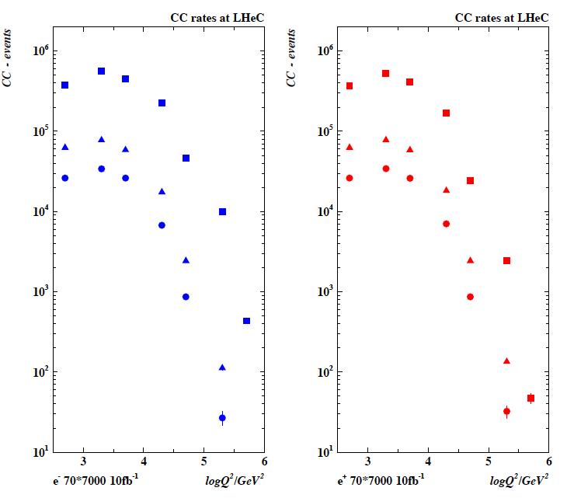
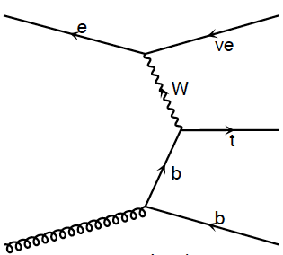
Single top and anti-top Production in Charged Currents
LHeC is a single top and
single tbar quark `factory’
CC t cross section O(5)pb
CC events for 10 fb⁻¹

Slide 38
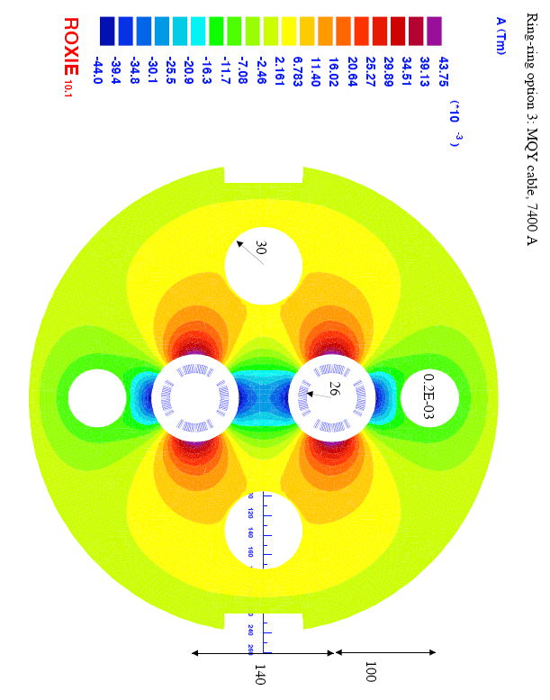
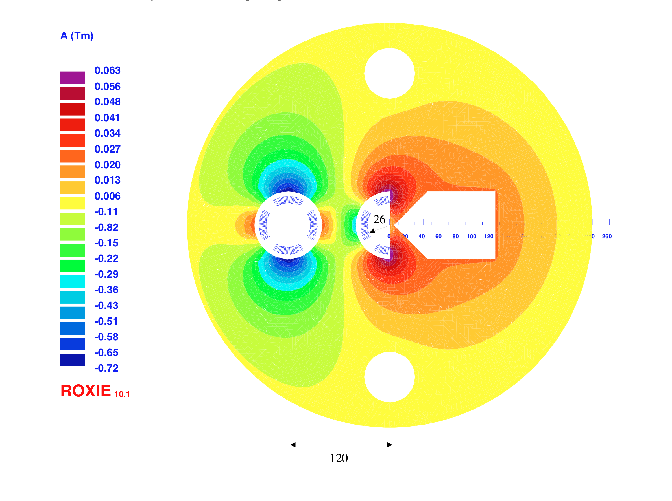
Interaction Region
Small crossing angle of about 1mrad to avoid first parasitic crossing (L x 0.77)
(Dipole in detector? Crab cavities? Design for 25ns bunch crossing [50ns?]
Synchrotron radiation –direct and back, absorption … recall HERA upgrade…)
Focus of current activity
1st sc half quad (focus and deflect)
separation 5cm, g=127T/m, MQY cables, 4600 A
2nd quad: 3 beams in horizontal plane
separation 8.5cm, MQY cables, 7600 A

