Slide 1
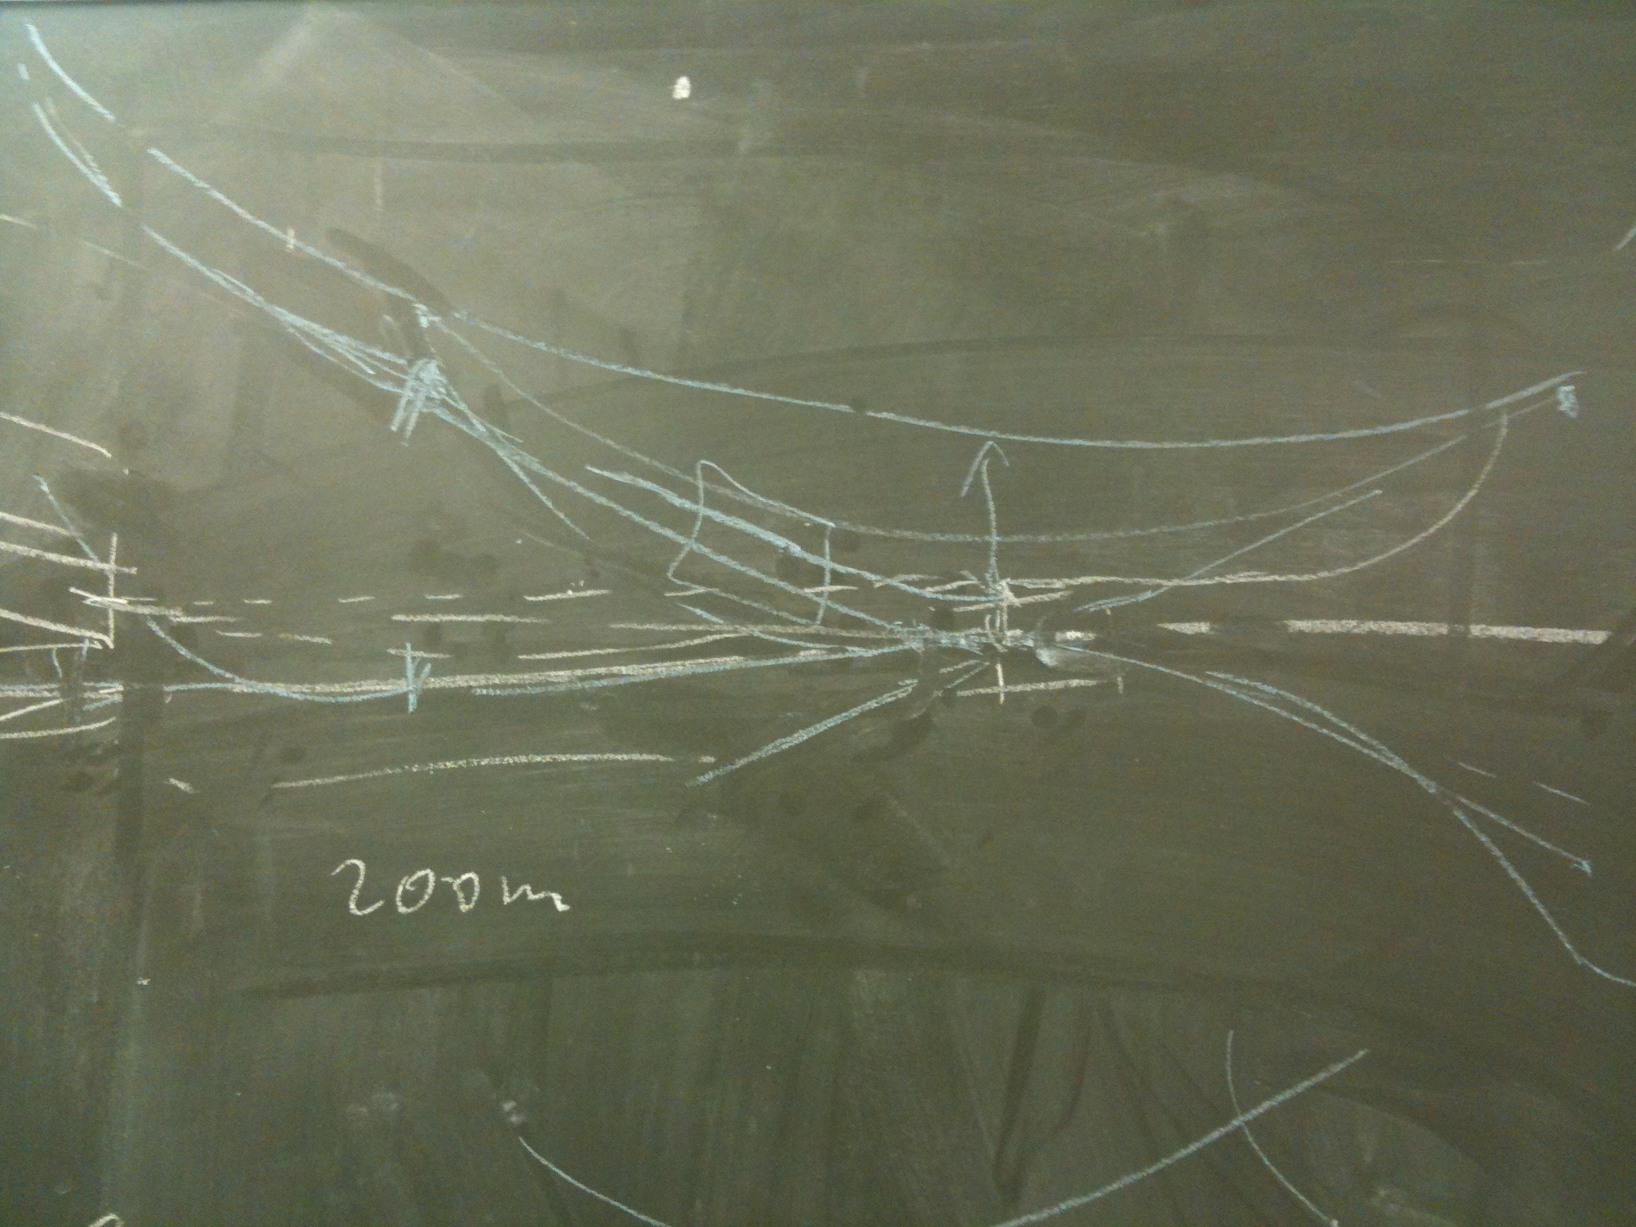
The LHeC Project
Max Klein
University of Liverpool
e
p
Overview
Physics
Accelerator
Detector
Seminar at UCL, London, 11.5.2012
http://cern.ch/lhec

Slide 2
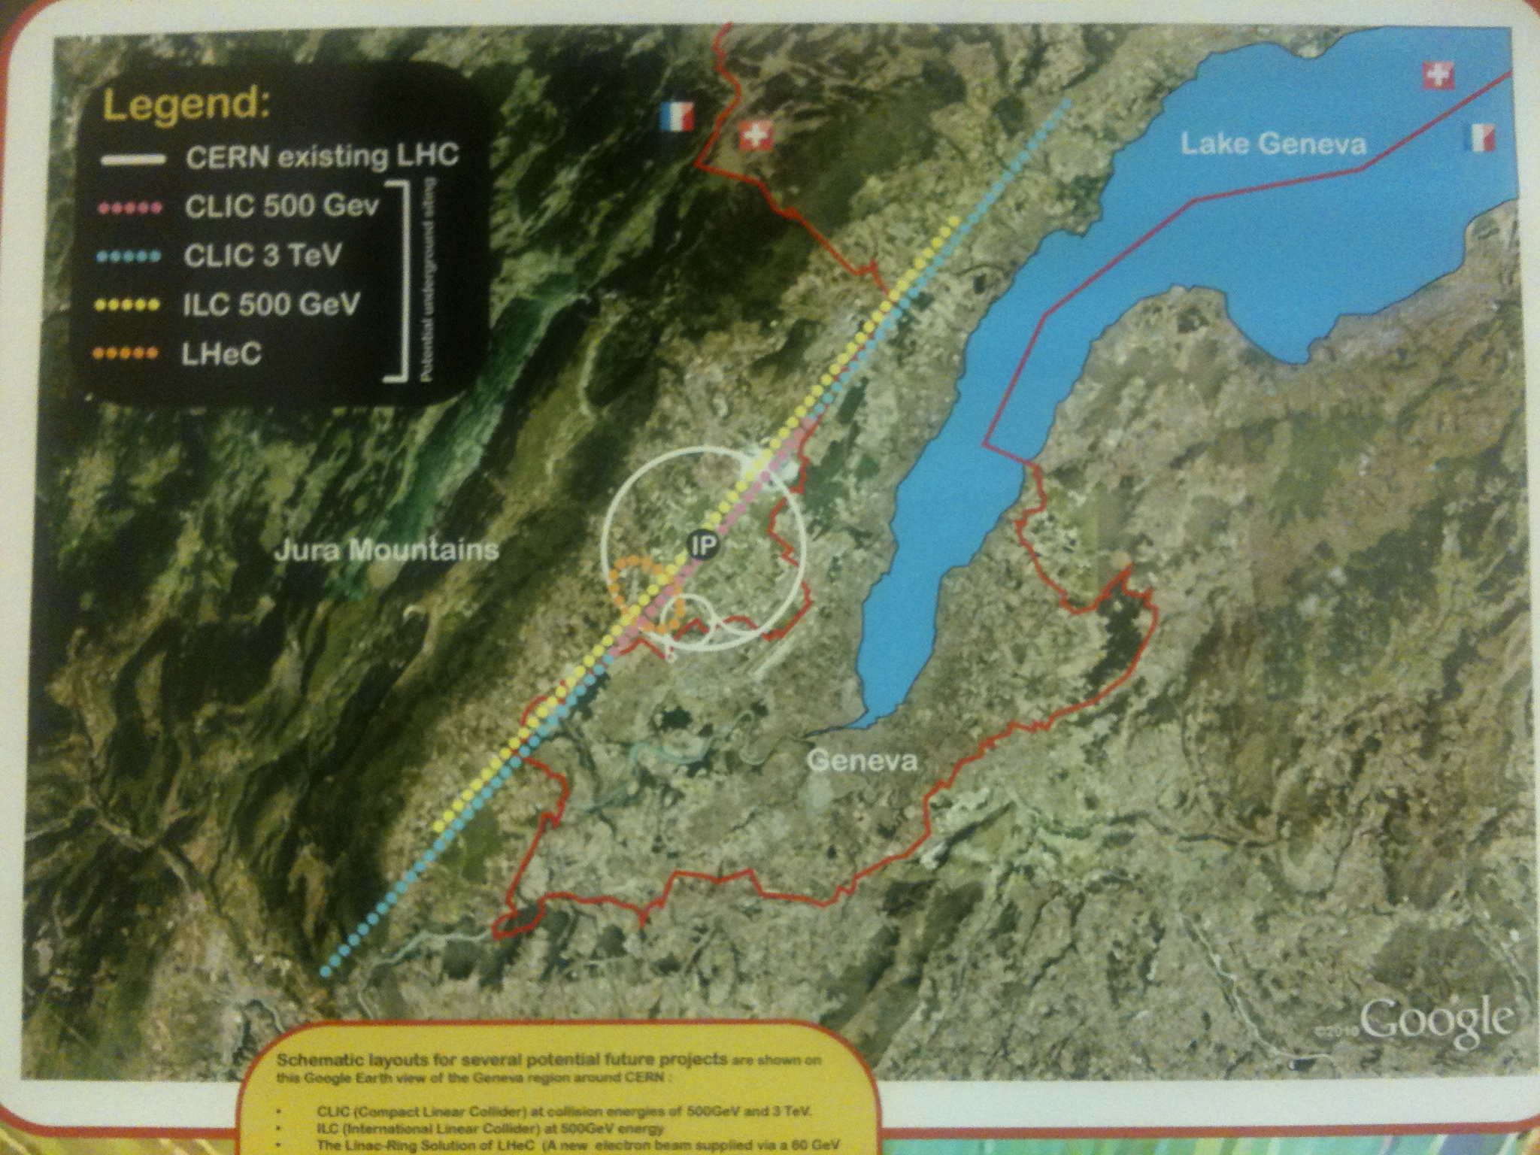
The LHeC Project
Max Klein
University of Liverpool
Seminar at UCL, 11.5.2012

Slide 3
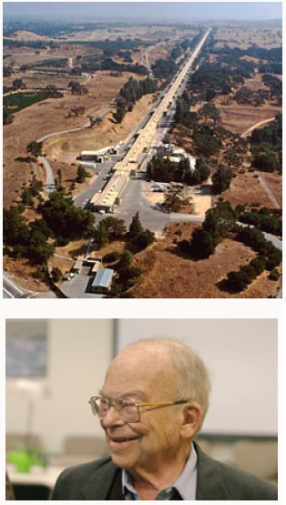
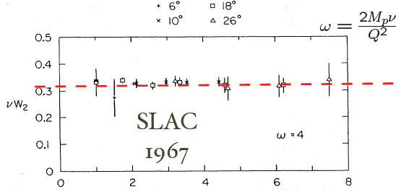
Foundation of DIS
2 mile electron linac
Q²
Bjorken scaling → Partons → Quark-Parton Model → QCD
SLAC 1967
LHeC 2024
With 2m (2*1km) linac, but off p at rest or the LHC
“Pief” Panowsky (1919-2007)

Slide 4
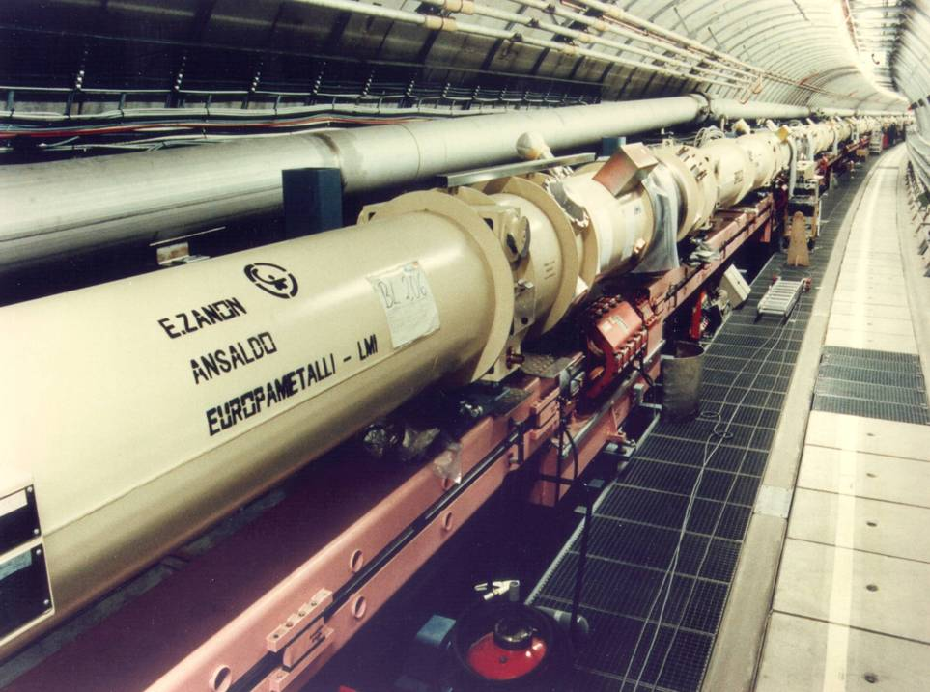
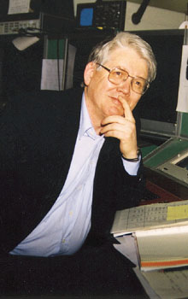
HERA ep: built 1985-1991
6.2 km ring accelerator(s)
Superconducting p ring
Warm magnet e ring
Data delivery 1992-2007
Bjoern Wiik
(1937-1999)

Slide 5
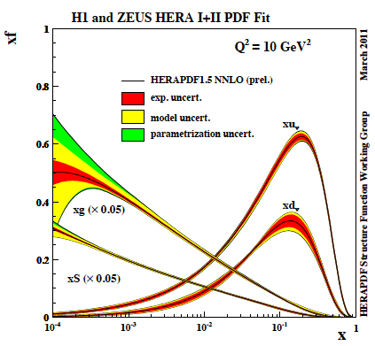
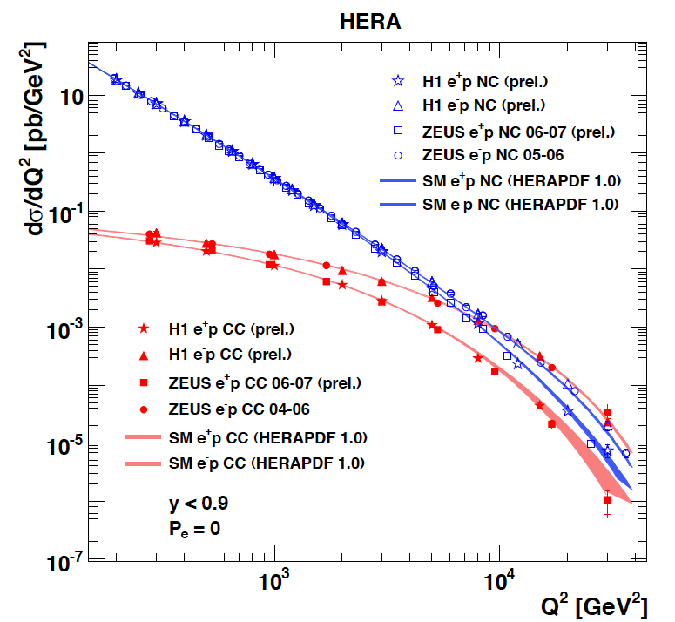
Results from HERA
F₂ rises towards low x, and xg too.
Parton evolution - QCD to NNLO
The weak and electromagnetic interactions reach similar strength when Q² ≥ M²_{W,Z}
Measurements on α_{s}, Basic tests of QCD: longitudinal structure function, jet production, γ structure
Some 10% of the cross section is diffractive (ep → eXp) : diffractive partons; c,b quark distributions
New concepts: unintegrated parton distributions (k_{T}) , generalised parton distributions (DVCS)
New limits for leptoquarks, excited electrons and neutrinos, quark substructure, RPV SUSY
Interpretation of the Tevatron measurements (high Et jet excess, M_{W}, searches..)
M.Klein, R.Yoshida: Collider Physics at HERA Prog.Part.Nucl.Phys. 61 (2008) 343-393 and recent H1,ZEUS results

Slide 6
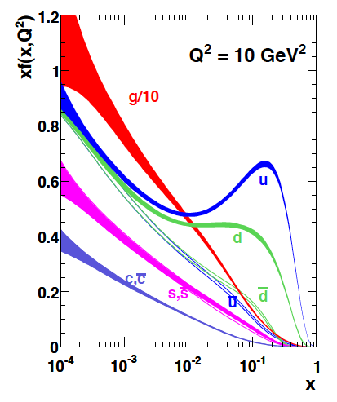
Results from HERA
MSTW08
The weak and electromagnetic interactions reach similar strength when Q² ≥ M²_{W,Z}
Measurements on α_{s}, Basic tests of QCD: longitudinal structure function, jet production, γ structure
Some 10% of the cross section is diffractive (ep → eXp) : diffractive partons; c,b quark distributions
New concepts: unintegrated parton distributions (k_{T}) , generalised parton distributions (DVCS)
New limits for leptoquarks, excited electrons and neutrinos, quark substructure, RPV SUSY
Interpretation of the Tevatron measurements (high Et jet excess, M_{W}, searches..)
M.Klein, R.Yoshida: Collider Physics at HERA Prog.Part.Nucl.Phys. 61 (2008) 343-393 and recent H1,ZEUS results

Slide 7
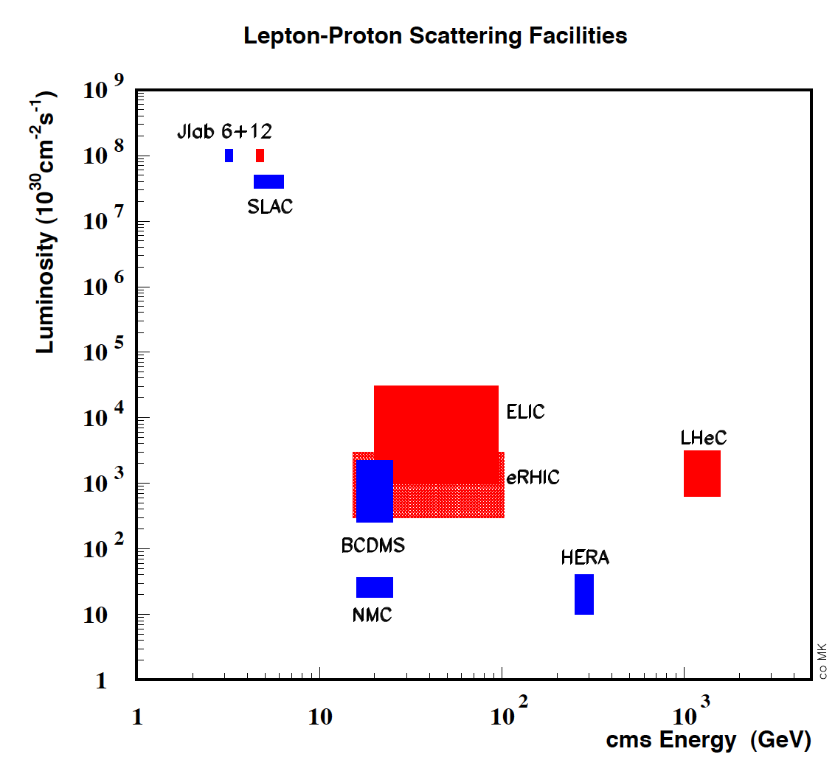
DIS beyond HERA
Built
Proposed
The LHeC is the
only proposal
and possibility
to exceed HERA
energy (and
luminosity).

Slide 8
L vs E_{e}
Storage Ring
Energy Recovery Linac

Slide 9

Project Milestones
2007: Invitation by SPC to ECFA and by (r)ECFA to work out a design concept
2008: First CERN-ECFA Workshop in Divonne (1.-3.9.08)
2009: 2nd CERN-ECFA-NuPECC Workshop at Divonne (1.-3.9.09)
2010: Report to CERN SPC (June)
3rd CERN-ECFA-NuPECC Workshop at Chavannes-de-Bogis (12.-13.11.10)
NuPECC puts LHeC to its Longe Range Plan for Nuclear Physics (12/10)
2011: Draft CDR (530 pages on Physics, Detector and Accelerator) (5.8.11)
being refereed and updated
2012: Publication of CDR – European Strategy
New workshop (Chavannes, June 14-15, 2012)
Goal: TDR by 2015
Perspective: Operation by 2023 (synchronous with pp)

Slide 10
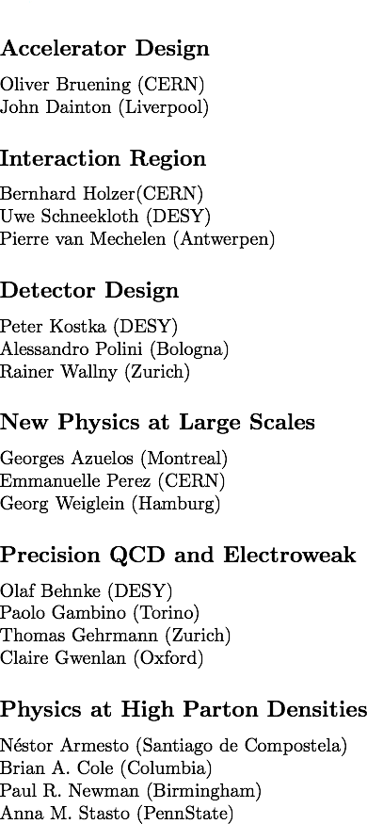
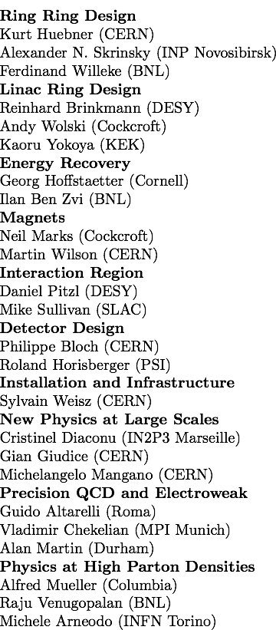
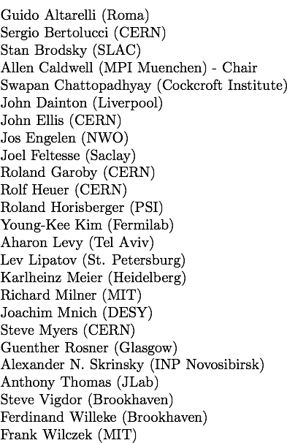

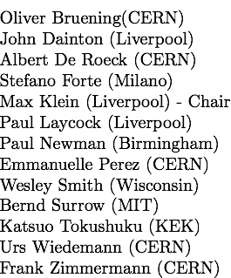
Organisation for CDR
Scientific Advisory Committee
Working Group Convenors
CERN Referees
Steering Committee

Slide 11
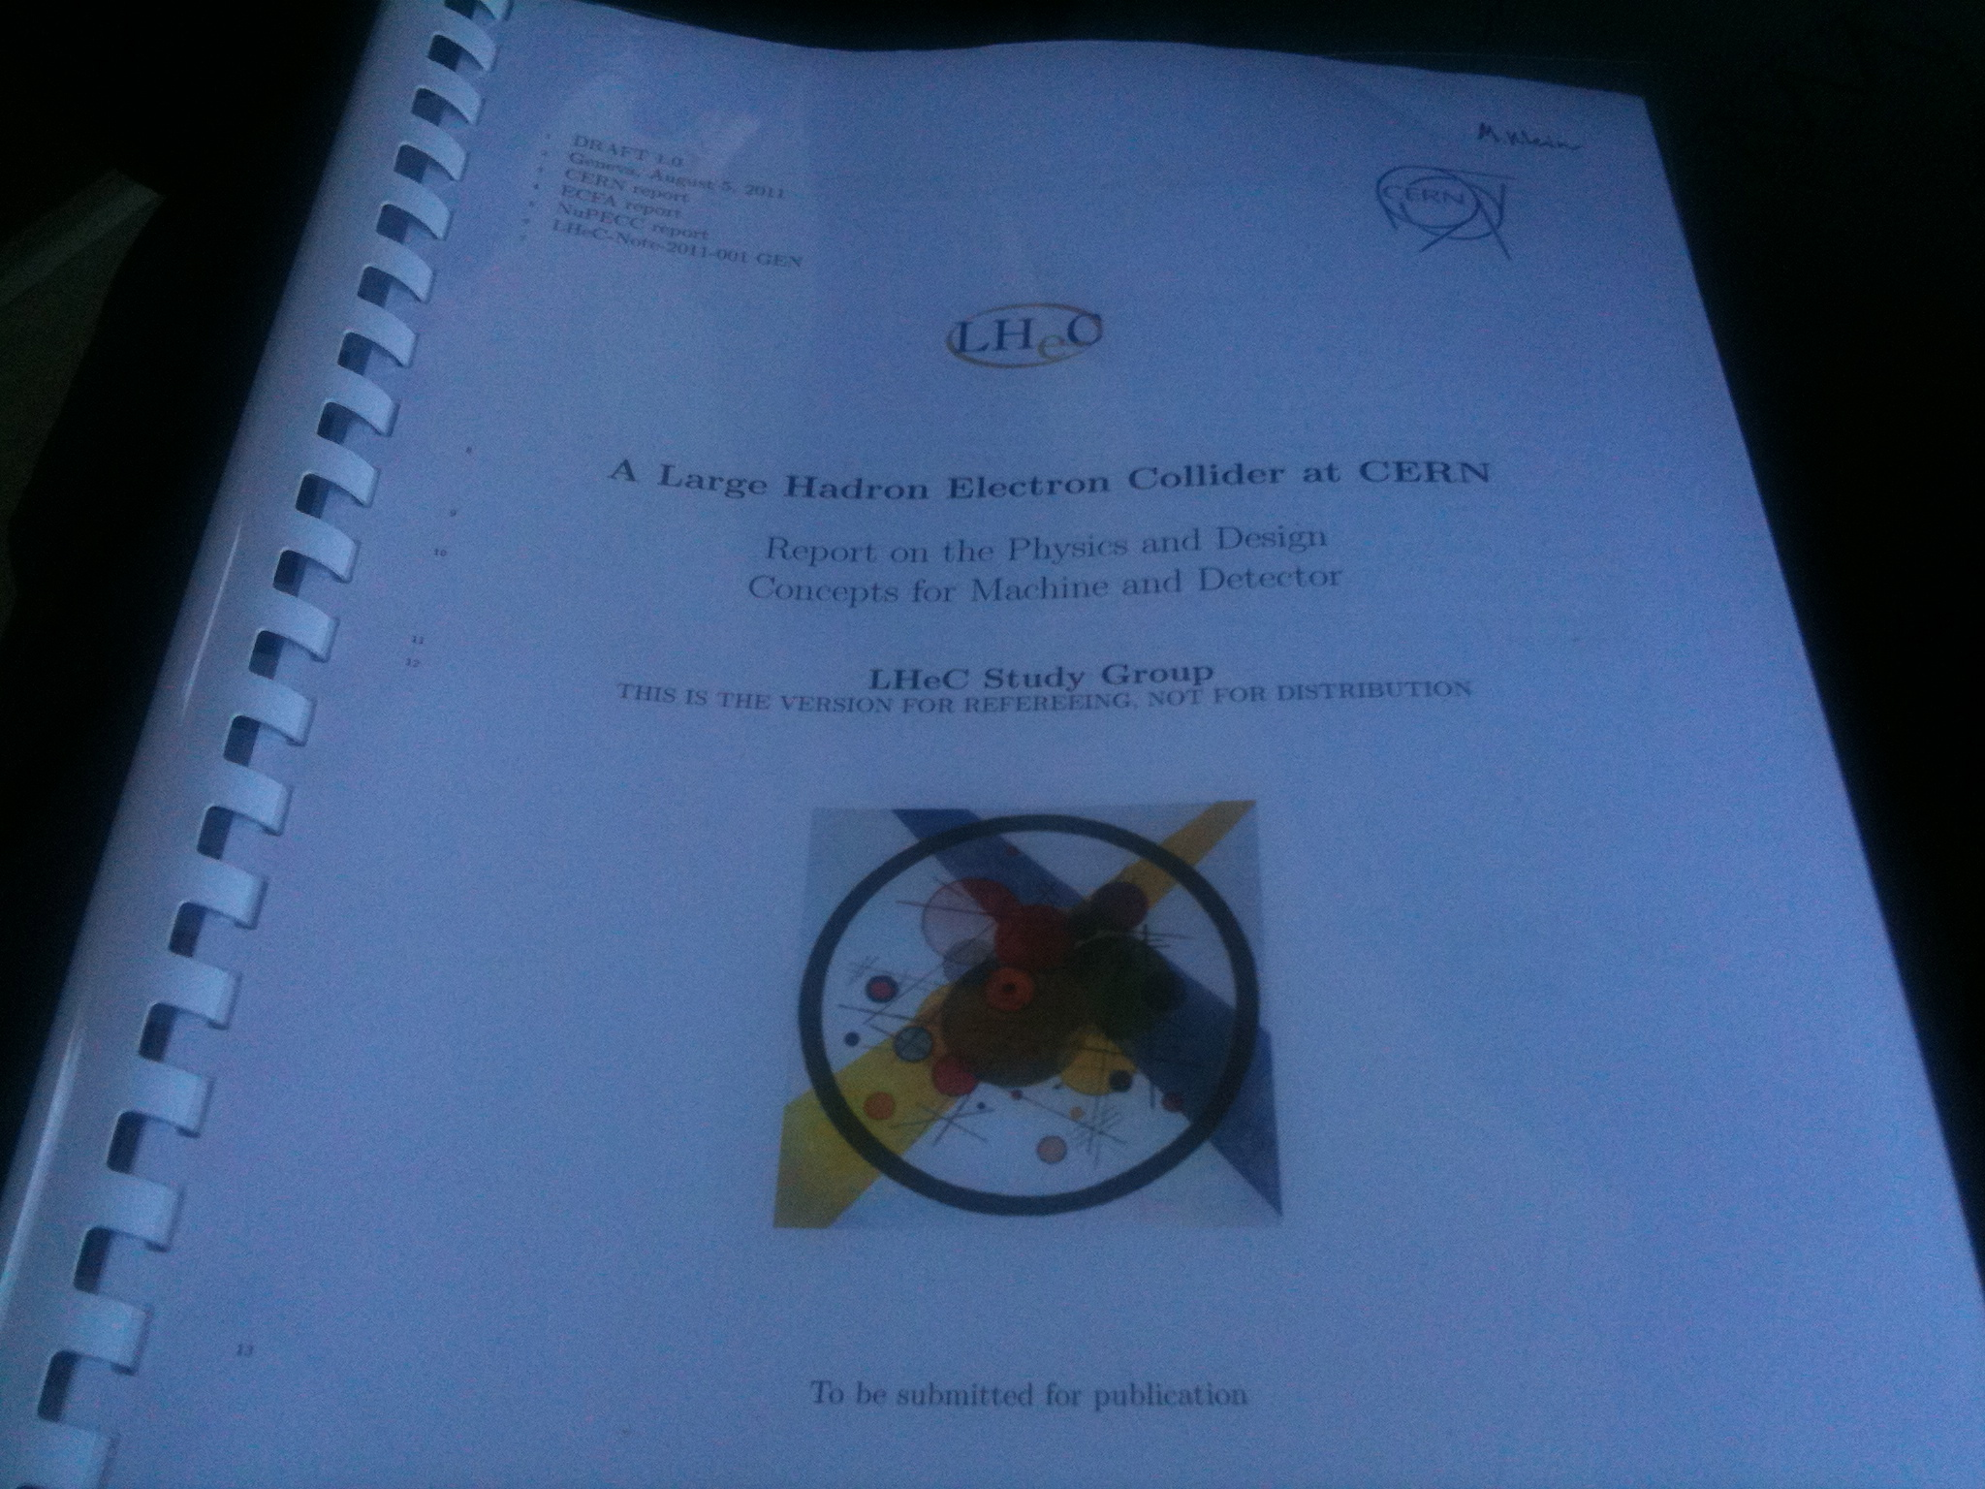
Draft LHeC Design Report
530 pages refereed →
Publication end of May 12
Most of plots from CDR.
LHeC-Note-2011-003 GEN

Slide 12
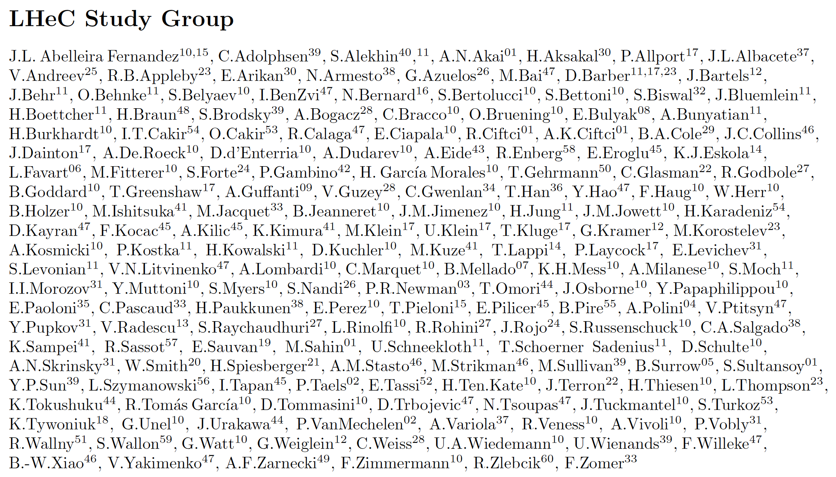
http://cern.ch/lhec
Supported by
CERN, ECFA, NuPECC
About 180 Experimentalists and Theorists from 60 Institutes
Tentative list of those who contributed to the CDR [11. May 12]

Slide 13
Why an ep/A Experiment at TeV Energies?
For resolving the quark structure of the nucleon with p, d and ion beams
For the development of perturbative QCD
For mapping the gluon field
For searches and the understanding of new physics
For investigating the physics of parton saturation
QPM symmetries, quark distributions (complete set from data!), GPDs, nuclear PDFs ..
N^{k}LO (k≥2) and h.o. eweak, HQs, jets, resummation, factorisation, diffraction
Gluon for ~10⁻⁵ < x <1 , is unitarity violated? J/ψ, F₂^{c}, … unintegrated gluon
GUT (α_{s} to 0.1%), LQs RPV, Higgs (bb, HWW) … PDFs4LHC… instanton, odderon,..?
Non-pQCD (chiral symm breaking, strings), black disc limit, saturation border..
..For providing data which could be of use for future experiments [Proposal for SLAC ep 1967]

Slide 14
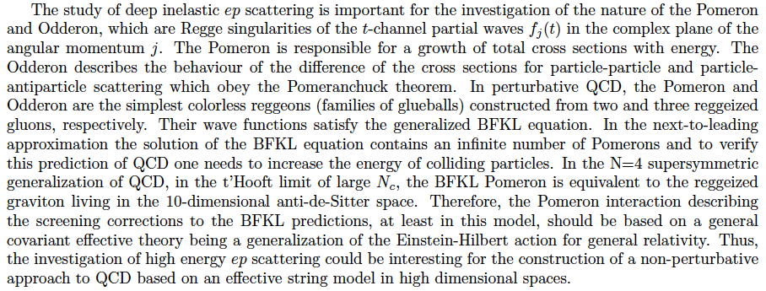
Candidates for Surprises and Discoveries
PDFs (t, s, q-q, val, xg)
Odderon
Instanton
(no) saturation, QCD
QGP initial state
Factorization pp-ep
LQs, RPV SUSY
e*
Higgs CP
α_{s} indeed small (GUT)
Lev Lipatov in the CDR…
Ultra high precision (detector, e-h redundancy) - new insight
Maximum luminosity and much extended range - rare, new effects
Deep relation to (HL-) LHC (precision+range) - complementarity
→ LHeC brings a substantial enrichment of LHC physics

Slide 15
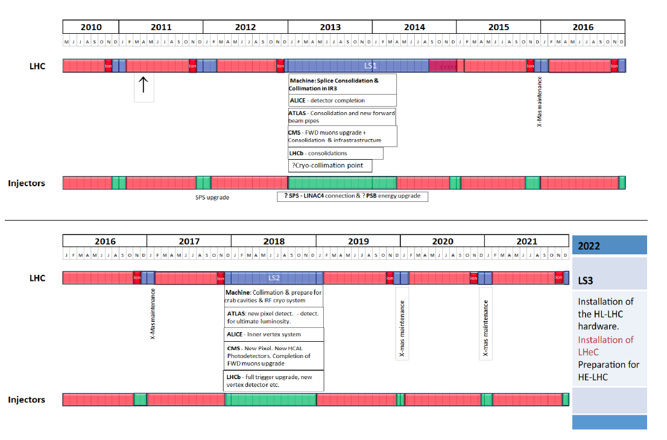
Draft LHC Schedule for the coming decade
as shown by S. Myers at EPS 2011 Grenoble

Slide 16
Physics with the LHeC

Slide 17
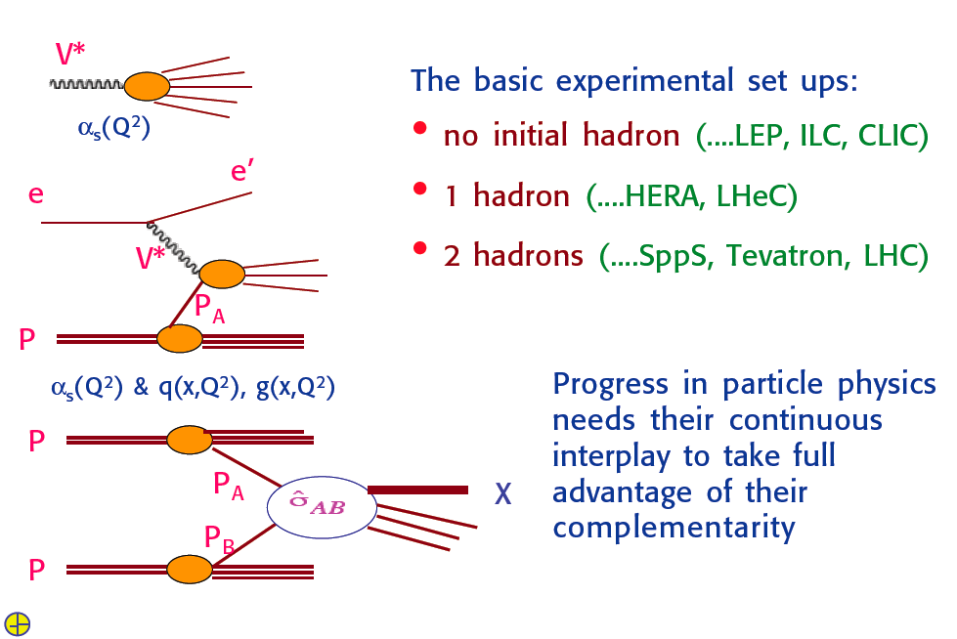
ee, ep, pp
G.Altarelli, LHeC Workshop Divonne 9/08

Slide 18
The Fermi Scale [1985-2012]
pp
b quark
top quark
M_{W}, H?
Tevatron
ep
e⁺e⁻
The Standard
Model Triumph
M_{Z} , sin² Θ
3 neutrinos
h.o. el.weak (t,H?)
gluon
h.o. strong
c,b distributions
high parton densities
LEP/SLC
HERA

Slide 19
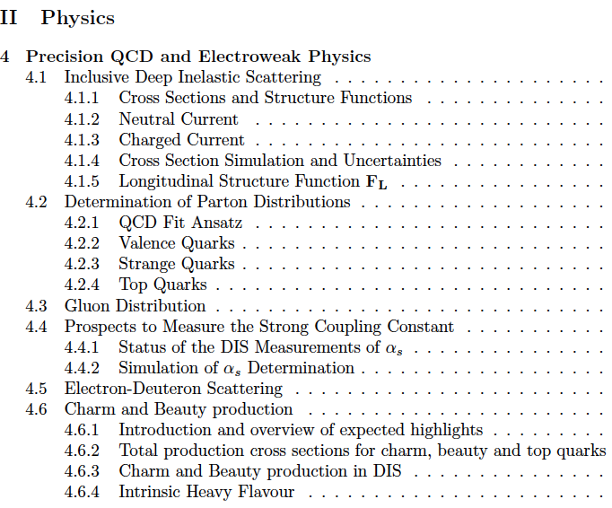
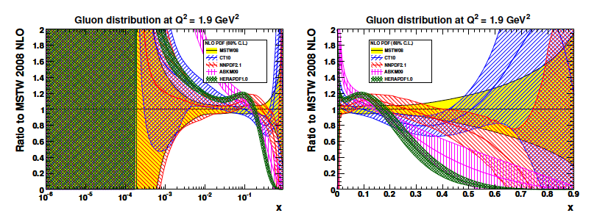
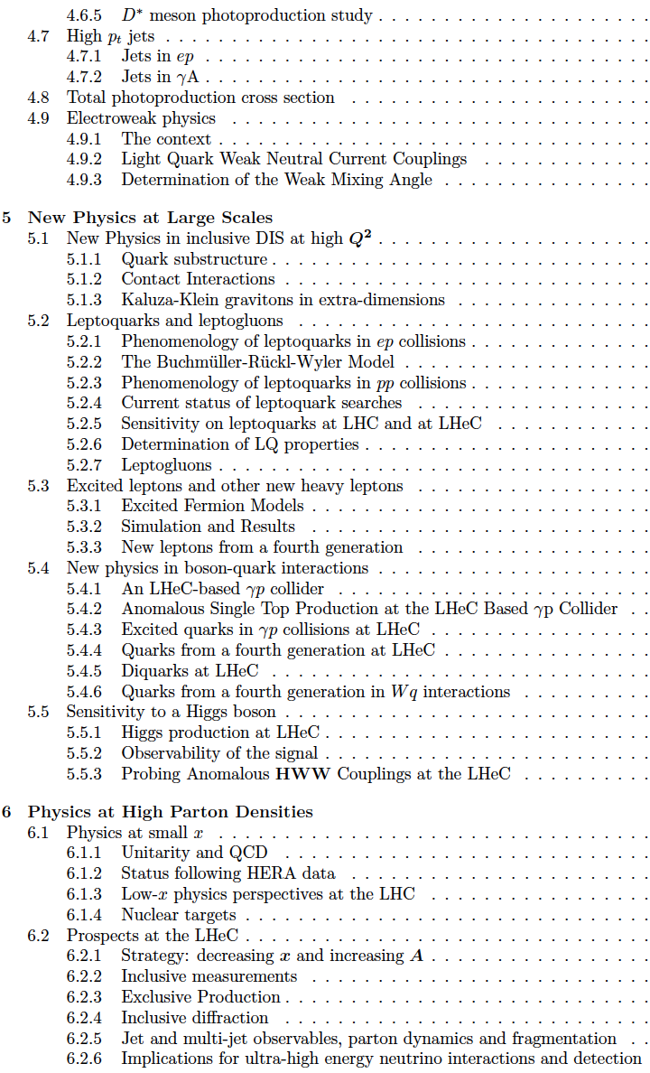
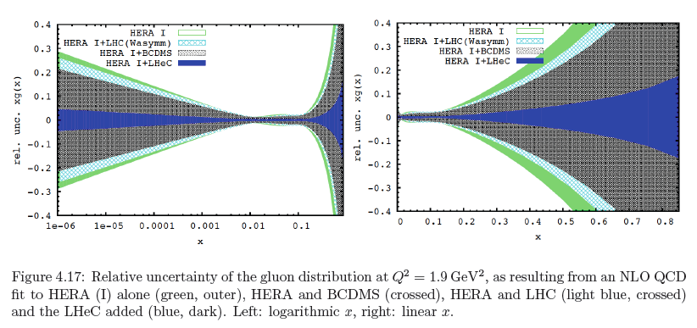
CDR Physics
Gluon Distribution
153 pages
now
then
Precision measurement of gluon density to extreme x → α_{s}
Low x: saturation in ep? Crucial for QCD, LHC, UHE neutrinos!
High x: xg and valence quarks: resolving new high mass states!
Gluon in Pomeron, odderon, photon, nuclei.. Local spots in p?
Heavy quarks intrinsic or only gluonic?

Slide 20
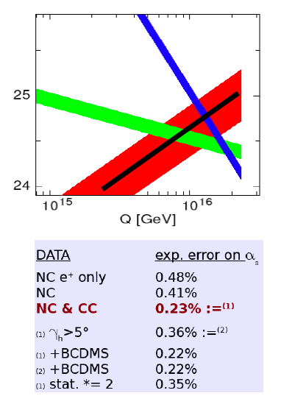
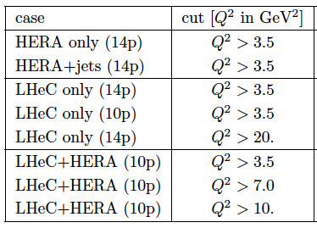
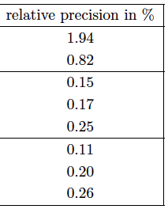
Strong Coupling Constant
α_{s} least known of coupling constants
Grand Unification predictions suffer from δα_{s}
DIS tends to be lower than world average
Recently challenged by MSTW and NNPDF – jets??
LHeC: per mille - independent of BCDMS.
Challenge to experiment and to h.o. QCD →
A genuine DIS research programme rather than
one outstanding measurement only.
1/α
fine structure
weak
strong
Two independent QCD analyses using LHeC+HERA/BCDMS
Full experimental uncertainties (unc+corr systematics)

Slide 21
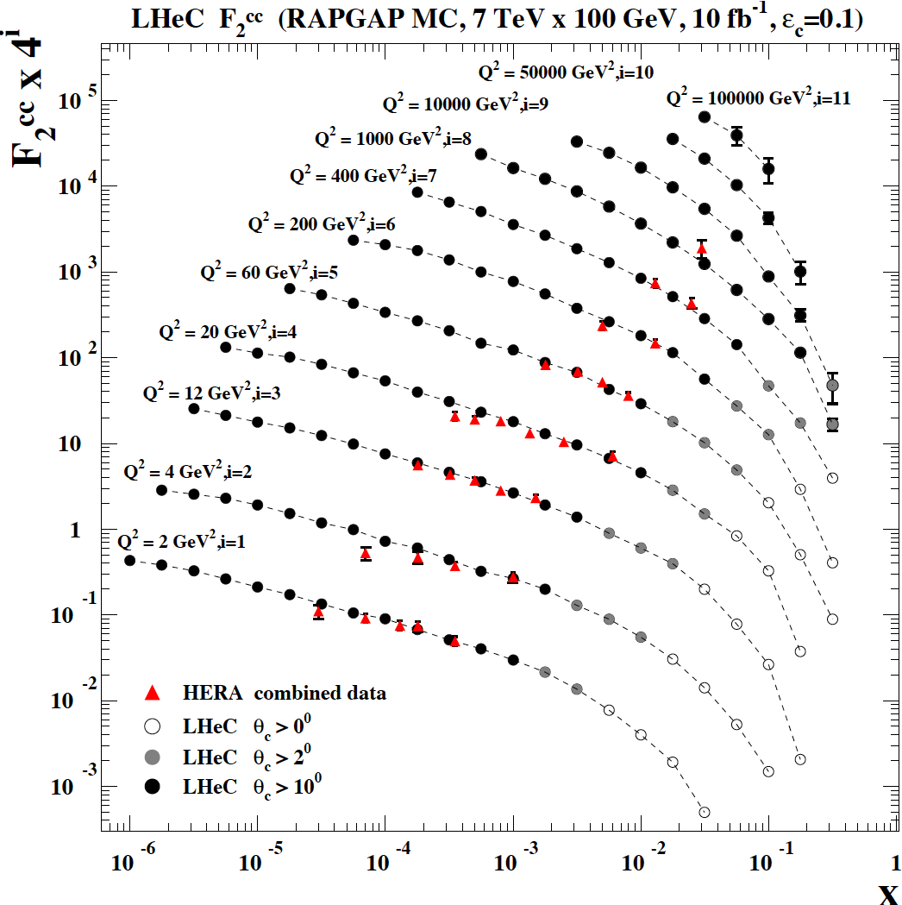
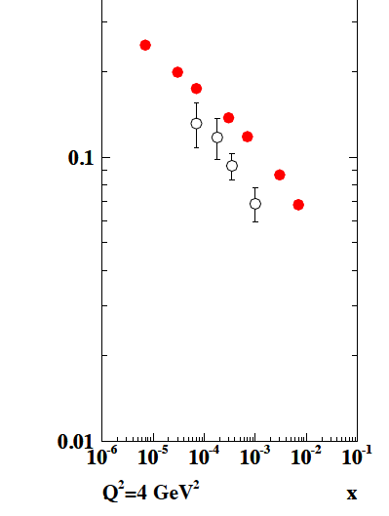
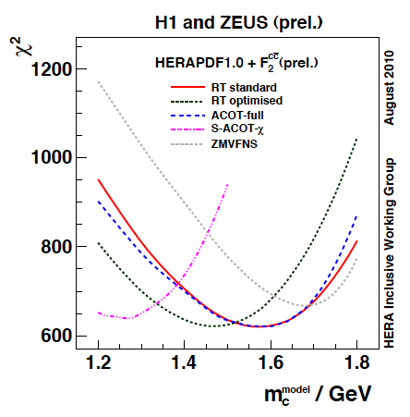
Treatment of charm influences α_{s}
F₂^{cc}
LHeC
HERA
LHeC vs HERA: higher fraction of c, larger range,
smaller beam spot, better Silicon detectors
note: 100 MeV of m_{c} is about 1% on α_{s}
Intrinsic charm at large x?
CDR

Slide 22
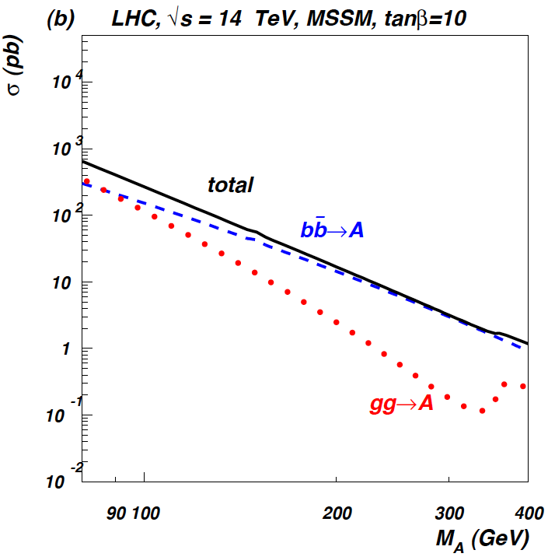
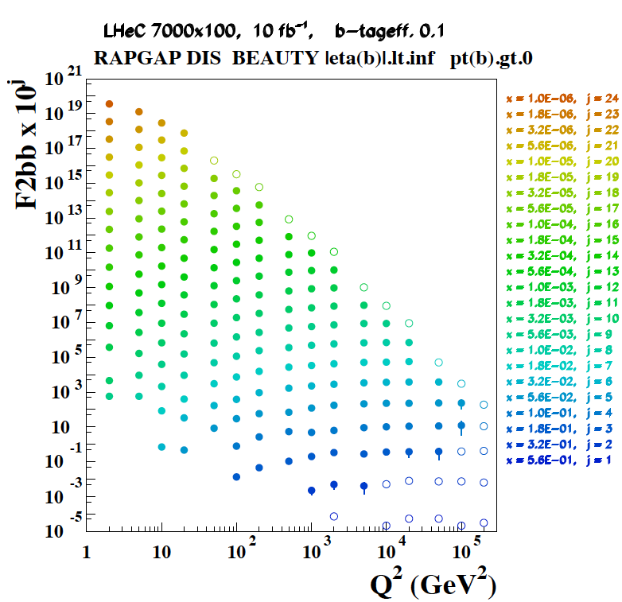
Beauty - MSSM Higgs
CTEQ Belyayev et al. JHEP 0601:069,2006
In MSSM Higgs production is b dominated
HERA: First measurements of b to ~20%
LHeC: precision measurement of b-df
LHeC: higher fraction of b, larger range,
smaller beam spot, better Si detectors

Slide 23
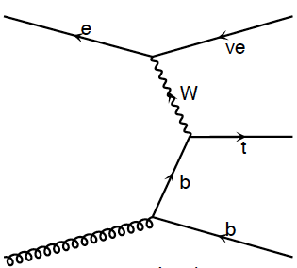
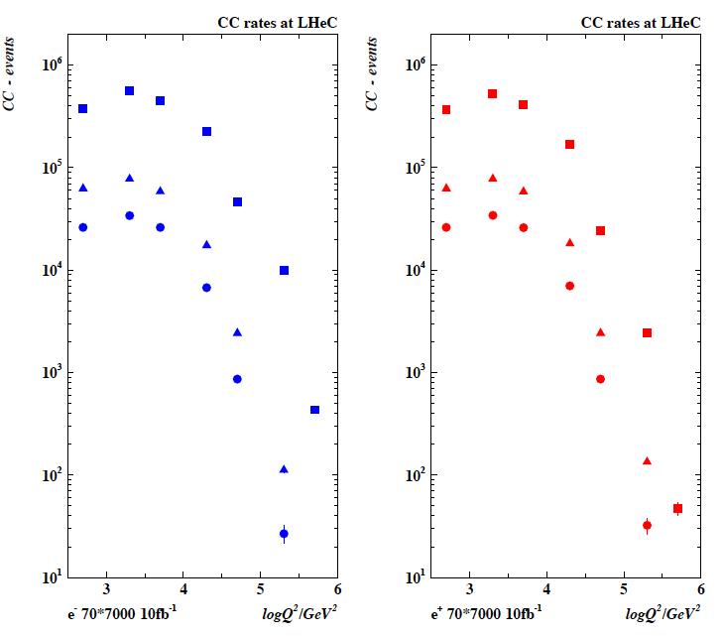
Top and Top Production in Charged Currents
LHeC copious
single top and anti-top
quark production
with a CC cross section
of O(10) pb
Study Q² evolution of
top quark onset –
6 quark CFNS
(Pascaud at DIS11)
m_{top}
Not yet simulated..

Slide 24
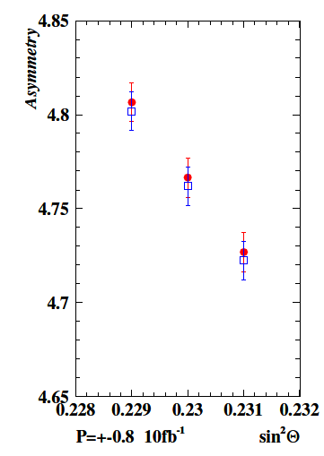
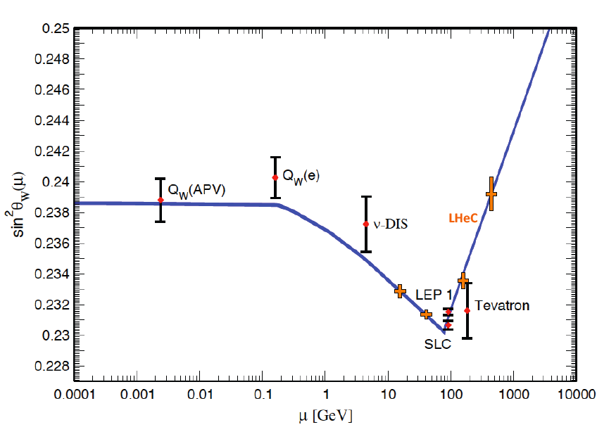


Weak Neutral Currents – Polarisation Asymmetry
MSTW
CTEQ
Measure running of the weak mixing
angle to high precision with polarised e⁻.
[stat. errors, much of syst cancels, pdfs
from LHeC itself]

Slide 25
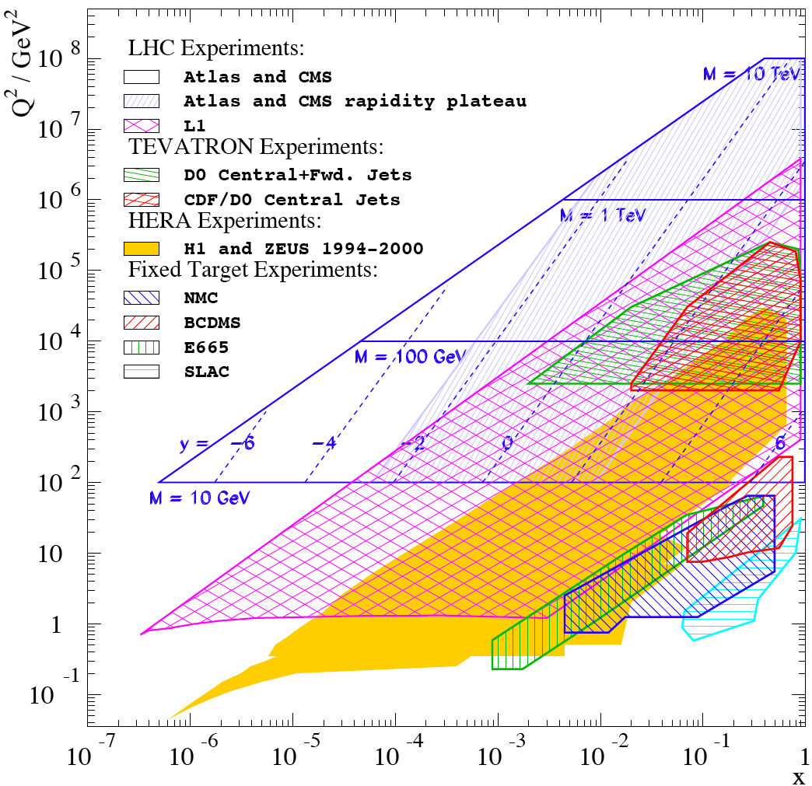
Complementing the LHC with ep/A
LHC partons: W,Z +c,b new constraints but severely limited in x,Q² range
Discoveries at the LHC will be at high
masses: large x and very high Q² which require high s, lumi of LHeC
for precision PDFs (u,d,xg mainly)
If the Higgs exists, its study will become a major field of research:
ep: WW→ H → bbar (CP odd/even?)
top distribution in the proton TDF
IF RP is violated and LQ or RPV SUSY
discovered: LHeC is uniquely suited
AA: QGP: study initial state in eA
Resolve parton distributions in nuclei
LHeC is unique in various areas, e.g.:
Low x and saturation physics
Strong coupling constant to 0.1% level
DIS →
In Drell-Yan kinematics: mass and rapidity relate to Q² and x

Slide 26
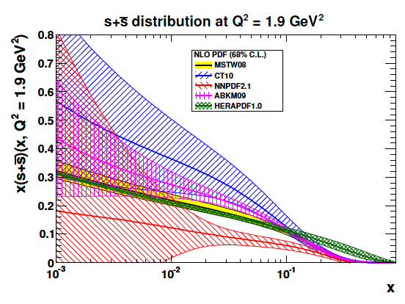
LHC and LHeC - Strange Quark Distribution
ATLAS → PRL
Trend confirmed in NNPDF collider only fit
Change of strange affects sea - UHE ν

Slide 27
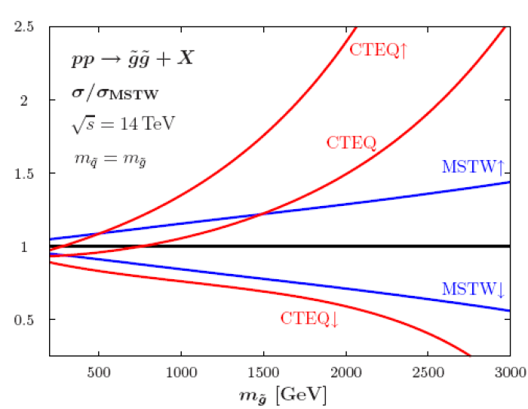
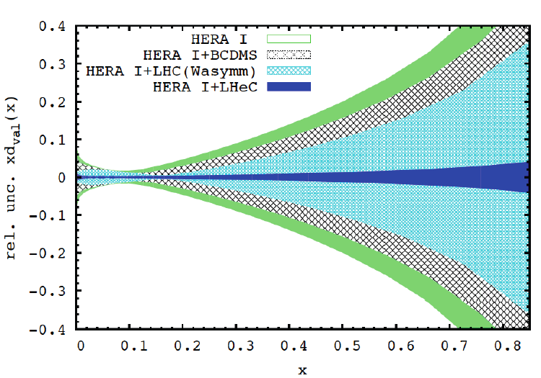
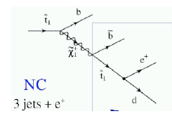
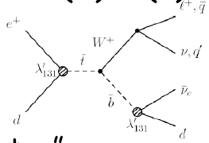
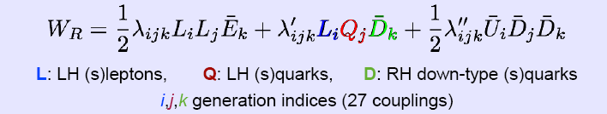
SUSY
HL-LHC will explore highest mass
range. This requires to control
very high Bj x, where LHeC pins down
partons such that resummation and
factorisation effects can be controlled.
RPV SUSY in 3rd generation?

Slide 28
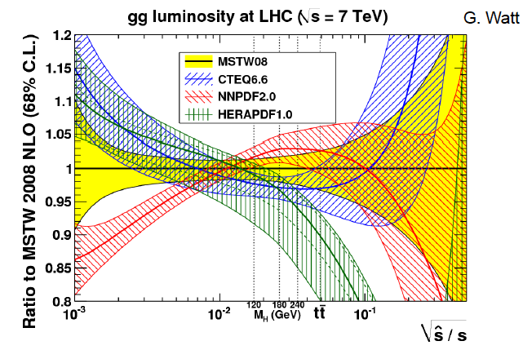

Slide 29
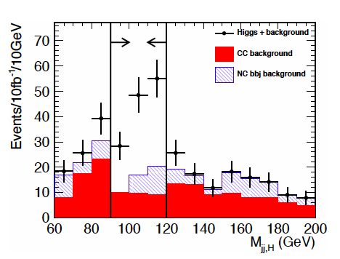
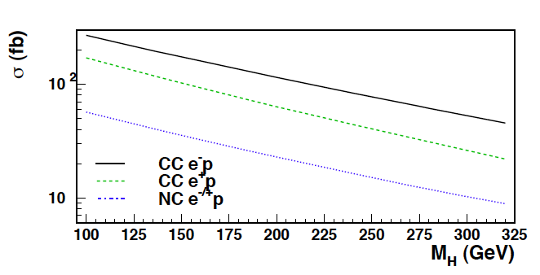
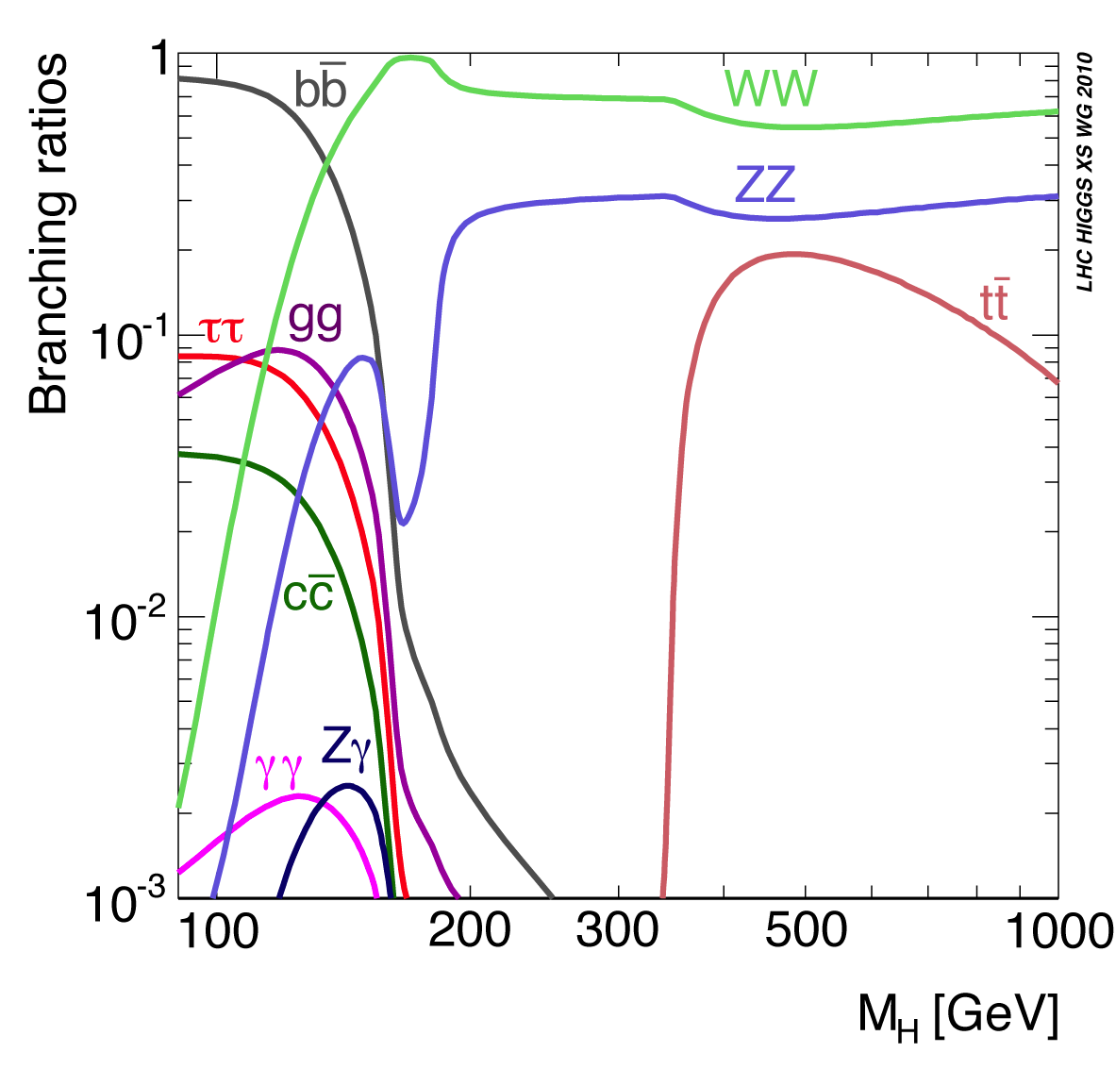
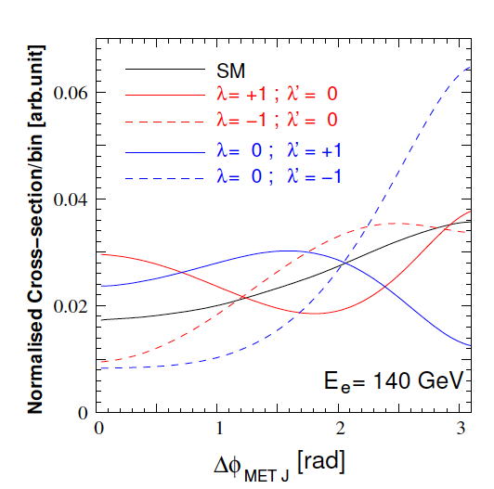
Higgs
Process determines
much of detector
acceptance and
calibration and b tag
(also single top)
and L/E_{e} requirement
Higgs is light (or absent), CC: WW→H→bb
CP even: SM, CP odd: nonSM, mixture?

Slide 30
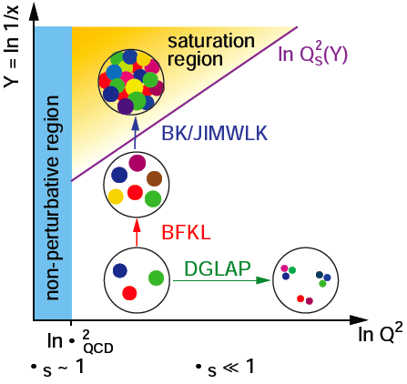
High Parton Densities
Should lead to
non-linear evolution
theory and eventually
discover saturation of
rise of gluon density
(unitarity limit?)
Needs highest energy
to be studied in both
ep and eA.
CDR L_{eN} ≅ 3-10 * 10³¹ cm⁻²s⁻¹ for D,A - not optimised

Slide 31
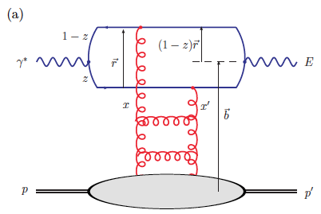
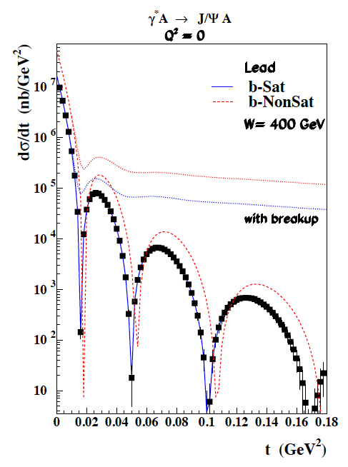


Low x physics - J/ψ in γ*p/A
Test of saturation
E=J/ψ or photon (DVCS)
Optical theorem relates J/ψ to F_{T}=F₂-F_{L}
Coherent production in y*A
Probing of nuclear matter

Slide 32

Electron-Ion Scattering
Dipole models predict saturation which
resummation in pQCD moves to lower x..
It requires highest energy, low x, Q²>M_{p}²
Saturation at the LHeC is predicted to be
observed both in ep AND in eA.
This combination is crucial to disentangle nuclear from unitarity effects.
Expect qualitative changes of behaviour
- Black body limit of F₂
Saturation amplified with A^{1/3}
Rise of diffraction to 50%? ….
Below x ~ 10⁻²: DIS data end. NO flavour
separation yet. However indications are
that e.g. shadowing is flavour dependent.
Deuterons: tag spectator,
relate shadowing-diffraction (Gribov)!
stabilise QCD evolution (singlet!)
Neutron (light sea, UHE neutrinos, QPM)
EIC programme:
see recent workshop arXiv:1108.1713 [nucl-th]

Slide 33



Nuclear Parton Distributions
Study using eA LHeC pseudodata
R=q^{Pb}/q^{p}
A complete determination of nPDFs in grossly extended range, into nonlinear regime
nPDFs - certainly more diverse than in V,S,G terms and cleaner than pA at the LHC
K.Eskola, H.Paukkunen, C.Salgado, Divonne09

Slide 34


In-medium Hadronisation
The study of particle production in eA (fragmentation functions and hadrochemistry)
allows the study of the space-time picture of hadronisation (the final phase of QGP).
Low energy (ν): need of
hadronization inside.
Parton propagation: pt broadening
Hadron formation: attenuation
High energy (ν): partonic
evolution altered in the
nuclear medium.
W.Brooks, Divonne09
LHeC :
+ study the transition from small to high energies in hugely extended range wrt. fixed target data
+ test of the energy loss mechanism crucial for understanding of the medium produced in HIC
+ detailed study of heavy quark hadronisation …
Notes:
34

Slide 35
The TeV Scale [2010-2035..]
pp
W,Z,top
Higgs?
New Particles??
New Symmetries?
LHC
ep
e⁺e⁻
New Physics
ttbar
Higgs?
Spectroscopy??
High Precision QCD
High Density Matter
Substructure??
eq-Spectroscopy??
ILC/CLIC
LHeC

Slide 36
Accelerator and Detector

Slide 37

How can we use the LHC for ep/A?
S.Russenschuck

Slide 38




e Ring- p/A Ring – “RR”
10 GeV injector
10 GeV injection: dipoles with low field and 10⁻⁴ reproducability

Slide 39






Magnets
5.35 m
0.013-0.08 T
~200kg/m
Prototypes from BINP and CERN: function to spec’s

Slide 40




60 GeV Energy Recovery Linac
CERN 1
CERN 2
Jlab
BNL
Two 10 GeV energy recovery Linacs, 3 returns, 720 MHz cavities

Slide 41


Linac Infrastructure
U_{LHeC}=U_{LHC}/3 : 1.5 x HERA
944 cavities
59 cryo modules per linac
721 MHz
20 MV/m CW
Multibunch wakefields - ok
Emittance growth - ok
[ILC 10nm, LHeC 10μm]
36σ separation at 3.5m - ok
Fast ion instability - probably ok
with clearing gap (1/3)

Slide 42



Cryogenics
from CDR LHeC

Slide 43

Linac has real
γ beam option
Proton beam parameters:
E_{p} perhaps 6.5 TeV
N_{p} almost achieved
ε_{p} already lower in 2011
Both the ring and the linac
are feasible and both
come very close to the
desired performance.
The decision is essentially
taken for the linac.
M.Klein at IPAC11

Slide 44





















LHeC Accelerator Design: Participating Institutes
TOBB ETU
KEK

Slide 45



Detector Requirements
  High Precision
  resolution, calibration, low noise at low y, tagging of b,c;
  Based on the recent detector developments, “settled” technology,
  avoiding time consuming dedicated R&D programs.
  Modular for installation and flexible for access
  Detector construction above ground (LHC schedule!)
  Small radius and thickness of beam pipe optimized in view of
  1-179º acceptance [for low x,Q² (e) as for high x (final state),
  synchrotron radiation and background production.
  Affordable - comparatively reasonable cost.
  One IR, one detector (no push-pull, two teams/reconstructions..?)

Slide 46

LHeC Detector Overview
LAr electromagnetic calorimeter
Tile Calorimeter
Detector option 1 for LR and full acceptance coverage
Forward/backward asymmetry in energy deposited and thus in geometry and technology
Present dimensions: LxD =14x9m² [CMS 21 x 15m² , ATLAS 45 x 25 m²]
Taggers at -62m (e),100m (γ,LR), -22.4m (γ,RR), +100m (n), +420m (p)

Slide 47


Silicon Tracker and EM Calorimeter
Transverse momentum
Δp_{t}/p²_{t} → 6 10⁻⁴ GeV⁻¹
transverse
impact parameter
→ 10μm

Slide 48



Liquid Argon Electromagnetic Calorimeter
Inside Coil
H1, ATLAS
experience.
Barrel: Pb, 20 X₀ , 11m³
fwd/bwd inserts:
FEC: Si -W, 30 X₀ ,0.3m³
BEC: Si -Pb, 25 X₀,0.3m³
GEANT4 Simulation

Slide 49




Hadronic Tile Calorimeter
Outside Coil: flux return
Modular. ATLAS experience.
R=2.6m
+5.9m
-3.6m
Combined GEANT4 Calorimeter Simulation

Slide 50
Some current+next steps

Slide 51



LR LHeC IR layout & SC IR quadrupoles
Exit hole for electrons & non-colliding protons
Synchrotron radiation
Q2
Electron beam
Q1
Q2
Q1
Nb₃Sn (HFM46): 5700 A, 175 T/m, 4.7 T at 82% on LL (4 layers), 4.2 K | Nb₃Sn (HFM46): 8600 A, 311 T/m, at 83% LL, 4.2 K
46 mm (half) ap., 63 mm beam sep. | 23 mm ap.. 87 mm beam sep.
0.5 T, 25 T/m | 0.09 T, 9 T/m
colliding proton beam
Non-colliding proton beam
Inner triplets
Inner triplets
High-gradient SC IR quadrupoles based on Nb₃Sn for colliding proton beam with common low-field
As shown by F. Zimmermann at Chamonix12

Slide 52
Magnet Development at CERN
L.Bottura
Chamonix 2/12
on Magnet R+D
for LHeC + HE-LHC

Slide 53
ERL Choice of frequency (Erk Jensen - Chamonix12)
The frequency has to be a harmonic of 20.04 MHz!
LHeC baseline: 721.42 MHz, alternative 1322.6 MHz.
Advantages of lower frequency:
  Less cryo-power
  High-power couplers easier
  Less cells per cavity – less trapped modes
  Less beam loading and transverse wake – better beam stability
  Less HOM power
  Synergy with SPL, e-RHIC and ESS.
Advantages of higher frequency:
  Larger R/Q → with same Q_{ext} less RF power (but Q_{ext} must be reduced!)
  Synergy with ILC/X-FEL

Slide 54

Collaboration on ERL
Budker Institute

Slide 55


Detector has to be pre-mounted on top of IP2,
the hall be emptied, the detector lowered and
to be mounted inside the L3 magnet barrel
during the 2-3 years shutdown LS3
Study of Installation of the LHeC Detector [ongoing] A.Gaddi, 7.5.2012

Slide 56
Concluding Remarks
The physics of deep inelastic scattering has been an essential part of HEP.
Major breakthroughs in (particle) physics are difficult to plan, despite certain
“overconfidence of theorists” [Ledermann ICHEP 1980] in the past.
The LHeC has passed a major milestone with a refereed CDR, supported
and monitored by CERN, ECFA and NuPECC, soon to be published.
The time schedule of the LHC is such that there is not more time than
a decade+ for realising the LHeC. This requires to continue to be realistic.
Collaborations are soon to be built for further design, of the machine
and the detector. The experimental prospect challenges theory and
requires to continue our intimate interaction with our thy colleagues.
A programme of technical and physics developments and a corresponding
project structure are being developed, with the goal to enable a project
decision by 2015 based on a technical design.
You are invited to join the workshop and so you wish the project too.

Slide 57

Next Workshop - Chavannes 14/15.6.2012

Slide 58
backup

Slide 59
---- sLHC 40 TeV (private guess)
Seminar at UCL, 11.5.2012

Slide 60


LHC
Selected SUSY Search Results → 3rd generation?
J.Gunion (CERN 27.3.2012)
Technicolor ??
“We argue that the existence of fundamental
scalar fields constitutes a serious flaw of the
Weinberg-Salam theory…
L.Susskind, Dynamics of Spontaneous Symmetry
Breaking in the Weinberg Salam Theory.
Phys D20 (1979) 2619-2625
Dimopoulos,Susskind: Mass Without Scalars
NP. B155 (1979) 237
CMS similar results
LHCb: B_{s}→μμ < 4.5 10⁻⁹ SM(3.2±0.2) 10⁻⁹

Slide 61
What HERA could not do or has not done
Test of the isospin symmetry (u-d) with eD - no deuterons
Investigation of the q-g dynamics in nuclei - no time for eA
Verification of saturation prediction at low x – too low s
Measurement of the strange quark distribution – too low L
Discovery of Higgs in WW fusion in CC – too low cross section
Study of top quark distribution in the proton – too low s
Precise measurement of F_{L} – too short running time left
Resolving d/u question at large Bjorken x – too low L
Determination of gluon distribution at hi/lo x – too small range
High precision measurement of α_{s} – overall not precise enough
Discovering instantons, odderons – don’t know why not
Finding RPV SUSY and/or leptoquarks – may reside higher up
…
The H1 and ZEUS apparatus were basically well suited
The machine had too low luminosity and running time
HEP needs a TeV energy scale machine with 100 times
higher luminosity than HERA to develop DIS physics
further and to complement the physics at the LHC. The
Large Hadron Collider p and A beams offer a unique
opportunity to build a second ep and first eA collider
at the energy frontier [discussed at DIS since Madison 2005]
HERA in one box
the first ep collider
E_{p}*E_{e}=
920*27.6GeV²
√s=2√E_{e}E_{p}=320 GeV
L=1..4 10³¹cm⁻²s⁻¹
→ ΣL=0.5fb⁻¹
1992-2000 & 2003-2007
Q²= [0.1 -- 3 * 10⁴ ] GeV²
-4-momentum transfer²
x=Q²/(sy) ≅10⁻⁴ .. 0.7
Bjorken x
y≅0.005 .. 0.9
inelasticity

Slide 62


Leptoquark Sensitivity
E6 new fields
TC bound states of technifermions
PS 4th colour of quarks
l,q composite models
The cross section in ep is (depending on couplings)
100 times higher than in pp,
but LHC is there, has pair production
and higher energy
LHeC has mass reach up to about the
cms energy (M < sqrt(s) = 1.3 .. 2 TeV
for 60 .. 140 GeV electron beam energy)
IF LQs are discovered at the LHC the
electron beam energy would possibly
be adjusted
The role of ep would be to determine
the quantum numbers

Slide 63


F₂^{charm} and F₂^{beauty} from LHeC
Hugely extended range and much improved precision
will pin down heavy quark behaviour at and away from thresholds

Slide 64

Tentative Time Schedule
LS3 --- HL LHC
from draft CDR

Slide 65

Physics and Range
New Physics
Large x
High precision
partons in plateau
of the LHC
Nuclear
Structure
& dynamics
High Density Matter
Q² = 4momentum transfer² x = Bjorken x: fraction of p’s momentum

Slide 66

Neutrino Scattering
N.Armesto at DIS12

Slide 67
Beauty – MSSM ?? Higgs
CTEQ Belyayev et al. JHEP 0601:069,2006
In MSSM Higgs production is b dominated
HERA: First measurements of b to ~20%
LHeC: precision measurement of b-df
LHeC: higher fraction of b, larger range,
smaller beam spot, better Si detectors

Slide 68


Bypassing ATLAS
For the CDR the bypass concepts
were decided to be confined to
ATLAS and CMS

Slide 69


Detector Magnets
Dipole (for head on LR) and
solenoid in common cryostat,
perhaps with electromagnetic LAr
3.5T field at ~1m radius to house
a Silicon tracker
Based on ATLAS+CMS experience

Slide 70
Summary of Design Parameters
electron beam | RR | LR | LR
e- energy at IP[GeV] | 60 | 60 | 140
luminosity [10³² cm⁻²s⁻¹] | 17 | 10 | 0.44
polarization [%] | 40 | 90 | 90
bunch population [10⁹] | 26 | 2.0 | 1.6
e- bunch length [mm] | 10 | 0.3 | 0.3
bunch interval [ns] | 25 | 50 | 50
transv. emit. γε_{x,y} [mm] | 0.58, 0.29 | 0.05 | 0.1
rms IP beam size σ_{x,y} [μm] | 30, 16 | 7 | 7
e- IP beta funct. β*_{x,y} [m] | 0.18, 0.10 | 0.12 | 0.14
full crossing angle [mrad] | 0.93 | 0 | 0
geometric reduction H_{hg} | 0.77 | 0.91 | 0.94
repetition rate [Hz] | N/A | N/A | 10
beam pulse length [ms] | N/A | N/A | 5
ER efficiency | N/A | 94% | N/A
average current [mA] | 131 | 6.6 | 5.4
tot. wall plug power[MW] | 100 | 100 | 100
proton beam | RR | LR
bunch pop. [10¹¹] | 1.7 | 1.7
tr.emit.γε_{x,y} [μm] | 3.75 | 3.75
spot size σ_{x,y} [μm] | 30, 16 | 7
β*_{x,y} [m] | 1.8,0.5 | 0.1
bunch spacing [ns] | 25 | 25
“ultimate p beam”
1.7 probably conservative
and emittance too
CDR has design also for
D and A (L_{eN} ≅ 3 * 10³¹ cm⁻²s⁻¹)
RR= Ring – Ring
LR =Linac –Ring
Ring: use 1º as baseline : L/2
Linac: clearing gap: L*2/3
High E_{e} Linac option (ERL?) if physics demands HE-LHC?

Slide 71




Quark-Gluon Dynamics - Diffraction and HFS (fwd jets)
Factorisation broken
(LHC fwd – LHeC diff)
Understand multi-jet emission (unintegr. pdf’s), tune MC’s
Production of high mass 1⁻ states
CDR
At HERA resolved γ effects mimic non-kt ordered emission

Slide 72

Deep Inelastic Scattering (“DIS”)
In DIS the inclusive
cross section depends
on two variables, the
negative 4-momentum
transfer squared (Q² ),
which determines the
resolving power of the
exchanged particle in
terms of p substructure,
and the variable
Bjorken x, which Feynman
could relate to the fraction
of momentum of the proton
carried by a parton [in
what he called the
‘infinite momentum frame’
in which the transverse
momenta are neglected].
- ep collider
Deep inelastic scattering resolves the nucleon structure. If s is high: produce new states
Kinematics is determined with scattered electron or with HFS → high precision due to redundancy

