Slide 1
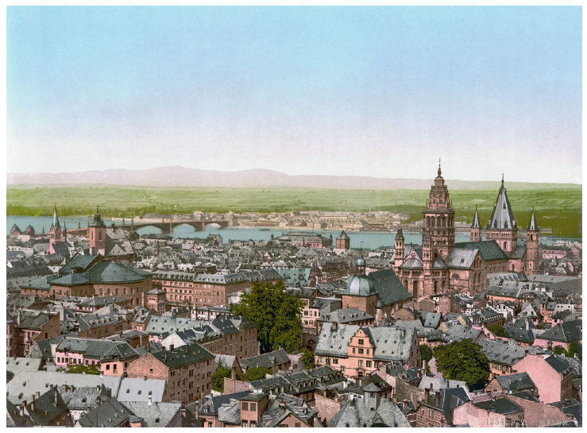




From HERA to the LHeC
From HERA to the LHeC
Deep Inelastic Scattering
QCD and Electroweak Physics
Nuclear Physics
New Physics: ep and pp at the LHC
Higgs with the LHeC
Accelerator and Detector Design
Prospects
Deep Inelastic Scattering
QCD and Electroweak Physics
Nuclear Physics
New Physics: ep and pp at the LHC
Higgs with the LHeC
Accelerator and Detector Design
Prospects
Max Klein
Colloquium at Mainz, Germany, June 25th, 2013
Max Klein – University of Liverpool
Colloquium at Mainz, Gutenberg University , 25th of June, 2013
http://cern.ch/lhec

Slide 2
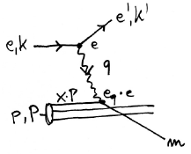
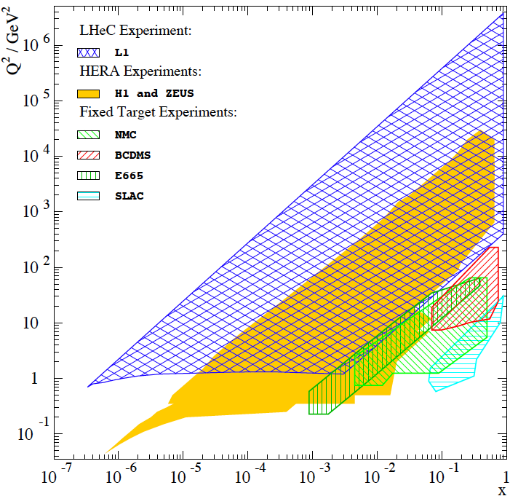


Deep Inelastic e/μp Scattering
NC
The birth of DIS, 45 years ago..
Max Klein, Mainz, 6/2013

Slide 3







Neutral (NC) and Charged Current (CC) DIS Cross Sections
Y±=1±(1-y)²
Sensitive to sum or difference of q and anti-q
Electroweak effects appear O(10⁻⁴Q²/GeV²).
Charge and polarisation asymmetry effects.
CC on protons are charge dependent.
Flavour separation but of sums of up
and down quarks. Propto (1 ± P_{e}).
Max Klein, Mainz, 6/2013

Slide 4
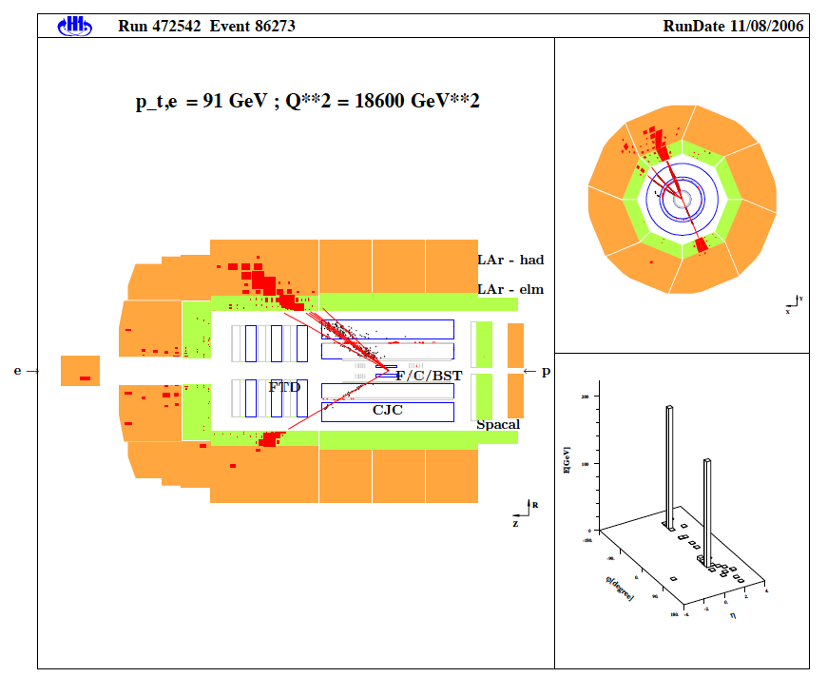
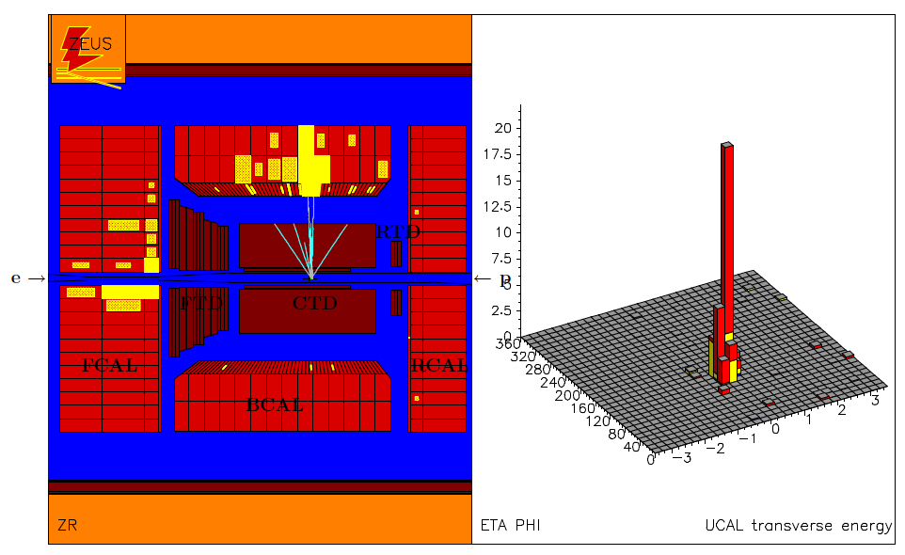
Neutral (NC) and Charged Current (CC) HERA Events
ZEUS Collaboration
H1 Collaboration
Max Klein, Mainz, 6/2013

Slide 5
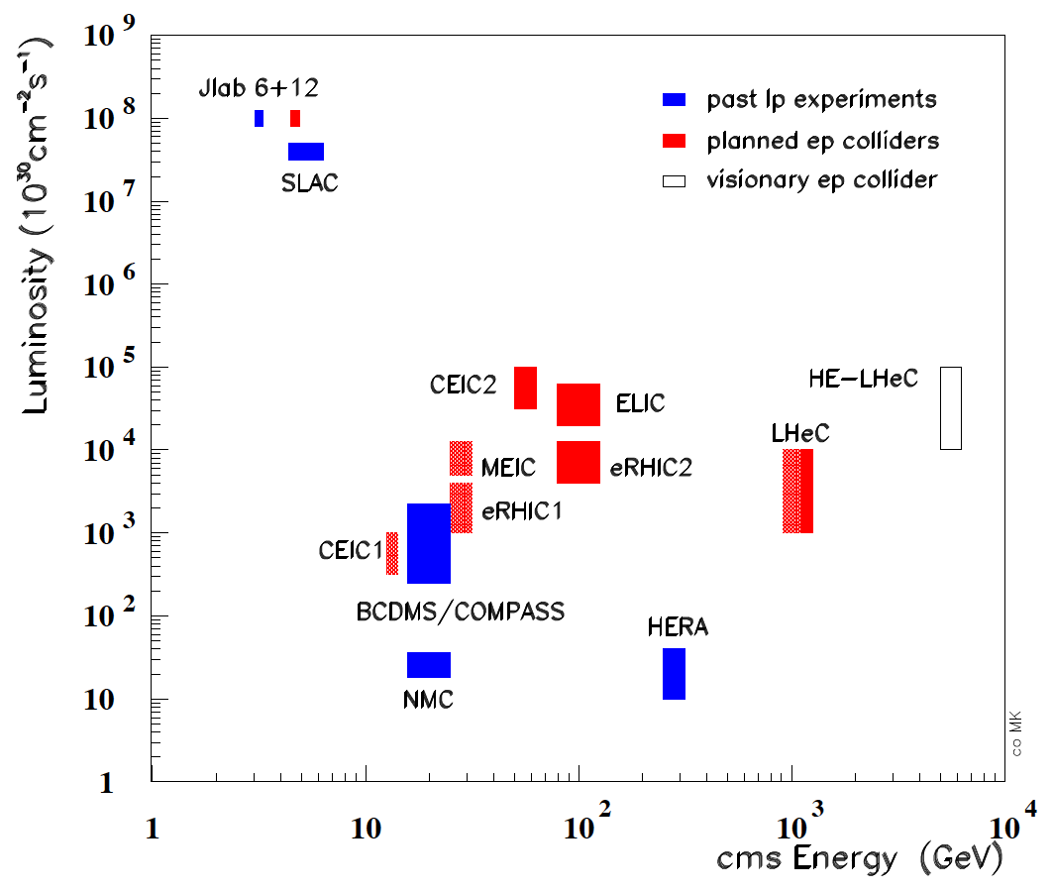
Lepton-Proton Scattering Projects (past and future)
MESA
High Intensity (low Q²) -- Medium Energies (polarised) -- Energy Frontier DIS
Max Klein, Mainz, 6/2013

Slide 6


Deep Inelastic Lepton-Hadron Scattering
Early and Recent ep Scattering
HERA
HERA’s Legacy I - Achievements
HERA’s Legacy II - Open Questions
The LHeC - One Slide
x,Q² Ranges
Physics Overview on the LHeC
Max Klein, Mainz, 6/2013

Slide 7
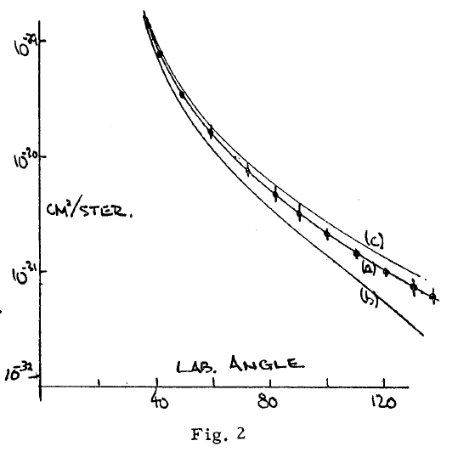
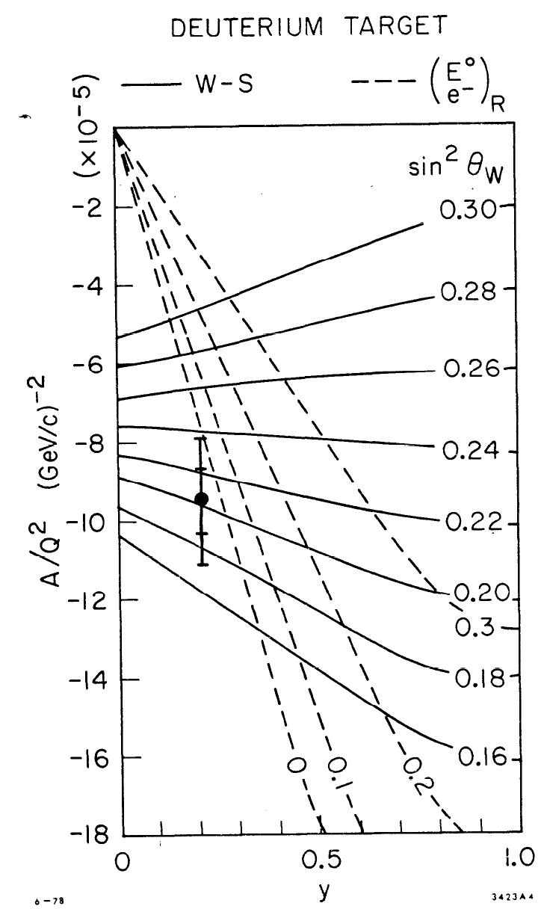
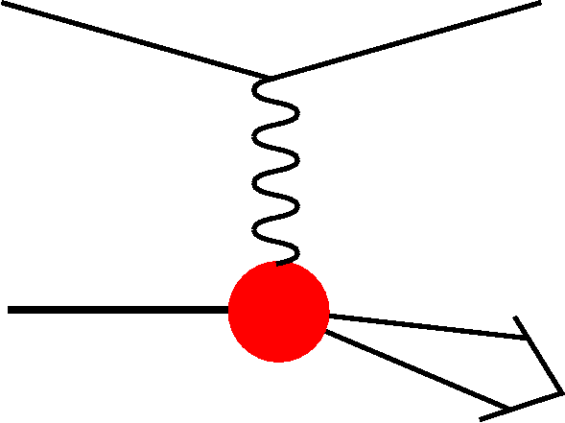
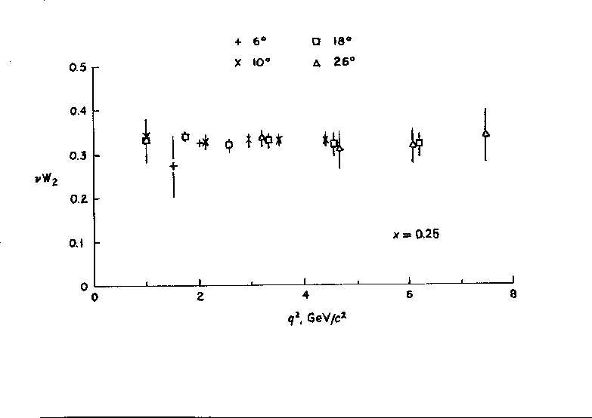


Early ep Scattering
Hofstadter et al, 1955, r_{p}=0.74±0.20fm
In DIS the
x and Q²
scales are
prescribed
by the
electron
kinematics
SLAC-MIT 1968 Bj Scaling → Partons
Prescott et al, 1978, I_{3,R}^{e}=0
Max Klein, Mainz, 6/2013

Slide 8
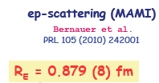
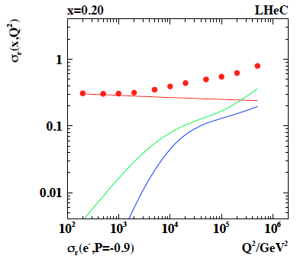

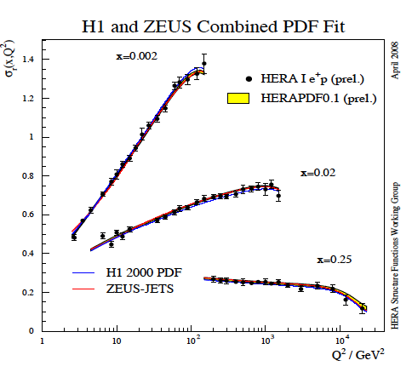
Recent/Future ep Scattering
← HERA
M.Vanderhaeghen 2009
?
HERA Violation of Bj Scaling → Gluon
MESA, Jlab, LHeC: sin²Θ(μ)

Slide 9
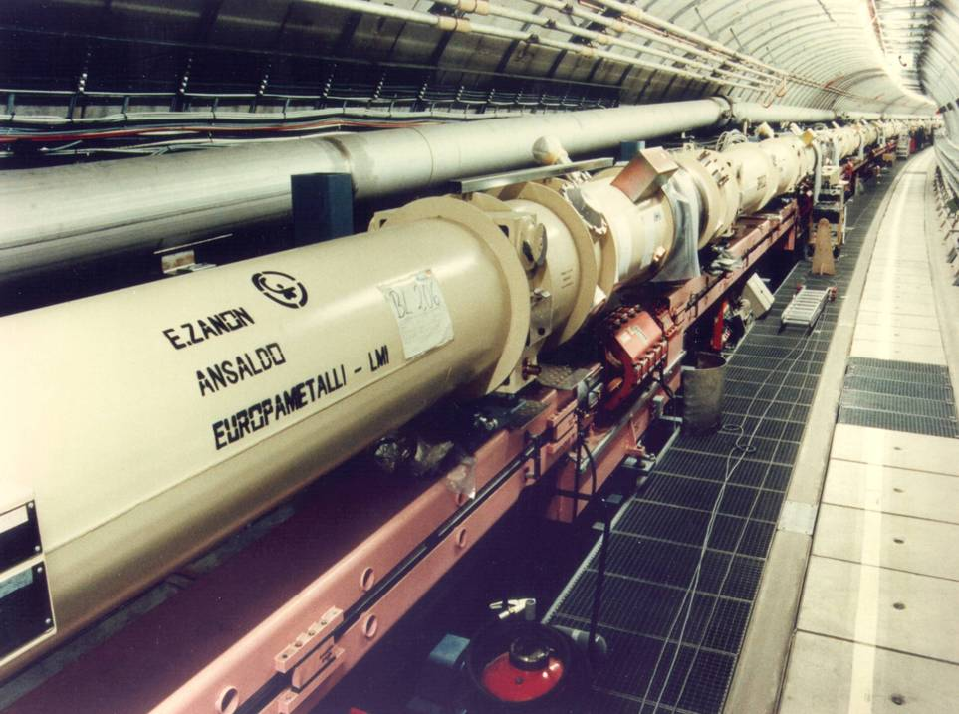
HERA: construction 1985-1991
6.2 km ring accelerator(s)
Superconducting p: E_{p} =460-920 GeV
Warm e: E_{e} =27.5 GeV, |P_{e}|=0.3..0.5
Data delivery (0.6fb⁻¹): 1992-2007
L=1 (HERAI)-4 (HERAII) 10³¹ cm⁻²s⁻¹
Max Klein, Mainz, 6/2013

Slide 10
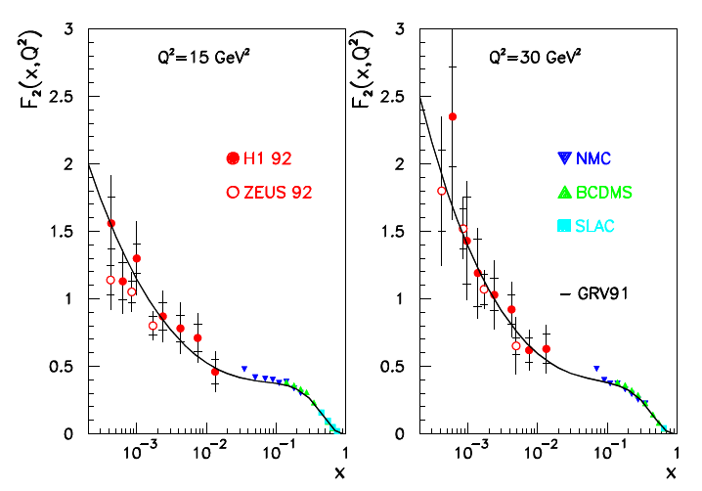
HERA: Discovery of the Rise of F₂ Towards Low x
H1 Collaboration, Nucl. Phys. B407 (1993) 515
ZEUS Collaboration, Phys. Lett. B316( 1993) 412
Not too steep, not flat (Regge)
in accord with 1974 expectation
hidden in pioneering pQCD paper
Max Klein, Mainz, 6/2013
20 years ago..

Slide 11
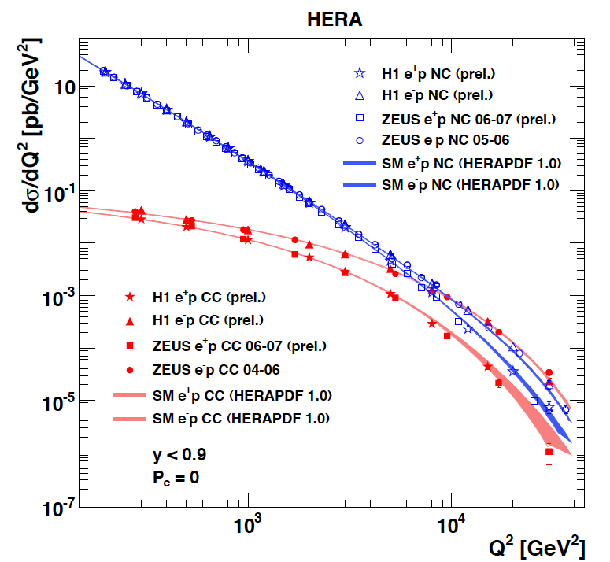
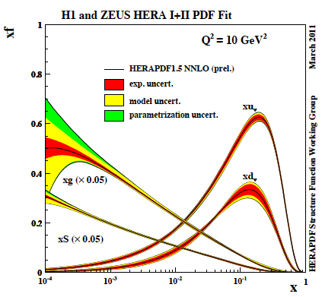
HERA’s Legacy I - Achievements
The weak and electromagnetic interactions reach similar strength when Q² ≥ M²_{W,Z}
F₂ rises towards low x, and xg too.
Parton evolution - QCD to NNLO
Measurements on α_{s}, Basic tests of QCD: longitudinal structure function, jet production, γ structure
Some 10% of the cross section is diffractive (ep → eXp) : diffractive partons; c,b quark distributions
New concepts: unintegrated parton distributions (k_{T}) , generalised parton distributions (DVCS), PDFs
New limits for leptoquarks, excited electrons and neutrinos, quark substructure, RPV SUSY
Interpretation of Tevatron+LHC measurements (high Et jet excess, M_{W}, searches, Higgs, ..)
Max Klein, Mainz, 6/2013
M.Klein, R.Yoshida: Collider Physics at HERA Prog.Part.Nucl.Phys. 61 (2008) 343-393 and recent H1,ZEUS results
A Recent review of The Theory of Deep Inelastic Scattering: J.Bluemlein arXiv:1208.6087 ProgPartNuclPhys 69(2013)28

Slide 12
HERA’s Legacy II – Open Questions
Test of the isospin symmetry (u-d) with eD - no deuterons
Investigation of the q-g dynamics in nuclei - no time for eA
Verification of saturation prediction at low x - too low s
Measurement of the strange quark distribution - too low L
Discovery of Higgs in WW fusion in CC - cross section ~0.5fb
Study of top quark distribution in the proton - too low energy
Precise measurement of F_{L} - too short running time left
Resolving d/u question at large Bjorken x - too low L
Determination of gluon distribution at hi/lo x - too small range
High precision measurement of α_{s} - overall not precise enough
Discovering instantons, odderons - don’t know why not
Finding RPV SUSY and/or leptoquarks - may reside higher up
…
→ Need: much higher luminosity, higher energy, nuclear targets
Max Klein, Mainz, 6/2013

Slide 13
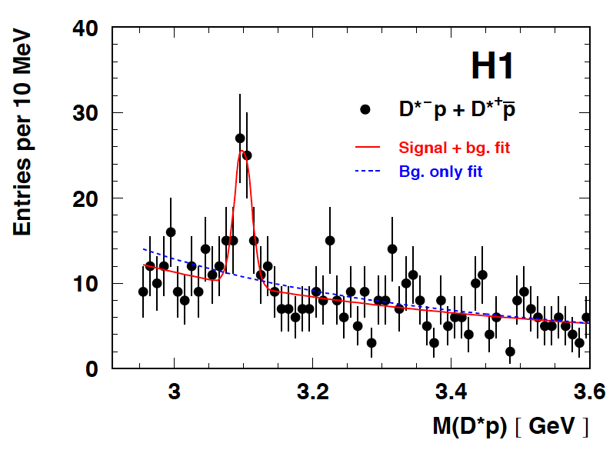
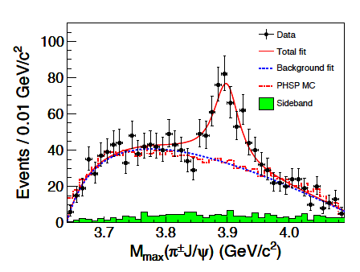
Puzzle – charm multi-quark states
uuddcbar
DESY 04-038 (2004)
Not seen by ZEUS..
udccbar
BESIII, arXiv:1303.5949
also seen by BELLE

Slide 14
Max Klein, Mainz, 6/2013
60 GeV electron beam energy, L= 10³³ cm⁻²s⁻¹, √s=1.3 TeV: Q²_{max}= 10⁶ GeV², 10⁻⁶ < x< 1
Recirculating linac (2 * 1km, 2*60 cavity cryo modules, 3 passes, energy recovery)
Ring-ring as fall back. “SAPHIRE” 4 pass 80 GeV option to do mainly: γγ→ H

Slide 15
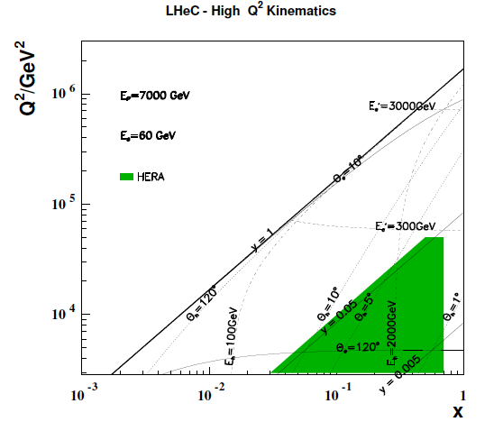
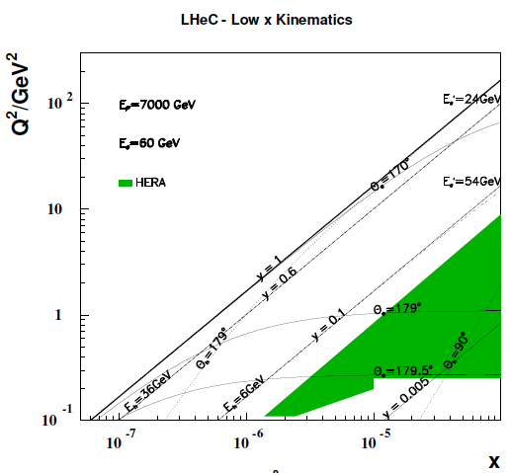
Kinematics - LHeC and HERA
Luminosity 100-1000 times higher
Access to “saturation” (?) region
in DIS (Q² > 1 GeV²) and ep
Extending beyond the Fermi scale with
precision Z and W exchange data →
high x, top PDF, flavour & new physics,
Forward/backward acceptance to 1/179º
Max Klein, Mainz, 6/2013

Slide 16
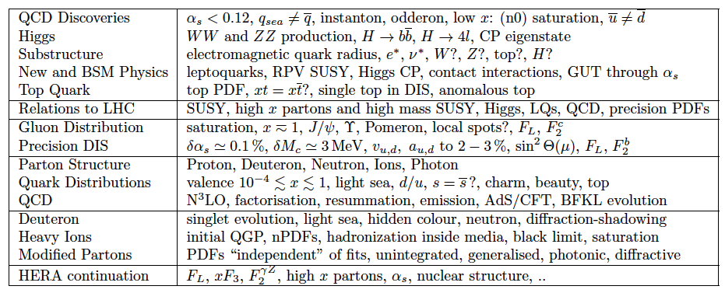
Summary of the LHeC Physics Programme
CDR, arXiv:1211.4831 and 1211.5102 http://cern.ch/lhec
Ultra high precision (detector, e-h redundancy) - new insight
Maximum luminosity and much extended range - rare, new effects
Deep relation to (HL-) LHC (precision+range) - complementarity
Max Klein, Mainz, 6/2013

Slide 17
QCD and Electroweak Physics
Mapping the Gluon Distribution
Proton Quark Distributions
Neutron Structure and Electron-Deuteron Scattering
Vector Meson Production and Diffraction
Weak Structure Functions and Asymmetries
x,Q² Range in Lepton-Nucleus Scattering
Nuclear Parton Distributions
Max Klein, Mainz, 6/2013

Slide 18
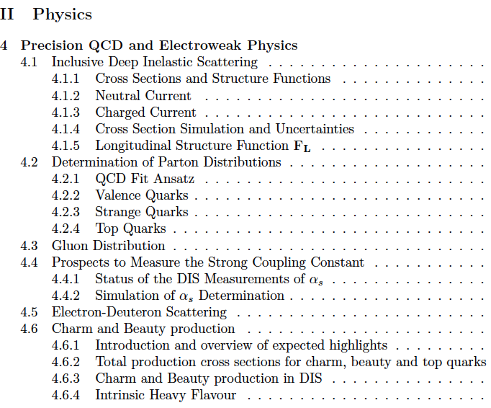
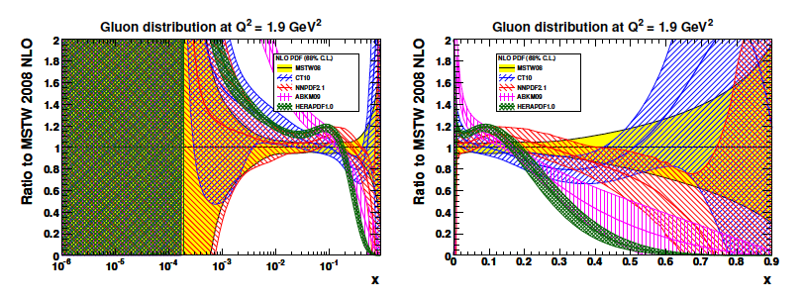
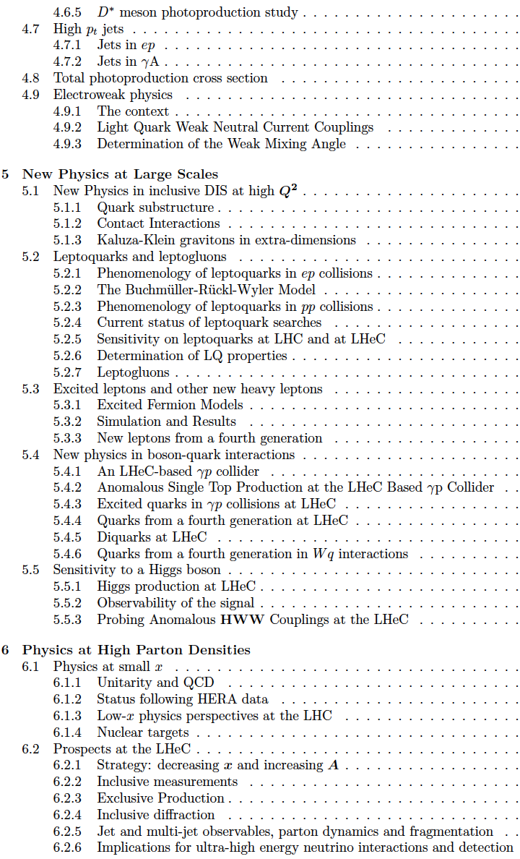
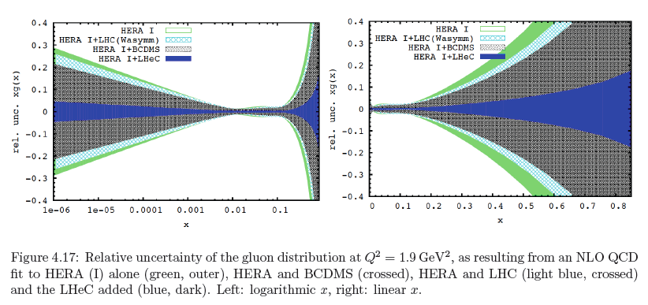
CDR
Gluon Distribution
153 pages
now
then
Precision measurement of gluon density to extreme x → α_{s}
Low x: saturation in ep? Crucial for QCD, LHC, UHE neutrinos!
High x: xg and valence quarks: resolving new high mass states!
Gluon in Pomeron, odderon, photon, nuclei.. Local spots in p?
Heavy quarks intrinsic or only gluonic?
Max Klein, Mainz, 6/2013

Slide 19
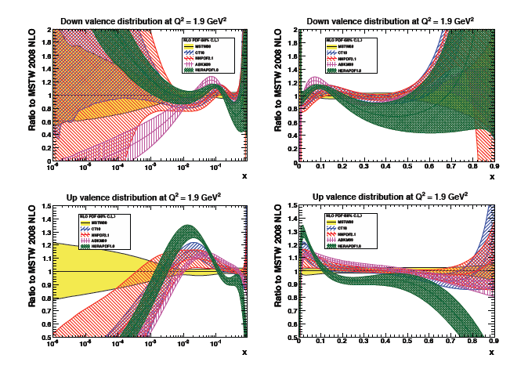
Valence Quarks - now
d_{V}
u_{V}
Max Klein, Mainz, 6/2013
logarithm x Bjorken
linear x Bjorken

Slide 20
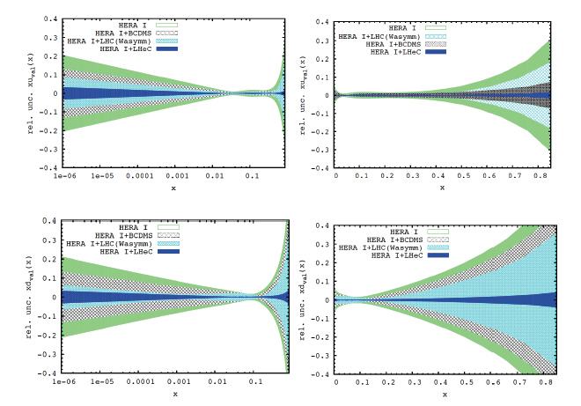
Valence Quarks - then
u_{V}
d_{V}
Max Klein, Mainz, 6/2013
logarithm x Bjorken
linear x Bjorken

Slide 21
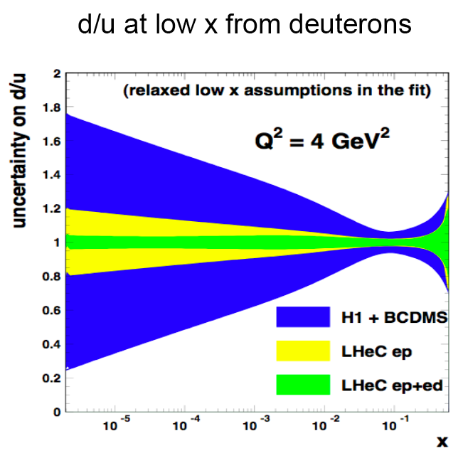
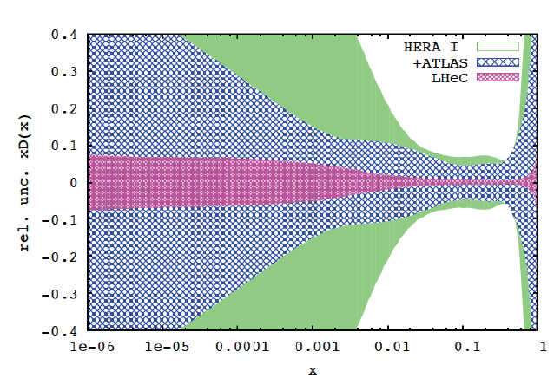

Deuterons and Light Sea Quark Asymmetry
D=“total down” from LHeC (ep) fit
with FREE d-u difference, including
simulated high precision LHC W,Z
CDR
Deuterons: Crucial for
NS-S decomposition
Neutron structure
Flavour separation
Nice: Gribov relation and spectator tagging to get rid off shadowing and Fermi motion!!
Max Klein, Mainz, 6/2013

Slide 22
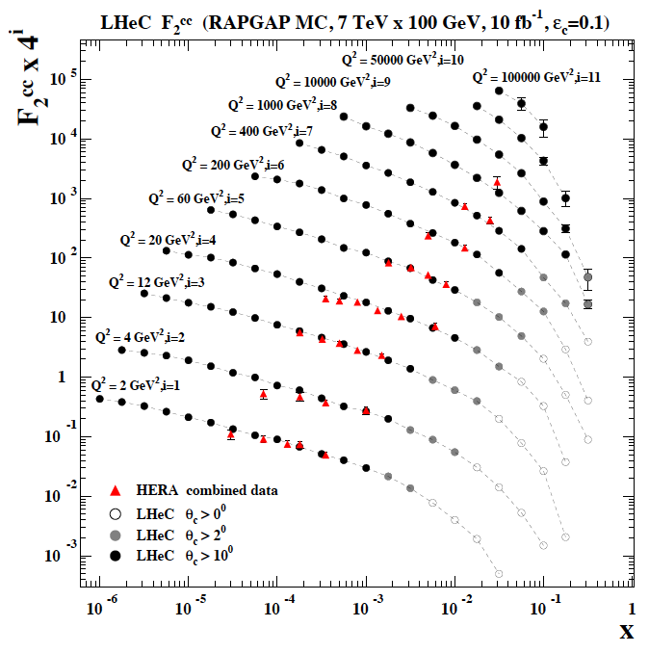
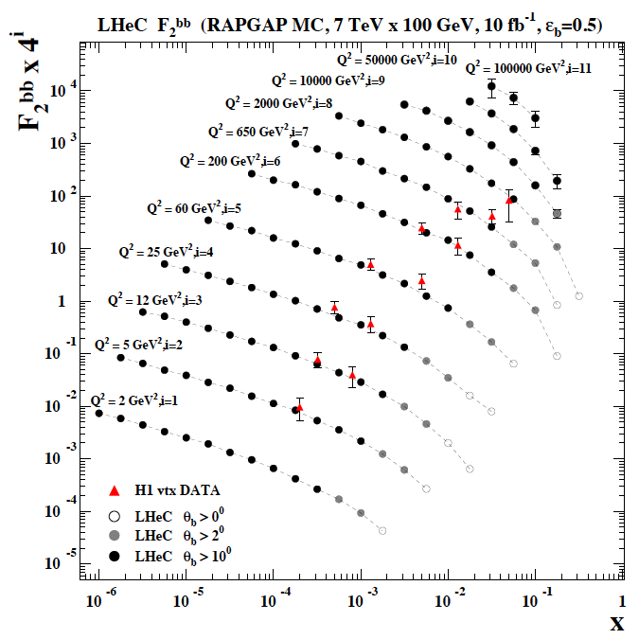
F₂^{charm} and F₂^{beauty} at HERA and the LHeC
Hugely extended range and much improved precision (δM_{c}=60 HERA → 3 MeV)
will pin down heavy quark behaviour at and far away from thresholds, crucial for precision t,H..
Intrinsic Charm? In MSSM, Higgs is produced dominantly via bb → H , but where is the MSSM..
Max Klein, Mainz, 6/2013

Slide 23
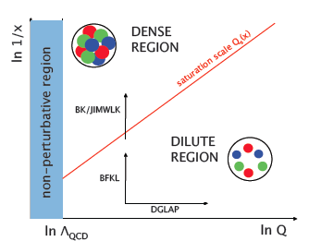
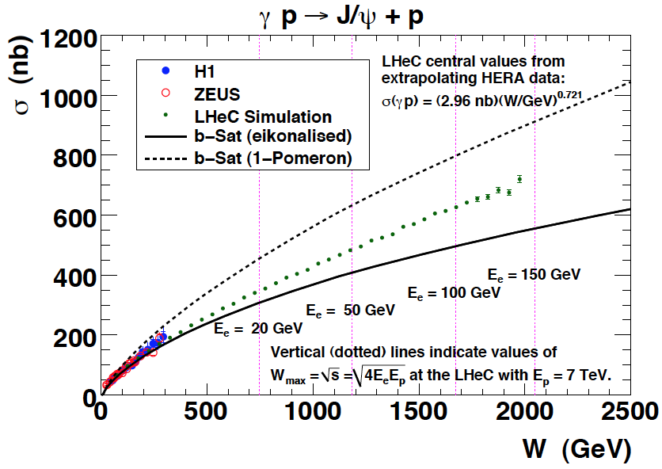
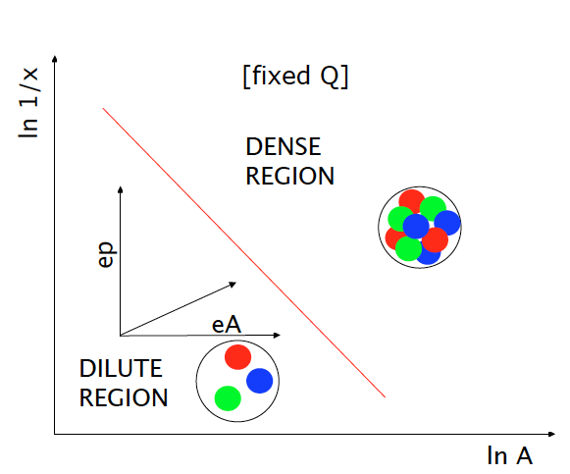
Low x Physics
Precision Measurements of various
crucial observables (F₂, F_{L}, J/ψ, diffraction
DGLAP → nonlinear evolution
Saturation of the gluon density??
Max Klein, Mainz, 6/2013

Slide 24
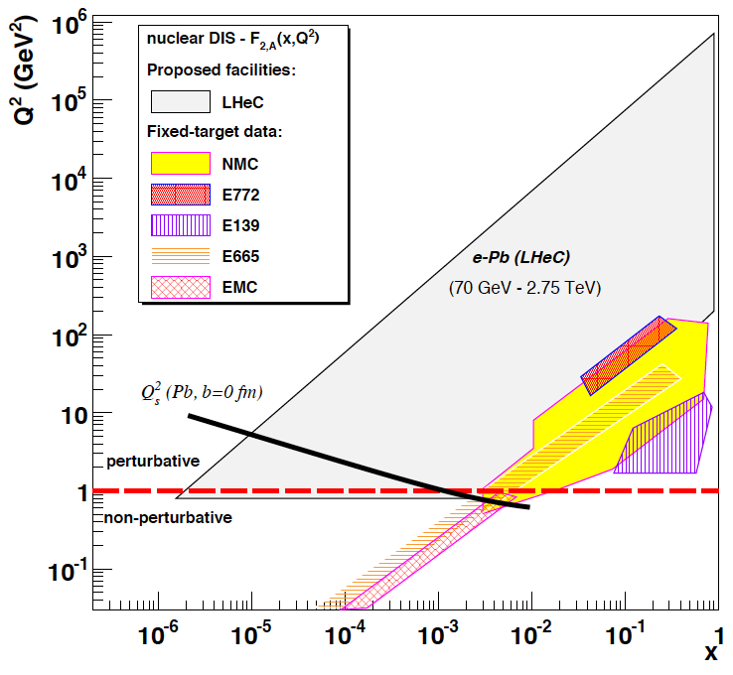
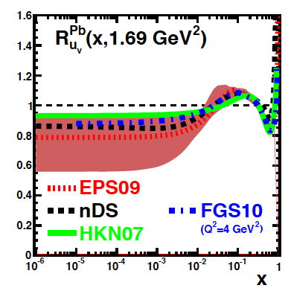
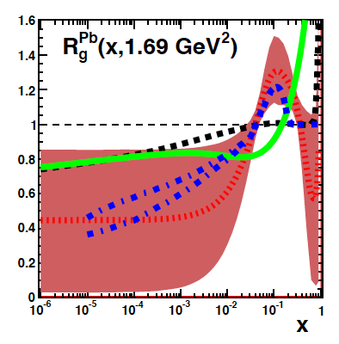
Nuclear Parton Distributions from eA
up valence
gluon
3-4 orders of magnitude extension of lA kinematic range
→ LHeC has huge discovery potential for new HI physics
(bb limit, saturation.. will put nPDFs on completely new ground
unmeasured | known?
Max Klein, Mainz, 6/2013

Slide 25
New Physics: LHeC and LHC
Physics of the Quark-Gluon Plasma
Grand Unification and the Strong Coupling Constant
PDFs, xg and the Higgs Production in pp at the LHC
PDFs, xg and the HL-LHC Discovery Reach
The strange quark distribution in ep and pp
Top Physics and Lepto-Quarks
Cf most recent: M.D’Onofrio New Physics with the LHeC, LPCC Workshop on LHeC 3/2013
Max Klein, Mainz, 6/2013

Slide 26
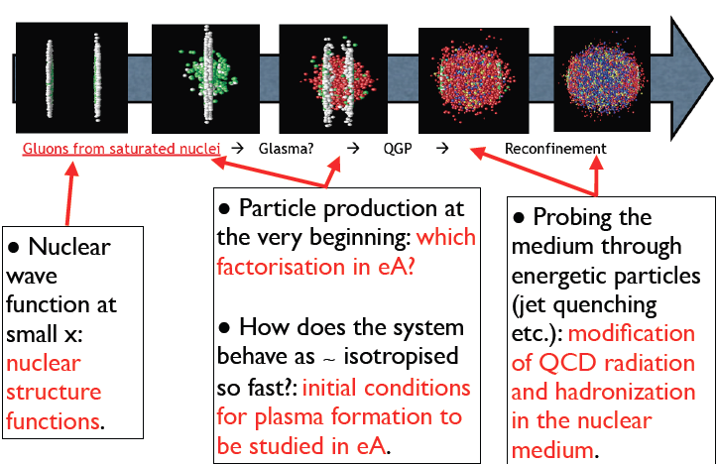
Relation of the LHeC and the LHC HI Program
Nestor Armesto DIS2013, Marseille

Slide 27
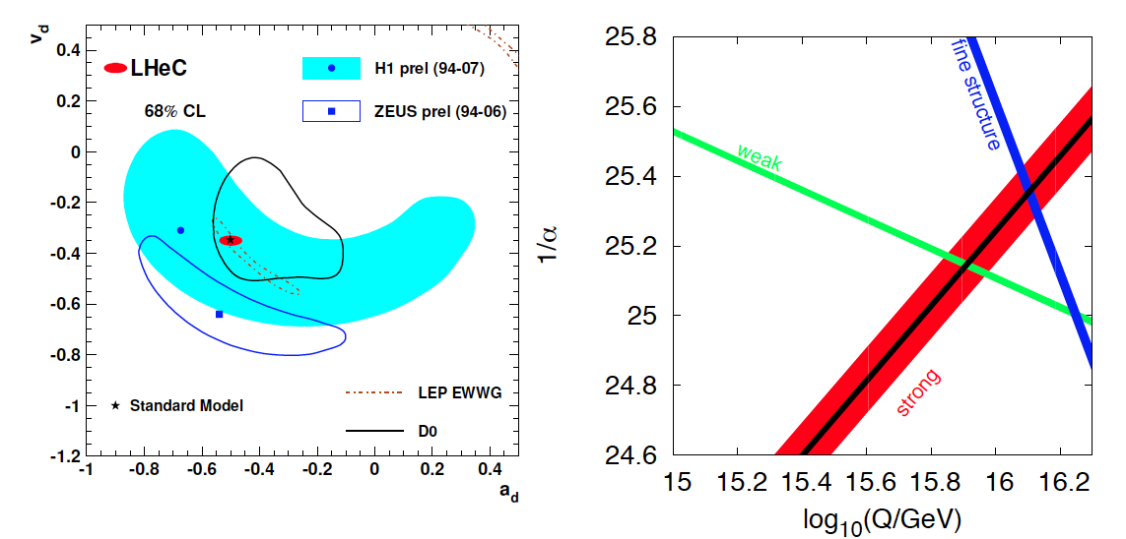
High Precision DIS
High Precision DIS
Q² >> M_{Z,W}², high luminosity, large acceptance
Unprecedented precision in NC and CC
Contact interactions probed to 50 TeV
Scale dependence of sin²θ left and right to LEP
→ A renaissance of deep inelastic scattering ←
Solving a 30 year old puzzle:
α_{s} small in DIS or high with jets?
Per mille measurement accuracy
Testing QCD lattice calculations
Constraining GUT (CMSSM40.2.5)
Charm mass to 3MeV, N³LO
Max Klein, Mainz, 6/2013

Slide 28
Exp uncertainty
of predicted H
cross section is
0.25% (sys+sta),
using LHeC only.
Leads to H mass
sensitivity.
Strong coupling
underlying
parameter
(0.005 – 10%).
LHeC: 0.0002
Needs N³LO
HQ treatment
important
PRECISION σ(H)
Calculated for scale of M_{H}/2
Bandurin (ICHEP12) Higgs physics at the LHC is limited by the PDF knowledge
Max Klein, Mainz, 6/2013

Slide 29
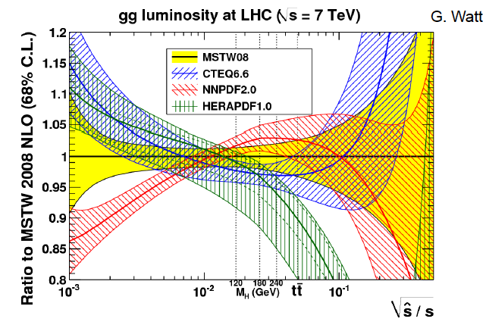
Max Klein, Mainz, 6/2013

Slide 30

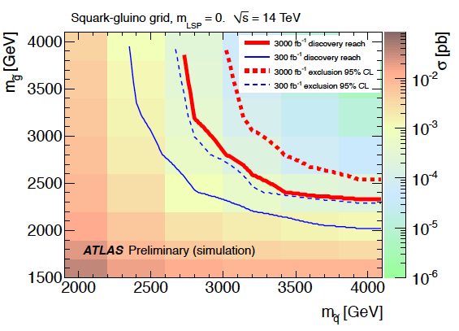
Link to HL LHC, e.g. High Mass SUSY
LHeC: arXiv:1211.5102
ATLAS October 2012 “Physics at High Luminosity”
With high energy and luminosity, the LHC search range will be extended to high masses,
up to 4-5 TeV in pair production, and PDF uncertainties come in ~ 1/(1-x), CI effects?
Max Klein, Mainz, 6/2013

Slide 31
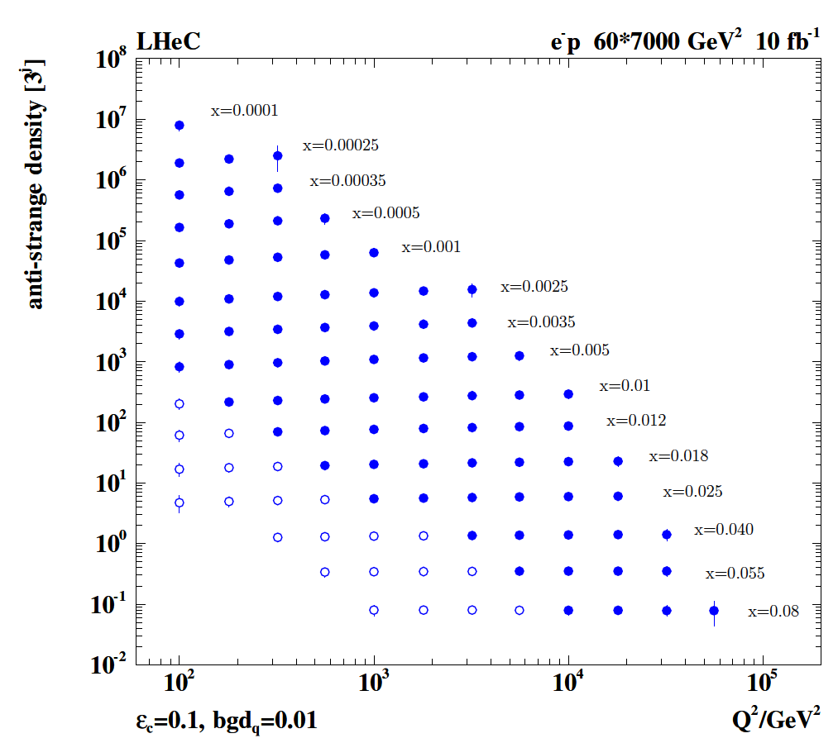
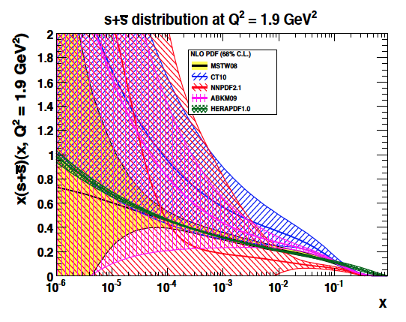
Strange Quark Distribution
High luminosity
High Q²
Small beam spot
Modern Silicon
NO pile-up..
First (x,Q²)
measurement of
the (anti-)strange
density, HQ valence?
x = 10⁻⁴ .. 0.05
Q² = 100 – 10⁵ GeV²
Initial study (CDR): Charm tagging efficiency of 10% and 1% light quark background in impact parameter
Max Klein, Mainz, 6/2013

Slide 32
Strange Quark Distribution
High luminosity
High Q²
Small beam spot
Modern Silicon
NO pile-up..
First (x,Q²)
measurement of
the (anti-)strange
density, HQ valence?
x = 10⁻⁴ .. 0.05
Q² = 100 – 10⁵ GeV²
HERA+ATLAS (W,Z data from 2010): Determination of strange/anti-down quark ratio: symmetric light sea?
Obtain PDF constraints from LHC, but: no direct determinations (Q2,x), less precision, factorisation, BSM?
Max Klein, Mainz, 6/2013

Slide 33
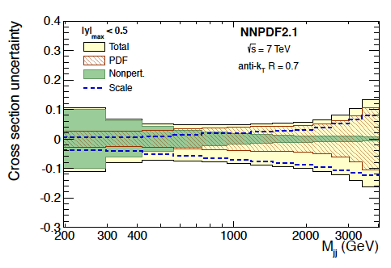
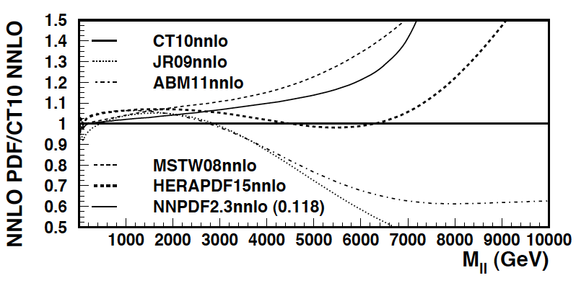
High Mass Drell Yan
Towards high mass the PDF uncertainties
rise, strongly towards the edge (√s) x → 1…
CMS Di-Jets arXiv:1212:6660
For HL-LHC:
Need to study limits
and interferences (ED?)
in context with energy
calibrations, and thy
uncertainties, + PDFs
vs BSM expectations
14 TeV, VRAP L.Dixon et al, U.Klein
Max Klein, Mainz, 6/2013

Slide 34
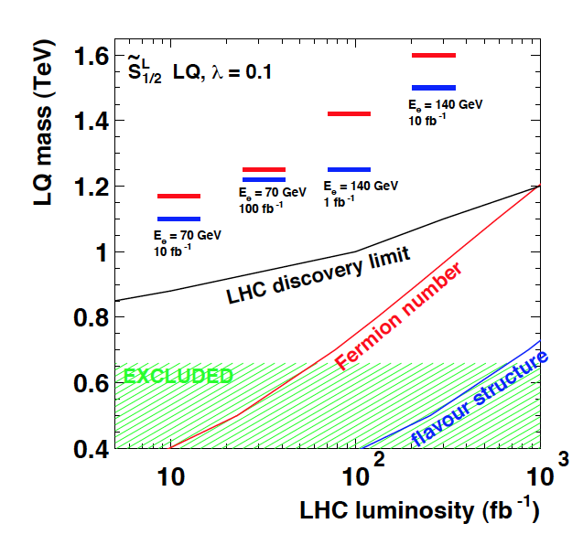
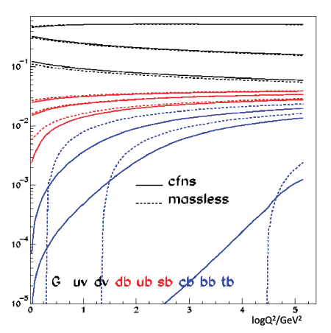
Top Quark and Leptoquarks
The LHeC is a (single) top quark production
factory, via Wb → t. Top was never observed
in DIS. With ep: top-PDF → 6 flavour VFNS,
precision M_{t} direct and from cross section,
anomalous couplings [to be studied]
Leptoquarks (-gluons) are predicted in RPV SUSY,
E6, extended technicolour theories or Pati-Salam.
The LHeC is the appropriate configuration to do their
spectroscopy, should they be discovered at the LHC.
Max Klein, Mainz, 6/2013

Slide 35
The LHeC Design and the Higgs
Ring-Ring and Linac-Ring Choice
A Simulation of WW→H→bbar
Higgs on ATLAS
LHeC as a Higgs “Factory”
Rates for LHeC and ILC
CP Properties at the WW and ZZ Vertices
Max Klein, Mainz, 6/2013

Slide 36
L vs E_{e}
Storage Ring
Energy Recovery Linac
Max Klein, Mainz, 6/2013

Slide 37
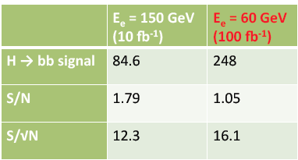
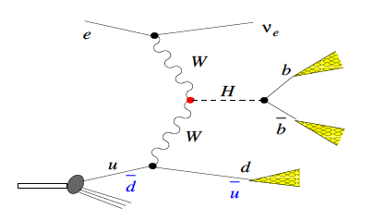
Higgs at the LHeC
Clean final state, no pile-up, low QCD bgd, uniquely WW and ZZ, small theory unc.ties
Default
U. Klein, ICHEP12, Melbourne for the LHeC
Full simulation of ep → nu H X → nu bbar X: reconstruction efficiency of 2.5%
With polarised electrons, 100fb⁻¹ - bb coupling measurement precision of 2-3%.
Max Klein, Mainz, 6/2013

Slide 38






CP Higgs at the LHeC
In the SM the Higgs is a J^{PC}=0⁺⁺ state.
One needs to measure the EV if CP
is conserved, and the mixture of even
and odd states if it is not.
λ (λ’) anomalous CP (non) conserving terms
S.Biswal et al,
PhysRevLett.109.261801
Max Klein, Mainz, 6/2013

Slide 39


H → γγ H→ ZZ* → 4l
Discovery of H
4.7.2012 ICHEP Melbourne
arXiv:1207.7214
arXiv:1207.7214
13.12.2012 CERN Council
ATLAS CONF 2012-168
ATLAS CONF 2012-169

Slide 40

LHeC at 10³⁴ Luminosity
LHeC Collaboration arXiv:1211:5102, see also O.Bruening and M.Klein arXiv:1305.2090, MPLA 2013
Max Klein, Mainz, 6/2013

Slide 41

LHeC Higgs Rates
H-bbar coupling to 0.7% precision with 1ab-1, at an S/B of 1 – studies of t, c, .. to come
The LHeC WW → H cross section is as large as the ILC Z*→ZH cross section (300fb)…
50pb LHC, HL-LHC + ep H and PDFs : transform the LHC facility into a genuine H factory
Max Klein, Mainz, 6/2013

Slide 42
Technical Design of the LHeC and a Detector
Civil Engineering
Components
Interaction Region and Q1
A Detector for Precision DIS Physics
Installation Study
Max Klein, Mainz, 6/2013

Slide 43


Civil Engineering
Shaft sinking installation
Roadheader 1
CDR: Evaluation of CE, analysis
of ring and linac by Amber Zurich
with detailed cost estimate
[linac CE: 249,928 kSF..] and time:
3.5 years for underground works using 2 roadheaders and 1 TBM
More studies needed for
Integration with all services
(EL,CV, transport, survey etc).
Geology
Understanding vibration risks
Environmental impact assessment
Tunnel connection in IP2
Roadheader 2
J.Osborne, Chavannes
Max Klein, Mainz, 6/2013

Slide 44





Chapter 9 of CDR
Components and Cryogenics
Jlab:
4 10¹¹
Need to develop LHeC cavity (cryo-module)
Max Klein, Mainz, 6/2013
from CDR LHeC

Slide 45

LHeC Detector Overview
LAr electromagnetic calorimeter
Tile Calorimeter
Max Klein, Mainz, 6/2013
Detector option 1 for LR and full acceptance coverage
Forward/backward asymmetry in energy deposited and thus in geometry and technology
Present dimensions: LxD =14x9m² [CMS 21 x 15m² , ATLAS 45 x 25 m²]
Taggers at -62m (e),100m (γ,LR), -22.4m (γ,RR), +100m (n), +420m (p)

Slide 46


Time Schedule*⁾
Detector installation
study for IP2, reuse
of L3 magnet as
support for LHeC.
Estimated 30 months
LHeC is to operate synchronous with HL-LHC
LS3 requires 2-3 years for ATLAS+. It is the
one extended time period, which will allow
installation and connection of LHeC
Max Klein, Mainz, 6/2013
*) LS3 → schedule most likely shifted by +2 years

Slide 47
Prospects and Next Steps
The Conceptual Design Report
LHeC Collaboration
ECFA’s Evaluation
An ERL Test Facility for the LHeC
Magnet Prototypes and Design
Interaction Region and Beam Pipe
Max Klein, Mainz, 6/2013

Slide 48


CERN Referees
arXiv:1206.2913
Max Klein, Mainz, 6/2013
arXiv:1211.4831 and 5102
Published 600 pages conceptual design report (CDR) written by 150 authors from 60 Institutes.
Reviewed by ECFA, NuPECC (long range plan), Referees invited by CERN. Published June 2012.

Slide 49

http://cern.ch/lhec
LHeC Study group and CDR authors (Dec.2012)
About 200 Experimentalists and Theorists from 76 (+3) Institutes

Slide 50


ECFA Review 2007-2012
CERN SPC, [r]ECFA Mandate given in 2007 to work out the LHeC
physics, detector and accelerator design(s) – looking back to 1994
CDR and referee process carefully evaluated by ECFA committee
…
Stressed: Link to LHC physics and operation, link to HEP, cost estimates, R&D, DIS community
ECFA Statement ECFA/12/279 December 2012
Max Klein, Mainz, 6/2013

Slide 51






Towards an LHeC ERL Test Facility at CERN
Contribution to IPAC13
Daresbury Workshop 22/23.1.:
- Collaboration: CERN, AsTEC, CI, JeffersonLab, U Mainz, +
- LHeC Parameters (C,Q,source,I) rather conservative
- Test Facility to develop full technology, key: cavity
- RF frequency chosen
Max Klein, Mainz, 6/2013
http://cern.ch/lhec

Slide 52



Magnet Developments
flux density in the gaps | 0.264 T 0.176 T 0.088 T
magnetic length | 4.0 m
vertical aperture | 25 mm
pole width | 85 mm
number of magnets | 584
current | 1750 A
number of turns per aperture | 1 / 2 / 3
current density | 0.7 A/mm²
conductor material | copper
resistance | 0.36 mΩ
power | 1.1 kW
total power 20 / 40 / 60 GeV | 642 kW
cooling | air
Prototypes for Ring dipoles
Fabricated and tested by
CERN (top) and Novosibirsk
LR recirculator dipoles and quadrupoles
New requirements (aperture, field)?
Combined apertures?
Combined functions (for example, dipole + quad)?
LR linac quadrupoles and correctors
New requirements (aperture, field)?
More compact magnets, maybe with at least two
families for quadrupoles?
Permanent magnets / superconducting for quads?
A.Milanese, Chavannes workshop
1/2m dipole model
Full scale prototype
Quadrupole for Linac
Magnets for ERL test stand
Collaboration of CERN, Beijing, Daresbury, Novosibirsk)
Max Klein, Mainz, 6/2013

Slide 53



Interaction Region Developments
Beam pipe: in CDR 6m, Be, ANSYS calculations
Composite material R+D, prototype, support..
→ Essential for tracking, acceptance and Higgs
Have optics compatible with LHC and β*=0.1m
Head-on collisions mandatory →
High synchrotron radiation load, dipole in detector
Specification of Q1 – NbTi prototype ( with KEK?)
Revisiting SR (direct and backscattered),
Masks+collimators
Beam-beam dynamics and 3 beam operation studies
Optimisation: HL-LHC uses IR2 quads to squeeze IR1
(“ATS” achromatic telescopic squeeze) Start in IR3 – 10cm ok.

Slide 54
Final Remarks
Searches for New Physics
Theory and Experiment
LHeC Physics in Q²,x
Higgs with the LHeC
Project Development
A Summary Slide
SLAC
Max Klein, Mainz, 6/2013

Slide 55

Searching for new physics
Extra Dimensions
Standard Model: remarkably successful description of known phenomena, but requires new physics at the (multi)TeV scale.
Large, warped, or universal extra dimensions
Might provide:
  Dark Matter candidate
  Solution to Hierarchy problem
  Unification of forces
Searches for new heavy particles, black holes..
Strong EW symmetry breaking
Modern variants of Technicolor
Might provide:
  Dark Matter
  Hierarchy problem
Possibly search for composite Higgs, new heavy vector bosons (Z’, W’…), 4th generation of quarks
Composite (SUSY) theories
Composite Higgs and top
Supersymmetry
Introduce heavy superpartners, scalar particles, light neutral Higgs
More than100 parameters even in MSSM
Notes:
SUSY must be broken

Slide 56



THEORY
M.Froissart ICHEP (“Rochester”) 1966
H.Murayama – ICFA11
→ Quarks in 1969
→ ?in 2015+?
Max Klein, Mainz, 6/2013
We like to see particle physics as driven by experiment … Burt Richter

Slide 57

New dreieck
Max Klein, Mainz, 6/2013

Slide 58

Higgs with the LHeC
ZZ → H ~10 times lower rate
LPCC LHeC Workshop at CERN– April12+ 13: indico: 244768 and 244990
Unique production mechanism (WW,ZZ)
Clean experimental conditions:
No pileup, simpler final state …
LHeC at 10³⁴cm⁻²s⁻¹ : arXiv:1211:5102
Nb: Cross section and luminosity as large
as are projected for the ILC. Access to
difficult channels (ττ, cc – under study)
With its unique Higgs measurements and
precision N³LO PDFs and δα_{s} ,
ep upgrade transforms the LHC facility
into a precision Higgs factory.
[cf arXiv:1211:5102 + OB, MK: arXiv:1305:2090]
Rates for E_{e}=60 GeV, proportional to E_{e}
Initial study for CDR:
H →bbar: selection efficiency: ~2.5%
which gives 5000 events with S/B=1.
corresponding to 0.7% coupling precision.
[cf: CDR, U.Klein ICHEP12, B.Mellado LPCC]
Max Klein, Les Houches 12.6.13

Slide 59


Project Development
CERN Mandate
LHeC three years programme
Accelerator
SC RF, LTF, Q1, Optimisation, Lumi,
Detector
IR, Technical Design, Installations
Physics
Higgs, RPV SUSY, top, ..LHC
Project
Workshops, Collaboration..
The LHeC is a challenge worth
developing for the future of HEP
S.Bertolucci at Chavannes workshop 6/12 based on
CERN directorate’s decision to include LHeC in the MTP
Max Klein, Mainz, 6/2013

Slide 60

Large Hadron Electron Collider - LHeC
Information on http://cern.ch/lhec
ep/A synchronous to pp/AA
- LHC is the only place for TeV energy DIS
- ~60 GeV electron beam upgrade to the LHC
- DIS at TeV energies: Q²_{max}10⁶, x > 10⁻⁶
- A new Higgs facility – new detector
Noteable:
Unprecedent precision (α_{s} to per mille)
Complete unfolding of PDFs (1st time)
Precision electroweak measurements
Novel precision input for LHC physics
BSM (RPV SUSY, e*, CI, lq resonances?)
Quark Gluon Plasma – initial formation
QCD
Discovery/disproval of saturation at low x
Less conventional partons (kt, diff., GPDs)
Nuclear structure in huge kinematic range
Top with 10pb cross section in DIS, tPDF
Max Klein, Les Houches 12.6.13
The LHeC is a new laboratory for energy frontier particle physics of unique character.
Ref’s: CDR arXiv:1205:2913, summary: arXiv:1211.4831, relation to LHC: arXiv:1211:5102

Slide 61





can one build a 2-3-km long linac?
it has been done before
Courtesy F.Zimmermann

Slide 62
Backup

Slide 63



LR LHeC IR layout & SC IR quadrupoles
Exit hole for electrons & non-colliding protons
Synchrotron radiation
Q2
Electron beam
Q1
Q2
Q1
Nb₃Sn (HFM46): 5700 A, 175 T/m, 4.7 T at 82% on LL (4 layers), 4.2 K | Nb₃Sn (HFM46): 8600 A, 311 T/m, at 83% LL, 4.2 K
46 mm (half) ap., 63 mm beam sep. | 23 mm ap.. 87 mm beam sep.
0.5 T, 25 T/m | 0.09 T, 9 T/m
colliding proton beam
Non-colliding proton beam
Inner triplets
Inner triplets
High-gradient SC IR quadrupoles based on Nb₃Sn for colliding proton beam with common low-field
Max Klein, Mainz, 6/2013
As shown by F. Zimmermann at Chamonix12

Slide 64


Silicon Tracker and EM Calorimeter
Transverse momentum
Δp_{t}/p²_{t} → 6 10⁻⁴ GeV⁻¹
transverse
impact parameter
→ 10μm
Max Klein, Mainz, 6/2013
LHeC-LHC: no pile-up, less radiation, smaller momenta apart from forward region

Slide 65




Hadronic Tile Calorimeter
Outside Coil: flux return
Modular. ATLAS experience.
R=2.6m
+5.9m
-3.6m
Combined GEANT4 Calorimeter Simulation

Slide 66



Liquid Argon Electromagnetic Calorimeter
Inside Coil
H1, ATLAS
experience.
Barrel: Pb, 20 X₀ , 11m³
fwd/bwd inserts:
FEC: Si -W, 30 X₀ ,0.3m³
BEC: Si -Pb, 25 X₀,0.3m³
GEANT4 Simulation

Slide 67
The 10-100 GeV Energy Scale [1968-1986]
(--)
pp
Drell Yan
Charm
W,Z
Jets
lh
e⁺e⁻
SU(2)_{L} x U(1)
QCD
Quarks
Neutral currents
Singlet e_{R}
Asymptotic Freedom
Charm
3 colours
Gluon Jets

Slide 68

Higgs at the ILC
U.Klein, before June 12

Slide 69



The ignored Neutron
Neutron structure unknown in HERA
range and below. Crucial to resolve its
parton structure and to predict scattering
on nucleons rather than proton targets.
Collider unique to en (p tag, diffraction)

Slide 70
From HERA to the LHeC
Deep Inelastic Scattering
QCD and Electroweak Physics
Nuclear Physics
New Physics: ep and pp at the LHC
Higgs with the LHeC
Accelerator and Detector Design
Prospects
Max Klein
Colloquium at Mainz, Germany, June 25th, 2013
http://cern.ch/lhec

Slide 71



Contact interactions (eeqq)
New currents or heavy bosons may produce indirect effect via new particle exchange interfering with γ/Z fields.
Reach for Λ (CI eeqq): 25-45 TeV with 10 fb⁻¹ of data depending on the model
Similar to LHC
ATLAS and CMS constraints on
eeqq CI (expected up to 30-40
TeV at c.o.m. 14 TeV LHC)

Slide 72








Nuclear Physics with the LHeC
1. Nuclear Parton Distribution Functions
2. Saturation (low x, nonlinear QCD)
3. Quark Gluon Plasma, its initial and final states
Gluon emission from saturated nuclei Glasma? QGP Reconfinement

Slide 73


Impact on discovery/exclusion reach
PDF uncertainties impact discovery / exclusion reach:
  Total yields
  Shape variations on discriminating quantities (in progress)
Impact on discovery/exclusion contours under various PDF hypothesis in progress
LHC @ 14 TeV 3 ab-1, M(squark) > 4 TeV
CT10 up
ABKM09 down
MSTW08 equivalent to LHeC PDF
Caution: very very preliminary, mostly as illustration
(UL for gl-gl courtesy of G.Redlinger)
(TeV)
Note: impact of PDF uncertainties on SM background also not negligible
However → mitigated by usage of Control Regions and semi data-driven estimate

Slide 74


Linac Characteristics
Multibunch wakefields - ok
Emittance growth - ok
[ILC 10nm, LHeC 10μm]
36σ separation at 3.5m - ok
Fast ion instability - probably ok
with clearing gap (1/3)
U_{LHeC}=U_{LHC}/3 : 1.5 x HERA
Tunneling: 150m per week – 60 weeks
Two 1km linacs with 59 cryomodules
of 8 cavities each → 1000 cavities

Slide 75
Large Hadron Electron Collider - LHeC
ep/A synchronous to pp/AA
- LHC is the only place for TeV energy DIS
- ~60 GeV electron beam upgrade to the LHC
- DIS at TeV energies: Q²_{max}10⁶, x > 10⁻⁶
- A new Higgs facility – new detector
Noteable:
Unprecedent precision (α_{s} to per mille)
Complete unfolding of PDFs (1st time)
Precision electroweak measurements
Novel precision input for LHC physics
BSM (RPV SUSY, e*, CI, lq resonances?)
Quark Gluon Plasma – initial formation
QCD
Discovery/disproval of saturation at low x
Less conventional partons (kt, diff., GPDs)
Nuclear structure in huge kinematic range
Top with 10pb cross section in DIS, tPDF
Information on http://cern.ch/lhec
Max Klein, Les Houches 12.6.13
The LHeC is a new laboratory for energy frontier particle physics of unique character.
Ref’s: CDR arXiv:1205:2913, summary: arXiv:1211.4831, relation to LHC: arXiv:1211:5102

