Slide 1
Large Hadron Electron Collider Progress Report to ECFA
Max Klein
for the LHeC Group
Poster at EPS09 and Lepton-Photon09
ECFA at CERN Geneva 27. November 2009
www.lhec.cern.ch

Slide 2
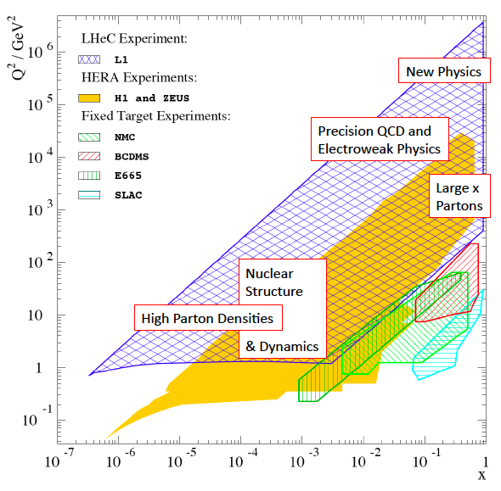
Kinematics and Recent Developments
2008
September Divonne workshop; NuPECC Meeting at Glasgow
October ICFA Seminar at SLAC
November ECFA Plenary at CERN
December Convenor’s Meeting at CERN
2009
March Visit to SLAC [Linac]
April DIS09 at Madrid:
LHeC premeeting, parallel, SAC
plenary panel (M.K. arXiv:0908.2877 [hep-ex])
April PAC09 at Vancouver - Papers, Talk, Proceedings
May Visit to BINP Novosibirsk [Ring Magnets]
June Low x / HPD meeting at CERN, pre-Blois
September Divonne II (CERN-ECFA-NuPECC Workshop)
~80 talks from ~ 100 participants
October NuPECC Long Range Planning Workshop

Slide 3
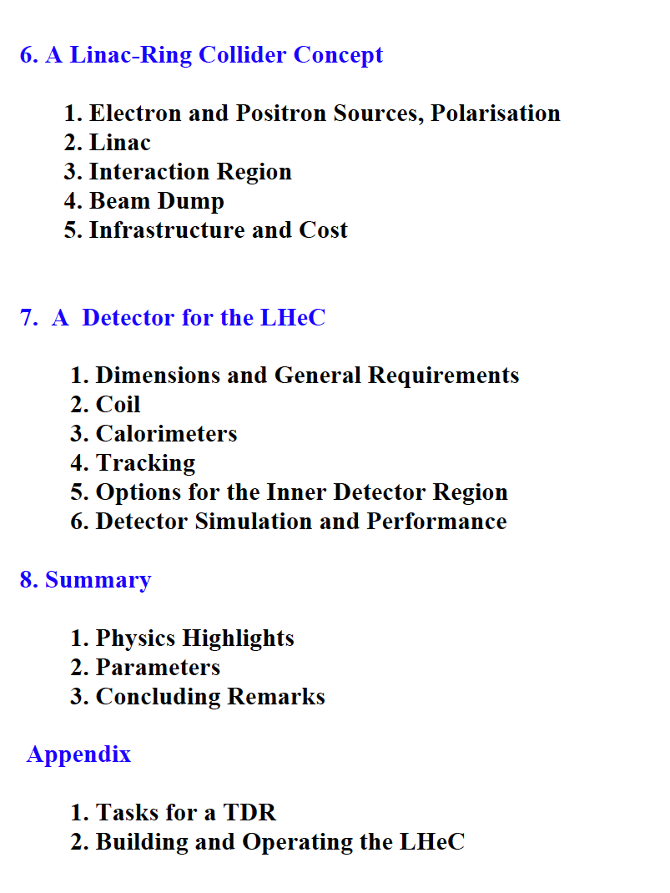
CDR
Extended version by Mid December09

Slide 4
Physics Programme of the LHeC
+ Unfolding completely the parton structure of the proton (and of the neutron
and photon) and search for sub-substructure down to 6 10⁻²⁰m
+ Exploration of new symmetries and the grand unification of particle interactions
with electroweak and strong interaction measurements of unprecedented precision.
+ Search for and exploration of new, Terascale physics, in particular for new states
with lepton qu.numbers (RPV SUSY, LQ, excited fermions), complementary to the LHC
+ Exploration of high density matter [low x physics beyond the expected unitarity
limit for the growth of the nucleon gluon density]
+ Unfolding the substructure and parton dynamics inside nuclei by an extension
of the kinematic range by four orders of magnitude [initial state of the QGP]
Large amount of studies done and ongoing, without aiming at complete list.
Follows an example per point each. Note that these are final when written up.

Slide 5
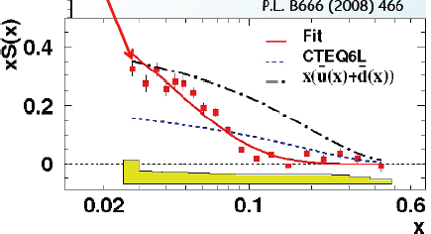
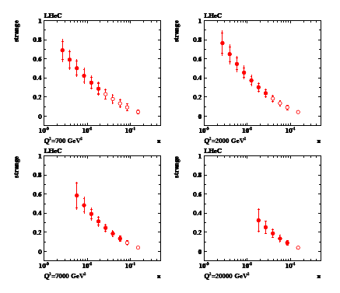
Strange and Anti-Strange Quark Distributions
Not measured with H1,ZEUS
HERMES (N_{K}): s much larger?
Dimuon data: s ≠ sbar?
HERMES, K.Rith EPS09
Q²~ 1 GeV²
W,Z sensitive to s
LHeC: measure both
strange and anti-s
with high precision
for the first time

Slide 6
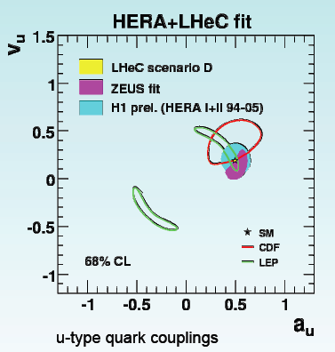
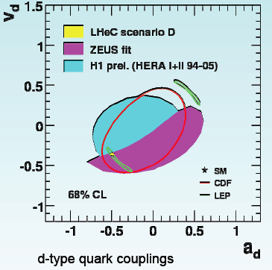
High Precision Electroweak Physics
Precision measurement of weak neutral current couplings (+pdf’s): access to new electroweak physics.
40 TeV limits on Contact Interactions and correspondingly on extra dimensions

Slide 7
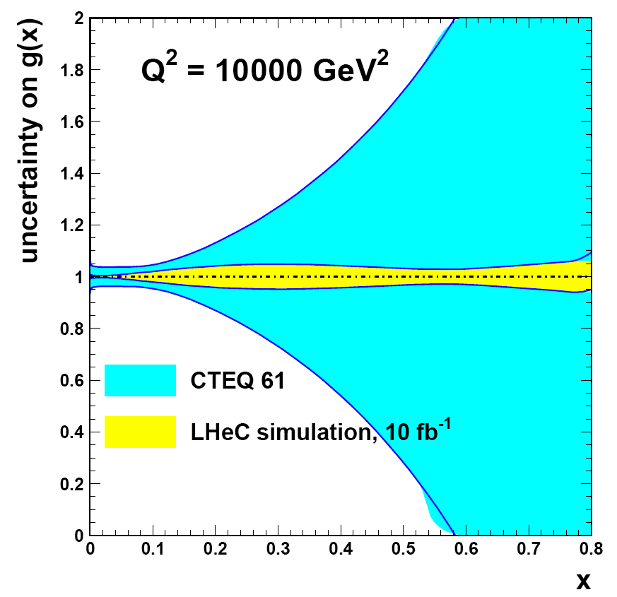
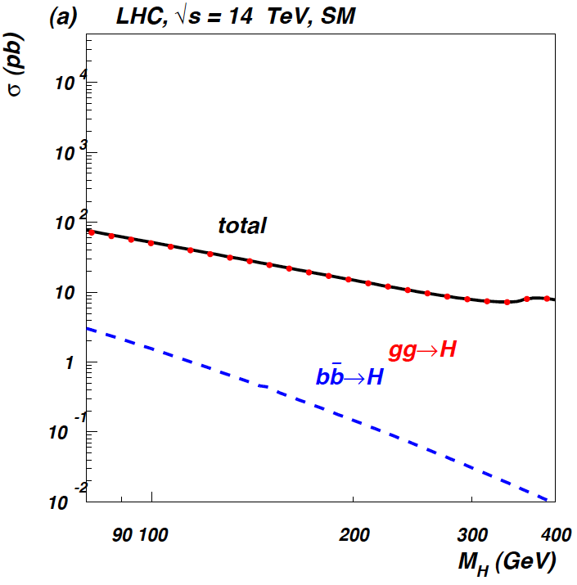
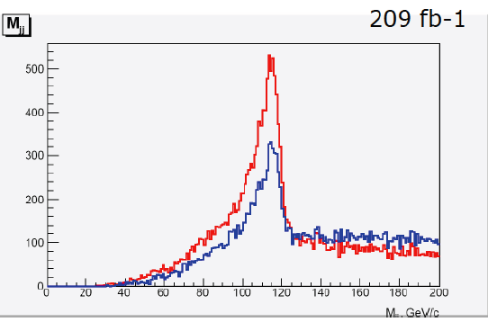
Gluon - SM Higgs
CTEQ Belyayev et al. JHEP 0601:069,2006
In SM Higgs production is gluon dominated
LHeC: huge x,Q² range for xg determination
WW to Higgs fusion has sizeable ep xsection
Cf Divonne 09 for QCD bgd studies + btagging

Slide 8
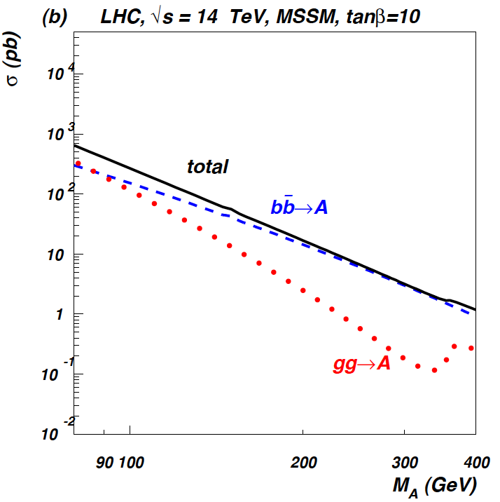
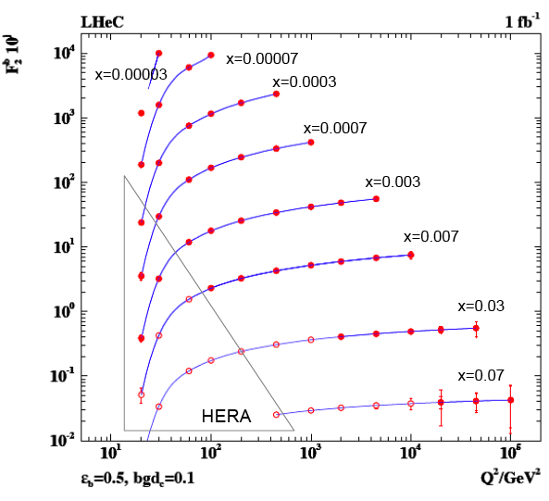
Beauty - MSSM Higgs
CTEQ Belyayev et al. JHEP 0601:069,2006
In MSSM Higgs production is b dominated
First measurement of b at HERA can be
turned to precision measurement.
LHeC: higher fraction of b, larger range,
smaller beam spot, better Si detectors

Slide 9
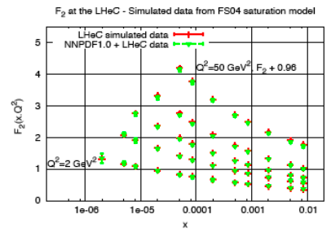
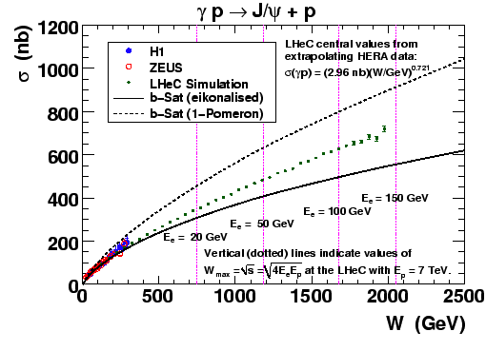
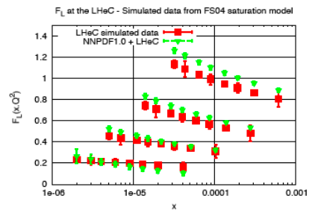
Discovery of Parton Saturation – ep, low x
Full simulation of F₂ and F_{L}
Both together must reveal saturation

Slide 10
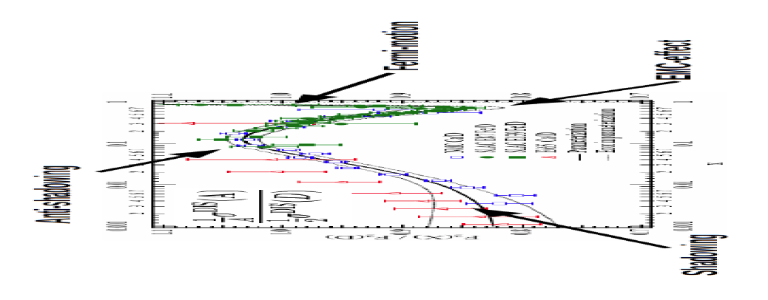
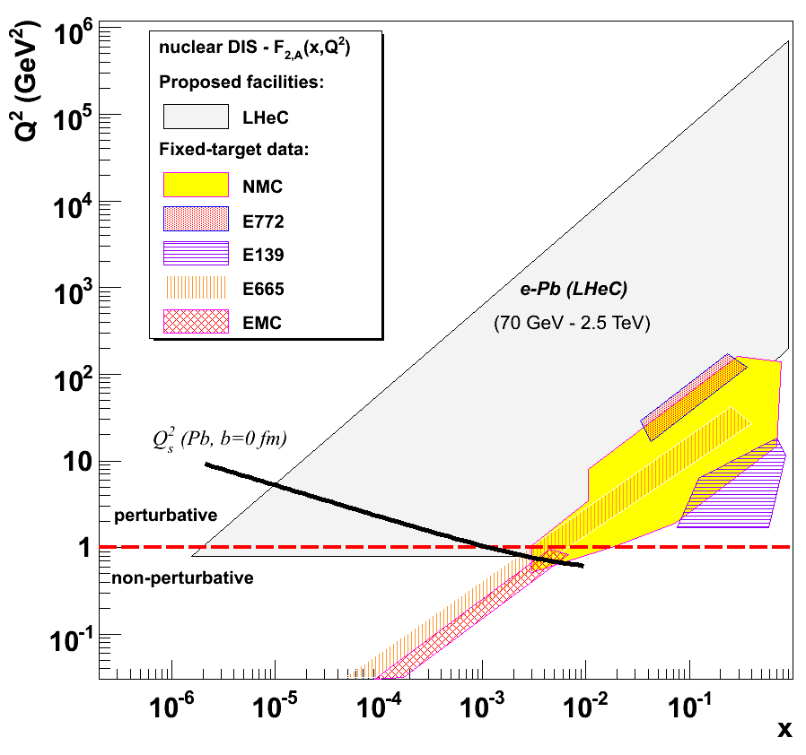
Nuclear Structure and Dynamics
Extension of Q², 1/x range by 10⁴
Fermi motion -- p tagging
Shadowing -- diffraction
p, D, Ca, Pb beams
Complete determination of nPDFs into nonlinear regime
LHeC is bound to discover parton saturation in eA AND ep

Slide 11
Accelerator and Detector Design
Collaborations of CERN
with experts from Cockcroft, BNL, DESY, KEK Lausanne, Novosibirsk, SLAC, TAC
20 workpackages with identified responsibles

Slide 12
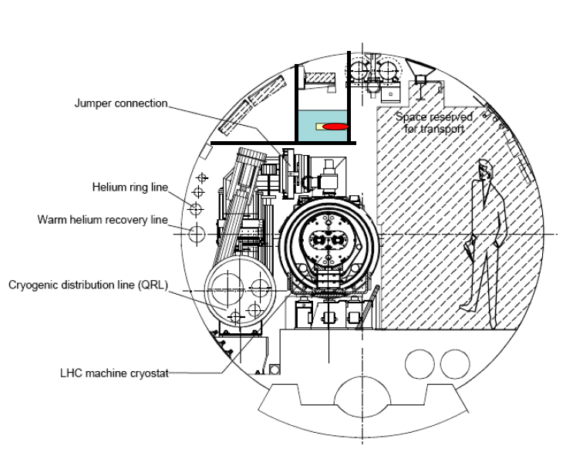
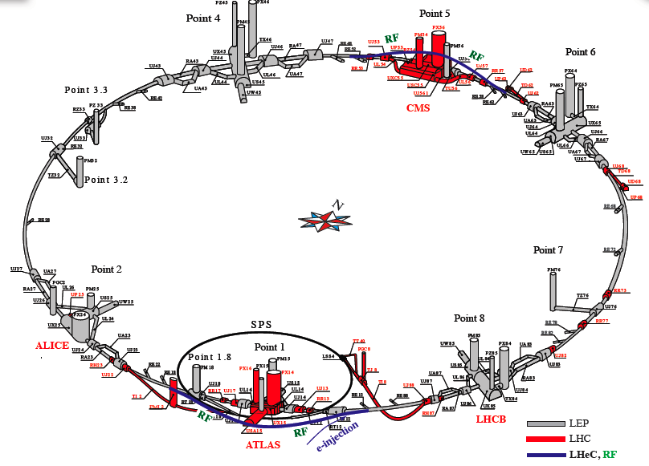
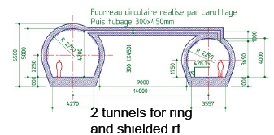
Ring-Ring ep/eA
E_{e}=10 … 70 GeV. L_{ep}~10³³cm⁻²s⁻¹ (100 times HERA)
Injector: dedicated or SPL based.
Detailed first design study in JINST P1001 (2006)

Slide 13
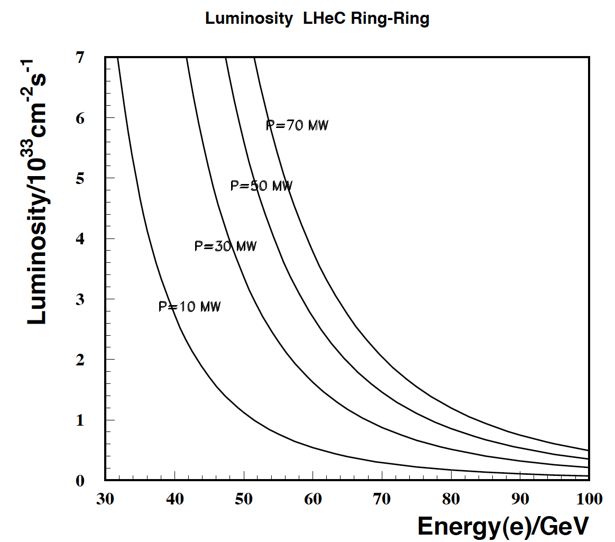
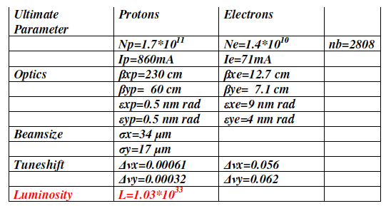
RR Luminosity and Parameters
Luminosity for e±p safely above 10³³cm⁻²s⁻¹
Used “ultimate” LHC beam parameters
Energy limited by injection and syn.rad losses
Power limit set to 100 MW
Small p tuneshift: simultaneous pp and ep

Slide 14
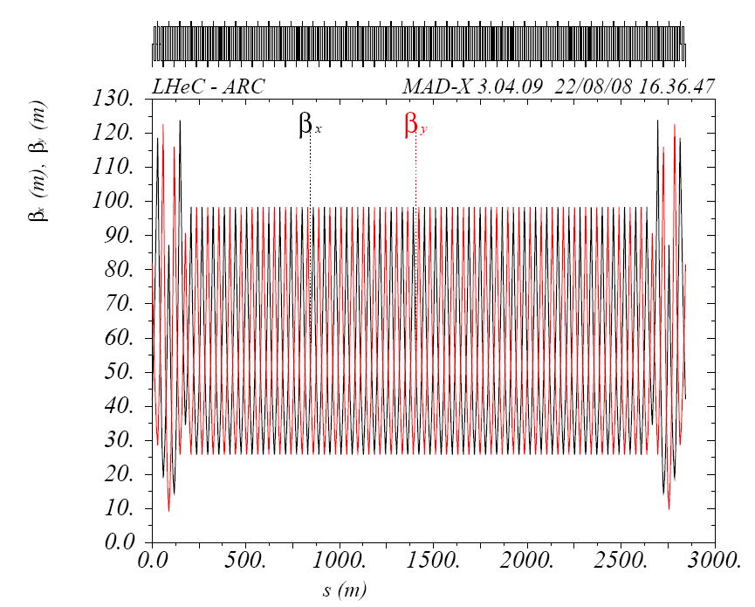
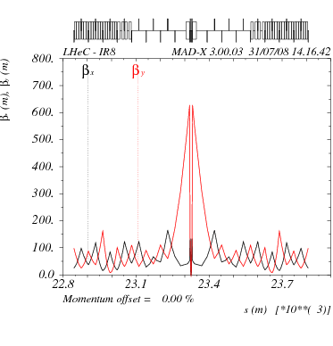
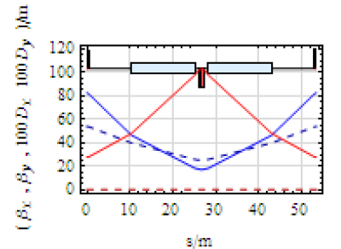
e Ring – Optics
Optics in the arcs
2009: optimisation of FODO cell
Dispersion reduced to 20-50cm
emittance ε_{x}=7.5nm ε_{y}=3.7 nm
MEDIUM or WEAK BEND SOLUTION
β functions for LHeC - 2008
Dispersion was 50-90cm
and horiz. emittance 22 nm
384 60m long cells
“inner” triplet focus
β_{x}=7.1cm β_{y}=12.7cm
Mini beta design
Optimisation ongoing

Slide 15
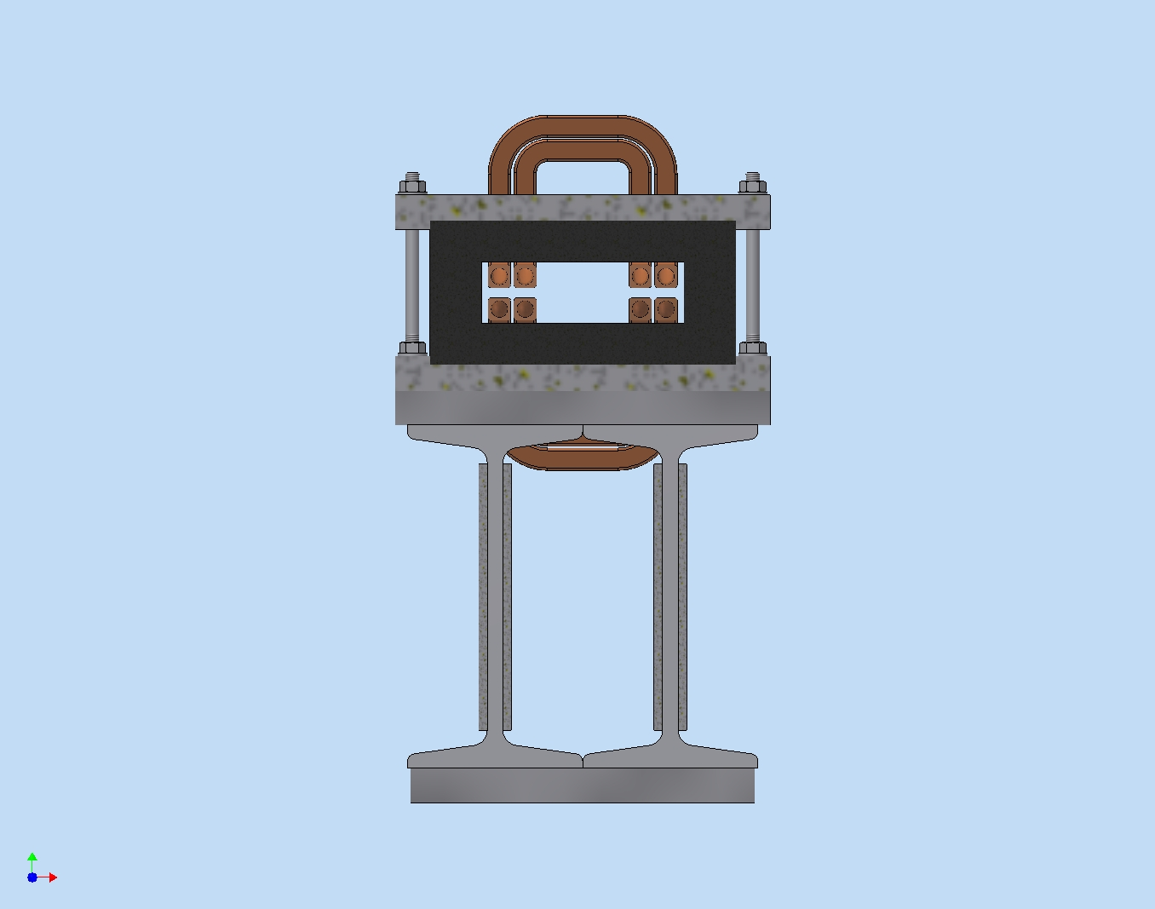
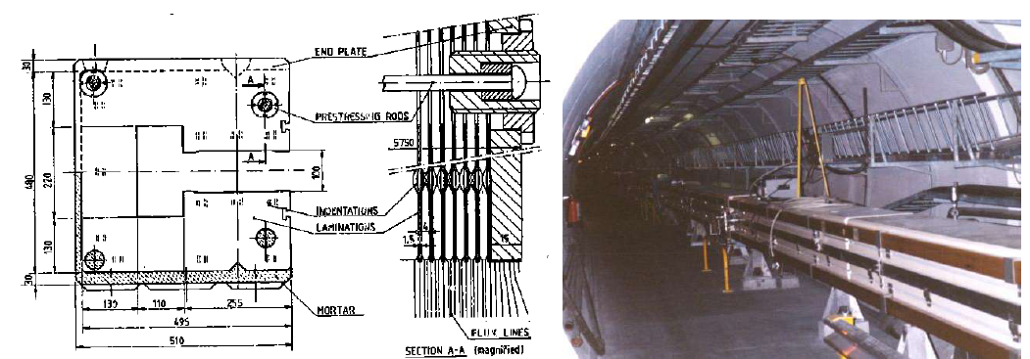
Dipole Magnets
Accelerator | LEP | LHeC
Cross Section/ cm² | 50 x 50 | 20 x 10
Magnetic field/ T | 0.02-0.11 | 0.02-0.135
Energy Range/GeV | 20-100 | 10-70
Good Field Area/cm² | 5.9 x 5.9 | 6 x 3.8
FODO length/m | 76 | 53
Magnet length/m | 2 x 34.5 | 2 x 14.76
segmentation | 6 cores | 14
Number of magnets | 736 | 488
Weight / kg/m | 800 | 240
O-shaped magnet with ferrite core [BINP-CERN]
Prototype design under way at Novosibirsk, May 2010
LEP

Slide 16
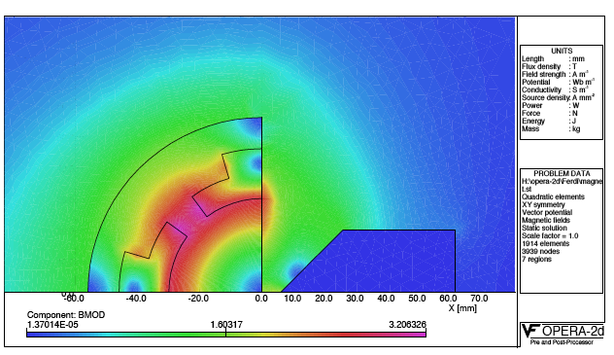
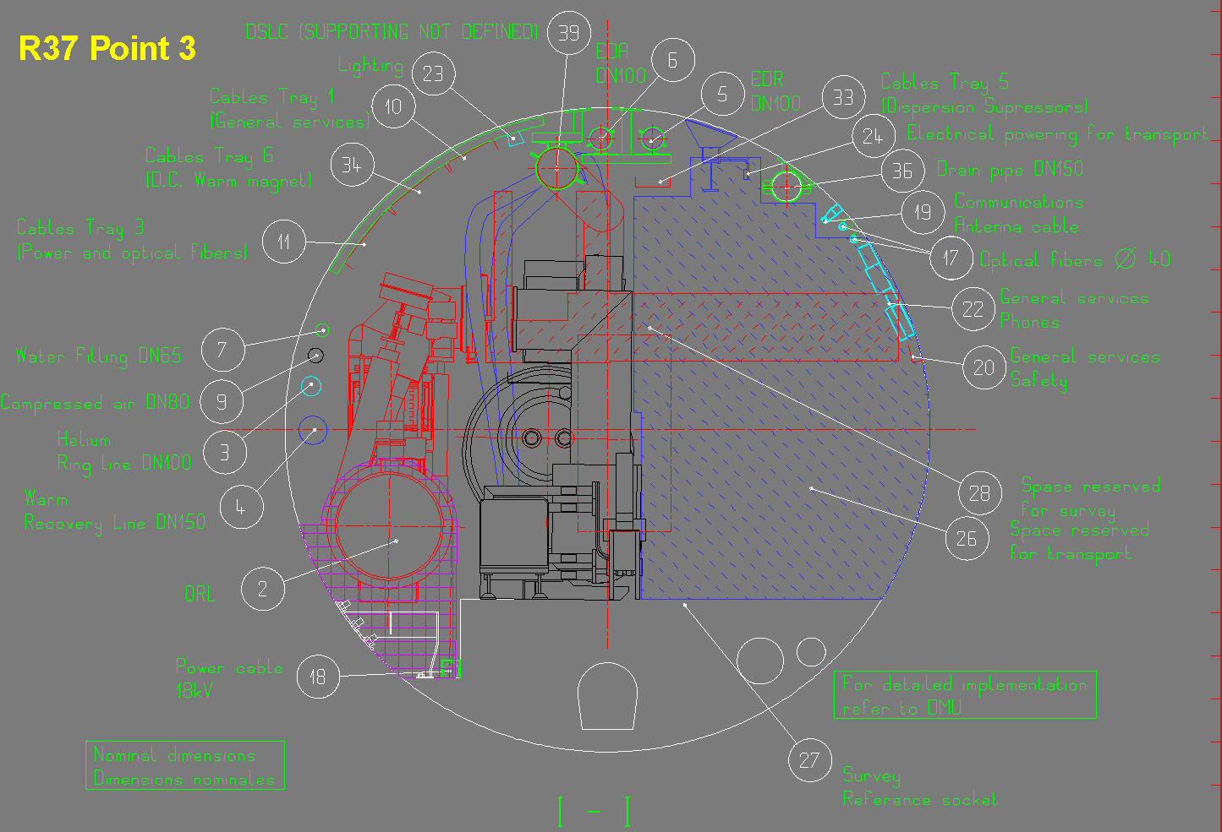
Ring – Work in progress
Interaction region design
Installation study
Systematic investigation of
clashes with LHC installation
and possible ways ‘around’
Installation sequence - timeline
Polarisation

Slide 17
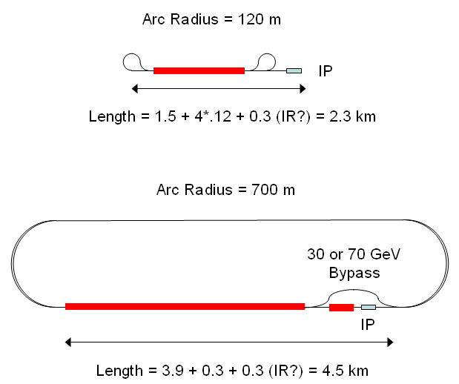
Two LINAC Configurations [CERN-SLAC]
60 GeV
31 MV/m, pulsed
two passes
60 GeV
13 MV/m CW ERL
4 passes
140 GeV
31 MV/m, pulsed
2 passes

Slide 18
LINAC-Ring Parameters
Configuration | 60 GeV, pulsed | 60 GeV CW ERL | 140 GeV pulsed
N_{e}/bunch/ 10⁹/50ns | 4 | 1.9 | 2
gradient MV/m | 32 | 13 | 32
normalised ε/ μm | 50 | 50 | 100
cryo power/MW | 3 | 20 | 6
effective beam power/MW | 50 | 40/(1-η_{ERL}) | 50
Luminosity for ultimate beam
The LR combination yet requires a still
better p beam or/and E_{e} recovery to
come to luminosity beyond 10³²cm⁻²s⁻¹

Slide 19
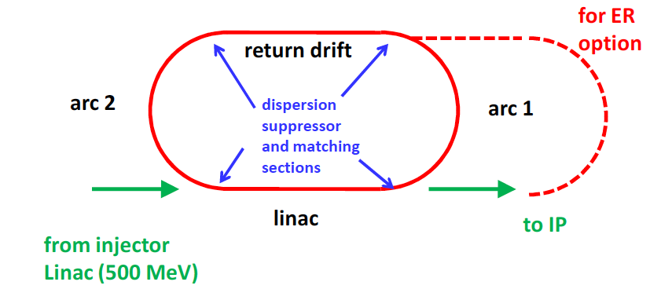
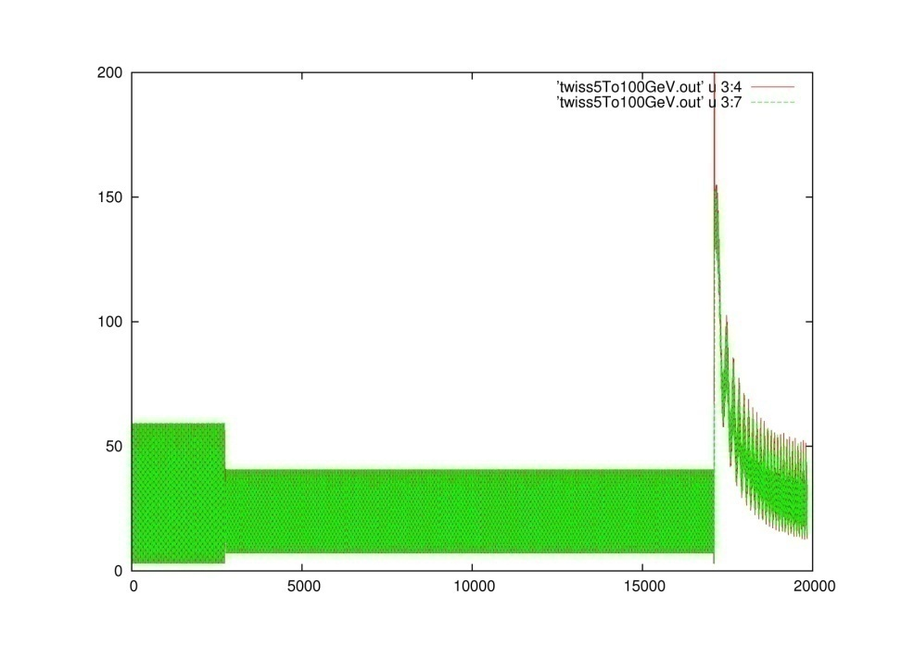
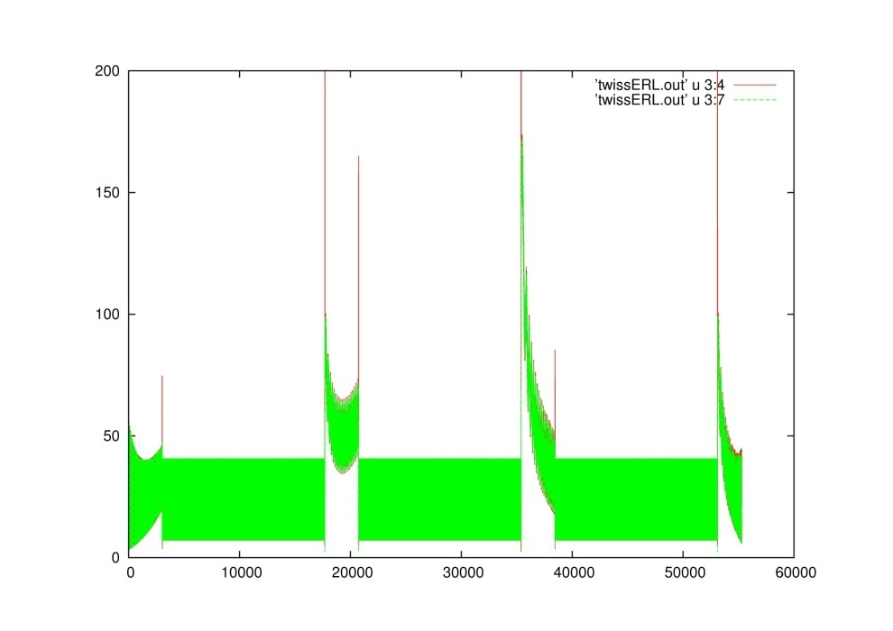
e Optics for LINAC
β_{x,y}
β_{x,y}
2 passes
4 passes - ERL

Slide 20
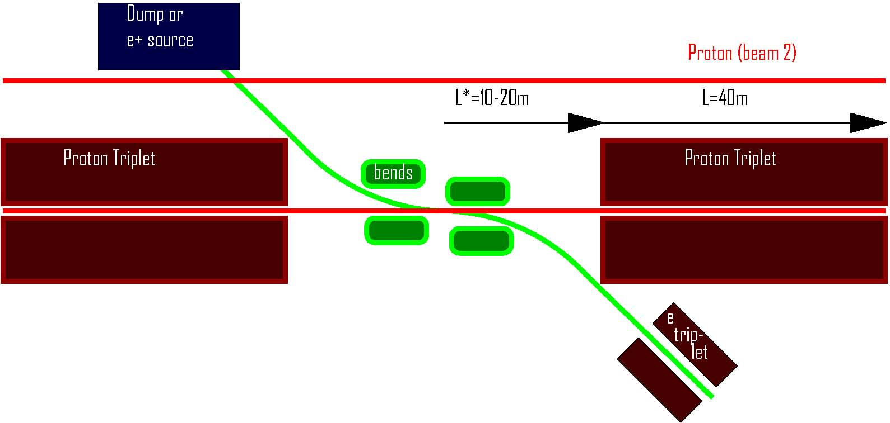
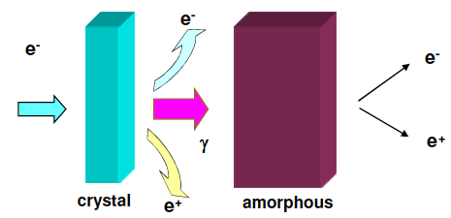
LINAC - Work in Progress
IR Options:
Head on → dipoles
Crossing → like RR IR
Positron source
Difficult to reach high intensity. Perhaps best
suited: hybrid target
production of unpolarised
positrons. Several stations?
cf Divonne

Slide 21
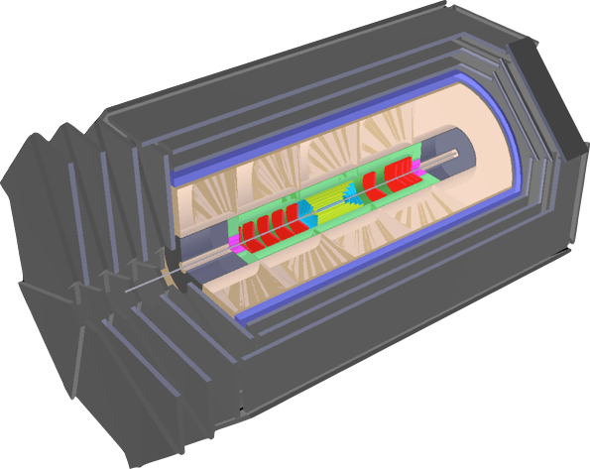
LHeC Detector version for low x and eA
Muon chambers
(fwd,bwd,central)
Coil (r=3m l=11.8m, 3.5T)
[Return Fe not drawn,
2 coils w/o return Fe studied]
Central Detector
Pixels
Elliptic beam pipe (~3cm - or smaller)
Silicon (fwd/bwd+central)
[Strip or/and Gas on Slimmed Si Pixels]
[0.6m radius for 0.03% * pt in 3.5T field]
El.magn. Calo (Pb,Scint. 9-12X0)
Hadronic Calo (Fe/LAr; Cu/Brass-Scint. ~30λ)
Fwd Detectors
(down to 1º)
Silicon Tracker
[Pix/Strip/Strixel/Pad Silicon or/and Gas on Slimmed Si Pixels]
Calice (W/Si); dual ReadOut - Elm Calo
FwdHadrCalo:
Cu/Brass-Scintillator
Bwd Detectors
(down to 179º)
Silicon Tracker
[Pix/Strip/Strixel/Pad Silicon or/and Gas on Slimmed Si Pixels]
Cu/Brass-Scintillator,
Pb-Scintillator (SpaCal - hadr, elm)
Extensions in fwd direction (tag p,n,d) and backwards (e,γ) under study.

Slide 22
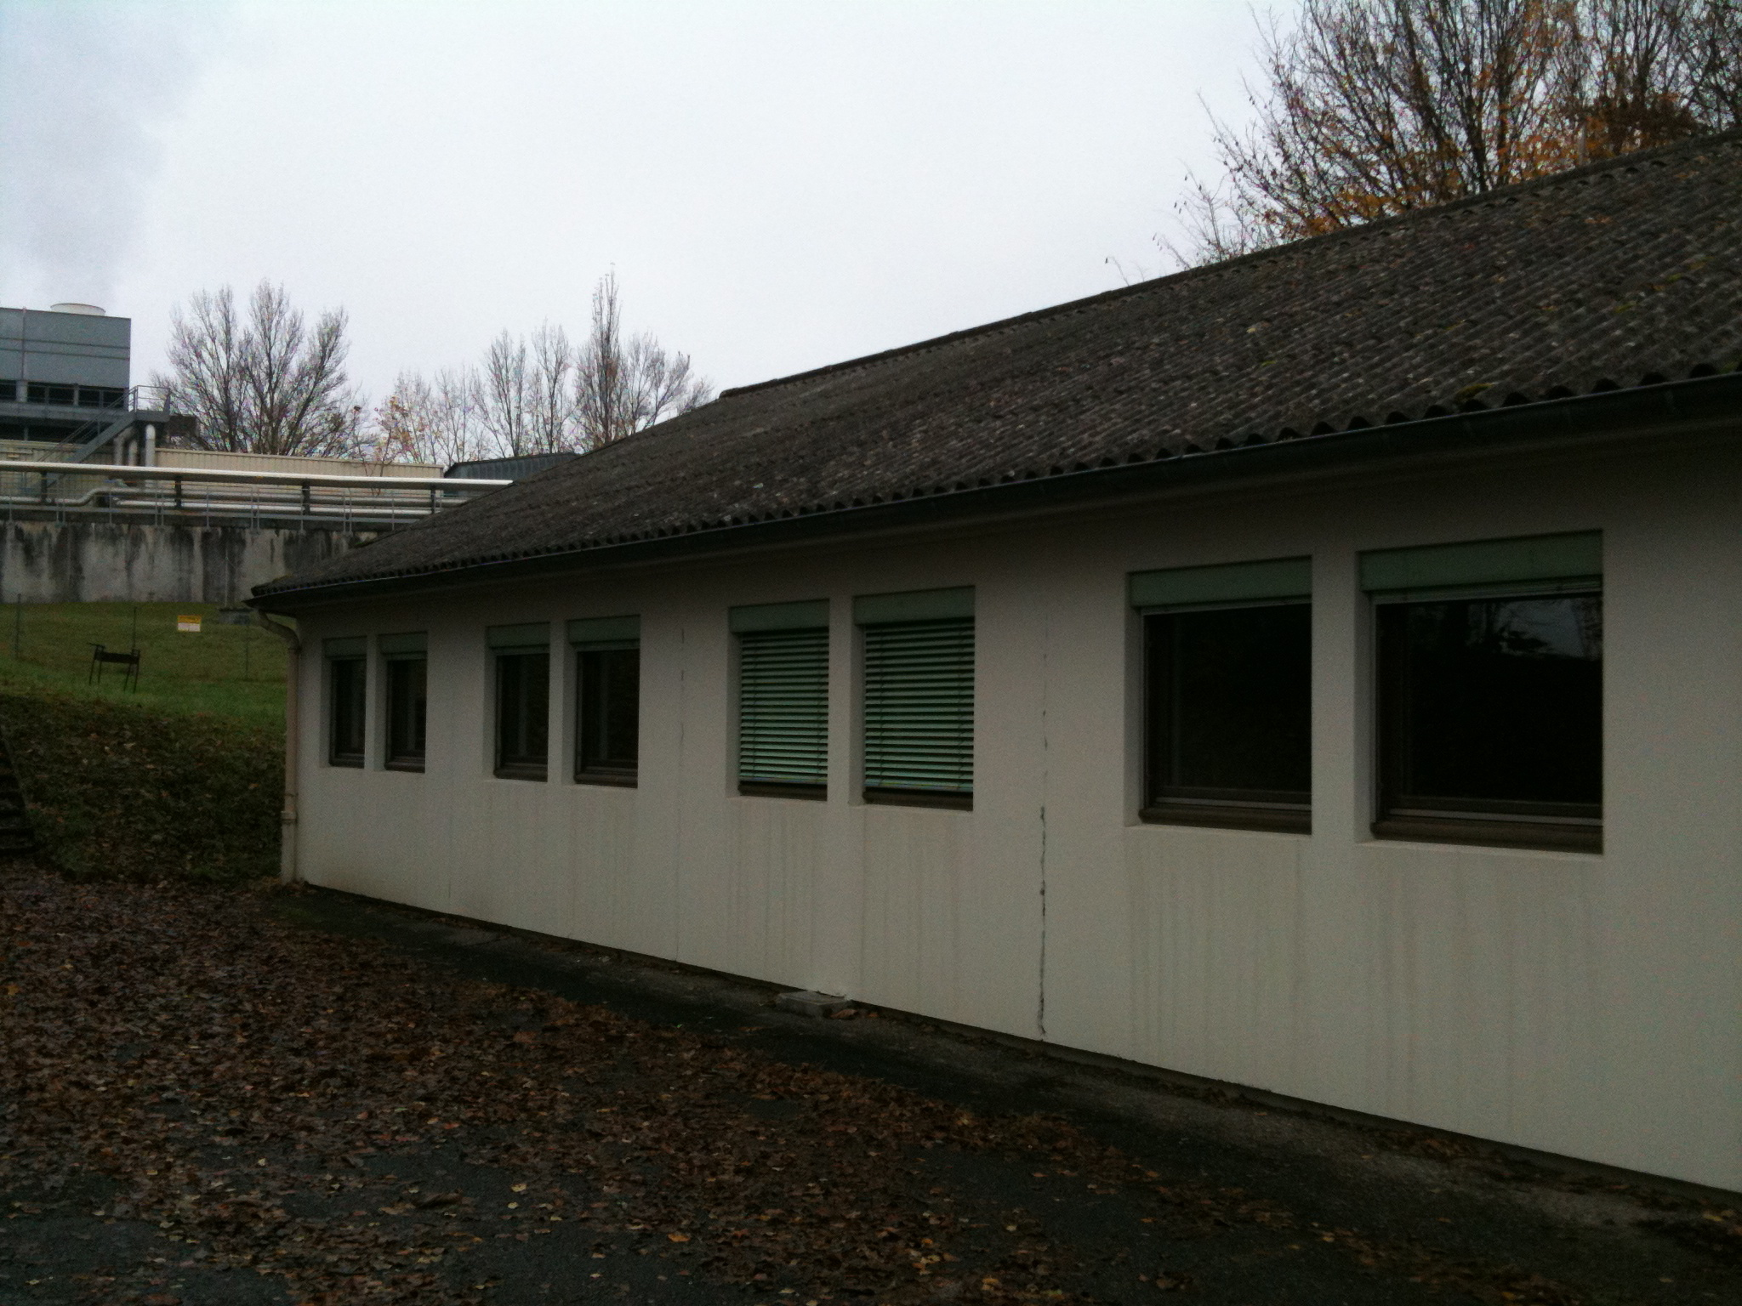
Completion of the CDR
Scientific Advisory Committee
Working Group Convenors
Guido Altarelli (Rome)
Sergio Bertolucci (CERN)
Stan Brodsky (SLAC)
Allen Caldwell -chair (MPI Munich)
Swapan Chattopadhyay (Cockcroft)
John Dainton (Liverpool)
John Ellis (CERN)
Jos Engelen (CERN)
Joel Feltesse (Saclay)
Lev Lipatov (St.Petersburg)
Roland Garoby (CERN)
Roland Horisberger (PSI)
Young-Kee Kim (Fermilab)
Aharon Levy (Tel Aviv)
Karlheinz Meier (Heidelberg)
Richard Milner (Bates)
Joachim Mnich (DESY)
Steven Myers, (CERN)
Tatsuya Nakada (Lausanne, ECFA)
Guenter Rosner (Glasgow, NuPECC)
Alexander Skrinsky (Novosibirsk)
Anthony Thomas (Jlab)
Steven Vigdor (BNL)
Frank Wilczek (MIT)
Ferdinand Willeke (BNL)
Accelerator Design [RR and LR]
Oliver Bruening (CERN),
John Dainton (CI/Liverpool)
Interaction Region and Fwd/Bwd
Bernhard Holzer (DESY),
Uwe Schneeekloth (DESY),
Pierre van Mechelen (Antwerpen)
Detector Design
Peter Kostka (DESY),
Rainer Wallny (UCLA),
Alessandro Polini (Bologna)
New Physics at Large Scales
George Azuelos (Montreal)
Emmanuelle Perez (CERN),
Georg Weiglein (Hamburg)
Precision QCD and Electroweak
Olaf Behnke (DESY),
Paolo Gambino (Torino),
Thomas Gehrmann (Zuerich)
Claire Gwenlan (Oxford)
Physics at High Parton Densities
Nestor Armesto (Santiago),
Brian Cole (Columbia),
Paul Newman (Birmingham),
Anna Stasto (PennState)
Steps to go in 2010
Finalise physics and technical studies
DIS10 Firenze [April] and IPACC Japan [May]
Draft CDR June 2010
Divonne III – Updates and Discussion with referees
November 10: Final report to ECFA
Submit CDR to CERN, ECFA, NuPECC
LHeC relies on expertise and enthusiasm of many
colleagues and support by ECFA, NuPECC and CERN
Steering Committee
Oliver Bruening (CERN)
John Dainton (Cockcroft)
Albert DeRoeck (CERN)
Stefano Forte (Milano)
Max Klein - chair (Liverpool)
Paul Newman (Birmingham)
Emmanuelle Perez (CERN)
Wesley Smith (Wisconsin)
Bernd Surrow (MIT)
Katsuo Tokushuku (KEK)
Urs Wiedemann (CERN))
LHeC barack 561

Slide 23
Backup slides

Slide 24
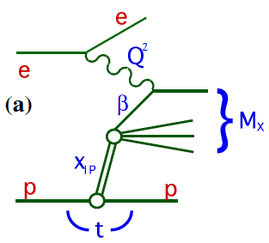
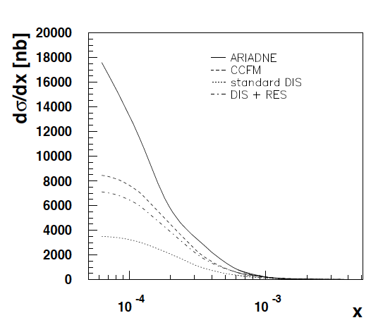
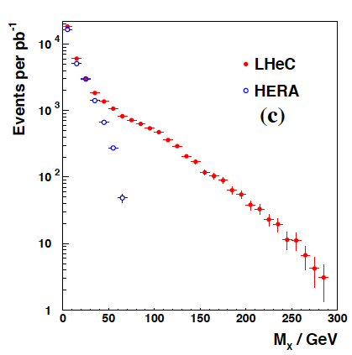
Quark-Gluon Dynamics - Diffraction and HFS (fwd jets)
HERA
H.Jung, L.Loennblad, THERA study
Diffraction to accompany (SUSY) Higgs fwd physics at LHC
Understand multi-jet emission (unintegr. pdf’s), tune MC’s
At HERA resolved γ effects mimic non-kt ordered emission
Crucial measurements for QCD, and for QCD at the LHC
P.Newman, DIS07

Slide 25
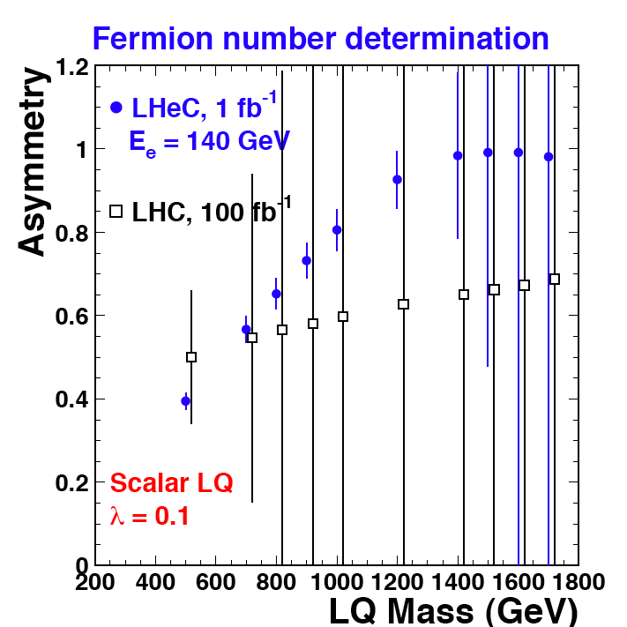
Determination of LQ properties in single production: e.g. Fermion Number
In pp: look at signal separately when resonance is formed by (e⁺ + jet) and (e⁻ + jet) :
g
F=0
e+
g
F=0
e-
_
σ(e⁺_{out} ) > σ(e⁻_{out})
for F=0
q
_
q
q
λ
q
λ
e-
e-
Sign of the asymmetry gives F, but could be statistically limited at LHC. (*)
Easier in ep ! Just look at the signal with
incident e+ and incident e-, build the
asymmetry between σ(e⁺_{in} ) and σ(e⁻_{in}).
If LHC observes a LQ-like resonance,
M < 1 - 1.5 TeV, LHeC could determine F
if λ not too small.
(*) First rough study done for the 2006 paper.
Need to check / refine with a full analysis of signal
and backgrounds.

Slide 26
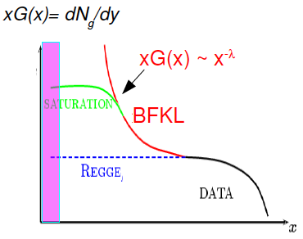
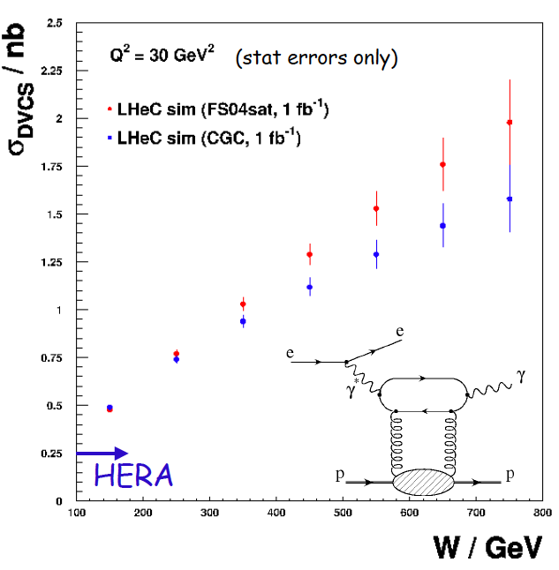
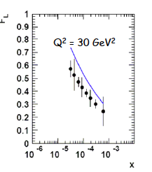
Quark-Gluon Dynamics (saturation, GPDs) - ep
P.Newman, L.Favart, DIS08
LHeC opens phase space to discover saturation in DIS
High luminosity, polarisation, accuracy for GPD’s (DVCS)
J.Forshaw et al, DIS08
J.Bartels at Divonne on low x theory
Divonne 08

Slide 27
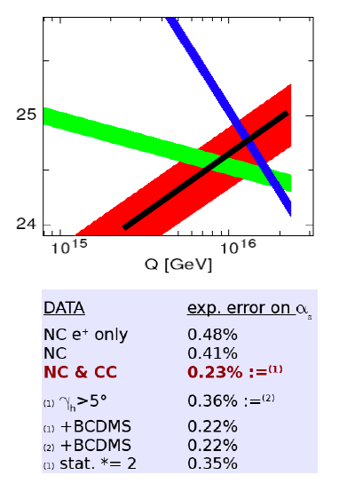
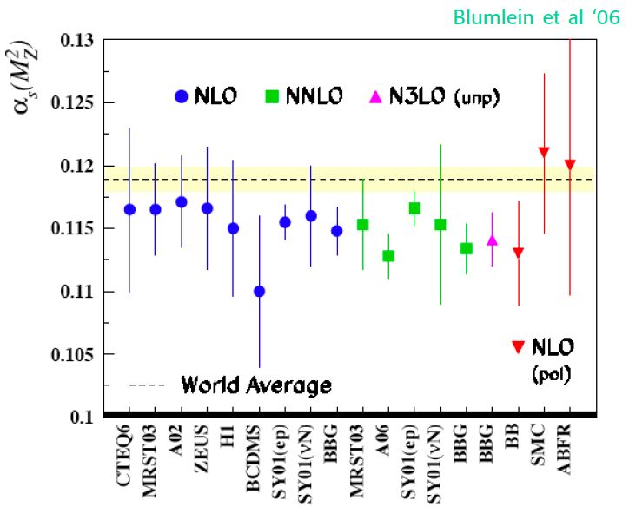
Strong Coupling Constant
Simulation of α_{s} measurement at LHeC
α_{s} least known of coupling constants
Grand Unification predictions suffer from δα_{s}
DIS tends to be lower than world average
LHeC: per mille accuracy indep. of BCDMS.
Challenge to experiment and to h.o. QCD
1/α
fine structure
weak
strong
MSSM - B.Allnach et al, hep-ex/0403133

Slide 28
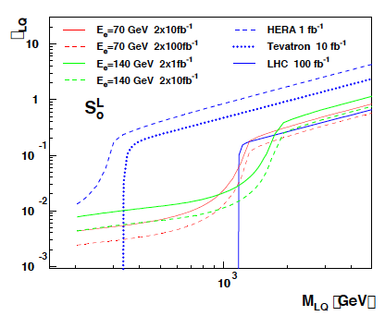
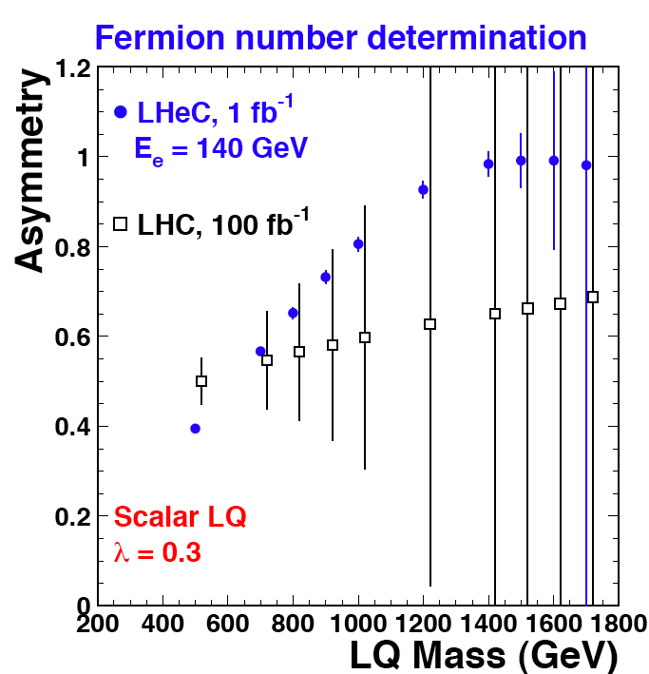
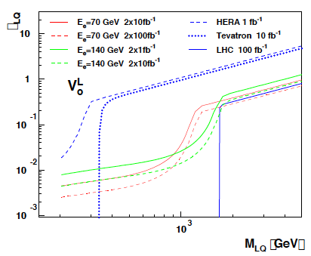
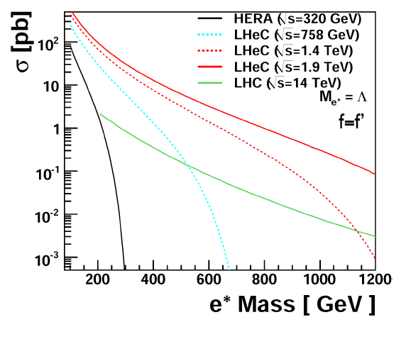
New Physics in the eq Sector
?LQ, RPV SUSY
Spectroscopy
?Excited fermions
Exact knowledge of pdf’s may be crucial to understand CI’s

