Slide 1
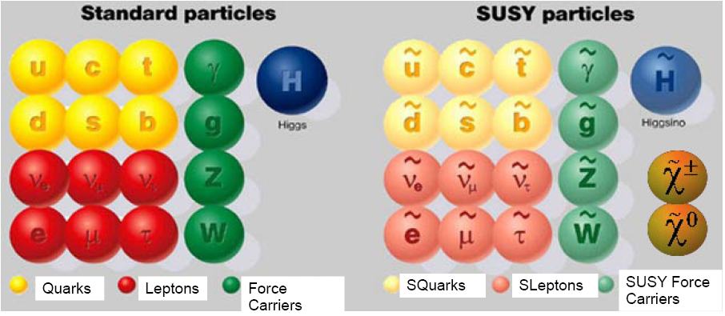
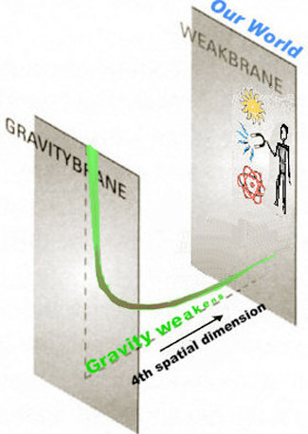
New Physics at the (HL)LHC and LHeC
Supersymmetry
Extra Dimension and RS resonances
New gauge bosons (W’, Z’) and more
Monica D’Onofrio
University of Liverpool
For the LHeC Study Group
BSM group (coordinators: G. Azuelos, E. Perez)
LHeC MiniWorkshop, LPCC-CERN
April 18th 2013

Slide 2
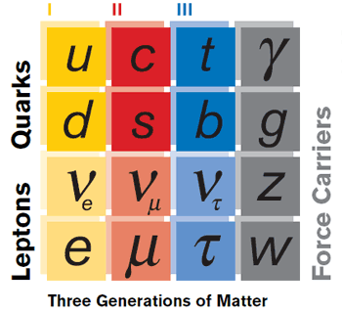
Searching for new physics
Extra Dimensions
Standard Model: remarkably successful description of known phenomena, but requires new physics at the (multi)TeV scale.
Large, warped, or universal extra dimensions
Might provide:
Dark Matter candidate
Solution to Hierarchy problem
Unification of forces
Searches for new heavy particles, black holes..
Strong EW symmetry breaking
Modern variants of Technicolor
Might provide:
Dark Matter
Hierarchy problem
Possibly search for composite Higgs, new heavy vector bosons (Z’, W’…), 4th generation of quarks
Composite (SUSY) theories
Composite Higgs and top
Supersymmetry
Introduce heavy superpartners, scalar particles, light neutral Higgs
More than100 parameters even in MSSM
Notes:
SUSY must be broken

Slide 3
Outline
“ The LHC is the primary machine to search for physics beyond the SM at the TeV scale. The role of the LHeC is to complement and possibly resolve the observation of new phenomena…”
LHeC CDR
Overview of the New Physics program @ LHeC
Contact interactions, excited leptons, Extra Dimension
Leptoquarks
R-parity violation SUSY and other uncharted scenarios
Emphasis on complementarities with (High Lumi) LHC:
Implication of LHC findings for LHeC reach
How LHeC can complement and resolve observation of new phenomena at the LHC
Implication of LHeC PDF constraints for the LHC
Based on LHeC CDR studies (100 fb-1 @ 10³³ instead of current 10³⁴ expected)
and High Luminosity LHC studies made for ATLAS European Strategy document

Slide 4
NP in inclusive DIS at high Q²
At these small scales new phenomena not directly detectable may become observable as deviations from the Standard Model predictions.
A convenient tool: effective four-fermion contact interaction
Observed as modification of the Q²
dependence → all information in
dσ/dQ²
Also parametrized as form factors
: Compositeness scale
→ LQ mass (>> √s) or
Modified Planck Scale in ED models

Slide 5
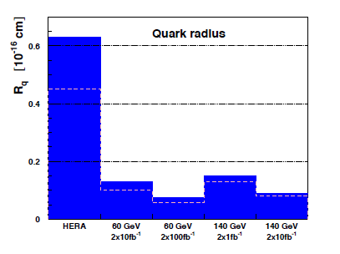
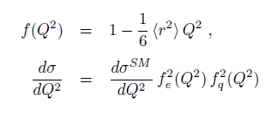
Quark substructure
If contact terms originate from a model where fermions are composite, scale proportional to composite object radius
Radius (→ distribution of EWK charge within q) reach below 10-¹⁹ cm
ATLAS and CMS constraints on
4-quarks CI (expected @ few 10’s TeV for 14 TeV LHC - not directly related to EWK R)

Slide 6
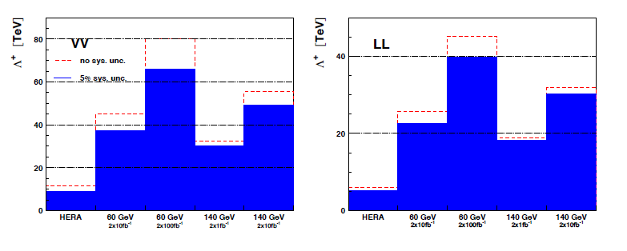
Contact interactions (eeqq)
New currents or heavy bosons may produce indirect effect via new particle exchange interfering with γ/Z fields.
Reach for Λ (CI eeqq): 25-45 TeV with 10 fb-1 of data depending on the model
Similar to LHC
ATLAS and CMS constraints on
eeqq CI (expected up to 30-40
TeV at c.o.m. 14 TeV LHC)

Slide 7
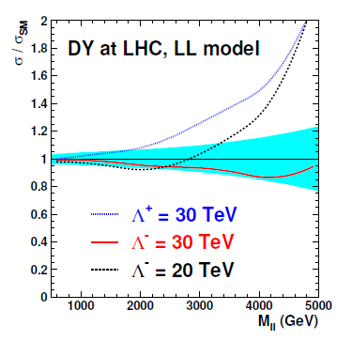
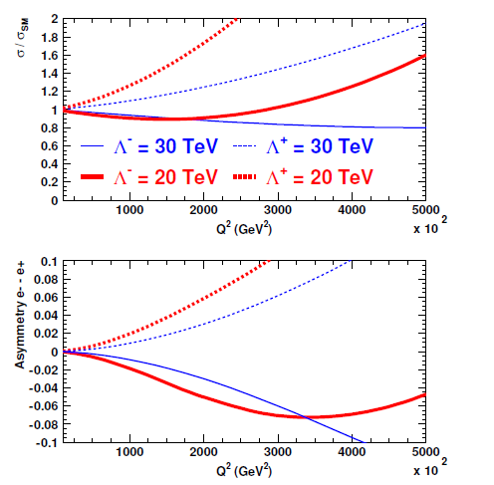
CI at LHC and LHeC
LHC: Variation of DY cross section for CI model
Cannot determine simultaneously Λ and sign of interference of the new amplitudes wrt SM (ε)
LHeC: sign ε from asymmetry
of σ/σ_{sm} in e+p and e-p data
Ex: negative interference too small to be disentagled

Slide 8
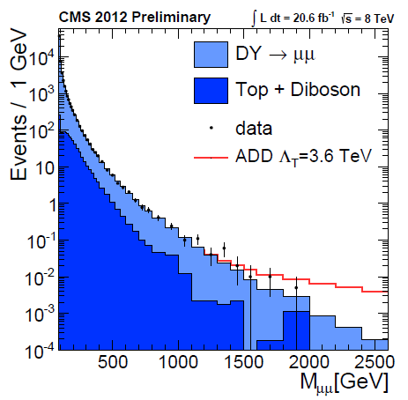
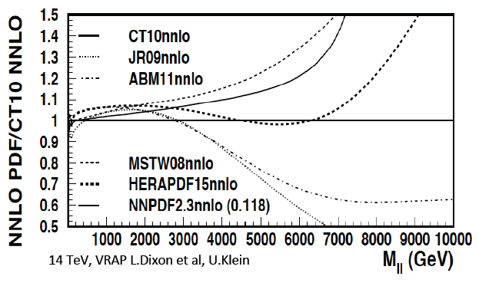
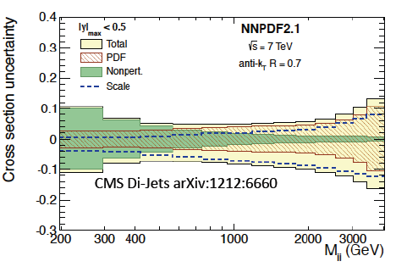
High mass Drell-Yan
Both CMS and ATLAS searching for deviations in m(ll) tails
Non resonant searches for ED (interference) sensitive to tails of DY distributions thus to PDF
For HL-LHC need to study in context with experimental uncertainties (calibrations)
CMS-PAS-EXO-12-027
CMS-PAS-EXO-12-031

Slide 9
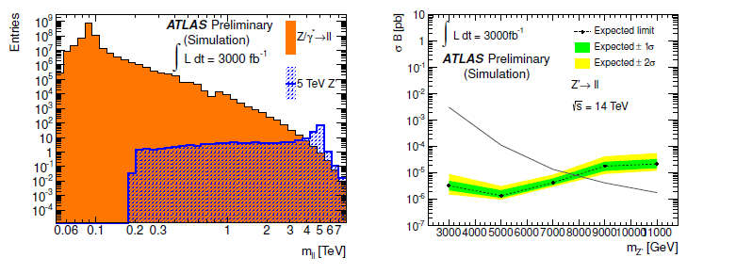
HL-LHC: Dilepton Resonances
Dielectron and dimuon channels explored for 14 TeV and Phase I (II) luminosity:
Example from dielectron selection:
→ Sensitivity up to about 8 TeV

Slide 10
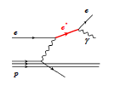
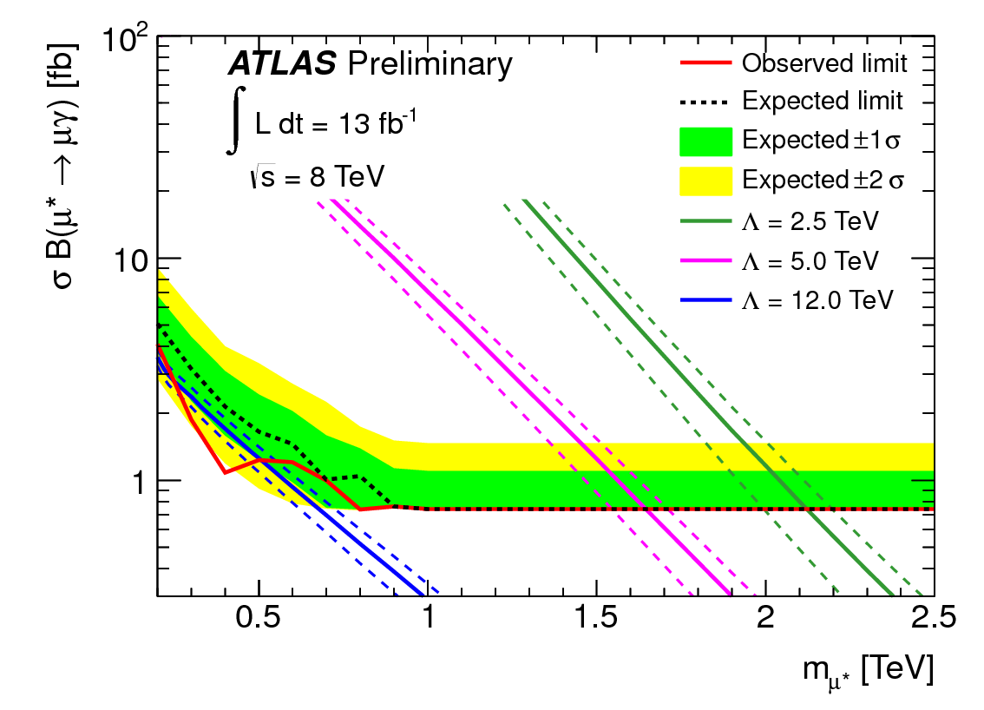
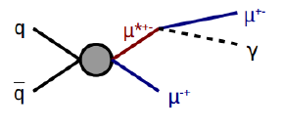
Excited fermions
Can be produced directly if their mass is below the compositness scale
At the LHC:
Stringent limits, which only apply to the contact interaction case

Slide 11
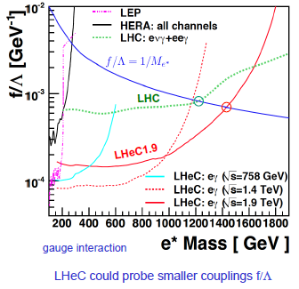
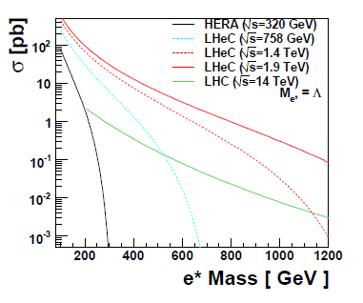
Excited fermions
For gauge interaction, LHeC cross section much higher
Very good sensitivity
Upper limit @ 95% CL (area above curves excluded)
f=f’=1
Exclusion f/Λ = 1/M* → 1.2 (1.5) TeV for √s 1.4(1.9) TeV

Slide 12
Leptoquarks (LQ)
By providing both B and L in the initial state, the LHeC is ideal to study the properties of new bosons with couplings to an e-q pair
Leptoquarks
Color-triplet bosons, couple to leptons and baryons of same generation
Can be scalar or vector
Masses at GUT scale, in various GUT theories as E6, some extended TC models also predict LQ at TeV-scale
Also → squarks in RPV SUSY (see later)
In narrow-width approx,
production cross section ~
λ

Slide 13
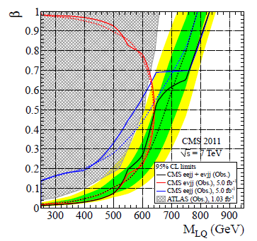
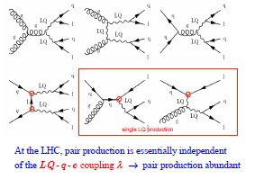
LQ production at LHC ad LHeC
At LHC, mostly pair production (from gg or qq)
if λ not too strong (0.3 or lower), cross section independent on λ
Exclude up to 900 GeV for 1° generation
Expect to exclude up to 1.2 (1.5) TeV at 14 TeV 300 fb⁻¹ for scalar (vector)-LQ

Slide 14
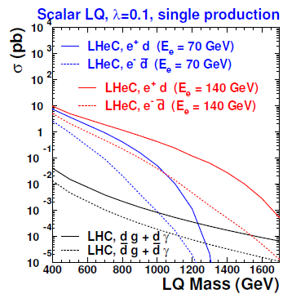
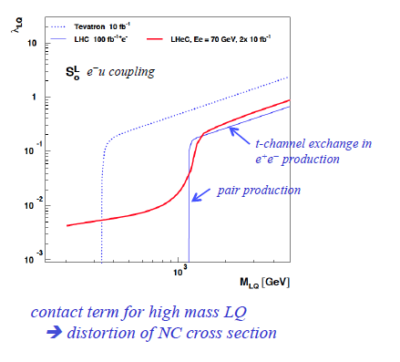
LQ production at LHC and LHeC
At LHeC, single particle production
Probe LQ up to TeV scale
0.1

Slide 15
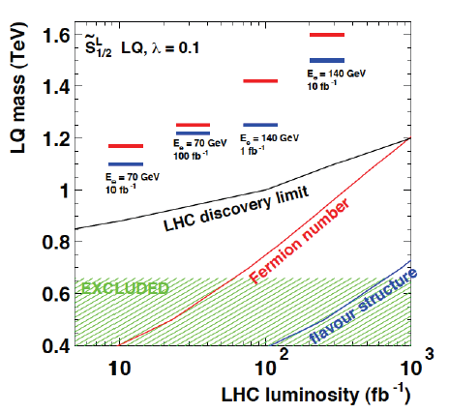
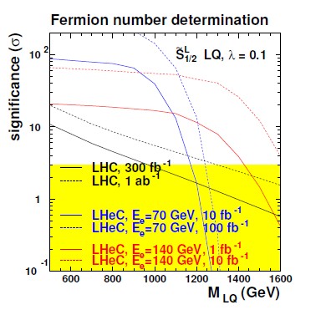
LQ properties
If LQ observed at LHC → At LHeC can measure fermion number, flavor structure, chiral structure (from polarization of beam)
Ex.: Fermion number:
Parton density u,d >> ubar,dbar →
σ(F=0) larger in e+p, σ(F=2) larger in e-p

Slide 16
R-parity violating SUSY
Squarks in RPV models could be an example of ‘Leptoquarks’
R-parity = (-1)^{3(B-L)+2s} (R = 1 for SM particles, -1 for MSSM partners)
If not conserved (RPV)→ different terms, couplings constraint by proton decay
ΔL =1, 9 λ couplings, 27 λ’ couplings
Plethora of new couplings, only partially constraints (m/100 GeV)

Slide 17
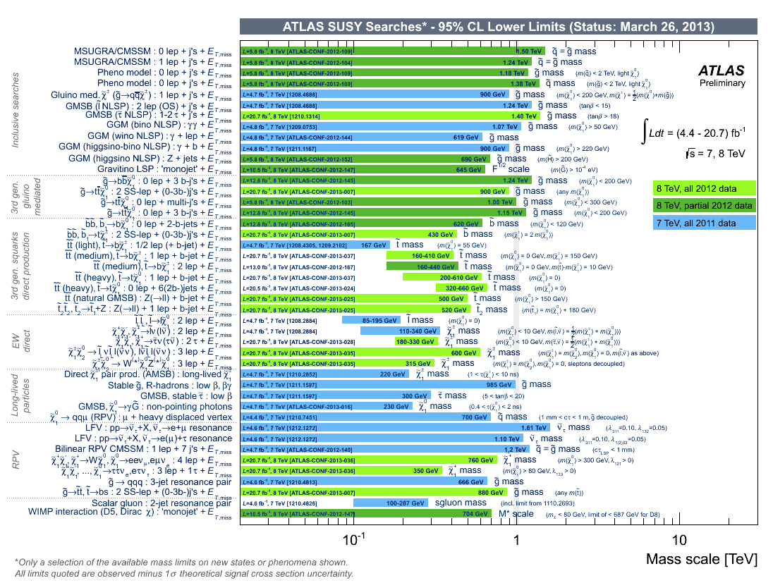
Various constraints on RPV scenarios

Slide 18
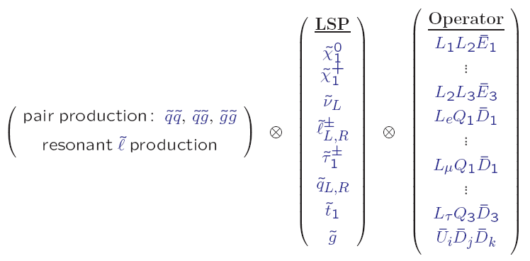
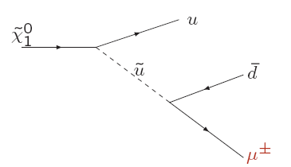
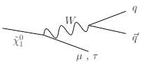
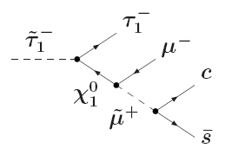
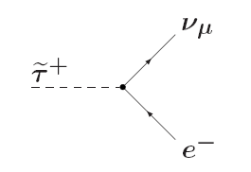
SUSY and RPV scenarios
Still, several final states to explore:
LSP no longer stable
Can be something like
> 700 possibilities + bilinear
couplings!
Result:
- RPV SUSY under-constrained
although several searches in progress
- limits depend on couplings assumptions

Slide 19
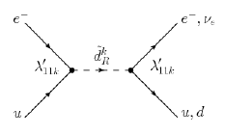
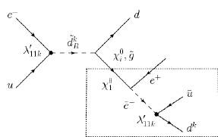
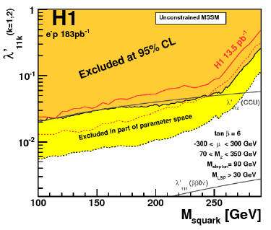
SUSY @ LHeC: RPV scenarios
For squark production:
λ’ couplings relevant in e-p production
Decays: direct or via cascade
Current limits up to HERA mass-bound
Strong lepto-quark constraints from LHC
to be taken into account if RPV~100%
Cascade decays (via RPC vertex) lead to more
complex and under-constrained signatures
Reach up to 1 TeV with LHeC
Feasibility of these searches will depend
on LHC findings (useful in case of evidence ☺)
LQ-like

Slide 20
Lot of efforts on RPC scenarios
Strong constraints on first (and second) generation squarks and other scenarios

Slide 21
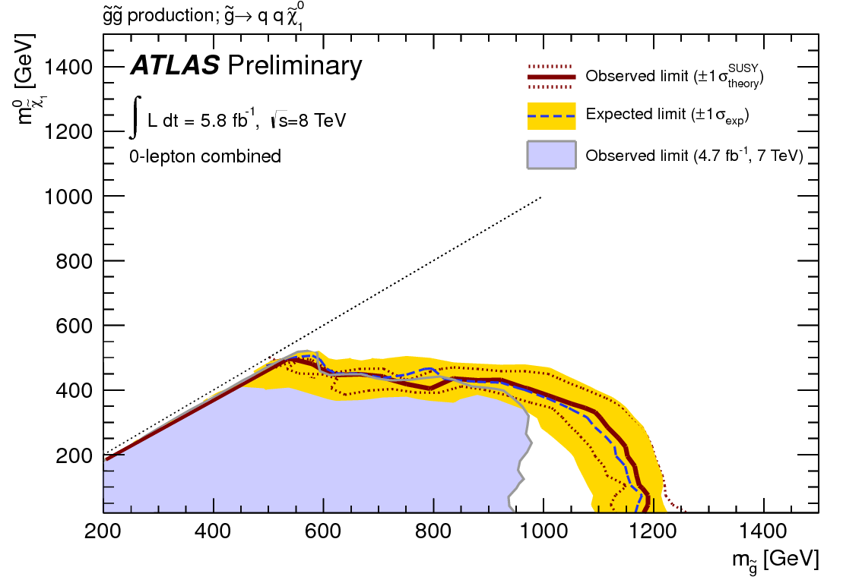
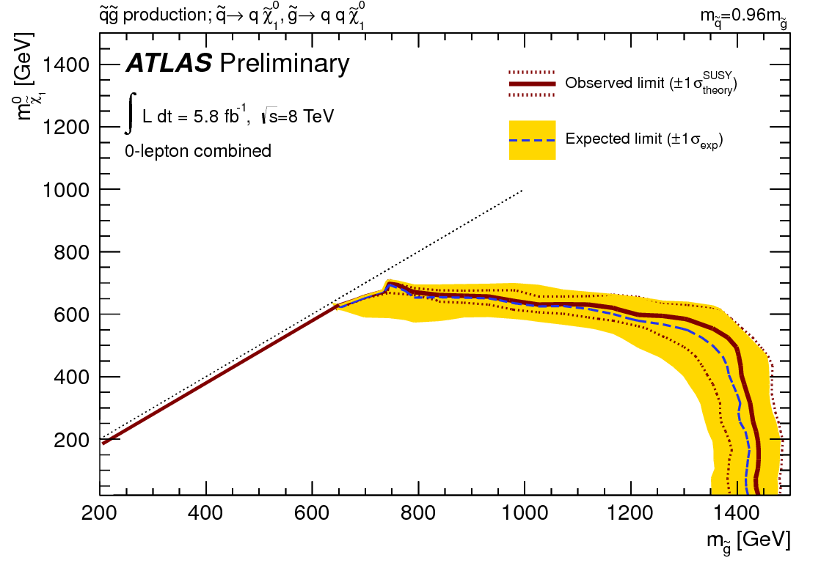
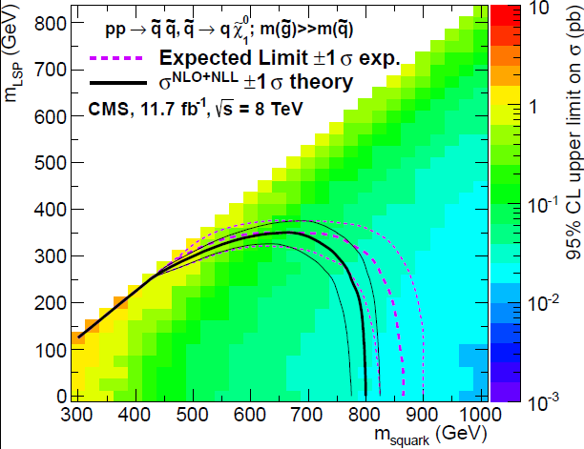
RPC scenarios: strong production
Strong constraints on gluino (1.4 TeV) and squark masses (up to 1.6 TeV) under certain assumptions
1st and 2nd generation squarks degenerate
Compressed scenarios difficult

Slide 22
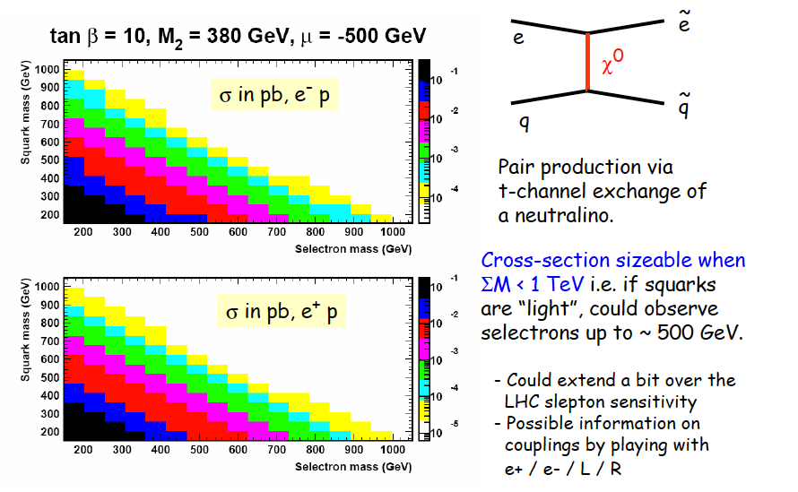
SUSY @ LHeC: RPC scenarios
Selectron-squark pair production
From last workshop:
Current LHC slepton limits: 250 GeV for m(LSP)<50 GeV
Are the current constraints really strong enough?

Slide 23
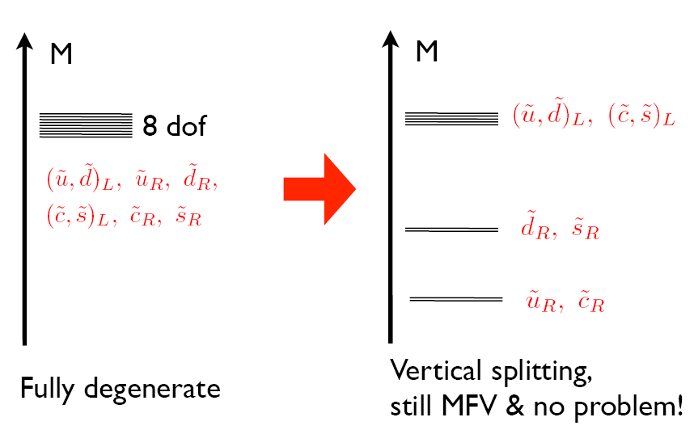
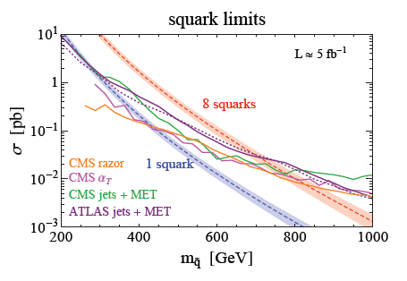
Non-degenerate 1st and 2nd generation squarks
Review of current constraints on usual assumption on mass degenerate of 1st and 2nd generation squarks:
http://arxiv.org/abs/1212.3328
Will depend on LHC boundaries on
these scenarios → might be hard considering the increasing trigger thresholds in MET and jet pT

Slide 24
LHC – LHeC interplay for SUSY
If no evidence for RPC SUSY is found in Run II, sparticles might become out of reach for LHeC
Still, interplay in terms of PDF quite relevant
Based on results shown for ES document and ATLAS PhaseII LoI
Strategy:
Consider three benchmark kind of processes: squark-gluino, stop,chargino/neutralino production
If No deviations from the SM observed in 300/fb
Extension of sensitivity (mass & cross section reach) with 3000/fb
Deviations from the SM observed in 300/fb
Signal characterization with 3000/fb

Slide 25
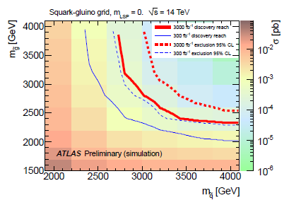
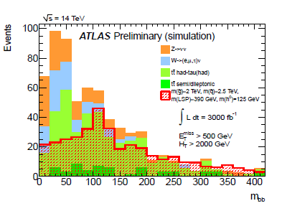
Search for squark/gluinos
Select events with high pT jets, high MET and HT
Sensitivity expressed as 95% CL exclusion limit and 5σ discovery
An increase of integrated luminosity from 300 fb⁻¹ to 3000 fb⁻¹ improves the sensitivity to sq/gl by approximately 400-500 GeV
Decay chain might be complex, including Z or Higgs → exploit m(bb)
Higgs boson in complex SUSY decay chain can be identified

Slide 26
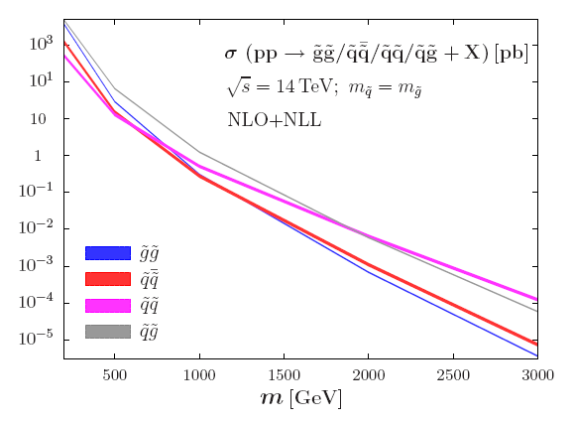
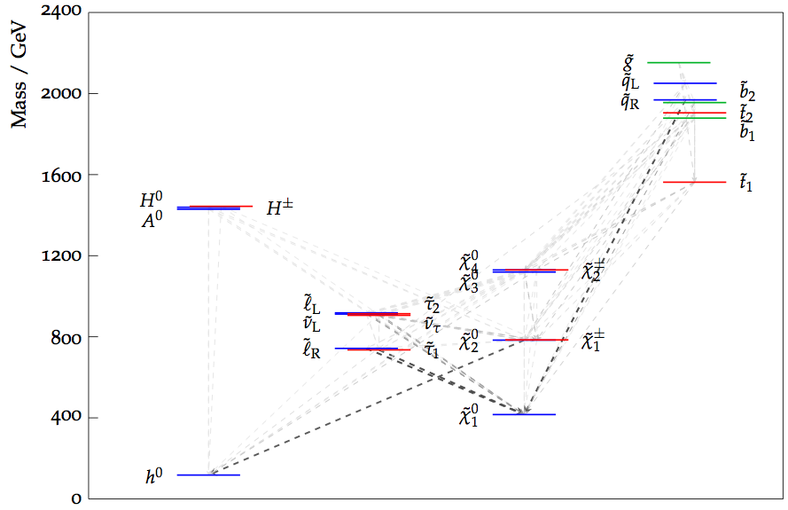
Strong production
xsection ~ 2.5 pb for m = 1000 GeV, ~ 0.01 pb for m(squark, gluino) = 2 TeV → clearly, high stats samples are needed.
mSUGRA reference point: m0=650, m1/2=975, xs 1.1E-05 nb
Decay chain might be complex, including Z or Higgs

Slide 27
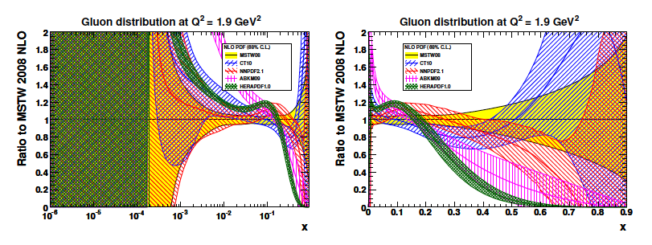
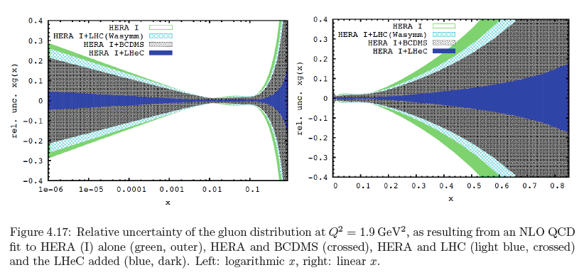
Gluon distributions
now
then
High x: xg and valence quarks: resolving new high mass states!

Slide 28
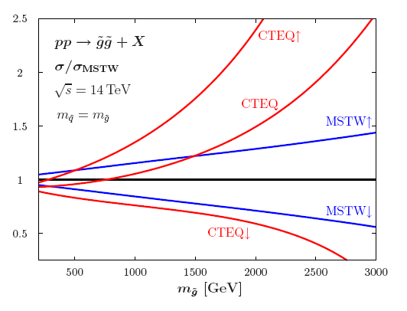
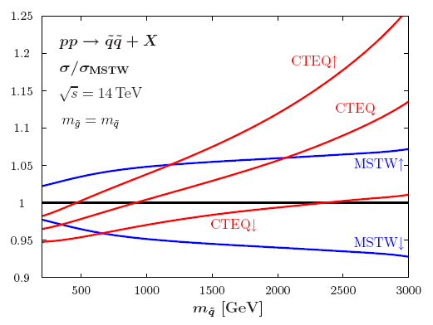
Importance of PDF
If we see deviations from SM, will be important to characterize the physics underneath. First studies on the case of strong production M.Kramer 2011)

Slide 29
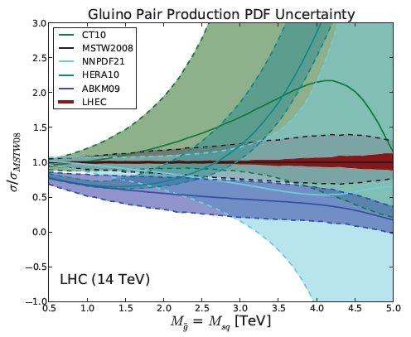
PDF for gluinos production
Impact of improved PDF fits on theoretical predictions for SUSY process:
Example: gl-gl production (assuming m_gl = m_sq)

Slide 30
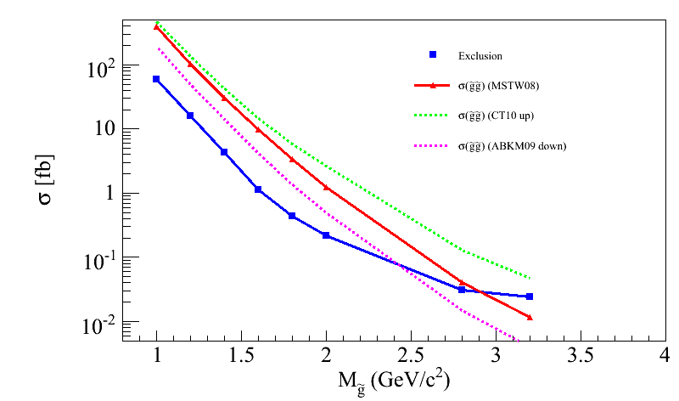
Impact on discovery/exclusion reach
PDF uncertainties impact discovery / exclusion reach:
Total yields
Shape variations on discriminating quantities (in progress)
Impact on discovery/exclusion contours under various PDF hypothesis in progress
LHC @ 14 TeV 3 ab-1, M(squark) > 4 TeV
CT10 up
ABKM09 down
MSTW08 equivalent to LHeC PDF
Caution: very very preliminary, mostly as illustration
(UL for gl-gl courtesy of G.Redlinger)
(TeV)
Note: impact of PDF uncertainties on SM background also not negligible
However → mitigated by usage of Control Regions and semi data-driven estimate

Slide 31
Summary and outlook
LHeC provides complementarities to the LHC SUSY search program in the twenties
Ideal to search and study properties of new bosons with couplings to electron-quark
Direct searches for CI, excited fermions, leptoquark, RPV SUSY, RPC SUSY in specific scenarios such as compressed, non-degeneracy for squarks
Interplay with HL-LHC to constraints on PDF crucial for model testing in case of observed deviations → an independent precision measurement of PDFs will be important for an efficient use of the high luminosity for setting reliable high mass limits

Slide 32
Back-up

Slide 33
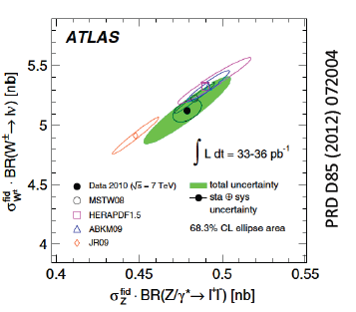
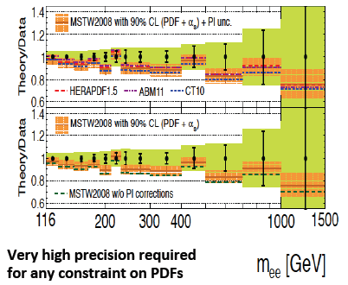
PDF for LHC
Use precision Drell-Yan (W,Z) data to constraint PDFs

Slide 34
Other properties of LQs
Spin:
LHC: LQ-LQ leads to angular distributions depending on g-LQ-LQ coupling
LHeC: cosθ* distribution of LQ decay is sensitive to spin
BR to neutrinos (good S/B for ν-q)
Coupling measurement, once spin and charge is determined

Slide 35
LQ isospin family
Classification used here (BRW framework)

Slide 36
Squark mass splitting
(A. Weiler)
Large splitting is possible

Slide 37
LHC: The Roadmap to 2030
ESPP-Cracow meeting:
LHC has still only delivered a small fraction of the effective parton-parton lumi→discovery physics programme just getting started!
Accelerator timescale driven by several aspects:
Radiation damage of LHC components
R&D and construction of LHC upgrades
Required schedule of detector upgrades
Long Shutdown (LS) periods to install upgrades
Possibility of an HE (High Energy ) LHC still under discussion

Slide 38
Searches for SuperSymmetry
Very stringent constraints from LHC on strongly produced sparticles (1st, 2nd generation squarks, gluinos) → can be quite heavy (multi-TeV)
Direct production of 3rd generation squarks and weak gauginos is becoming accessible as the amount of integrated luminosity increases (low cross sections)
If No deviations from the SM observed in 300/fb
Extension of sensitivity (mass & cross section reach) with 3000/fb
Deviations from the SM observed in 300/fb
Signal characterization with 3000/fb
Determination of masses by measuring endpoints of visible mass distributions
Measurement of couplings and spin (via angular analysis)

Slide 39
Third generation
If sq/gl are not found < 3 TeV
Still the stop (and possibly sbottom) are among the most important SUSY particles to be found!
At 14 TeV, stop cross section ~ 10-20 x xsect @ 7 TeV
Mass | MSTW2008 | CTE6.6
400 GeV | 2.34 pb | 2.19 pb
600 GeV | 0.24 pb | 0.23 pb
1 TeV | 0.008 pb | 0.008 pb
For 3000 fb-1 of lumi @ 14 TeV
@ 600 GeV: 720 x 10³ events
@ 1 TeV: 24 x 10³ events
Analysis < 1 % efficiency
Acceptance depends on the decay mode

Slide 40
Stop analyses
For stop → t+LSP: 1-lepton + MET + jets
For stop→ b+chargino (C1 into W+N1): 2-lepton (+MET,jets)
Discriminant: MET, MT2
An increase of integrated luminosity from 300 fb-1 to 3000 fb-1 improves the sensitivity to sq/gl by approximately 200 GeV
Can do more adding shape discriminants and / or boosted top reconstruction

Slide 41
Weak Production
As for light stop, light gauginos well motivated by naturalness
Rare process
@ 500 GeV chargino / neut 2 mass, expect ~ 6 x 10⁴ events for 3 ab⁻¹
Direct access to weak gauginos
Mass hierarchy via kinematic edge studies (potential model dependent fit), couplings
Search in the ‘classical’ three-lepton and ETmiss final state originating from the decay of χ1± and χ20 as W+ χ10 and Z+ χ10 respectively
arxiv.org/abs/1207.4846 by H. Baer addressed χ20 → higgs+χ10

