Slide 1

LHeC
Introduction & motivation
Two options: -Ring-Ring collider
-Linac-Ring collider with Energy Recovery
On behalf of the LHeC Collaboration!
➔ LHeC-Note-2011-001 GEN
IR Layout
Summary
Planning and timeline
EPS-HEP, 23 July 2011, Grenoble
Oliver Brüning CERN
1

Slide 2
CDR Authorlist 29.6.11
C. Adolphsen (SLAC)
S. Alekhin (Serpukhov, DESY)
H. Aksakal (CERN)
P. Allport (Liverpool)
J.L. Albacete (IPhT Saclay)
V. Andreev (LPI Moscow)
R. Appleby (Cockcroft)
N. Armesto (St. de Compostela)
G. Azuelos (Montreal)
M. Bai (BNL)
D. Barber (DESY)
J. Bartels (Hamburg)
J. Behr (DESY)
O. Behnke (DESY)
S. Belyaev (CERN)
I. Ben Zvi (BNL)
N. Bernard (UCLA)
S. Bertolucci (CERN)
S. Bettoni (CERN)
J. Bluemlein (DESY)
H. Boettcher (DESY)
S. Brodsky (SLAC)
A. Bogacz (Jlab)
C. Bracco (CERN)
O. Bruening (CERN)
A. Bunyatian (DESY)
H. Burkhardt (CERN)
R. Calaga (BNL)
E. Ciapala (CERN)
R. Ciftci (Ankara)
A.K.Ciftci (Ankara)
B.A. Cole (Columbia)
J.C. Collins (Penn State)
J. Dainton (Liverpool)
A. De Roeck (CERN)
D. d'Enterria (CERN)
A. Dudarev (CERN)
A. Eide (NTNU)
E. Eroglu (Uludag)
K.J. Eskola (Jyvaskyla)
L. Favart (IIHE Brussels)
M. Fitterer (CERN)
S. Forte (Milano)
P. Gambino (Torino)
T. Gehrmann (Zurich)
C. Glasman (Madrid)
R. Godbole (Tata)
B. Goddard (CERN)
T. Greenshaw (Liverpool)
A. Guffanti (Freiburg)
C. Gwenlan (Oxford)
T. Han (Harvard)
Y. Hao (BNL)
F. Haug (CERN)
W. Herr (CERN)
B. Holzer (CERN)
M. Ishitsuka (Tokyo I.Tech.)
M. Jacquet (Orsay, LAL)
B. Jeanneret (CERN)
J.M. Jimenez (CERN)
H. Jung (DESY)
J. Jowett (CERN)
D. Kayran (BNL)
F. Kosac (Uludag)
A. Kilic (Uludag}
K. Kimura (Tokyo I.Tech.)
M. Klein (Liverpool)
U. Klein (Liverpool)
T. Kluge (Hamburg)
G. Kramer (Hamburg)
M. Korostelev (Cockcroft)
Kosmicki (CERN)
P. Kostka (DESY)
H. Kowalski (DESY)
M. Kuze (Tokyo I.Tech.)
T. Lappi (Jyvaskyla)
P. Laycock (Liverpool)
E. Levichev (BINP)
S. Levonian (DESY)
V.N. Litvinenko (BNL)
C. Marquet (CERN)
B. Mellado (Harvard)
K-H. Mess (CERN)
S. Moch (DESY)
I.I. Morozov (BINP)
Y. Muttoni (CERN)
S. Myers (CERN)
P.R. Newman (Birmingham)
T. Omori (KEK)
J. Osborne (CERN)
E. Paoloni (Pisa)
C. Pascaud (LAL Orsay)
H. Paukkunen (St. de Compostela)
E. Perez (CERN)
T. Pieloni (CERN)
E. Pilic (Uludag)
A. Polini (Bologna)
V. Ptitsyn (BNL)
Y. Pupkov (BINP)
V. Radescu (Heidelberg U)
S. Raychaudhuri (Tata)
L. Rinolfi (CERN)
R. Rohini (Tata India)
J. Rojo (Milano)
S. Russenschuck (CERN)
C. A. Salgado (St. de Compostela)
K. Sampai (Tokyo I. Tech)
E. Sauvan (Lyon)
U. Schneekloth (DESY)
T. Schoerner Sadenius (DESY)
D. Schulte (CERN)
N. Soumitra (Torino)
H. Spiesberger (Mainz)
A.M. Stasto (Penn State)
M. Strikman (Penn State)
M. Sullivan (SLAC)
B. Surrow (MIT)
S. Sultansoy (Ankara)
Y.P. Sun (SLAC)
W. Smith (Madison)
I. Tapan (Uludag)
P. Taels (Antwerpen)
H. Ten Kate (CERN)
J. Terron (Madrid)
H. Thiesen (CERN)
L. Thompson (Cockcroft)
K. Tokushuku (KEK)
R. Tomas Garcia (CERN)
D. Tommasini (CERN)
D. Trbojevic (BNL)
N. Tsoupas (BNL)
J. Tuckmantel (CERN)
K. Tywoniuk (Lund)
G. Unel (CERN)
J. Urakawa (KEK)
P. Van Mechelen (Antwerpen)
R. Veness (CERN)
A. Vivoli (CERN)
P. Vobly (BINP)
R. Wallny (ETHZ)
G. Watt (CERN)
G. Weiglein (Hamburg)
C. Weiss (JLab)
U.A. Wiedemann (CERN)
U. Wienands (SLAC)
F. Willeke (BNL)
V. Yakimenko (BNL)
A.F. Zarnecki (Warsaw)
F. Zimmermann (CERN)
F. Zomer (Orsay LAL)

Slide 3
LHeC: Motivation
Exploring the interaction of matter in three channels:
-hadronic interaction: pp or pp-bar collisions (e.g. SppS, Tev)
-leptonic interactions: ep collisions (e.g. SLC, LEP)
-hadronic-leptonic interactions (e.g. HERA)
In the past the exploration of all three channels have provided vital insight for the construction of the Standard Model
e-p collisions for the TeV Scale:
-TeV CM collision energies using the LHC require lepton beam
energies between 60 GeV and 140 GeV
-Efficient exploitation requires a luminosity of: L ≈ 10³³ cm⁻² s⁻¹
EPS-HEP, 23 July 2011, Grenoble
Oliver Brüning CERN
3

Slide 4
LHeC Proposal endorsed by ECFA (30.11.2007)
As an add-on to the LHC, the LHeC delivers in excess of 1 TeV to the electron-quark cms system. It accesses high parton densities ‘beyond’ what is expected to be the unitarity limit. Its physics is thus fundamental and deserves to be further worked out, also with respect to the findings at the LHC and the final results of the Tevatron and of HERA.
First considerations of a ring-ring and a linac-ring accelerator layout lead to an unprecedented combination of energy and luminosity in lepton-hadron physics, exploiting the latest developments in accelerator and detector technology.
It is thus proposed to hold two workshops (2008 and 2009), under the auspices of ECFA and CERN, with the goal of having a Conceptual Design Report on the accelerator, the experiment and the physics. A Technical Design report will then follow if appropriate.
Unanimously supported by rECFA and ECFA plenary in November 2007

Slide 5
Rolf Heuer: 3/4. 12. 09 at CERN: From the Proton Synchroton to the Large Hadron Collider
50 Years of Nobel Memories in High-Energy Physics
new physics around 2011-12 ?
3 to 5 fb⁻¹ by end 2011!
CDR currently in print
Goal: CDR late 2010
CDR in Draft
CDR: 2010/12

Slide 6
NuPECC – Roadmap 5/2010: New Large-Scale Facilities
 |  |  | 2010 |  |  |  |  | 2015 |  |  |  |  | 2020 |  |  |  |  | 2025
FAIR | PANDA | R&D Construction Commissioning |  |  |  |  |  |  |  |  | Exploitation
 | CBM | R&D Construction Commissioning |  |  |  |  |  |  |  |  | Exploitation |  |  | SIS300
 | NuSTAR | R&D Construction Commissioning |  |  |  |  |  |  |  |  | Exploit. |  | NESR FLAIR
 | PAX/ENC | Design Study R&D Tests Construction/Commissioning |  |  |  |  |  |  |  |  |  |  |  |  |  | Collider
SPIRAL2 |  | R&D Constr./Commission. |  |  |  |  | Exploitation |  |  |  |  |  |  | 150 MeV/u Post-accelerator
HIE-ISOLDE |  |  | Constr./Commission. |  |  |  | Exploitation |  |  |  |  |  |  |  | Injector Upgrade
SPES |  |  |  | Constr./Commission. |  |  |  | Exploitation
EURISOL |  | Design Study R&D Preparatory Phase / Site Decision Engineering Study Construction
LHeC |  | Design Study R&D Engineering Study Construction/Commissioning
We are here: at the transition from
Design Study to R&D
G. Rosner, NuPECC Chair, Madrid 5/10 – published in December 2010

Slide 7
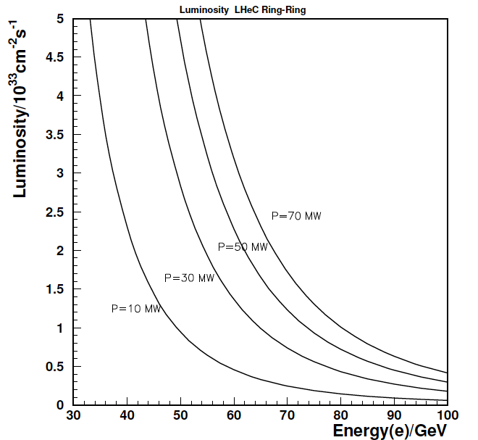
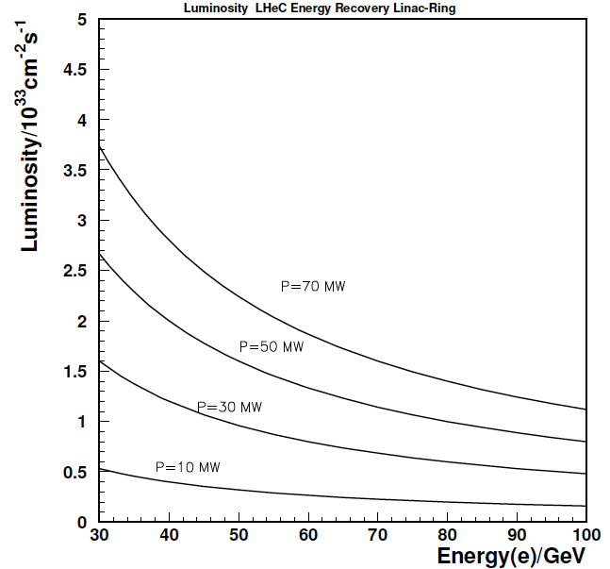
Design Considerations
LHC hadron beams: E_{p}=7 TeV; CM collision energy: E²_{CM} = 4 E_{e}* E_{p,A} ➔ 50 to 150GeV
Integrated e±p : O(100) fb⁻¹ ≈ 100 * L(HERA) → synchronous ep and pp operation
Luminosity O (10³³) cm⁻²s⁻¹ with 100 MW power consumption ➔ Beam Power < 70 MW
Start of LHeC operation together with HL-LHC in 2023 (installation in LS3 in 2022)
e Ring in the LHC tunnel (Ring-Ring - RR) Superconducting ERL (Linac-Ring -LR)

Slide 8
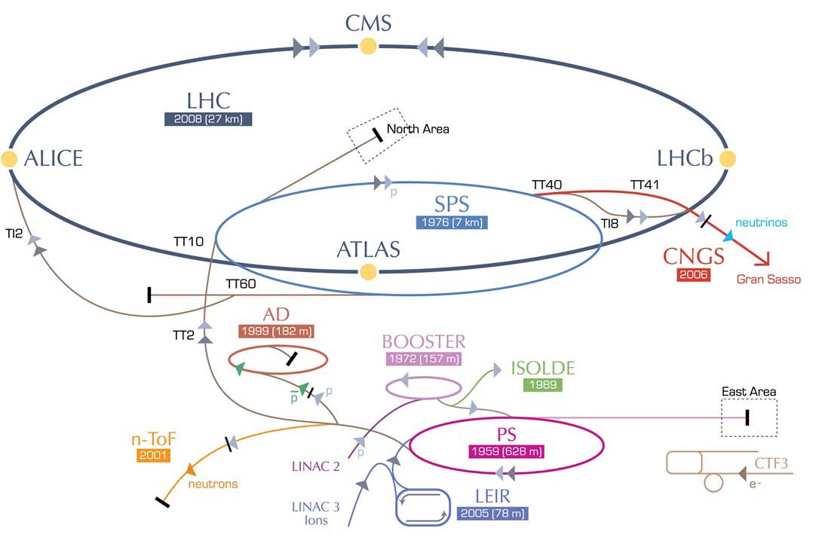
LHeC options: RR and LR
RR LHeC:
new ring in
LHC tunnel,
with bypasses
around
experiments
RR LHeC
e-/e+ injector
10 GeV,
10 min. filling time
LR LHeC:
recirculating
linac with
energy
recovery,
or straight
linac
Frank Zimmermann, UPHUK4 Bodrum 2010

Slide 9
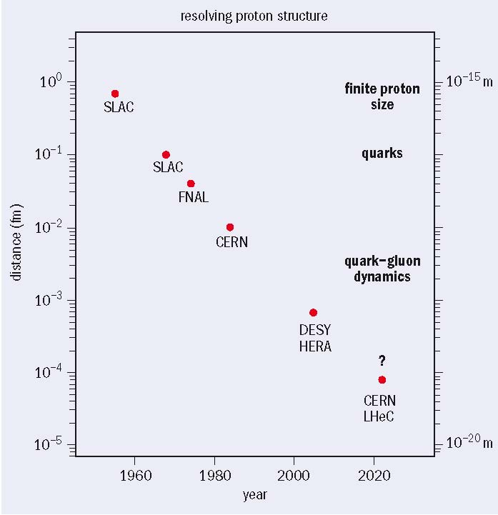
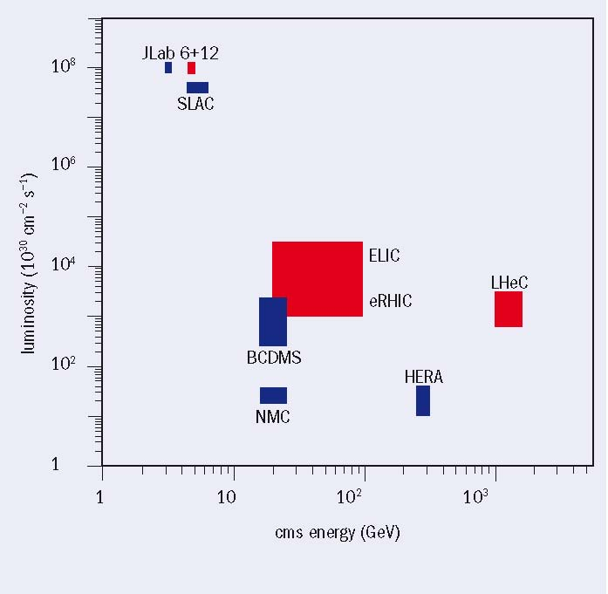
LHeC - Physics motivation
>5x HERA c.m. energy
>>10x HERA luminosity
Max Klein & Paul Newman,
CERN Courier April 2009
Max Klein & Paul Newman, CERN Courier April 2009
distance scales resolved in lepton-hadron scattering experiments since 1950s, and some of the new physics revealed
energies and luminosities of existing and proposed future lepton-proton scattering facilities
EPS-HEP, 23 July 2011, Grenoble
Oliver Brüning CERN

Slide 10
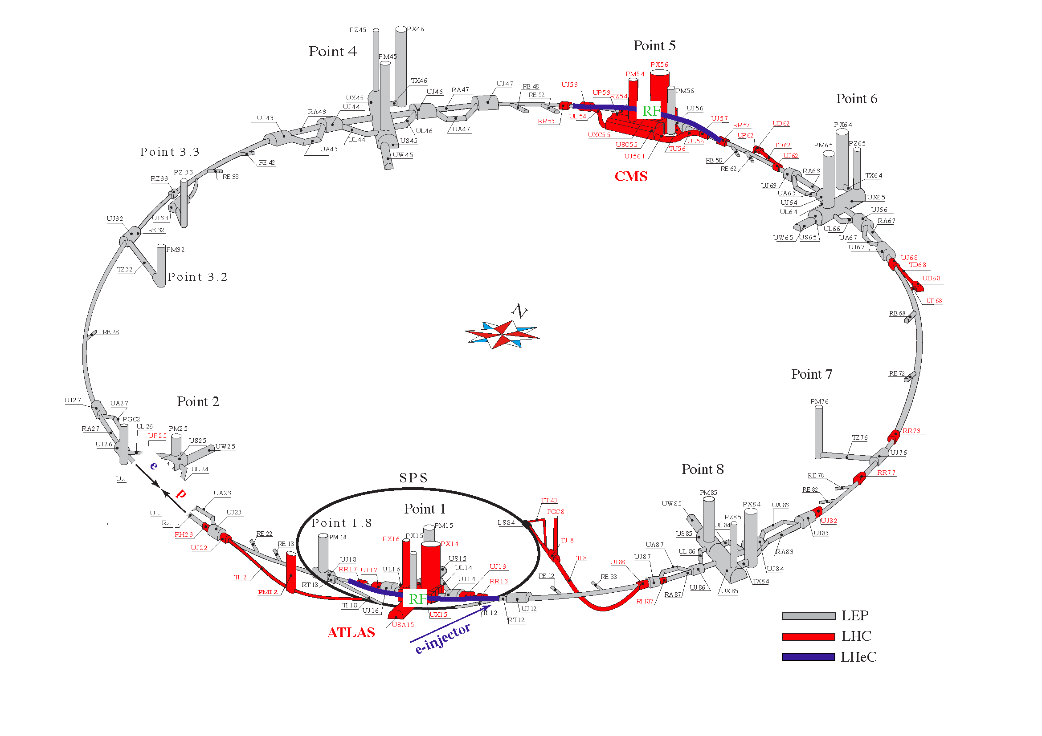
LHeC: Ring-Ring Option
Challenge 1: Bypassing the main LHC detectors
EPS-HEP, 23 July 2011, Grenoble
Oliver Brüning CERN
10

Slide 11
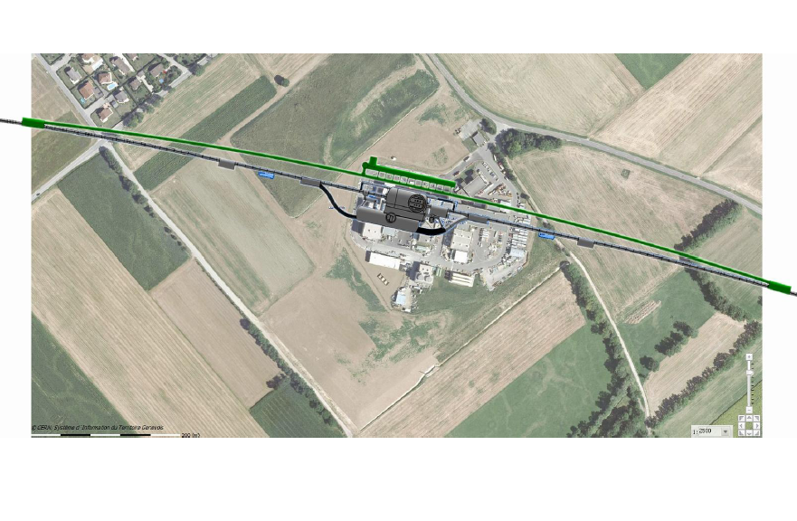
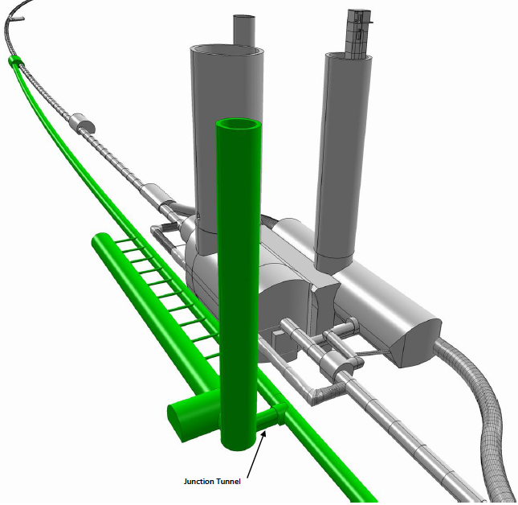
Bypassing CMS: 20m distance to Cavern
RF
EPS-HEP, 23 July 2011, Grenoble
Oliver Brüning CERN

Slide 12
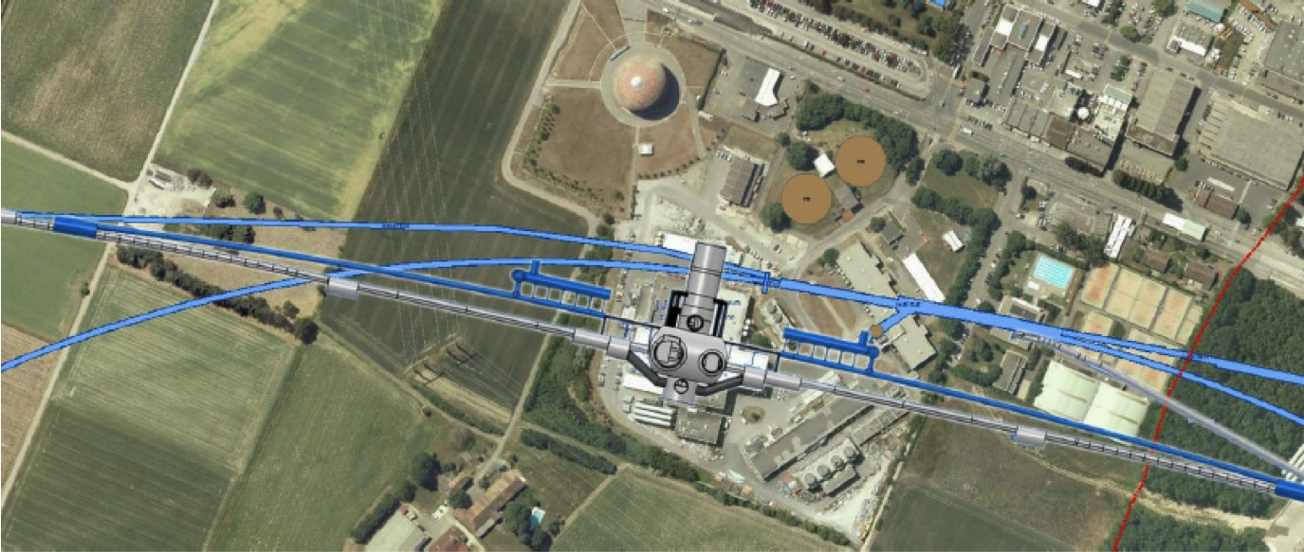
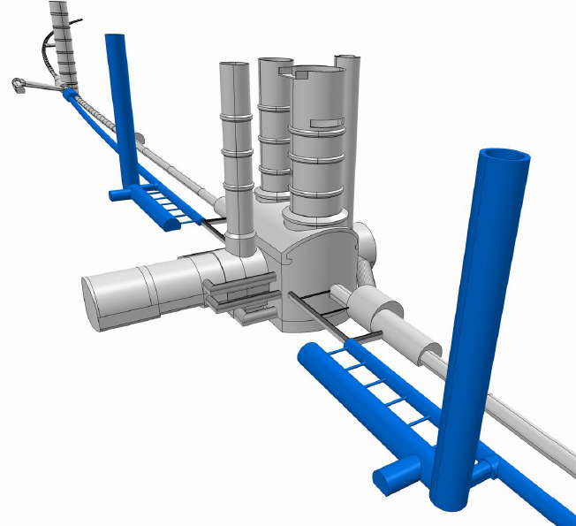
Bypassing ATLAS: 100m wo survey gallery
For the CDR the bypass concepts
were decided to be confined to
ATLAS and CMS
EPS-HEP, 23 July 2011, Grenoble
Oliver Brüning CERN

Slide 13
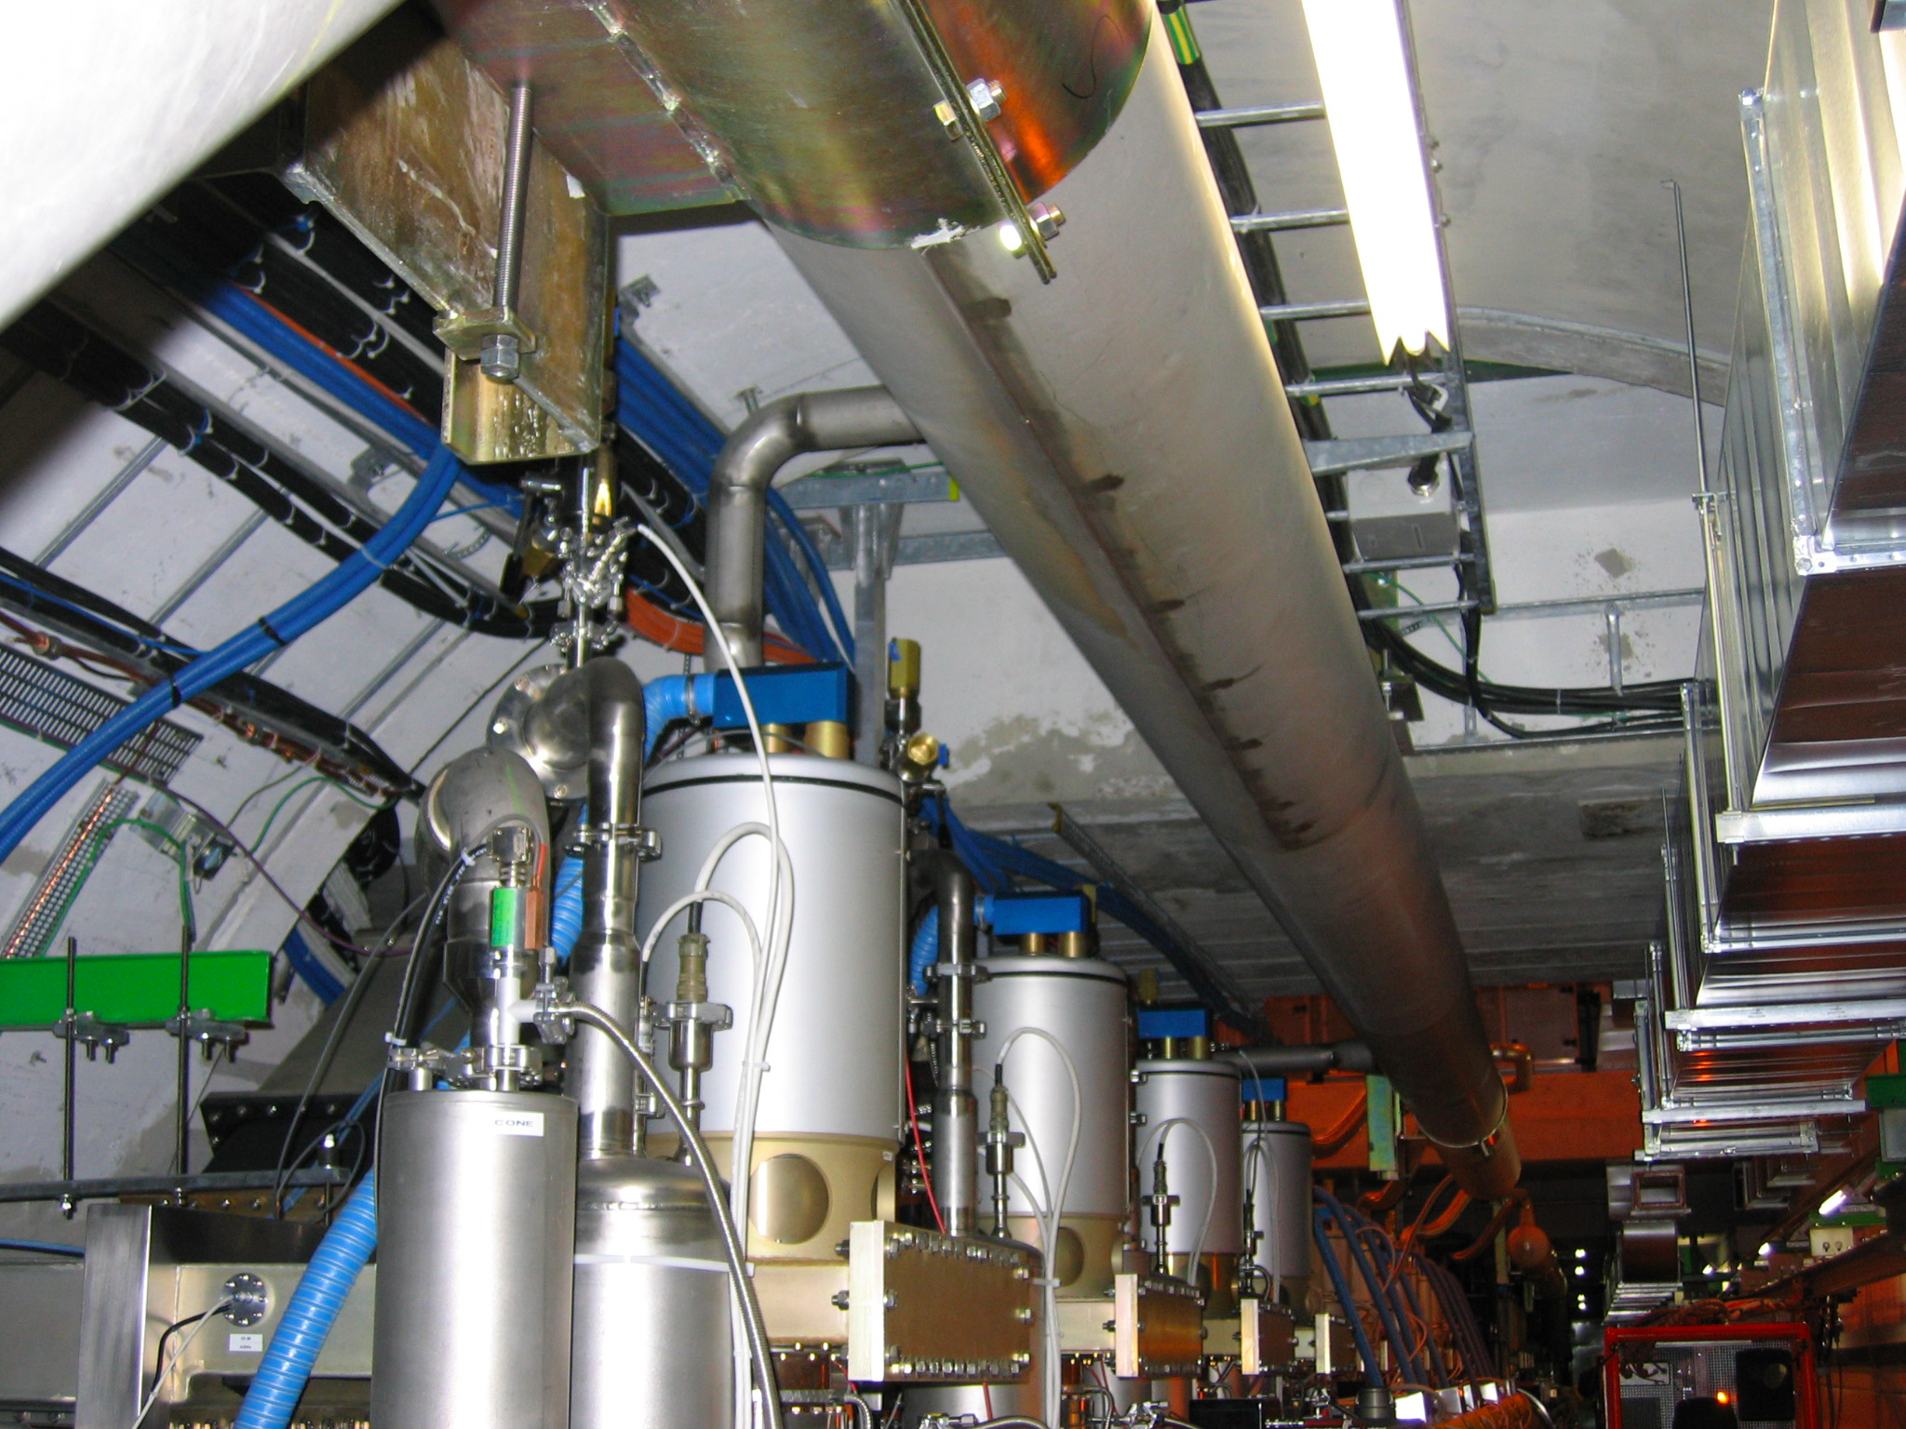
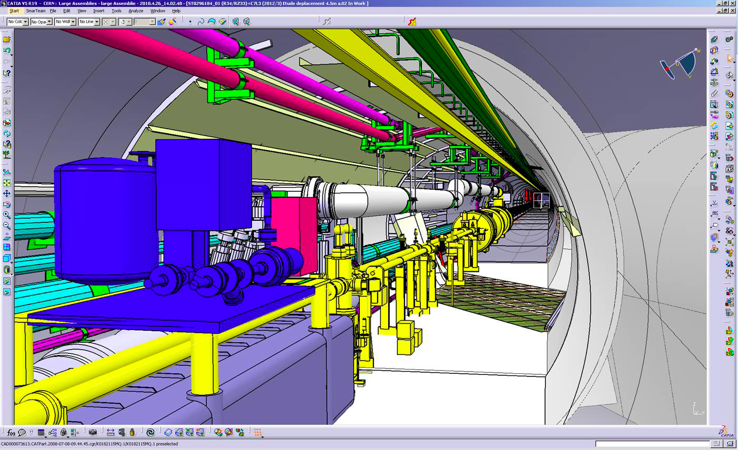
LHeC: Ring-Ring Option
Challenge 2: Integration in the LHC tunnel
RF Installation in IR4
Cryo link in IR3
EPS-HEP, 23 July 2011, Grenoble
Oliver Brüning CERN
13

Slide 14
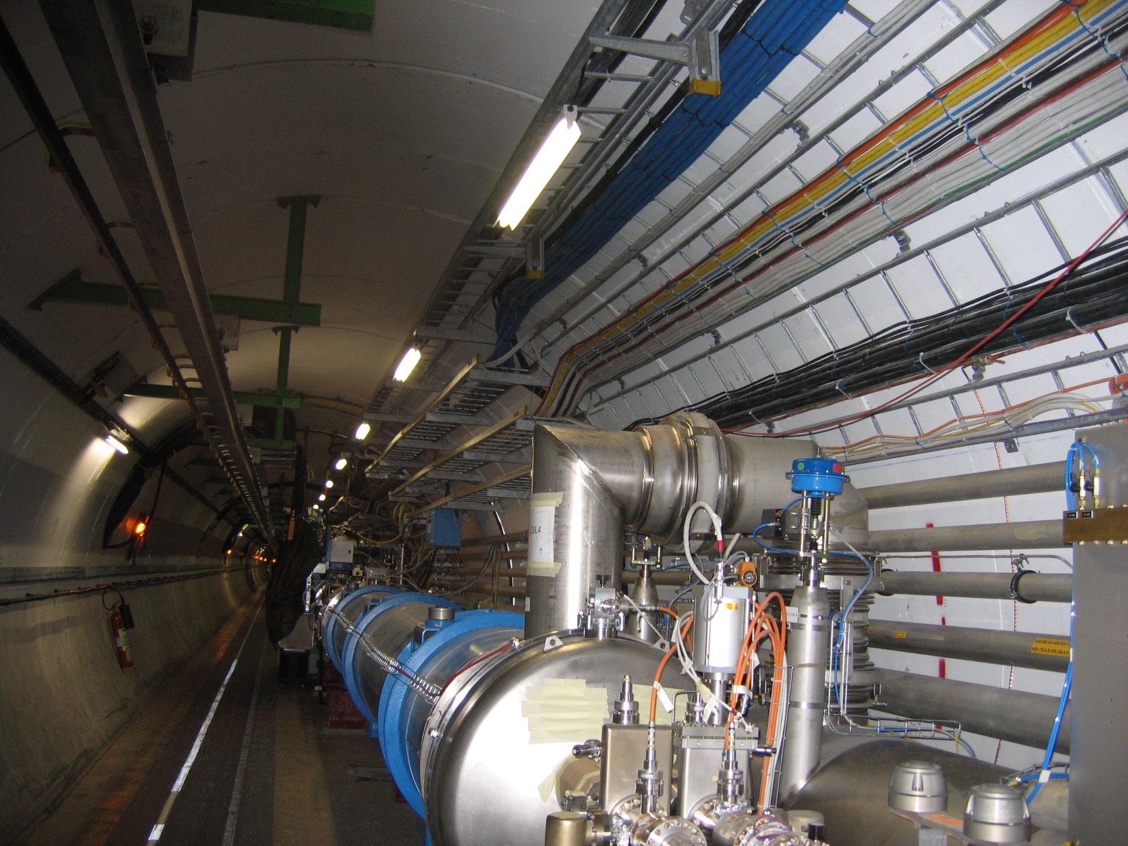
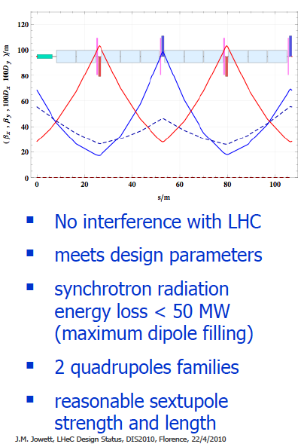
Arc Cell Design – Double FODO
Cryo jumpers
accounted for in
FODO design.
Further interferences
mapped and being studied.
EPS-HEP, 23 July 2011, Grenoble
Oliver Brüning CERN

Slide 15
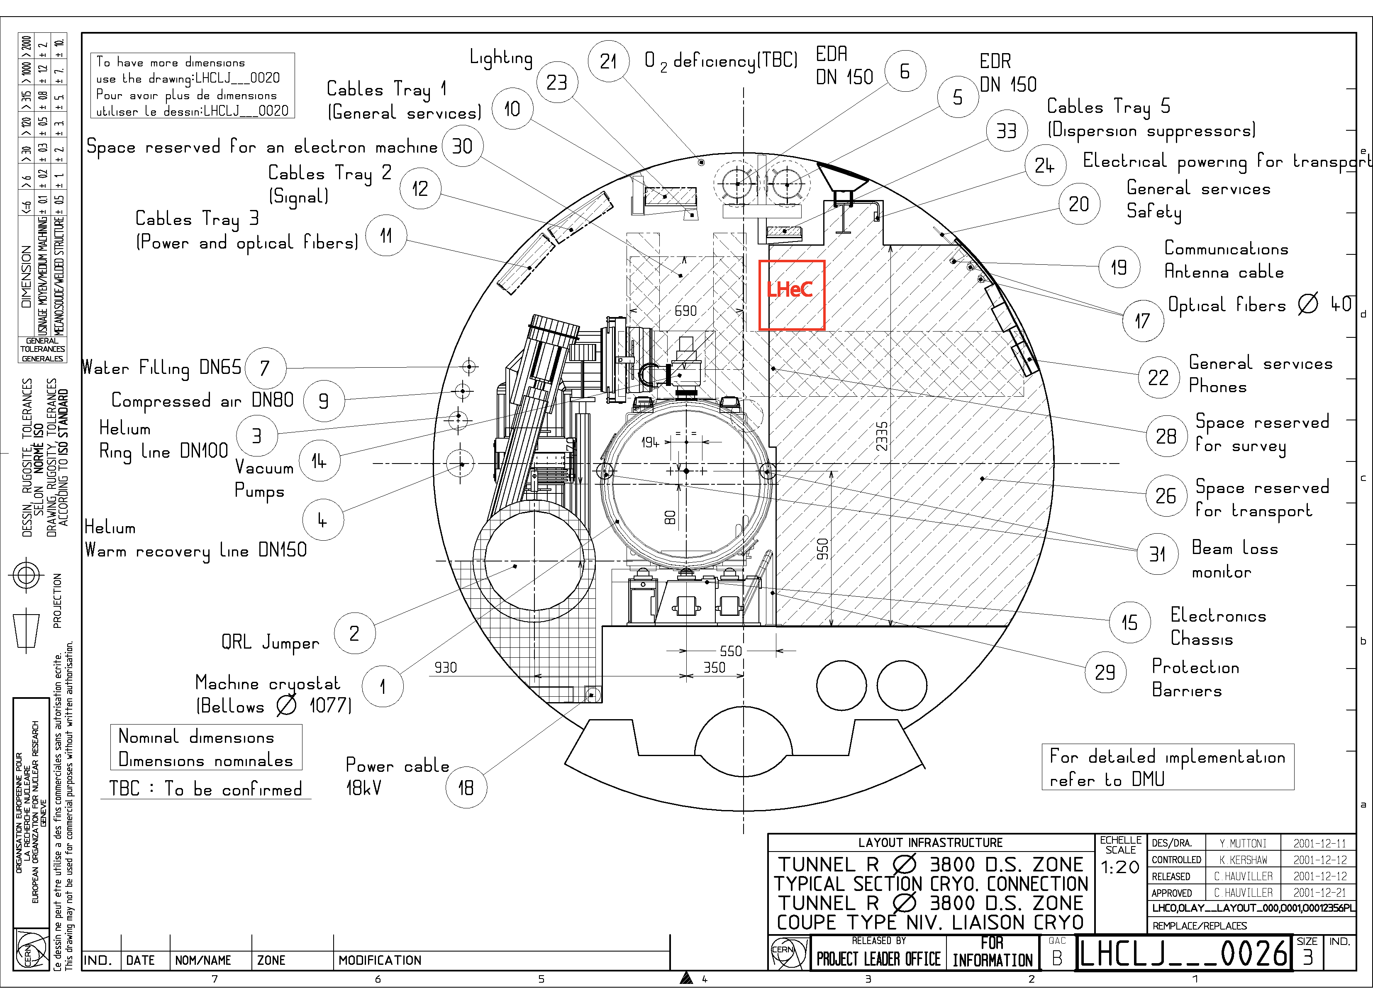
LHeC: Ring-Ring Option
Challenge 3: Installation with LHC circumference:
requires:
support
structure
with
efficient
montage
and
compact
magnets
EPS-HEP, 23 July 2011, Grenoble
Oliver Brüning CERN
15

Slide 16
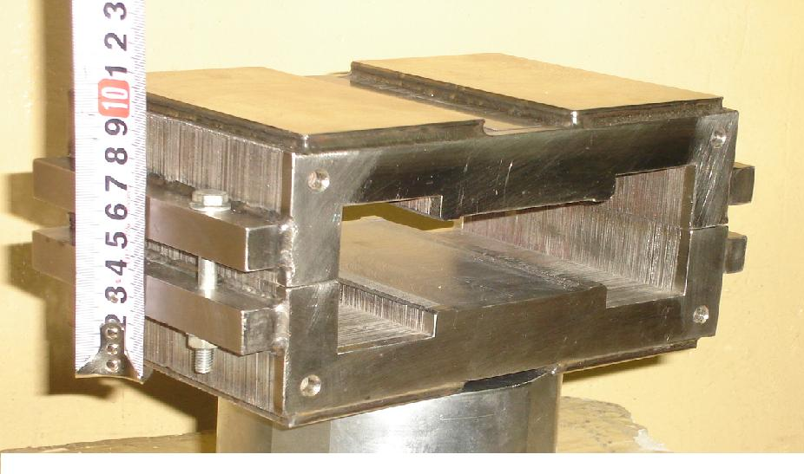
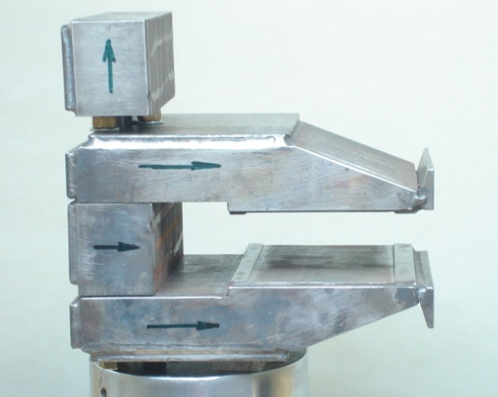
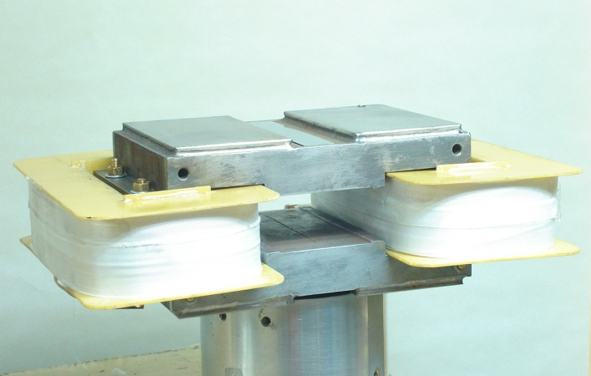
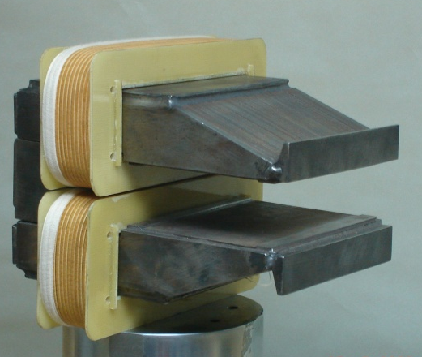
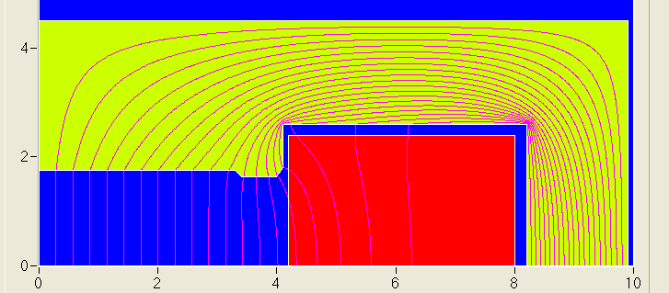
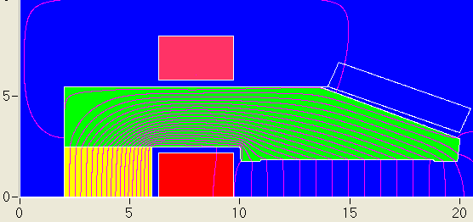
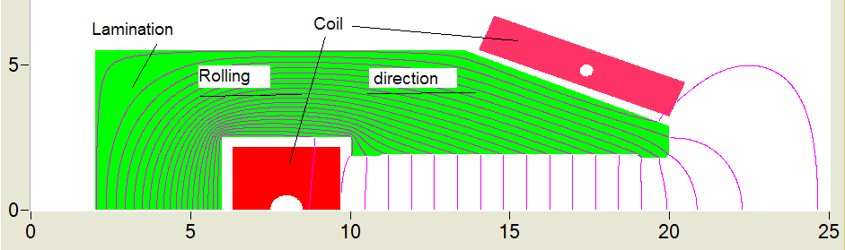
Dipole Prototype- BINP (Novosibirsk)
22A/m
6A/m
3408 grain oriented steel
0.35 mm thick laminations
same results for the two alternatives
laminations of alternated rolling
Reproducibility of injection field is below 0.1 Gauss!
EPS-HEP, 23 July 2011, Grenoble
Oliver Brüning CERN

Slide 17
LHeC: Linac-Ring Option ➔
Considered Various Layout
p-60
erl
1.67 km
LHC p
injector
0.34 km
dump
10-GeV linac
injector
30-GeV linac
IP
dump
2.0 km
“least expensive"
LHC p
1.0 km
high
luminosity
p-140
10-GeV linac
IP
2.0 km
LHC p
3.9 km
injector
70-GeV linac
IP
dump
high
energy
p-140’
7.8 km
IP
injector
140-GeV linac
dump
EPS-HEP, 23 July 2011, Grenoble
Oliver Brüning CERN

Slide 18
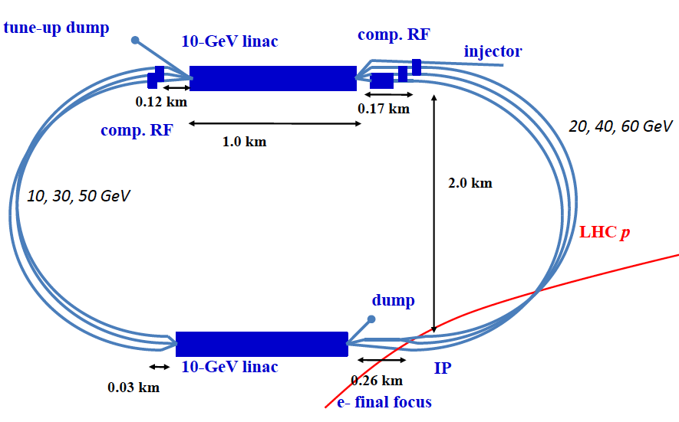
LHeC: Baseline Linac-Ring Option
Challenge 1: Super Conducting Linac with Energy Recovery
& high current (> 6mA)
Two 1 km long SC
linacs in CW operation (Q ≈ 10¹⁰)
requires Cryogenic
system comparable
to LHC system!
Challenge 2: Relatively large return arcs
ca. 9 km underground tunnel installation
total of 19 km bending arcs
same magnet design as for RR option: > 4500 magnets
EPS-HEP, 23 July 2011, Grenoble
Oliver Brüning CERN
18

Slide 19
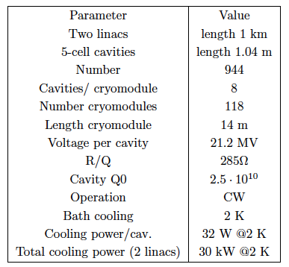
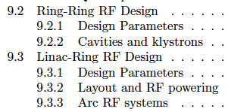

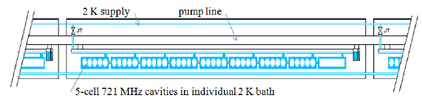

CDR draft
EPS-HEP, 23 July 2011, Grenoble
Oliver Brüning CERN

Slide 20
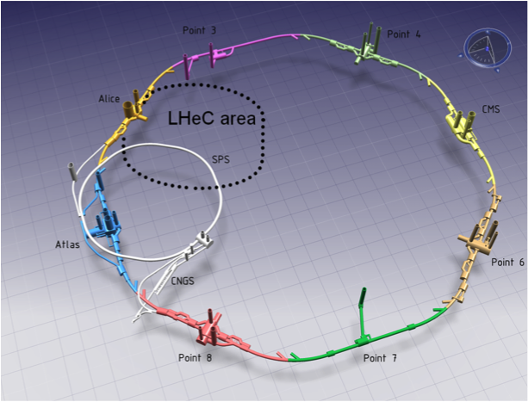
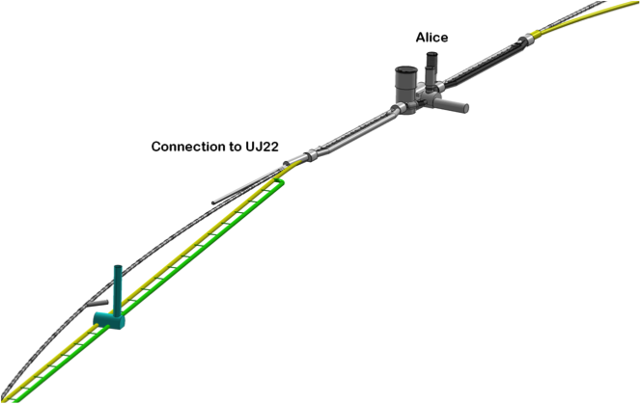
LINAC – Ring: connection to the LHC
IP2
-944 cavities
-59 cryo modules per linac
-721 MHz, 21 MV/m CW
-Similar to SPL, ESS, XFEL, ILC,
eRHIC, Jlab
-24 - 39 MW RF power
-29 MW Cryo for 37W/m heat load
-4500 Magnets in the 2 * 3 arcs:
600 - 4m long dipoles per arc
240 - 1.2m long quadrupoles per arc
Linac (racetrack)
inside the LHC for
access at CERN
Territory
U=U(LHC)/3=9km
EPS-HEP, 23 July 2011, Grenoble
Oliver Brüning CERN

Slide 21
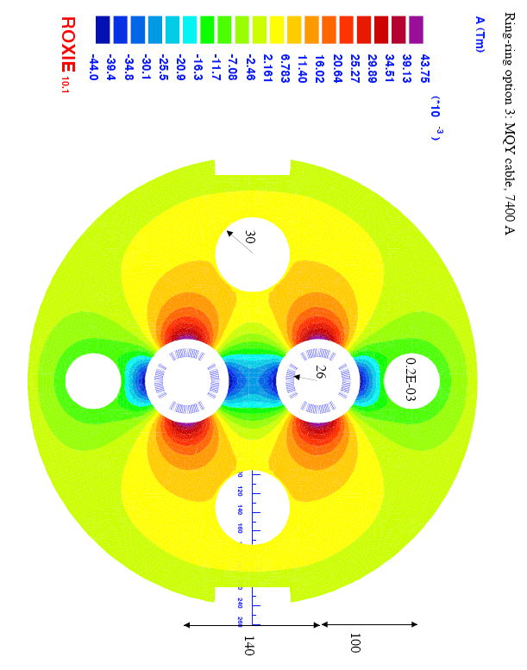
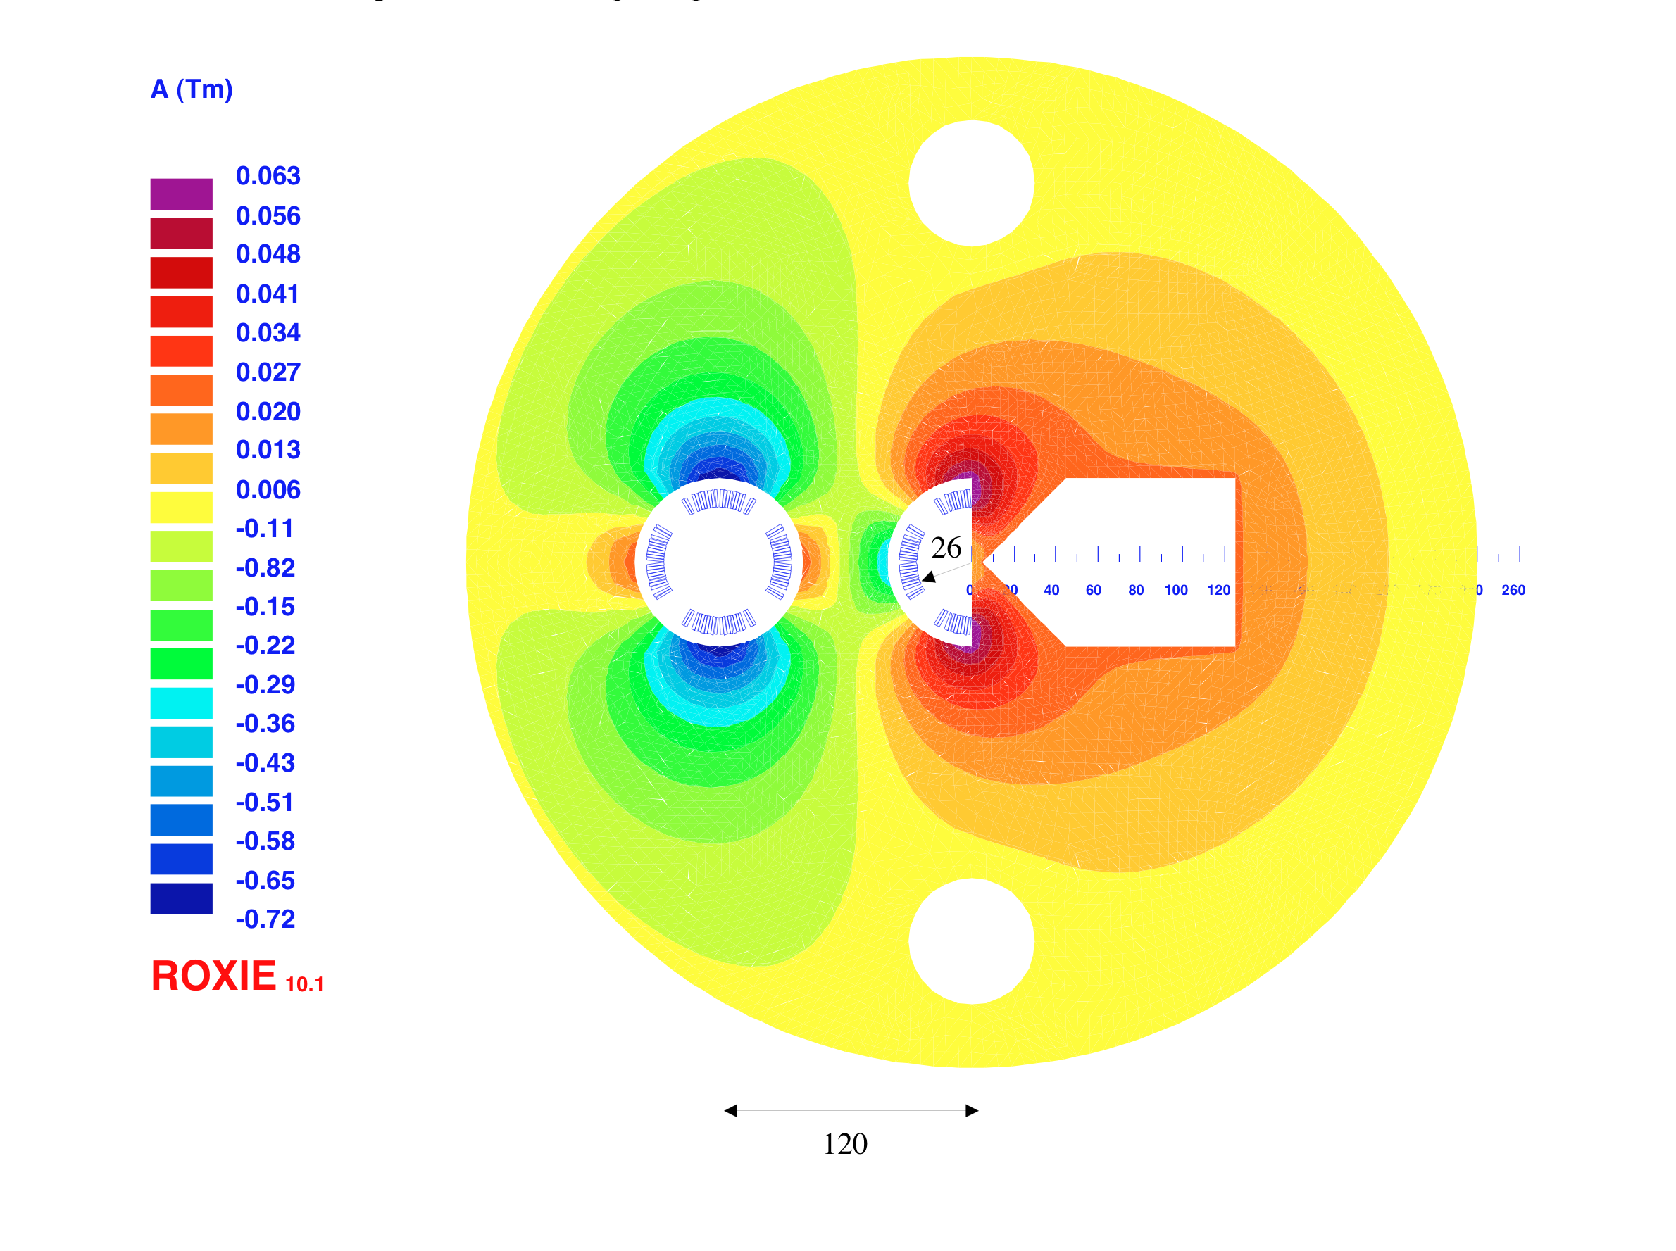
Interaction Region: Accommodating 3 Beams
Small crossing angle of about 1mrad to avoid first parasitic crossing (L x 0.77)
(Dipole in detector? Crab cavities? Design for 25ns bunch crossing [50ns?]
Synchrotron radiation –direct and back, absorption … recall HERA upgrade…)
Focus of current activity
1st sc half quad (focus and deflect)
separation 5cm, g=127T/m, MQY cables, 4600 A
2nd quad: 3 beams in horizontal plane
separation 8.5cm, MQY cables, 7600 A
EPS-HEP, 23 July 2011, Grenoble
Oliver Brüning CERN

Slide 22
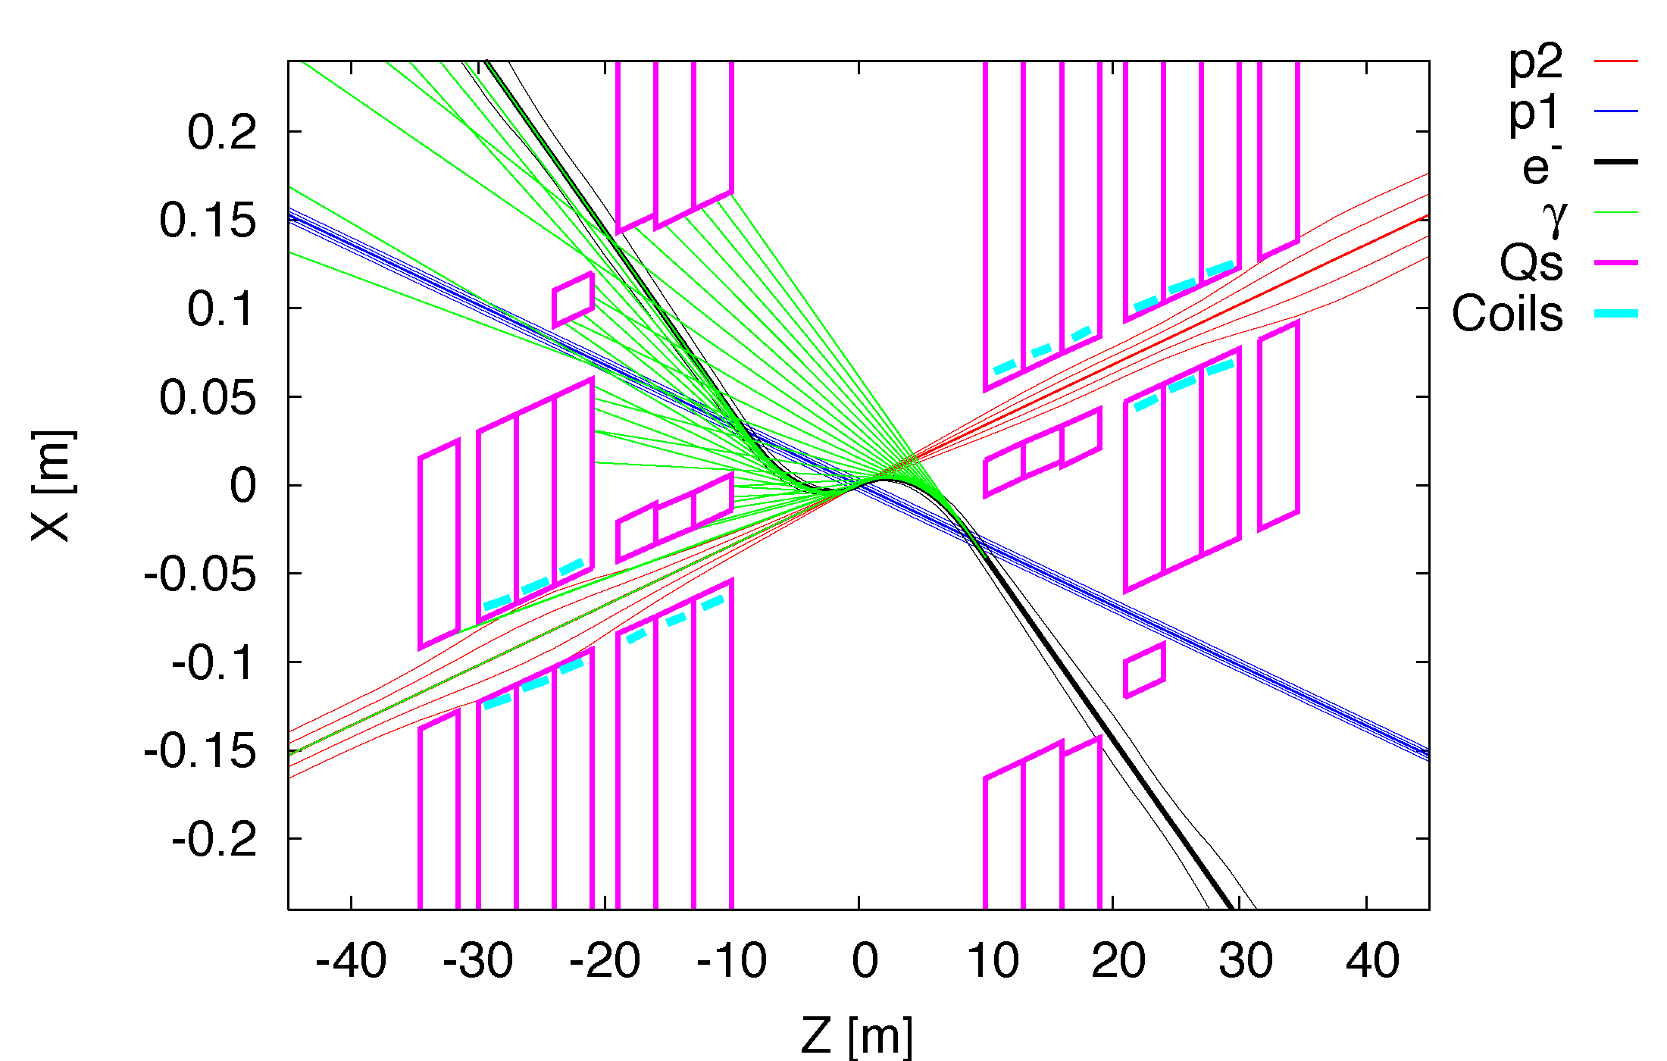
Interaction Region: Synchrotron Radiation
Radiation Fan: Example Linac-Ring
EPS-HEP, 23 July 2011, Grenoble
Oliver Brüning CERN

Slide 23
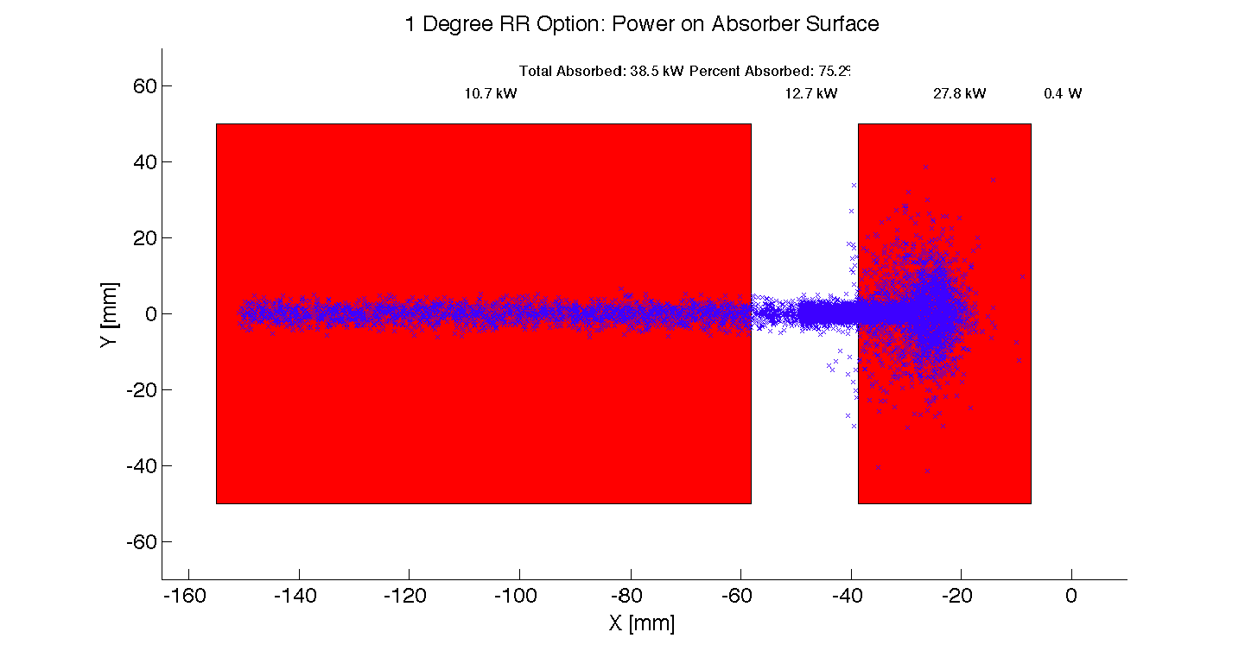
Interaction Region: Synchrotron Radiation
Significant power: > 20 kW. Example Ring-Ring
Focus of current activity
EPS-HEP, 23 July 2011, Grenoble
Oliver Brüning CERN

Slide 24
Design Parameters
electron beam | RR | LR | LR*
e- energy at IP[GeV] | 60 | 60 | 140
luminosity [10³² cm⁻²s⁻¹] | 17 | 10 | 0.44
polarization [%] | 40 | 90 | 90
bunch population [10⁹] | 26 | 2.0 | 1.6
e- bunch length [mm] | 10 | 0.3 | 0.3
bunch interval [ns] | 25 | 50 | 50
transv. emit. γε_{x,y} [mm] | 0.58, 0.29 | 0.05 | 0.1
rms IP beam size σ_{x,y} [μm] | 30, 16 | 7 | 7
e- IP beta funct. β*_{x,y} [m] | 0.18, 0.10 | 0.12 | 0.14
full crossing angle [mrad] | 0.93 | 0 | 0
geometric reduction H_{hg} | 0.77 | 0.91 | 0.94
repetition rate [Hz] | N/A | N/A | 10
beam pulse length [ms] | N/A | N/A | 5
ER efficiency | N/A | 94% | N/A
average current [mA] | 131 | 6.6 | 5.4
tot. wall plug power[MW] | 100 | 100 | 100
proton beam | RR | LR
bunch pop. [10¹¹] | 1.7 | 1.7
tr.emit.γε_{x,y} [μm] | 3.75 | 3.75
spot size σ_{x,y} [μm] | 30, 16 | 7
β*_{x,y} [m] | 1.8,0.5 | 0.1
bunch spacing [ns] | 25 | 25
Final parameter set to be developed as we gain experience with LHC operational (beam-beam, spacing etc)
The goal here is to demonstrate that realistic sets exist for both LHeC versions
“ultimate p beam”
1.7 probably conservative
Design also for deuterons
(new) and lead (exists)
RR= Ring – Ring
LR =Linac –Ring
Ring uses 1º as baseline : L/2
Linac: clearing gap: L*2/3
*) pulsed, but high energy ERL not impossible
EPS-HEP, 23 July 2011, Grenoble
Oliver Brüning CERN

Slide 25
Disclaimer:
Very short summary of CDR with ca. 500 pages:
-Many topics could not be covered here:
Physics
Detector
Accelerator:
        Sources
        Damping rings and injector complex
        Injection and injector complex
        Collective effects and Beam-Beam
        Cryogenic system
        Polarization
        Beam Dump
        Vacuum
        Power generation and distribution, etc…..
➔ LHeC-Note-2011-001 GEN
EPS-HEP, 23 July 2011, Grenoble
Oliver Brüning CERN

Slide 26
LHeC Options: Executive Summary
Ring-Ring option:
-We know we can do it: ➔ LEP 1.5
-Challenge 1: integration in the LHC tunnel and co-existence with
LHC hardware
-Challenge 2: installation within shutdowns of LHC schedule
CDR will be reviewed by Expert Panel
The goal is to identify the best option for the LHeC by the end of the year
Linac-Ring option:
-Installation decoupled from LHC operation and shutdown planning
-Infrastructure investment with potential exploitation beyond LHeC
-Challenging new technology: high current SC ERL
EPS-HEP, 23 July 2011, Grenoble
Oliver Brüning CERN
26

Slide 27
LHeC Planning and Timeline
We assume the LHC will reach end of its lifetime with the end of the HL-LHC project:
-Goal of integrated luminosity of 3000 fb⁻¹ with 200fb⁻¹ to 300fb⁻¹ production per year ➔ ca. 10 years of HL-LHC operation
-Current planning based on HL-LHC start in 2022
➔ end of LHC lifetime by 2032 to 2035
LHeC operation:
-Luminosity goal based on ca. 10 year exploitation time (100fb⁻¹)
-LHeC operation beyond or after HL-LHC operation will imply significant operational cost overhead for LHC consolidation
EPS-HEP, 23 July 2011, Grenoble
Oliver Brüning CERN
27

Slide 28
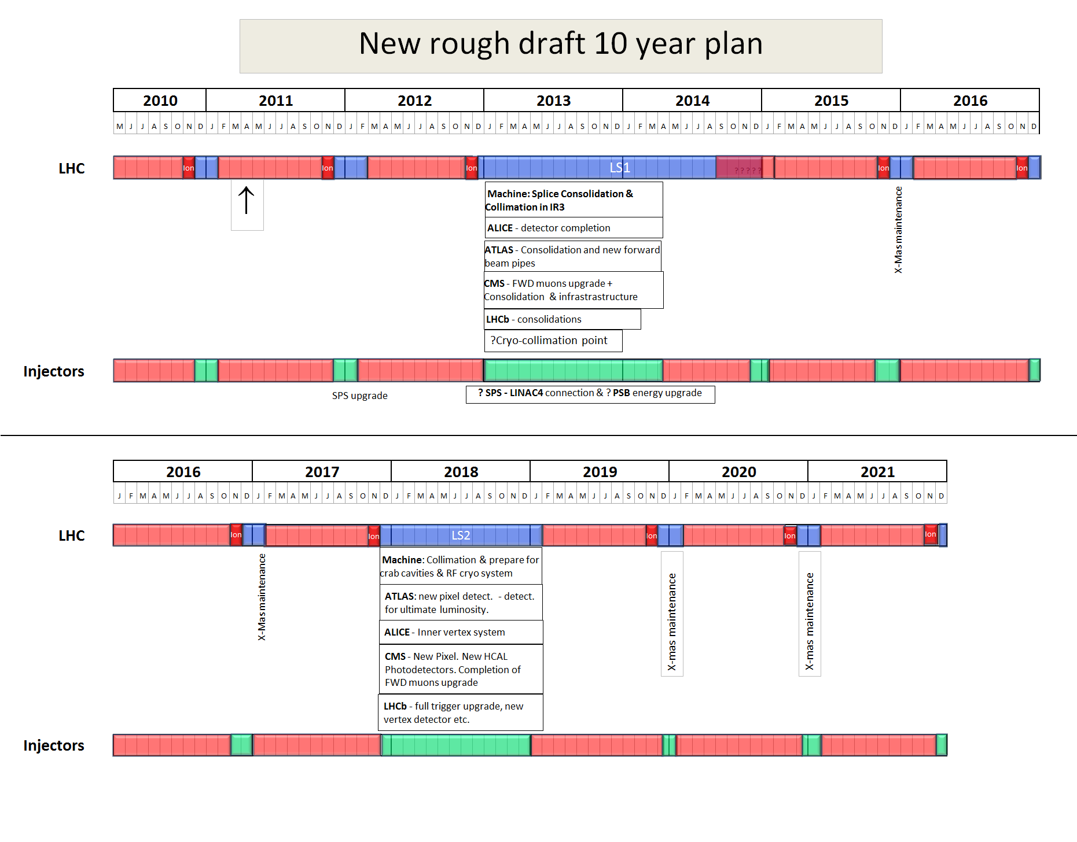
Not yet approved!
2022
LS3
Installation of the HL-LHC hardware
EPS-HEP, 23 July 2011, Grenoble
Oliver Brüning CERN

Slide 29
LHeC Planning and Timeline
CERN Medium Term Plan:
-Only 2 long shutdowns planned before 2022
-Only 10 years for the LHeC from CDR to project start (other smaller projects like ESS and PSI XFEL plan for 8 to 9 years [TDR to project start] and the EU XFEL plans for 5 years from construction to operation start)
LHeC planning:
-Need to start R&D work as soon as possible
-Need to develop detailed TDR after feedback from review panel
➔ concentrate future effort on only one option
EPS-HEP, 23 July 2011, Grenoble
Oliver Brüning CERN
29

Slide 30
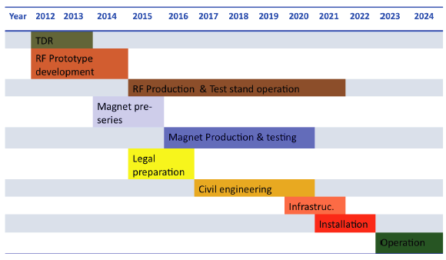
LHeC Tentative Time Schedule
LS3 --- HL LHC
EPS-HEP, 23 July 2011, Grenoble
Oliver Brüning CERN

Slide 31
LHeC Planning and Timeline
R&D activities:
-Superconducting RF with high Q-value
-Normal conducting compact magnet design
-Superconducting IR magnet design
-Test facility for Energy recovery operations and – or
compact injector complex
-High intensity polarized positron sources
EPS-HEP, 23 July 2011, Grenoble
Oliver Brüning CERN
31

Slide 32



















LHeC - Participating Institutes: A very rich collaboration
TOBB ETU
KEK

Slide 33
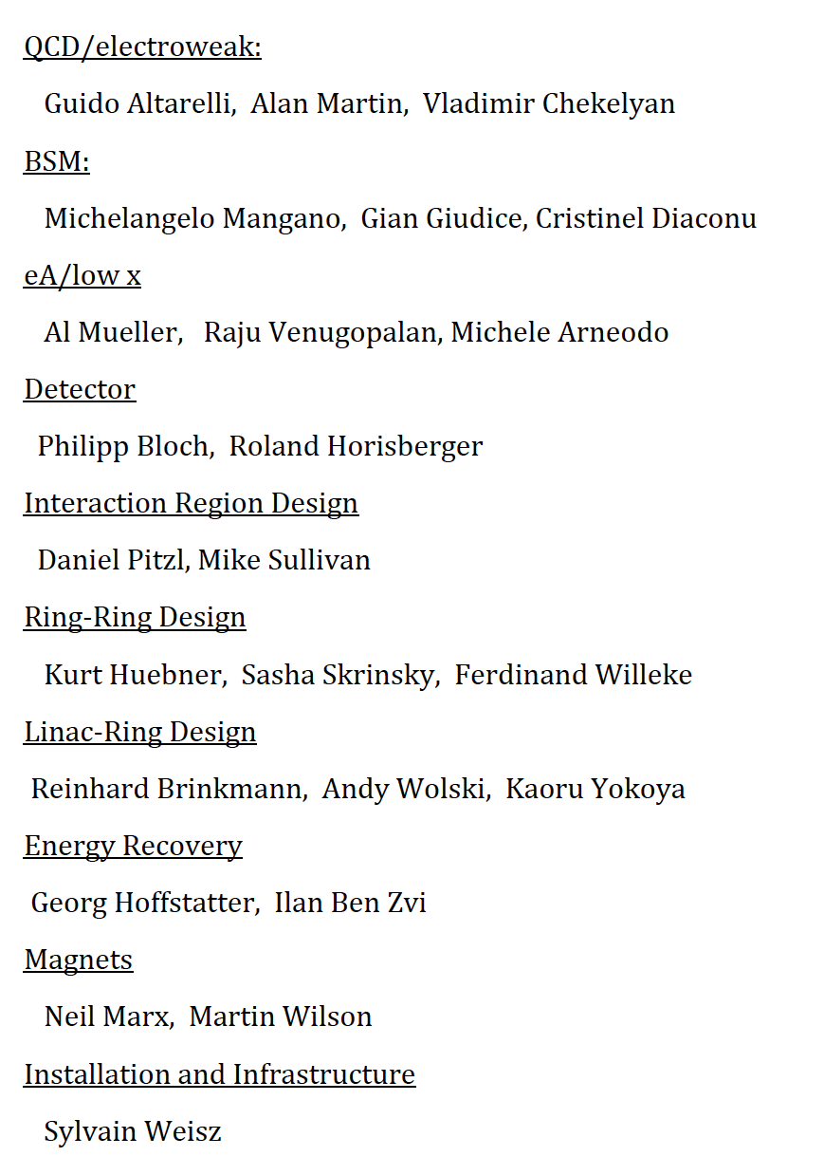
LHeC organisation
Scientific Advisory Committee
Working Group Conveners
Review Panel with experts on physics,
detector, accelerator, specific systems
Guido Altarelli (Rome)
Sergio Bertolucci (CERN)
Stan Brodsky (SLAC)
Allen Caldwell -chair (MPI Munich)
Swapan Chattopadhyay (Cockcroft)
John Dainton (Liverpool)
John Ellis (CERN)
Jos Engelen (CERN)
Joel Feltesse (Saclay)
Lev Lipatov (St.Petersburg)
Roland Garoby (CERN)
Roland Horisberger (PSI)
Young-Kee Kim (Fermilab)
Aharon Levy (Tel Aviv)
Karlheinz Meier (Heidelberg)
Richard Milner (Bates)
Joachim Mnich (DESY)
Steven Myers, (CERN)
Tatsuya Nakada (Lausanne, ECFA)
Guenther Rosner (Glasgow, NuPECC)
Alexander Skrinsky (Novosibirsk)
Anthony Thomas (Jlab)
Steven Vigdor (BNL)
Frank Wilczek (MIT)
Ferdinand Willeke (BNL)
Steering Committee
Accelerator Design [RR and LR]
Oliver Bruening (CERN),
Max Klein (Liverpool)
Interaction Region and Fwd/Bwd
Bernhard Holzer (DESY),
Uwe Schneekloth (DESY),
Pierre van Mechelen (Antwerpen)
Detector Design
Peter Kostka (DESY),
Rainer Wallny (U Zurich),
Alessandro Polini (Bologna)
New Physics at Large Scales
George Azuelos (Montreal)
Emmanuelle Perez (CERN),
Georg Weiglein (Durham)
Precision QCD and Electroweak
Olaf Behnke (DESY),
Paolo Gambino (Torino),
Thomas Gehrmann (Zuerich)
Claire Gwenlan (Oxford)
Physics at High Parton Densities
Nestor Armesto (Santiago),
Brian Cole (Columbia),
Paul Newman (Birmingham),
Anna Stasto (MSU)
Oliver Bruening (CERN)
John Dainton (Cockcroft) Inst
Albert DeRoeck (CERN)
Stefano Forte (Milano)
Max Klein - chair (Liverpool)
Paul Laycock (secretary) (L’pool)
Paul Newman (Birmingham)
Emmanuelle Perez (CERN)
Wesley Smith (Wisconsin)
Bernd Surrow (MIT)
Katsuo Tokushuku (KEK)
Urs Wiedemann (CERN))
Frank Zimmermann (CERN)
EPS-HEP, 23 July 2011, Grenoble
Oliver Brüning CERN

Slide 34
CDR Authorlist 29.6.11
C. Adolphsen (SLAC)
S. Alekhin (Serpukhov, DESY)
H. Aksakal (CERN)
P. Allport (Liverpool)
J.L. Albacete (IPhT Saclay)
V. Andreev (LPI Moscow)
R. Appleby (Cockcroft)
N. Armesto (St. de Compostela)
G. Azuelos (Montreal)
M. Bai (BNL)
D. Barber (DESY)
J. Bartels (Hamburg)
J. Behr (DESY)
O. Behnke (DESY)
S. Belyaev (CERN)
I. Ben Zvi (BNL)
N. Bernard (UCLA)
S. Bertolucci (CERN)
S. Bettoni (CERN)
J. Bluemlein (DESY)
H. Boettcher (DESY)
S. Brodsky (SLAC)
A. Bogacz (Jlab)
C. Bracco (CERN)
O. Bruening (CERN)
A. Bunyatian (DESY)
H. Burkhardt (CERN)
R. Calaga (BNL)
E. Ciapala (CERN)
R. Ciftci (Ankara)
A.K.Ciftci (Ankara)
B.A. Cole (Columbia)
J.C. Collins (Penn State)
J. Dainton (Liverpool)
A. De Roeck (CERN)
D. d'Enterria (CERN)
A. Dudarev (CERN)
A. Eide (NTNU)
E. Eroglu (Uludag)
K.J. Eskola (Jyvaskyla)
L. Favart (IIHE Brussels)
M. Fitterer (CERN)
S. Forte (Milano)
P. Gambino (Torino)
T. Gehrmann (Zurich)
C. Glasman (Madrid)
R. Godbole (Tata)
B. Goddard (CERN)
T. Greenshaw (Liverpool)
A. Guffanti (Freiburg)
C. Gwenlan (Oxford)
T. Han (Harvard)
Y. Hao (BNL)
F. Haug (CERN)
W. Herr (CERN)
B. Holzer (CERN)
M. Ishitsuka (Tokyo I.Tech.)
M. Jacquet (Orsay, LAL)
B. Jeanneret (CERN)
J.M. Jimenez (CERN)
H. Jung (DESY)
J. Jowett (CERN)
D. Kayran (BNL)
F. Kosac (Uludag)
A. Kilic (Uludag}
K. Kimura (Tokyo I.Tech.)
M. Klein (Liverpool)
U. Klein (Liverpool)
T. Kluge (Hamburg)
G. Kramer (Hamburg)
M. Korostelev (Cockcroft)
Kosmicki (CERN)
P. Kostka (DESY)
H. Kowalski (DESY)
M. Kuze (Tokyo I.Tech.)
T. Lappi (Jyvaskyla)
P. Laycock (Liverpool)
E. Levichev (BINP)
S. Levonian (DESY)
V.N. Litvinenko (BNL)
C. Marquet (CERN)
B. Mellado (Harvard)
K-H. Mess (CERN)
S. Moch (DESY)
I.I. Morozov (BINP)
Y. Muttoni (CERN)
S. Myers (CERN)
P.R. Newman (Birmingham)
T. Omori (KEK)
J. Osborne (CERN)
E. Paoloni (Pisa)
C. Pascaud (LAL Orsay)
H. Paukkunen (St. de Compostela)
E. Perez (CERN)
T. Pieloni (CERN)
E. Pilic (Uludag)
A. Polini (Bologna)
V. Ptitsyn (BNL)
Y. Pupkov (BINP)
V. Radescu (Heidelberg U)
S. Raychaudhuri (Tata)
L. Rinolfi (CERN)
R. Rohini (Tata India)
J. Rojo (Milano)
S. Russenschuck (CERN)
C. A. Salgado (St. de Compostela)
K. Sampai (Tokyo I. Tech)
E. Sauvan (Lyon)
U. Schneekloth (DESY)
T. Schoerner Sadenius (DESY)
D. Schulte (CERN)
N. Soumitra (Torino)
H. Spiesberger (Mainz)
A.M. Stasto (Penn State)
M. Strikman (Penn State)
M. Sullivan (SLAC)
B. Surrow (MIT)
S. Sultansoy (Ankara)
Y.P. Sun (SLAC)
W. Smith (Madison)
I. Tapan (Uludag)
P. Taels (Antwerpen)
H. Ten Kate (CERN)
J. Terron (Madrid)
H. Thiesen (CERN)
L. Thompson (Cockcroft)
K. Tokushuku (KEK)
R. Tomas Garcia (CERN)
D. Tommasini (CERN)
D. Trbojevic (BNL)
N. Tsoupas (BNL)
J. Tuckmantel (CERN)
K. Tywoniuk (Lund)
G. Unel (CERN)
J. Urakawa (KEK)
P. Van Mechelen (Antwerpen)
R. Veness (CERN)
A. Vivoli (CERN)
P. Vobly (BINP)
R. Wallny (ETHZ)
G. Watt (CERN)
G. Weiglein (Hamburg)
C. Weiss (JLab)
U.A. Wiedemann (CERN)
U. Wienands (SLAC)
F. Willeke (BNL)
V. Yakimenko (BNL)
A.F. Zarnecki (Warsaw)
F. Zimmermann (CERN)
F. Zomer (Orsay LAL)

Slide 35
Reserve Transparencies
LHCC meeting, CERN, 14 June 2011
Oliver Brüning BE-ABP
35

Slide 36
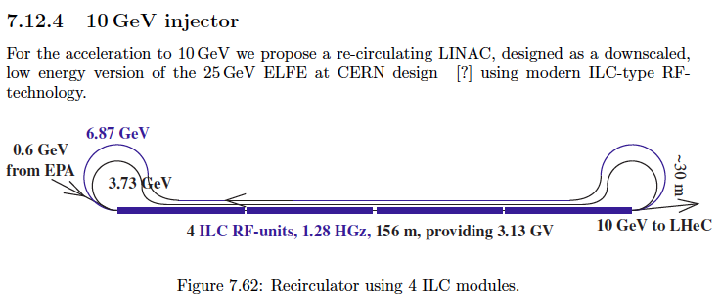
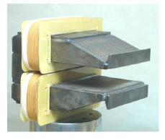
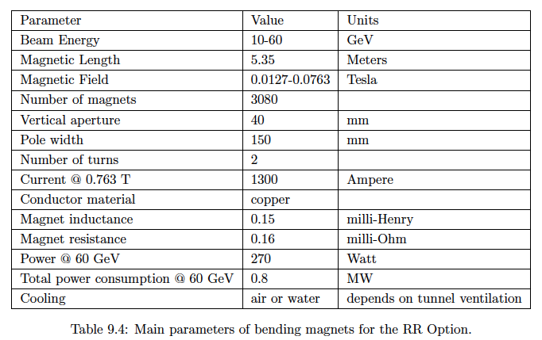
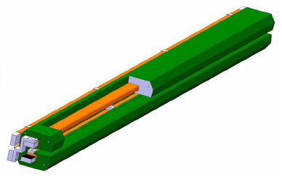
Magnets
Injector to Ring – similar to Linac design [R+D]
Novosibirsk dipole prototype
measured field reproducible
to the required 2 10⁻⁴
CERN prototype under test
3080 dipoles
336+148 F+D

Slide 37
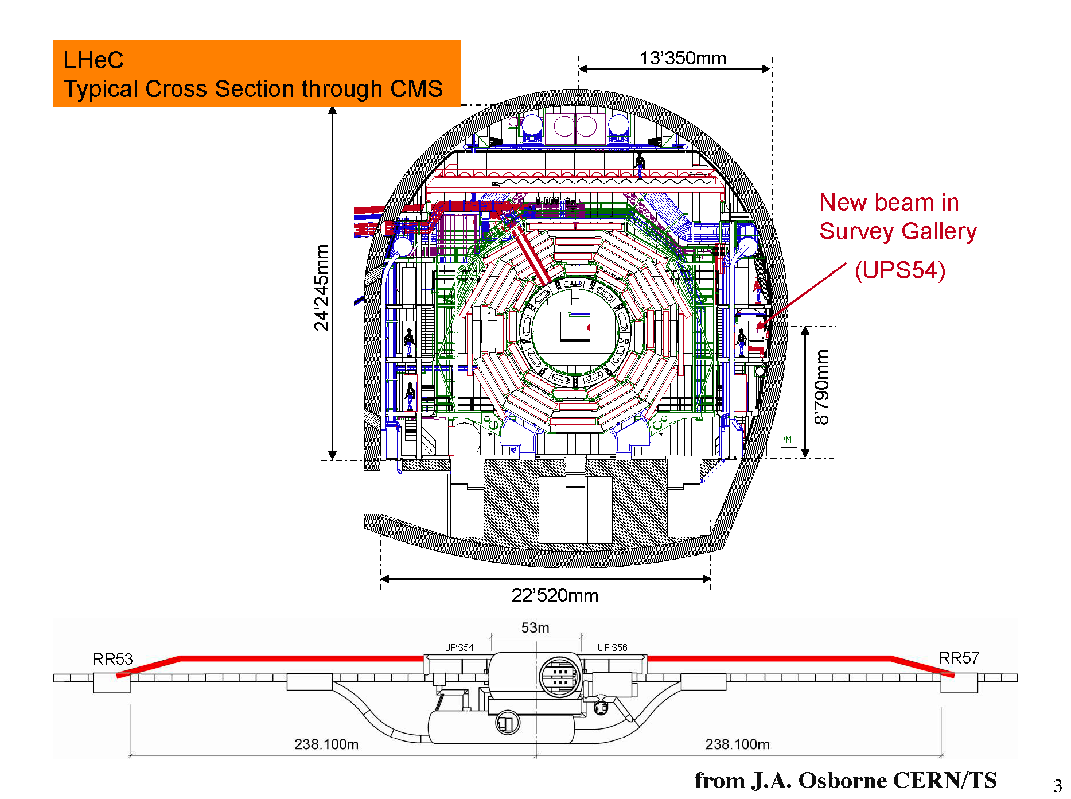
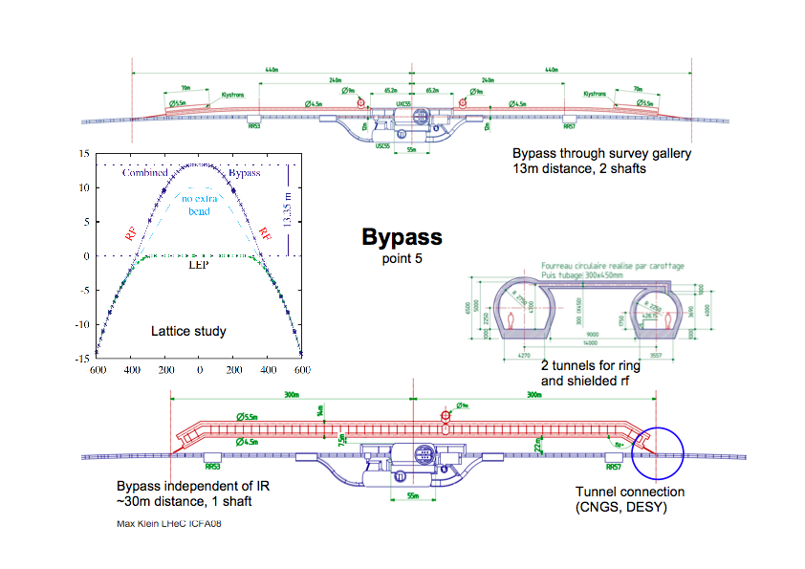
H. Burkhard

Slide 38
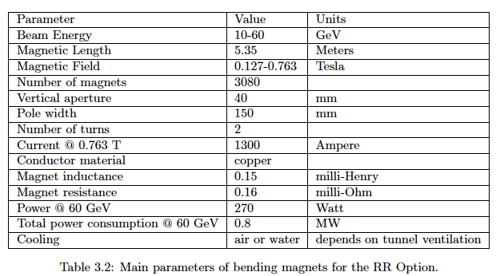
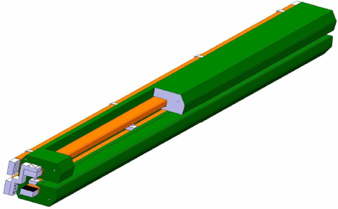
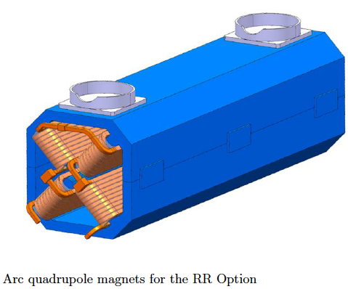
Ring: Dipole + Quadrupole Magnets
BINP &
CERN
prototypes
5m long
(35 cm)²
slim + light
for installation
736 magnets
1.2 m long

Slide 39
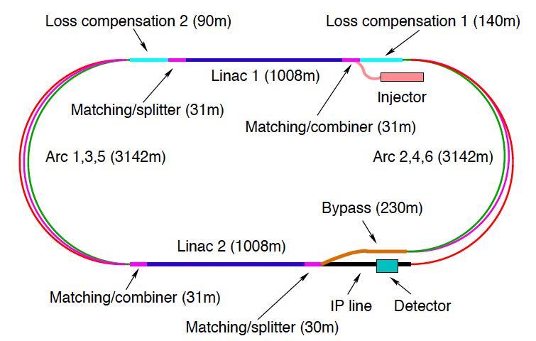
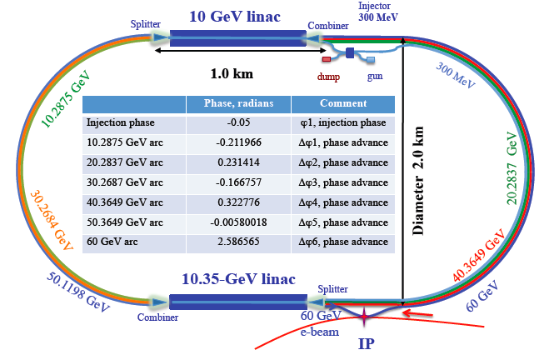
60 GeV Energy Recovery Linac
CERN 1
CERN 2
Jlab
BNL
Two 10 GeV energy recovery Linacs, 3 returns, 720 MHz cavities

Slide 40
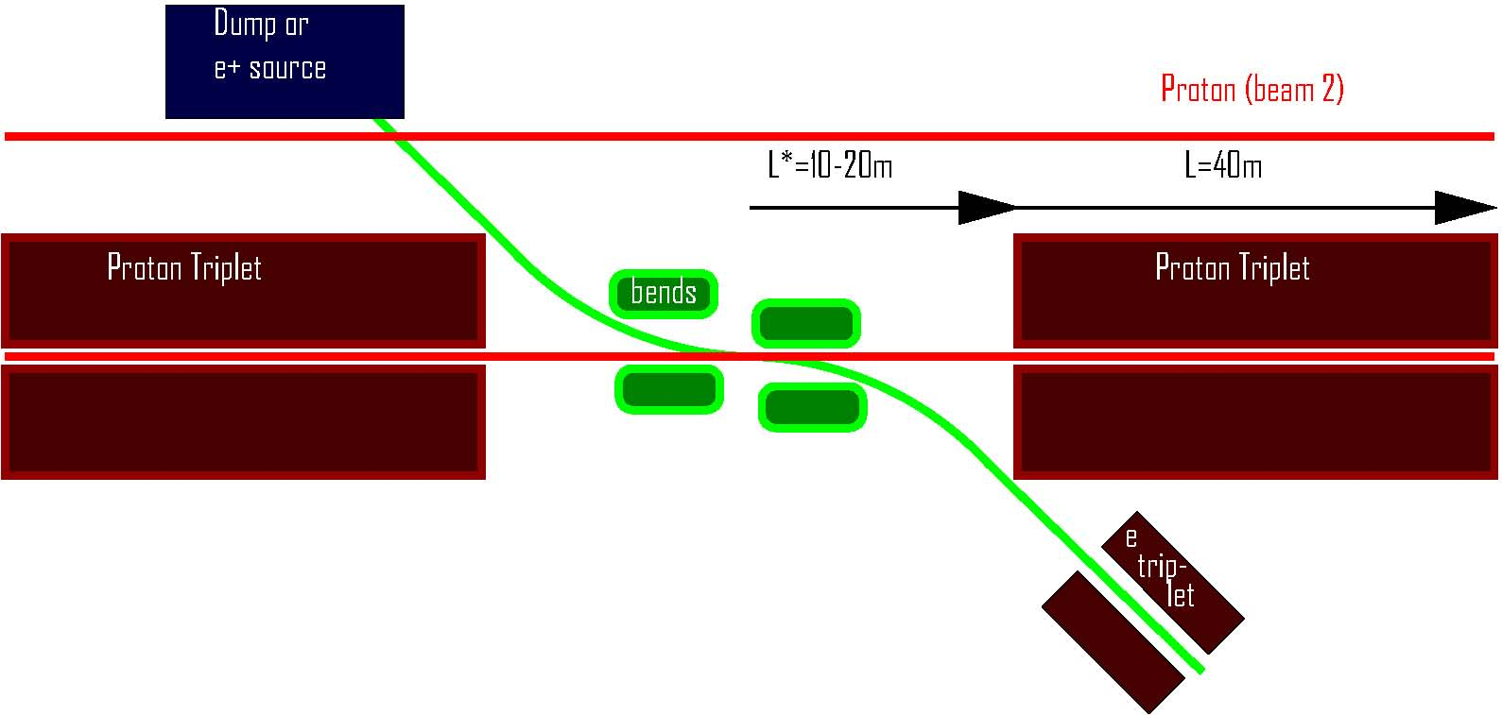
interaction region (2008)
R. Tomas, F.Z.
or return loop
small e- emittance → relaxed β_{e}* → L_{e}* > L_{p}*, can&must profit from ↓β_{p}* ; single pass & low e-divergence → parasitic collisions of little concern; → head-on e-p collision realized by long dipoles

Slide 41
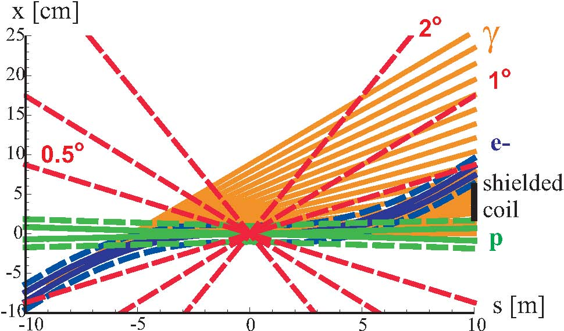
IR layout w. head-on collision
detector integrated dipole: field ~0.45 T
critical photon energy ~ 1 MeV
average SR power = 87 kW
8x10¹⁰ γ / bunch passage
is the SR
acceptable
for the
detector?
beam envelopes of 10σ (electrons) [solid blue] or 11σ (protons) [solid green], the same envelopes with an additional constant margin of 10 mm [dashed], the synchrotron-radiation fan [orange], and the approximate location of the magnet coil between incoming protons and outgoing electron beam [black]

Slide 42
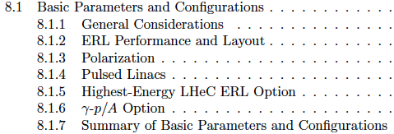
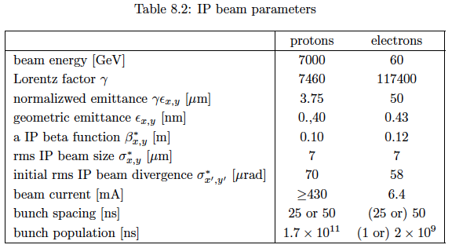



CDR draft
LINAC 60 GeV ERL

Slide 43

Physics and Range
New Physics
Physics
eQ states
GUT (δα_{s}=0.1%)
Excited fermions
Hot/cold spots
Single top
Higgs
PDFs
Multi-Jets
DVCS
Unintegrated
partons
Saturation
Vector Mesons
IP - graviton
Odderons
NC couplings
sin²Θ
Beauty
Charm
Partons in nuclei
Shadowing
….
Large x
High precision
partons in plateau
of the LHC
Nuclear
Structure
& dynamics
High Density Matter
Q² = 4momentum transfer² x = Bjorken x: fraction of p’s momentum

Slide 44
Detector:
Integrated dipole field?

Slide 45

Initial Phase of LHC will tell the way to go
Rolf Heuer: 3/4. 12. 09 at CERN: From the Proton Synchroton to the Large Hadron Collider
50 Years of Nobel Memories in High-Energy Physics
The Next Decades
Possible ways beyond LHC
hadron - hadron collider (sLHC / DLHC)
lepton - lepton collider (ILC / CLIC)
lepton - hadron collider (LHeC)

