Slide 1

LHeC
Design Considerations
Two options: -Ring-Ring collider
-Linac-Ring collider with Energy Recovery
On behalf of the LHeC Collaboration!
IR Layout
Planning and timeline
Next steps
DIS13, 22nd – 26th April 2013
Oliver Brüning, CERN
1

Slide 2
LHeC Proposal endorsed by ECFA (30.11.2007)
As an add-on to the LHC, the LHeC delivers in excess of 1 TeV to the electron-quark cms system. It accesses high parton densities ‘beyond’ what is expected to be the unitarity limit. Its physics is thus fundamental and deserves to be further worked out, also with respect to the findings at the LHC and the final results of the Tevatron and of HERA.
First considerations of a ring-ring and a linac-ring accelerator layout lead to an unprecedented combination of energy and luminosity in lepton-hadron physics, exploiting the latest developments in accelerator and detector technology.
It is thus proposed to hold two workshops (2008 and 2009), under the auspices of ECFA and CERN, with the goal of having a Conceptual Design Report on the accelerator, the experiment and the physics. A Technical Design report will then follow if appropriate.
Maximum Exploitation of the LHC
infrastructure investment!
Unanimously supported by rECFA and ECFA plenary in November 2007
DIS13, 22nd – 26th April 2013
Oliver Brüning, CERN
2

Slide 3
NuPECC – Roadmap 5/2010: New Large-Scale Facilities
 |  |  | 2010 |  |  |  |  | 2015 |  |  |  |  | 2020 |  |  |  |  | 2025
FAIR | PANDA | R&D Construction Commissioning |  |  |  |  |  |  |  |  | Exploitation
 | CBM | R&D Construction Commissioning |  |  |  |  |  |  |  |  | Exploitation |  |  | SIS300
 | NuSTAR | R&D Construction Commissioning |  |  |  |  |  |  |  |  | Exploit. |  | NESR FLAIR
 | PAX/ENC | Design Study R&D Tests Construction/Commissioning |  |  |  |  |  |  |  |  |  |  |  |  |  | Collider
SPIRAL2 |  | R&D Constr./Commission. |  |  |  |  | Exploitation |  |  |  |  |  |  | 150 MeV/u Post-accelerator
HIE-ISOLDE |  |  | Constr./Commission. |  |  |  | Exploitation |  |  |  |  |  |  |  | Injector Upgrade
SPES |  |  |  | Constr./Commission. |  |  |  | Exploitation
EURISOL |  | Design Study R&D Preparatory Phase / Site Decision Engineering Study Construction
LHeC |  | Design Study R&D Engineering Study Construction/Commissioning
We are here: at the start of R&D
DIS13, 22nd – 26th April 2013
Oliver Brüning, CERN
3

Slide 4
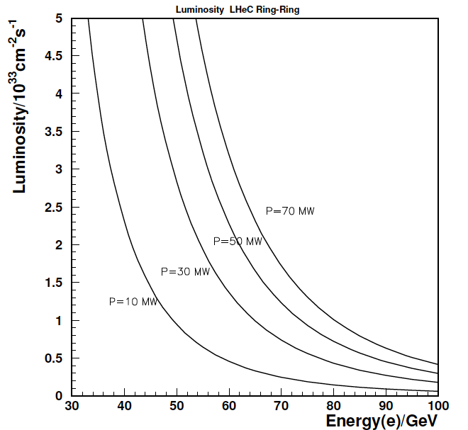
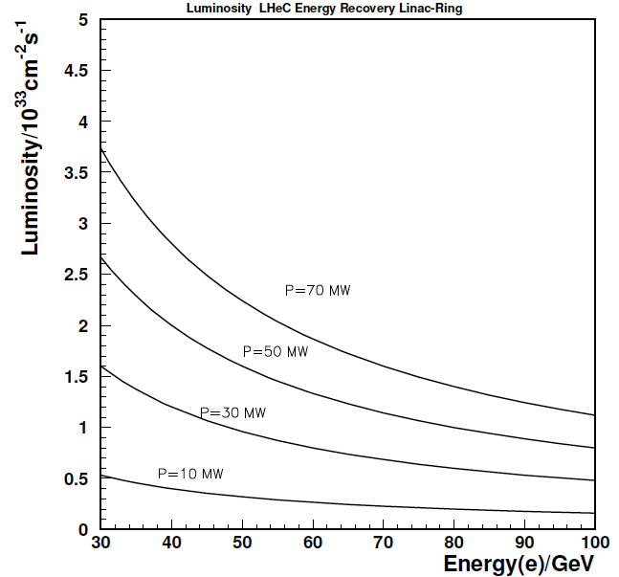
Design Considerations
LHC hadron beams: E_{p}=7 TeV; CM collision energy: E²_{CM} = 4 E_{e}* E_{p,A} ➔ 50 to 150GeV
Integrated e±p : O(100) fb⁻¹ ≈ 100 * L(HERA) → synchronous ep and pp operation
Luminosity O (10³³) cm⁻²s⁻¹ with 100 MW power consumption ➔ Beam Power < 70 MW
Start of LHeC operation together with HL-LHC in 2023 (installation in LS3 in 2022)
e Ring in the LHC tunnel (Ring-Ring - RR) Superconducting ERL (Linac-Ring -LR)
Luminosity - Energy & Power tradeoff
We chose 60GeV Beam Energy as reference case for comparison in the CDR
DIS13, 22nd – 26th April 2013
Oliver Brüning, CERN
4
4

Slide 5
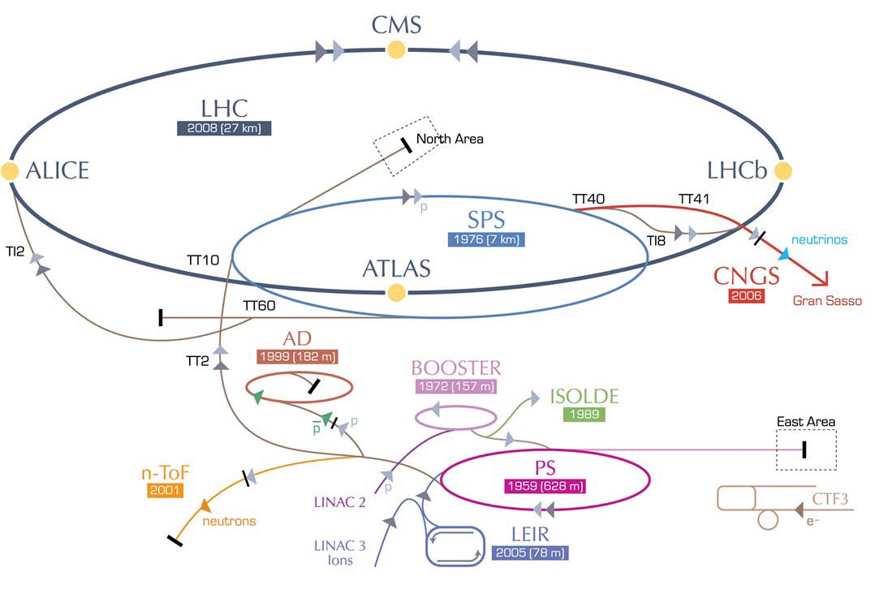
LHeC options: RR and LR
RR LHeC:
new ring in
LHC tunnel,
with bypasses
around
existing
experiments
RR LHeC
e-/e+ injector
10 GeV,
10 min. filling time
LR LHeC:
recirculating
linac with
energy
recovery,
or straight
linac
DIS13, 22nd – 26th April 2013
Oliver Brüning, CERN
5

Slide 6
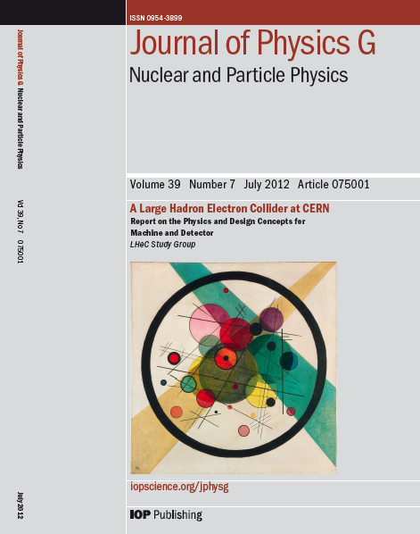
LHeC CDR
1. Design for synchronous ep and pp
operation (including eA) → after LS3
which is about 2025 – no firm schedule
exists for HL-LHC, but it may operate
until ~2035
2. LHeC is a new collider: the cleanest
microscope of the world, a complementary
Higgs facility, a unique QCD machine with
a striking discovery potential, with possible
applications as γγ → H or
injector to TLEPP or others
AND an exciting new accelerator project
3. CERN Mandate to develop key technologies
for the LHeC for project decision after start of
LHC Run II and in time for start parallel to
HL LHC phase
DIS13, 22nd – 26th April 2013
Oliver Brüning, CERN
6

Slide 7
CERN Mandate: 5 main points
The mandate for the technology development includes studies and prototyping of the following key technical components:
Superconducting RF system for CW operation in an Energy Recovery Linac (high Q₀ for efficient energy recovery) S
Superconducting magnet development of the insertion regions of the LHeC with three beams. The studies require the design and construction of short magnet models
Studies related to the experimental beam pipes with large beam acceptance in a high synchrotron radiation environment
The design and specification of an ERL test facility for the LHeC.
The finalization of the ERL design for the LHeC including a finalization of the optics design, beam dynamics studies and identificationof potential performance limitations
The above technological developments require close collaboration between the relevant technical groups at CERN and external collaborators.
Given the rather tight personnel resource conditions at CERN the above studies should exploit where possible synergies with existing CERN studies.
S.Bertolucci at Chavannes workshop 6/12 based on
CERN directorate’s decision to include LHeC in the MTP
DIS13, 22nd – 26th April 2013
Oliver Brüning, CERN
7

Slide 8
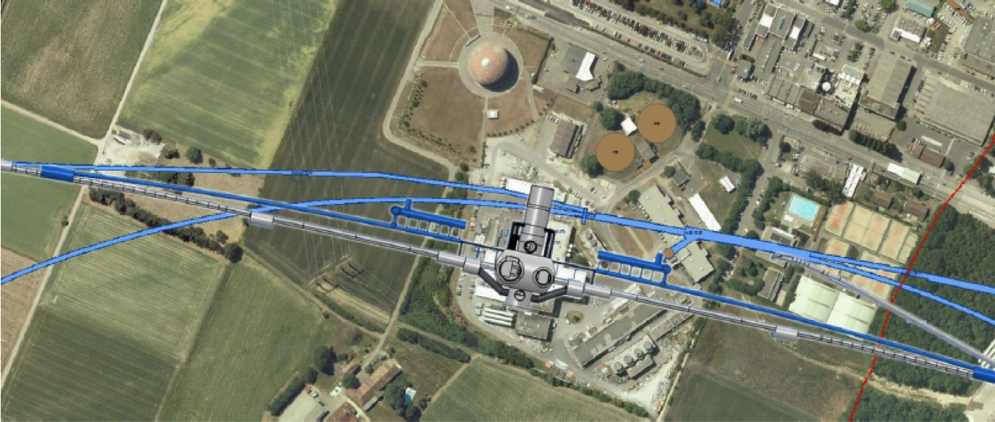
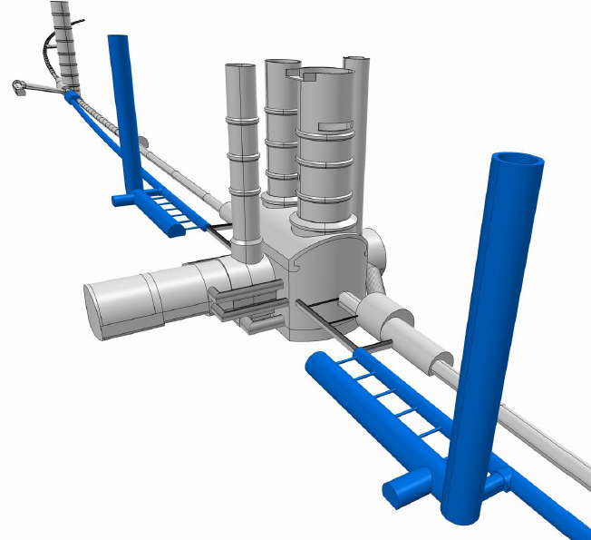
LHeC: Ring-Ring Option
Challenge 1: Bypassing the main LHC detectors
Without using the survey gallery the ATLAS bypass would need to be 100m away from the IP or on the inside of the tunnel!
For the CDR the
bypass concepts
were decided to be confined to
ATLAS and CMS
ca. 1.3 km long bypass
ca. 170m long dispersion free area for RF
DIS13, 22nd – 26th April 2013
Oliver Brüning, CERN
8

Slide 9
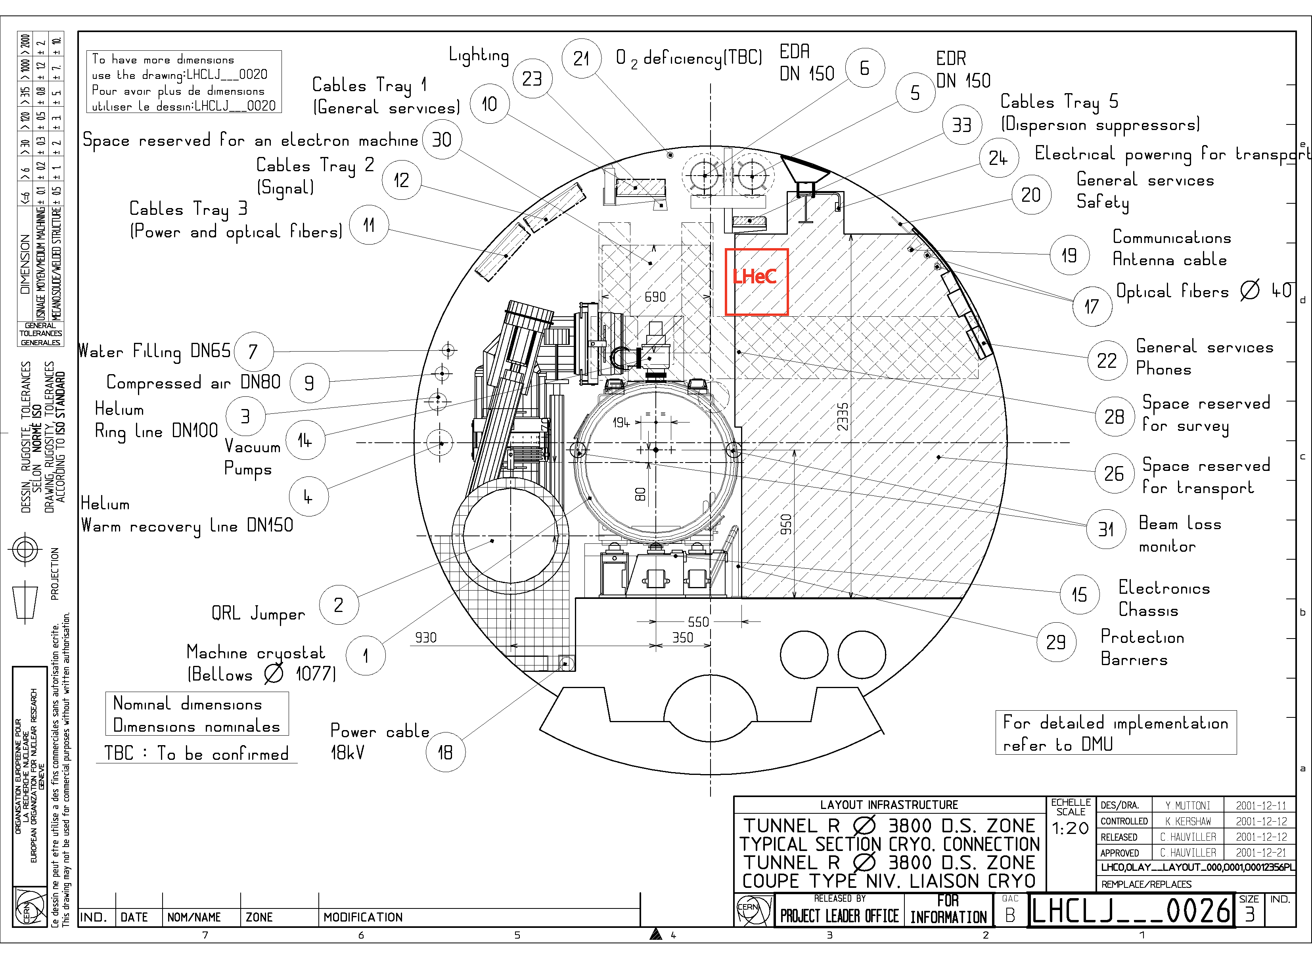
LHeC: Ring-Ring Option
Challenge 3: Installation with LHC circumference:
requires:
support
structure
with
efficient
montage
and
compact
magnets
DIS13, 22nd – 26th April 2013
Oliver Brüning, CERN
9

Slide 10
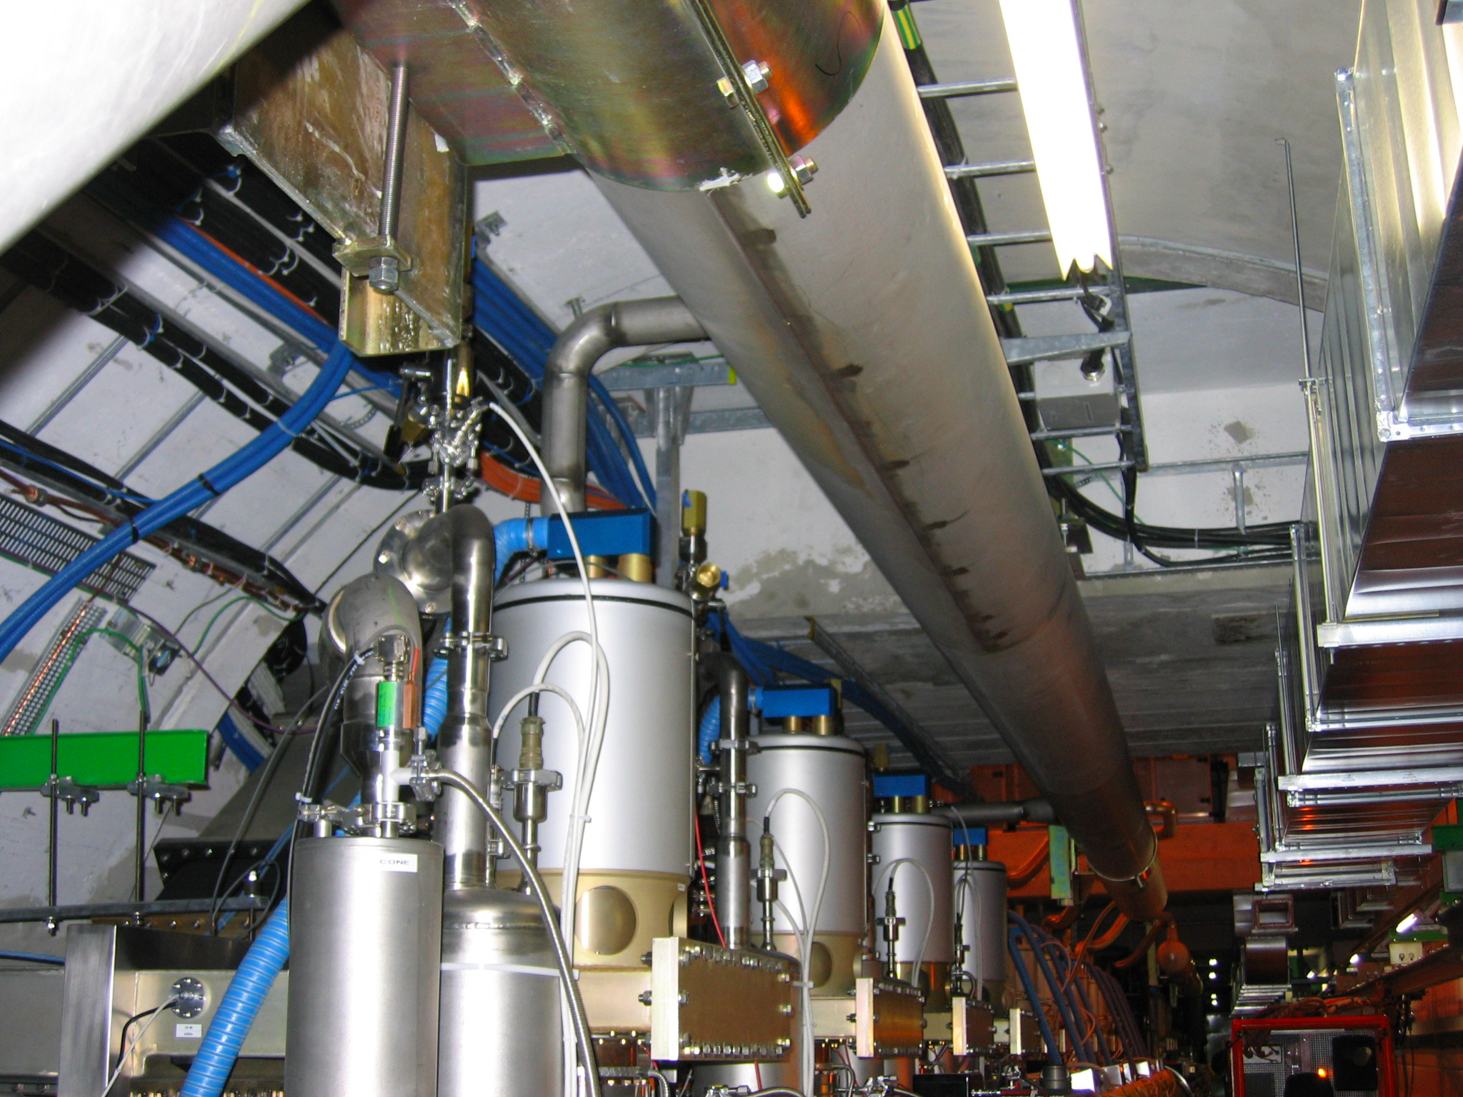
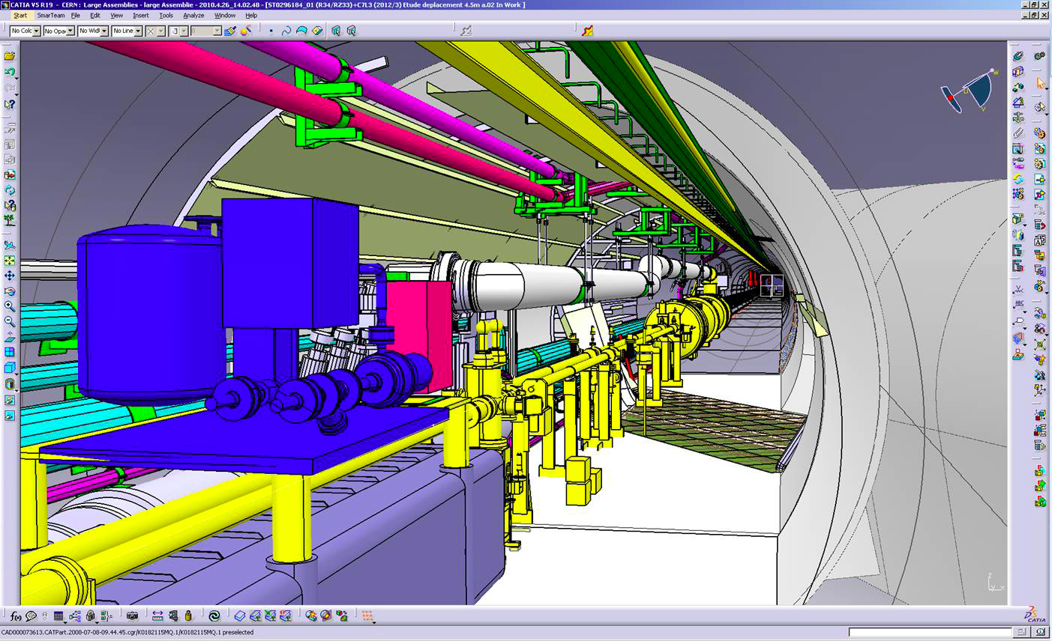
LHeC: Ring-Ring Option
Challenge 2: Integration in the LHC tunnel
RF Installation in IR4
No principal problem found yet!
(Still missing 3D integration study)
Cryo link in IR3
DIS13, 22nd – 26th April 2013
Oliver Brüning, CERN
10

Slide 11
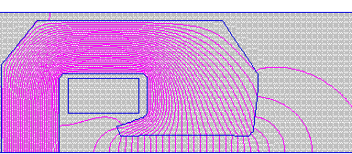
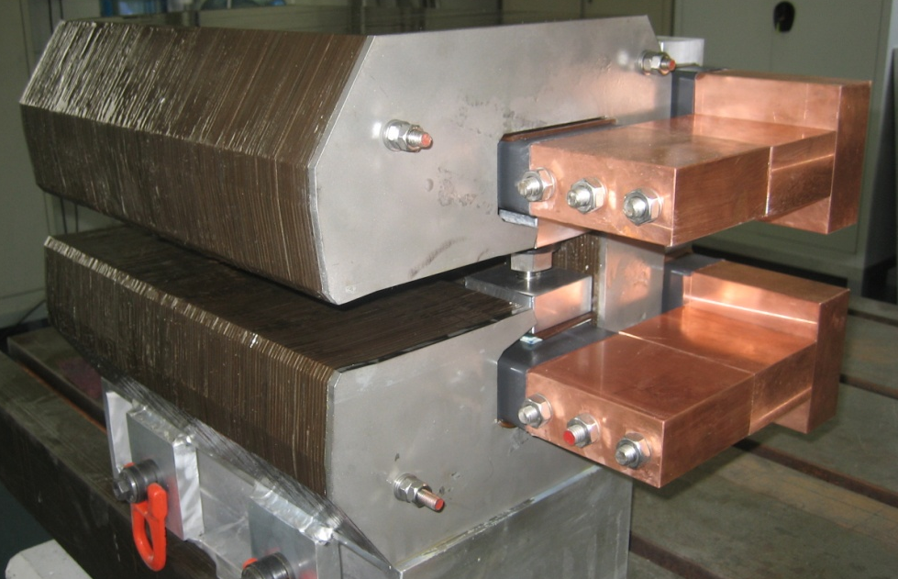
LHeC Ring-Ring dipole 400 mm long CERN model
interleaved ferromagnetic laminations
air cooled
two turns only, bolted bars
0.4 m models with different types of iron
Similar prototype development from Novosibirsk
➔ Long prototype with light magnet design shows that required field quality and reproducibility is feasible!
30 cm
[Davide Tommasini]
Magnet Parameters of the full length magnet
Beam Energy [GeV] | 70
Magnetic Length [m] | 5.45
Magnetic field [Gauss] | 127-763
Number of magnets | 3080
Vertical aperture [mm] | 40
Pole width [mm] | 150
Number of coils | 2
Number of turns/coil | 1
Current [A] | 1500
Conductor section [mmxmm] | 92x43
Conductor material | aluminum
Magnet Inductance [mH] | 0.15
Magnet Resistance [mΩ] | 0.2
Power per magnet [W] | 450
Cooling | air
Weight [tons] | 1.5
Manufacture & tests of 3 models
DIS13, 22nd – 26th April 2013
Oliver Brüning, CERN
11

Slide 12
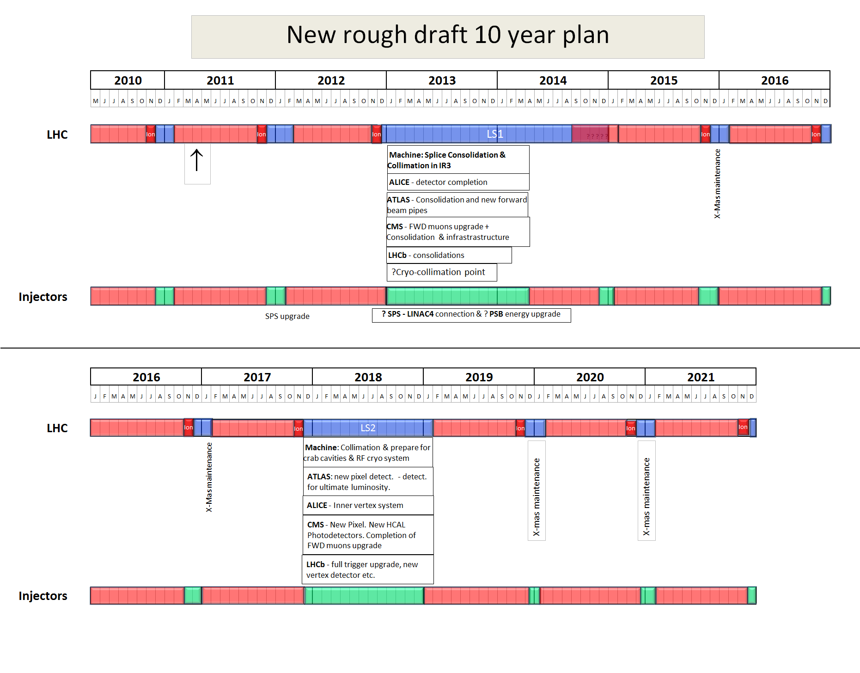
Current 10 Year Plan for LHC Operation
R-R Installation is very challenging within current schedule!
LS1 and LS2 are too soon to be used for LHeC activities inside LHC tunnel!
Leaves essentially only one long shutdown for LHeC installation!
2022
LS3
Installation of the HL-LHC hardware Installation of LHeC Preparation for HE-LHC
DIS13, 22nd – 26th April 2013
Oliver Brüning, CERN
12

Slide 13
LHeC: Linac-Ring Option Considered Various Layout Options
p-60
erl
1.67 km
LHC p
injector
0.34 km
dump
10-GeV linac
injector
30-GeV linac
IP
dump
2.0 km
Luminosity limited by power
High luminosity ➔ baseline
“least expensive"
LHC p
1.0 km
high
luminosity
p-140
10-GeV linac
IP
2.0 km
LHC p
3.9 km
Highest Energy but Luminosity limited by power and
Cost!
injector
70-GeV linac
IP
dump
high
energy
p-140’
7.8 km
IP
injector
140-GeV linac
dump
DIS13, 22nd – 26th April 2013
Oliver Brüning, CERN
13

Slide 14

LHeC: Baseline Linac-Ring Option
Challenge 1: Super Conducting Linac with Energy Recovery
& high current (> 6mA)
Two 1 km long SC
linacs in CW operation (Q > 10¹⁰)
requires Cryogenic
system comparable
to LHC system!
Installation fully decoupled from LHC operation!
Challenge 2: Relatively large return arcs
ca. 9 km underground tunnel installation
total of 19 km bending arcs
same magnet design as for RR option: > 4500 magnets
DIS13, 22nd – 26th April 2013
Oliver Brüning, CERN
14

Slide 15
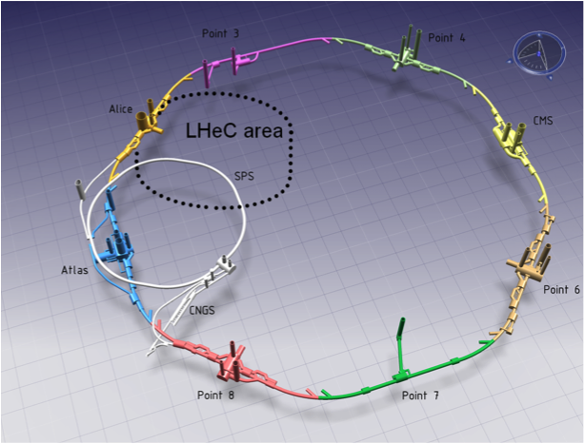
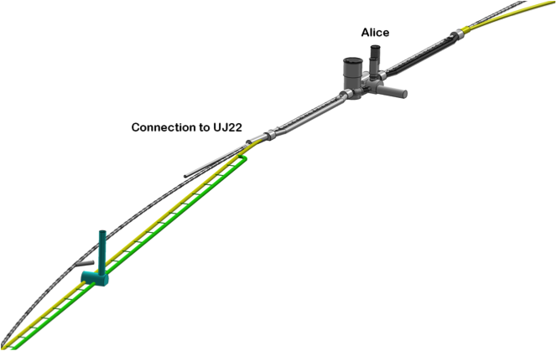
LINAC – Ring: connection to the LHC
LHeC CDR based on 721 MHz cavity design
But RF Frequency has been re-optimized after publication of the CDR!
800 MHz chosen after CDR
IP2
-944 cavities
-59 cryo modules per linac
-721 MHz, 21 MV/m CW
-Similar to SPL, ESS, XFEL, ILC,
eRHIC, Jlab
-24 - 39 MW RF power
-29 MW Cryo for 37W/m heat load
-4500 Magnets in the 2 * 3 arcs:
600 - 4m long dipoles per arc
240 - 1.2m long quadrupoles per arc
Linac (racetrack)
inside the LHC for
access at CERN
Territory
U=U(LHC)/3=9km
DIS13, 22nd – 26th April 2013
Oliver Brüning, CERN
15

Slide 16
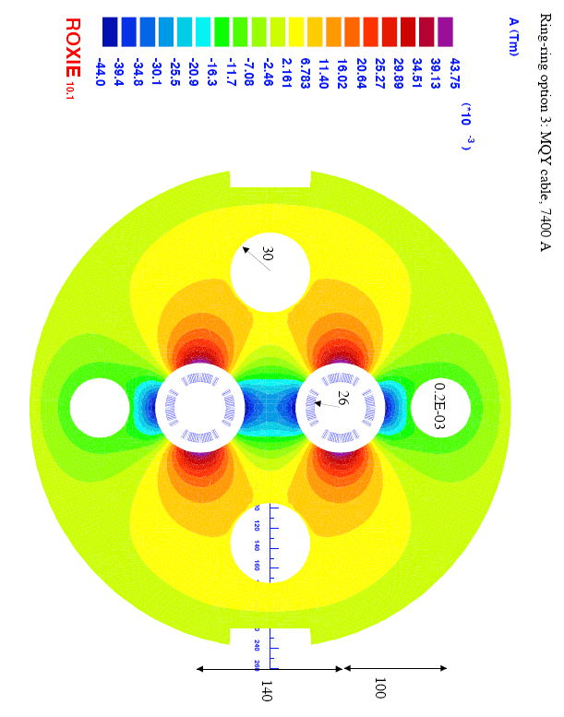
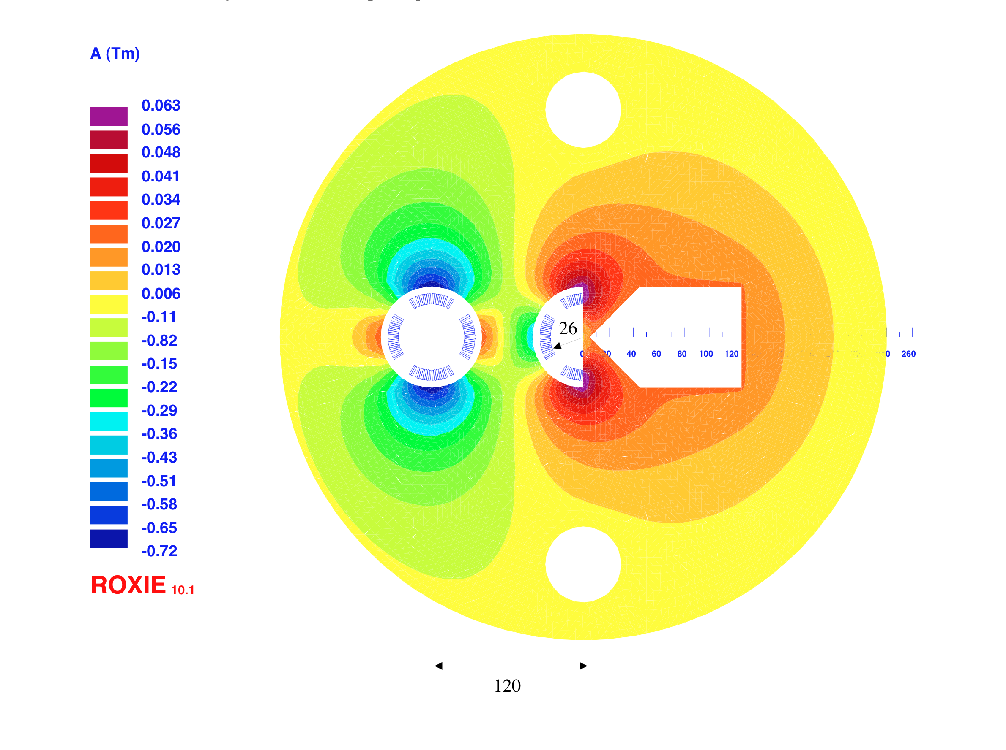
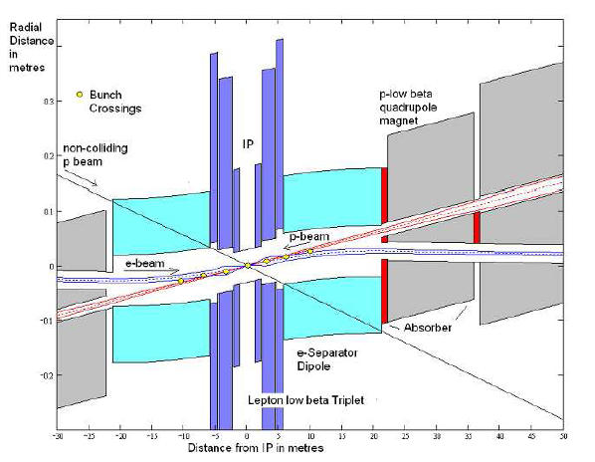
Interaction Region: Accommodating 3 Beams
Small crossing angle of about 1mrad to avoid first parasitic crossing (L x 0.77)
(Dipole in detector? Crab cavities? Design for 25ns bunch crossing [50ns?]
Synchrotron radiation –direct and back, absorption … recall HERA upgrade…)
First conceptual SC magnet designs exist
But: Still requires additional design work and R&D!
Synergies with HL-LHC triplet development!
Focus of current activity
1st sc half quad (focus and deflect)
separation 5cm, g=127T/m, MQY cables, 4600 A
2nd quad: 3 beams in horizontal plane
separation 8.5cm, MQY cables, 7600 A
DIS13, 22nd – 26th April 2013
Oliver Brüning, CERN
16

Slide 17
LHeC Planning and Timeline
We assume the LHC will reach end of its lifetime with the end of the HL-LHC project:
-Goal of integrated luminosity of 3000 fb⁻¹ with 200fb⁻¹ to 300fb⁻¹ production per year ➔ ca. 10 years of HL-LHC operation
-Current planning based on HL-LHC start in 2022
➔ end of LHC lifetime by 2032 to 2035
LHeC operation:
-Luminosity goal based on ca. 10 year exploitation time (➔100fb⁻¹)
-LHeC operation beyond or after HL-LHC operation will imply
significant operational cost overhead for LHC consolidation
DIS13, 22nd – 26th April 2013
Oliver Brüning, CERN
17

Slide 18
LHeC Options: Executive Summary
Ring-Ring option:
-We know we can do it: ➔ LEP 1.5
-Challenge 1: integration in tunnel and co-existence with LHC HW
-Challenge 2: installation within LHC shutdown schedule
Linac-Ring option:
-Installation decoupled from LHC operation and shutdown planning
-Infrastructure investment with potential exploitation beyond LHeC
-Challenge 1: technology ➔ high current, high energy SC ERL
-Challenge 2: Positron source
DIS13, 22nd – 26th April 2013
Oliver Brüning, CERN
18

Slide 19
LHeC CDR:
Details remain to be addressed
Decision to focus R&D work on LR
technologies over coming 4 years
Main Conclusion so far:
            LHeC can be realized in parallel with HL-LHC if necessary studies are not delayed!
Total of ca. 500 pages: Detailed coverage of many topics:
Accelerator: Sources
        Damping rings and injector complex
        Injection and injector complex
        Collective effects and Beam-Beam
        Cryogenic system
        Polarization
        Beam Dump
        Vacuum
        Power generation and distribution, etc…..
➔ LHeC-Note-2011-003 GEN
DIS13, 22nd – 26th April 2013
Oliver Brüning, CERN
19

Slide 20
LINAC: Beam Dynamics Issues
Has been studied for the linacs only
  Arcs need to be included
  Only analytics estimates used
Continuous beam would trap ions in the linacs
  This would lead to unstable beam
One 10μs long gap in beam prevents long-term trapping
  Rise time of instability during the train between gaps seems to be acceptable (10 turns)
Full study needed
  Arcs will make instability worse
  Ions are not completely lost during one passage of the gap
  But the frequency of the induced instability varies along the machine, which helps
DIS13, 22nd – 26th April 2013
Oliver Brüning, CERN
20

Slide 21
Post CDR Studies: ERL Beam Dynamics
Beam Instabilities:
➔ Optimum choice for LHeC RF frequency?
Daniel Schulte @ LHeC Seminar 12. March 2013
Increased bunch charge
To allow for ion-clearing gaps
N=3 10⁹
Note: bunches were placed in the gaps
F_{rms}=1.05 for ILC cavity
F_{rms}=1.001 for SPL cavity
Beam is stable for both cases but more margins for lower RF frequency
DIS13, 22nd – 26th April 2013
Oliver Brüning, CERN
21

Slide 22
Post CDR Studies: ERL Beam Dynamics
Beam-Beam effects:
➔ Optimum choice for LHeC RF frequency?
Daniel Schulte @ LHeC Seminar 12. March 2013
N=3 10⁹
Beam-beam effect included
as linear kick
Result depends on seed for frequency spread
“worst” of ten seed shown
F_{rms}=1.135 for ILC cavity
F_{rms}=1.002 for SPL cavity
Beam is stable but very small margin with 1.3GHz cavity
DIS13, 22nd – 26th April 2013
Oliver Brüning, CERN
22

Slide 23
Post CDR Studies: RF Frequency
Review of the SC RF frequency:
-HL-LHC bunch spacing requires bunch spacing with multiples of
25ns (40.079 MHz)
Frequency choice: h * n* 40.079 MHz
Symmetry in ERL: n=3 ➔ h * 120.237 MHz
h=6: 721 MHz or h=11: 1.323GHz
SPL & ESS: 704.42 MHz; ILC & XFEL: 1.3 GHz
Frequencies are slightly different (20MHz) from existing technologies! But having the harmonic number be a multiple of the ERL symmetry is not a strong requirement ➔ asymmetric bunch patterns
DIS13, 22nd – 26th April 2013
Oliver Brüning, CERN
23

Slide 24
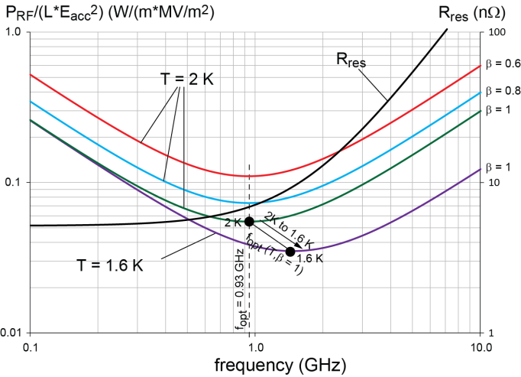
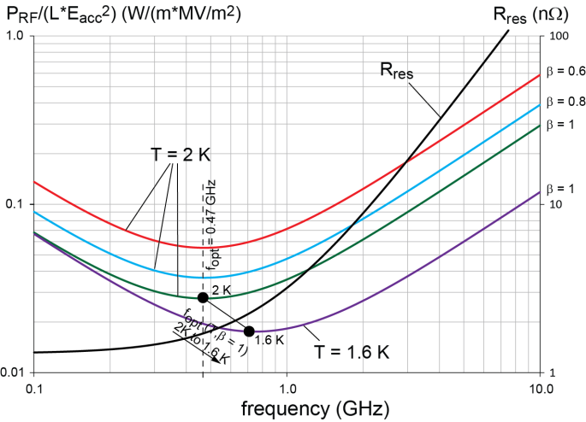
Optimum RF Frequency: Power Considerations
Results from F. Marhauser
Small-grain (normal) Nb:
Optimum frequency at 2K between 700 MHz and 1050 MHz
Lower T shift optimum f upwards
Large-grain Nb:
Optimum frequency at 2K between 300 MHz and 800 MHz
Lower T shift optimum f upwards
DIS13, 22nd – 26th April 2013
Oliver Brüning, CERN
24

Slide 25
Optimum RF Frequency: around 800 MHz
Erk Jensen @ March 2013 LHeC Seminar
F_{RF} = 20* 40.079 MHz ➔ 801.58 MHz
  Buckets with slightly unevenly spaced bunches
  One could vary the number of passes through the ERL:
Synergy with HL-LHC: Higher Harmonic RF System and TLEP!
1st pass
2nd pass
3rd pass
1st pass
1st pass
2nd pass
3rd pass
4th pass
1st pass
DIS13, 22nd – 26th April 2013
Oliver Brüning, CERN
25

Slide 26
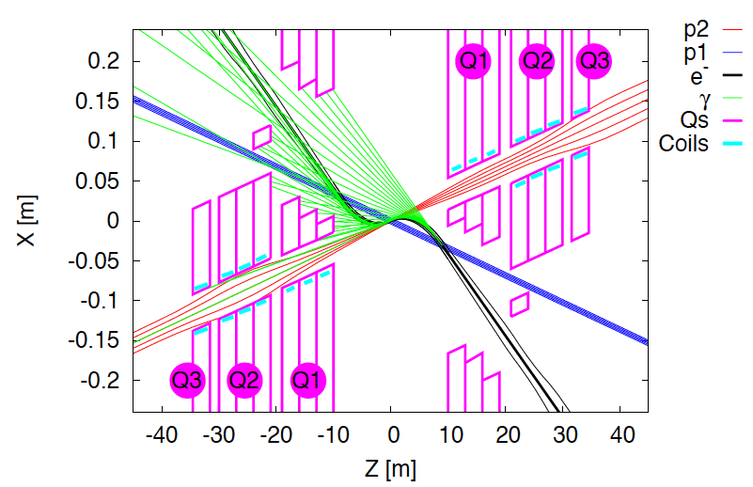
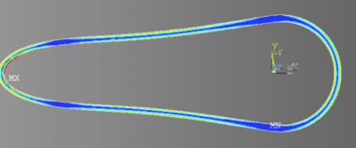
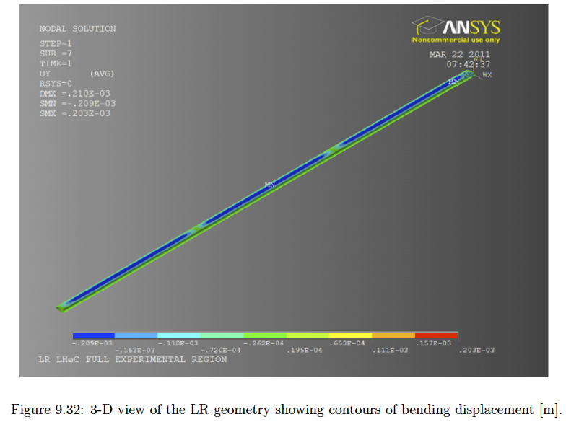
Next Steps: Interaction Region Design
Beam pipe: in CDR 6m, Be, ANSYS calculations
Composite material R+D, prototype, support..
→ Essential for tracking, acceptance and Higgs
Have optics compatible with LHC ATS optics and β*=0.1m
Head-on collisions mandatory →
High synchrotron radiation load, dipole in detector
Adapt LHeC to LHC ATS optics
Specification of Q1 – NbTi prototype
Revisit SR (direct and backscattered),
Masks+collimators
Beam-beam dynamics and 3 beam operation studies
DIS13, 22nd – 26th April 2013
Oliver Brüning, CERN
26

Slide 27
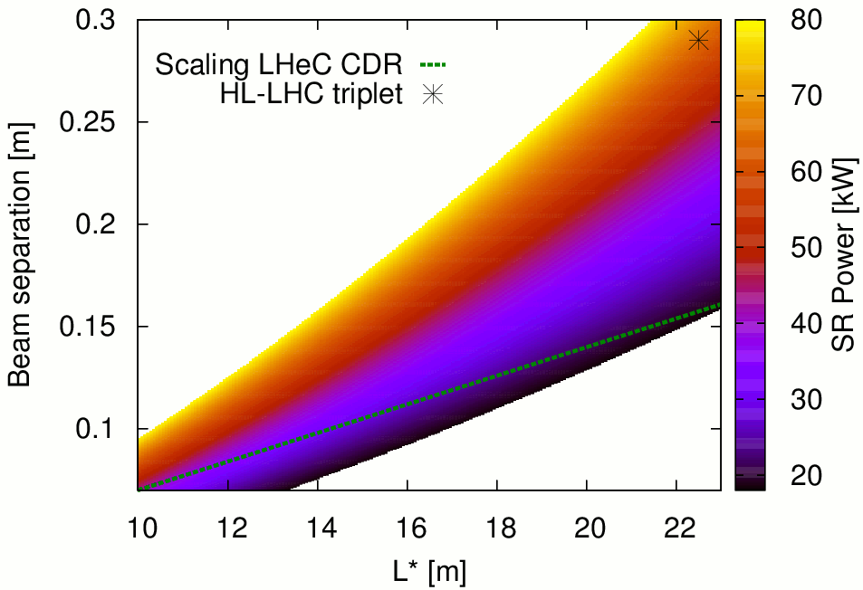
Interaction Region Design
Final parameter set will be developed as we gain experience with LHC operational (beam-beam, spacing etc.)
Performance reach of L = 10³⁴ cm⁻²s⁻¹ seems to be well within reach of the LHeC!
DIS13, 22nd – 26th April 2013
Oliver Brüning, CERN
27

Slide 28
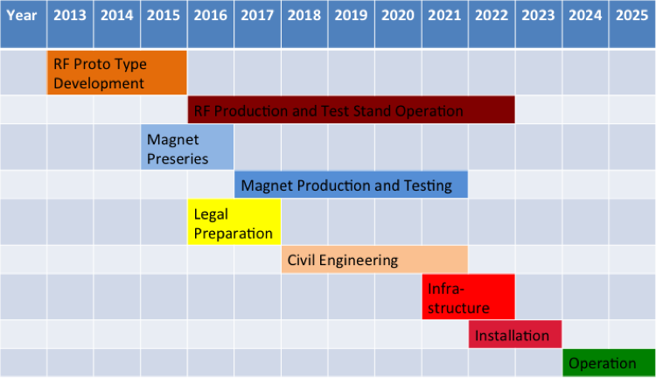
LHeC Tentative Time Schedule
LHeC Project is still on track for startup with HL-LHC:
-10 years for the LHeC from CDR to project start.
(Other smaller projects like ESS and PSI XFEL plan for 8 to 9
years [TDR to project start] and the EU XFEL plans for 5 years
from construction to operation start)
HERA required ca.10 years from proposal to completion
On schedule for launching SC RF development
➔ Synergies with HL-LHC and TLEP
LS3 --- HL LHC
DIS13, 22nd – 26th April 2013
Oliver Brüning, CERN
28
28

Slide 29
2022
LS3
Installation of the HL-LHC hardware Installation of LHeC Preparation for HE-LHC
DIS13, 22nd – 26th April 2013
Oliver Brüning, CERN
29

Slide 30
LHeC: Post CDR Plans
Launch SC RF and ERL R&D and Establish collaborations:
-SC RF R&D has direct impact on cryo power consumption
  -Synergy with HL-LHC and TLEP!
-ERL is a hot topic with many applications
  -Synergy with national research plans: e.g. MESA
Magnet R&D activities:
-Normal conducting compact magnet design ✔
-Superconducting IR magnet design
  Detailed magnet design depends on IR layout and optics
  Optics & IR magnet design influence experimental vacuum beam pipe
DIS13, 22nd – 26th April 2013
Oliver Brüning, CERN
30

Slide 31
LHeC: Post CDR Plans
Develop an ERL test facility @ CERN:
-Beam Dynamics for ERL operation ➔ develop expertise at CERN
-Synergy with other research plans: SC RF and TLEP
DIS13, 22nd – 26th April 2013
Oliver Brüning, CERN
31

Slide 32
Next Steps: RF Prototype and Test Facility
Develop 2 RF Cryomodule Prototypes over the nest 3 years
-LHeC RF frequency choice driven by power considerations
  Choice of ERL RF frequency: 801.58 MHz
  ➔ Synergy with HL-LHC and Higher Harmonic RF system!
Design an ERL test facility @ CERN:
-Optimize magnet design for ERL return arcs
Optimize and Iterate on LHeC ERL layout:
-Optimization of linac configuration & of number of passages
-Optimization of Civil Engineering layout
-Optimization of Interaction Region (L*) and Synchroton Light
DIS13, 22nd – 26th April 2013
Oliver Brüning, CERN
32

Slide 33
Reserve Transparencies
DIS13, 22nd – 26th April 2013
Oliver Brüning, CERN
33
33

Slide 34
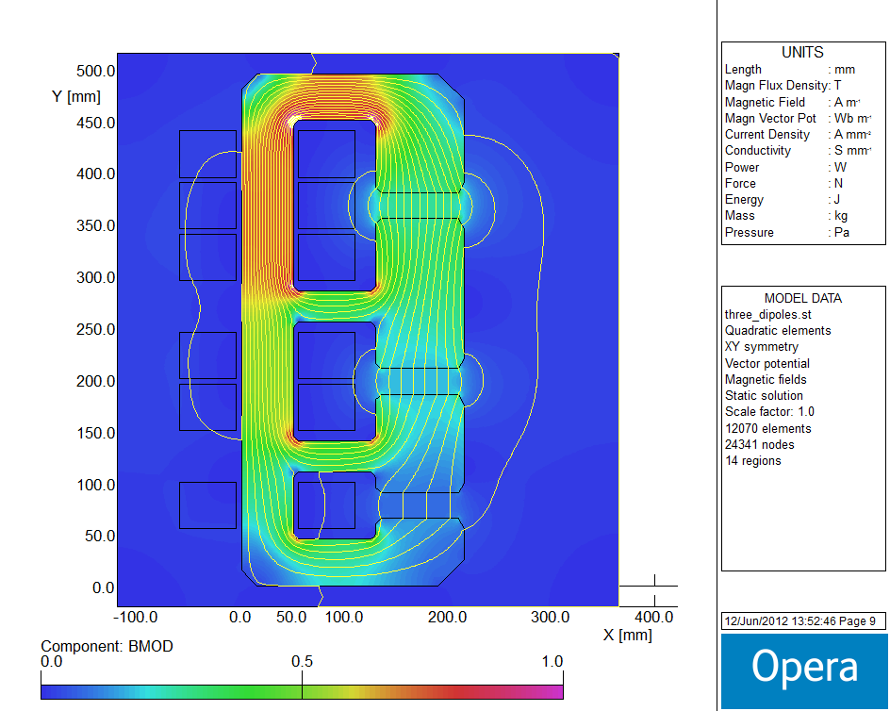
Next Steps: Test Facility and Magnets
First conceptual cross-section
flux density in the gaps | 0.264 T 0.176 T 0.088 T
magnetic length | 4.0 m
vertical aperture | 25 mm
pole width | 85 mm
number of magnets | 584
current | 1750 A
number of turns per aperture | 1 / 2 / 3
current density | 0.7 A/mm²
conductor material | copper
resistance | 0.36 mΩ
power | 1.1 kW
total power 20 / 40 / 60 GeV | 642 kW
cooling | air
Oliver Brüning, CERN
DIS13, 22nd – 26th April 2013
34

Slide 35
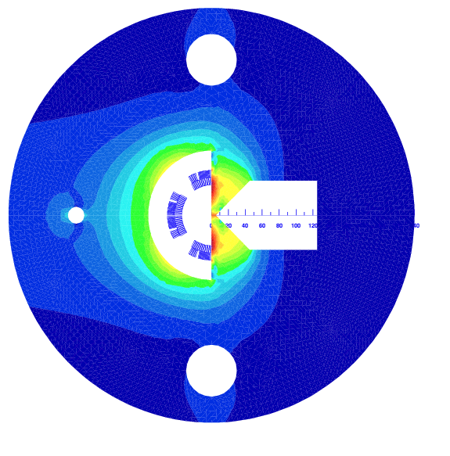
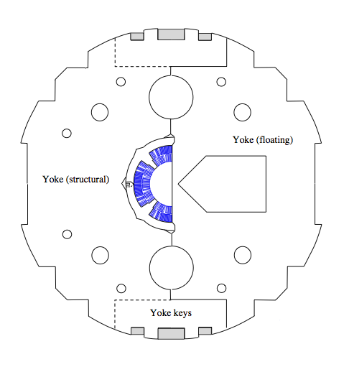
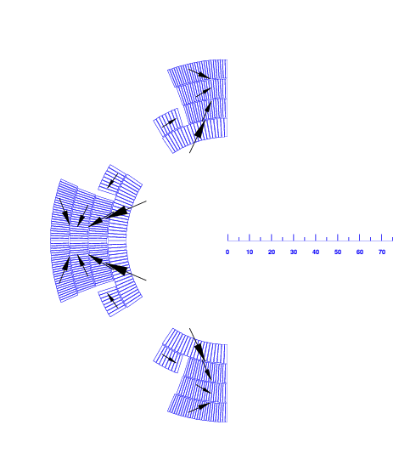
Next Steps: LHeC IR Quadrupole
Luca Bottura @
Chamonix 2012
Half-quad with field-free region, assembled using MQXC coils
  2.5 FTE
  500 kCHF
  approx. 2 years till test
Large forces on the magnetic wedge
(> 50 tons/m)
DIS13, 22nd – 26th April 2013
Oliver Brüning, CERN
35

Slide 36
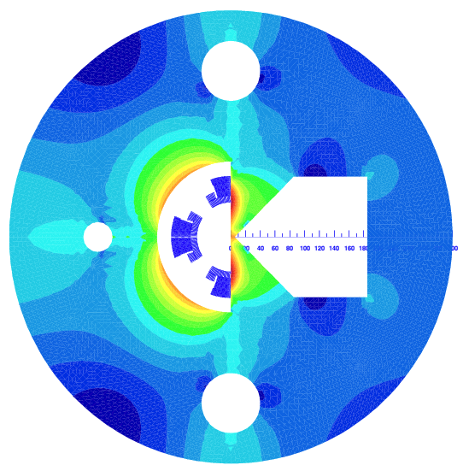
IR magnets
Luca Bottura @ Chamonix 2012
Ring-ring
  G=140 T/m
  A=70 mm
  B_{fringe} = 30 mT
  O(15) kW SR power in the proton aperture
NbTi suitable for this medium gradient option
Mechanics ?
Heat removal ?
Linac-Ring
  G=250-300 T/m
  A=90 mm
  B_{fringe} = 500 mT
  O(2) kW SR power in the proton aperture
100 tons/m
NbTi or Nb3Sn ?
Large aperture ?
Mechanics ?
Heat removal ?
By courtesy of S. Russenschuck

Slide 37
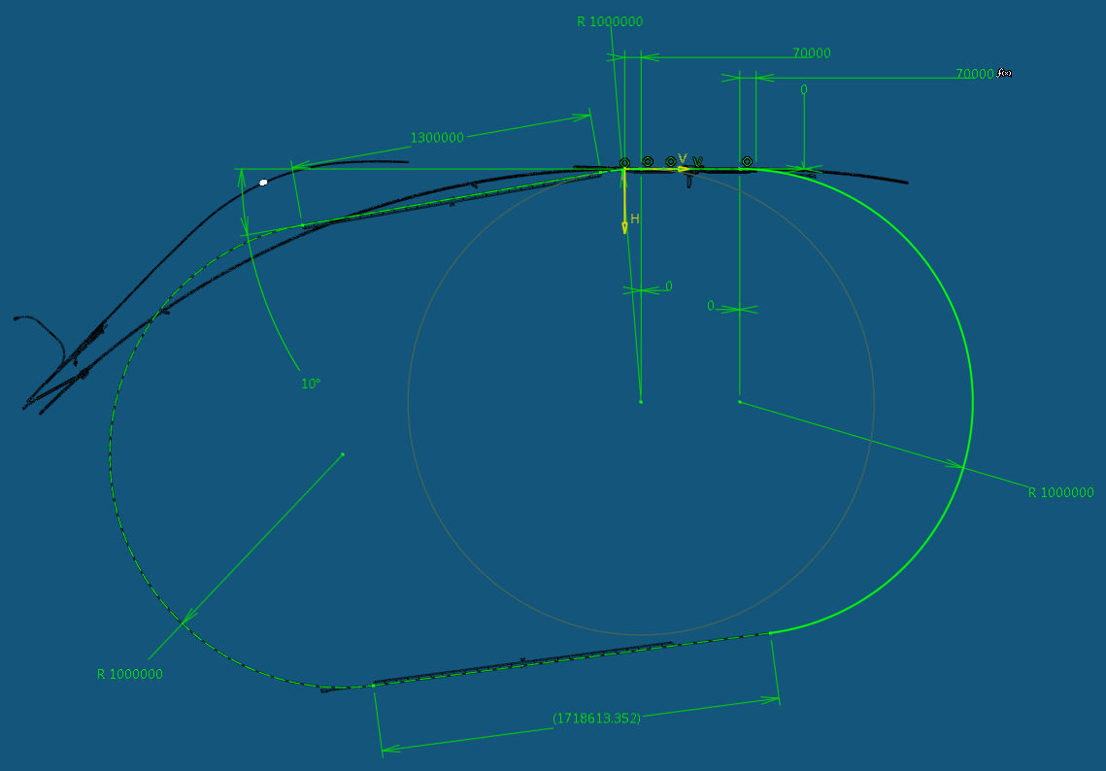
Next Steps: ERL Layout Finalization
J. Osborne
IP
Arc 6 (60 GeV)
Arc5 (50 GeV)
DIS13, 22nd – 26th April 2013
Oliver Brüning, CERN
37

Slide 38





















LHeC - Participating Institutes: A very rich collaboration
TOBB ETU
KEK

Slide 39
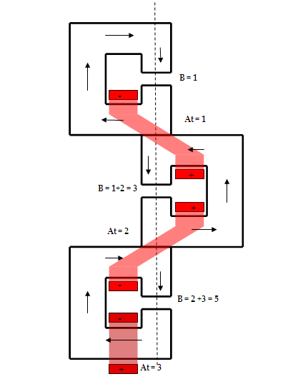
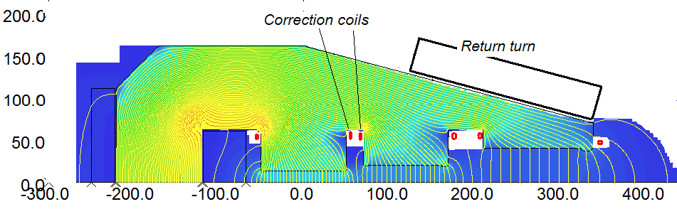
Next Steps: Test Facility and Magnets
Intend to build Collaboration of CERN Magnet
Group for the dipole and possibly further arc
magnets for the Test Facility (two turns)
and the LHeC.
Initial designs for Linac magnets in CDR and
further discussions/thoughts from Daresbury,
CERN and BINP colleagues.
Attilio Milanese and Yuri Pupkov 11/12
Neil Marks 7/12
DIS13, 22nd – 26th April 2013
Oliver Brüning, CERN
39

Slide 40
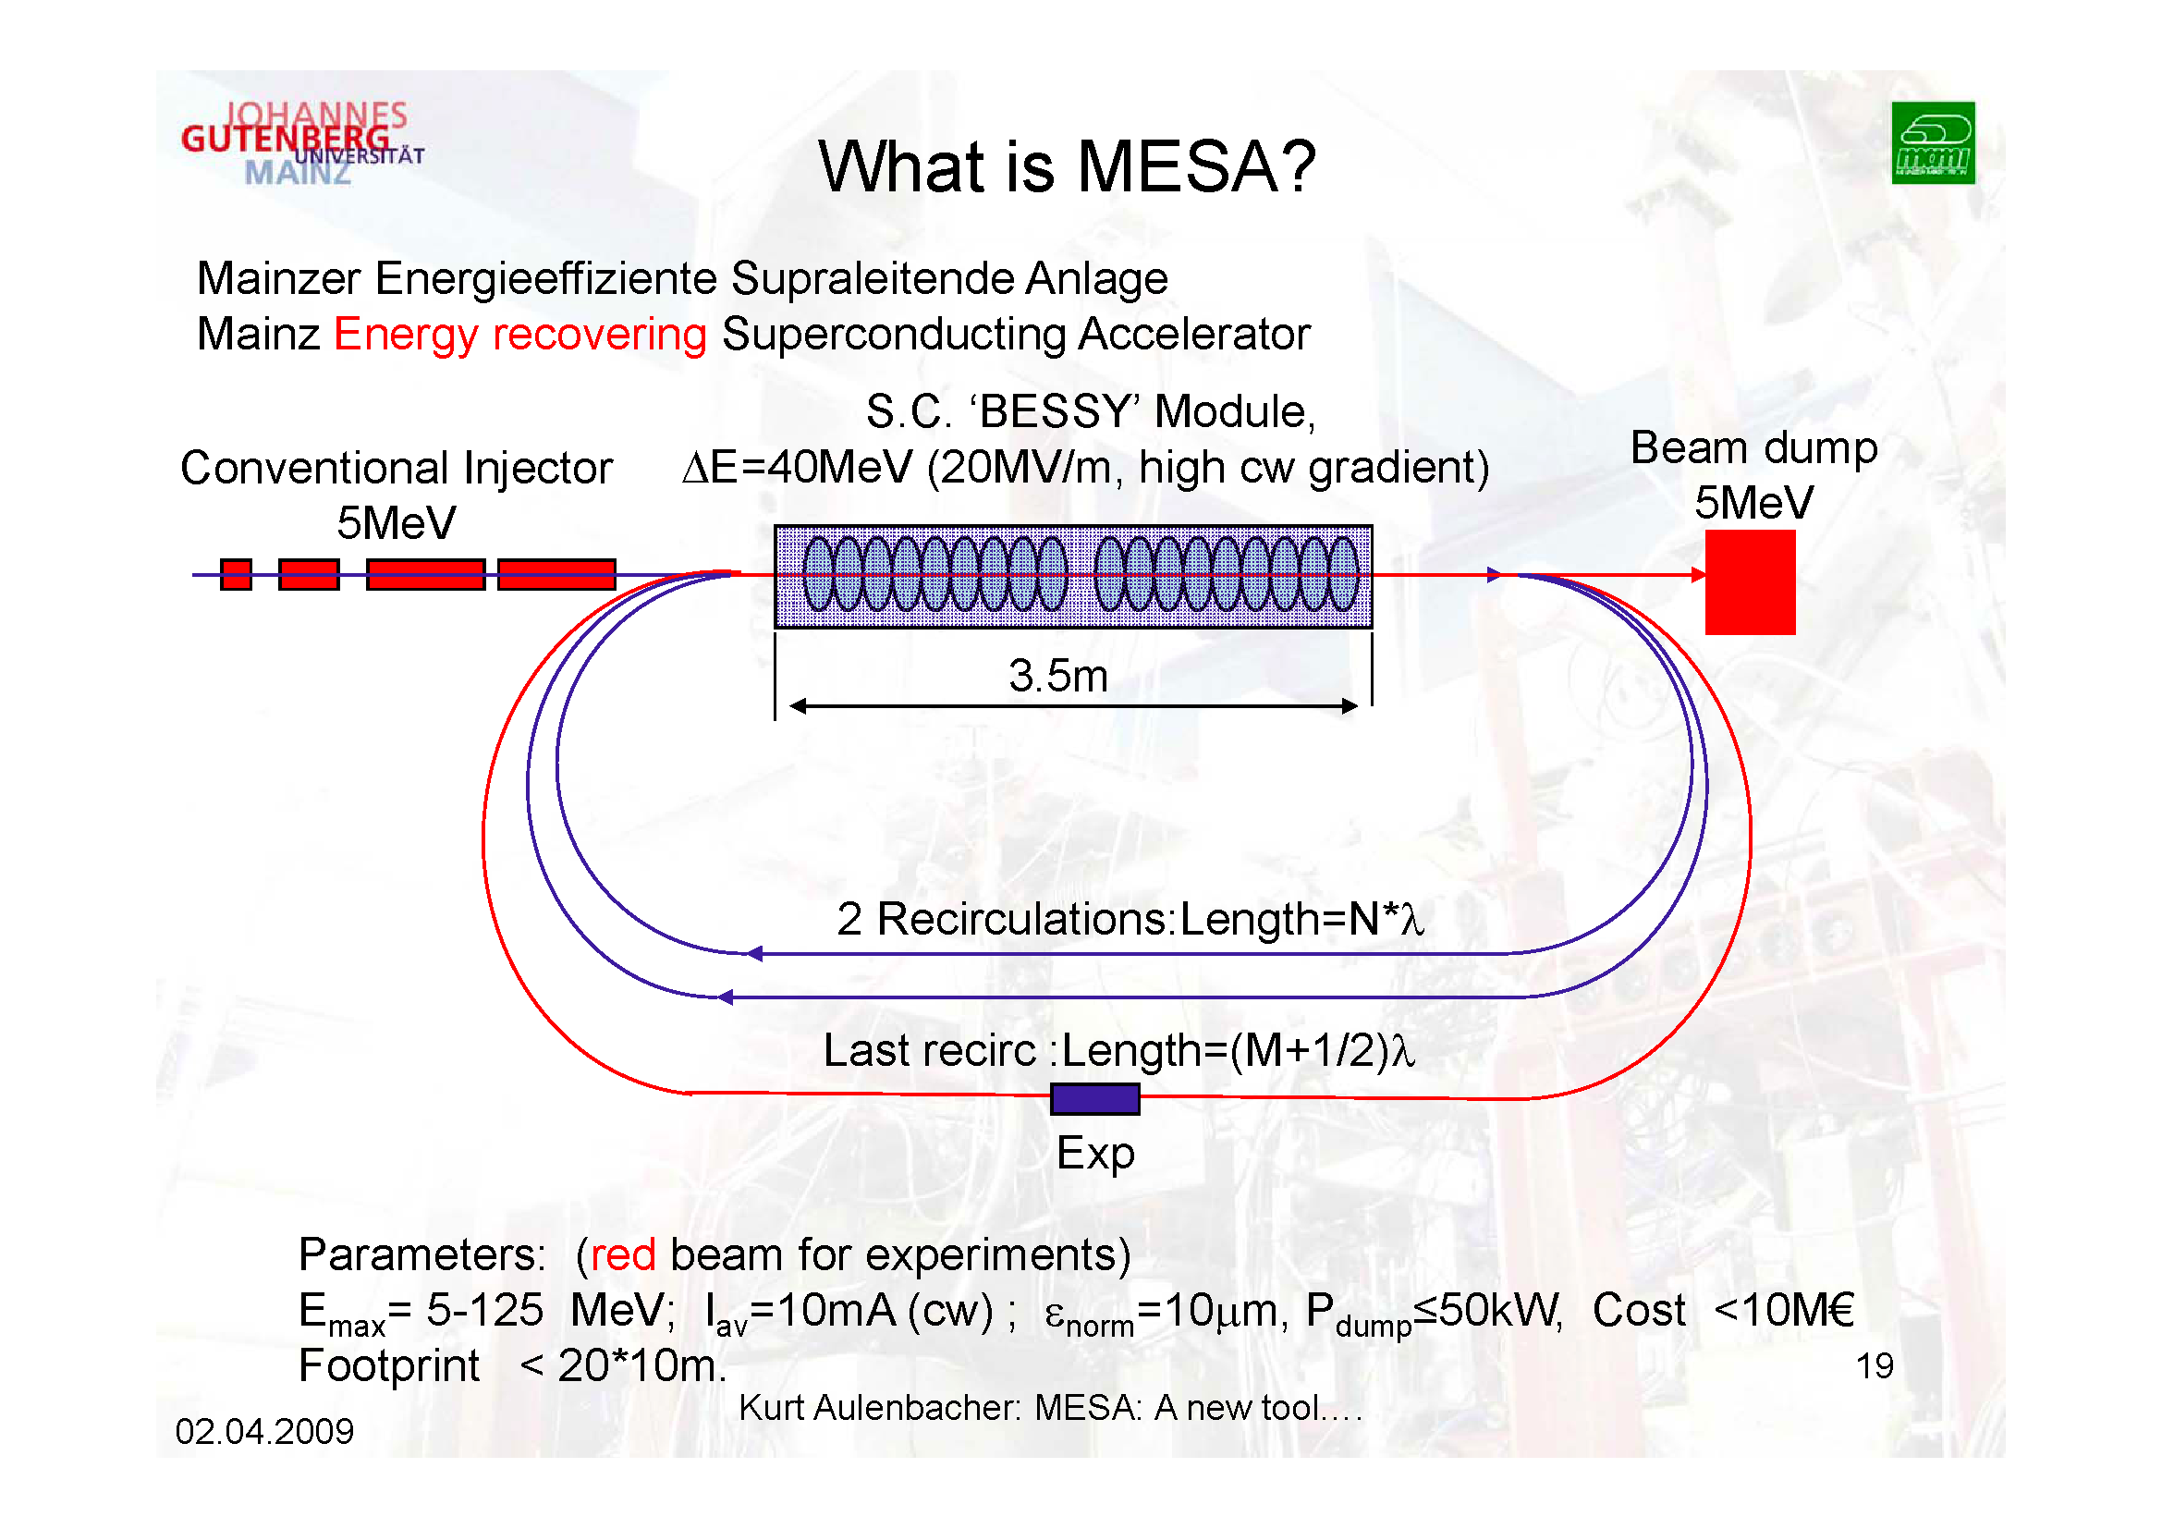
MESA Project at MAMI Mainz
MESA
40

Slide 41
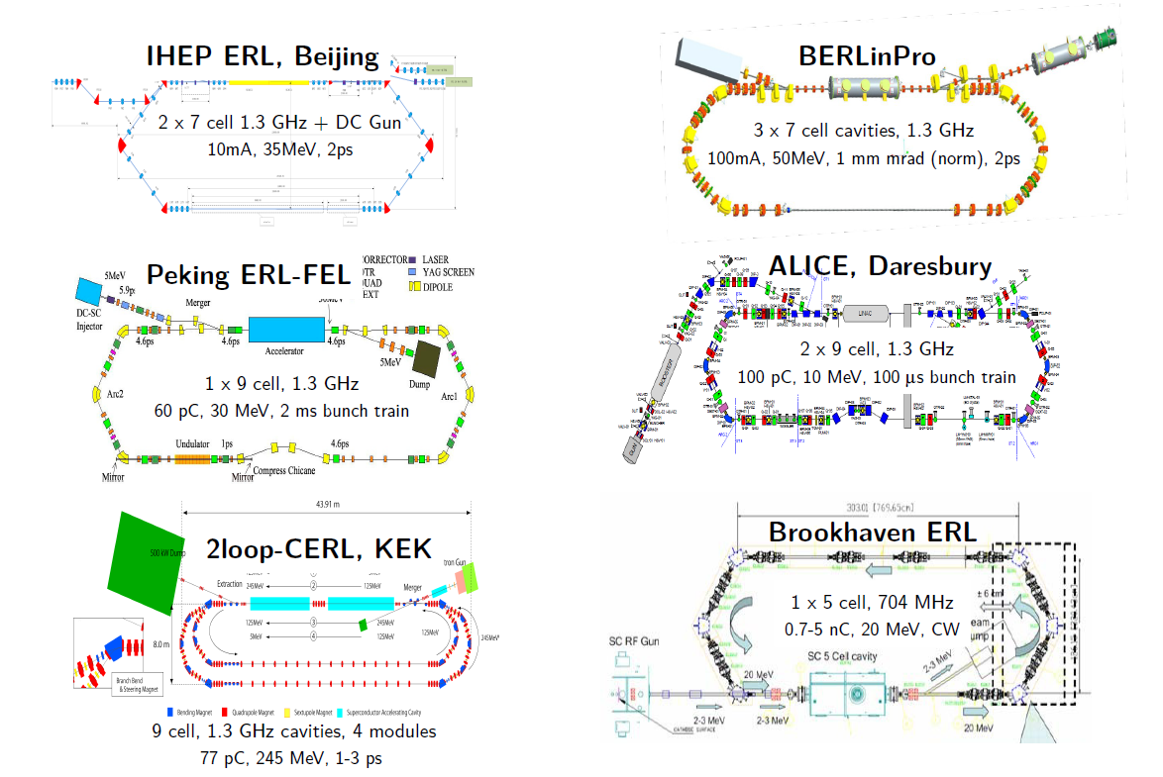
ERL Facilities around the World
Planned Test Facilities and Installations:
Frequency choice!
41

Slide 42
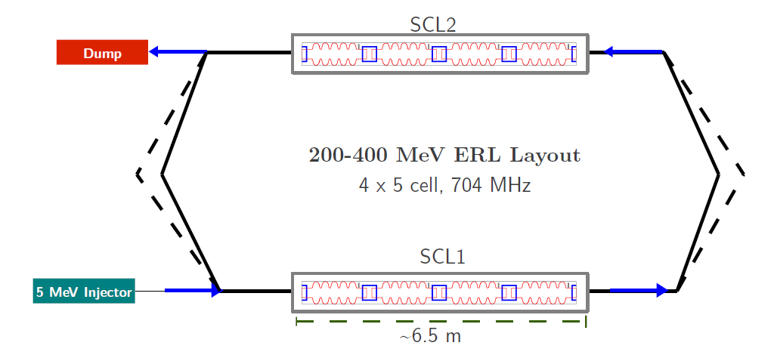
ERL Test Facility at CERN
Erk Jensen
Potential layout:
42

Slide 43
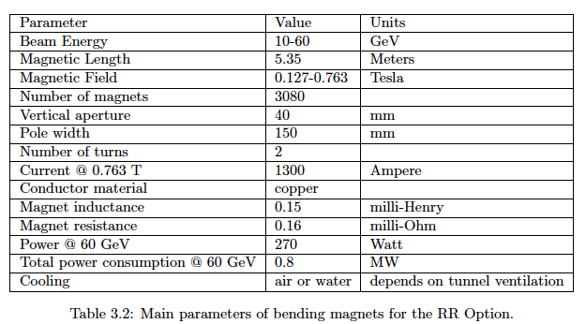
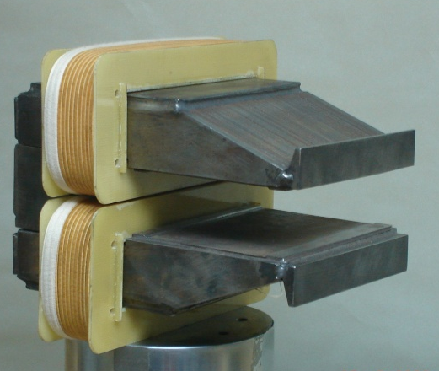
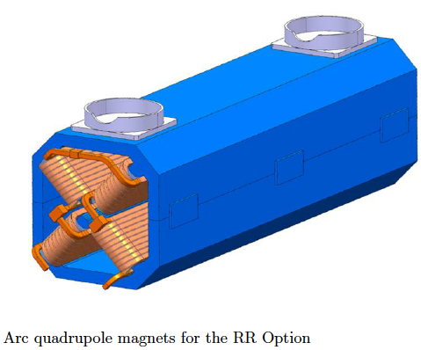
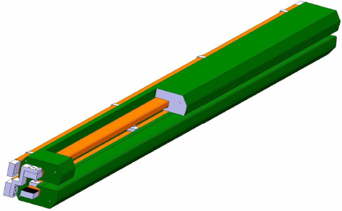
Ring: Dipole + Quadrupole Magnets
BINP &
CERN
prototypes
5m long
(35 cm)²
slim + light
for installation
736 magnets
1.2 m long

Slide 44
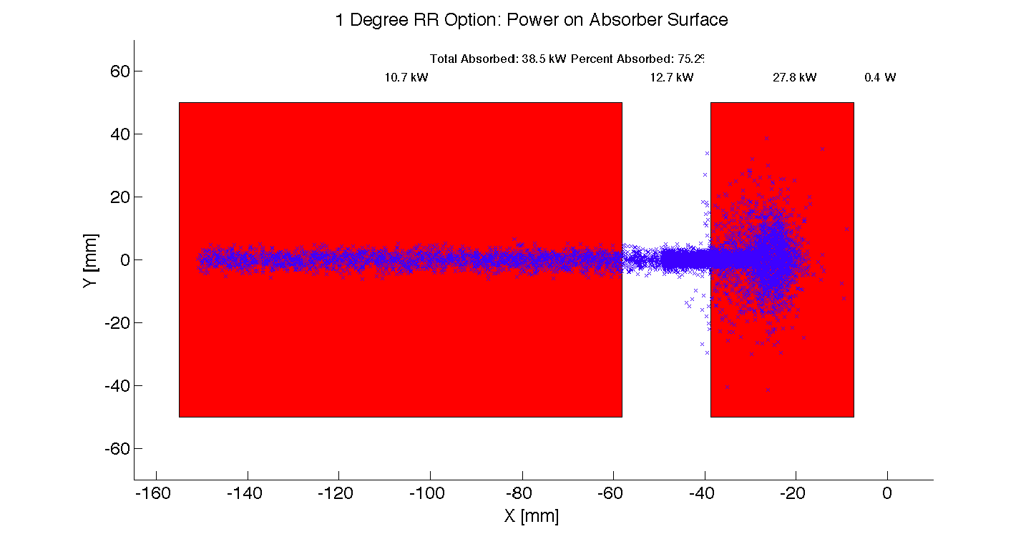
Interaction Region: Synchrotron Radiation
Significant power: > 20 kW. Example Ring-Ring
Focus of current activity
First design of SR masks exists.
But still require more detailed vacuum and background studies for such high SC radiation power.
DIS13, 22nd – 26th April 2013
Oliver Brüning, CERN
44

Slide 45
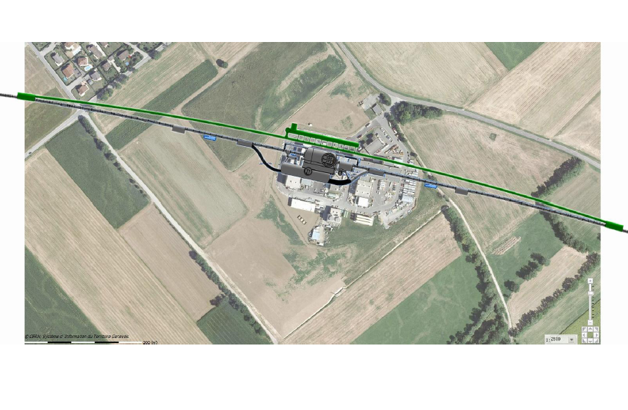
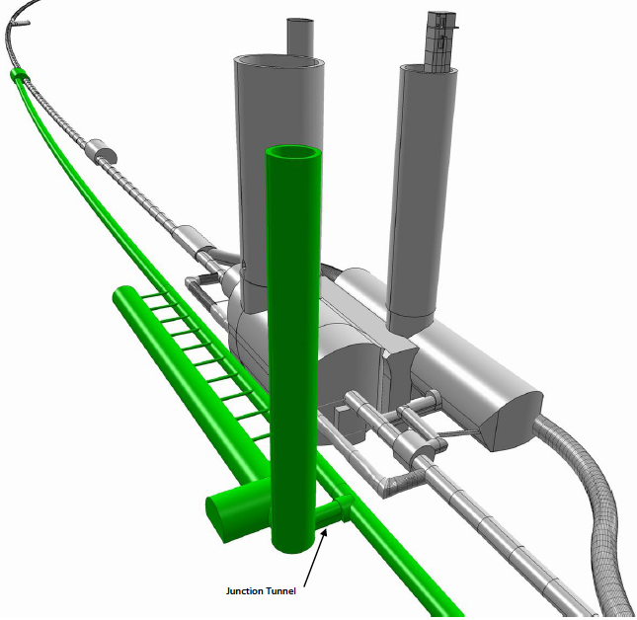
Bypassing CMS: 20m distance to Cavern
RF
ca. 1.3 km long bypass
ca. 300m long dispersion free area for RF installation
DIS13, 22nd – 26th April 2013
Oliver Brüning, CERN
45

Slide 46
Design Parameters
electron beam | RR** | LR | LR*
e- energy at IP[GeV] | 60 | 60 | 140
luminosity [10³² cm⁻²s⁻¹] | 0.9 | 10 | 0.44
polarization [%] | 40 | 90 | 90
bunch population [10⁹] | 20 | 2.0 | 1.6
e- bunch length [mm] | 6.88 | 0.3 | 0.3
bunch interval [ns] | 25 | 50 | 50
transv. emit. γε_{x,y} [mm] | 0.26, 0.15 | 0.05 | 0.04
rms IP beam size σ_{x,y} [μm] | 30, 16 | 7 | 7
e- IP beta funct. β*_{x,y} [m] | 0.4, 0.2 | 0.12 | 0.14
full crossing angle [mrad] | 1.0 | 0 | 0
geometric reduction H_{hg} | 0.86 | 0.91 | 0.94
repetition rate [Hz] | N/A | N/A | 10
beam pulse length [ms] | N/A | N/A | 5
ER efficiency | N/A | 94% | N/A
average current [mA] | 100 | 6.6 | 5.4
tot. wall plug power[MW] | 100 | 100 | 100
proton beam | RR | LR
bunch pop. [10¹¹] | 1.7 | 1.7
tr.emit.γε_{x,y} [μm] | 3.75 | 3.75
spot size σ_{x,y} [μm] | 30, 16 | 7
β*_{x,y} [m] | 1.8,0.5 | 0.1
bunch spacing [ns] | 25 | 25
Final parameter set to be developed as we gain experience with LHC operational (beam-beam, spacing etc)
The goal here is to demonstrate that realistic sets exist for both LHeC versions
“ultimate p beam”
1.7 probably conservative
Design also for deuterons
(new) and lead (exists)
RR= Ring – Ring
LR =Linac –Ring
Ring uses 1º as baseline : L/2
Linac: clearing gap: L*2/3
*) pulsed, but high energy ERL not impossible; ** ) 1º acceptance optics
DIS13, 22nd – 26th April 2013
Oliver Brüning, CERN
46

Slide 47
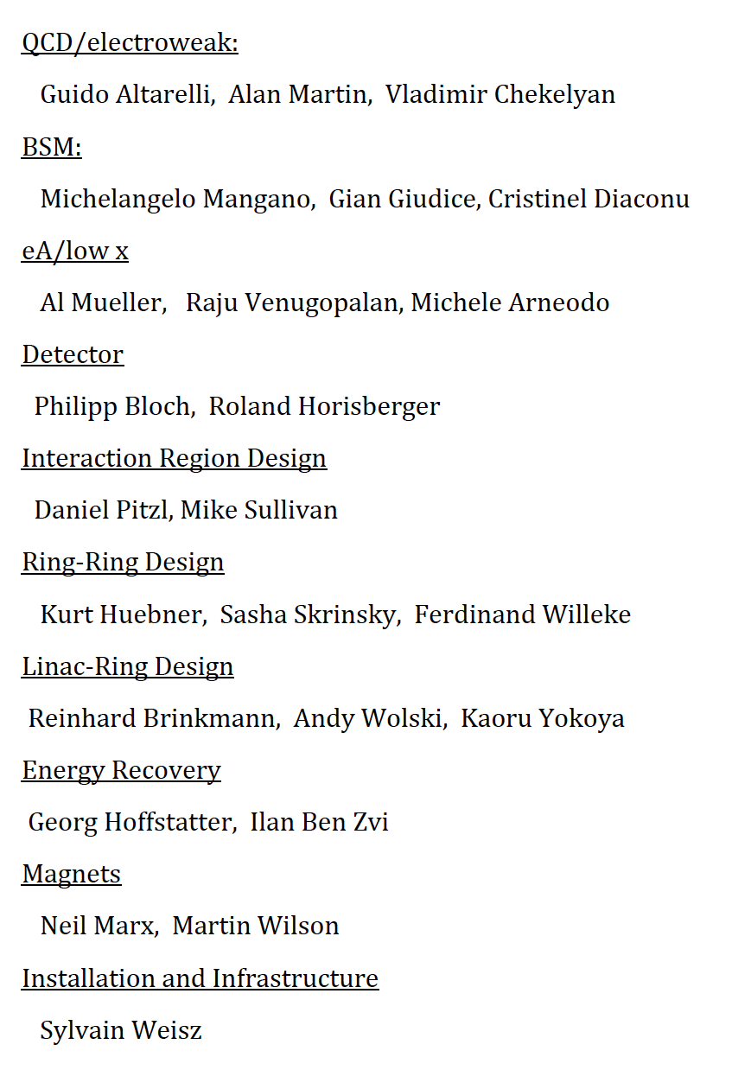
LHeC organisation
Scientific Advisory Committee
Working Group Conveners
Review Panel with experts on physics,
detector, accelerator, specific systems
Guido Altarelli (Rome)
Sergio Bertolucci (CERN)
Stan Brodsky (SLAC)
Allen Caldwell -chair (MPI Munich)
Swapan Chattopadhyay (Cockcroft)
John Dainton (Liverpool)
John Ellis (CERN)
Jos Engelen (CERN)
Joel Feltesse (Saclay)
Lev Lipatov (St.Petersburg)
Roland Garoby (CERN)
Roland Horisberger (PSI)
Young-Kee Kim (Fermilab)
Aharon Levy (Tel Aviv)
Karlheinz Meier (Heidelberg)
Richard Milner (Bates)
Joachim Mnich (DESY)
Steven Myers, (CERN)
Tatsuya Nakada (Lausanne, ECFA)
Guenther Rosner (Glasgow, NuPECC)
Alexander Skrinsky (Novosibirsk)
Anthony Thomas (Jlab)
Steven Vigdor (BNL)
Frank Wilczek (MIT)
Ferdinand Willeke (BNL)
Steering Committee
Accelerator Design [RR and LR]
Oliver Bruening (CERN),
Max Klein (Liverpool)
Interaction Region and Fwd/Bwd
Bernhard Holzer (DESY),
Uwe Schneekloth (DESY),
Pierre van Mechelen (Antwerpen)
Detector Design
Peter Kostka (DESY),
Rainer Wallny (U Zurich),
Alessandro Polini (Bologna)
New Physics at Large Scales
George Azuelos (Montreal)
Emmanuelle Perez (CERN),
Georg Weiglein (Durham)
Precision QCD and Electroweak
Olaf Behnke (DESY),
Paolo Gambino (Torino),
Thomas Gehrmann (Zuerich)
Claire Gwenlan (Oxford)
Physics at High Parton Densities
Nestor Armesto (Santiago),
Brian Cole (Columbia),
Paul Newman (Birmingham),
Anna Stasto (MSU)
Oliver Bruening (CERN)
John Dainton (Cockcroft) Inst
Albert DeRoeck (CERN)
Stefano Forte (Milano)
Max Klein - chair (Liverpool)
Paul Laycock (secretary) (L’pool)
Paul Newman (Birmingham)
Emmanuelle Perez (CERN)
Wesley Smith (Wisconsin)
Bernd Surrow (MIT)
Katsuo Tokushuku (KEK)
Urs Wiedemann (CERN))
Frank Zimmermann (CERN)
47

Slide 48
CDR Authorlist 05.8.2011

