Slide 1


Lattice Design Choices for LHeC ERL
  Alex Bogacz
Jefferson Lab
March 17-20, 2014

Slide 2
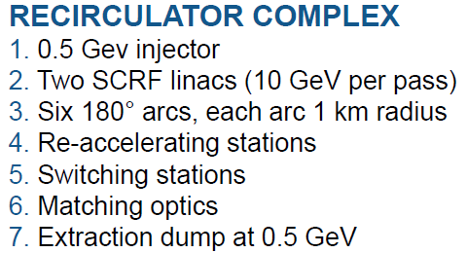
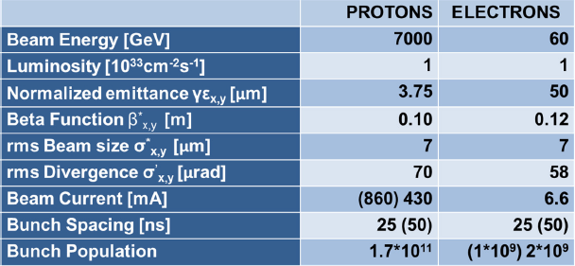
Linac-Ring Option − LHeC ERL Recirculator
total circumference ~ 8.9 km
F. Zimmermann
The baseline 60 GeV ERL option proposed can give an e-p luminosity of 10³³ cm⁻²s⁻¹ (extensions to 10³⁴ cm⁻²s⁻¹ and beyond are being considered)
EIC14 Workshop, Jefferson Lab, March 20, 2014

Slide 3
Why Energy Recovering RLA?
High energy (60 GeV), high current (6.4 mA) beams: (384 MW beam power) would require sub GW (0.8 GW)-class RF systems in conventional linacs .
Ιnvoking Energy Recovery alleviates extreme RF power demand (power reduced by factor (1 − η_{ERL}) ⇨ Required RF power becomes nearly independent of beam current.
Energy Recovering Linacs promise efficiencies of storage rings, while maintaining beam quality of linacs: superior emittance and energy spread and short bunches (sub-pico sec.).
GeV scale Energy Recovery demonstration with high ER ratio (η_{ERL} = 0.98) was carried out in a large scale SRF Recirculating Linac (CEBAF ER Exp. in 2003)
No adverse effects of ER on beam quality or RF performance: gradients, Q, cryo-load observed – mature and reliable technology (next generation light sources)
EIC14 Workshop, Jefferson Lab, March 20, 2014

Slide 4
LHeC Recirculator with ER
injector
Linac 1
0.5 GeV
10 GeV/pass
Arc1, 3, 5
dump
Arc 2, 4, 6 + λ/2
Linac 2
0.5 GeV
10 GeV/pass
IP
60 GeV
LHC
EIC14 Workshop, Jefferson Lab, March 20, 2014

Slide 5
LHeC Recirculator with ER
injector
Linac 1
0.5 GeV
10 GeV/pass
Arc1, 3, 5
dump
Arc 2, 4, 6 + λ/2
Linac 2
0.5 GeV
10 GeV/pass
IP
60 GeV
LHC
EIC14 Workshop, Jefferson Lab, March 20, 2014

Slide 6
LHeC Recirculator with ER
injector
Linac 1
0.5 GeV
10 GeV/pass
Arc1, 3, 5
dump
Arc 2, 4, 6 + λ/2
Linac 2
0.5 GeV
10 GeV/pass
IP
60 GeV
LHC
EIC14 Workshop, Jefferson Lab, March 20, 2014

Slide 7
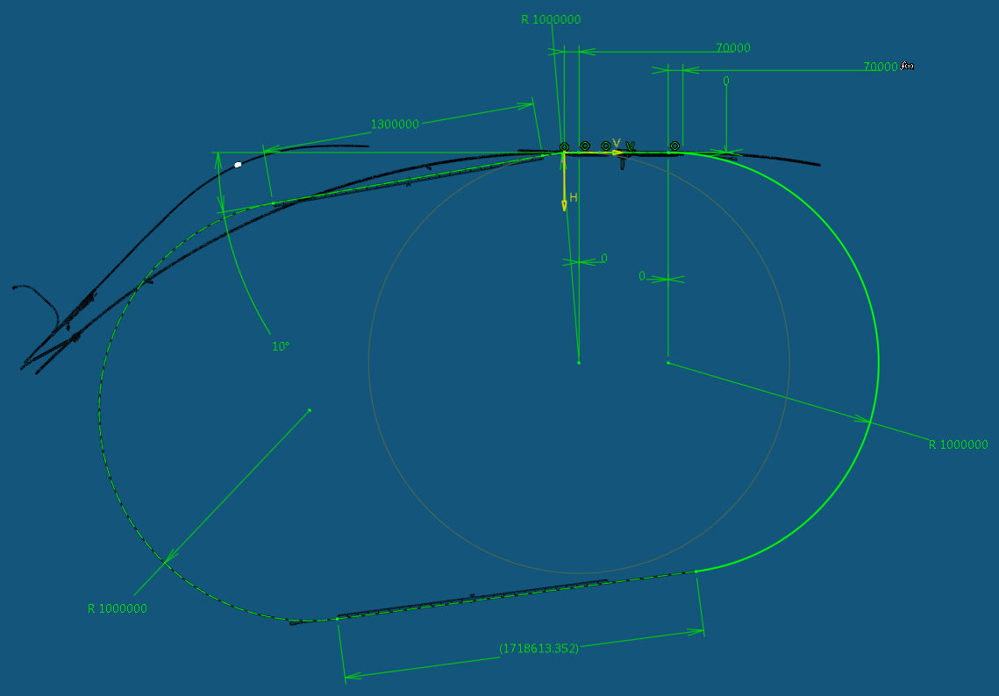
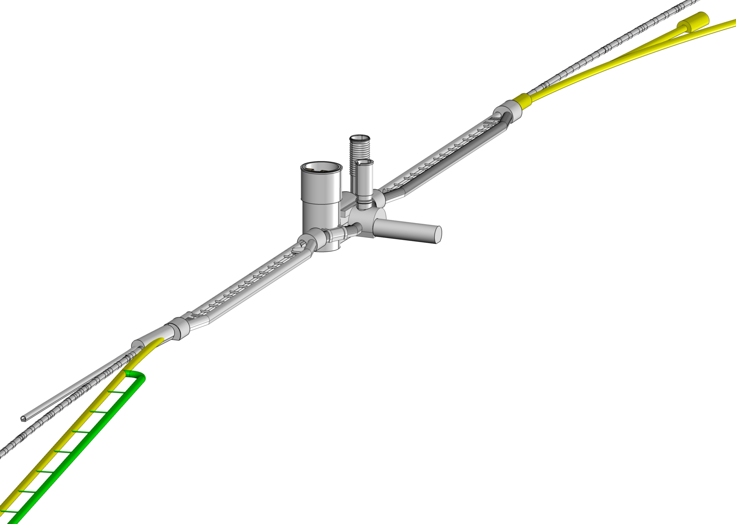
ERL–Ring: Dimensions/Layout
J. Osborne
IP
EIC14 Workshop, Jefferson Lab, March 20, 2014

Slide 8
Beam Dynamics Challenges/Mitigations
Incoherent and coherent synchrotron radiation related effects on the electron beam
  energy losses Size/Layout
  longitudinal emittance increase Size/Layout
  transverse emittance increase Lattice
Beam Breakup Instability (BBU)
  single beam Lattice
  multi-pass Lattice
Depolarization effects Lattice
EIC14 Workshop, Jefferson Lab, March 20, 2014

Slide 9
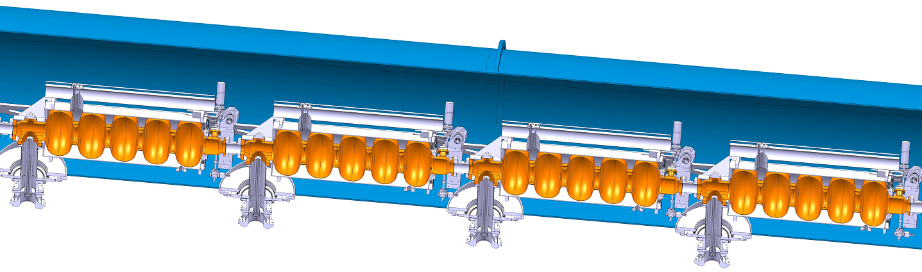
Cryo Unit Layout/Optics − Half-Cell 130⁰ FODO
160
5
BETA_X&Y[m]
×38
L_{c}
0
0
0
BETA_X
BETA_Y
DISP_X
DISP_Y
29.6
quad
Cavity Cryo: 8 RF cavities
Cavity Cryo: 8 RF cavities
802 MHz RF, 5-cell cavity:
λ = 37.38 cm
L_{c} = 5λ/2 = 93.45 cm
Grad = 18 MeV/m (16.8 MeV per cavity)
ΔE= 269.14 MV per Cryo Unit
D. Schulte
EIC14 Workshop, Jefferson Lab, March 20, 2014

Slide 10
10 GeV Linac − Focusing profile
E = 0.5 − 10.5 GeV
200
quad gradient
5
BETA_X&Y[m]
DISP_X&Y[m]
0
0
0
BETA_X
BETA_Y
DISP_X
DISP_Y
1008
19 FODO cells (19 × 2 × 16 = 608 RF cavities)
EIC14 Workshop, Jefferson Lab, March 20, 2014

Slide 11
Linac 1 − Multi-pass ER Optics
EIC14 Workshop, Jefferson Lab, March 20, 2014

Slide 12
Linac 1 and 2 − Multi-pass ER Optics
EIC14 Workshop, Jefferson Lab, March 20, 2014

Slide 13
Arc Optics – Beam Dynamics Issues
Natural momentum spread due to quantum excitations:
Emittance dilution due to quantum excitations:
Momentum Compaction – synchronous acceleration in the linacs:
EIC14 Workshop, Jefferson Lab, March 20, 2014

Slide 14
135⁰ FODO Cell
150
1.5
BETA_X&Y[m]
DISP_X&Y[m]
0
-1.5
0
BETA_X
BETA_Y
DISP_X
DISP_Y
52.3599
EIC14 Workshop, Jefferson Lab, March 20, 2014

Slide 15
Flexible Momentum Compaction (FMC) Cell
150
0.3
BETA_X&Y[m]
DISP_X&Y[m]
Emittance dispersion
〈H〉avereged over bends
Momentum compaction
0
-0.3
0
BETA_X
BETA_Y
DISP_X
DISP_Y
52.3599
factor of 2.5 smaller than 135⁰ FODO
factor of 27 smaller than 135⁰ FODO
EIC14 Workshop, Jefferson Lab, March 20, 2014

Slide 16
Arc Optics – Emittance preserving FMC cell
Arc 1 , Arc2
Arc 3, Arc 4
Arc5, Arc 6
500
Imaginary γ_{t} Optics
0.5
500
DBA-like Optics
0.5
500
TME-like Optics
0.5
BETA_X&Y[m]
DISP_X&Y[m]
BETA_X&Y[m]
BETA_X&Y[m]
DISP_X&Y[m]
DISP_X&Y[m]
0
-0.5
0
-0.5
0
-0.5
0
BETA_X
BETA_Y
DISP_X
52.3599
DISP_Y
0
BETA_X
BETA_Y
DISP_X
DISP_Y
0
BETA_X
BETA_Y
DISP_X
52.3599
52.3599
DISP_Y
factor of 18 smaller than FODO
total emittance increase in Arc 5: Δε_{x}^{N} = 4.268 μm rad
EIC14 Workshop, Jefferson Lab, March 20, 2014

Slide 17
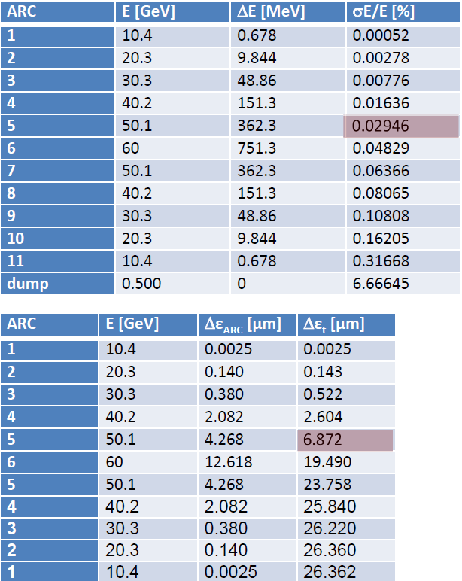
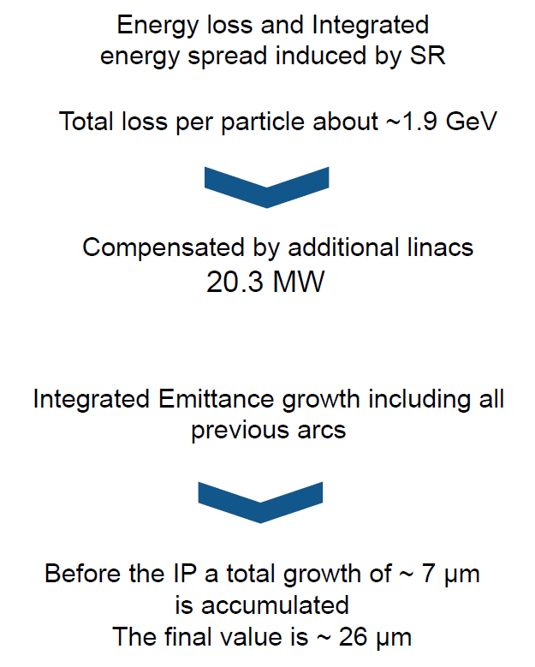
Energy Loss and Emittance Dilution in Arcs
A. Valloni
EIC14 Workshop, Jefferson Lab, March 20, 2014

Slide 18
Vertical Separation of Arcs
Arc 1 (10 GeV)
Arc 3 (30 GeV)
Arc 5 (50 GeV)
EIC14 Workshop, Jefferson Lab, March 20, 2014

Slide 19
Vertical Spreaders − Optics
600
0.6
Spr. 1
BETA_X&Y[m]
DISP_X&Y[m]
0
-0.6
0
BETA_X
BETA_Y
DISP_X
DISP_Y
path-length adjustment ‘doglegs’
76
vertical step I
vertical step II
600
0.6
Spr. 3
BETA_X&Y[m]
DISP_X&Y[m]
0
-0.6
0
BETA_X
BETA_Y
DISP_X
DISP_Y
76
vertical step I
vertical step II
path-length adjustment ‘doglegs’
600
0.6
Spr. 5
BETA_X&Y[m]
DISP_X&Y[m]
0
-0.6
0
BETA_X
BETA_Y
DISP_X
DISP_Y
path-length adjustment ‘doglegs’
76
vertical chicane
EIC14 Workshop, Jefferson Lab, March 20, 2014

Slide 20
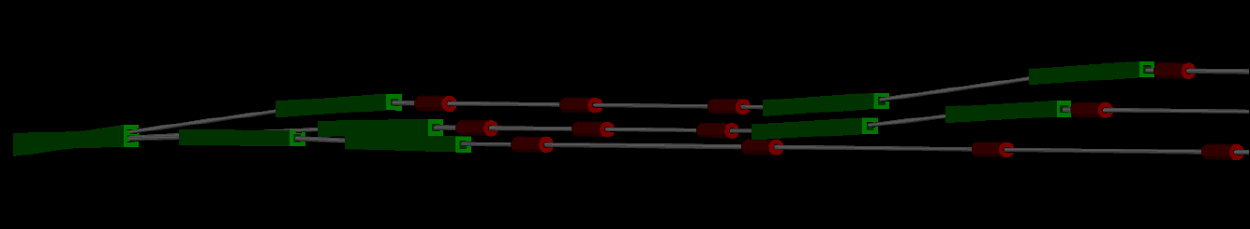
Vertical Separation of Arcs
Arc 1 (10 GeV)
Arc 3 (30 GeV)
Arc 5 (50 GeV)
EIC14 Workshop, Jefferson Lab, March 20, 2014

Slide 21
Arc 1 Optics (10 GeV)
600
0.6
600
0.6
BETA_X&Y[m]
BETA_X&Y[m]
DISP_X&Y[m]
DISP_X&Y[m]
0
-0.6
0
-0.6
0
BETA_X
BETA_Y
DISP_X
DISP_Y
230
3060
BETA_X
BETA_Y
DISP_X
DISP_Y
3292.61
vert. 2-step spreader
doglegs
dis. sup. cell
58 FMC cells
dis. sup. cell
doglegs
vert. 2-step recombiner
180 deg. Arc
Arc dipoles:
$Lb=400 cm
$B=0.47 kGauss
EIC14 Workshop, Jefferson Lab, March 20, 2014

Slide 22
Arc 3 Optics (30 GeV)
600
0.6
600
0.6
BETA_X&Y[m]
BETA_X&Y[m]
DISP_X&Y[m]
DISP_X&Y[m]
0
-0.6
0
-0.6
0
BETA_X
BETA_Y
DISP_X
DISP_Y
230
3060
BETA_X
BETA_Y
DISP_X
DISP_Y
3292.58
vert. 2-step spreader
doglegs
dis. sup. cell
58 FMC cells
dis. sup. cell
doglegs
vert. 2-step recombiner
180 deg. Arc
Arc dipoles:
$Lb=400 cm
$B=1.37 kGauss
EIC14 Workshop, Jefferson Lab, March 20, 2014

Slide 23
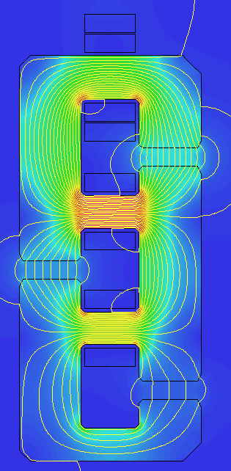
Vertical Stack − Combined Aperture Arc Dipole
∙
∙
×
×
0.264 T
60 GeV
×
0.176 T
40 GeV
∙
∙
×
0.088 T
20 GeV
A. Milanese
EIC14 Workshop, Jefferson Lab, March 20, 2014

Slide 24
Summary
High luminosity Linac-Ring option − ERL
  RF power nearly independent of beam current.
Multi-pass linac Optics in ER mode
  Choice of linac RF and Optics − 802 MHz SRF and 130⁰ FODO
  Linear lattice: 3-pass ‘up’ + 3-pass ‘down’
Arc Optics Choice − Emittance preserving lattices
  Quasi-isochronous lattices
  Flexible Momentum Compaction Optics
  Balanced emittance dilution & momentum compaction
Complete Arc Architecture
  Vertical switchyard
  Matching sections & path-length correcting ‘doglegs’
Alternative ERL Topology − ‘Dogbone’ Option?
EIC14 Workshop, Jefferson Lab, March 20, 2014

Slide 25
Special Thanks to:
Frank Zimmermann
Daniel Schulte
Erk Jensen
Oliver Brüning
and
Max Klein
EIC14 Workshop, Jefferson Lab, March 20, 2014

Slide 26
‘Racetrack’ vs ‘Dogbone’ RLA
Twice the acceleration efficiency for the ‘Dogbone’ topology
ΔE/2
1.5 ΔE
ΔE/2
ΔE
3 ΔE
Challenge: traversing linac in both directions while accelerating
EIC14 Workshop, Jefferson Lab, March 20, 2014

Slide 27
‘Dogbone’ vs ‘Racetrack’ – Arc-length
9×ΔE/2
9×ΔE/2
n×
= n(π + 4α)R
2n×
= 2nπR
α
α
Net arc-length break even: if α = π/4
EIC14 Workshop, Jefferson Lab, March 20, 2014

Slide 28
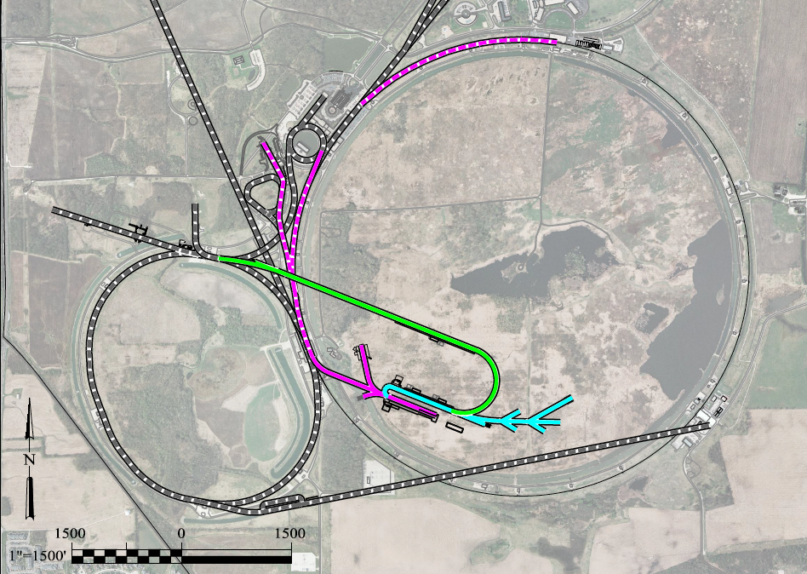
Future Muon Facilities − Muon Acceleration
ν to Homestake
Neutrino Factory
LBNE
Higgs Factory
NF Decay Ring
RLA to 63 GeV
Project X
Stage III
Linac + RLA to 4 GeV
Project X
Stage II
Project X
Stage I
J.-P. Delahaye, MASS
(Muon Accelerator Staging Studies)
Fermilab
EIC14 Workshop, Jefferson Lab, March 20, 2014

Slide 29
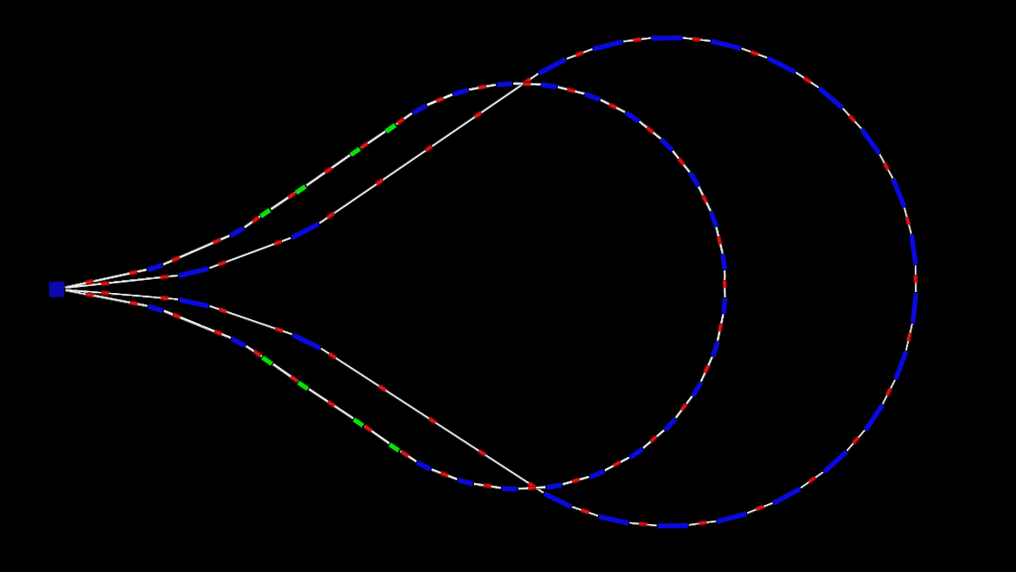
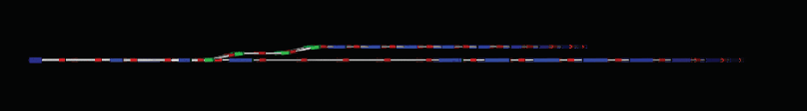
Droplet Arcs − Layout
top view
1.2 GeV
2.4 GeV
side view
1.2 GeV
↑ 1 m
2.4 GeV
EIC14 Workshop, Jefferson Lab, March 20, 2014

Slide 30
‘Racetrack’ vs ‘Dogbone’ ERL for LHeC
Baseline
3-pass RLA
0.5 GeV
10 GeV
10 GeV linac
20 GeV
30 GeV
0.5 GeV
40 GeV
50 GeV
60 GeV
10 GeV linac
IP
60 GeV
‘Dogbone’
5-pass RLA
24GeV
12 GeV
36 GeV
48 GeV
0.5 GeV
60 GeV
0.5 GeV
12 GeV linac
IP
60 GeV
EIC14 Workshop, Jefferson Lab, March 20, 2014

Slide 31
‘Dogbone’ RLA − Multi-pass Linac Optics
Acceleration
Deceleration
EIC14 Workshop, Jefferson Lab, March 20, 2014

Slide 32
Pros and Cons of a ‘Dogbone’ RLA
High acceleration efficiency (≤2) – traversing the linac in both directions while accelerating
Better orbit separation at linac’s end ~ energy difference between consecutive passes (2ΔE) vs (ΔE) in case of the ‘Racetrack’
Suppression of depolarization effects Beam trajectory can be made to follow a Figure-8 path (by reversing field directions in opposing droplet arcs)
Beams of different energies moving in the opposite direction through the linac – orbit separation needed to avoid parasitic collisions.
As linac length and number of passes are increased, the BBU threshold can be a problem.
Travelling ‘clearing gaps’ to alleviate ion trapping − No practical solution found
EIC14 Workshop, Jefferson Lab, March 20, 2014

